Slide 2
SIL Assessment for TS PSS SIFs
TS PSS CDR
PRESENTED BY Jonny Gale & Fan YE

Slide 3
Agenda
1 Introduction to PSS SIL Assessment
2 TS PSS Safety Instrumented Functions (SIFs)
3 TS PSS Safety Requirements Specification (SRS)
4 TS PSS SIL Assessment Results
5 TS PSS Event Tree Analysis

Slide 4
1
Introduction to PSS SIL Assessment

Slide 5
PSS SIL Assessment
Risk Assessment
SIL Determination
Inputs – Risk Assessments, ConOps
Outputs – SIL targets for each SIF in terms of PFD/PFH and SIL
SIL Verification
Inputs – SIL Determination, SIF configurations, Failure Data
Method – Reliability Block Diagram (RBD), ProSET
Outputs – SIL Verification results in terms of achieved PFD/PFH and SIL
SIL Determination
SRS
SIL Verification
Notes:
Point out during presentation that this was already presented in the PDR. We want to give an introduction for new committee members.
The functional safety work we do is the first 4 phases on the lifecycle. So for phase 1 hazard and risk assessment the Risk Assessments for TS PSS was used where the SIFs are identified for the radiation and conventional hazardous scenarios. Then we needed to allocate the TS PSS SIFs a Safety Integrity Level Target which the SIL determination part for phase 2. And once we’d worked out what the SIFs needs to meet we document this in the Safety Requirements Specification which is phase 3. And then finally once had the SIFs configuration and all of the devices we complete the SIL verification which is phase 4 of the lifecycle.

Slide 6
SIL Determination and Verification
Objectives
SIL Determination
To determine the required SIL target (and reliability target PFD/PFH) for each SIF
Layers of Protection Analysis (LOPA) used for SIL determination
Guideline for SIL Assessment for Personnel Safety Systems (ESS-1408224)
SIL Verification
To verify the proposed SIF design will meet the corresponding SIL (and PFD/PFH) target
Reliability Block Diagram (RBD) used for SIL verification
Event Tree Analysis (ETA) used to confirm frequency of individual hazardous scenarios meet the risk target
PFD = Probability of Failure on Demand
PFH = Average frequency of a dangerous failure per hour

Slide 7
2
Target Station PSS Safety Instrumented Functions

Slide 8
ID Pattern for Target Station SIFs
System_SIFNumber
System
TS PSS
Number
1 Emergency Switch-Off Button (ESOB) Interlock
2 Emergency Exit Door Interlock
3 Access Door Interlock
4 Access Door Locks (4 variations for different doors)
5 High Radiation Interlock
Notes:
There are several SIFs that are expected to be required in each PSS. SIFs 1 to 5 are usually numbered in the same order to facilitate cross-referencing between the systems. Target has a slight difference where SIF2 is the Emergency Exit Door Interlock. For SIF4 we have 4 different SIFs for each Door Lock.

Slide 9
Link between SIFs and Risk Assessments
SIF Tag | SIF Name | Hazard ID
TSPSS_SIF1 | ESOB Interlock | RadHaz4, RadHaz8, RadHaz12, RadHaz16, RadHaz20, RadHaz32, RadHaz36, RadHaz40 (Risk Assessment for Target PSS (ESS-4121077)
TSPSS_SIF2 | Emergency Exit Door Interlock | RadHaz14, RadHaz18, RadHaz30, RadHaz34, RadHaz38 (Risk Assessment for Target PSS (ESS-4121077)
TSPSS_SIF3 | Access Doors Interlock | RadHaz2, RadHaz6, RadHaz10, RadHaz14, RadHaz18, RadHaz30, RadHaz34, RadHaz38 (Risk Assessment for Target PSS (ESS-4121077)
TSPSS_SIF4_1 | Sliding Concrete Door Lock (level 91) | RadHaz14, RadHaz18, RadHaz30, RadHaz34, RadHaz38 (Risk Assessment for Target PSS (ESS-4121077)
TSPSS_SIF4_2 | Sliding Concrete Door Lock (level 103) | RadHaz10 (Risk Assessment for Target PSS (ESS-4121077)
TSPSS_SIF4_3 | Sliding Concrete Door Lock (level 115) | RadHaz6 (Risk Assessment for Target PSS (ESS-4121077)
TSPSS_SIF4_4 | Double-gated Access Door to Connection Cell Lock (level 115) | RadHaz2 (Risk Assessment for Target PSS (ESS-4121077)
TSPSS_SIF5 | High Radiation Interlock | AA ACC2W - Accident Analysis Report - Worker- Off-Normal Beam Loss (ESS-3791615)

Slide 10
Target PSS SIFs
TSPSS_SIF1
If any ESOB in Target Station (TS) PSS controlled area is detected pressed, and the bending magnets are detected energised (Beam on Target (BoT) allowed), act on the Proton Beam Actuators.
Sensors:
ESOS push-button
BoT allowed: Bending magnet status (Feedback signals from contactors read by ACC PSS,2 contactors 1oo2)
Logic solver:
Target PSS PLC + Nexus PSS PLC + ACC PSS PLC
Actuators:
Proton beam actuators ISrc HVPS (2 contactors) + Grounding relay (Contactor relay)
Reset conditions:
The reset conditions for TSPSS_SIF1 are the following:
All ESOBs in the TS PSS controlled area are unlatched
The proton beam is interlocked OFF the target
Search status of the part of TS PSS controlled area where the ESOB is pressed is broken
Notes:
Jump to RBD for each SIF in the report. Don’t need to read slides

Slide 11
Target PSS SIFs
TSPSS_SIF2 E-Exit Door Interlock
If any of the following doors is detected open:
Emergency exit door from the Accelerator to D02.091.4003 (on level 90)
Emergency exit door from D02.103.4005 to the Experimental Hall (D03) (on level 103)
and the bending magnets are detected energised (Beam on Target (BoT) allowed), act on the Proton Beam Actuators.
Sensors:
Emergency exit door on level 90 (1oo2 magnetic + mechanical switch)
Emergency exit door on level 103 (1oo2 magnetic + mechanical switch)
BoT allowed: Bending magnet status (Feedback signals from contactors read by ACC PSS, 2 contactors 1oo2)
Logic solver:
Target PSS PLC + Nexus PSS PLC + ACC PSS PLC
Actuators:
Proton beam actuators ISrc HVPS (2 contactors) + Grounding relay (Contactor relay)
Reset conditions:
The reset conditions for TSPSS_SIF2 are the following:
• The proton beam is interlocked OFF the target,
• The search of area behind the E-Exit doors are broken
• The doors are closed and locked (safety circuits are reset)

Slide 12
Target PSS SIFs
TSPSS_SIF3 Access door interlock
If any of the following doors is detected open:
Sliding concrete door to room D02.091.4003 (level 91)
Sliding concrete door to room D02.103.4003 (level 103)
Sliding concrete door to room D02.115.4003 (level 115)
Double-gated access doors to the Connection Cell from Target/A2T (to level 115) close the instrument shutter and prevent its opening.
and the bending magnets are detected energised (Beam on Target (BoT) allowed), act on the Proton Beam Actuators.
Sensors:
Sliding concrete door to level 091 position switches (1oo2 magnetic + mechanical switch)
Sliding concrete door to level 103 position switches (1oo2 magnetic + mechanical switch)
Sliding concrete door level 115 position switches (1oo2 magnetic + mechanical switch)
Double-gated access door to level 115 position switches (4x 1oo2 magnetic + mechanical switch
BoT allowed: Bending magnet status (Feedback signals from contactors read by ACC PSS, 2 contactors 1oo2)
Logic solver:
Target PSS PLC + Nexus PSS PLC + ACC PSS PLC
Actuators:
Proton beam actuators ISrc HVPS (2 contactors) + Grounding relay (Contactor relay)
Reset conditions:
The reset conditions for TSPSS_SIF3 are the following:
• The proton beam is interlocked OFF the target,
• TS PSS controlled area is ready for operation, i.e. TS PSS access doors are closed and locked, TS PSS controlled area is searched and all entry keys are returned back to the key exchange unit.

Slide 13
Target PSS SIFs
TSPSS_SIF4_1 Sliding Concrete Door Lock (level 91)
Upon removal of the entry key to the sliding concrete door to D02.091.4003 from the door lock unit, lock the door via solenoid.
Note: This is done without a logic solver. PLC will monitor the safety circuits from the lock unit to ensure the door is locked.
Sensors:
Entry key 4 position monitoring (key switch, Fortress)
Actuators:
Fortress lock unit on a sliding concrete door to D02.091.4003 - solenoid
Reset conditions:
A manual reset shall be required if TSPSS_SIF4_1 is tripped:
• by returning the entry key to the sliding concrete doors to position ON.

Slide 14
Target PSS SIFs
TSPSS_SIF4_2 Sliding Concrete Door Lock (level 103)
Upon removal of the entry key to the sliding concrete door to D02.103.4003 from the door lock unit, lock the door via solenoid.
Note: This is done without a logic solver. PLC will monitor the safety circuits from the lock unit to ensure the door is locked.
Sensors:
Entry key 3 position monitoring (key switch, Fortress)
Actuators:
Fortress lock unit on a sliding concrete door to D02.103.4003 - solenoid
Reset conditions:
A manual reset shall be required if TSPSS_SIF4_2 is tripped:
• by returning the entry key to the sliding concrete doors to position ON.

Slide 15
Target PSS SIFs
TSPSS_SIF4_3 Sliding Concrete Door Lock (level 115)
Upon removal of the entry key to the sliding concrete door to D02.115.4003 from the door lock unit, lock the door via solenoid.
Note: This is done without a logic solver. PLC will monitor the safety circuits from the lock unit to ensure the door is locked.
Sensors:
Entry key 2 position monitoring (key switch, Fortress)
Actuators:
Fortress lock unit on a sliding concrete door to D02.115.4003 - solenoid
Reset conditions:
A manual reset shall be required if TSPSS_SIF4_3 is tripped:
• by returning the entry key to the sliding concrete doors to position ON.

Slide 16
Target PSS SIFs
TSPSS_SIF4_4 Double-gated Access Door to Connection Cell Lock (level 115)
Upon removal of the entry key to the access door to D02.115.4001 (Connection Cell) from the door lock unit, lock the door via solenoid.
Note: This is done without a logic solver. PLC will monitor the safety circuits from the lock unit to ensure the door is locked.
Sensors:
Entry key 1 position monitoring (key switch, Fortress)
Actuators:
Fortress lock unit on a sliding concrete door to D02.115.4001 - solenoid
Reset conditions:
A manual reset shall be required if TSPSS_SIF4_4 is tripped:
• by returning the entry key to the sliding concrete doors to position ON.

Slide 17
Target PSS SIFs
TSPSS_SIF5 High Radiation Interlock
If any of 4 radiation monitors in D02.120.4014 or the monitor in D02.115.4005 sends high radiation alarm signal or major fault signal to TS PSS, and the bending magnets are detected energised (Beam on Target (BoT) allowed), act on the Proton Beam Actuators.
Sensors:
Radiation Monitors (REMS)
BoT allowed: Bending magnet status (Feedback signals from contactors read by ACC PSS, 2 contactors 1oo2)
Logic solver:
Target PSS PLC + Nexus PSS PLC + ACC PSS PLC
Actuators:
Proton beam actuators ISrc HVPS (2 contactors) + Grounding relay (Contactor relay)
Reset conditions:
The reset conditions for TSPSS_SIF5 are the following:
• All Area Mixed-Field Radiation Monitors are healthy and no high radiation is detected.

Slide 18
Target PSS SIFs
TSPSS_SIF5
Sources of demand:
Beam loss leading to increased radiation outside TS PSS controlled area (off nominal beam) or failure of the radiation monitor.
Safe state definition: ISrc HVPS de-energised and Grounding relay connected to earth.
Dangerous Combinations of Output States: ISrc HVPS contactors and Grounding relay shall not be triggered at the same time as it can cause the short-circuiting of HVPS and damage to the Isrc (Ion source).
Electrical Power Loss: The Target PSS Safety PLC shall be fail-safe upon loss of power (i.e. all final elements de-energised).)
Bypasses/overrides:
There shall be no overrides/inhibits/bypasses for this SIF.
Notes:
Useful for the audience to understand we define many things for each SIF. Then we show in the next slide how it is documented, and that it is done for the SIS as well.

Slide 19
3
Safety Requirements Specification (SRS)

Slide 20
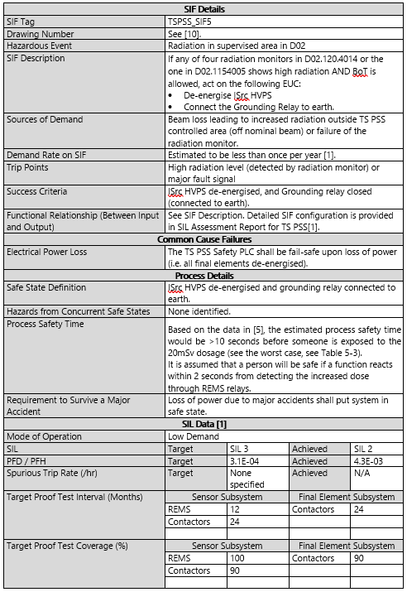
Target PSS SRS
See ESS-5301078
SIS Logic Solver reqs
TSPSS_SIF1 reqs
TSPSS_SIF2 reqs
TSPSS_SIF3 reqs
TSPSS_SIF4_1 reqs
TSPSS_SIF4_2 reqs
TSPSS_SIF4_3 reqs
TSPSS_SIF4_4 reqs
TSPSS_SIF5 reqs
Notes:
SRS details of all of the crucial functional and integrity requirements for the logic lover and the SIFs.

Slide 21
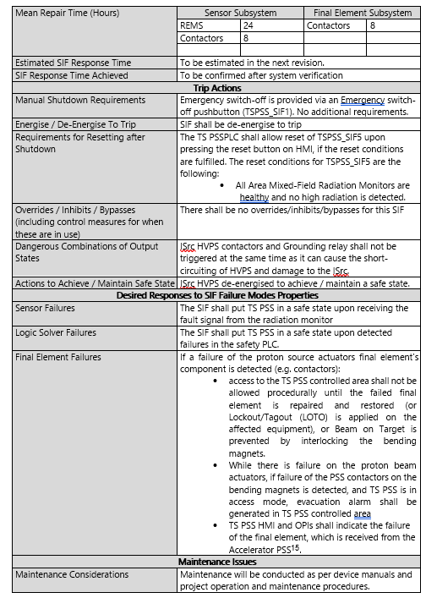
Target PSS SRS
See ESS-5301078
SIS Logic Solver reqs
TSPSS_SIF1 reqs
TSPSS_SIF2 reqs
TSPSS_SIF3 reqs
TSPSS_SIF4_1 reqs
TSPSS_SIF4_2 reqs
TSPSS_SIF4_3 reqs
TSPSS_SIF4_4 reqs
TSPSS_SIF5 reqs
Notes:
SRS details of all of the crucial functional and integrity requirements for the logic lover and the SIFs.

Slide 22
4
Target Station PSS
SIL Assessment

Slide 23
SIL Assessment Results
Target Station PSS Low Demand SIFs
SIF Tag | Selected PFD Target | PFD Achieved | Selected SIL Target | Max Allowable SIL (Architectural Constraints) | Result
TSPSS_SIF1 – ESOB Interlock | N/A | 4.1E-4 | SIL 1 | SIL 2 | Passed
TSPSS_SIF2 – Emergency Exit Doors Interlock | 1.5E-1 | 1.8E-4 | SIL a | SIL 3 | Passed
TSPSS_SIF5 – High Radiation Interlock | 3.1E-4 | 4.3E-3 | SIL 3 | SIL 2 | Failed
SIS Logic Solver SIL Target | SIL 2 based on the highest SIL target of all SIFs implemented on the Target PSS Safety PLC

Slide 24
SIL Assessment Results
Target Station PSS High Demand SIFs
SIF Tag | Selected PFH Target | PFH Achieved (/hr) | Selected SIL Target | Max Allowable SIL (Architectural Constraints) | Result
TSPSS_SIF3 – Access Door Interlock | 1.7E-7 | 1.7E-8 | SIL 2 | SIL 3 | Passed
TSPSS_SIF4_1 - Sliding Concrete Door Lock (level 91) | 1.7E-6 | 1.1E-7 | SIL 1 | SIL 2 | Passed
TSPSS_SIF4_2 - Sliding Concrete Door Lock (level 103) | 1.7E-6 | 1.1E-7 | SIL 1 | SIL 2 | Passed
TSPSS_SIF4_3 - Sliding Concrete Door Lock (level 115) | 1.7E-6 | 1.1E-7 | SIL 1 | SIL 2 | Passed
TSPSS_SIF4_4 - Double-gated Access Door to Connection Cell Lock (level 115) | 1.7E-6 | 1.1E-7 | SIL 1 | SIL 2 | Passed
SIS Logic Solver SIL Target | SIL 2 based on the highest SIL target of all SIFs implemented on the Target PSS Safety PLC
Notes:
SIS Logic Solver SIL Target: SIL 2 based on the highest SIL target of all SIFs implemented on the Target PSS Safety Programmable Logic Controller (PLC)

Slide 25
4
Target Station PSS
Event Tree Analysis

Slide 26
Event Tree Analysis (ETA)
ETA01a - Person in the TS PSS controlled area is missed by search while BoT operation started, Radiation hazard
Notes:
The failure of search has been credited with a PFD of 0.001 based on search for a small area by trained personnel following written procedure 0.01, supported by Target PSS provides another order of magnitude for the PFD (0.1).

Slide 27
Event Tree Analysis (ETA)
ETA01b - Person in the TS PSS controlled area is missed by search, zone gate error (not detected open) while BoT operation started, Radiation hazard

Slide 28
Event Tree Analysis (ETA)
ETA02 -Light shutters open inadvertently while personnel are in the target basement, Radiation hazard

Slide 29
Event Tree Analysis (ETA)
ETA03a - Personnel attempt to access TS PSS controlled area via an emergency exit door during BoT operation, Radiation hazard

Slide 30
Event Tree Analysis (ETA)
ETA03b - Personnel attempt to access TS PSS controlled area via any of the access doors during BoT operation, Radiation hazard

Slide 31
Event Tree Analysis (ETA)
ETA03c - Personnel attempt to access TS PSS controlled area via any of the access doors during BoT operation using override keys, Radiation hazard

Slide 32
Event Tree Analysis (ETA)
ETA04a - Person exposed to high radiation in Technical Supply Routing room, Radiation hazard

Slide 33
Event Tree Analysis (ETA)
ETA04b - Person exposed to high radiation in A2T/Target Access area, Radiation hazard

Slide 34
Notes
To address in next revision…
Currently TSPSS_SIF5 has a SIL 3 target. The ESS PSS Functional Safety Management System states that SIFs cannot be design greater than SIL 2. TSPSS_SIF5 does not have any associated IPLs and the SIL target is only based on the IE frequency and conditional modifiers. TSPSS_SIF5 should be reviewed for independent layers of protection that will reduce the SIL target of the SIF.
Barriers needs to be reviewed for the following hazardous events:
ETA01a - Person in the TS PSS controlled area is missed by search while BoT operation started, Radiation hazard
ETA04b - Person exposed to high radiation in A2T/Target Access area, Radiation hazard

Slide 35
Thank you for your attention!

