Slide 1
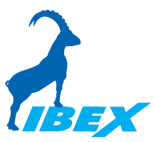
IBEX - the new Instrument Control System at the ISIS Pulsed Neutron and Muon Source
Freddie Akeroyd
ISIS Computing Group STFC ISIS Facility, GB

Slide 2
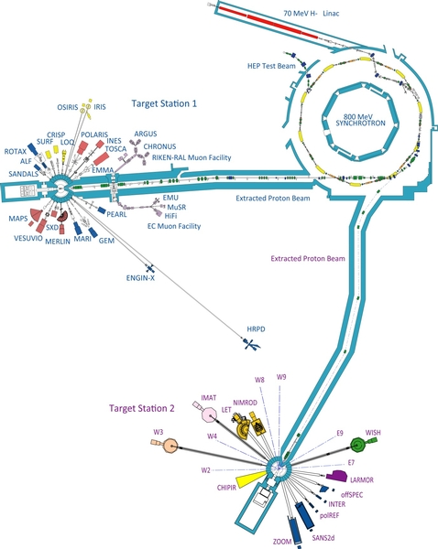
ISIS Facility
Pulsed neutron and muon source
~30 experiment beamlines
World leading materials research facility
Every year over:
1000 proposals
700 experiments
400 publications

Slide 3
New Control System?
Old/existing system (SECI) based on LabVIEW:
C# manager GUI
Performed well, remains good for most instruments
However concerns for future instruments:
Performance
Scalability
Maintainability
After evaluation exercise, develop new system based on EPICS framework

Slide 4
EPICS on one slide
C++
Python
Java
C#
LabVIEW
…
Subscribe to Process Variables (PVs)
IN:LARMOR:MOT:STACK:THETA:SP
Channel Access (CA)
IOC
IOC
IOC
IOC
Publish Process Variables (PVs)
IN:LARMOR:DAE:MON:5:C
IN:LARMOR:MOT:STACK:THETA:SP
Device
Device
Device
Device
Notes:
EPICS is a software framework for building control systems
EPICS = Experimental Physics and Industrial Control System
Widely used: SNS, ESS, Diamond, ITER, APS @ ANL, NSLS-II @ Brookhaven, PSI, SLAC, Fermilab, DESY, Keck Telescope, Gemini Telescope, …
EPICS uses a publish-subscribe paradigm
In this slide the boxes are processes (it says nothing about where those processes are running)
Processes can publish information about their state – as process variables (PVs)
Other processes can request information about a process’s state – subscribe to PVs
A subscriber can also request that a publisher change its state – e.g. change a set-point
A process can be both a publisher and a subscriber
EPICS processes communicate using a protocol called Channel Access (CA)
CA sits on top of TCP/IP
EPICS processes are very loosely-coupled
Publishers don’t care how (or where) their subscribers are implemented (and vice-versa)
Provides a very flexible architectural framework
IOCs are EPICS processes used to control hardware devices
IOC = Input/Output Controller
IOCs communicate with the hardware via device drivers
IOC publishes PVs which describe the state of the device
Subscribing processes can ask the IOC to change the state of the device
Output from one IOC can be used as input to another

Slide 5
IBEX Technologies
EPICS framework
also used at Diamond, SNS ORNL and ESS
Eclipse / RCP for the main IBEX GUI
can use components from CS Studio
Python for scripting
Continue to use MS Windows:
For compatibility with existing business systems
Allows install alongside old SECI system
However IBEX can run on Linux too

Slide 6
IBEX System Components
IBEX Client (GUI)
IBEX Client (Python Script)
IBEX Client (Web Dashboard)
EPICS External Gateway (access control)
Blocks Gateway (aliases)
Run Control
Instrument Archiver
Alarm Server
Blockserver (configurations)
Neutron Acquisition Program (with EPICS interface)
Blocks Archiver
Message Logger
IOC
IOC
IOC
Sample Environment
NeXus Data Files
MySQL
ActiveMQ
Notes:
IBEX is built using EPICS
IBEX has a distributed, client-server architecture based on the EPICS publish-subscribe paradigm
IBEX server runs on the NDXxxxxxx machine
IBEX client can run on any machine connected to the ISIS network
On the NDXxxxxxx server itself, on a PC in the instrument cabin, on your office PC, on your home PC
IBEX Server is not a single executable
It is a collection of individual control components called IOCs (Input/Output Controllers), plus loggers/archivers
IOCs are analogous to VIs in LabVIEW
Each IOC communicates with one type of device (Galils, Choppers, Eurotherms, CAENs, DAE, etc.)
Some IOCs can manage several devices of the same type: e.g. the Galil IOC can manage several Galil crates
EPICS manages the communication between individual IOCs and between IOCs and any client applications
IBEX clients running on the instrument sub-net have read-write access to the IBEX server
Instrument sub-net = instrument blockhouse + instrument server room + instrument cabin
IBEX clients running elsewhere have read-only access to the IBEX server
The EPICS Gateway determines whether a client has read-write or read-only access
You can run the IBEX client on the NDXxxxxxx server itself
You can point any IBEX client at any IBEX server on any NDXxxxxxx machine

Slide 7
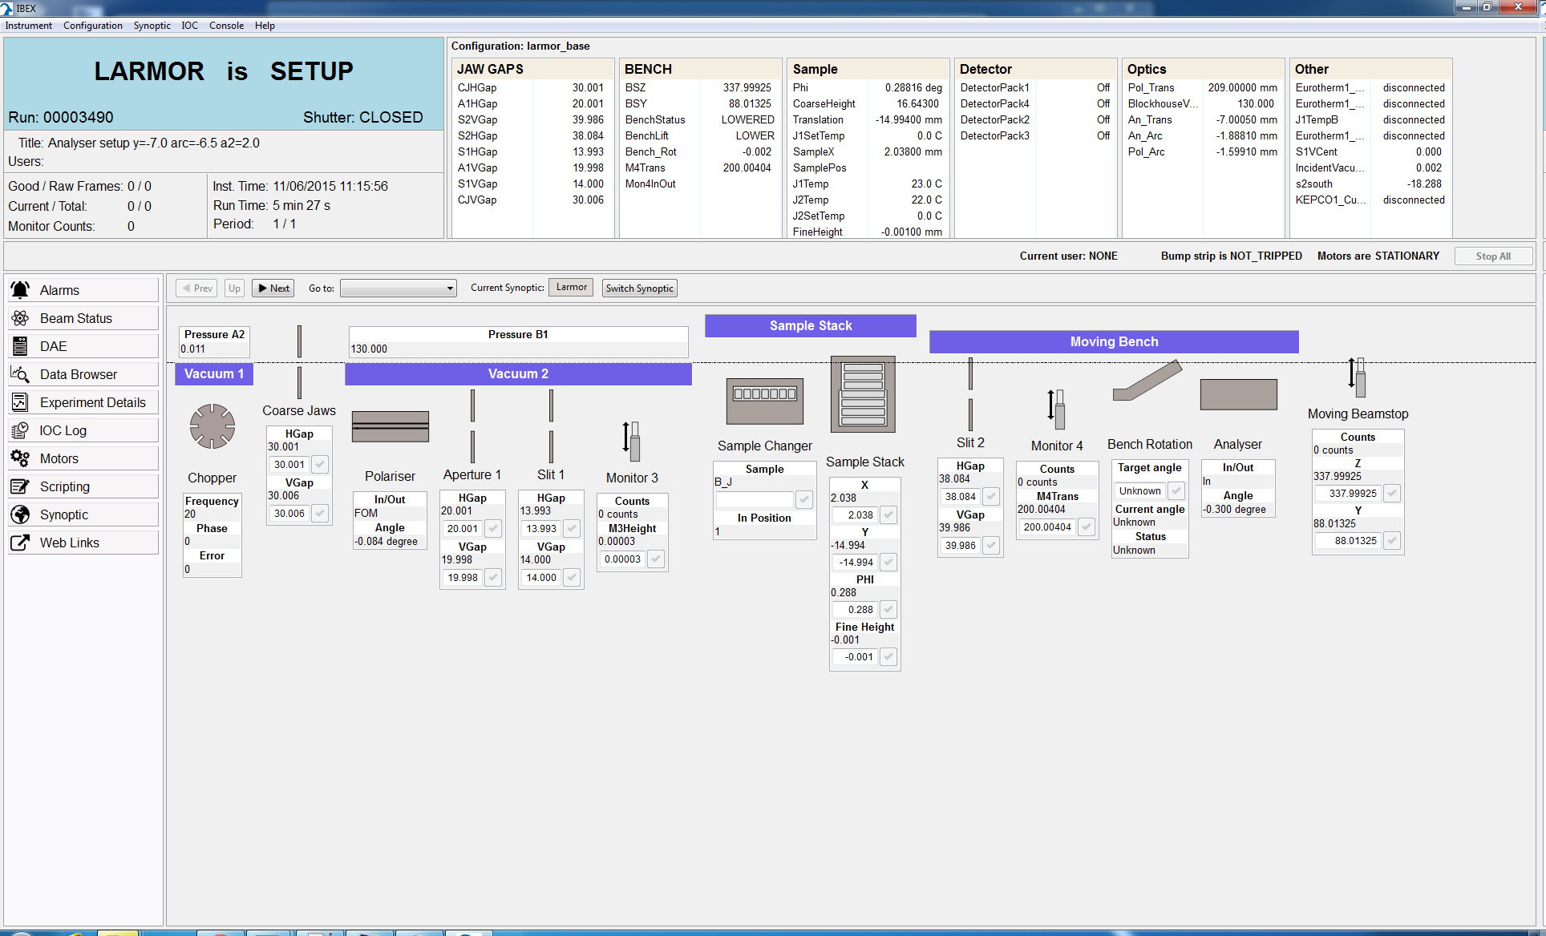
IBEX Client GUI
Notes:
The IBEX Client is the primary means of interaction with the IBEX server
It is the primary GUI for IBEX
This screenshot shows a typical view. We’ll illustrate the main components one by one.

Slide 8
Key IBEX Features
GUI uses SWT widgets & CS Studio BOY OPIs
Synoptic view, editor and drill down
Drill down is to BOY OPIs
Can define multiple synoptic views
Dashboard summary view
Blocks (user requested key information)
Block values copied into NeXus (HDF5) data file
Data collection suspended if block out of range
(Other PVs logged to diagnostic archive)

Slide 9
Key IBEX Features (cont.)
Configurations and components
Which IOCs to start, macros to set etc.
Alarm view (BEAST)
“Table of motors” view
IOC log messages view
Python user scripting window
Instrument selector
client can view another instrument

Slide 10
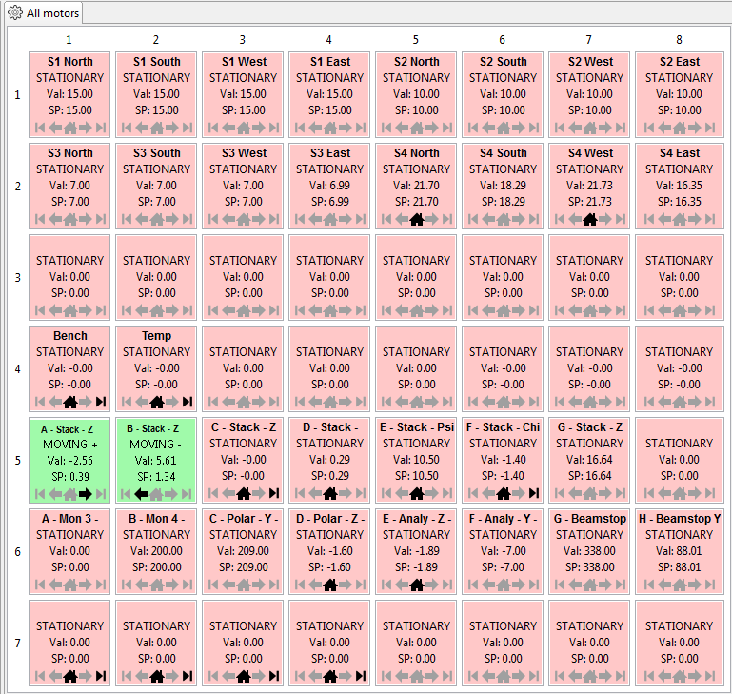
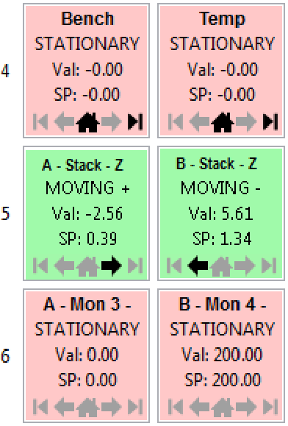
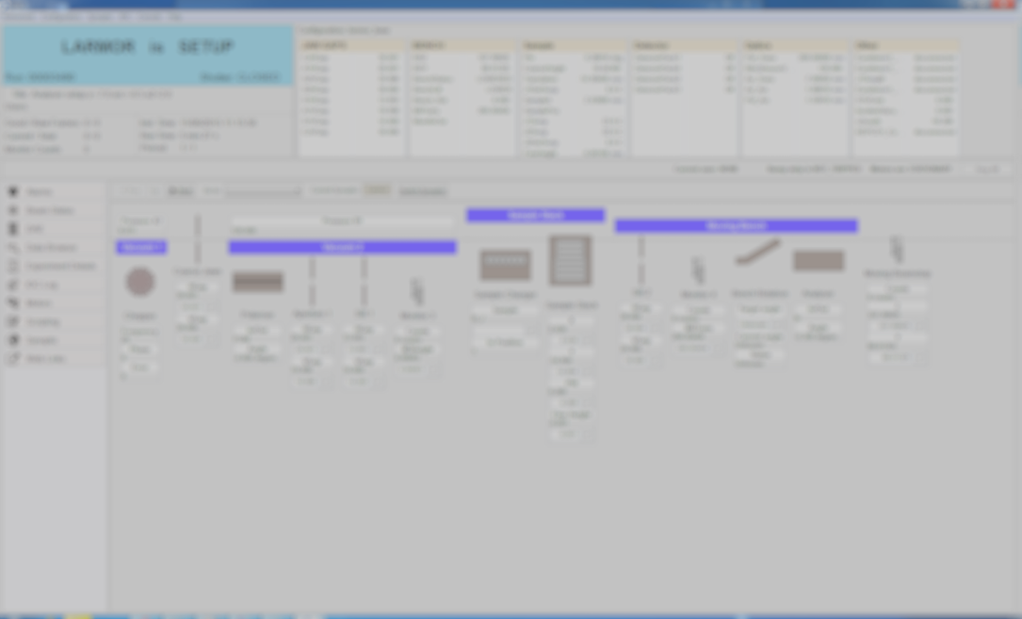
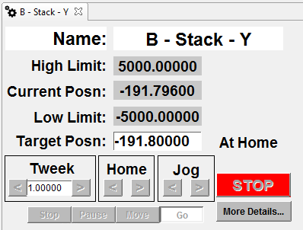
IBEX Client: Table of Motors View
Notes:
Table of Motors View
A quick way to see status of all motors
Each row is a single Galil motor controller (crate) - up to 8 ports
As many rows as there are motor controllers
Pink: motor is stationary; Green: motor is in motion; Grey: motor is not present
Icons show if motor is homed, in motion or at a limit.
Drill-down (double-click) to see and change detailed settings of any motor

Slide 11
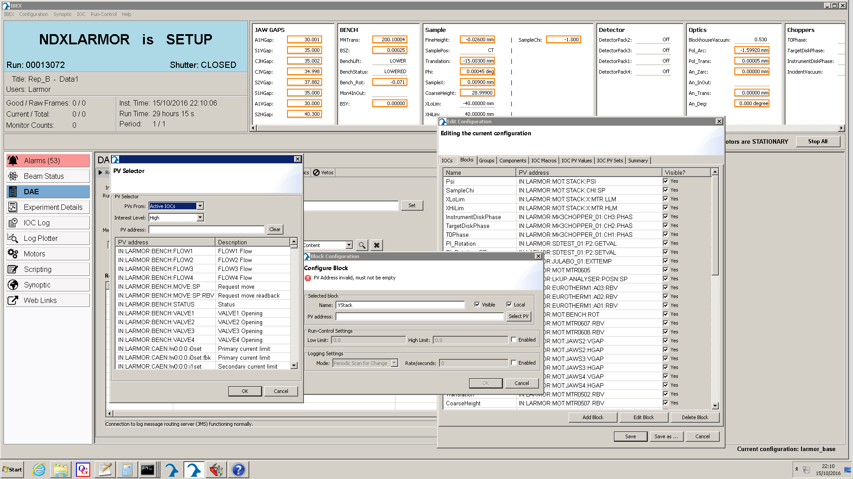
IBEX Client: Adding Blocks

Slide 12
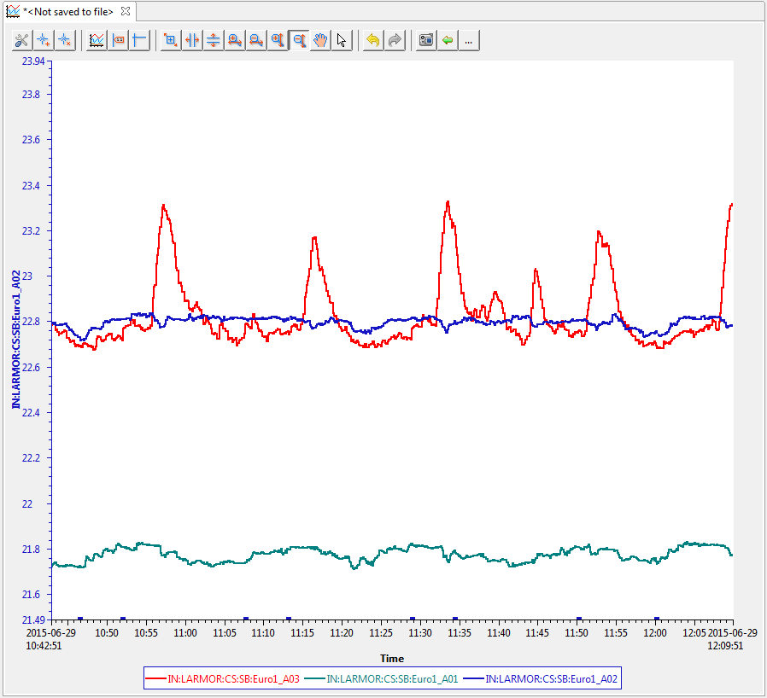
IBEX Client: Block History
Notes:
You can view the history of any Block (or PV for that matter)
Right click on the block and select from the drop-down menu
This example shows 3 sample temperatures being monitored by a Eurotherm (on LARMOR)
You can display as many Blocks (or PVs) on a trace as required
You can change the scale, zoom in, zoom out, you can change the colour of the traces, etc.
You can export the trace as a tab-delimited file or a Matlab file
You can save the image as a PNG file

Slide 13
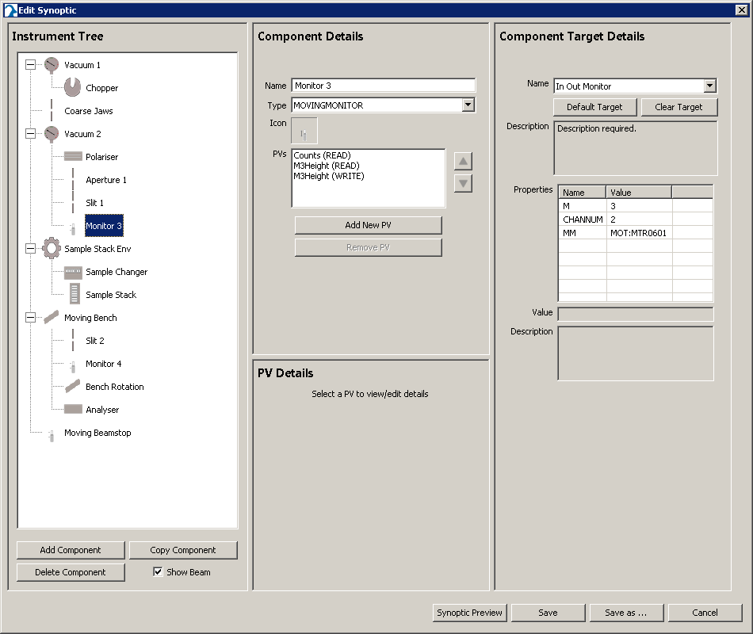
IBEX Client: Synoptic Editor

Slide 14
Configurations
Detail appropriate drivers and settings
Which IOCs to start
Plus macros, and additional PV values to set
“Blocks” and “block groups”
Aliases for relevant experiment PVs
Also logging, run control limits
A default synoptic view
Stored as XML files in folders on disk
Managed and served by “blockserver” process
Versioned in git

Slide 15
Components
A configuration can include “components”
These are like mini-configurations
An instrument’s equipment is composed of:
Fixed beamline devices (e.g. choppers, slits)
Variable experiment devices (e.g. cryostat)
A particular configuration would contain:
A base fixed devices component
Additional movable equipment components

Slide 16
Current IBEX Status
Fully deployed to three instruments so far
2 new, 1 existing
IBEX parts used for Muon Front-end upgrade
Highlights IBEX benefits more widely
Lightweight LabVIEW (CA Lab) interface in SECI
Planning upgrade of remaining 27 instruments
This will take several years!
Working on script server interface
Using NICOS (FRM-II) to manage scripts

Slide 17
Acknowledgements
Many people have contributed to IBEX:
Freddie Akeroyd, Kathryn Baker, Matt Clarke, Simon Fernandez, Lottie Greenwood, Jack Harper, Michael Hart, Gareth Howells, David Keymer, Thomas Lohnert, Chris Moreton-Smith, Dominic Oram (STFC), Martin Bell, Ian Bush, John Holt, Robert Nelson, Adrian Potter, Isabella Rey, Kris Ward, Kevin Woods (Tessella)
Code hosted at: https://github.com/ISISComputingGroup

