Slide 1
Applications of electron linear accelerators for radiotherapy
Lars Hjorth Præstegaard
Aarhus University Hospital

Slide 2
Outline
Basic theory of electron linear accelerators (linacs)
Rationale of radiotherapy
Electron linacs for radiotherapy
Exercise: How to change beam energy of linacs for radiotherapy?

Slide 3
Basic theory of electron linear accelerators

Slide 4
Linear acceleration of an electron
Lorentz force:
e: Elementary charge
E: Electric field vector
v: Velocity vector
B: magnetic field vector
Requirements for acceleration:
Electric field
Electric force in direction of v
Significant linear acceleration⇒ Extended linear overlap of electric field and electron trajectory
E
v
F=-eE
Electron
v
Linear electron
trajectory
E
E
E
E

Slide 5
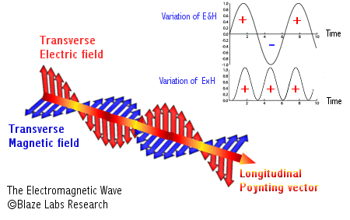
Electromagnetic wave in free space
Electromagnetic wave in free space:
Planar wave:
E(z,t)=E₀Exp(i(ωt+k_{z}z))
Transverse electromagnetic wave (TEM wave)
⇒
Both electric and magnetic field perpendicular to direction of wave propagation (z axis)
⇒
No electric field opposite to the direction of propagation: No acc.
Dispersion relation for TEM wave (propagation along z axis) :
ω: Angular frequency (2πf).
λ_{z}: Wavelength
k_{z} : Wave number (2π/λ).
c: Speed of light
ω
≡ 2πf = 2πc/λ_{z}
≡ k_{z}c
Dispersion relation: Relation between ω and k_{z} (λ_{z})
⇒
Phase velocity ≡ ω/k_{z} = c
Group velocity ≡ dω/dk_{z} = c
wave in -z dir.
wave in +z dir.

Slide 6
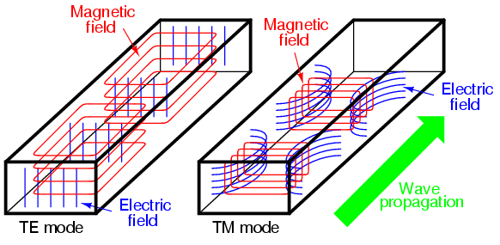
Electromagnetic waves in a waveguide
Maxwell equations + Boundary conditions
Waves in a waveguide:
TE: Transverse electric (not suited for particle acceleration)
TM: Transverse magnetic (suited for particle acceleration)

Slide 7
Linear acceleration in a waveguide
Dispersion relation for TM mode:
Generator
frequency
ν_{ϕ}=c (free space)
Stopband
wave in -z dir.
wave in +z dir.
⇒ Phase velocity for TM mode = ω/k_{z} > c
⇒
No average transfer of energy to electrons
⇒

Slide 8
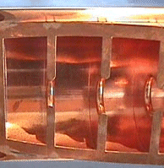
Disc-loaded waveguide
Disc-loaded waveguide: Addition of discs to the waveguide:
Disk-loaded waveguide with period d
⇒ Reflections from discs
⇒ Positive interference of reflections from neighbor disks if
Phase advance = k_{z}*2d ≈ 2π ⇒ k_{z} ≈ π/d
⇒ Standing wave behavior for k_{z} ≈ π/d (no energy transport)
⇒ Group velocity close to zero for k_{z} ≈ π/d
⇒ Large perturbation of waveguide dispersion relation for k_{z} ≈ π/d

Slide 9
Disk-loaded waveguide: Dispersion
Dispersion relation for disk-loaded waveguide:
Passband
wave in -z dir.
wave in +z dir.
π/d
k_{z}
Disks ⇒ Frequency exist for which ν_{ϕ}= c
⇒ Acceleration of relativistic electrons (v=c)

Slide 10
Disk-loaded waveguide: Modes
p=2
Small holes in discs
⇒
Scattering of forward wave (hole=source of wave propagation)
⇒
Positive interference: phase advance = k_{z}*pd = 2π
p=1,2,3,...
⇒
Loss-free propagation: k_{z}d = 2π/p
Modes used for particle acceleration:
0 mode: k_{z}d=2π (p=1)
π mode: k_{z}d=π (p=2)
2π/3 mode: k_{z}d=2π/3 (p=3)
π/2 mode: k_{z}d=π/2 (p=4)

Slide 11
Traveling wave (TW) acceleration
Disk-loaded waveguide (slowed-down wave)
TM wave and electron beam travels synchronous
Input of RF power at first cell
Output of RF power at last cell
Injection of electron beam along axis of waveguide
RF load
Resistive loss in walls
+ Energy transfer to beam
⇒
Reduction of microwave power along waveguide
RF power in
electron gun

Slide 12
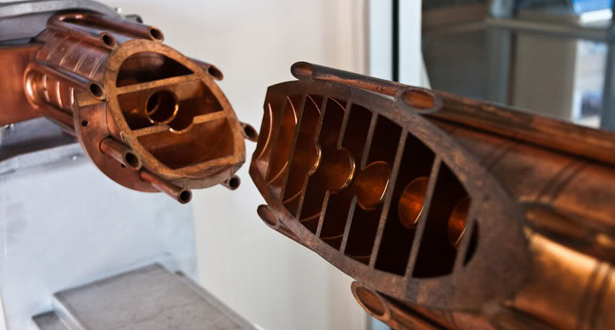
TW acceleration: Stanford linear accelerator
50 GeV electrons
932 disc-loaded sections of 3.05 m
RF input
Water cooling
Discs

Slide 13
Standing wave (SW) acceleration
1. Disk-loaded waveguide with reduced apertures at ends:
d
⇒ Full reflection of traveling waves at structure ends
2. Low wave attenuation along structure
Standing waves
Acceleration by both forward/backwards waves (0, π-mode)

Slide 14
SW acceleration: π/2-mode
π-mode: Large energy gain
π/2-mode:
Short fill time (large group velocity)
Insensitive to geometrical errors
Low energy gain
Coupling cavity
π/2 mode
Looks like π-mode for beam
bi-periodic π/2 mode
Biperiodic π/2-mode SW structure:
All advantages for π/2 and π modes

Slide 15
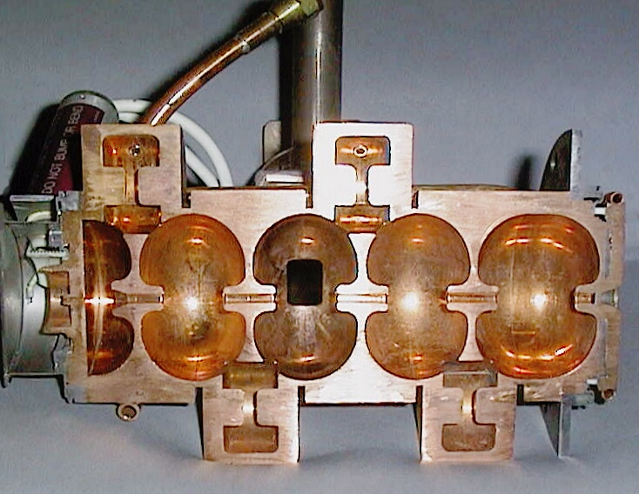
SW acceleration: Medical linac
Varian 600c biperiodic π/2-mode SW structure:
coupling cavity
RF input
Normal cavity

Slide 16
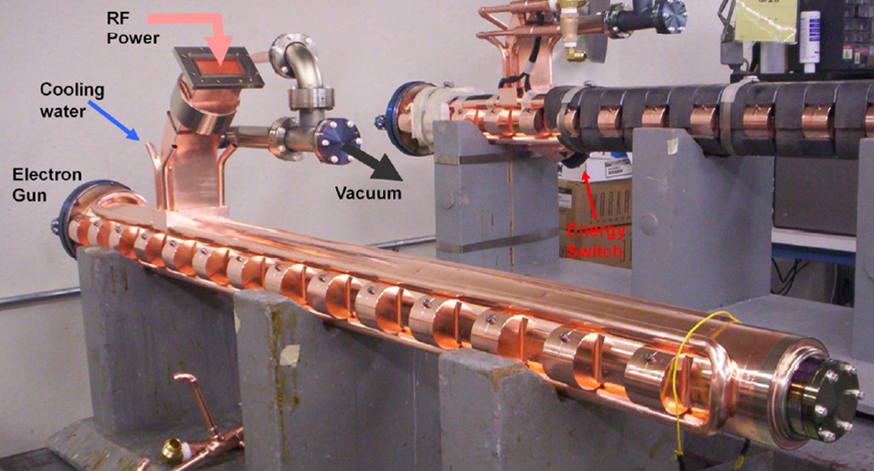
SW acceleration: Medical linac
Varian TrueBeam biperiodic π/2-mode SW structure:
Coupling cavity

Slide 17
Rationale for radiotherapy
18

Slide 18
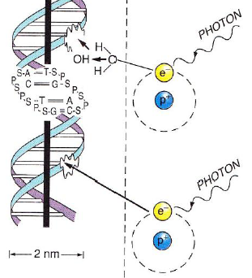
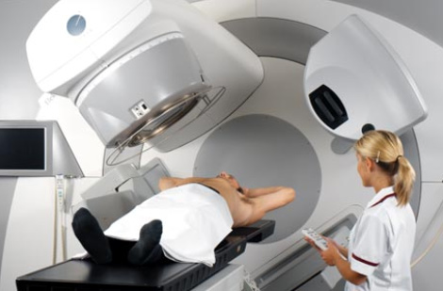
What is radiotherapy?
Radiotherapy:
Killing of cancer cells by ionizing radiation (x-rays or ionizing particles)
Damage to DNA by ionizing radiation:
Radiotherapy:
Indirect DNA damage
Direct DNA damage
~50 % of all cancer patients receives radiotherapy
Dead of cell at cell division

Slide 19
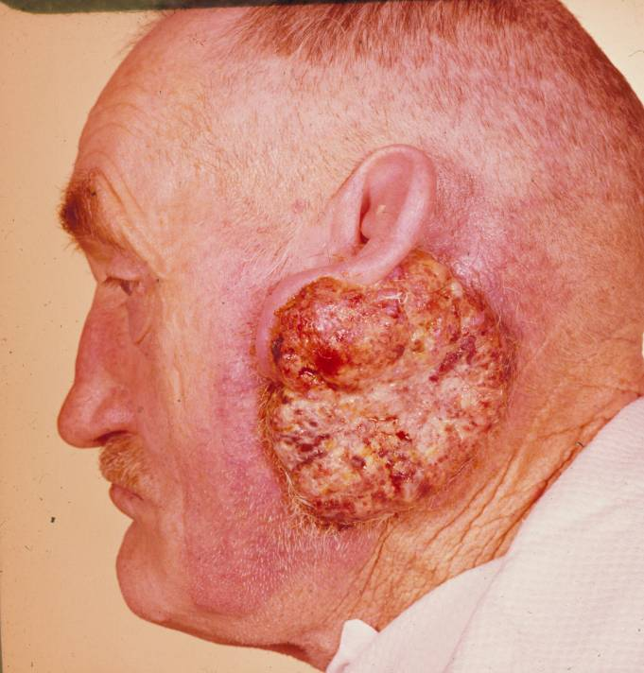
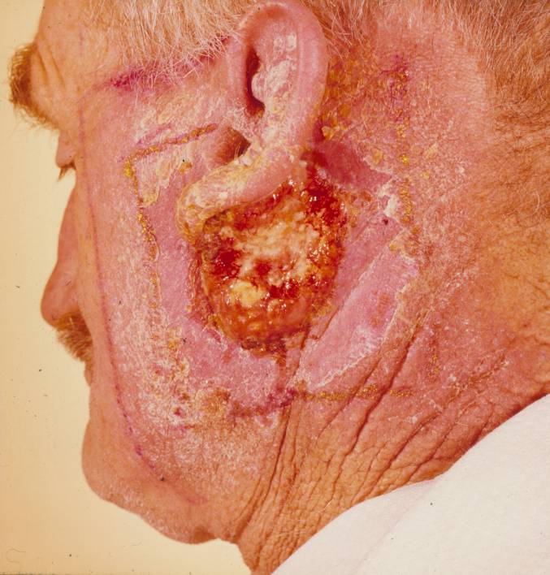
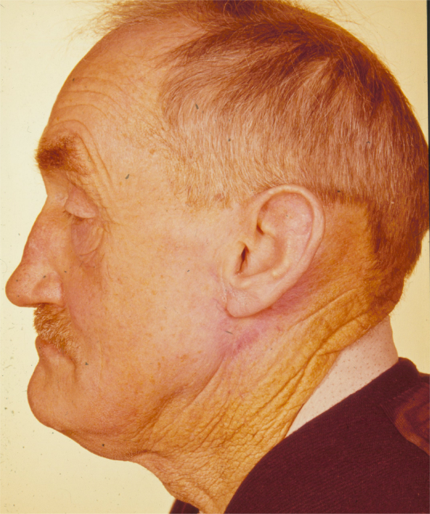
Why does radiotherapy work?
Before treatment
During treatment
After treatment
Cancer cells are sensitive to ionizing radiation:
Cancer cells are mutated cells with reduced DNA repair capability
Cancer divide (copying of DNA) more than healthy tissue + Higher sensitivity to radiation at cell division

Slide 20
Dose response
Response
100 %
Normal tissue complication probability
Tumor control probability
0 %
Dose
Dose: Compromise between cure and toxicity to healthy tissue

Slide 21
Electron linear accelerators for radiotherapy

Slide 22
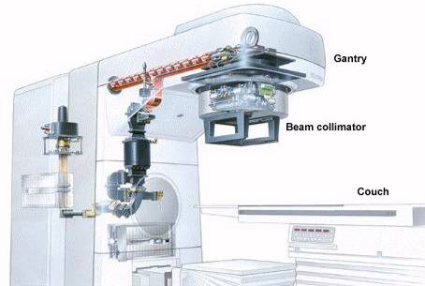
Main components of medical linac
Disc-loaded
waveguide for acceleration
Bending magnet
Electron gun
Gantry
Microwave
amplifier
Treatment head
Couch
RF waveguide

Slide 23
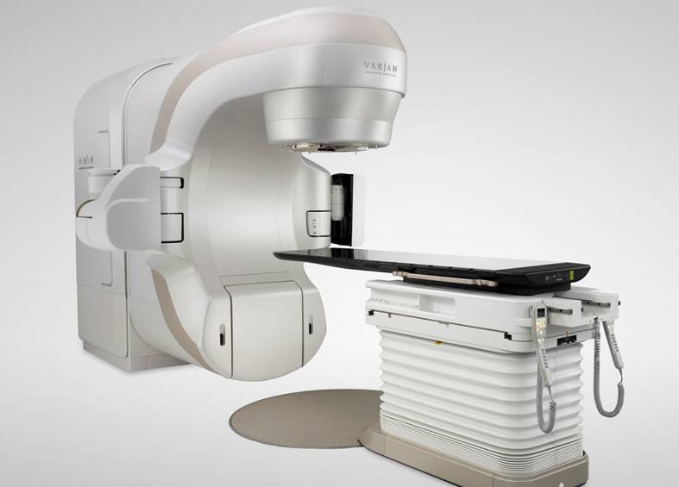
Main manufacturers of medical linacs
Elekta
4-22 MeV TW accelerator
Varian
4-22 MeV SW accelerator

Slide 24
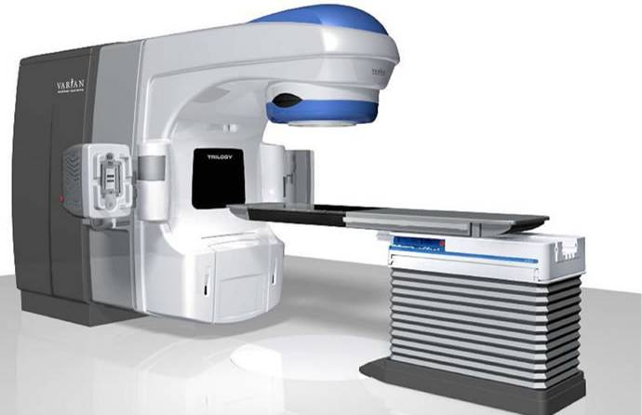
Gantry and couch degrees of freedom
Isocenter:
Intersection of gantry rotational axis and collimator rotational axis
(100 cm from x-ray target)
Gantry
Collimator
Couch

Slide 25
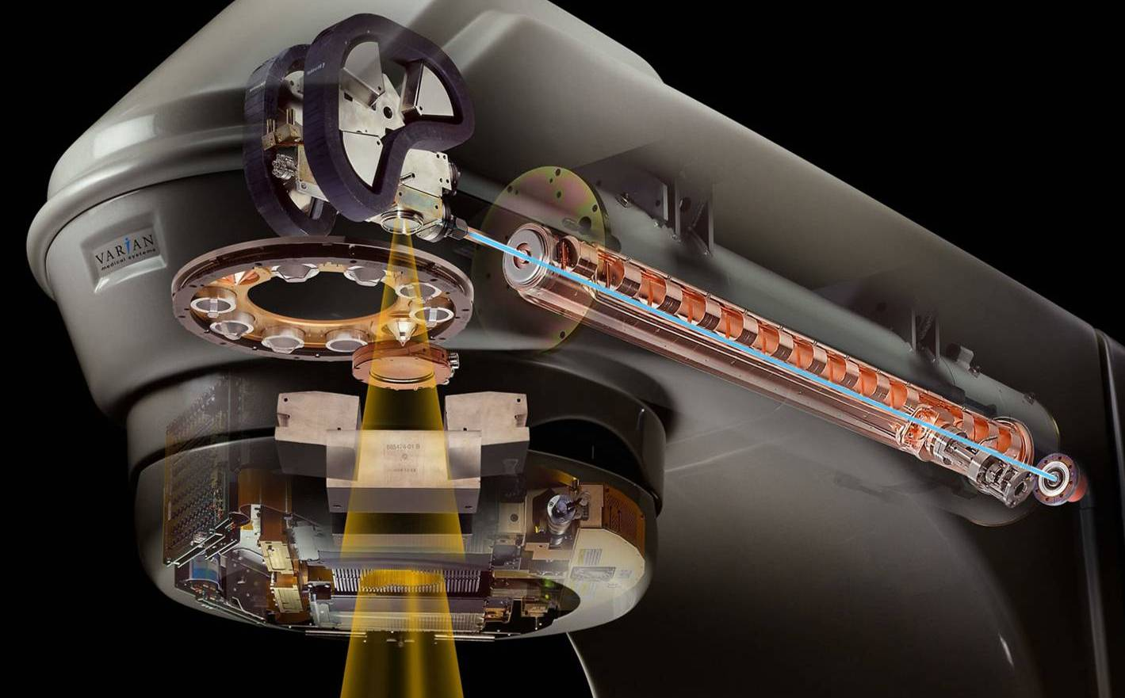
Treatment head
X-ray treatment: Fast electrons + target ⇒ Intense bremsstrahlung (x-rays)
Electron treatment: Fast electrons (no target)
Bending
magnet
Target
Disc-loaded
waveguide
Flattening
filters
Dual monitor chamber
Secondary
collimators
Multi-leaf collimator

Slide 26
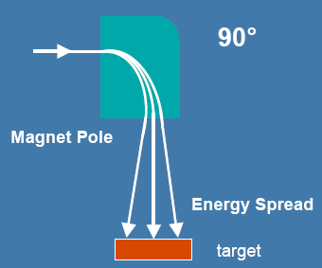
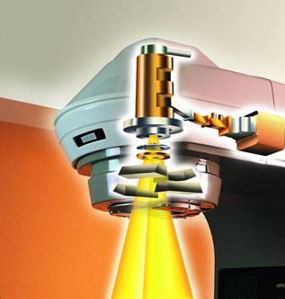
Bending magnet
Chromatic
deflection
Achromatic
deflection
Large beam spot
Varian / Siemens HE
Achromatic
deflection
Elekta
Varian (low energy)

Slide 27
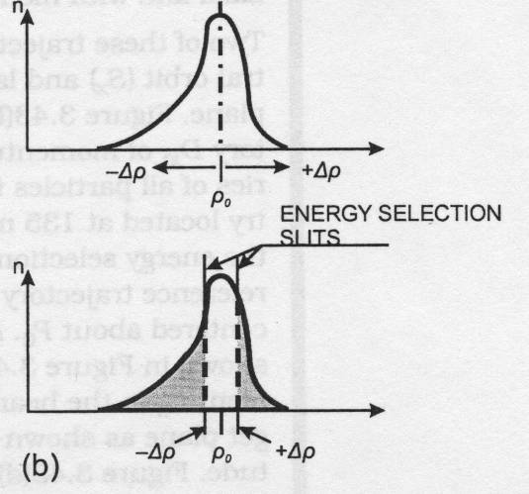
Bending magnet: Varian Clinac HE
Energy slit:
Slit at position with non-zero dispersion
Target

Slide 28
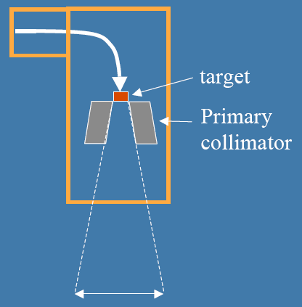
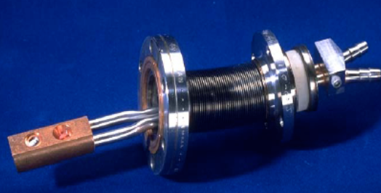
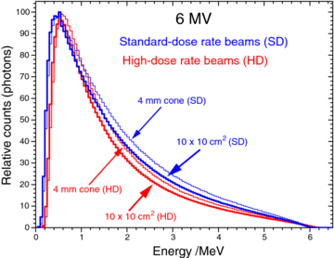
X-ray target
Varian Clinac x-ray target:
X-ray target:
Located inside vacuum
Conversion of electron beam to bremsstrahlung (x-ray) ⇒ X-ray treatment
Target materials:
Target materials affects x-ray yield and spectrum
Copper/water for cooling
6 MeV bremsstrahlung spectrum:

Slide 29
Primary collimator
Primary collimator:
Large tungsten block defining the maximum treatment field size
Effective shielding of leakage radiation
Usually opening with a conical shape ⇒ Round maximum field size

Slide 30
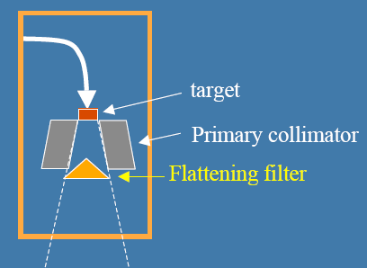
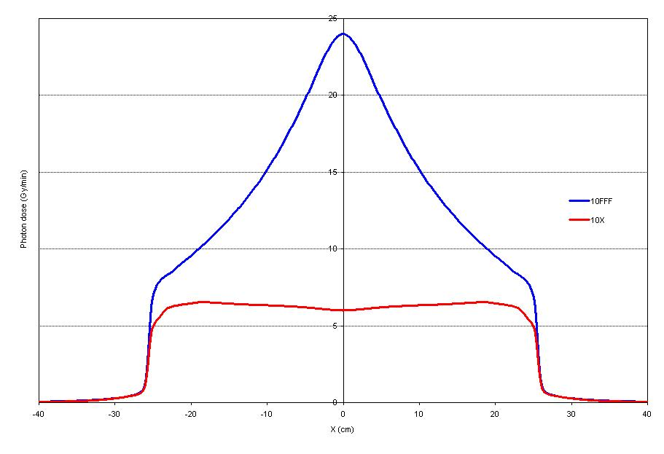
X-ray flattening filter
Bremsstrahlung is forward-peaked
Convenient with flat dose profile
Varian flattening filters:
⇒ Use flattening filter:
Cancellation of off-axis intensity variation
Reduction in dose rate
Off-axis photon energy spectrum variation
High energy
Low energy

Slide 31
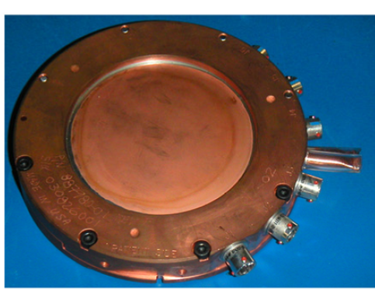
Monitor chamber
Dual transmission ionization chamber:
Determination of treatment beam dose
Two chambers: Redundant dose determination
TrueBeam dual transmission monitor chamber

Slide 32
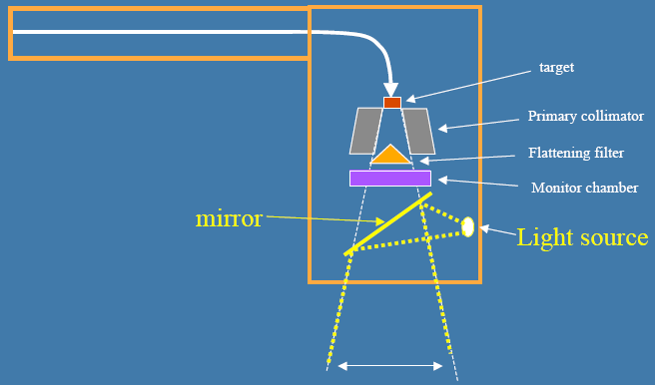
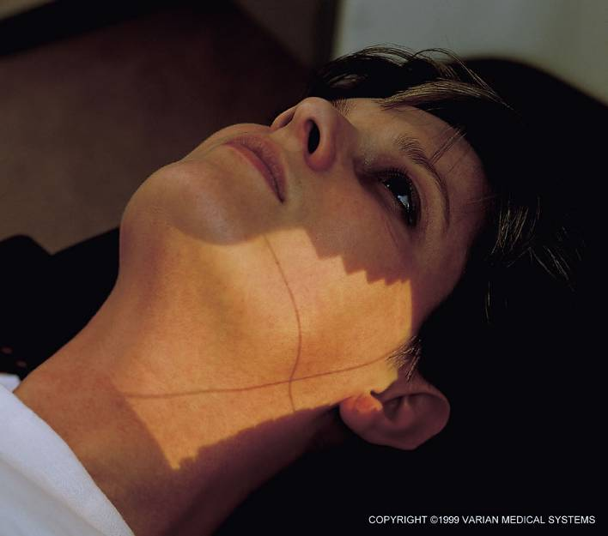
Light field
Light field = extend of treatment field

Slide 33
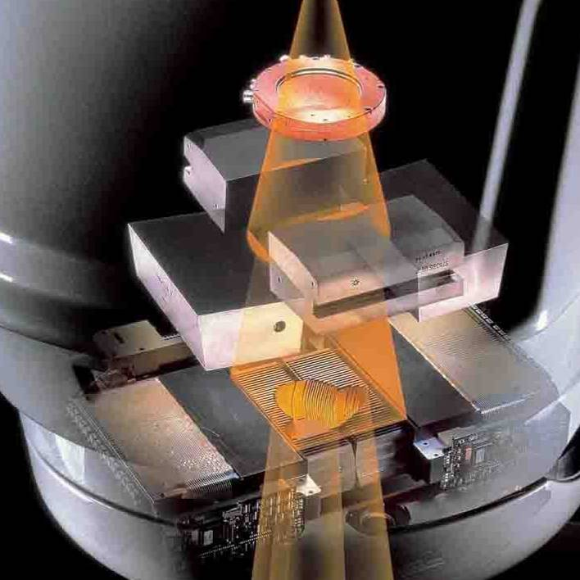
Secondary collimators (or jaws)
Varian secondary collimators (tungsten):
Secondary
collimators

Slide 34
Multi-leaf collimator (MLC)
MLC:
2 rows of thin tungsten blades
Detailed shaping of the treatment field
Typical leaf width: 5 mm
MLC
Varian 120 leaf MLC (leaf width: 5 mm)

Slide 35
X-rays: Secondary electron cascade
Photoelectric
effect
e⁻
γ
e⁻
Patient
e⁺
Annihilation
γ
γ
Pair
production
e⁺
γ
e⁻
Photoelectric
effect
Compton scattering
e⁻
γ
Photoelectric
effect
Low ionization (dose) at patient skin
= Dose buildup
Bremsstrahlung
e⁻
= Ionization

Slide 36
X-ray dose versus depth
Dose buildup
Decreasing dose:
Attenuation
Inverse square law
Skin dose ≈ 25 % ⇒ Skin sparing

Slide 37
Electron treatment
Detailed field shaping:
Lead end-frame cut-out
Elekta electron applicator

Slide 38
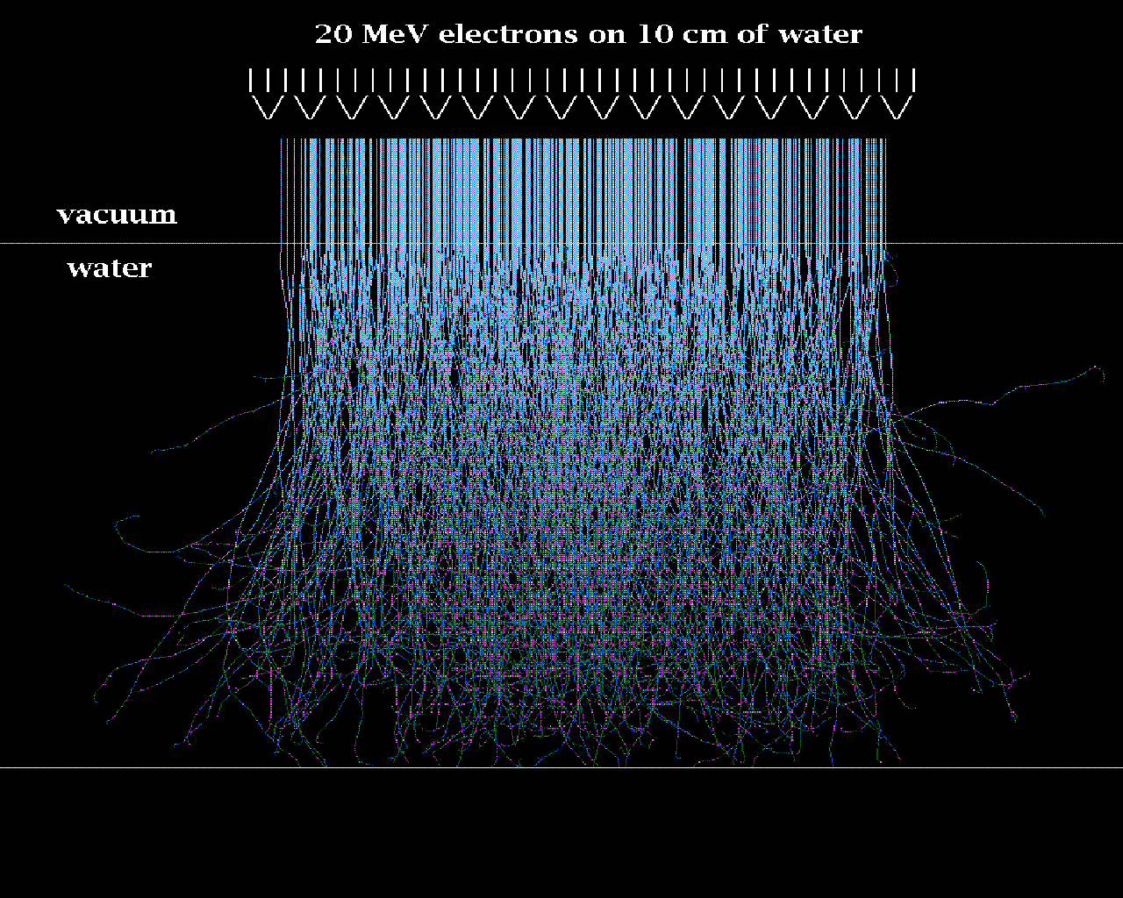
Electron dose versus depth
Ionization tracks (20 MeV electrons):
Dose
High ionization (dose) at surface
Water
Electron range depends on electron energy
Electrons are used for cancer close to the skin
Bremsstrahlung tail
Depth

Slide 39
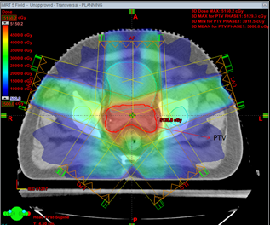
Example: 5 field prostate x-ray treatment
Transverse view of patient pelvis
Field 2
Field 1
Field 3
Prostate target
Field 5
Field 4
Overlap of all fields at cancer target
⇒ Large dose in cancer target relative to dose in healthy tissue

Slide 40
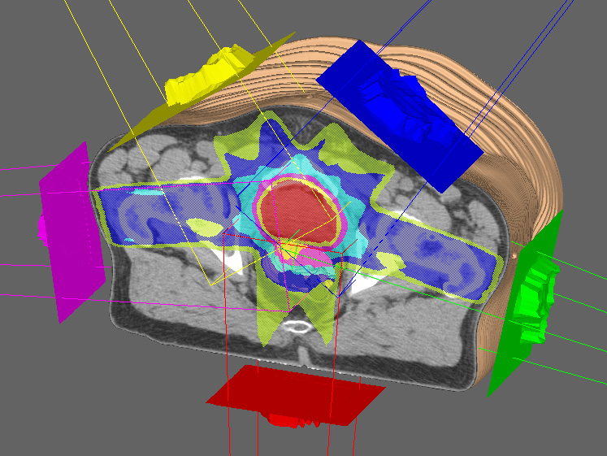
Example: Intensity-modulated RT (IMRT)
IMRT: Modulation of each field with MLC ⇒ Dose distribution fits better to the cancer target

Slide 41
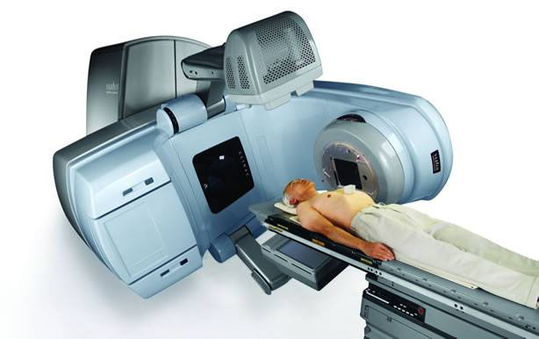
Imaging systems on-board accelerator
Imaging systems ⇒ Verification of patient position
kV source on
robotic arm
MV radiation
head
MV detector on
robotic arm
KV detector on
robotic arm
Imaging systems:
2D MV imaging
2D KV imaging (good contrast)
2D KV imaging + gantry rotation: CT scanning of pt. in treatment position

Slide 42
Video
Elekta medical accelerator

Slide 43
Exercise:
How to change beam energy of linac for radiotherapy?

Slide 44
Change of RF input power
Change of RF input power
Change of the electric field in the disc-loaded waveguide
Change of the energy, capture efficiency, and energy spread
Only optimum capture efficiency and energy spread for a particular RF input power (beam energy)
⇒ Problem for multi-energy linac ⇒ Design compromise
Siemens linac: 6 MeV
Siemens linac: 18 MeV
Large energy spread
Capture efficiency: 36%
⇒
Small percentage of electrons reach the target
⇒
Low dose rate + stray rad.
Small energy spread
Capture efficiency: 44%
⇒
Large percentage of electron reach the target

Slide 45
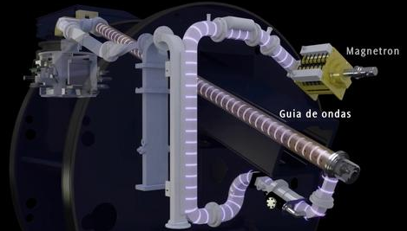
Change of RF frequency
t₂
t₁
Buncher
Elekta Synergy
RF frequency shift ⇒ Change of phase velocity ⇒
Desynchronization of wave and particle ⇒ Particle energy decrease
Only small change of electric field in the buncher section
Design of optimum capture efficiency and energy spread for a wide range of beam energies.
High dose rate for all treatment energies

Slide 46
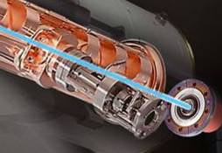
Change of number of active cells
Motorized energy switch:
Modification of cavity coupling
Varian Clinac
Buncher
+RF input
Reduced electric field
Same electric field in buncher for all beam energies
⇒ Design of optimum capture efficiency and energy spread for wide range of beam energies
⇒ Efficient transfer of electrons from gun to target for all energies
⇒ High dose rate for all energies

Slide 47
Appendix:
Treatment workflow

Slide 48
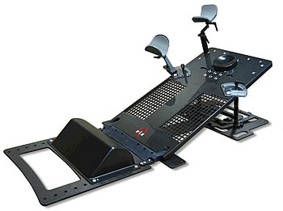
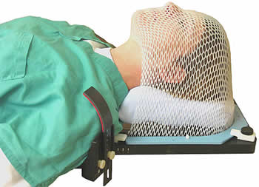
Step 1: Patient fixation
Creation of patient-specific fixation.
Patient fixation:
  High geometrical accuracy.
  High positional reproducibility.
Head & neck fixation
Fixation for breast treatment

Slide 49
Step 2: CT scanning
CT scanner: Acquisition of 3D patient anatomy for treatment planning.
CT coordinate system is marked on patient or fixation using room lasers:

Slide 50
Step 3: Target delineation
Delineation of:
Gross tumor (visible tumor).
Suspected microscopic tumor spread (CTV).
Critical healthy tissue
Dose:
Specification of the dose to all targets.
Target delineation is performed by a radiation oncologist

Slide 51
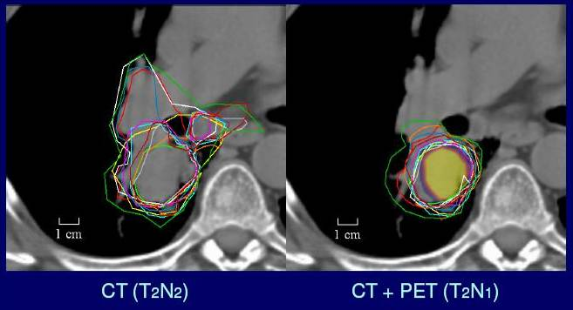
Step 3: Target delineation
Target delineation is the largest uncertainty in modern high-precision radiotherapy:
Delineation by several radiation oncologists
Large improvement of target delineation with PET imaging
Lung tumor

Slide 52
Step 4: Treatment planning
Aim:
Get specified dose to all targets (<5 % accuracy required).
Get as low dose as possible to critical healthy tissue (organ specific).
How?
Choice of modality (x-ray or electrons).
Choice of beam directions (gantry angle and couch angle).
  The more beams the better sparing of critical tissue.
Beam weight (dose), shaping (MLC) and modulation (MLC).

Slide 53
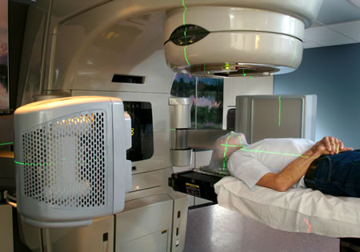
Step 5: Treatment
Position the patient in patient-specific fixation
Adjustment of the patient position using room lasers and marks on the patient/fixation
Correct the position of the patient position using on-board kV or MV image systems

