Slide 1
Medical application of
proton accelerators
Lars Hjorth Præstegaard
Aarhus University Hospital

Slide 2
Outline
Basic theory of the proton cyclotrons
Production of medical radionuclides
Rationale for proton therapy
Treatment delivery of proton therapy

Slide 3
Basic theory of proton cyclotrons

Slide 4
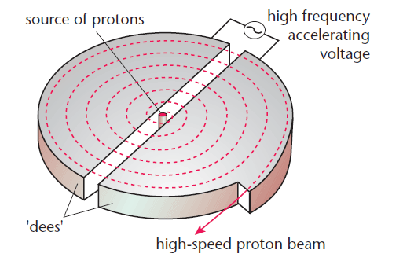
Cyclotron: The basic concept
Magnetic field

Slide 5
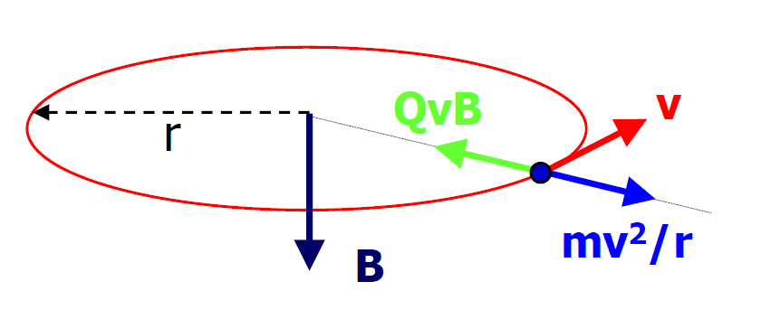
Circular orbit
Circular orbit:
Centrifugal force = Magnetic Lorentz force
⇒
z
m: Mass of ion.
q: Number of charges
e: Elementary charge
v: Speed of ion
r: Radial position of ion
B_{z}: Magnetic field strength in the z direction
Angular frequency:
Gyrofrequency or cyclotron frequency
Typically 10-30 MHz

Slide 6
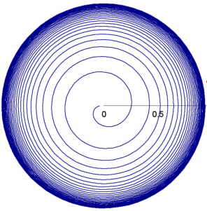
Isochronous cyclotron
CW high intensity proton beam
Simultaneous acceleration of low/high energy protons
Revolution period should be energy independent (isochronous cyclotron)
Isochronous cyclotron:
⇒
⇒ B_{z}(r) = γ(r)B(0) ,
⇒ Field increases versus r + r is limited
Problem:
Reduced orbit separation ⇒ More difficult extraction

Slide 7
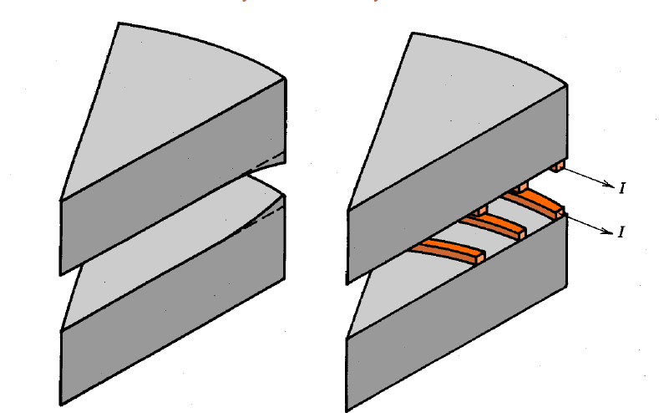
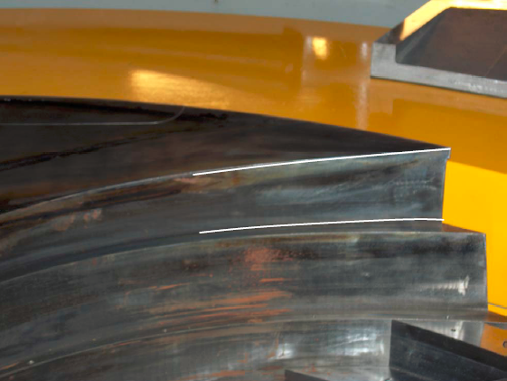
Isochronous cyclotron
Methods for increasing the field versus r:
Decreasing pole gab versus r
Trimming coils
Increase hill/valley ratio
IBA C235
Isochronism: The magnet poles must be machined and shimmed with very high accuracy (relative field error below 10⁻⁴)

Slide 8
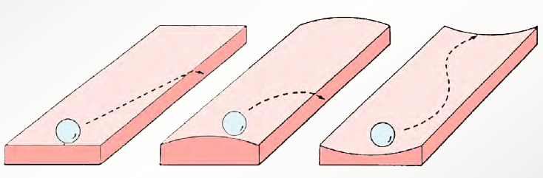
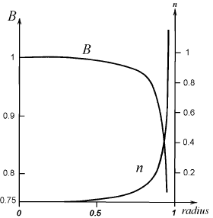
Transverse focusing
Betatron tune: Number of oscillation periods per revolution
Weak focusing: Less than one oscillation per revolution
Strong focusing: More than one oscillation per revolution
Cylindrical symmetric magnet pole:
Radial betatron tune: ν_{r}²=1-n
Vertical betatron tune: ν_{z}²=n
No beam loss ⇒ Both radial and vertical focusing
ν_{r}²=1-n > 0 and ν_{z}²=n > 0
0<n<1 (weak focusing)
Small field decrease versus r

Slide 9
Vertical focusing
Problem:
Isochronous cyclotron: Magnetic field↑ versus r
Vertical focusing: Magnetic field↓ versus r
Solution:
Increasing field versus r + additional vertical focusing
Not
compatible!
Vertical Lorentz force:
Vertical defocusing for isochronous cyclotron
=0 for field with no dependence on θ
≠0 for field with dependence on θ
Additional vertical focusing: Non-cylindrical magnet pole

Slide 10
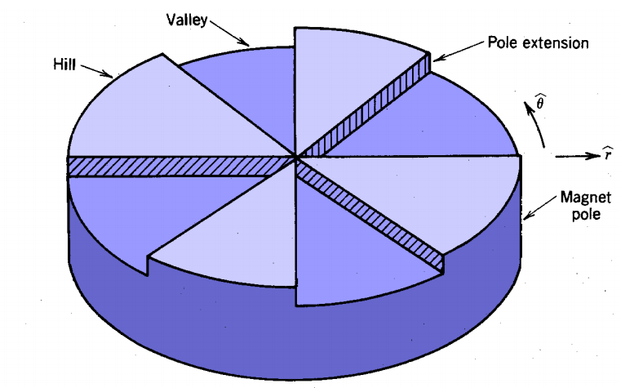
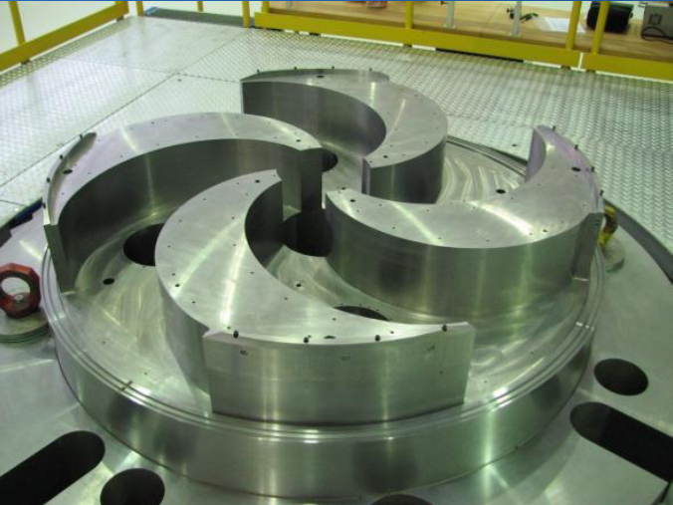
Vertical focusing: Azimuthally varying Field
Azimuthally-varying field (AVF):
AVF ⇒ B_{θ}≠0:
AVF + spiral pole geometry:
Additional vertical focusing
Isochronous cyclotron with strong transverse focusing

Slide 11
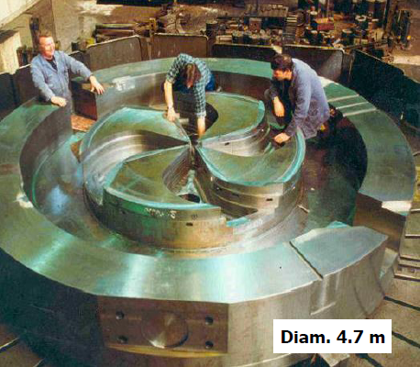
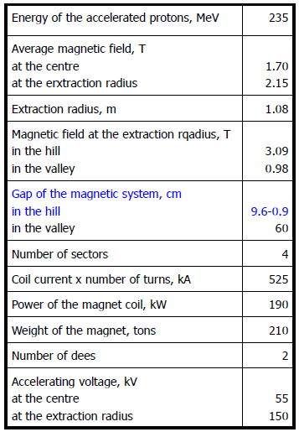
Vertical focusing: IBA medical cyclotron

Slide 12
Synchro-cyclotron
Very compact cyclotron ⇒ Very high magnetic field (>5 T)
⇒ Significant saturation of iron
Significantly reduced azimuthal field variation
Insufficient vertical focusing for isochronous cyclotron
Synchro-cyclotron (non-isochronous cyclotron):
B↓ versus r (vertical focusing)
Relativistic ions: m(r) increases versus r
⇒
Only acceleration of a limited number of proton bunches (neighbor orbits) per acceleration cycle
Low duty factor (significantly reduced beam current)
decreases versus r

Slide 13
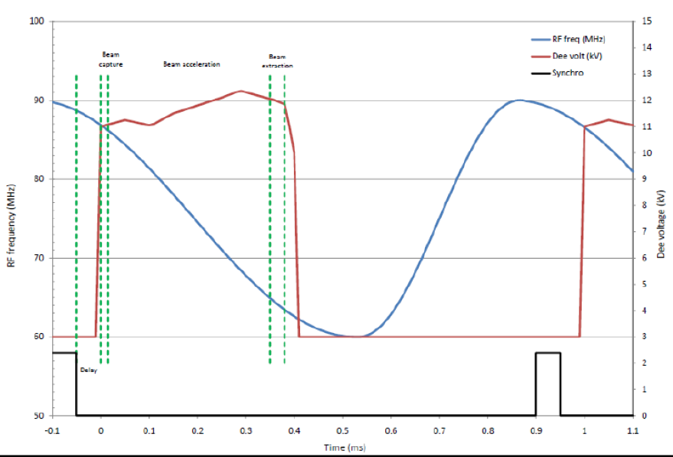
Synchro-cyclotron: Acceleration cycle
IBA S2C2:

Slide 14
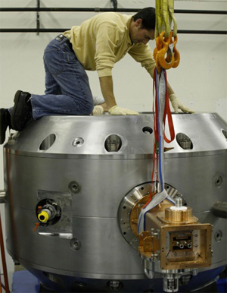
Synchro-cyclotron: Example
Mevion synchro-cyclotron for proton therapy (250 MeV, ~9 T):

Slide 15
Production of medical radionuclides

Slide 16
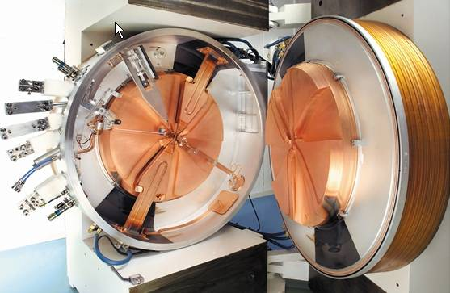
Cyclotron for radionuclide production
GE PETtrace 700
RF input
RF cavity
Targets for radionuclide production
RF cavity
Spiral sectors
RF input

Slide 17
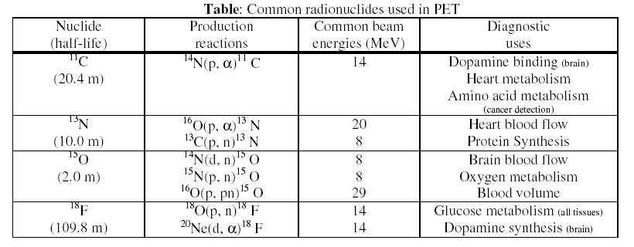
Cyclotron-produced radionuclides
Acceleration of protons or deuterium by a cyclotron

Slide 18
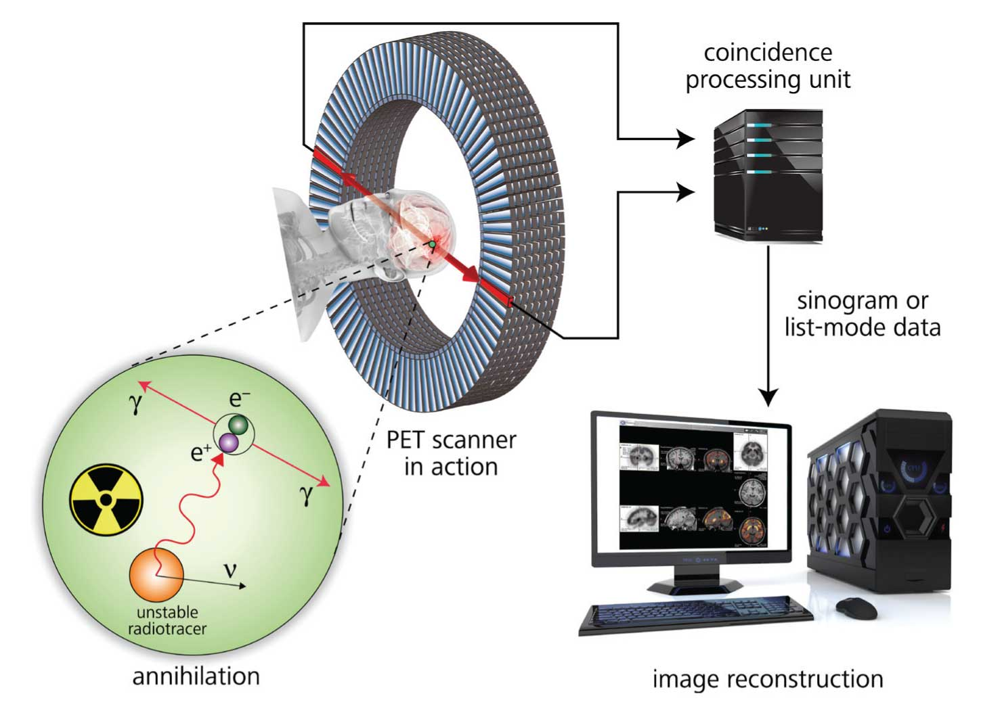
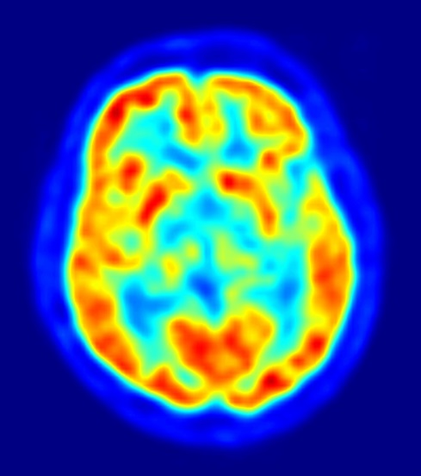
Positron emission tomography (PET)
511 keV
511 keV

Slide 19
Rationale for proton therapy
17

Slide 20
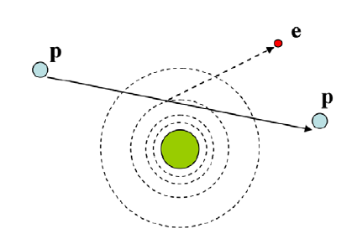
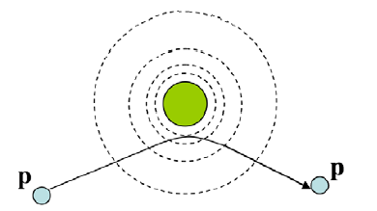
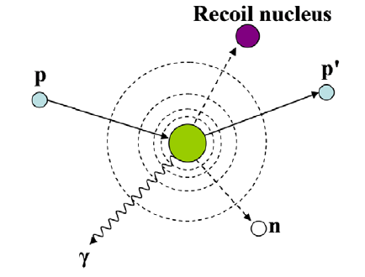
Interactions of a proton in matter
1. Inelastic Coulomb interaction with atomic electrons
Dominating interaction:
Ionization (=dose)
Small energy loss per interaction ⇒ Continuous slowing down of proton ⇒ Well-defined range
Range secondary electrons < 1mm ⇒ Dose is absorbed locally
No significant deflection of protons (m_{p} = 1832⋅m_{e})
2. Elastic coulomb scattering with nucleus
3. Non-elastic nuclear interaction
Neutrons are the main external radiation hazard
Lateral scattering of treatment field versus depth

Slide 21
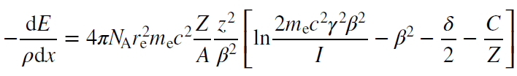
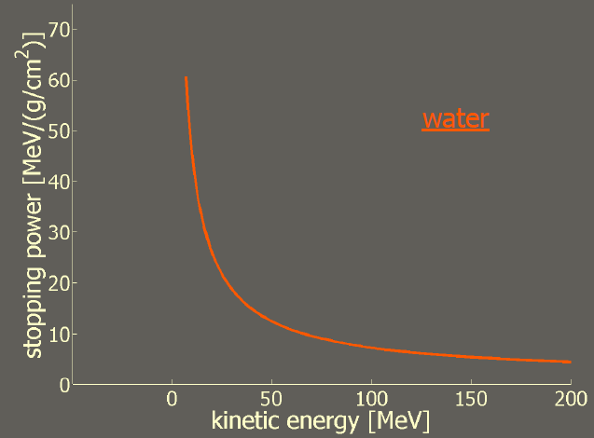
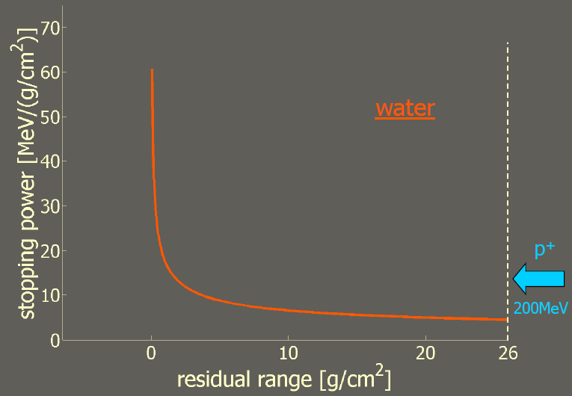
Energy loss of a charged particle
Energy loss per unit length (stopping power):
N_{A}: Avogadro’s number, r_{e}: Classical electron radius, m_{e}: Electron mass, z: Charge of the projectile, Z: Atomic number of the absorbing material, A: Atomic weight of the absorbing material, c: Speed of light, v: Velocity of the projectile, β=v/c, γ = (1 − β²)^{−1/2}, I: Mean excitation potential of the absorbing material, δ: Density correction arising from the electron shielding, C: Shell correction item
To first order: -dE/dx ∝ 1/v²
200 MeV protons in water
200 MeV protons in water

Slide 22
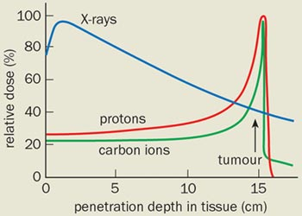
The Bragg peak
Dose = Number of protons ⋅ stopping power ∝ 1/v²
⇒ Most dose is deposited at the final range of the charged particle
Position of peak: Given by the initial particle energy
Width of peak: Range straggling
Dose beyond peak: Dose from inelastic nuclear interactions

Slide 23
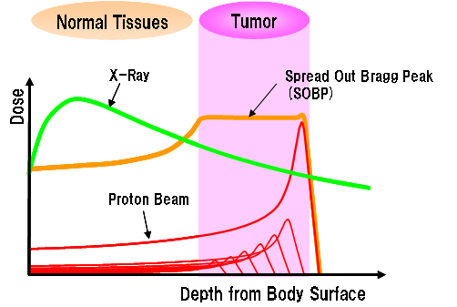
Spread-out Bragg peak
Less dose
Less dose

Slide 24
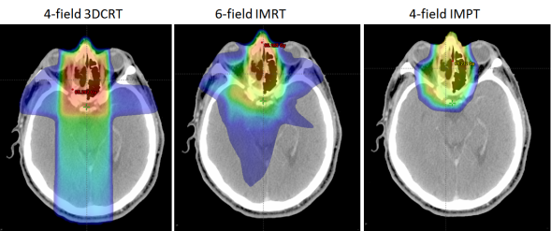
Dose distribution of proton treatment
Conventional x-ray
Advanced x-ray
Advanced proton
Proton therapy: Less dose to healthy tissue
1. Less complications (same dose)
2. Better tumor control (higher dose,
~10 % of patients can significantly benefit from proton therapy
same complications)

Slide 25
Treatment delivery of proton therapy

Slide 26
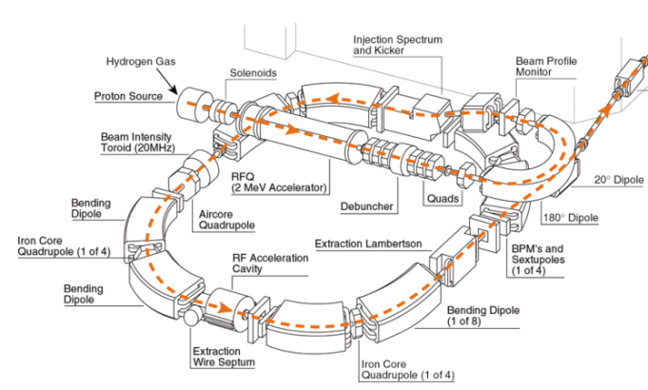
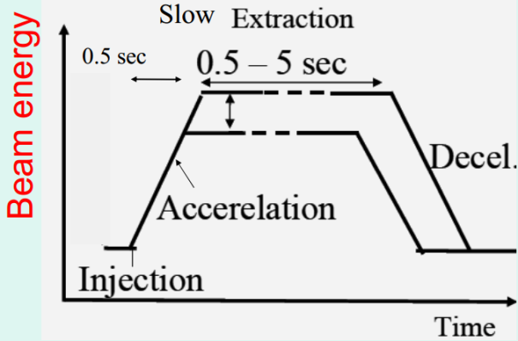
Synchrotron for proton therapy
Special features:
Proton linac
Variable-frequency RF cavity
Slow extraction

Slide 27
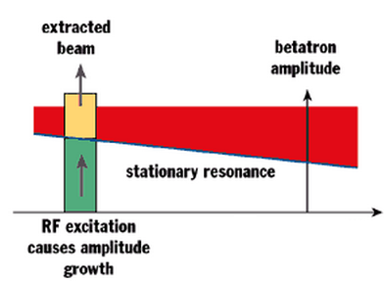
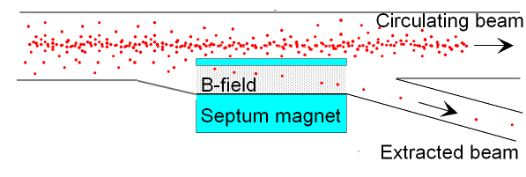
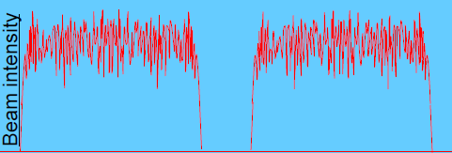
Synchrotron: Slow extraction
Proton therapy ⇒ Need for CW beam
Slow extraction:
Betatron tune close to resonance ⇒ Reduced area of transverse separatrix
Transverse RF excitation of the beam
⇒ Particles excited outside separatrix
⇒ Particles spiral outside extraction septum
Spill cyclus:
Fill ring with ~10⁹ protons
Accelerate (~0.5-1 s)
Slow extraction during 1-10 s
Decelerate (~0.5-1 s)

Slide 28
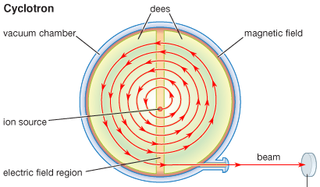
Accelerators types for proton therapy
 | Cyclotron | Synchrotron | Synchro-cyclotron
Magnetic field | Fixed/1-2 T | Vary/1-2 T | Fixed/5-9 T
Particle radius | Vary | Fixed | Vary
RF frequency | Fixed | Vary | Vary
Focusing | Strong (AVF cyclotron) | Strong | Weak
Size | Compact | Large | Very compact
Energy | Fixed | Vary | Fixed
Beam pattern | Continuous beam | Pulsed | Pulsed
Beam current | High | Low | Low

Slide 29
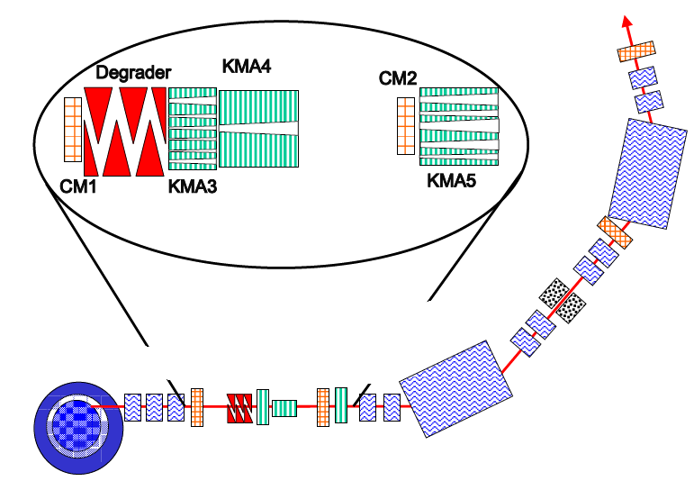
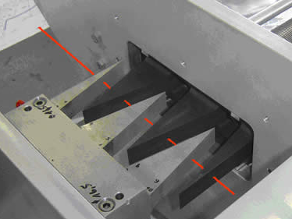
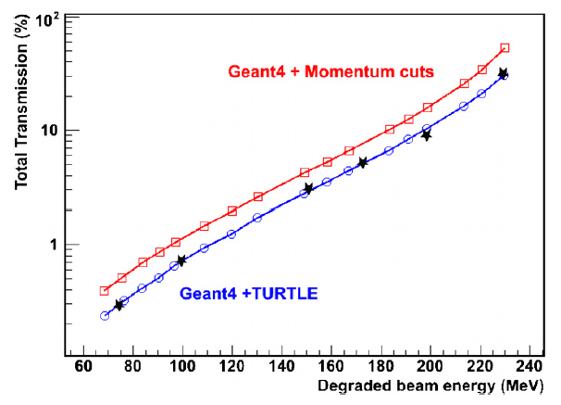
Cyclotron: Energy change
Courtesy by PSI
Apertures
Apertures
Dipole
Energy
slit
Energy slit:
Selection of treatment energy
Dipole
Degrader + ESS transmission:
Cyclotron
Degrader
Degrader:
Beam energy ↓
Beam size and divergence ↑

Slide 30
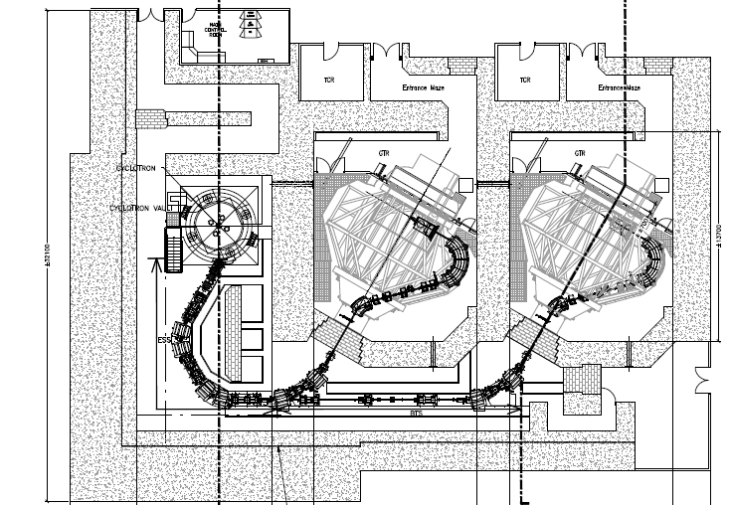
Cyclotron-based proton therapy facility
Gantry
(100-200 tons)
Cyclotron
Degrader: Energy adjustment
Energy selection system (ESS)
Beam line

Slide 31
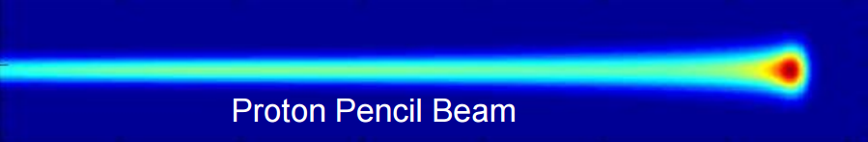
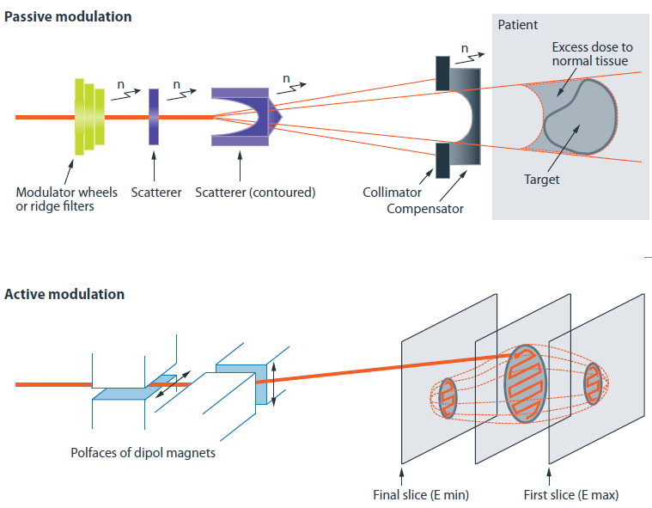
Dose deposition in the patient
Dose distribution of raw beam:
Passive scattering:
Simple
Straight forward treatment of moving organs
Excess dose to normal tissue
Significant neutron dose
Patient-specific collimators and compensators
Pencil beam scanning (PBS):
No requirement of patient-specific collimators and compensators
Interplay effect for moving organs

Slide 32
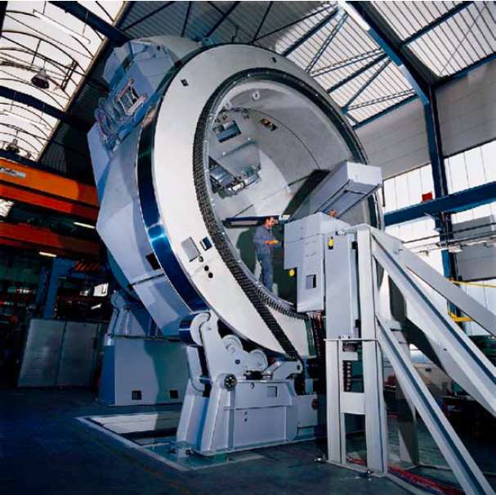
Gantry
Varian gantry in Munich
Proton gantry:
Weight: 100-200 t
Diameter: ~10 m
Speed: 360°/min
Treatment center accuracy: < 1 mm

Slide 33
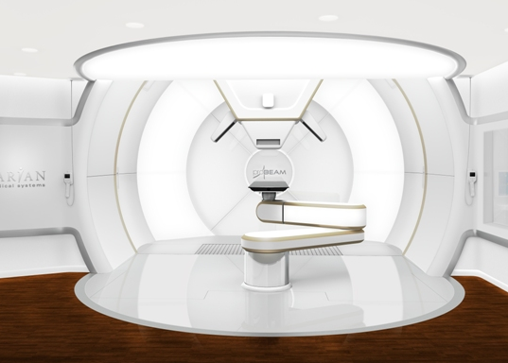
Treatment room
Varian ProBeam:
Gantry nozzle
Imaging
system
Patient couch

Slide 34
Proton therapy vender videos
IBA proton therapy
Varian proton therapy
Mevion proton therapy

Slide 35
Challenges in proton therapy

Slide 36
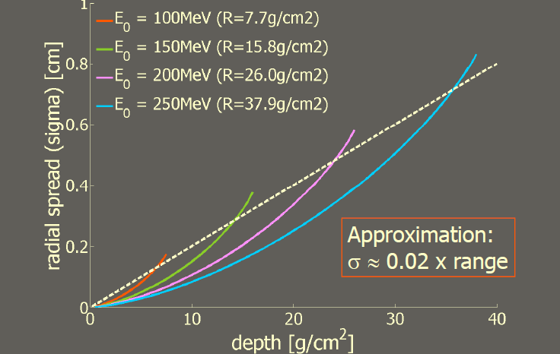
Lateral proton scattering in the patient
Lateral scattering of protons in water:
Beam size in air:
~4-6 mm (energy dependent)

Slide 37
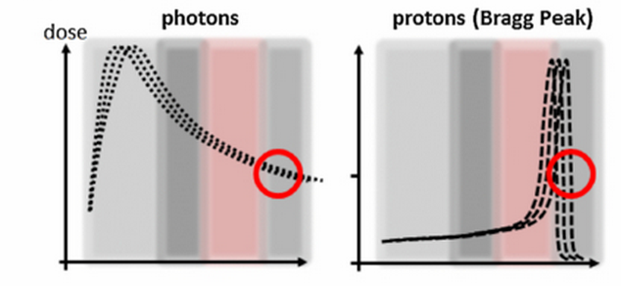
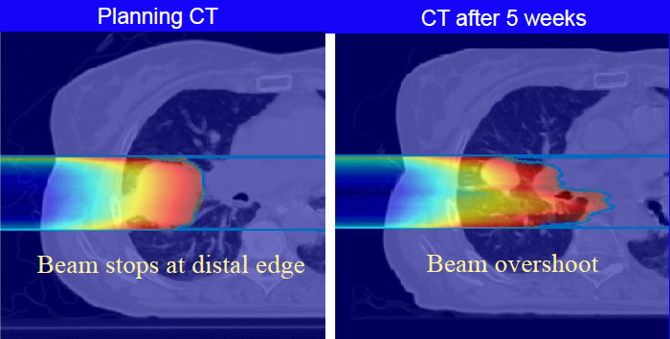
High sensitivity range uncertainties
Causes of range uncertainty:
CT number to stopping power conversion (200 mm depth: uncertainty of ~6 mm)
Tumor shrinkage
Organ motion during treatment (respiration, rectum gas, bladder filling etc.)
Consequence: Large treatment margin :=(

