Slide 1
Pushing the frontiers
Lecture at the Nordic Particle Accelerator School 2015
August 2015, Lund, Sweden
Erik Adli
Department of Physics, University of Oslo, Norway
Erik.Adli@fys.uio.no

Slide 2
Introduction
The users communities continuously ask for improved accelerator parameters; higher beam energy, better beam brilliance and higher beam power.
In this lecture we together go through a few of the main limitations of current accelerator technology and we discuss ideas and research aimed to overcome these limitations.
I will highlight especially plasma wakefield acceleration research, as this is a hot research topic in European and worldwide. NB: some author bias.

Slide 3

Technology limitations : energy, emittance/brilliance, power consumption?

Slide 4
Reminder: some limitations
Synchrotron radiation energy loss (power)
  Fundamental limit : E⁴ / (R² x m₀⁴)
Accelerating gradient (few 10’s MV/m)
  High-gradient RF research
Power consumption / efficiency : (limit ~ 100 MW)
  Optimize efficiency
Magnetic field strength (iron ~1T, SC ~10 T)
  Research in SC technology
Multi-particle / collective effects (beam-beam)
  Research in collective effects

Slide 5
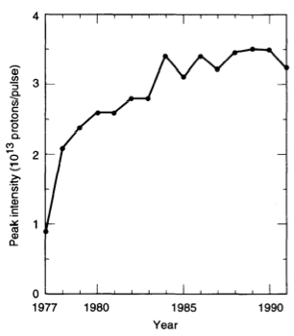
Research: accelerator physics
Particle accelerators are continuously being pushed to new parameter regimes with higher currents, higher power and higher intensity
Particle accelerator performance is usually limited by multi-particle effects, including collisions and collective instabilities
A core element of particle accelerator physics is the study of collective effects. The understanding of collective instabilities has made it possible to overcome limitations and increase performance significantly
z
Example of increase in beam intensity in the CERN PS over the years

Slide 6
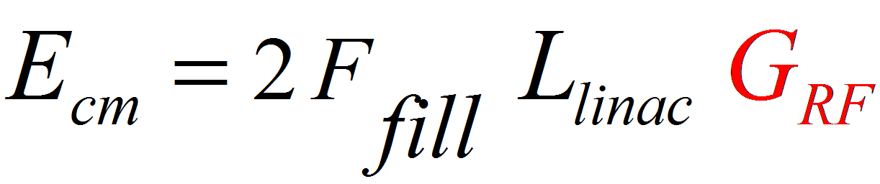
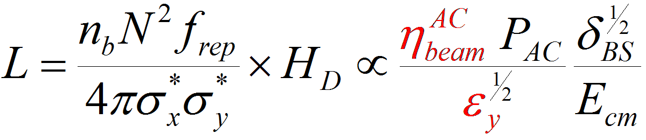
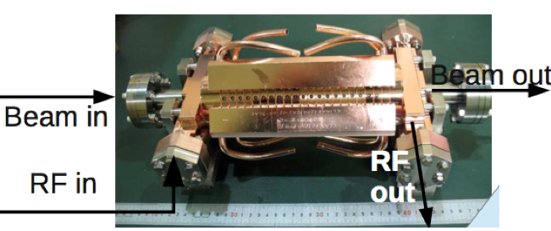
CLIC: pushing the limits
e+
e-
source
main linac
Energy reach
beam delivery
Luminosity
High acceleration gradient: > 100 MV/m
    “Compact” collider: total length < 50 km at 3 teV
  Normal conducting acceleration structures at
  high RF frequency (12 GHz)
Novel Two-Beam Acceleration Scheme
  Efficient, cost effective, reliable
Single tunnel, no active power components
CLIC main linac structure :
12 GHz Cu TW
100 MV/m gradient (loaded)
Rf pulse length: t_{p} = 240 ns
AC to beam efficiency: ~5%
Emittance preservation: ~10 nm

Slide 7
Linear collier technology readiness: conventional technology
High gradient (CLIC 100 MV/m)
Good energy efficiency (CLIC 5-10%)
Small emittance generation (CLIC ε_{Ν,0}~10 nm)
Excellent emittance preservation (Δε_{Ν}~10 nm)
Low energy spread (CLIC ~1%)
Status:
Feasible
Challenging

Slide 8
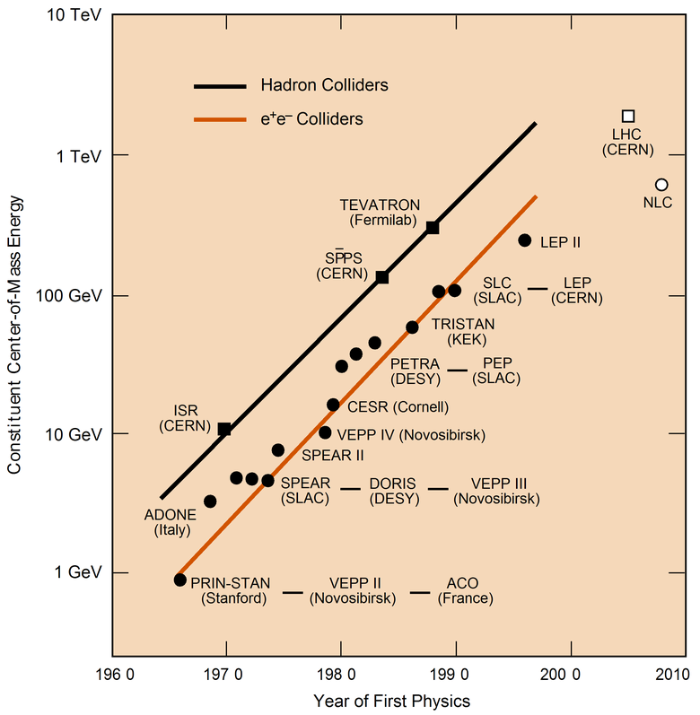
Particle collider Livingstone plot
We want to go here, and beyond
CLIC
ILC

Slide 9
Pushing the frontiers

Slide 10
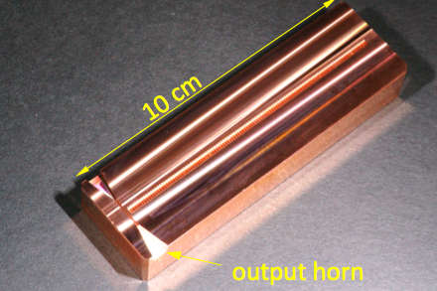
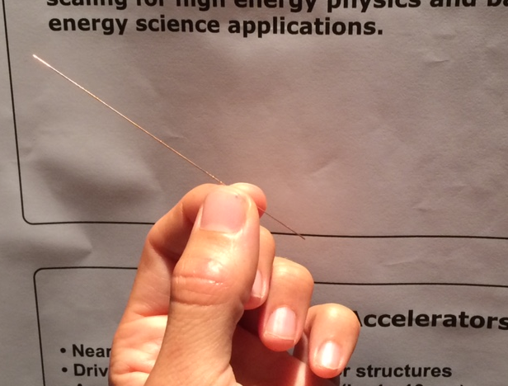
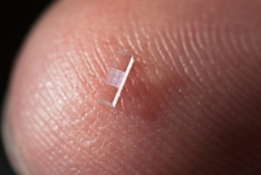
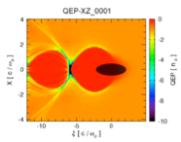
Advanced accelerator research
Cutting edge accelerator physics research. The objective is to overcome limitations in conventional RF based accelerator technology.
Very high frequency normal conducting rf structures (~100 GHz - ~THz)
Dielectric structures
SiO₂
~1.0 THz,1-10GV/m
116 GHz structure (SLAC)
Laser based acceleration
Plasma wakefield acceleration
“DLA”
(SLAC)
[later slides]
[later slides]

Slide 11
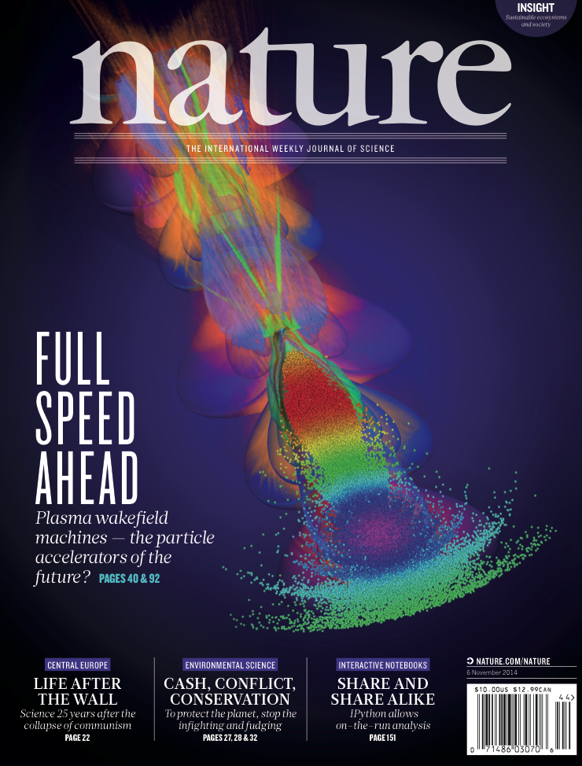
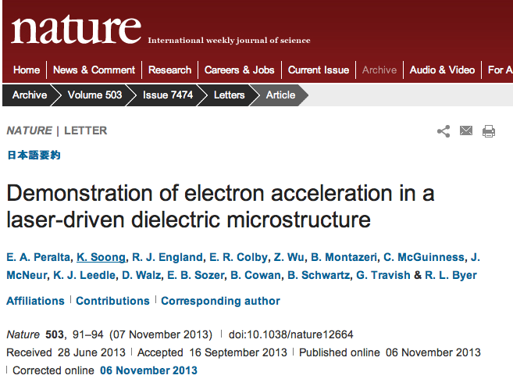
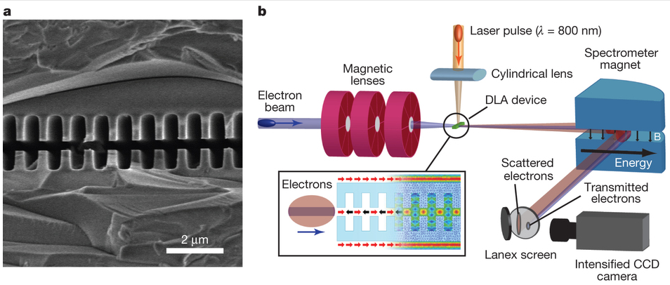
Advanced acceleration research
Key milestones in advanced accelerator research are counted in term of experimental progress.
Experimental progress =
ideas + funding + hard work
Two recent examples :

Slide 12
High power lasers today can produce very intense fields (10s of GV/cm)
Can we accelerate a particle on a laser wave propagating in free space?

Slide 13
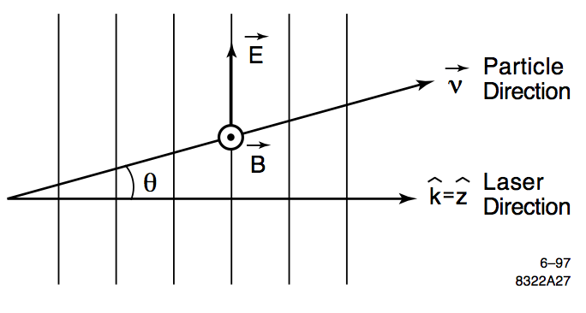
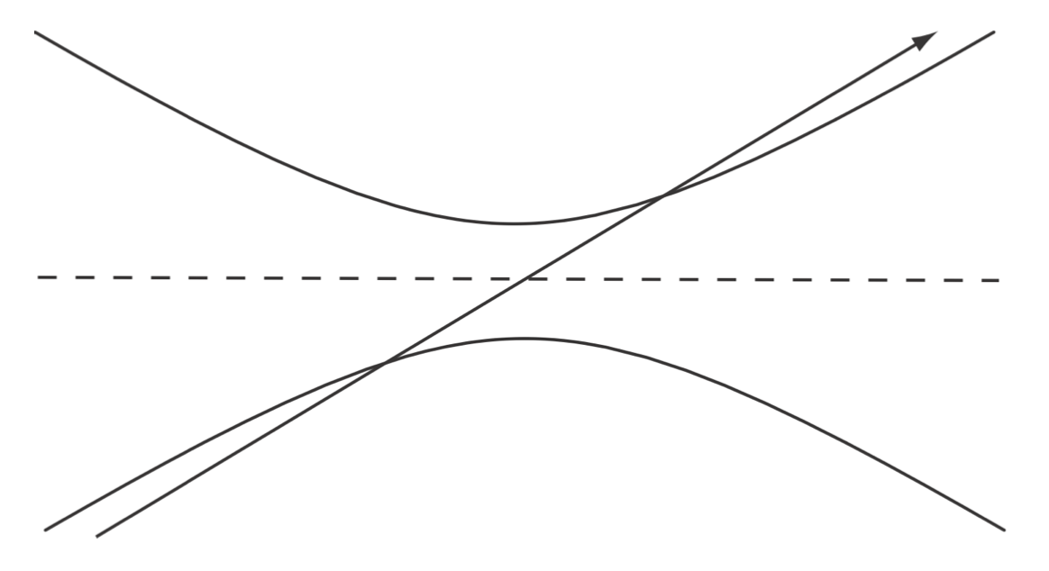
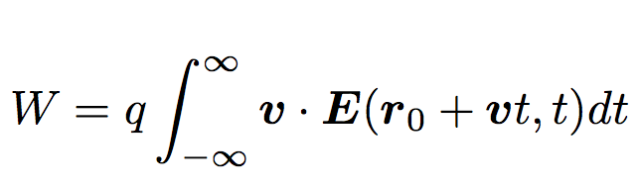
Direct laser acceleration?
Laser technology, and achievable laser fields, is advancing rapidly. For example, a 1 J, 100 fs laser beam focused into a spot size of 10 micron, has a maximum electric field about 40 GV/cm. Can we use this field for particle acceleration?
Lawson-Woodward theorem: a particle cannot get a net energy gain if interacting with laser in free space (linear approximation).
= 0
Large particle energy gains, in straight particle trajectories, can only be achieved if material boundaries are used to confine the laser field.

Slide 14
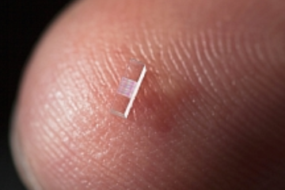
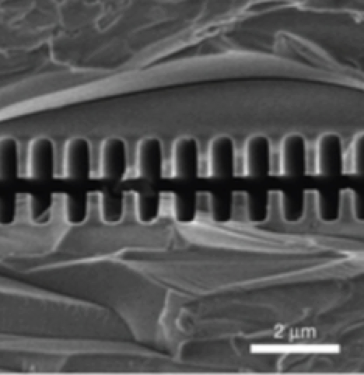
Direct laser acceleration:
“System on a chip”
Laser pulse:
incident on dielectric structure
Direct acceleration from a laser beam, guided in a dielectric structure. This laser beam operates at optical or near infrared wavelengths. Dielectrics show high damage threshold and low loss at those wavelength. Gradients of ~300 MV/m has been been demonstrated across a ~1 mm long structure.
Potential for ultra-compact, high-repetition rate acceleration.

Slide 15
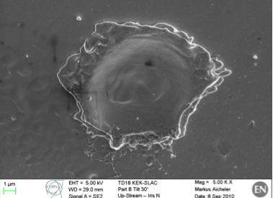
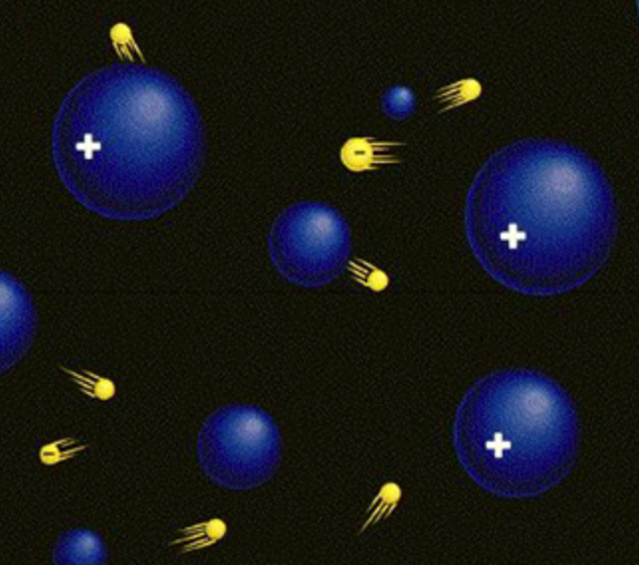
Breakdown limits and plasma
Recap: if you push the field to hard inside metallic structure, the field will eventually break down, creating electric discharges. Field cannot be sustained. Structures may be damaged. Current limit for accelerating structure (CLIC): ~100 MV/m electric field. Some factor higher for dielectric structures.
A plasma: collection of free positive and negative charges (ions and electrons). Material is already broken down. A plasma can therefore sustain very high fields.

Slide 16

Use Gauss law to get an estimate of fields in a plasma wave
Assume that all electrons are suddenly pushed out of a small volume of plasma.
Use a plasma density of n₀ = 1e17/cm3.

Slide 17
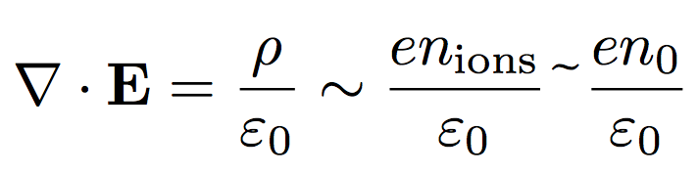
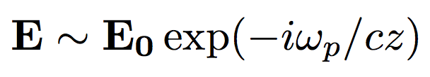
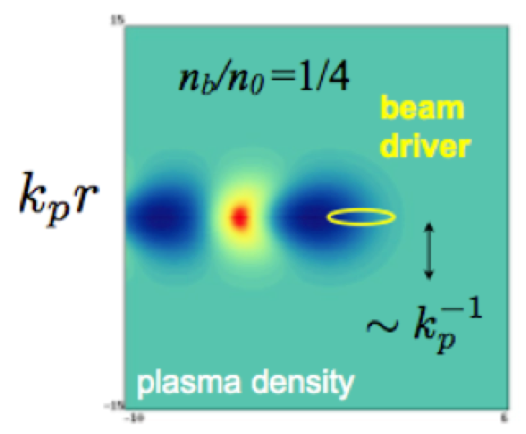
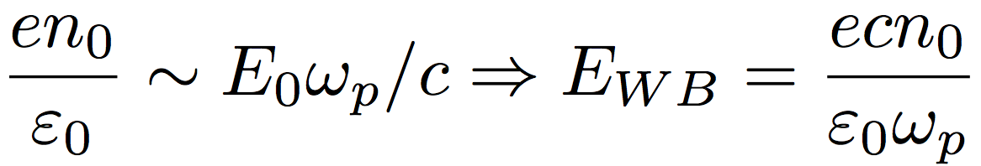
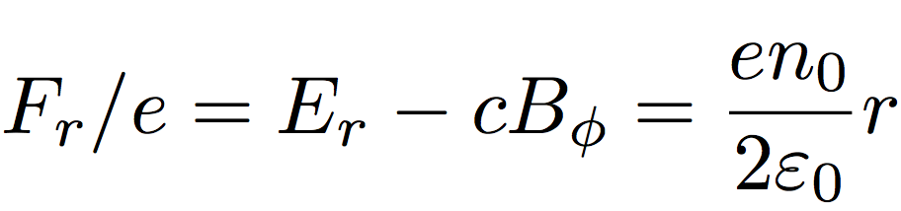
Plasma wakefield acceleration
Scale of electrical fields :
Plasma electrons may be blown away by beam or laser driver. Bare ions is left behind. High fields and no break down.
Gauss’ law:
Wave solutions:
Apply Gauss’ law:
n₀ ~ 1e17/cm3 : E_{WB} = 30 GV/m
Scale of radial focusing forces :
n₀ ~ 1e17/cm3 : F_{r}/c ~ MT/m
Quadrupolar r-focusing.
Ideas of ~100 GV/m electric fields in plasma, using 10¹⁸ W/cm² lasers: 1979 T.Tajima and J.M.Dawson (UCLA), Laser Electron Accelerator, Phys. Rev. Lett. 43, 267–270 (1979)
n₀ : plasma density
E_{WB}: “wave breaking field” – the field scale in PWFA
"Acceleration and Focusing of Electrons in Two-Dimensional Nonlinear Plasma Wake-fields'', J. B. Rosenzweig (UCLA), Phys. Rev. A -- Rapid Comm . 44, R6189 (1991).

Slide 18
PWFA: linear theory

Slide 19
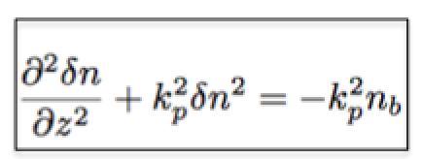
Linear wakes in plasma
We assume here that a charged particle beam to drive a plasma, through its space charge fields (“PWFA”).
A powerful laser may also be used (“LWFA”)
n_{e} = n₀
n_{b}
n_{e} = n₀+δn
z = s - vt
s
Let an electron beam travel towards the right with speed c. The co-moving coordinate z = s-ct is defined in a frame following the beam travelling with speed v , and gives thus the relative position inside the beam.
For small perturbations in plasma density (n_{b} << n₀), the problems can be easily solved in one dimension using Gauss’ law (see extra slides) to get
k_{p}=ω_{p}/c: plasma wavenumber.

Slide 20
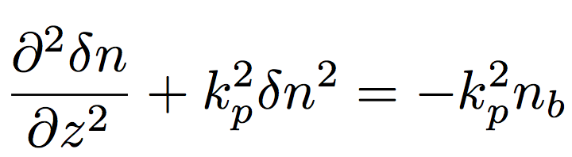
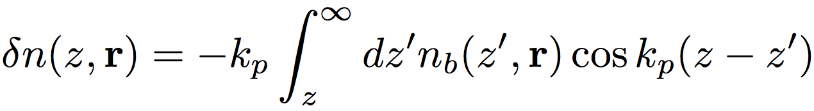
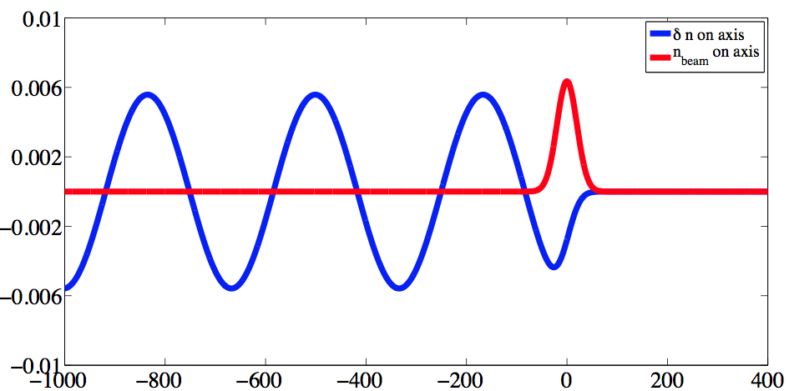
Linear plasma density perturbation
General solution of :
is
Example for n₀ = 10¹⁶/cm3, σ_{z} = 20 μm and N = 10⁶, Gaussian electron bunch bunch.
( δn / n₀ << 1 )
δn / n₀
z = s – ct [um]
Example from I. Blumenfeld

Slide 21
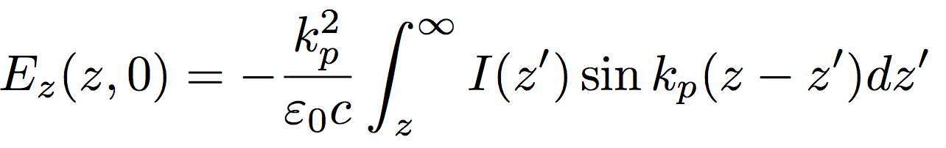
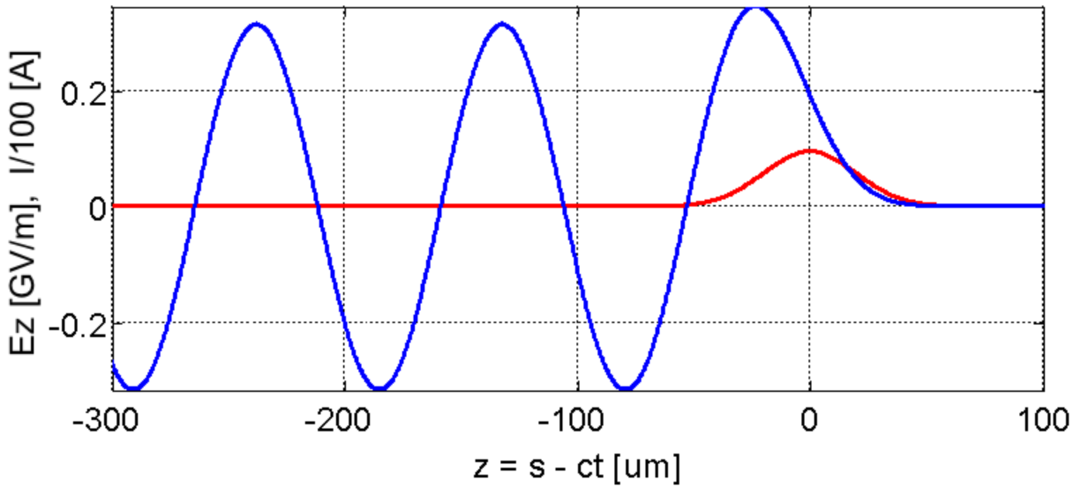

PWFA is driver plus witness
Theory can be further developed. 2D regime (narrow beam) : sinusoidal waves.
?
z = s - vt
s
?
Reminder: our objective is to accelerate a witness bunch. Keywords :
Gradient – where will a witness bunch be accelerated?
Energy transfer efficiency
Energy spread
Emittance preservation - focusing?

Slide 22
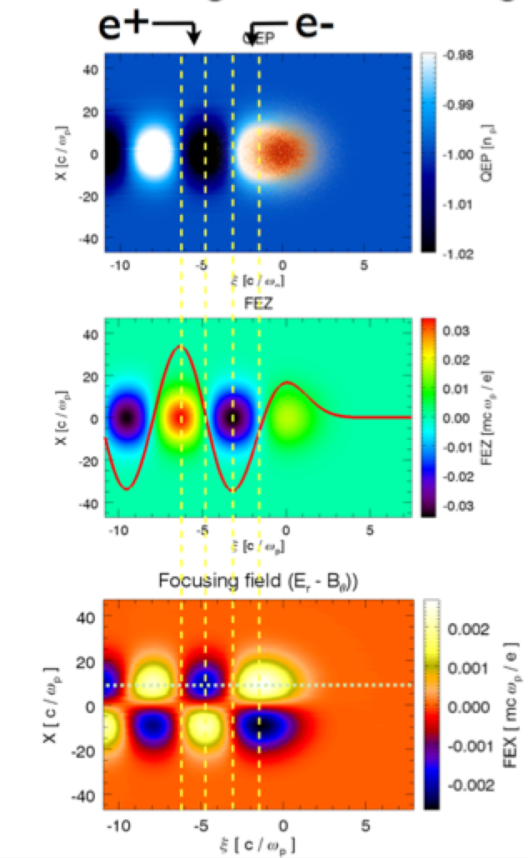
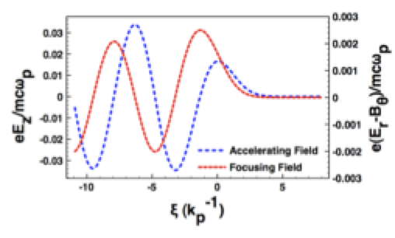
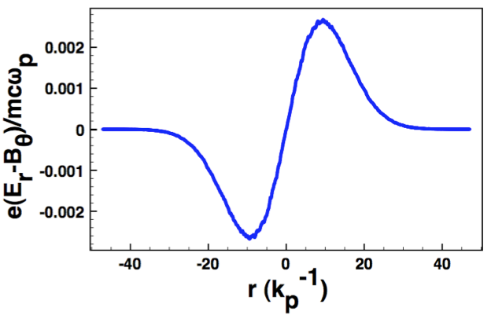
Linear PWFA regime : e- and e+ equivalent
3D
sims.
e- and e+ : feel same force, when phase is shifted by π/2.
NB: focusing force is non-linear in r
QuickPIC, W. Mori, UCLA

Slide 23
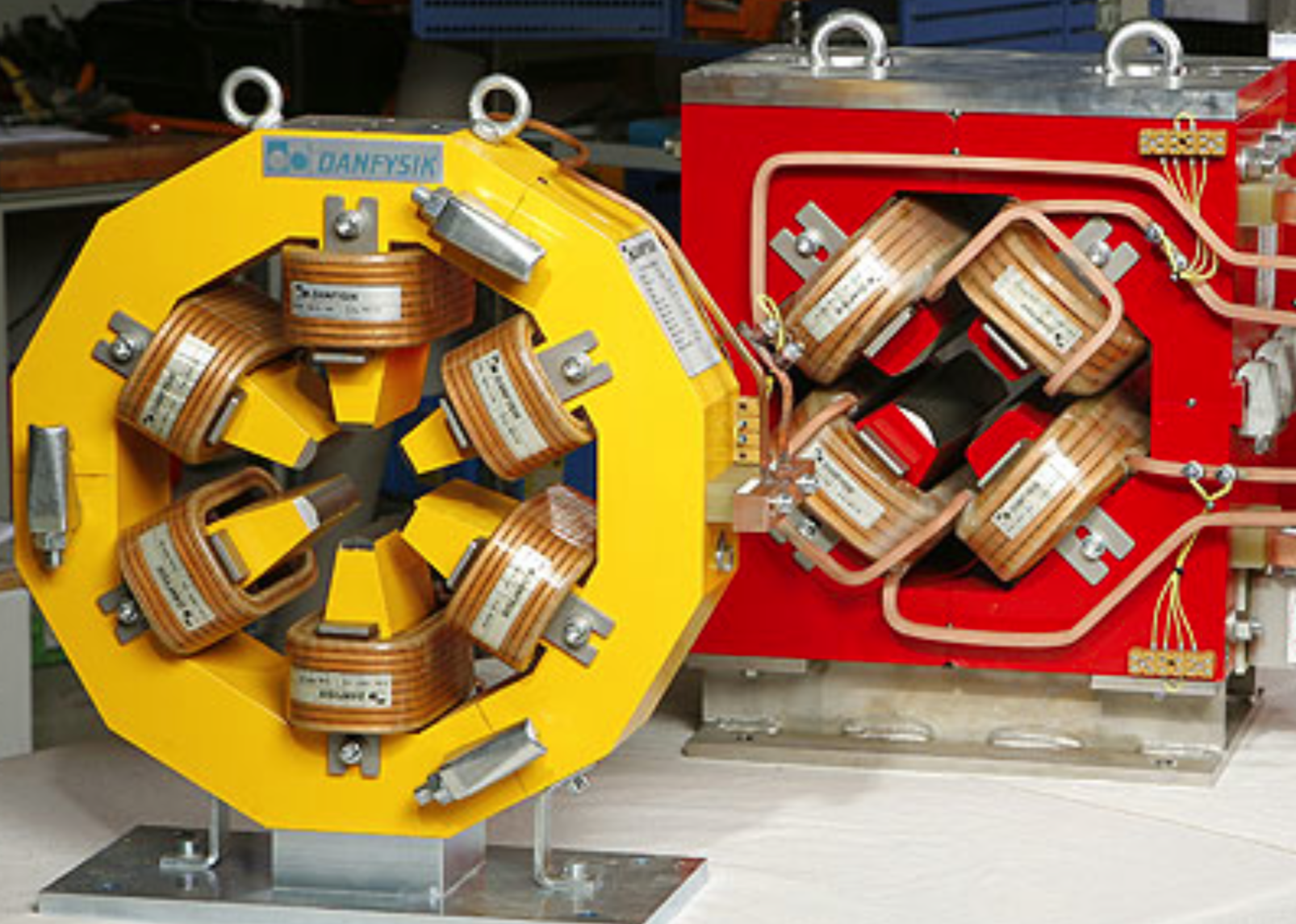
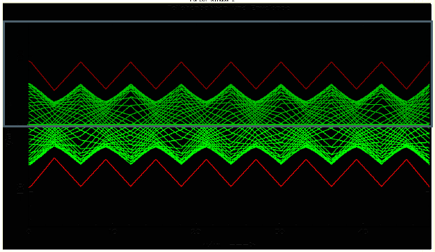
Reminder: conventional accelerators
Under perfect quadrupolal focusing, the emittance in conventional RF accelerators is perfectly conserved. We have learned, over > 70 years, to preserve emittance very well. For CLIC: believe we can reach < ~10 nm normalized emittance growth.
The rms beam size:
Focusing magnets:
Provide linear focusing force
Can easily reach field precision of 10⁻⁴ – 10⁻⁵
F_{r}
r
Beam quality
Lattice design

Slide 24
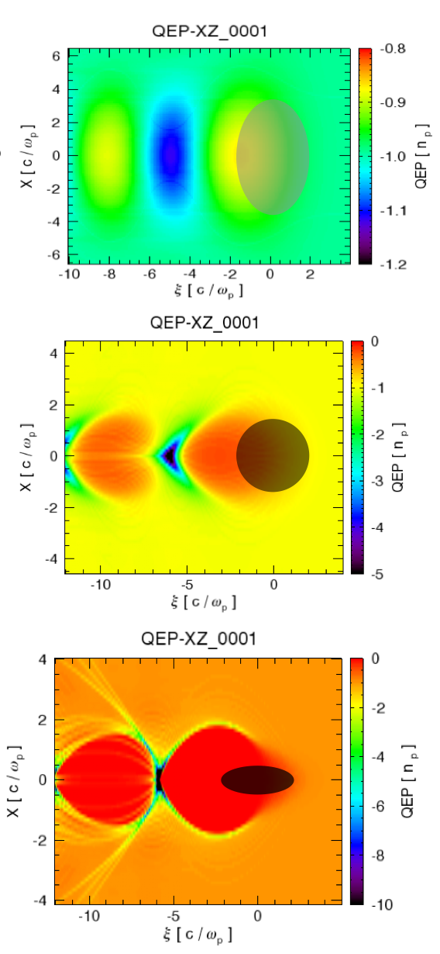
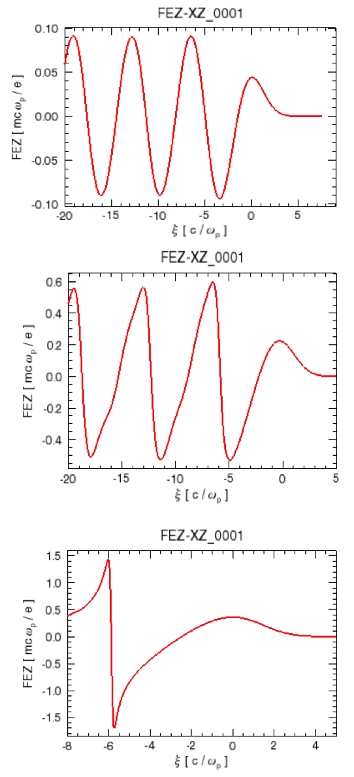
From linear to non-linear
n_{b} << n₀ – linear regime
n_{b} ~ n₀ – non-linear wakes
n_{b} >> n₀ – blow-out regime
W. Mori (UCLA)

Slide 25
The PWFA blow-out regime
Vacuum
Plasma
Focusing
Accelerating
Decelerating
Plasma ion “bubble”
e⁻
As the beam enters the plasma, plasma electrons are expelled, leaving behind plasma ions.
The plasma ions are heavy and stationary. They exert a restoring force on the plasma electrons pulling them back to the axis.
The field is decelerating in the front half of the bubble. The plasma extracts energy from the electron beam.
The field is accelerating in the back half of the bubble. Beam electrons can extract energy from the plasma wake in this region.
The plasma electrons keep oscillating after the beam has passed by.
An electron beam propagates to the right into a neutral plasma.
The field is focusing everywhere in the bubble.
S. Gessner (SLAC)
Notes:
A plasma wakefield accelerator is a transformer. The plasma extracts energy from an incoming electron “drive” beam, and stores that energy in a high-gradient plasma wakefield. A trailing “witness” beam extracts energy from the plasma wake. In typical experiments at FACET, electron beams gain over 10 GeV of energy per meter. Compare that to the SLAC accelerator, where the gradient is just 20 MeV/m.
co-moving frame
Blow-out or “bubble” regime for expts at SLAC
Linear transverse for electron beam, defocusing for positron beam

Slide 26
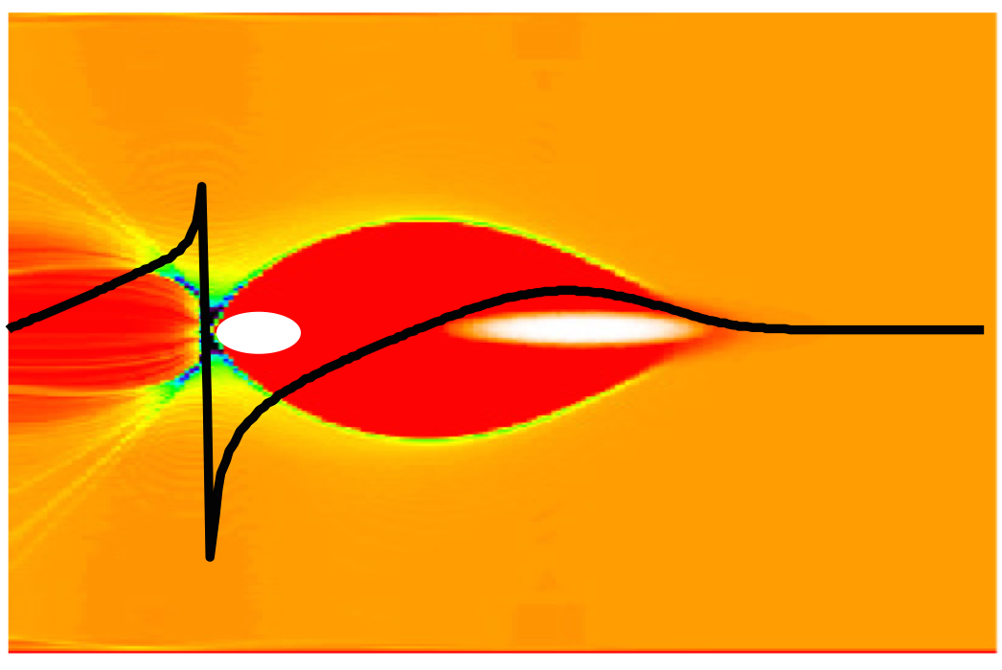
Blow-out regime
E_{z}
plasma electron
trajectories
Accelerating
cavity
z = s -ct
If the driver beam current is strong enough, the space-charge force of the driver may blow away all the plasma electrons in its path, leaving a uniform layer of ions behind (ions move on a slower time scale).
The plasma electronics will form a narrow sheath around the evacuated area, and be pulled back by the ion-channel after the drive beam has passed
In practice: an accelerating cavity has been formed in the plasma
The back of the blown-out region is ideal for plasma acceleration

Slide 27
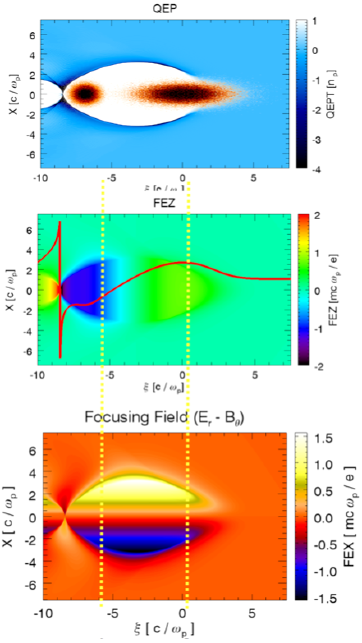
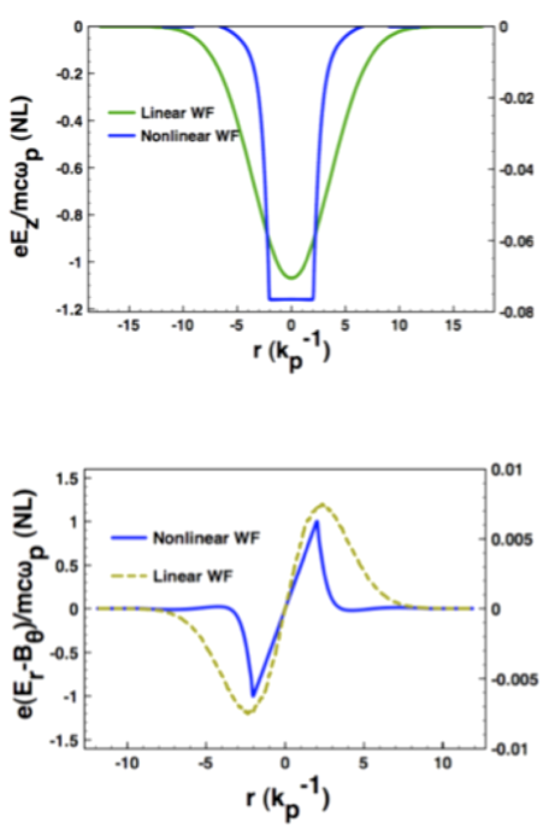
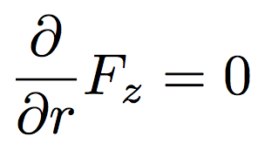
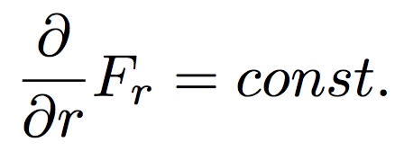
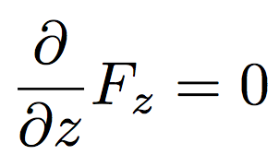
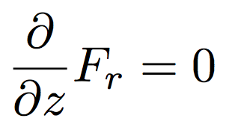
Blow-out regime: ideal for e-
(loaded)
Sim by W. Mori (UCLA)

Slide 28
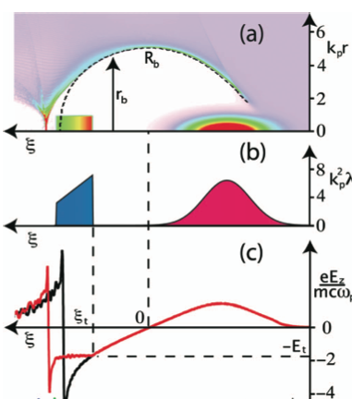
Energy spread and efficiency
An ideal-shaped witness bunch can perfectly flatten the field and a bunch can be accelerated without added energy spread.
Charge ratio drive to witness may be a few. High charge witness acceleration possible.
High efficiencies of energy transfer from drive bunch to witness bunch shown in PIC simulations, up to 90%.
M. Tzoufras et al. Phys. Rev. Lett. 2008
(simulations)

Slide 29

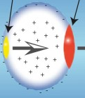
Emittance growth
Emittance growth due to multiple scattering in plasma
In the blow-out regime :
Acceleration to 1 TeV in n₀ = 1e17/cm³ -> Δε ~ 10 um
V. Lebedev and S. Nagaitsev, http://arxiv.org/abs/1304.2419
Emittance growth due to ion motion: not well studied. Not negligible for sub-um level emittances
Positrons/protons: attracts plasma e-, repelled by ions (no r focusing). Emittance growth.
Possible mitigation: hollow channel plasmas? Under study.

Slide 30
PWFA: experiments

Slide 31
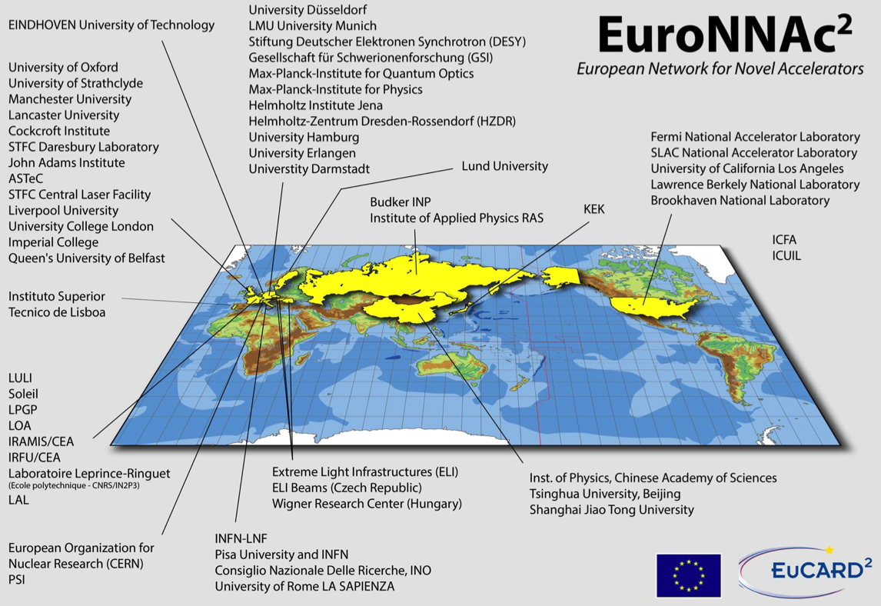
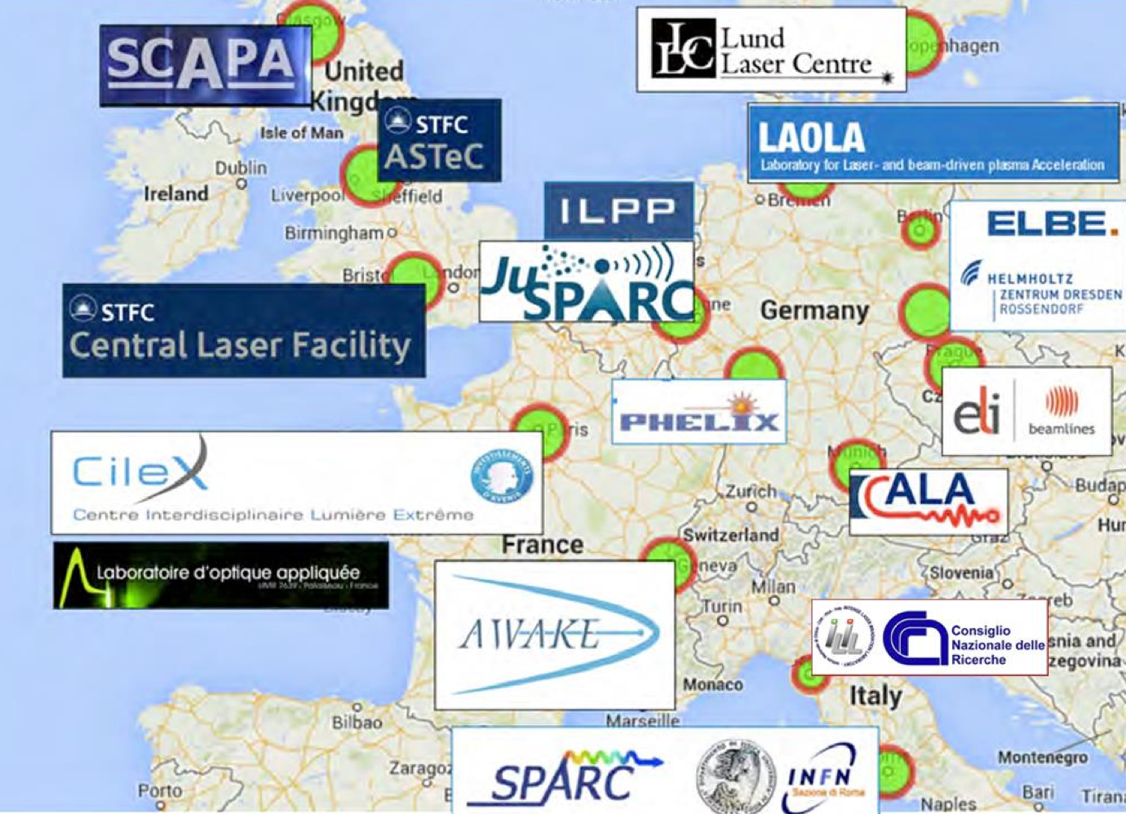
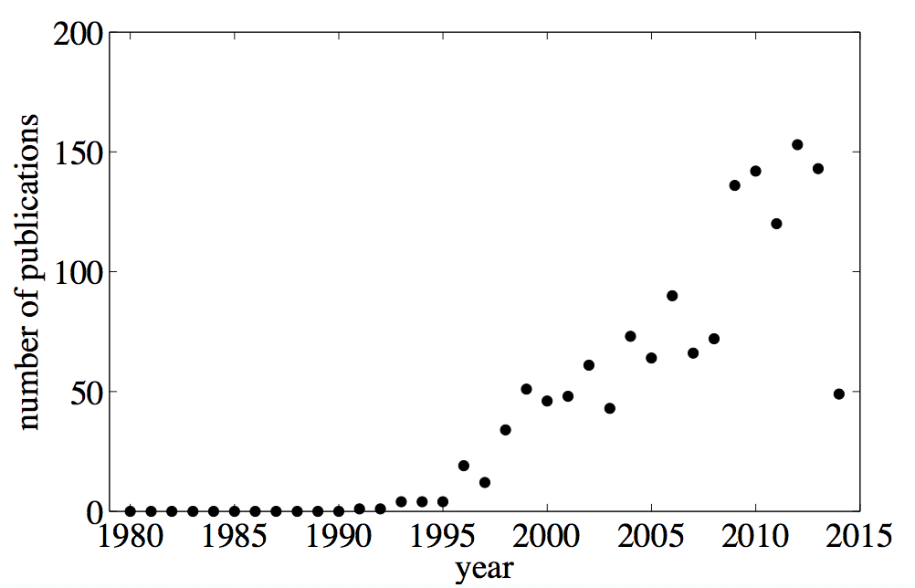
PWFA, LWFA and high-power laser research
Steadily growing interest in European community. A large number of planned or proposed new PWFA and LWFA experments.
Published articles with :
“laser” + “wakefield”

Slide 32
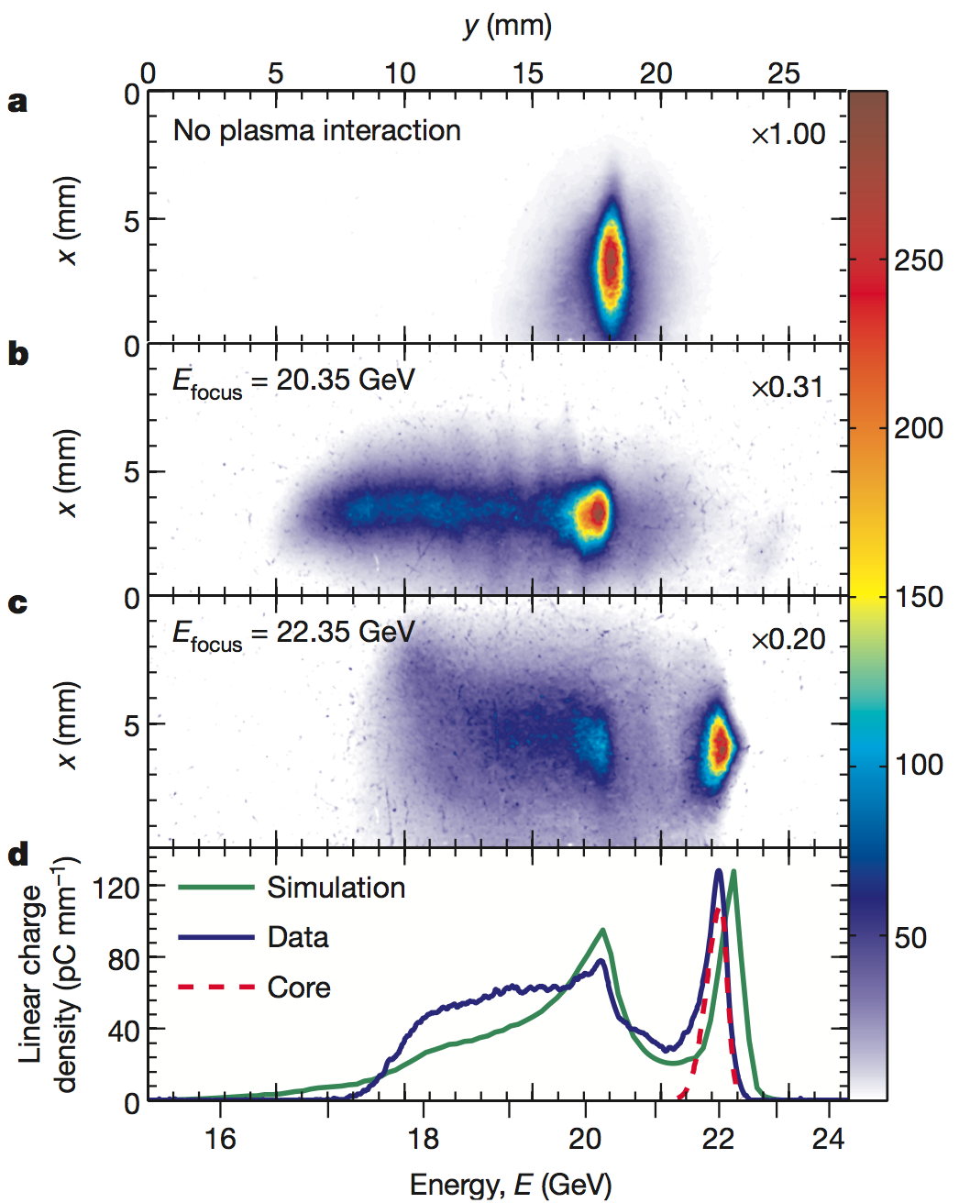

Recent progress in beam-driven PWFA
Results from PWFA experiments at FACET, 2012-2015 (the blow-out regime)
Two bunch acceleration of electrons, with high gradient, high efficiency, low energy spread :
Blow-out regime :
High gradient acceleration of positron, with a spectrally distinct accelerated bunch :
Litos, M. et al. High-efficiency acceleration of an electron beam in a plasma wakefield accelerator. Nature 515, 92–95 (2014).
The FACET E200 collaboration: to be published (in 6 days)

Slide 33








Plasma wakefield experiments at SLAC
The FACET PWFA experiments at SLAC
Talk for another day
2 km
Deflecting cavity
10 TW Ti:Sa laser
Li OVEN
CHERENKOV
YAG
LANEX
Spectrometer y-dipole
e- beam ->
<- W-chicane
Imaging quadrupoles
100 m

Slide 34


The AWAKE experiment at CERN
Talk for another day
AWAKE: “A Proton Driven Plasma Wakefield Acceleration Experiment at CERN”. Idea: use CERN proton bunches with kJ energies as a PWFA driver. A 400 GeV SPS bunch is sent into a plasma source, in which it drives self-modulated wake fields with accelerating fields of about 1 GV/m over 10 meters. An e- bunch will sample the wake. Global collaboration with MPI as lead experiment partner. First beam: 2016.
The low-density long beam will self-modulated and generate intense wake fields.

Slide 35



Recent progress in laser-driven LWFA
150 J, 15 fs (10 PW) ~ 2016

Slide 36
Can plasma wakefield acceleration be used for all kind of particles? (electrons, positrons, protons … ?

Slide 37

Proton / ion acceleration
Most studied technique: TNSA, Target Normal Sheath Acceleration.
Laser incident on target heats electrons. Hot electrons propagates through the thin target, leading to a charge separation on the rear side, with very large longitudinal electric fields. Ions from target and/or surface are accelerated in this field.

Slide 38


Proton / ion acceleration – recent results
TNSA: protons have been accelerated up to ~< 100 Mev.

Slide 39

Back to the e- e+ linear collider

Slide 40
Linear collider technology readiness: conventional technology (~ 1 TeV)
High gradient (CLIC 100 MV/m)
Good energy efficiency (CLIC 5-10%)
Small emittance generation (CLIC ε_{Ν,0}~10 nm)
Excellent emittance preservation (Δε_{Ν}~10 nm)
Low energy spread (CLIC ~1%)
Status:
Feasible
Challenging

Slide 41
Linear collider technology readiness:
plasma wakefield acceleration
Gradient (~>10 GV/m)
Efficiency (~>50%)
Emittance preservation
Emittance generation (~< 100 nm)
Energy spread (~1%)
Status:
Established
Current research
Challenging
NB: these are the author’s personals remarks, other expert’s opinions may differ

Slide 42

A European demonstration plasma wakefield accelerator?
EuPRAXIA : Europan collaboration towards a European demonstration plasma accelerator.
R. Assmann, DESY, EuroNNAc

Slide 43
Conclusions
Advanced acceleration research: necessary for high-energy physics (and accelerator research) to advance
Recently very encouraging experimental results for plasma/laser wakefield acceleration for electrons and positrons, as well as laser ion acceleration
Research and development of high power lasers is strongly linked to advanced accelerator research
Beam quality and beam stability are not yet at the point where one these technologies can be used for applications
Advanced accelerator research : an exiting field, currently bustling with activity. Lot’s of good opportunities for the young physics or engineering student

Slide 44
Extra

Slide 45
Research: high gradient RF
High frequency, high gradient reserach: ~20 years of 12 GHz X-band RF technology development at CERN, SLAC and KEK
X-band acceleration can give accelerating gradients up to three to five times those obtained with L-band and S-band (CLIC: 100 GV/m)
The wall plug power consumption can be significantly reduced using X-band technology, because the accelerating structure power scales inversely with the square root of the structure frequency, for a given accelerating voltage
Potential for more compact FELs, hadron therapy etc.

Slide 46


One dimensional solution
We can fully solve the system in one dimension (z), assuming a very wide bunch and all fields in the z-direction. Let the bunch have constant surface charge density, n_{b} = σ [m⁻²] from z=-σ_{z} to z=0.
z=-σ_{z}
z=0
z = s - vt
s
n_{b}
NB: symbols “σ”, surface charge density, and “σ_{z”}, bunch length, are unrelated.
NB: This wide-bunch 1-D scenario is most often not a good model.

Slide 47

Two dimensional solutions
Analytical expressions can be developed. Main features is that solutions are more complex and that the longitudinal and radial fields depend non-linearly on r :
In the narrow beam limit, the on-axis longitudinal field becomes:
Example for n₀ = 10¹⁷/cm3, σ_{z} = 20 μm and N = 10⁸, Gaussian bunch (I_{peak} ~ 10 A). We see E_{z} << E_{WB} (ok)
Sinusoidal fields: measure of linearity of plasma wakes

Slide 48

Quasi-static approximation
Driver is moving with speed c, and is unaffected by the plasma on the time scale the plasma electrons move. z = s – ct. Maxwell equations are in this case simplified as follows :
We assume a cylindrical symmetric system with coordinaties (z, r, φ).
At v=c the beam has radial (E_{r}) and azimuthal (B_{φ}) fields only, and travels along z (j=j_{z}).
The plasma fields set up can be longitudinal or radial (j_{z}, j_{r}).
This implies that there are no field components E_{φ},B_{z}, B_{r} in the beam-plasma system.
“Wave symmetry”

Slide 49




Resulting charge-field relations
The Maxwell equations with these simplifications gives directly (easily shown) :
The longitudinal (electric) field is given by the radial currents. For the blow-out regime, a constant E_{z} to the plasma electron sheath; amplitude given by slope of sheath electron trajectories.
The transverse fields are given by charge density. For the blow-out regime, only ions, with density n₀ remains inside the bubble, yielding radial r-focusing for electrons.
Valid inside a fully blown-out bubble.
Inside the fully blow-out bubble, a special case of the Panofsky-Wenzel theorem holds :

Slide 50



Transformer ratio
E_{d}
E_{a}

Slide 51


Linear density equation
n_{e} = n₀
n_{b}
n_{e} = n₀+δn
z = s - vt
s

Slide 52


Dielectric laser acc. experiment
Proof of principle: laser accelerates (some) particles.
Very far from an accelerator applications.

