Slide 1

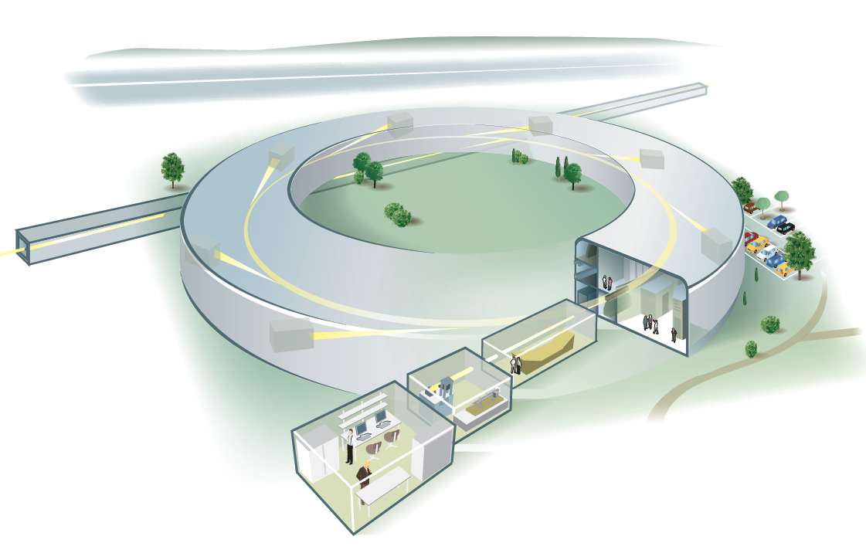

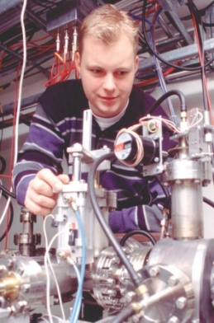

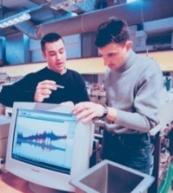
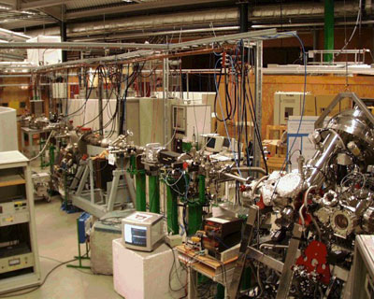
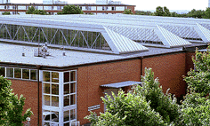

Production of synchrotron radiation
Sverker Werin
MAX IV laboratory,
Lund university

Slide 2

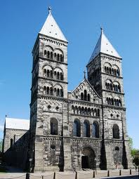

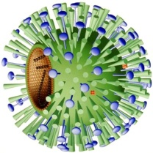

Light to investigate the world
Atom nucleus
DNA
Virus
Cell
Fly
Human
Building
Atom
Wavelength
1 nm
1 um
1 mm
1 m
1 km
X-ray
Visible light
Microwaves
Radio waves
IR light
UV light

Slide 3
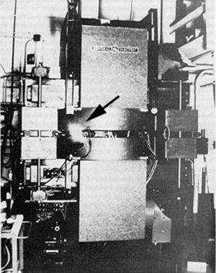
First discovery of SR 1947
"On April 24, Langmuir and I were running the machine … we asked the technician to observe with a mirror around the protective concrete wall. ” (Herb Pollock)
General Electric Research Laboratory, Schenectady, NY, US

Slide 4

Light sources – electric field
www.nature.com

Slide 5
Light sources – electric field
www.nature.com
☹
Near field
Far field

Slide 6
No questions?

Slide 7
Dipole radiation (antenna)

Slide 8
Dipole radiation (relativistic)

Slide 9
Dipole radiation (relativistic)

Slide 10
Dipole radiation (relativistic)
1/γ=1/energy

Slide 11
What is the wavelength of this signal?
Quick duty
Please talk!
15
30
45
60

Slide 12

Radiation
~1/energy
time

Slide 13
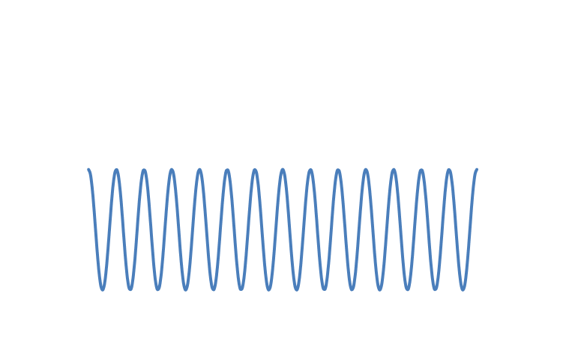
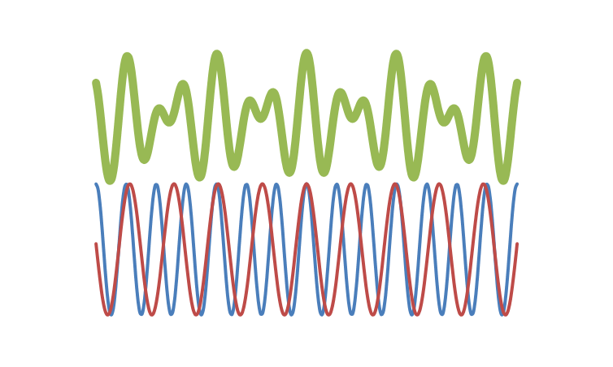
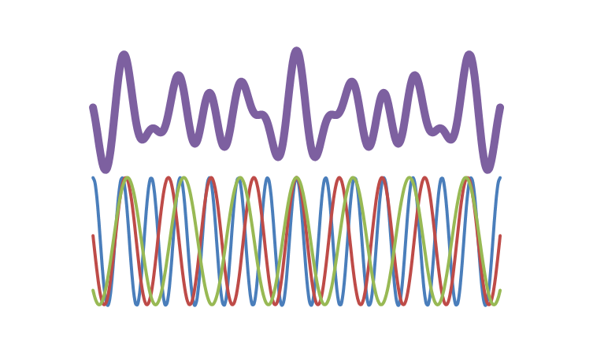
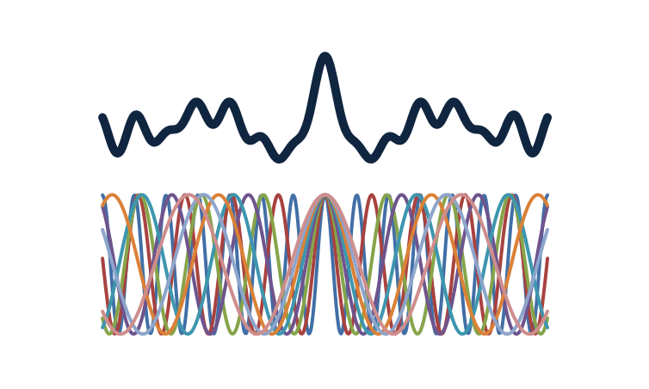
Light and waves
Light wave
Wavelenght=> colour

Slide 14
Which colour/wavelength?
Fouriertransform
X
Wavelength
Energy

Slide 15
Filter the light
Filter
?

Slide 16
Filter the light
When did the light get colour?

Slide 17
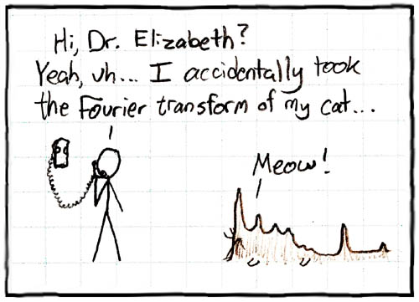

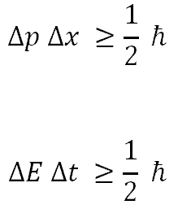
… and in ”fancy” language
Heisenberg’s uncertainty relation
Fourier transform

Slide 18
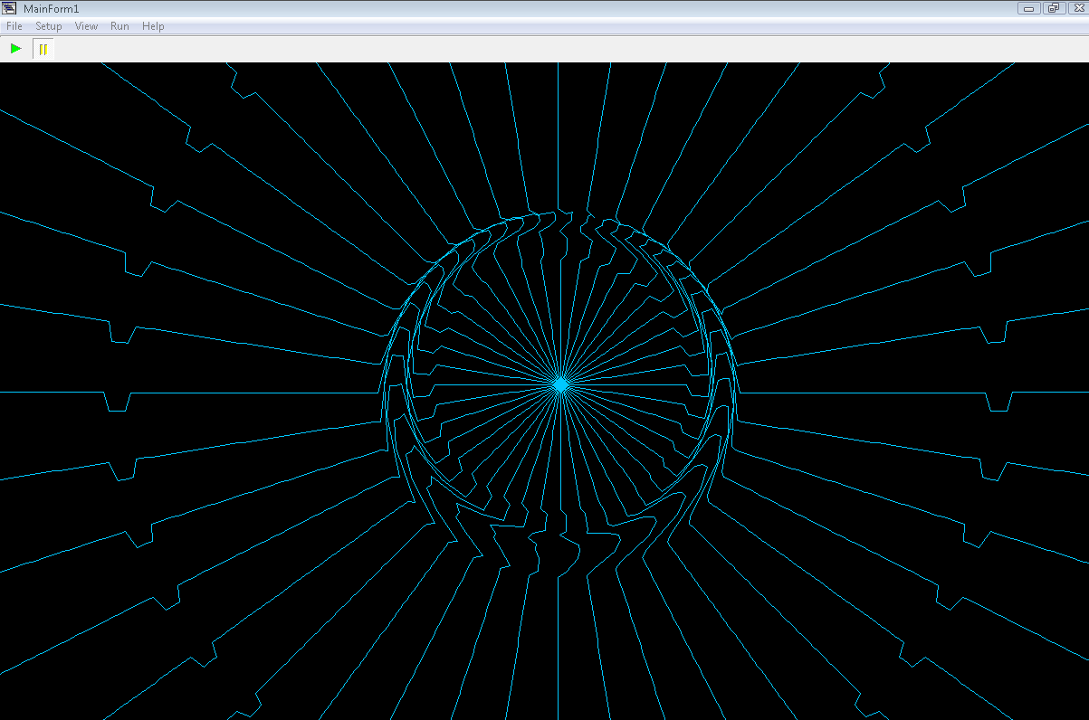
Radiation 2D by T. Shintake
http://www.shintakelab.com/en/enEducationalSoft.htm

Slide 19
In the synchrotron
Bending magnet radiation
Wavelength
Energy

Slide 20

Bending magnet
Example (MAX II)
Energy 1.5 MeV (γ≈3000)
R 3.5 m
λ_{critical} 0.54 nm
E_{critical} 2.3 KeV
Energy lost by one e- over one turn
$$∆E\left[keV\right]=88.5\frac{E^{4}\left[GeV\right]}{ρ\left[m\right]}$$

Slide 21

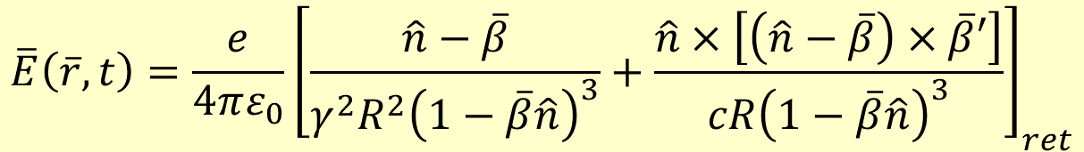


Liénard-Weichert fields
$$\overline{E}\left(\overline{r},t\right)=\frac{e}{4πε_{0}}{\left[\frac{\hat{n}−\overline{β}}{γ^{2}R^{2}{\left(1−\overline{β}\hat{n}\right)}^{3}}+\frac{\hat{n}×\left[\left(\hat{n}−\overline{β}\right)×\overline{β}′\right]}{cR{\left(1−\overline{β}\hat{n}\right)}^{3}}\right]}_{ret}$$
near
far
$$\overline{n }$$
$$\overline{β }′$$
$$\overline{β }$$

Slide 22
No questions?

Slide 23
Polarisation
E field in direction of acceleration ➔ polarisation
Changes with observation plane

Slide 24
Time structure
RF system
500 MHz
100 MHz
Storage ring 100-300 ps
MAX IV SPF 100 fs
Slicing 50 fs
Free Electron Laser 20 fs
Multi bunch Single bunch Uneven fill patterns

Slide 25

10 ns, plenty of time!
By: Goscinny.
Idea: PSI.

Slide 26
Flux and brilliance
What counts
To compare
Light
Electrons
0.1%BW
Peak brilliance
During the peak of a bunch
Average brilliance
Forever or during a macro pulse from the accelerator
E₀

Slide 27


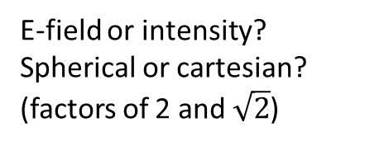

Think of a gaussian light beam…
$$σ_{φ}=\frac{λ}{2πw_{0}}=σ_{r′}$$
φ
w₀
w(z)
$$w_{0}=σ_{r}$$
Define a quality factor:
$$σ_{r}σ_{r′}=\frac{λ}{2π}$$
Today’s challenge for development
Fundamental feature of light!
(=nothing to do about it ;-)
E-field or intensity?
Spherical or cartesian?
(factors of 2 and $\sqrt{2}$)

Slide 28




…and then of an electron beam.
$$σ_{x}$$
$$σ_{x′}$$
x
x’
$$σ_{x}σ_{x′}=ε$$
Emittance
The goal for the accelerator designer is to make the electron beam ”smaller” than the light diffraction:
$$σ_{r}σ_{r′}=\frac{λ}{2π}>ε{=σ}_{x}σ_{x′}$$
But, increasingly difficult for shorter and shorter wavelengths.

Slide 29
Flux and brilliance
What counts
To compare
Light
Electrons
0.1%BW
Peak brilliance
During the peak of a bunch
Average brilliance
Forever or during a macro pulse from the accelerator
E₀

Slide 30
In the synchrotron (revisited)

Slide 31
In the synchrotron (revisited)
Insertion devices
Undulator/ Wiggler
Periodic magnetic structures

Slide 32
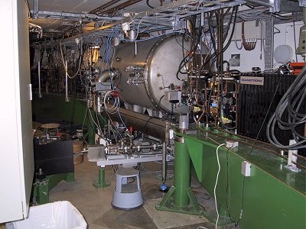
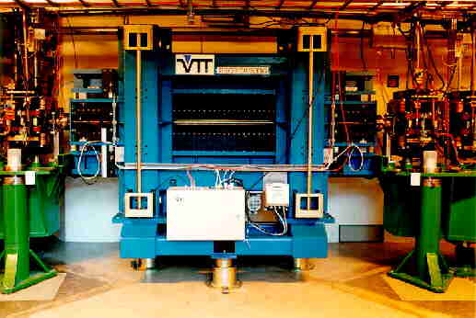
Insertion devices
Superconducting multi pole wiggler in MAX II
Undulator in MAX II

Slide 33
A wiggler
Shorter wavelength / higher photon energy
3 or many strong magnets
Flux is the sum (no interference)

Slide 34
Undulator
Many weak magnets
Interference peaks
Harmonics
Helical polarisation exists
K = undulator parameter, typically between 1 and 4
λ_{undulator} = period length for magnets, typically 2-3 cm

Slide 35
Interference in the undulator

Slide 36
Interference in the undulator

Slide 37
Interference in the undulator
1 st harmonic
3 rd harmonic

Slide 38
Undulator
Many weak magnets
Interference peaks
Harmonics
Helical polarisation exists
K = undulator parameter, typically between 1 and 4
λ_{undulator} = period length for magnets, typically 2-3 cm

Slide 39
Linewidth, energy and angular spread

Slide 40
Why wiggler, why undulator?
MAX II SC MPW
(Super Conducting Multi Pole Wiggler)
Period = 0.06 m
K = 20
B = 3.5 T
R = 1.4 m
_{critical} = 0.22 nm ( 5.6 KeV)
_{undulator} = 670 nm (1.8 eV)

Slide 41
Why wiggler, why undulator? (p 2)
MAX II undulator
Period = 0.06 m
K = 4
B = 0.7 T
R = 7.2 m
_{critical} = 1.1 nm ( 1.1 KeV)
_{undulator} = 30 nm (41 eV)

Slide 42
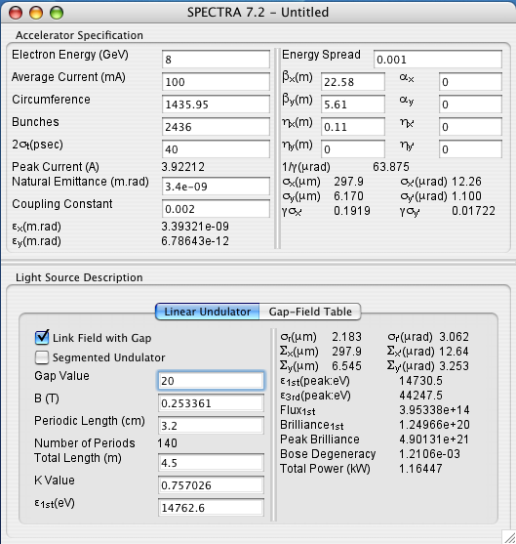
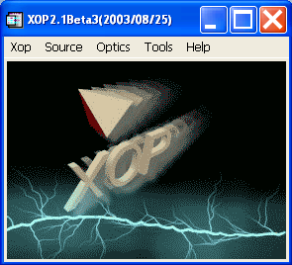
Software
http://ftp.esrf.eu/pub/scisoft/xop2.3/
http://radiant.harima.riken.go.jp/spectra/

Slide 43
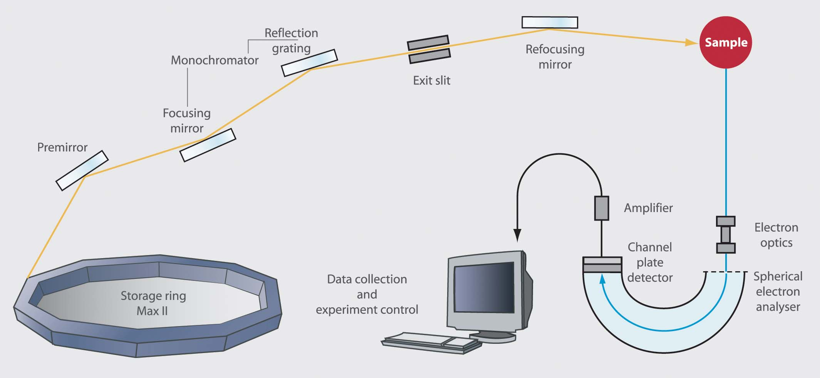
A beam line

Slide 44
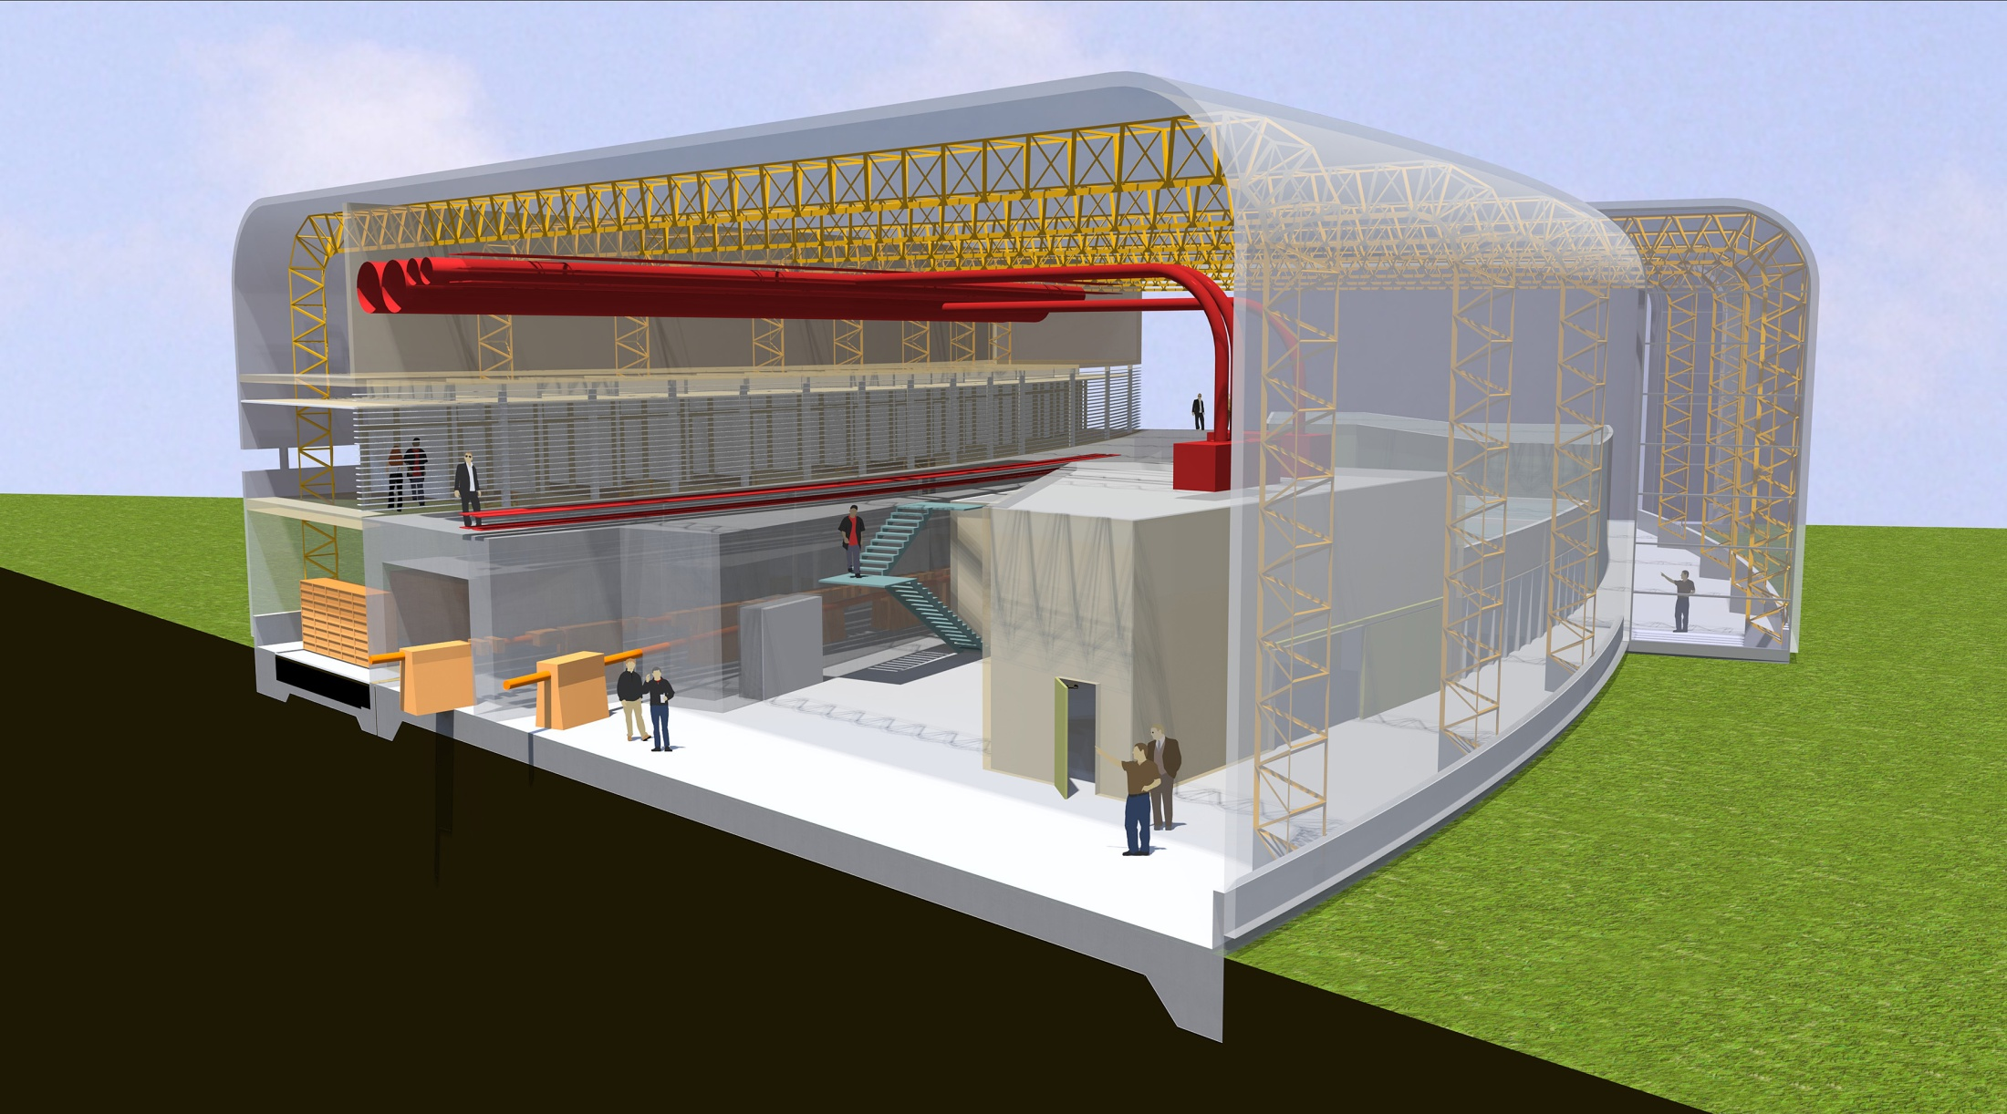
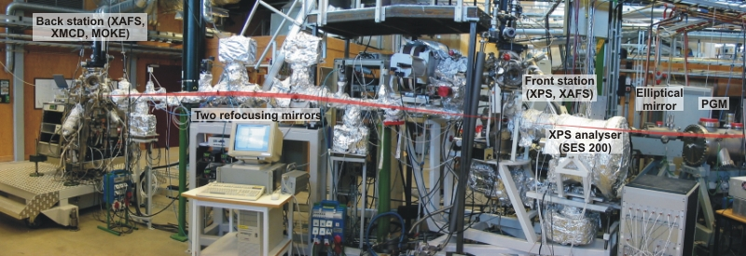
Inuti ringbyggnaden

Slide 45
Photo electrons

Slide 46
Photo electrons

Slide 47
Absorption
?

Slide 48
Scattering

Slide 49
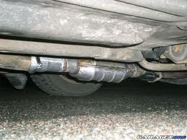
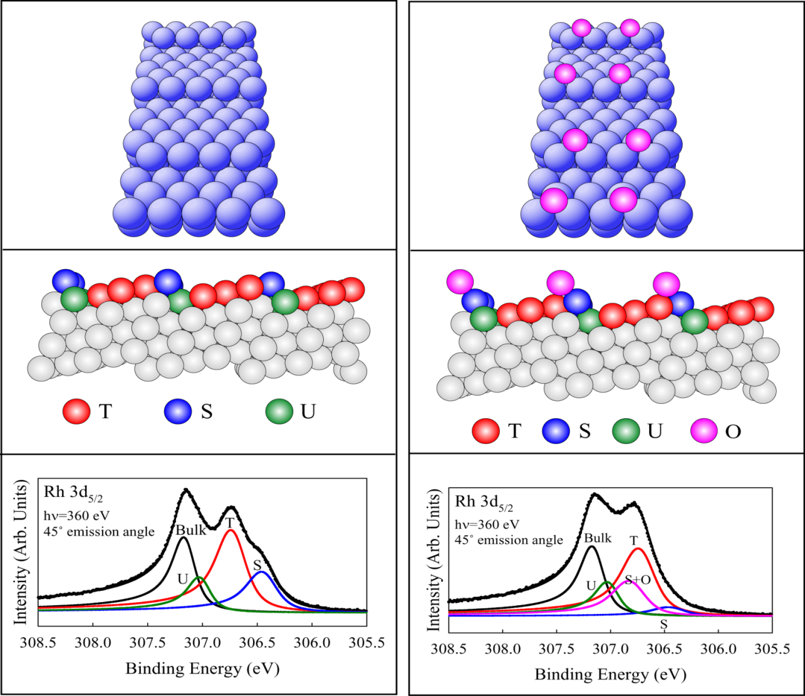
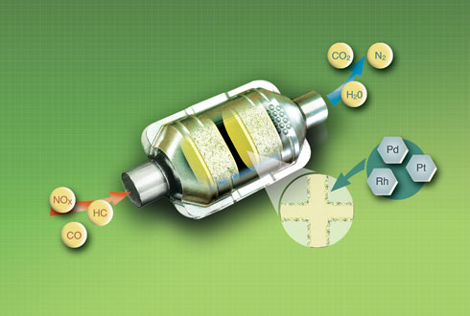
Rhodium
Geometry and chemicals bonds with the help of photon spectroscopy
Clean rhodium crystal surface
With a small amount
of oxygen

Slide 50
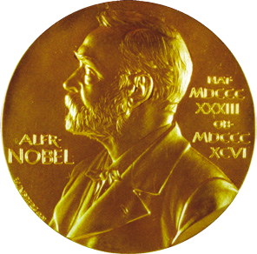
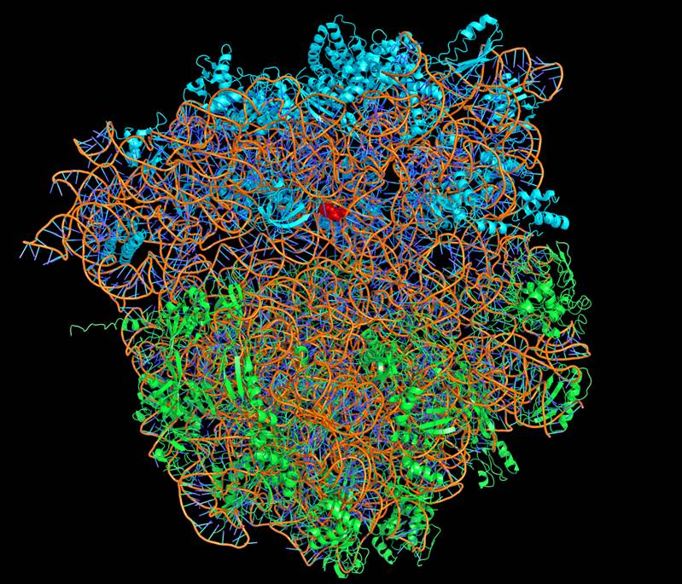
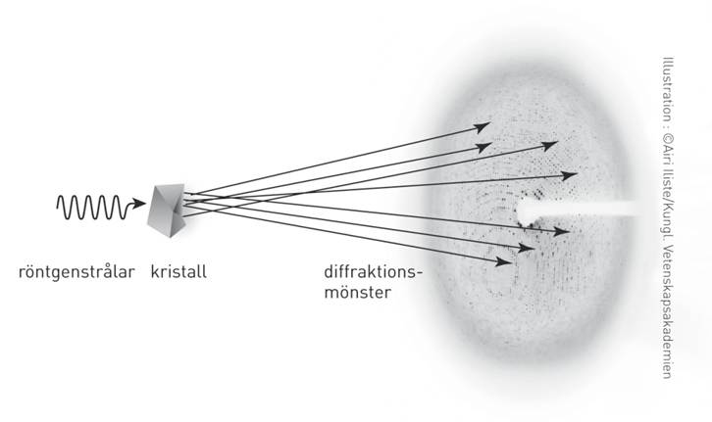
The Ribosome structure and function
2009 years Nobelprice in Chemistry
Venkatraman Ramakrishnan, Thomas A. Steitz och Ada E. Yonath

Slide 51
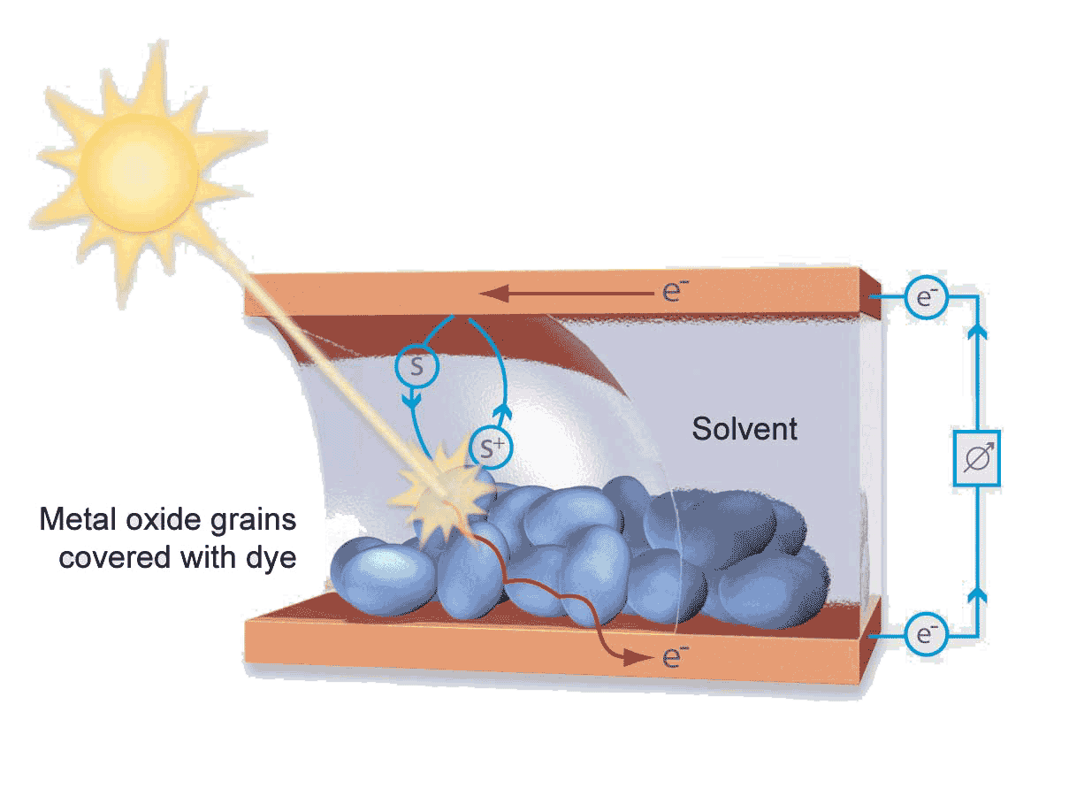
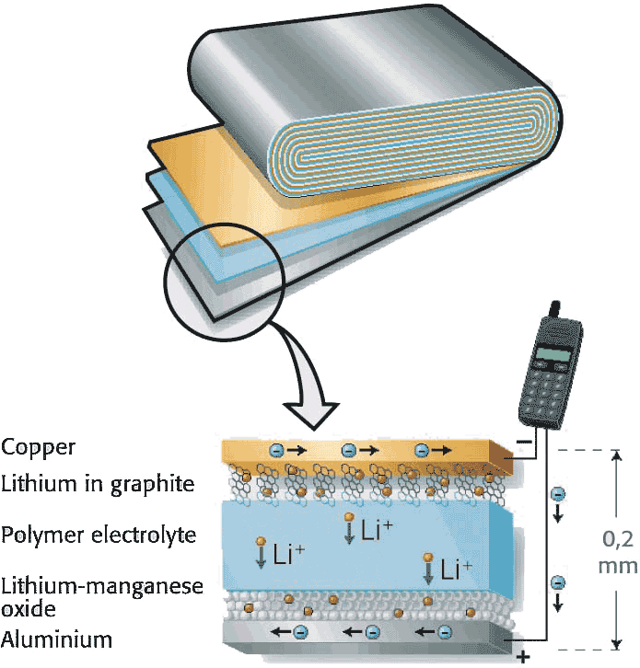
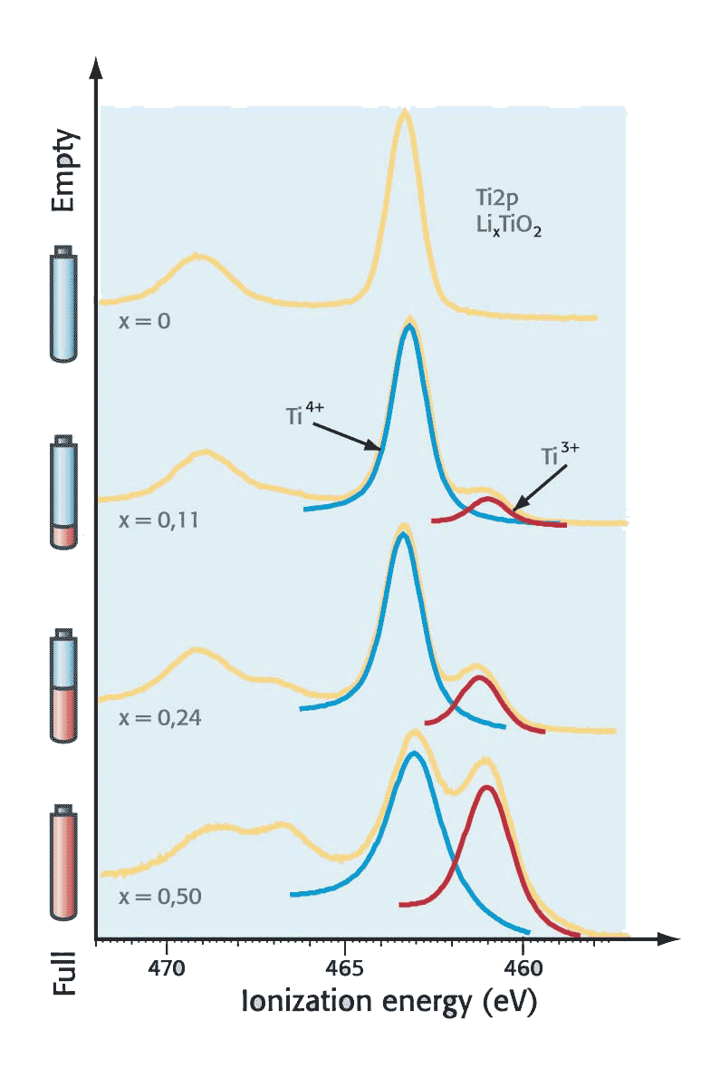
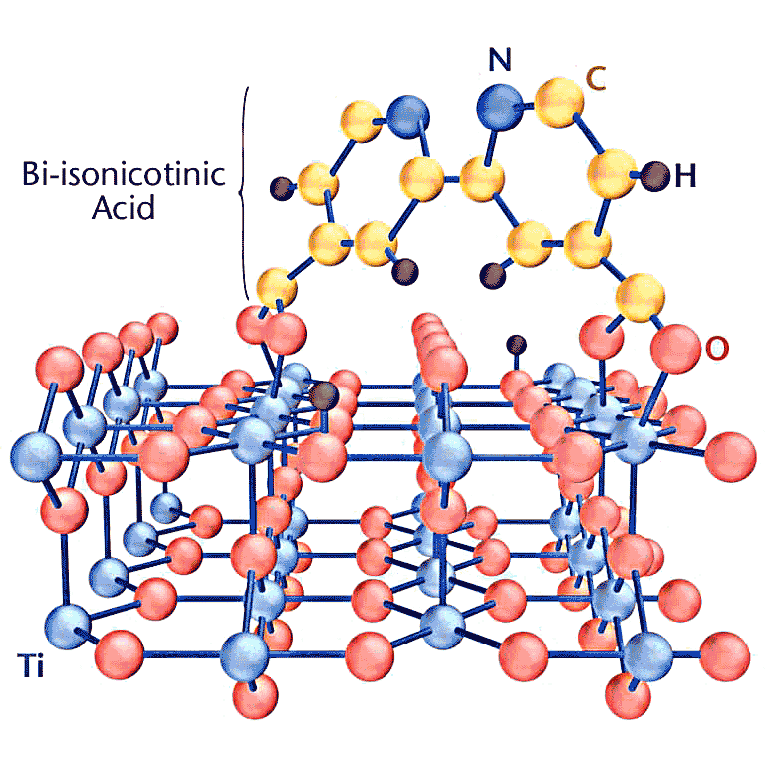
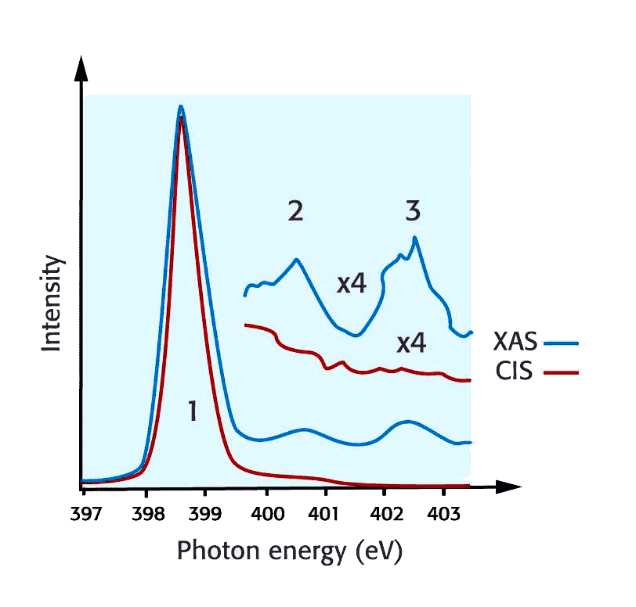
Solar cells and batteries
Grätzel type solar cell
Rechargeable Li batteries
Bonding of dye molecules
Probing charge transfer times
< 2.5 fs
J. Schnadt et al.

Slide 52
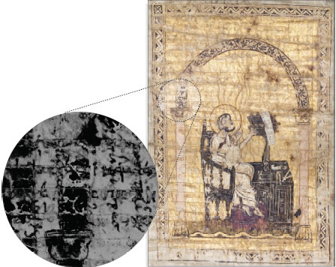
Forgery – and new discoveries…
STANFORD SCIENTISTS USE X-RAYS TO SEE 2,000-YEAR-OLD DOCUMENT
Archimedes’ original text
Archimedes used ink which contained large amount of iron.
By using X-rays at different wavelengths (close to the Fe Kα edge) one could see where the iron was.

Slide 53

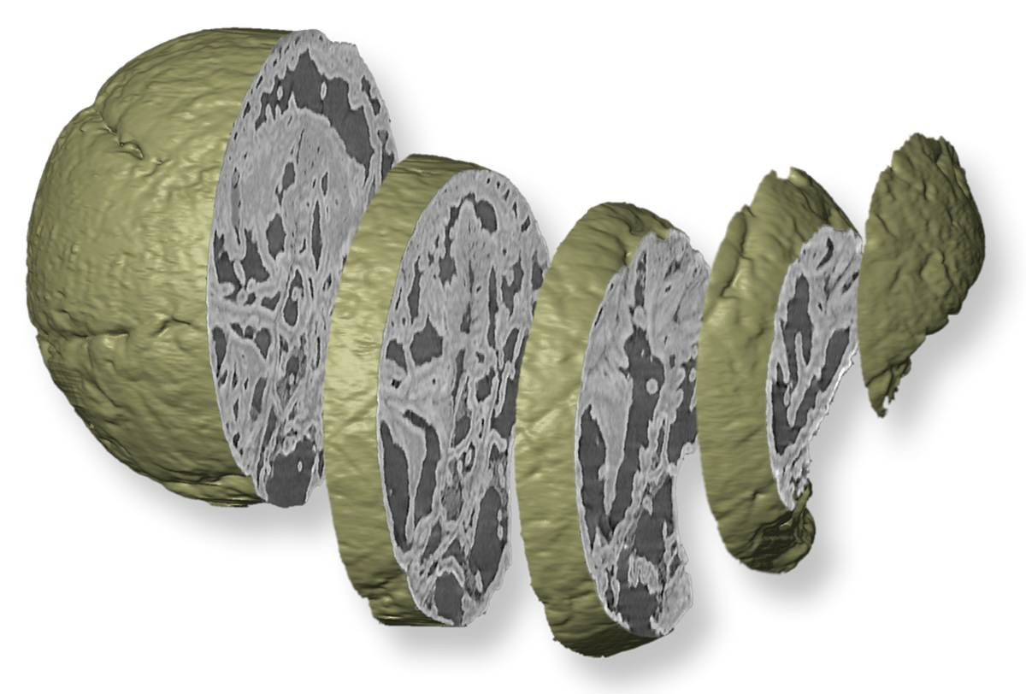
... the greatest invention since sliced bread!!!
Petrified embryo of animals

Slide 55
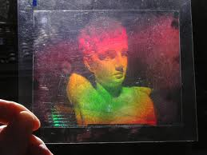
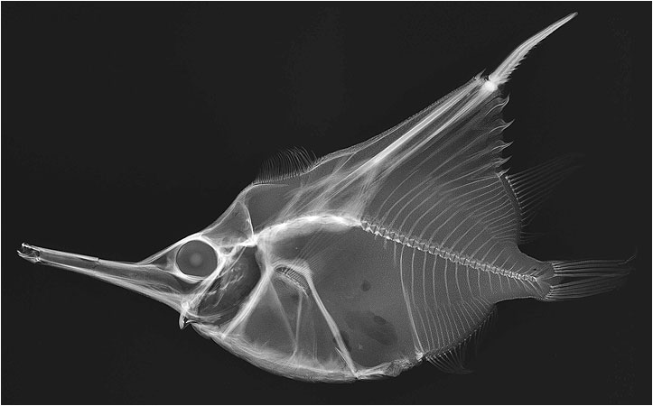
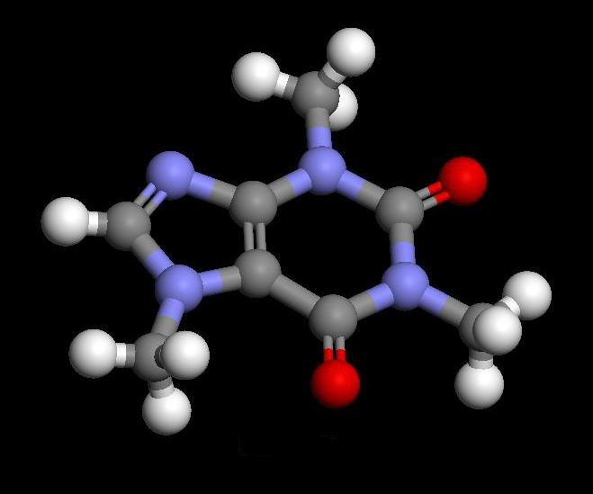

Let us start dreaming…
Hologram, 3D image
X-ray image
What happens if we combine them?
See atoms and molecules
Movie of moving objects
http://www.mnh.si.edu
http://eartholographics.blogspot.se
http://www.netanimations.net
http://dev.nsta.org

Slide 56
Synchrotron light
Incoherent
”Long” pulses (100 ps)
High average power
Ring
Electrons
Undulators
Free electron laser
Coherent
Short pulses (10 fs)
High peak power (GW)
Linear accelerator
Electrons
Undulators

Slide 57
In principle it is fairly simple!
25 - 100 m
Make the electron beam slightly better:
Reduce the emittance 50 times
Reduce the pulse lengdth 1000 times
Accelerate a little more
Fix a little higher stability and filter
…

Slide 58
Still no questions?

Slide 59
Emission of light and coherence
A bunch of electrons
E= cos(ωt+φ1) + cos(ωt+φ2) + ….
I=E² = cos²(ωt+φ1) + cos²(ωt+φ2) + ….
…+ cos(ωt+φ1)cos(ωt+φ2) +… =
= N_{electrons} cos²(ωt+φ1)
N_{electrons} = 10⁸

Slide 60
Emission of light and coherence
A single electron in an undulator
E= cos(ωt+φ1) + cos(ωt+φ1+2π) + ….
I=E² = cos²(ωt+φ1) + cos²(ωt+φ1+2π) + ….
…+ cos(ωt+φ1)cos(ωt+φ1+2π) +… =
= N²_{magnets} cos²(ωt+φ1)
N_{magnets} = 100

Slide 61
Emission of light and coherence
A bunch of electrons in an undulator
E= cos(ωt+φ1) + cos(ωt+φ1+2π) + ….
I=E² = cos²(ωt+φ1) + cos²(ωt+φ1+2π) + ….
…+ cos(ωt+φ1)cos(ωt+φ1+2π) +… =
= N²_{magnets} N_{electrons} cos²(ωt+φ1)
MAX II
MAX IV
N_{magnets, undulator} = 100
N_{electrons} = 10⁸

Slide 62
Emission of light and coherence
A micro bunched beam in an undulator
Micro bunching
E= cos(ωt+φ1) + cos(ωt+φ1+2π) + ….
I=E² = cos²(ωt+φ1) + cos²(ωt+φ1+2π) + ….
…+ cos(ωt+φ1)cos(ωt+φ1+2π) +… =
= N²_{magnets} N²_{electrons} cos²(ωt+φ1)
It can’t be true!
N_{magnets, undulator} = 100
N_{electrons} = 10⁸
Also valid for harmonics!
x10²⁰

Slide 63
In principle it is fairly simple!
25 - 100 m
Make the electron beam slightly better:
Reduce the emittanse 50 times
Reduce the pulse lengdth 1000 times
Accelerate a little more
Fix a little higher stability and filter
…

Slide 64
How to make the bunching?
Make an energy modulation
Transform it into a density modulation
Coherent radiation in harmonics
Energy modulation
Density modulation
10 um
1 km
1 Å
1 cm

Slide 65
Light interacting with an electron beam
Undulator

Slide 66
Energy exchange
E-field
e⁻
v_{x}
λ_{γ}
Some e⁻ gain energy
Some e⁻ loose energy
Σ = 0

Slide 67
Bunching
-ΔE
Detour & lower v
Shortcut & higher v
+ΔE
e⁻
Bunched e⁻ with distance of light wavelength
λ_{γ}

Slide 68
Saturation
v_{x}
λ_{γ}
Overbunching

Slide 69
Amplification
E-field
v_{x}
λ_{γ}
All e⁻ loose energy
E-field gains energy
Σ ≠ 0
Phase shift
(Frequency slightly off resonance)

Slide 70
SASE
(Self Amplified Stimulated Emission)
P
From noice
No mirrors (➔ X-rays)
Tunable
”Spiky” (t and λ)
L

Slide 71
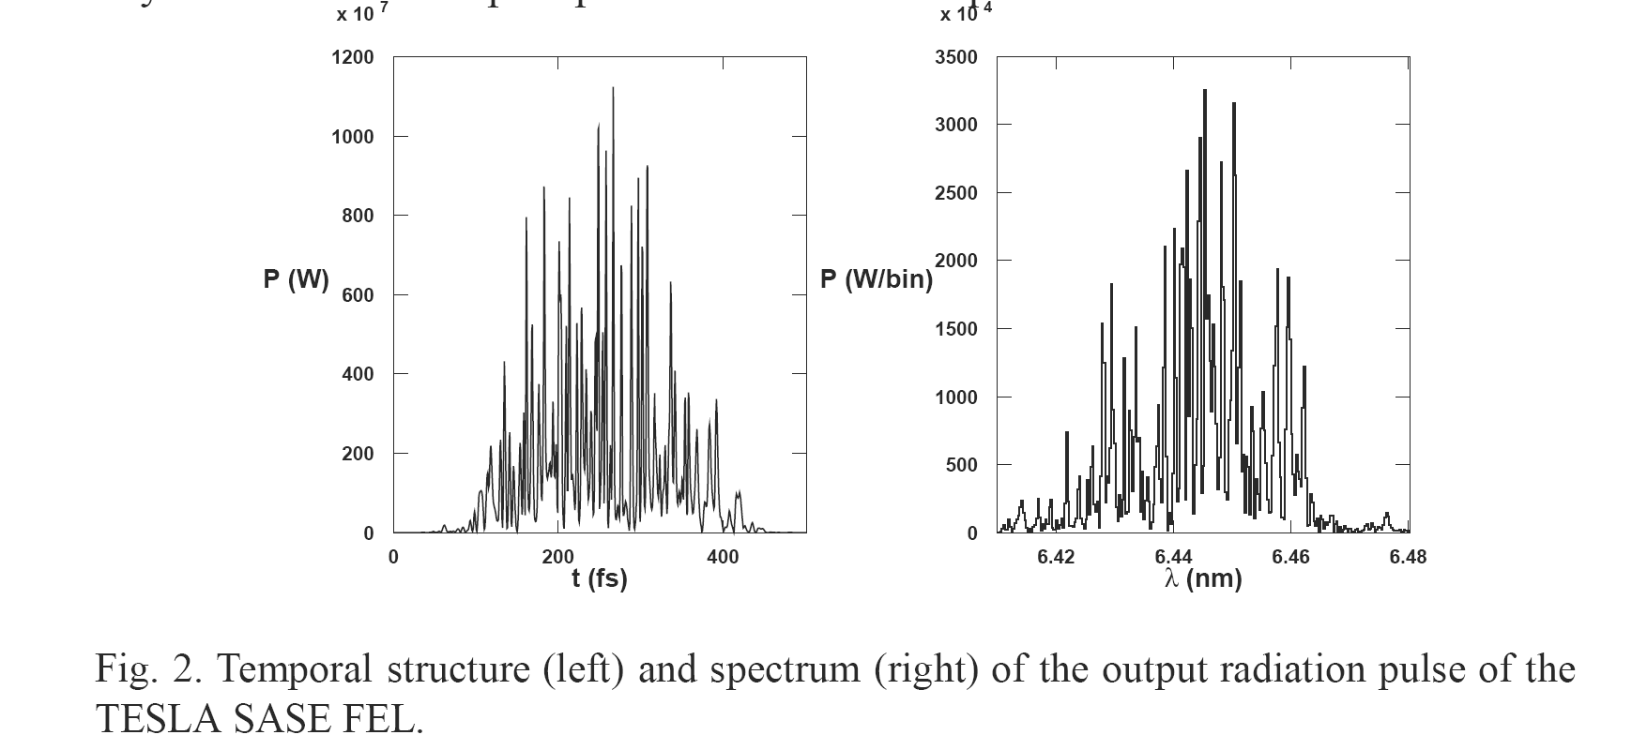
Noise in SASE

Slide 72
Resonator FEL
IR 5-250 μm
UV ≅ 200 nm
Tunable: magnet / e- energy
Mirrors limit
Storage ring: high rep. Rate, ”stable”
Linac: high peak power, ”unstable”

Slide 73
SEEDING
laser
Remove instabilities
CHG with gain HGHG
Monochromator

Slide 74
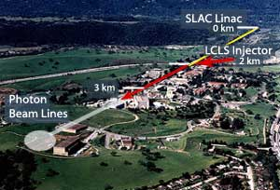
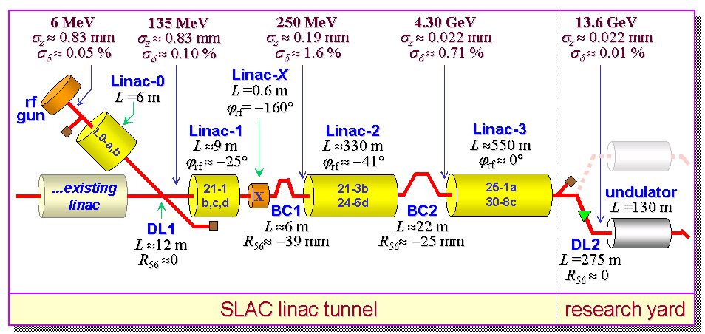
LCLS, Stanford
1.5 Å
SASE

Slide 75
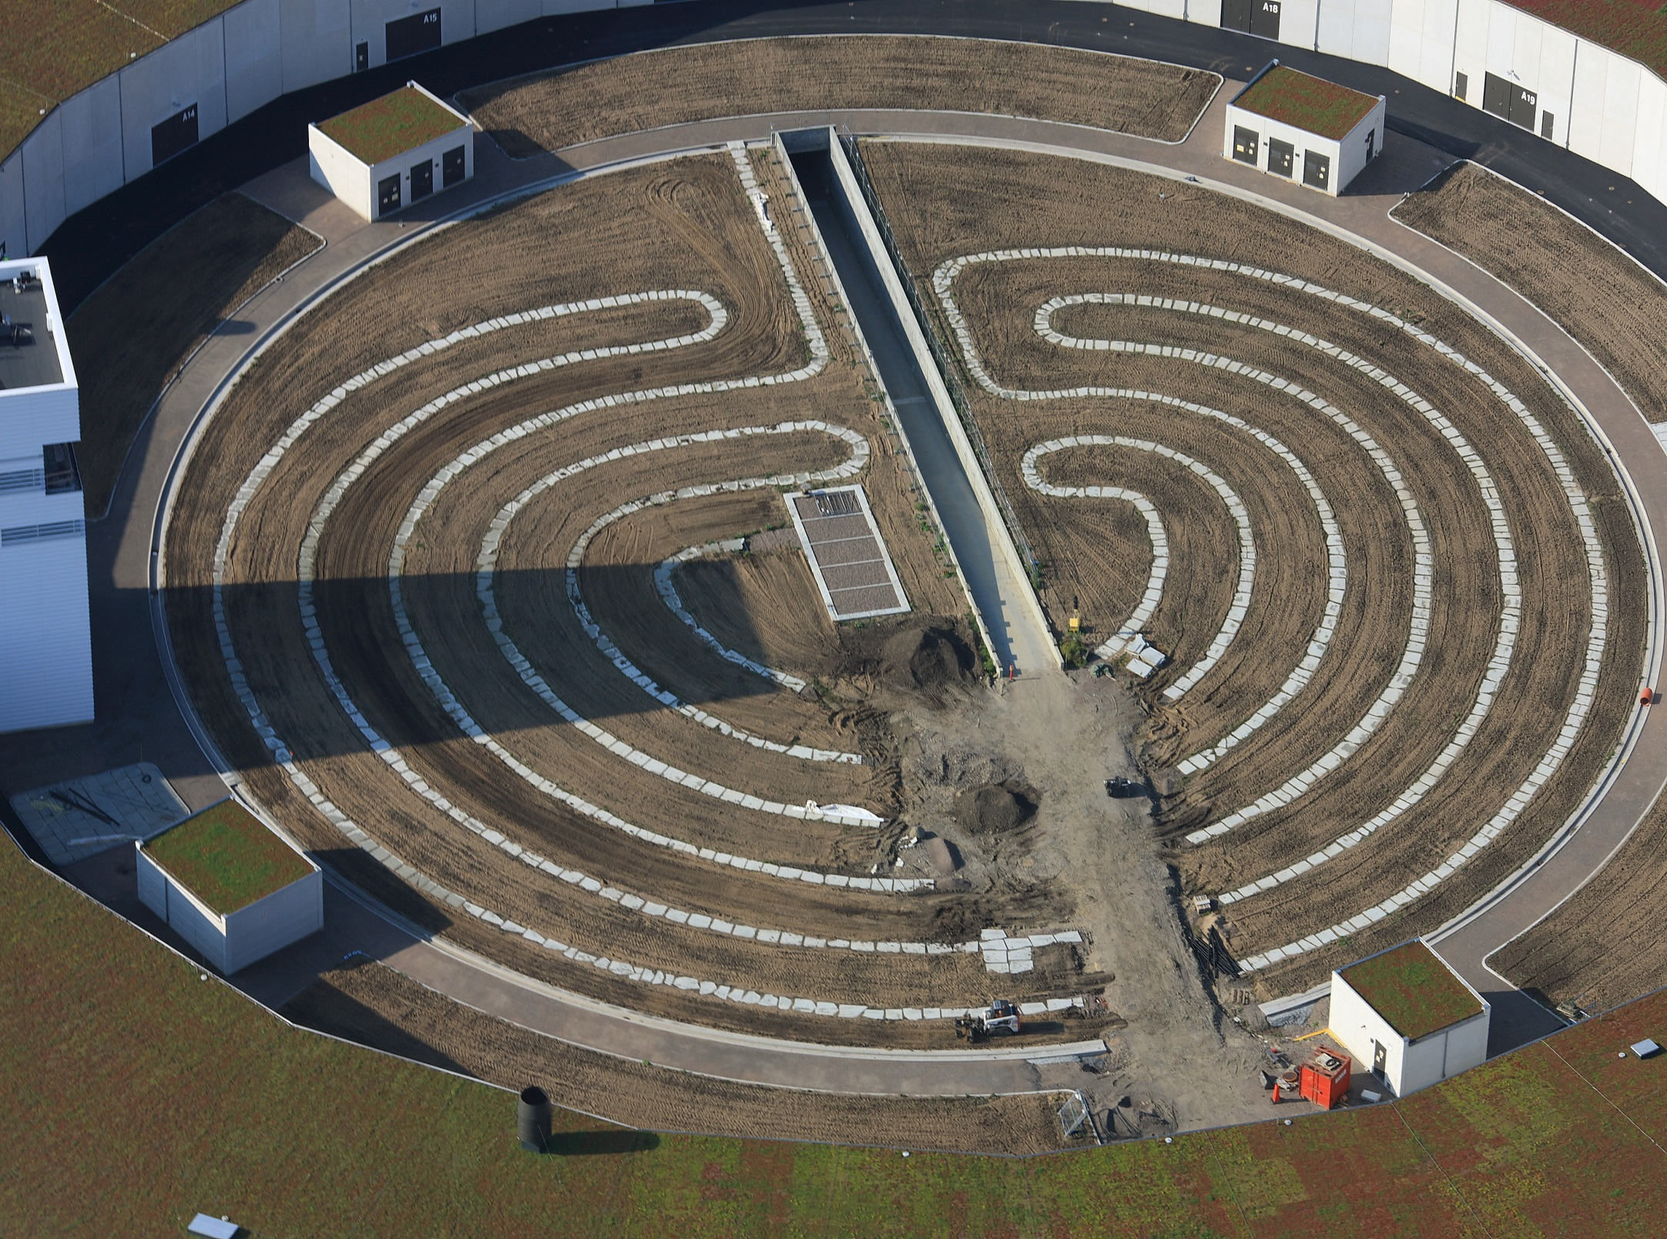
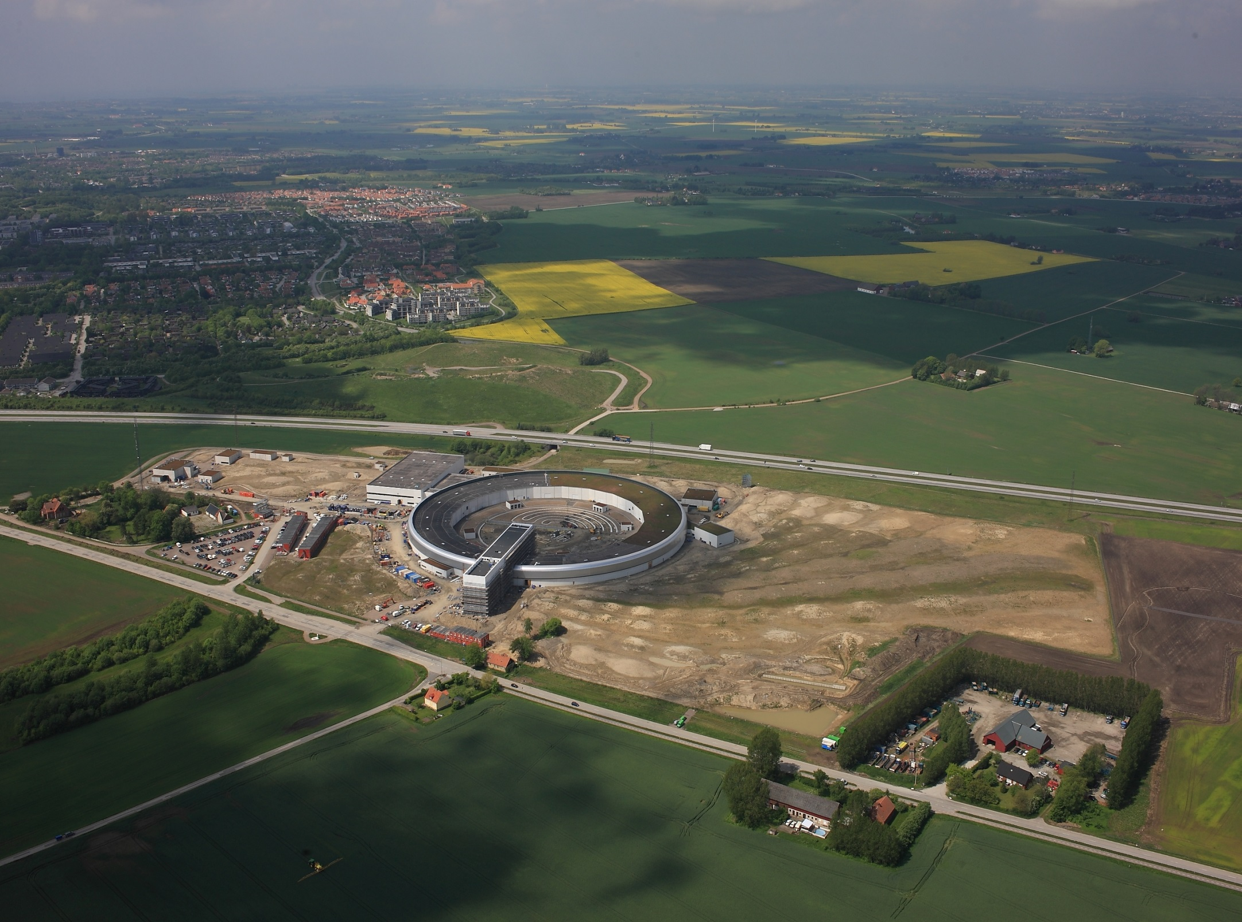
Thanks for listening!

