Slide 1


AD retreat Accelerator
2012 December
Mats Lindroos, David McGinnis, Suzanne Gysin, Jörgen Andersson and Steve Peggs

Slide 2
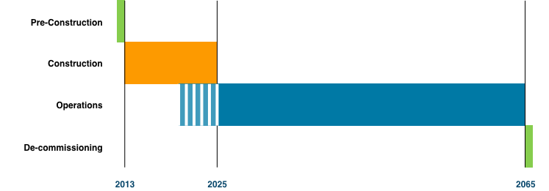
Programme Phases

Slide 3
Accelerator Design Update (ADU)
ADU (collaborations) objectives
  TDR (scope), cost and schedule
  Initial prototyping
ADU Technical Board
  All WP leaders and and ESS AB
  Meets once a month
  Minutes, action log and Decision log available
  CCB for accelerator project
ADU Collaboration board
  All collaboration partners (IPNO, CEA, INFN, Uppsala, Lund U, Aarhus U, ESS-Bilbao) meets twice a year
  Link to ESS through Project leader
TODAY we are presenting the October 2012 baseline which is the TDR
  Talk by David McGinnis at the end of the TAC meeting on design options

Slide 4






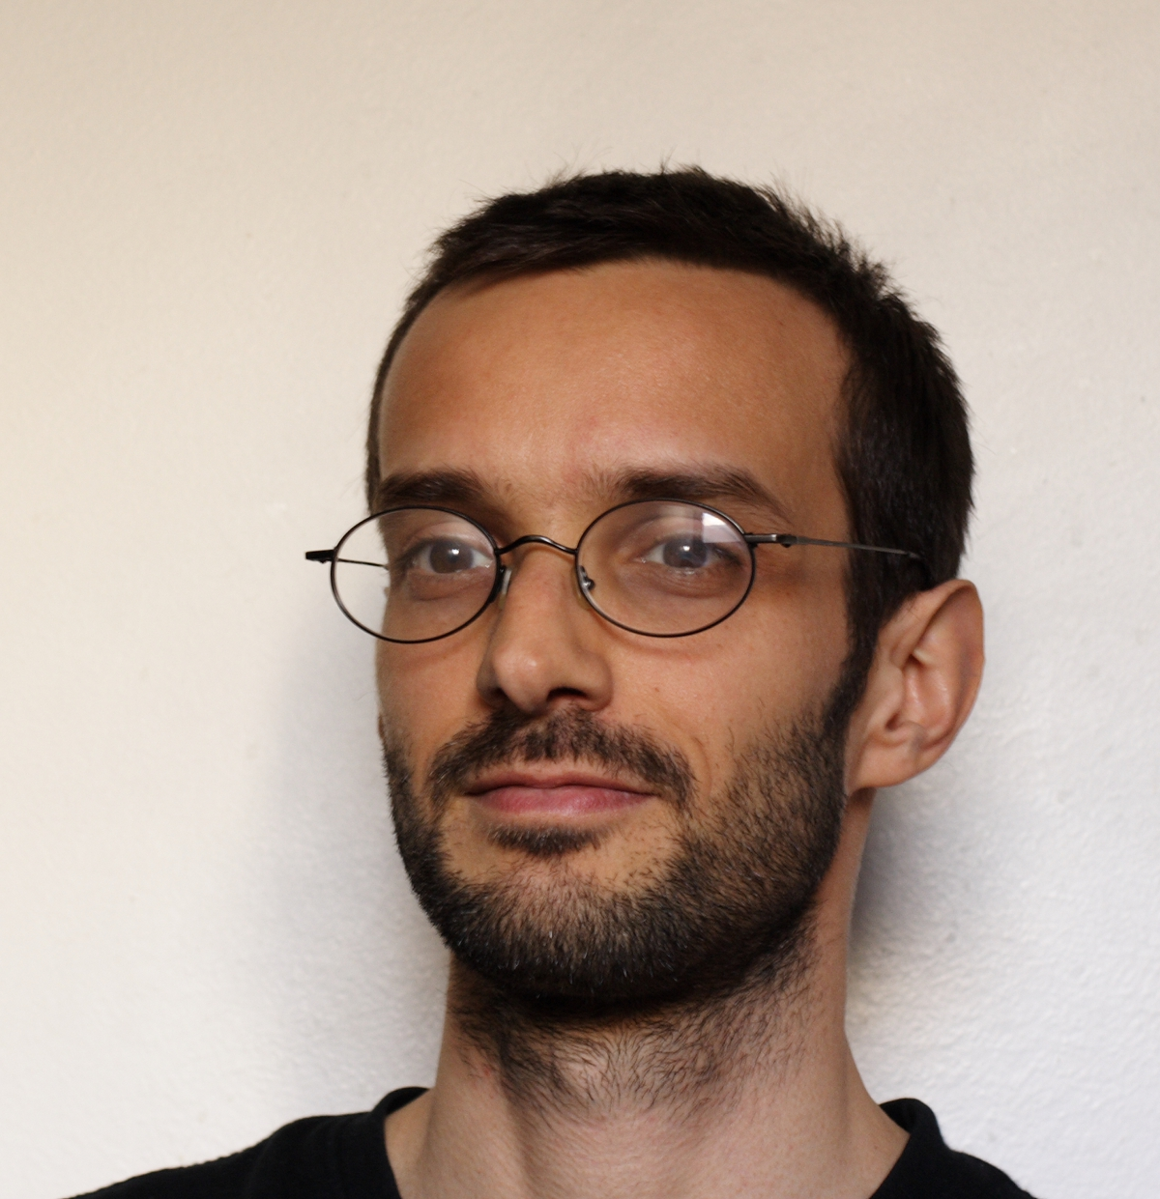
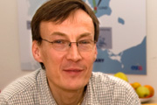

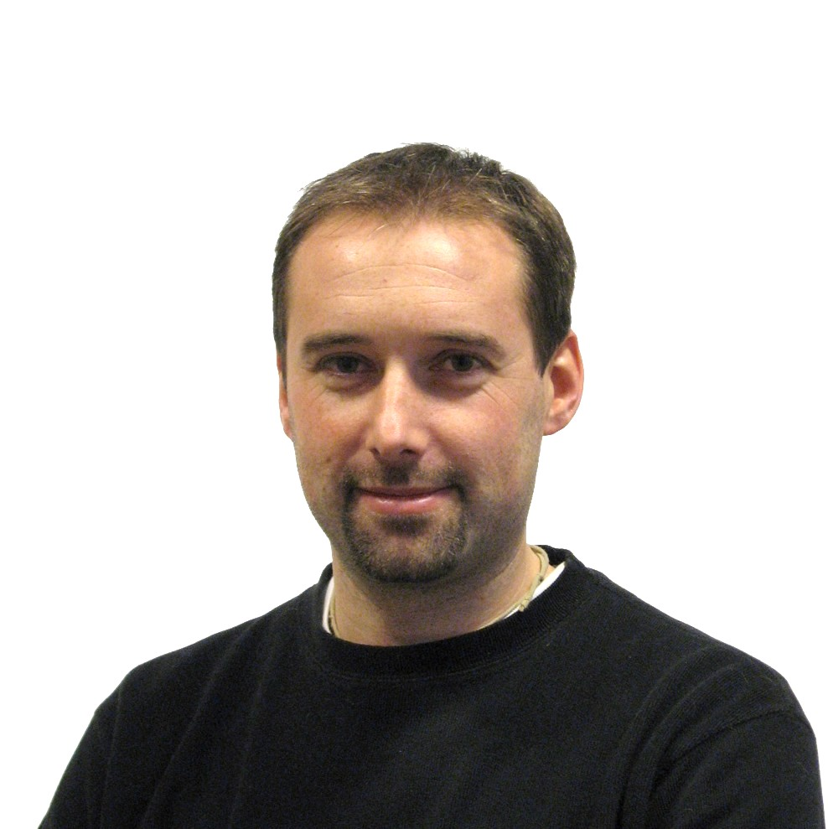
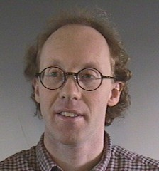
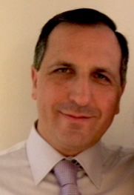

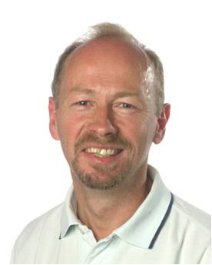



Accelerator Design Update
Steve Peggs
Cristina Oyon
David McGinnis
Work Package (work areas)
1. Management Coordination – ESS AB (Mats Lindroos)
2. Accelerator Science – ESS AB (Steve Peggs)
(3. Infrastructure Services – now ESS AB!)
4. SCRF Spoke cavities – IPN, Orsay (Sebastien Bousson)
5. SCRF Elliptical cavities – CEA, Saclay (Guillaume Devanz)
6. Front End and NC linac – INFN, Catania (Santo Gammino)
7. Beam transport, NC magnets and Power Supplies – Århus University (Søren Pape-Møller)
8. RF Systems – ESS AB (Dave McGinnis)
19. Test stands – Uppsala University (Roger Ruber)
Romuald Duperrier (30 years ago)
Guillaume Devanz
Mats Lindroos
Sebastien Bousson
Roger Ruber
Søren Pape Møller
Santo Gammino

Slide 5
Progress ADU

Slide 6
Programme Committees
Programme Director
EPG
Board, ,STC, AFC, SAC, TAC Programme Decisions
Programme Reviews
Programme Budget
CCB Machine
Programme Planning
Configuration control
Preparation of EPG Decisions
Definition of deliverables
Programme Office
Project Managers
Accelerator
Target
NSS
ICS
Energy
CF
Pre-Construction
ESS line organisation
Construction
Operations
De-Commissioning

Slide 7
ESS AD
With ICS we are 31 staff today
Five groups
  Beam Physics (Håkan Danared)
  Beam instrumentation (Andreas Jansson)
  RF systems (David McGinnis)
  Specialized technical services for all of ESS (John Weisend)
  Control systems for all of ESS (Garry Trahern)
30 recruitements planned for next year

Slide 8
Accelerator Design Update
Project goals set to be achieved by ADU collaboration
  Requirement document for all systems done
  7 Internal peer reviews held with external reviewers
  Description of where the interface is to other projects done
  Prototypes of ion source, SC cavities and one modulator on the way
  Technical Design work on all systems well under way
  Cost, schedule and plan for construction project done
  Schedule assumes staged installation with first neutrons in 2019 with only medium beta cavities installed (623 MeV, 1.25 MW)
  Proposal from three labs received and evaluated for medium beta TD
  TDR delivered (Release 1)
The ADU collaboration including all the ESS AD staff have done a fantastic work under very high pressure with many last moment changes
  I’m so proud to be the project leader!

Slide 9

Design Drivers
High Average Beam Power (5 MW)
High Peak Beam Power (125 MW)
High Availability (> 95%)

Slide 10
The Long Pulse Concept
Advantage - No compressor ring required
  No space charge tune shift so peak beam current can be supplied at almost any energy
  Very relaxed constraints on transverse and longitudinal emittance
  No H- and associated intra-beam stripping losses
Disadvantage - Experiment requirements “imprint” Linac pulse structure
  Duty factor is large for a copper linac
  Duty factor is small for a superconducting linac

Slide 11
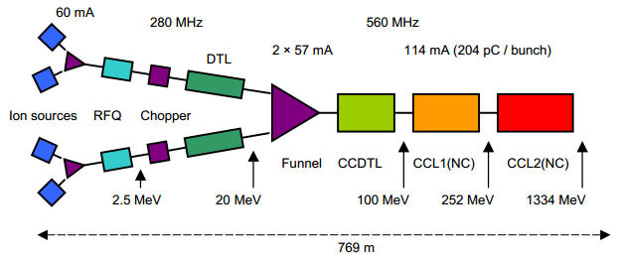
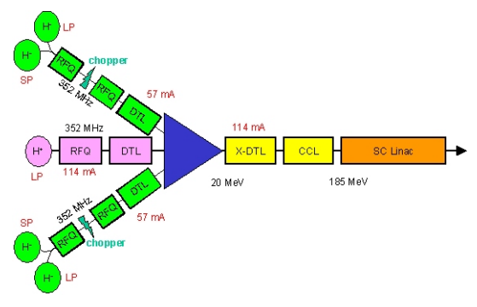
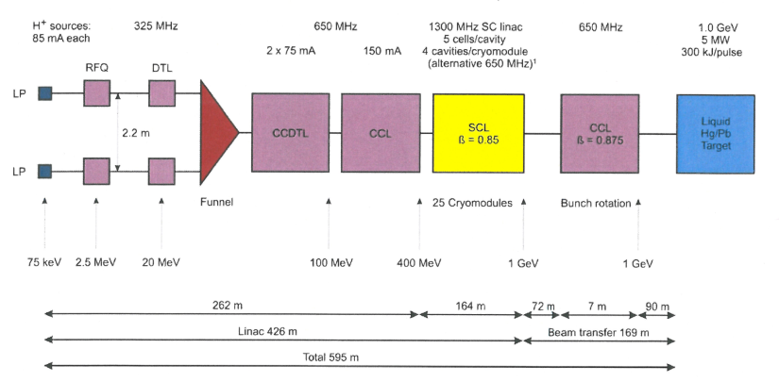
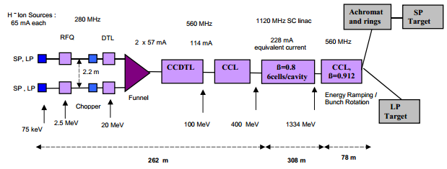
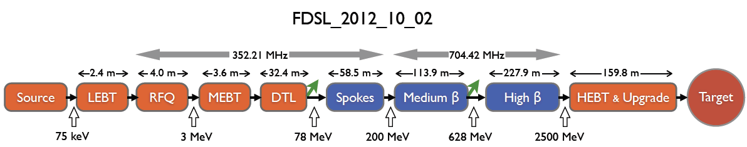
ESS Linac Evolution

Slide 12
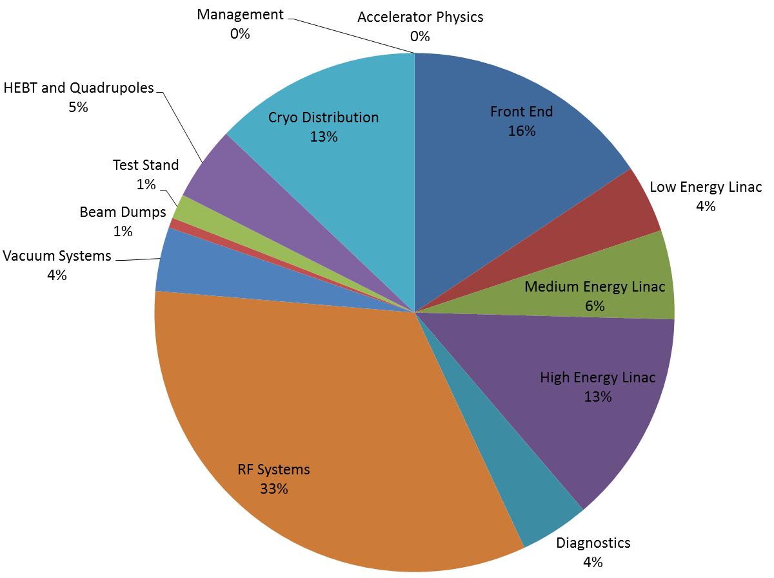


2008 Design
Design Features
  1.0 GeV, 150mA, 2mS, 16.6 Hz
  40% in Copper
  H- Funnel
  Superconducting Linac at 1.3 GHz
    3x current in ¼ the aperture
      7cm bore compared to current 14cm
    Low gradient – 12 MV/meter (compared to 17 MV/meter)
    Dynamic heat load 25% (compared to current 65%)
2008 Costing Report

Slide 13
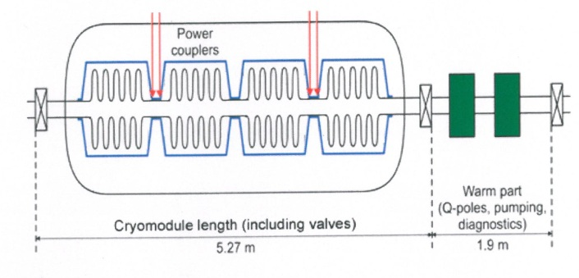
2008 Design
The low cost of the ESS accelerator 2008 design was achieved by placing one coupler for every two superconducting cavities with one RF source feedings this coupler.
  This would require a superconducting coupler with a power capability that doesn't exist.
    Peak Coupler Power 1.8 MW
    Average Coupler Power 60 kW
  In addition, due to long pulse Lorentz de-tuning, the two cavities fed by a single coupler would not match over the long pulse so the pulse length would have to be reduced to 1 Lorentz de-tuning time constant.
  Other scenarios for sharing power sources has been studied during the ESS design update but with all resulting in increased cost (or at best the same cost) and a significant increase of power consumption
Bottom line, the maximum beam power of the 2003-2008 design might not reach above 1.2 MW.

Slide 14
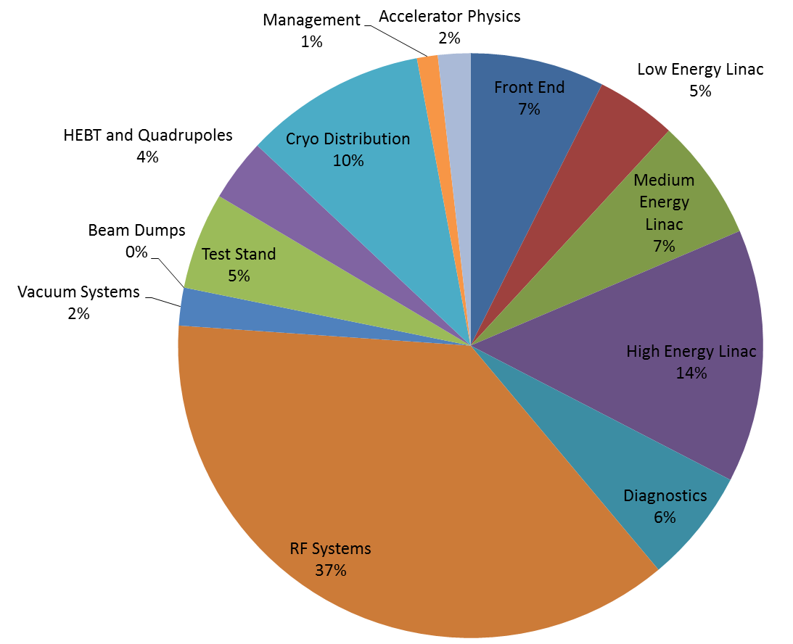
2012 Design
The 2012 design is 98% superconducting
There are 208 individual RF power stations
Courtesy of S. Gysin

Slide 15
Superconducting Linacs Flexibility, and Availability
Superconducting linacs permit the individual powering of short sections of linac
  Short sections of linac have a much higher velocity acceptance
  2012 linac can lose many sections of linac and still run and provide full beam current at a lower energy
  The long pulse concept is very well suited to operations at different energy
  MTTF of the ESS linac should be large because of flexible operation scenarios.
In addition, superconducting linacs have huge aperture
  2012 aperture is 14cm
  2008 aperture is 7 cm in the SCL

Slide 16
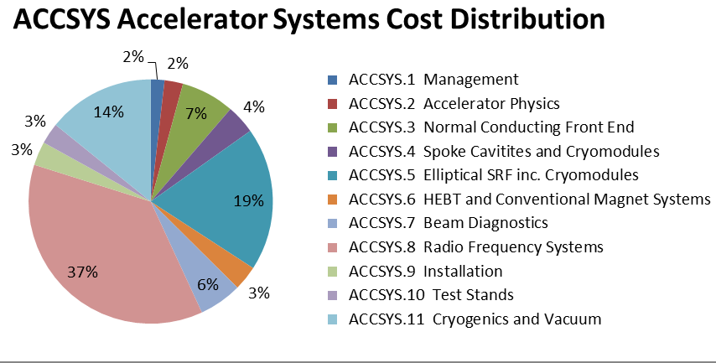
Cost Drivers
RF Systems – 37%
  Modulators – 15%
  Klystrons – 14%
Elliptical Cryomodules -19%
Cryogenics – 14%
Courtesy of A. Sunesson
Courtesy of S. Gysin

Slide 17
Contingency
We have developed cost estimates for the accelerator that aim to match our cost targets
ESS is in the initial stages of prototyping some of the major cost drivers.
  Cryomodules
  Klystrons
  Modulators
We are investigating possible sources of design contingency that will permit us to cope with
  market fluctuations
  and/or design alterations as a result of prototype results for the major cost drivers

Slide 18
Design Contingency Strategy
The long pulse concept along with a superconducting linac provide a wide range of flexibility for design contingency
The major cost drivers are the High Beta cryomodules along with the associated RF systems.
Reduce the number of Cryomodules
  Saves cryomodule cost
  Saves on RF stations
Keep beam power fixed

Slide 19
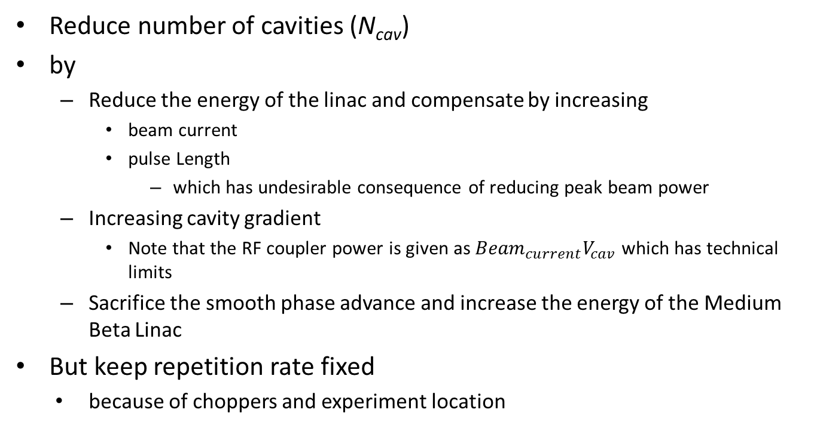
Constant Beam Power
Reduce number of cavities (N_{cav})
by
  Reduce the energy of the linac and compensate by increasing
    beam current
    pulse Length
      which has undesirable consequence of reducing peak beam power
  Increasing cavity gradient
    Note that the RF coupler power is given as which has technical limits
  Sacrifice the smooth phase advance and increase the energy of the Medium Beta Linac
  But keep repetition rate fixed
    because of choppers and experiment location

Slide 20
Constant Beam Power
Cost Impact

Slide 21
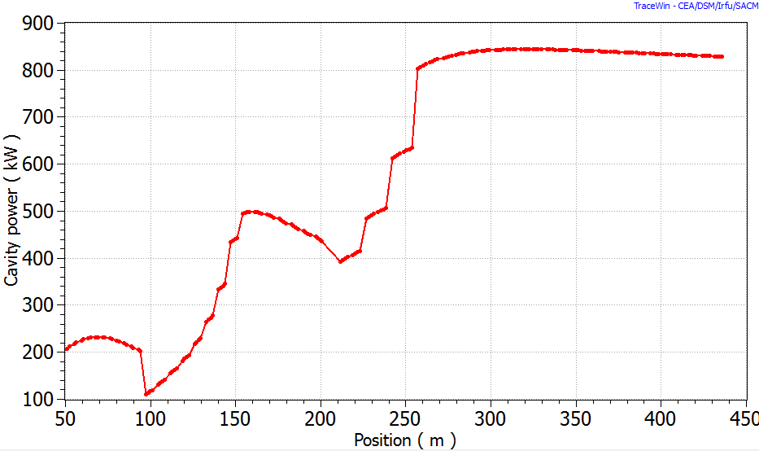
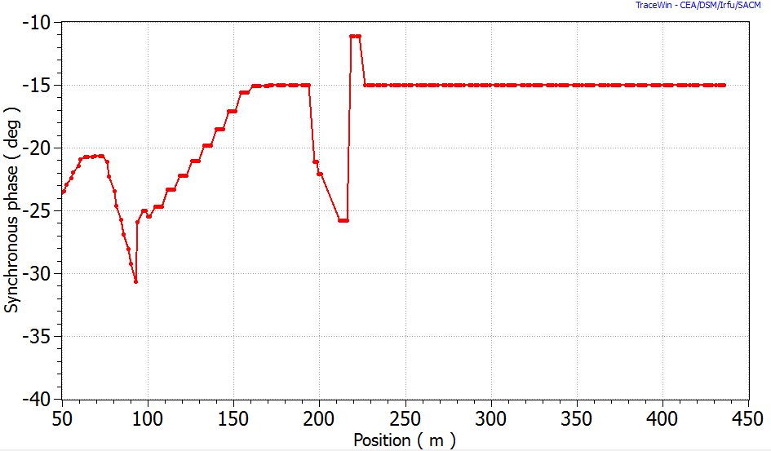
Medium Beta Linac Gradient
ESS Linac Design Rules
  Phase advance per focusing period smaller than 90 degrees
  Phase advance per meter varies smoothly.
  Tune depression in all the three planes stay above 0.4
Smooth phase advance requirement at the Spoke-Medium Beta transition requires medium beta cryomodule to run substantially below maximum gradient

Slide 22
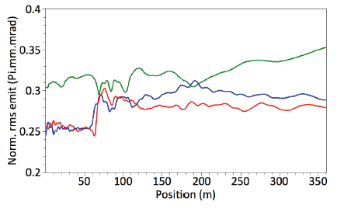
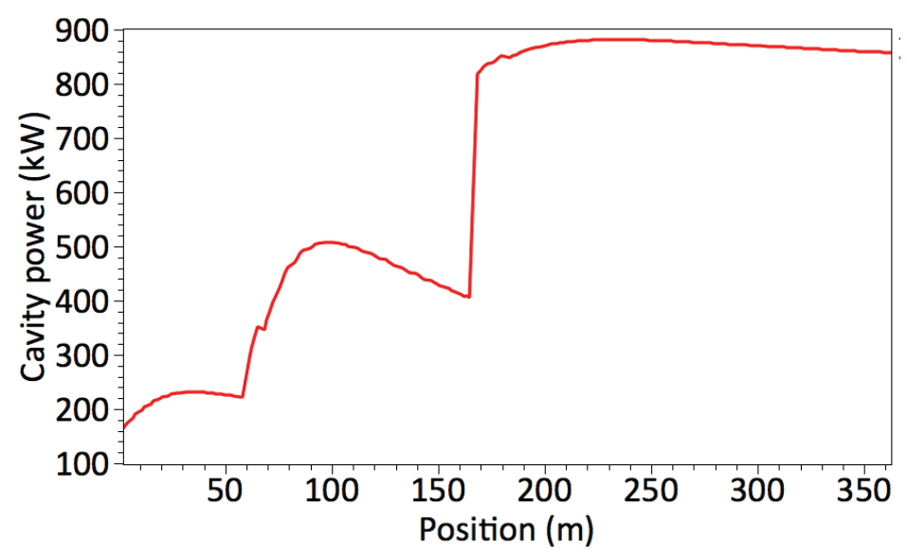
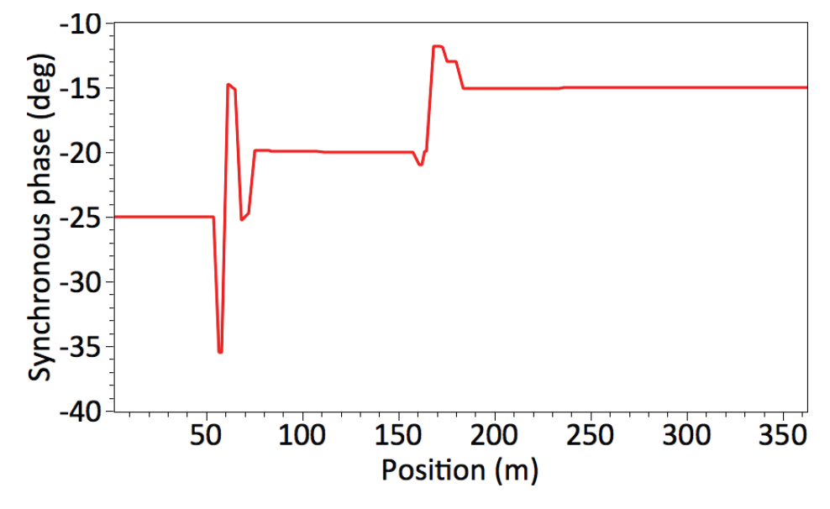
Medium Beta Linac Gradient
Relaxing smooth phase advance requirement
  Requires four fewer cryomodules without penalty of investment into higher peak RF power
  At the expense of an 20% emittance increase
Courtesy of M. Eshraqi

Slide 23
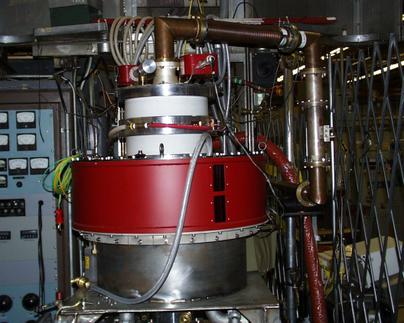
New Technology
Multi-Beam IOT’s
  Replace klystrons with Multi-Beam IOT’s
    Modulators become much simpler with lower voltage and no switching
    Higher efficiency requires fewer modulators
  A prototype Multi-Beam IOT at 704 MHz has achieved 1 MW
  Saves:
    21.5 Meuro for High Beta
    4.6 Meuro for Medium beta
    3-4 MW in RF power (~2-3 Meuro/year)
Strategy
  Medium Beta Staging makes concept feasible
  Invest NRE on developing a 1 MW, 704 MHz, IOT
  Still use klystrons & modulators for Medium Beta Linac
    IOTs might not be ready in time for Medium beta staging
    Provides backup technology in case IOTs have problem
  Use IOT’s in High Beta Linac
1 MW, 704 MHz IOT by CPI

Slide 24
EPG decision
Increase the peak field in the cavities from 40 MV/meter to 44 MV/meter
  Permits removing three high beta cryomodules and reduces cost by 13 Meuro
  Associated risk: Higher power in cavity couplers and cost increase due to drop in cavity yield
Increase the peak beam current from 50 to 54.3 mA
  Drop the maximum energy in the linac from 2.5 GeV to 2.3 GeV
  But limit peak power in the RF coupler to 1070 MW
  Permits removing three cryomodules by and reduces cost by 13 Meuro.
  Associated risk: Higher power in cavity couplers and larger beam loss
Relax smooth phase advance requirement
  Permits removing three cryomodules by and reduces cost by 17 Meuro.
  Associated risk: emittance increase
Total: Remove 9 cryomodules from the current design and reduce cost by 43 Meuro
  If the tunnel length is left un-changed it is possible to gain a higher total beam power than the original scope by adding the removed cryomodules back in the future

Slide 25
Energy Staging
Protons above 400 MeV can make spallation neutrons
The long pulse concept does not require a compressor ring
  Provides an avenue of staging the installation of the linac and provide substantial beam power at an intermediate energy
The Medium Beta Linac reaches an energy of 623 MeV
  Accelerate protons to 623 MeV at the end of the Medium beta cavities and drift to the target
  Requires Front-end, DTL, Spokes
  Warm quads and spool pieces in the high beta section and HEBT
  margin of over 200 MeV
  1 .25 MW on target
    no compressor ring so beam current is not limited at lower energy
    minor impact on target efficiency

Slide 26
Energy Staging
Run operations (i.e. making neutrons for users) in 2020, 2021, and 2022 at with at reduced running time (~1000-2000 hours / year?)
Relatively long shutdowns (6 months? ) in 2020, 2021, and 2022 to install remaining equipment
Complete High beta linac by 2022
Can have an intermediate stage before 2022 (i.e 1.2 GeV in 2021)

Slide 27
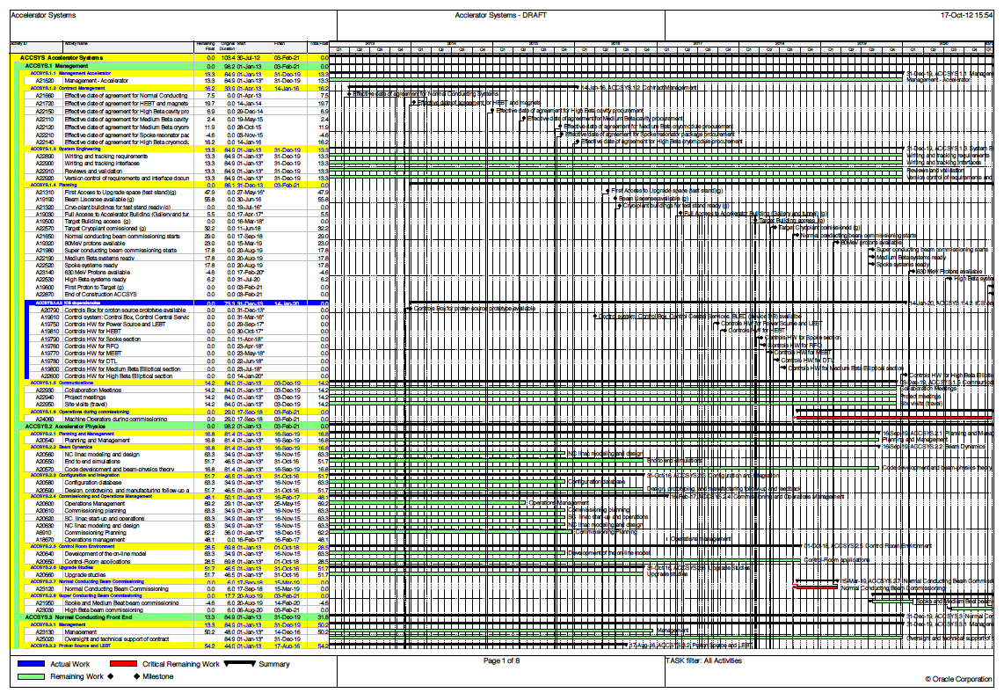
Towards construction

Slide 28
 | Q1, 2012 | Q2, 2012 | Q3, 2012 | Q4, 2012 | 2013
Executive Report
Programme Plan
Technical design Report
Project Specifications, Construction
Prel. Project Spec., Operations
Prel. Project Spec., De-comm.
Transition Plan to Operations
Budget and Cost Book
Risk List Summary
ESS Framework Project (QMP)
ESS Board Meetings
STC meetings
AFC meetings
SAC meetings
TAC meetings
03-23
08-03
11-01
12-03
03-19
06-11
10-01
12-03
01-21
06-25
10-01
10-29
12-03
06-11
10-29
01-21
10-01
01-01
10-01
01-01
08-15
10-01
01-21
06-11
10-01
12-03
01-21
01-23
07-02
10-01
12-03
01-21
03-31
06-30
09-30
12-31
08-24
02-08
03-20
04-24
06-04
08-14
10-24
11-16
01-18
01-11/12
05-10/11
09-13/14
12-17/18
04-12
07-02/03
11-13/14
03-21/22
06-07/08
11-29/30
02-15/17
06-27/28
11-14/15

Slide 29
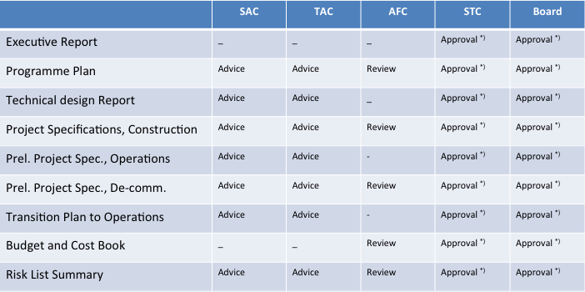
Pre-Construction approval process

Slide 30
ESS Top-Level Schedule
(2012-09-12, v1) | 2012 |  |  |  | 2013 |  |  |  |  |  |  |  |  |  |  |  | 2014
 | Sep | Oct | Nov | Dec | Jan | Feb | Mar | Apr | May | Jun | Jul | Aug | Sep | Oct | Nov | Dec | Jan | Feb
MoU 1 year extension
Draft Int’l agreement
ESS doc. delivery
STC
Cost Management Audit
Negotiations
Sign LOI (bi-lateral)
Formal national ratifications of final agreement
Ground break
1/12
1/12
1/12
13-14/9
(?)
16-17/12
18-19/2
1/12
31/1
15/5
Signature event
1/6
15/2

Slide 31
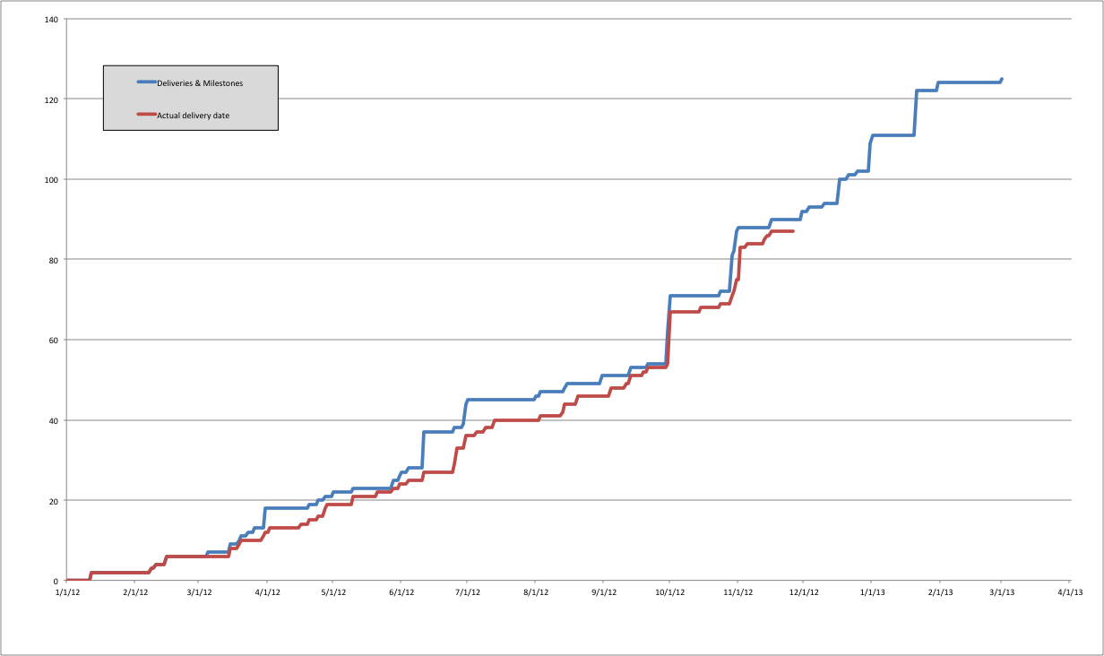
Status deliverables

Slide 32
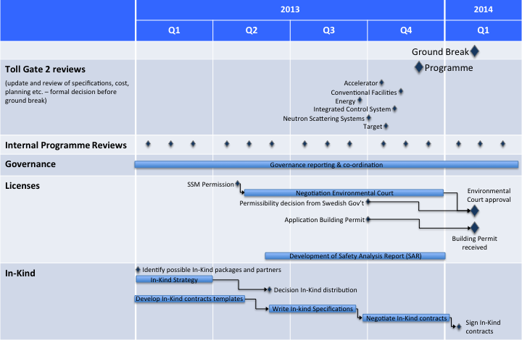
Programme Schedule 2013

Slide 33
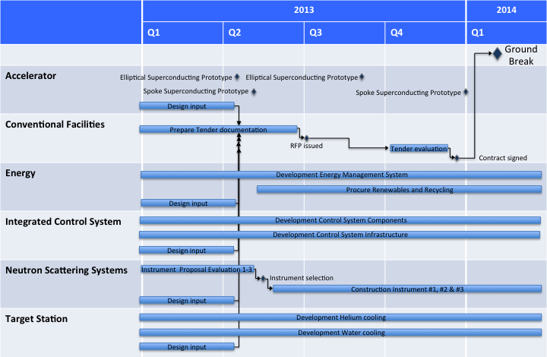
Project Schedule 2013

Slide 34
Reporting during Construction Phase
Internal monthly reporting:
Earned Value reporting
  on Project level (6 projects)
  on Work Package level (≈ 50 WP’s)
  total approx. 60 Earned Value curves each month
Risk & Opportunities
  on Project level
  on Work Package level
Milestones
  delivered
  delayed
  upcoming
External quarterly reporting:
Earned Value
  on Programme level
  on Project level
  total 7 Earned Value curves
Written progress report
  on Programme level
  on Project level
Risk & Opportunities
  on Programme level
  on Project level

Slide 35
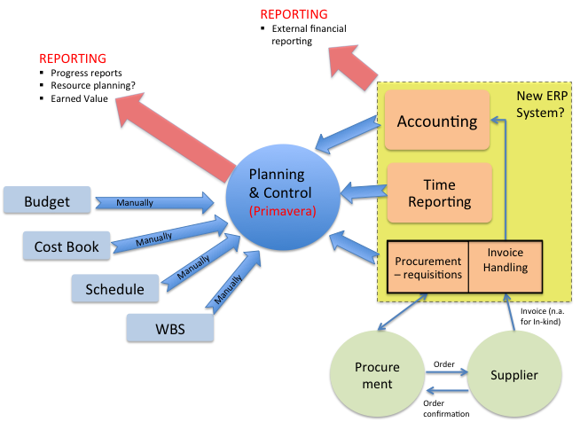
Schematic picture system set-up

Slide 36
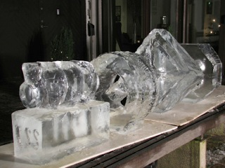
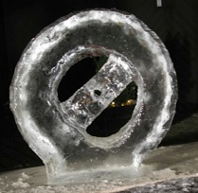
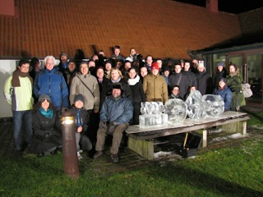
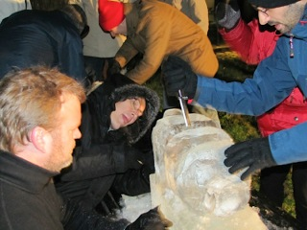
Many, many thanks to all of you!
ESS, A wonderfull challenge!

