Slide 1
SPL thermal studies
Rossana Bonomi
Rossana.Bonomi@cern.ch
ESS Retreat Meeting, Lund, 28-29/11/2012

Slide 2
Outline
1
Short cryomodule heat loads and refrigeration powers
Thermal analyses of components
Double-walled tube
Cold-warm transition
Vacuum vessel and thermal shield
Mock-up test
ESS Retreat Meeting, Lund, 28-29/11/2012

Slide 3
Short Cryomodule
2
ESS Retreat Meeting, Lund, 28-29/11/2012

Slide 4
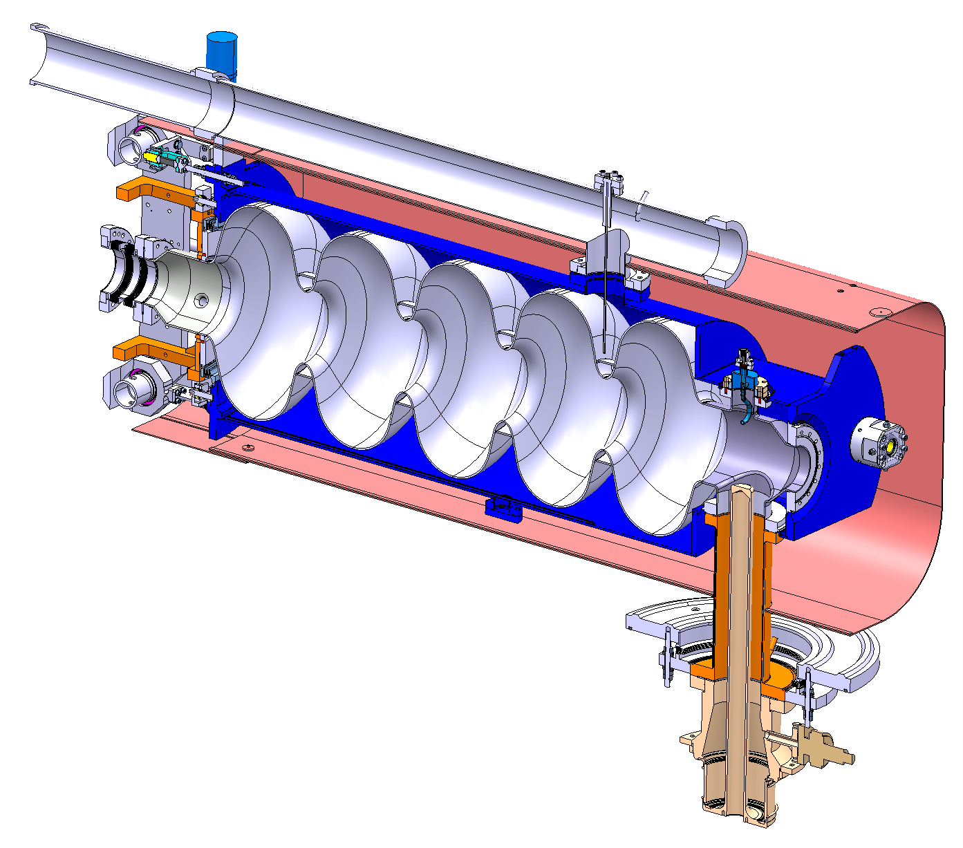
Short Cryomodule
3
Bi-phase helium tube
Helium Tank
Bellows
CEA’s tuner
Bulk Niobium 5-cells cavity
Magnetic shielding
(old design)
Hom Coupler
Inter-cavity support
Double walled tube
RF Power Coupler
ESS Retreat Meeting, Lund, 28-29/11/2012

Slide 5
Cryomodule temperature levels
4
VV
Temperature levels:
Bath 2 K
Inlet helium gas 4.5 K
Thermal shield 50-70 K
Vacuum vessel 300 K
TS
CM
CWT
Heat contributions from:
Double-walled tube to 2 K, 4.5 K
Cold-warm transition to 2 K, 50-70 K
Vacuum vessel to 50-70 K
Thermal shield to 2 K
DWT
ESS Retreat Meeting, Lund, 28-29/11/2012

Slide 6
Cryomodule heat loads
5
Subassembly | Type | Source | Desti-nation | @ 2 K [W] |  |  |  | @ 4.5 K [W] |  |  |  | @ 50-70 K [W]
Double-walled tube DWT | cd rad RF | DWT | bath | 13 ⁽¹⁾ x 5 = 65 | 0.1 ⁽²⁾ x 5 = 0.5 | 0.5 ⁽³⁾ x 4 + 0.1 x 1 = 2.1 | 22 ⁽⁴⁾ x 4 + 13 x 1 = 101 | - | - | - | - | -
 | cv | DWT | gas | - | - | - | - | - ⁽¹⁾ | 60 ⁽²⁾ x 5 = 300 | 60 ⁽³⁾ x 5 = 300 | - ⁽⁴⁾ | -
Cold-warm transition * CWT | cd | WF | TS | - |  |  |  | - | - | - | - | 23.0 x 2 = 46.0
 | cd | TS | CM | 0.8 x 2 = 1.6 | 0.8 x 2 = 1.6 | 0.8 x 2 = 1.6 | 0.8 x 2 = 1.6 | - | - | - | - | -
 | rad | WF + wall | CM | 1.0 x 2 = 2.0 | 1.0 x 2 = 2.0 | 1.0 x 2 = 2.0 | 1.0 x 2 = 2.0 | - | - | - | - | -
 | rad | WF | TS | - | - | - | - | - | - | - | - | 0.2 x 2 = 0.4
Vacuum vessel VV | rad ** | VV | TS | - | - | - | - | - | - | - | - | 33.0
Thermal shield TS | rad ** | TS | CM | 1.1 | 1.1 | 1.1 | 1.1 | - | - | - | - | -
Cavity *** | RF | cavity | CM | - ⁽¹⁾ | - ⁽²⁾ | 20.0 ⁽³⁾ x 4 = 80.0 | 20.0 ⁽⁴⁾ x 4 = 80.0 | - | - | - | - | -
TOT for SCM [W] |  |  |  | 69.7 ⁽¹⁾ | 5.2 ⁽²⁾ | 86.8 ⁽³⁾ | 185.7 ⁽⁴⁾ | - | 300 ⁽²⁾ | 300 ⁽³⁾ | - | 79.4
DWT Static heat loads
(1) RF off, cool off
(2) RF off, cool on
DWT Dynamic heat loads
(3) RF on, cool on
(4) RF on, cool off
* Thermal shield at 50 K, placed at 0.15 m from cold flange
** C. Maglioni, V. Parma’s technical note: “Assessment of static heat loads in the LHC arc, from the commissioning of sector 7-8”, LHC Project Note 409, 2008 (VV→ TS 1.7 W/m² - TS → CM 0.1 W/m²)
*** V. Parma’s presentation: http://cdsweb.cern.ch/record/1302738/files/thp004.pdf

Slide 7
Cryomodule refrigerator powers
6
@ 2 K (990 W_{el}/W_{th}*):
@ 50-70 K (16 W_{el}/W_{th}*):
@ 4.5 K - DWT cooling:
40 mg/s warm gas are equivalent to 4 W_{th} @ 4.5 K (100 W_{th}/(g/s))
4 W_{th} @ 4.5 K cost 880 W_{el} (220 W_{el}/W_{th}*)
For 4+1 DWT → 4.4 kW_{el}
(1) | 70 W_{th} | 69.3 kW_{el}
(2) | 5 W_{th} | 5.0 kW_{el}
(3) | 87 W_{th} | 86.1 kW_{el}
(4) | 186 W_{th} | 184.1 kW_{el}
Static operations
Dynamic operations
 | 79 W_{th} | 1.3 kW_{el}
* S. Claudet et al. “1.8 K Refrigeration Units for the LHC: Performance Assessment of Pre-series Units”, proceedings ICEC20
(@ 2 K: 15% Carnot, @ 50-70 K: 30% Carnot, @ 4.5 K: 30% Carnot)

Slide 8
Cryomodule refrigerator tot power
7
Around 92 kW_{el} of refrigerator power are expected during nominal operation for the SPL short cryomodule (4 cavities)
Heat loads due to instrumentation and critical regions are disregarded
ESS Retreat Meeting, Lund, 28-29/11/2012

Slide 9
Double-walled tube
8
Semi-analytical model*
1D, 3 layers, 22 nodes
L = 300 mm
D = 50 mm
S = 1152 mm²
m = 40 mg/s
* Based on O. Capatina ‘s presentation: http://indico.cern.ch/getFile.py/access?contribId=3&resId=1&materialId=slides&confId=86123

Slide 10
Double-walled tube
9
Results are comparable with FE 2D simulations (Comsol)
Heat load at bath:
< 0.5 W
RF power: 10.1 W
Antenna radiation load: 0.6 W
No COOL
40 mg/s He
ESS Retreat Meeting, Lund, 28-29/11/2012

Slide 11
Double-walled tube
10
RF currents node position is critical ..
RF currents
Shift [mm] | Prf [W] | Qrad (W) | Qbath [W]
0 | 10.189 | 0.579 | 0.110
50 | 15.503 | 0.581 | 0.375
100 | 14.077 | 0.587 | 0.576
150 | 8.213 | 0.586 | 0.346
200 | 8.802 | 0.580 | 0.113
250 | 14.512 | 0.580 | 0.278
300 | 15.252 | 0.586 | 0.571
ESS Retreat Meeting, Lund, 28-29/11/2012

Slide 12
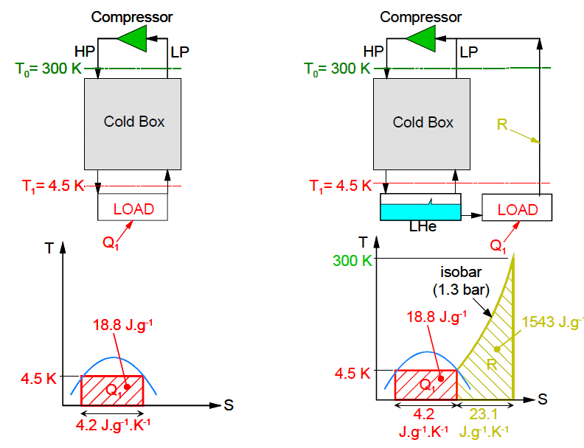
Thermodynamic efficiency of DWT gas cooling
11
Electrical power for liquefaction of 1 g/s helium: 6200 W_{el}
Carnot COP @ 4.5 K: 66 W_{el}/W_{th}
1 g/s liquid helium is equivalent to 100 W_{th} @ 4.5 K *
He refrigeration He Liquefaction
(Figure from: « An Introduction to Cryogenics », Ph.Lebrun, CERN/AT 2007-1)
* U. Wagner s presentation: http://cdsweb.cern.ch/record/808372/files/p295.pdf

Slide 13
Thermodynamic efficiency of DWT gas cooling
12
Comparison with other ways of cooling (heat intercepts, self-sustained cooling)
990 @ 2 K, 220 @ 9 or 4.5 K, 16 @ 80 K
Case | Q @ 2K [W] | P [W_{el}] | Q @ 9K [W] | P [W_{el}] | Q @ 80K [W] | P [W_{el}] | vapours rate [g/s] | Q equiv. @ 4.5K [W] (1g/s=100W) | P [W_{el}] | Total power [Wel]
A) No intercept | 12.6 | 12,375 | - | - |  |  | - | - | - | 12,375
B) 1 optimised intercept @ 80K | 2.2 | 2,178 | - | - | 44.6 | 714 | - | - | - | 2,892
C) 2 optimised intercepts @ 80K & 9K | 0.18 | 178 | 3.2 | 704 | 30.6 | 490 | - | - | - | 1,372
D) 4.5K self-sustained vapour cooling | 0.03 | 30 | - | - | - | - | 0.020 | 2 | 440 | 470
E) He vapour cooling (4.5K-300K) | 0.10 | 99 | - | - | - | - | 0.04 | 4 | 880 | 979
F) He vapour cooling (4.5K-300K), RF power on | 0.50 | 495 | - | - | - | - | 0.04 | 4 | 880 | 1,375
G) No He vapour cooling, RF power on | 22 | 21,780 | - | - | - | - | 0 | 0 | 0 | 21,780
ESS Retreat Meeting, Lund, 28-29/11/2012

Slide 14
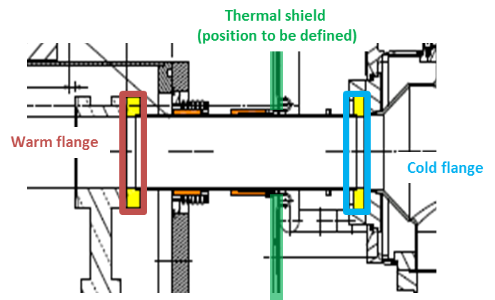
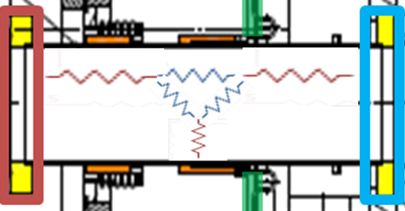
Cold-warm transition
13
Mathcad/Matlab analytical analysis for each position and temperature of thermal shield
Heat due to radiation and to conduction are evaluated
TS
Equivalent electric
ESS Retreat Meeting, Lund, 28-29/11/2012

Slide 15
Cold-warm transition
14
Heat to BATH [W]
IDEAL refr power [kW_{el}]
Cold flange
Warm flange
Heat to TS [W]
Cold flange
Warm flange
ESS Retreat Meeting, Lund, 28-29/11/2012

Slide 16
Vacuum vessel and thermal shield
15
Radiation values rescaled from LHC commissioning of sector 7-8
LHC linear heat loads (average values):
4.3 W/m vacuum vessel to thermal shield
0.2 W/m thermal shield to cold mass
For SPL SCM:
33.0 W @ TS from vacuum vessel
1.1 W @ 2 K from thermal shield
* C. Maglioni, LHC Project Note 409 - http://cdsweb.cern.ch/record/1087253/files/project-note-409.pdf

Slide 17
Mock-up test
16
1.5 cavities
2 DWTs
1 intercavity support
Cooled by LN2 (rescaling to He)
Test of all possible cooling conditions
No RF power
Validation of:
Cavity supporting system
Assembly-realignment of cavities via vessel interface
Alignement measurign device (OWPM)
Thermal contractions
DWT active cooling
ESS Retreat Meeting, Lund, 28-29/11/2012

Slide 18
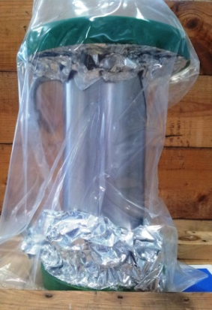
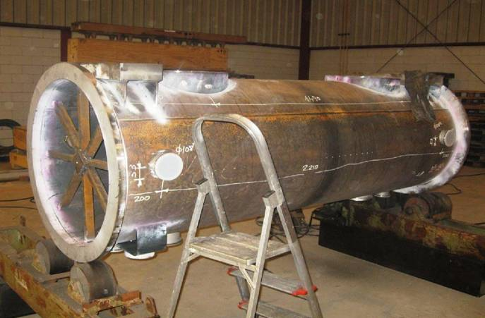
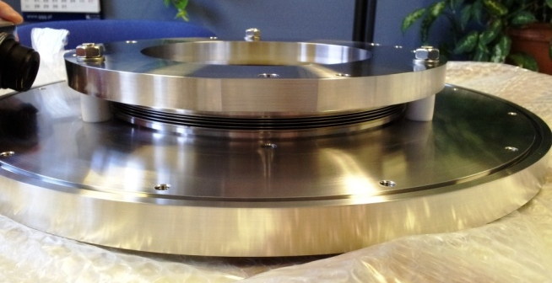
Mock-up test
17
ESS Retreat Meeting, Lund, 28-29/11/2012

Slide 19
Questions?
18
..save Helium (for pacific purposes)!
The National Helium Reserve, also known as the Federal Helium Reserve, is a strategic reserve of the United States holding over a billion cubic meters (1E9 m³) of helium gas.
The helium is stored at the Cliffside Storage Facility about 12 miles northwest of Amarillo, Texas, in a natural geologic gas storage formation, the Bush Dome reservoir.
The reserve was established in 1925 as a strategic supply of gas for airships, and in the 1950s became an important source of coolant during the Space Race and Cold War.
The natural gas in these fields contains unusually high percentages of helium, from 0.3% to 2.7%; they constitute the largest source of helium in the United States. The helium is separated as a byproduct from the produced natural gas.
After the Helium Acts Amendments of 1960, the U.S. Bureau of Mines arranged for five private plants to recover helium from natural gas. For this helium conservation program, the Bureau built a 425-mile pipeline from Bushton, Kansas, to connect those plants with the government's partially depleted Cliffside gas field. This helium-nitrogen mixture was injected and stored in the Cliffside gas field until needed, when it then was further purified.
(source: Wikipedia)
Cliffside Gas Field, Amarillo – TX (2012)

Slide 20
Participants to the collaboration effort:
System/Component/Activity | Person(s) in charge | Lab
Cavities/He vessel/tuner construction | O.Brunner, O.Capatina, Th.Renaglia, F.Pillon, N.Valverde, M.Esposito, I.Aviles, G.Devanz | CERN CEA-Saclay
SRF, magnetic shielding, Clean-Room activities, RF test stations (SM18) | E.Ciapala, T.Junginger, K.Shirm, J.Chambrillon, O.Brunner | CERN
RF Coupler | E.Montesinos, G.Devanz | CERN CEA Saclay
Vacuum systems | G.Vandoni | CERN
Cryogenics (cryo infrastructure SM18) | O.Pirotte | CERN
Survey and alignment | P.Bestman | CERN
Cryo-module conceptual design | R.Bonomi, O.Capatina, P.Coelho, V.Parma,T.Renaglia, A.Vande Craen, L.R.Williams | CERN
Cryo-module detailed design & Integration & Cryostat assembly tooling | P.Dambre, P.Duthil, P.Duchesne, S.Rousselot, D.Reynet | CNRS/IPNO-Orsay
SPL Machine architecture | F.Gerigk | CERN
ESS Cryomodule developments | C.Darve | ESS
Cryo-module Technical Coordination | V.Parma | CERN
Thanks for your attention! Tack för din uppmärksamhet !

Slide 22
Master schedule
ESS Retreat Meeting, Lund, 28-29/11/2012

Slide 23
SPL operational conditions
ESS Retreat Meeting, Lund, 28-29/11/2012

Slide 24
SPL operational conditions
Operating condition | Value
Beam current/pulse lenght | 40 mA/0.4 ms beam pulse | 20 mA/0.8 ms beam pulse
cryo duty cycle | 4.11% | 8.22%
quality factor | 10 x 10⁹ | 5 x 10⁹
accelerating field | 25 MV/m | 25 MV/m
Source of Heat Load | Heat Load @ 2K
Beam current/pulse lenght | 40 mA/0.4 ms beam pulse | 20 mA/0.8 ms beam pulse
dynamic heat load per cavity | 5.1 W | 20.4 W
static losses | <1 W (tbc) | <1 W (tbc)
power coupler loss at 2 K | <0.2 W | <0.2 W
HOM loss in cavity at 2 K | <1 | <3 W
HOM coupler loss at 2 K (per coupl.) | <0.2 W | <0.2 W
beam loss | 1 W
Total @ 2 K | 8.5 W | 25.8 W
ESS Retreat Meeting, Lund, 28-29/11/2012

Slide 25
Ideal vs. real refrigerator power
Temperature level [K] | IDEAL - Carnot [Wel/Wth] | REAL [Wel/Wth] | Efficiency wrt Carnot [%]
2 | 149 | 990 | 15
4.5-9 | 66-32 | 220 | <30
50-70 | 5-3 | 16 | <30
ESS Retreat Meeting, Lund, 28-29/11/2012

Slide 26
(B) 1 Heat intercept
300K
x1
Q @ 80K
L
Q @ 2K
ESS Retreat Meeting, Lund, 28-29/11/2012

Slide 27
(C) 2 Heat intercepts
300K
x₁
Q @ 80K
L
x₂
Q @ 8K
Q @ 2K
ESS Retreat Meeting, Lund, 28-29/11/2012

Slide 28
(D) He vapour cooling
300K
attenuation factor
L
Q in g/s
4.5K
ESS Retreat Meeting, Lund, 28-29/11/2012

Slide 29
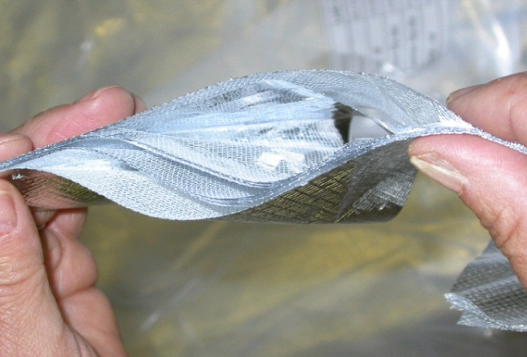
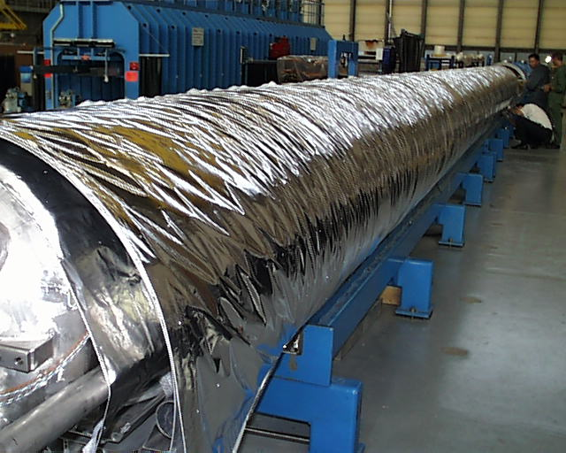
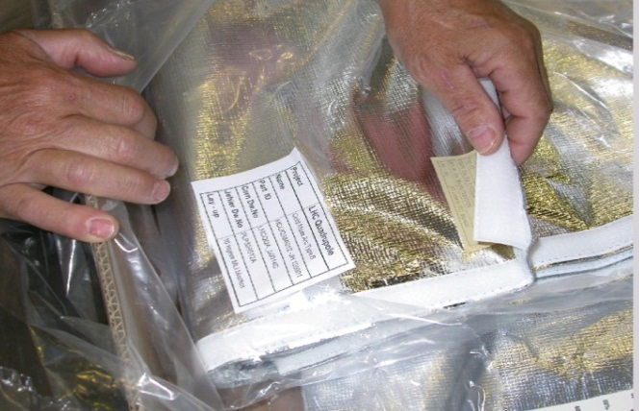
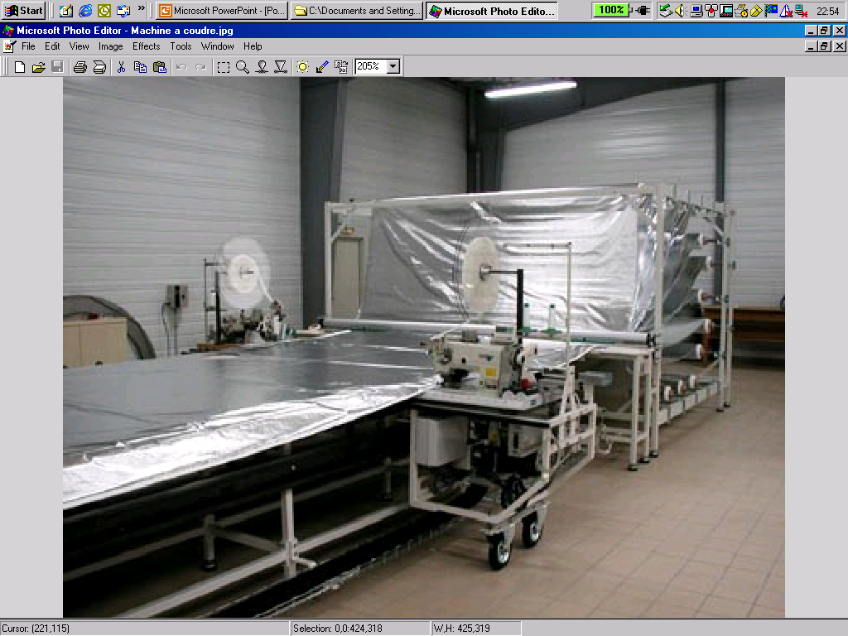
LHC Multi layer insulation (MLI)
Features:
1 blanket (10 reflective layers) on cold masses (1.9 K)
2 blankets (15 reflective layers each) on Thermal Shields (50-65 K)
Reflective layer: double aluminized polyester film
Spacer: polyester net
Stitched Velcro™ fasteners for rapid mounting and quality closing
Interleaved reflectors and spacers
Velcro™ fasteners
1 blanket on CM, 2 on thermal shield
Blanket manufacturing
ESS Retreat Meeting, Lund, 28-29/11/2012

Slide 30
SCM instrumentation

