Slide 1
Prototype uTCA.4 BPM Electronics Test
Accelerator Division 2012 Retreat
28-29 Nov. 2012
Hooman Hassanzadegan
ESS, Beam Instrumentation Group

Slide 2
Outline
Background information about xTCA
Motivation for hardware platform prototyping
Prototype MTCA.4 system:
  Infrastructure modules
  Application-specific modules
Preliminary tests results with a demo MTCA.4 system
Next steps

Slide 3
Telecom Computing Architecture (xTCA)
μTCA vs. ATCA
ATCA carrier blade with AMCs
ATCA chassis
AMCs
μTCA chassis
ATCA module with RTM
The PICMG (PCI Industrial Computer Manufacturers Group) consortium works on xTCA improvement for Physics experiments.
3

Slide 4
AMC connection to the RTM/backplane
Zone 1:
  Power
  Physical address
  Shelf management: IPMI
Zone 2:
  Fabric (data transfer between the boards and the outside network)
    Ethernet
    PCI-Express, Rapid IO, etc.
  Base fabric (control, firmware uploading, OS boot, etc.)
    10, 100, 1000 BASE-T Ethernet
  Synchronization (clock and trigger)
  Update channels (interconnection of two hubs or processor boards)
Zone 3:
  User defined
  Can be used to connect the front module to:
    Backplane
    RTM
    Cables

Slide 5
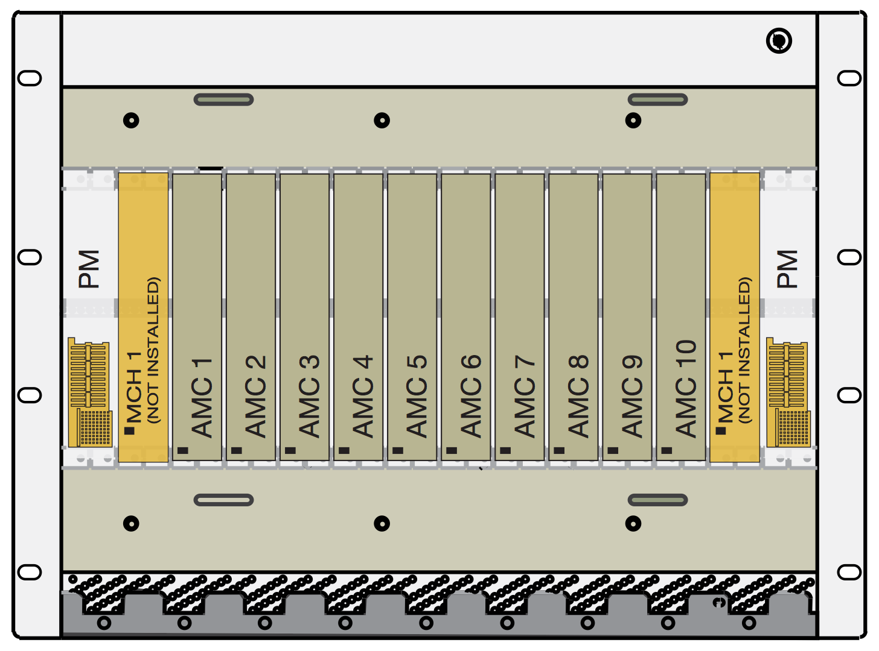
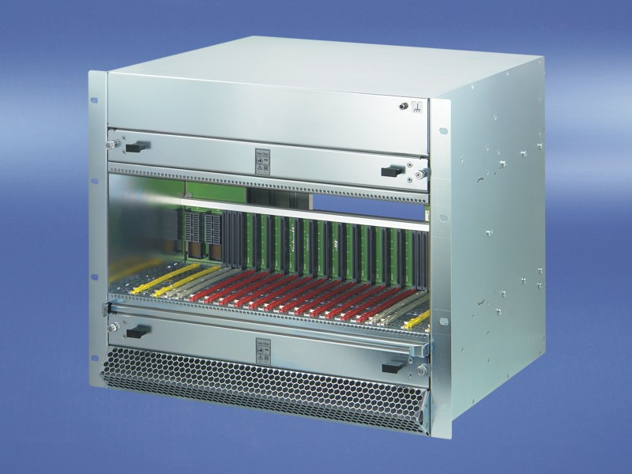
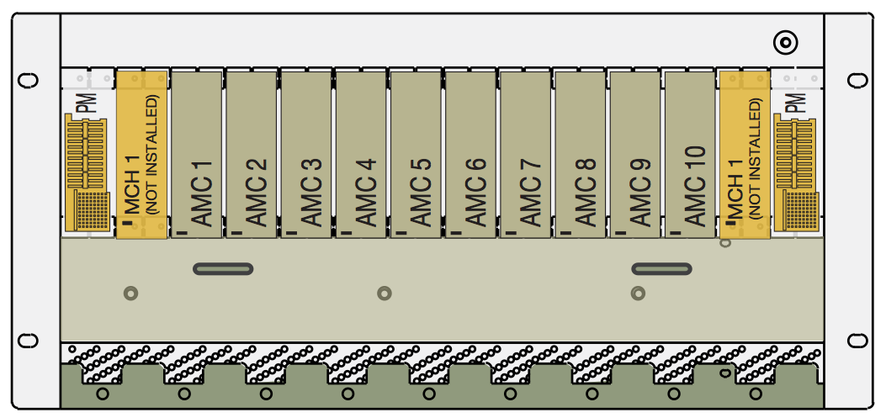
MTCA.4 chassis platform
AMC form factors
12-slot MTCA.4 chassis
7-slot MTCA.4 chassis

Slide 6
Hardware platforms for ESS
Following a detailed study of available hardware platforms, in March 2012, a decision was made to use two platforms for prototyping purposes at ESS:
  cPCI / cPCIe (general purpose platform)
  MTCA.4 (high performance platform)
Reasons for choosing MTCA.4 include high redundancy / availability, timing and synchronization resources, possibility of using an RTM and future support.

Slide 7
Motivation for MTCA.4 prototyping
  To check:
  Possibility of using high speed ADC sampling in RF / IF
  Timing and synchronization resources (ex. delay and jitter)
  Possibility of developing part of the electronics in house
  Power module noise / ripple
  System redundancy / availability
  Linux drivers for EPICS integration
  Identify MTCA.4 drawbacks and weak points
  Customer support
  Cost
  Etc.

Slide 8
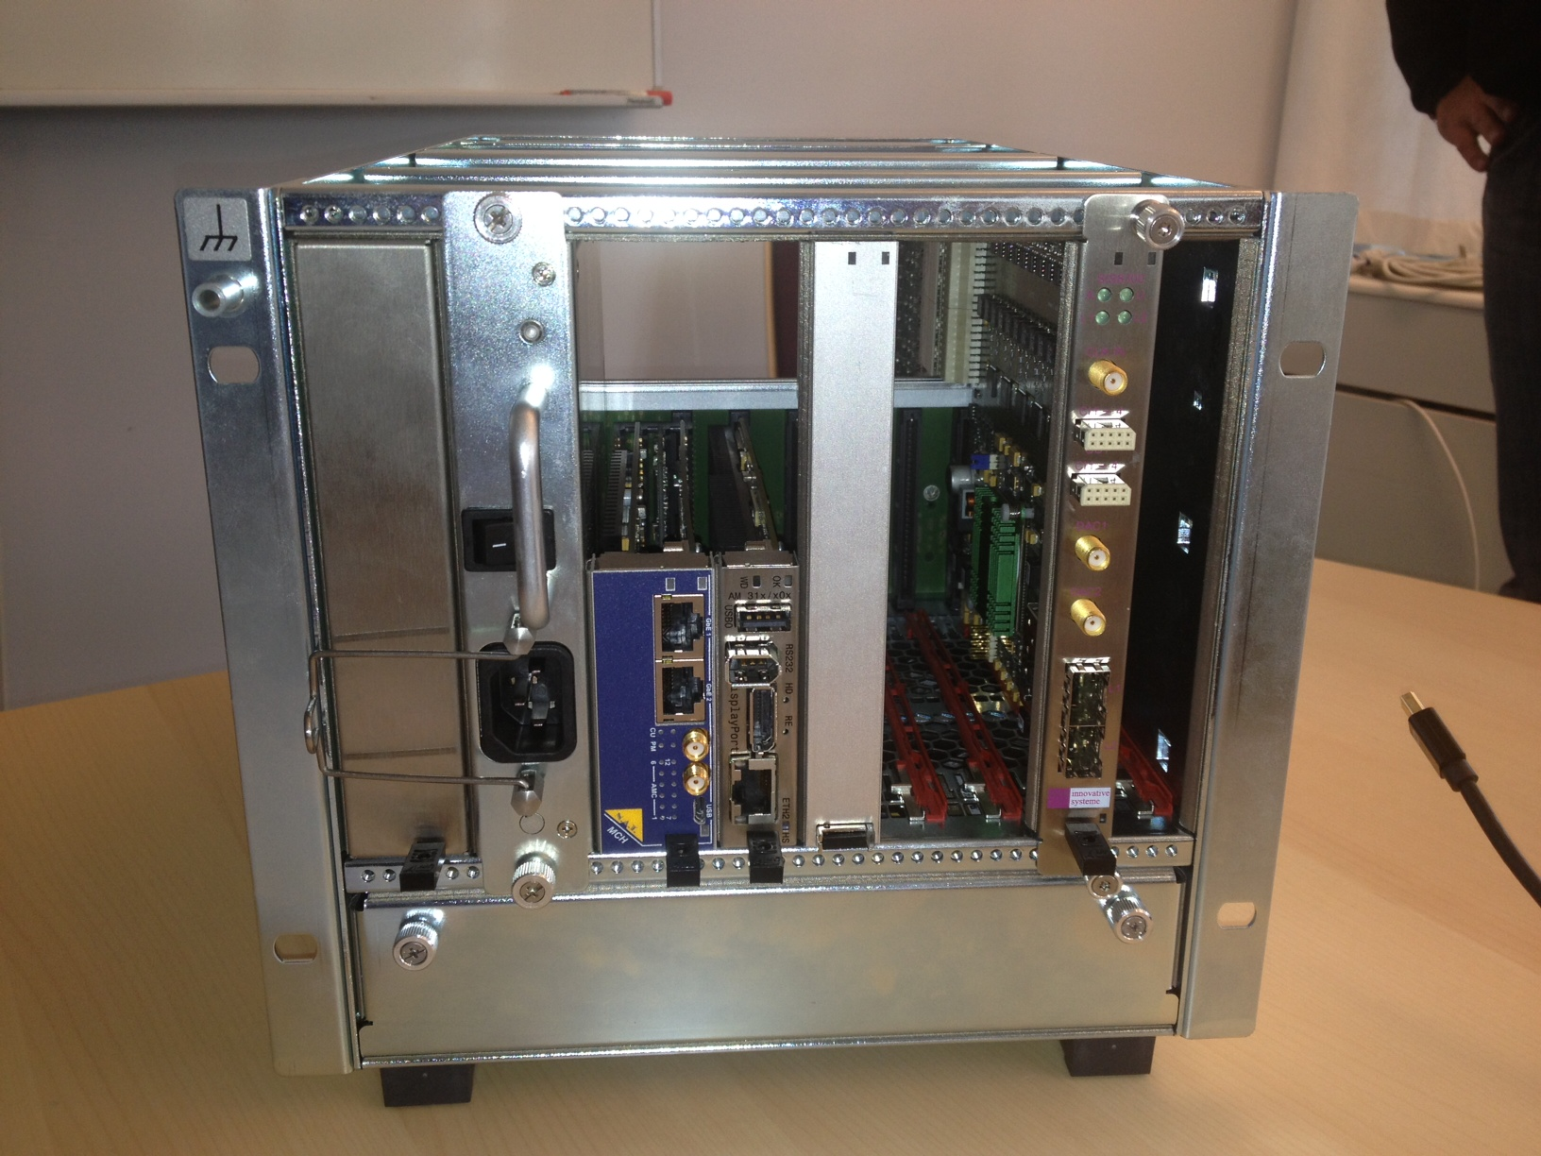
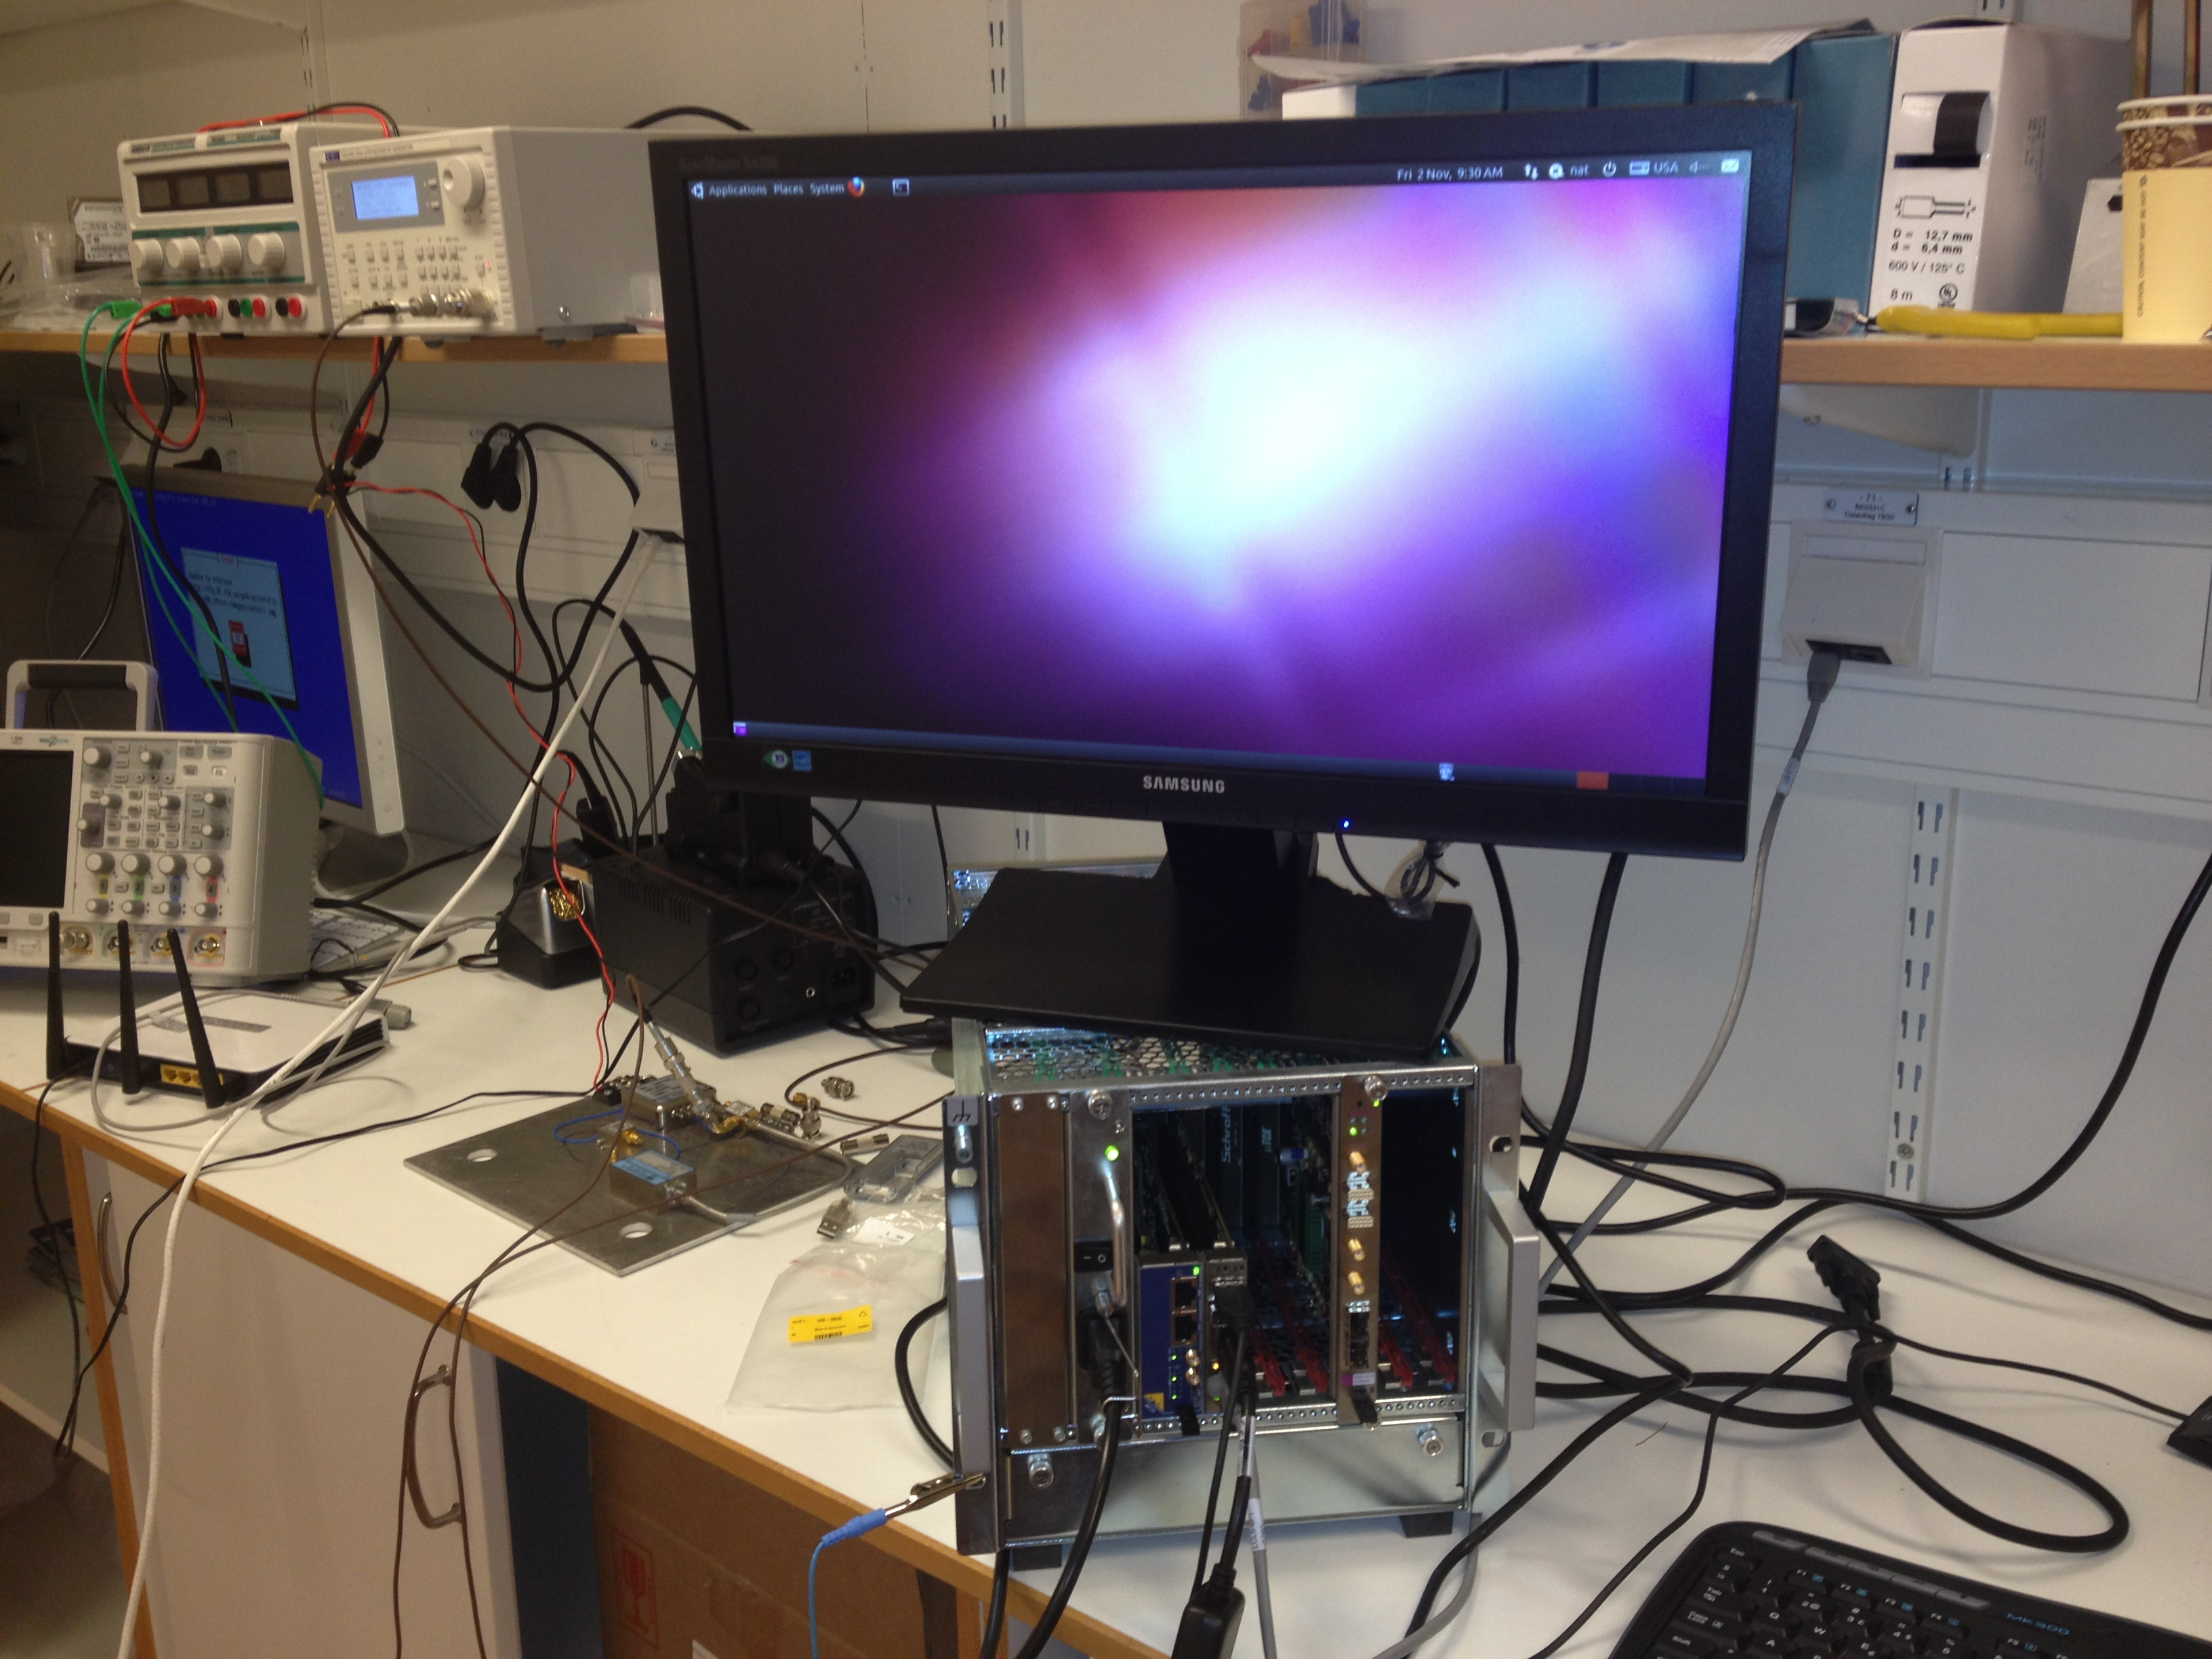
MTCA.4 demo system
MTCA.4 setup (electronics lab.)
MTCA.4 demo system (loaner system from RECAB)

Slide 9
AMC and RTM
SIS8300 AMC from Struck:
10 ADCs + 2 DACs +
4 Gbit memory +
Virtex-5 FPGA
SIS8900 RTM from Struck:
Signal conditioning of the 10 analogue inputs

Slide 10
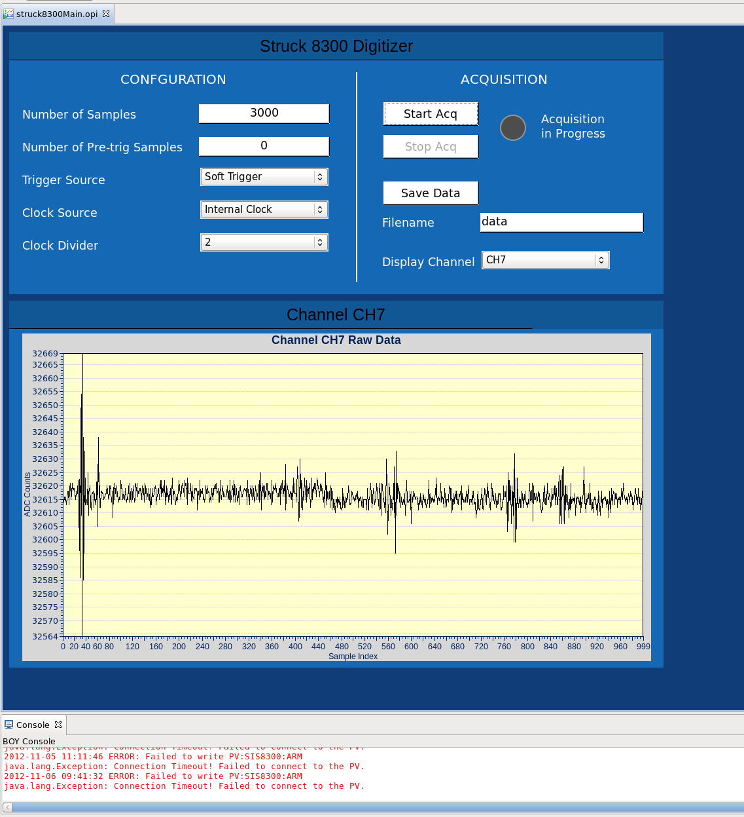
Data acquisition with the MTCA.4 demo system
The software which is currently being used for data acquisition consists of the following parts:
SIS8300 kernel module supplied (Struck)
User-space driver (Cosylab)
EPICS application (Cosylab)
CSS GUI (Cosylab)
Command-line test program (supplied by SLAC, but then modified by Cosylab to extend its functionality)
Some MATLAB programs for ADC data analysis (SLAC)
Simple GUI for data acquisition with the SIS8300 digitizer

Slide 11
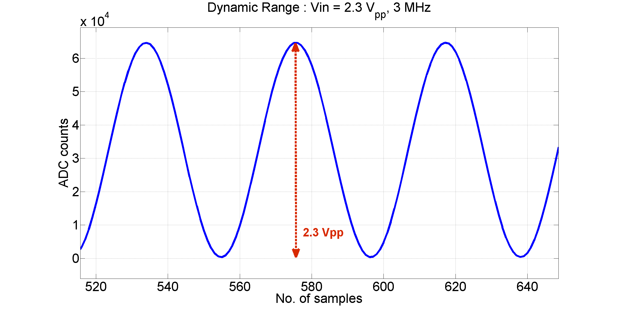
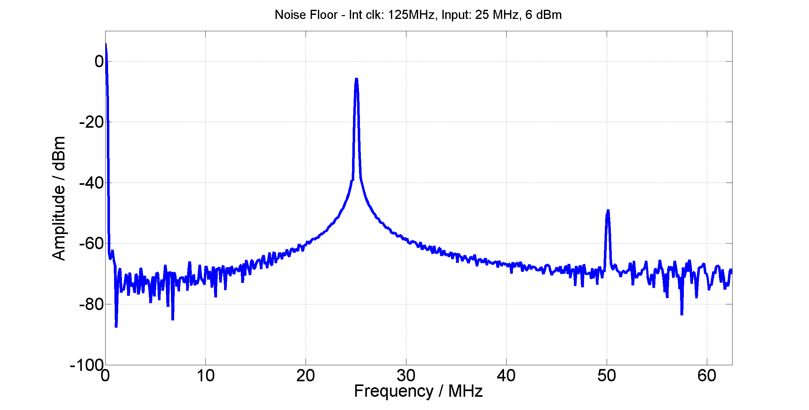
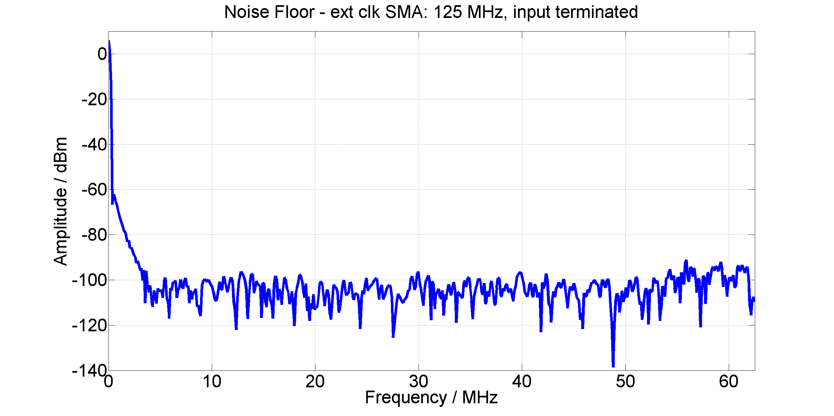
Some preliminary test results
Dynamic range of the analog inputs:
2.3 Vpp @ 3 MHz
Ch-to-ch cross talk:
-77 dB @ 25 MHz for two adjacent channels
-81 dB @ 25 MHz with one unconnected channel in between
Noise floor
Input freq. = 25 MHz
Clock : internal (125 MSPS)
Input terminated

Slide 12
Test results
Some more things we learned about:
Electronics bandwidth
Effective number of bits
Clock jitter
DC offsets
Issues / problems (some of them are already resolved):
PCI bus hangs up at system boot-up
Minor problems with GUI initialization
Problems with displayed waveforms (not always according to the selected channel)
Existence of gaps (ADC count= 0) between each 1000 samples of the recorded data
Large noise on the first 1000-2000 samples
Sudden changes of the DC offsets (ADC readout)

Slide 13
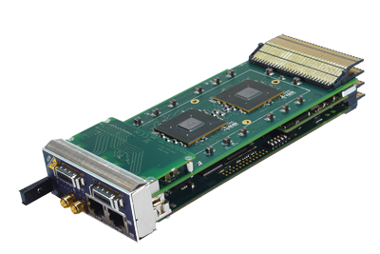
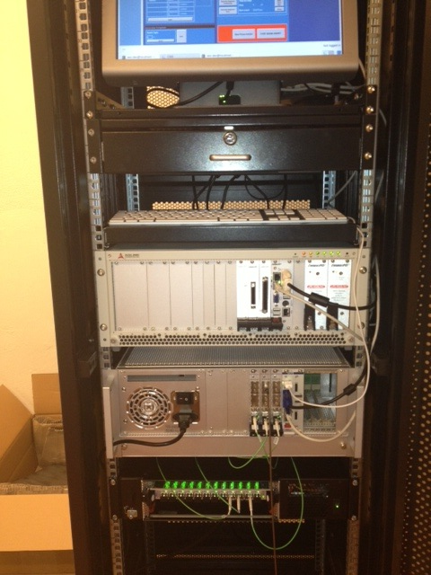
Next improvements of the MTCA.4 prototype
New 7-slot chassis from Schroff
Linear Power Module from Telkoor (less noise/ripple)
Combined CPU/MCH from NAT
Synchronization of the crate to a 14 signal from the MRF timing system (provided by the ESS Controls group)

Slide 14
Future steps
Replacement of the MTCA system demo system with the ordered system to RECAB, consisting of a 7-slot chassis, a ripple-free power supply and a combined MCH/CPU module
Replacement of the UBUNTU Linux (the current version being used on the CPU) with the ESS approved version (Scientific Linux)
Connection of the MTCA system to an ACCT for current measurements
Connection of the MTCA system to a BPM detector and programming the SIS8300 FPGA for position, phase and intensity measurements
These steps are being coordinated with the Controls group.

Slide 15

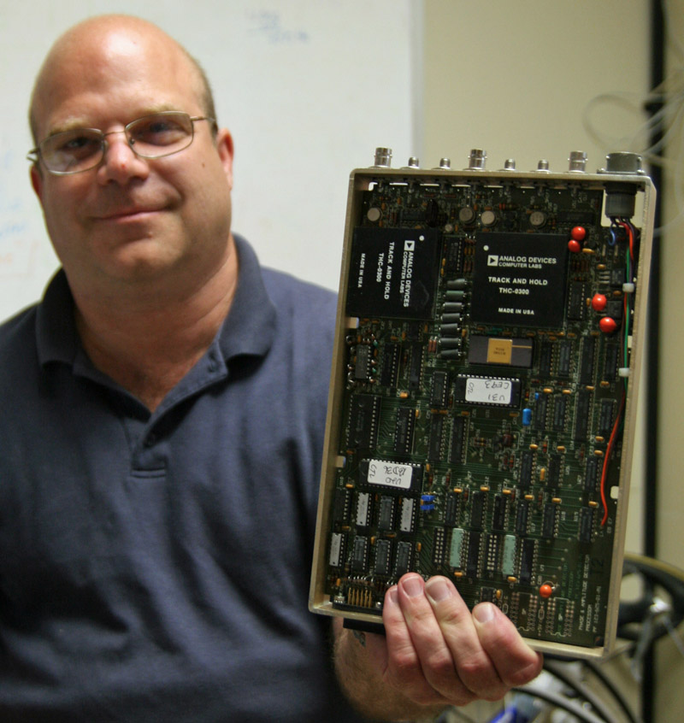
Thanks to…
Klemen Strniša (Cosylab)
Andrew Young (SLAC)
ESS Controls group and Miha Reščič

