Slide 1
Overview over CEA Saclay RF test stands and use of the FMC IOxOS ADC3111 board
Alexis Gaget & Françoise Gougnaud
with Daniel Bogard, Adelino Gomes
CEA Saclay Irfu
EPICS meeting May 2016

Slide 2
OUTLINE
CEA control packages in the ESS collaboration
ESS control box for RF test stands
The 704 MHz pulsed RF source test stand
Control of the RF source for the coupler conditioning test
Requirements for conditioning fast acquisition
Solutions selected by ESS ICS
Measurement of the ESS ICS driver
Results according to our context
Modifications
Measurement including our modifications

Slide 3
CEA control packages in the Collaboration
Source and LEBT control at Catania
Contribution for the RFQ control
Several RF test stands at Saclay for ESS
Cavity coupler conditioning test with the currently RF 704 MHz source
RF power tests on the ESS prototype cryomodule ECCTD
ESS RFQ coupler conditioning test with the pulsed RF 352 MHz source NEW and late 2016
704 MHz pulsed RF source to test the power couplers for ESS linac NEW and summer 2017

Slide 4
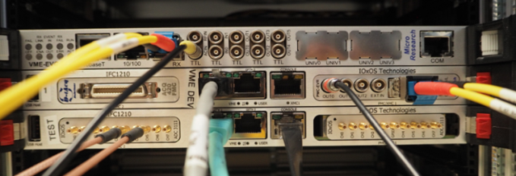
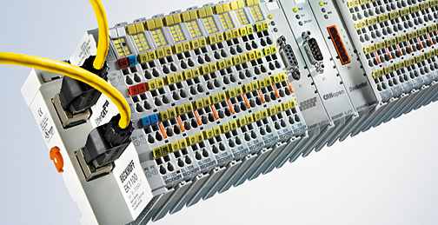
Ess control box for RF test stands
Choice to use EPICS for Saclay RF test stands
Fast acquisition needed by the different coupler conditioning tests
Choice to use the VME64X ESS platform (first one available) based on IOxOS boards for Saclay RF test stands with the ESS EPICS Environment
See “ESS EPICS Environment Integration at CEA Saclay” by Nicolas Senaud
MRF Timing System
IOxOS CPU 1210
with FMC ADC3111
Beckhoff on EtherCAT

Slide 5
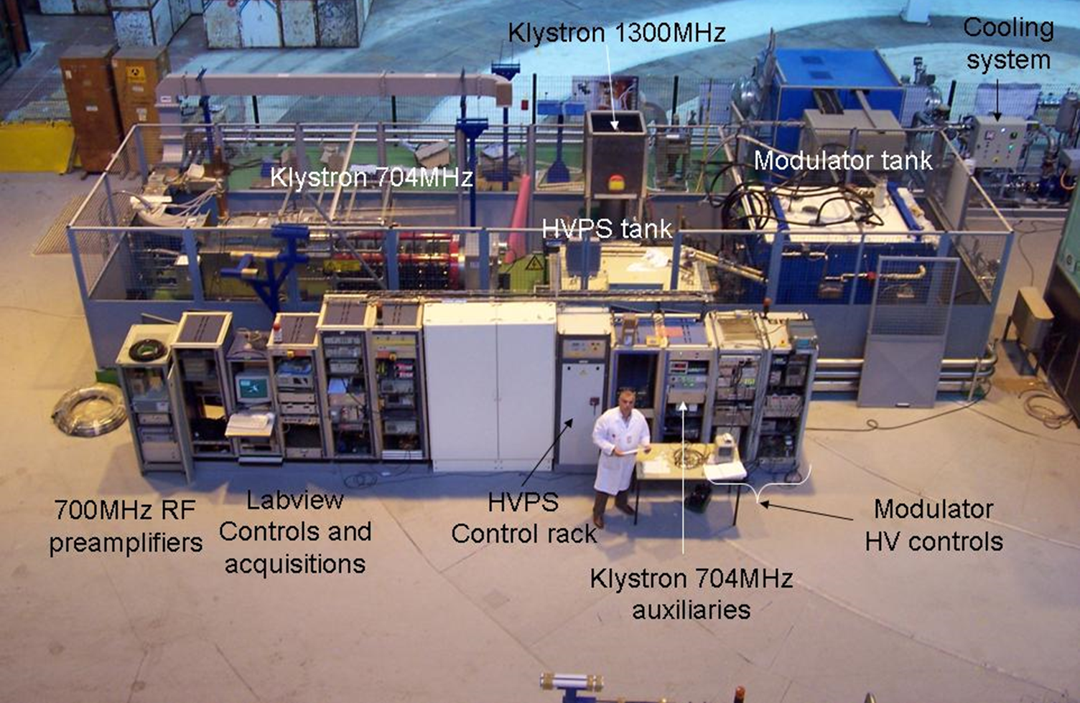
the 704 MHz pulsed RF source test stand
The 704 MHz pulsed RF source will be used for the prototype and series coupler conditioning test
Heterogeneous controls of HV modulator and klystron are being moved to EPICS

Slide 6
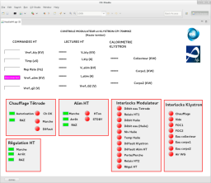
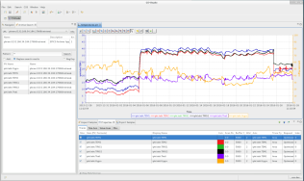
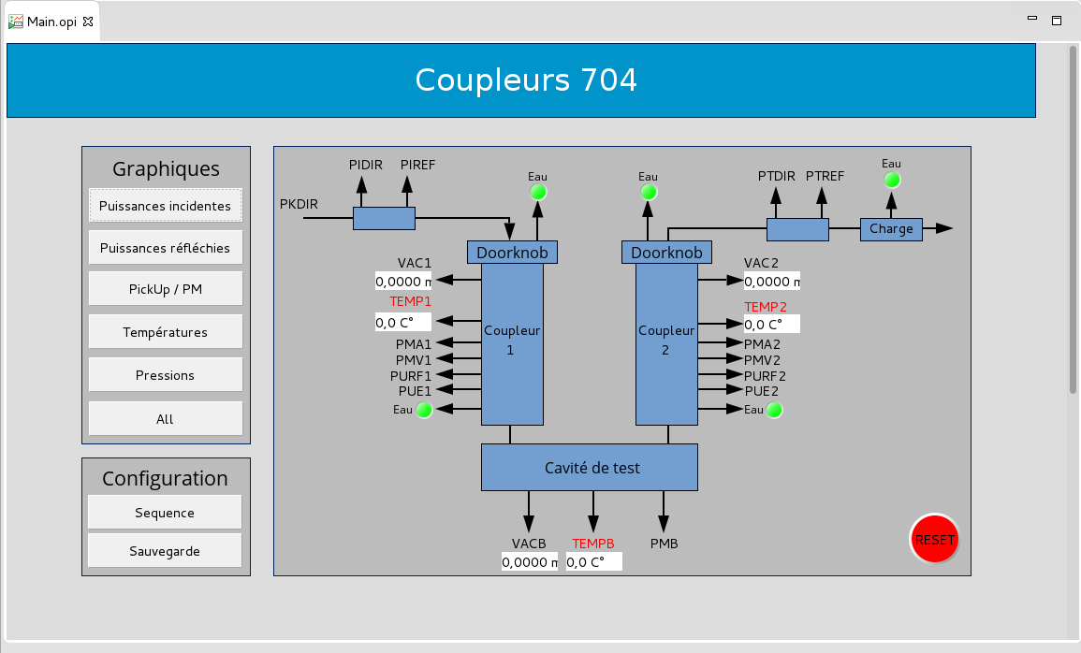
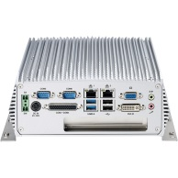
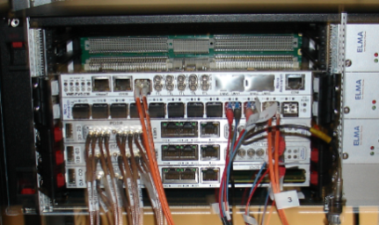
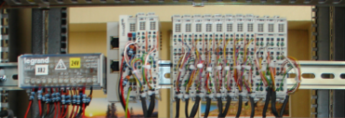
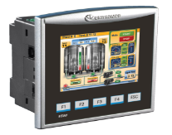
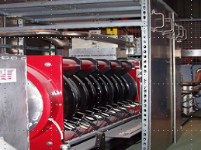
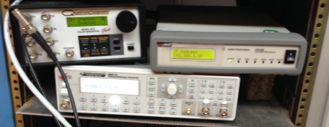
Control of the RF source AND the coupler conditioning TEST STAND
Archiver
Appliance
Channel Access
ESS VME/IOxOS
NISE 3500 IPC
CEA EEE
Beckhoff/EtherCAT
Modbus/Tcp
LAN
GPIB
Interlocks
PLC V350 Unitronix
Water
vacuum
Safety
RF
Security box
Klystron 704MHz
HV Modulator

Slide 7
Requirements for conditioning fast acquisition
Hardware Requirements
Sampling rate from 250KSamples/s up to 1MSamples/s
External trigger to synchronize the acquisitions
At least 18 channels
Software requirements
Display windows from 5ms up to 10ms at 1MS/s -> Waveform up to 10000 samples
Sampling rate configurable
Measurement functions (min, max, average, sum ...) using configurable cursor and threshold
Non linear conversion

Slide 8
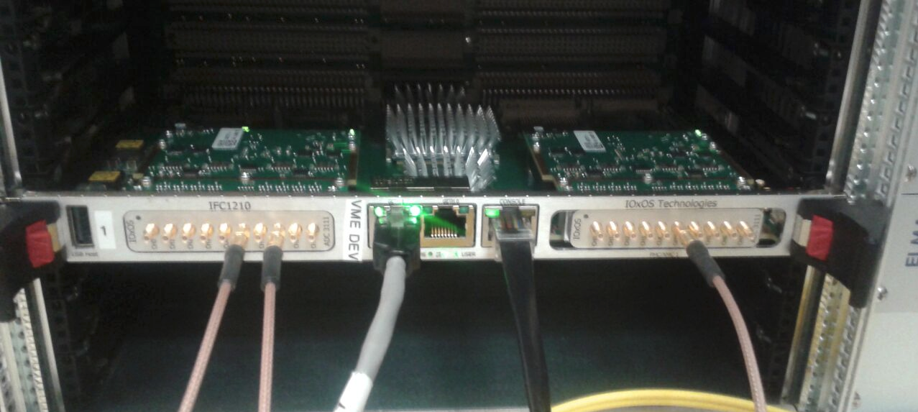
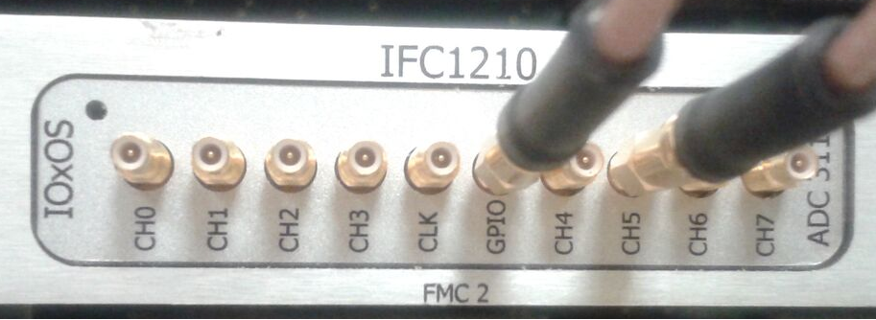
Solution selected by ess ics
Ioxos ifc1210 single board adc3111 fast acquisition mezzanine card
VME64x
Realtime Linux
CPU 1.2GHz
1 slot FMC
1 slot FMC / PMC
2 Ethernet slots
8 channels
External trigger
16 bits resolution
Sampling rate : 50KSamples/s up to 250MSamples/s
Up to 16384 Samples per channel
+/- 0.5V Range
DC Coupling
PSI EPICS Driver updated by ESS ICS
Waveform up to 16384
Sampling rate configurable
Configurable trigger (source, delay, edge …)
Measurement function (min, max, top average...etc)
Oscilloscope type function (gain, offset...etc)
Linear conversion
Common interface for a family of ADC modules (ADC3310, ADC3111, D-tAcq …)

Slide 9
Measurement of the ess ics driver
Conditions
ESS ICS EPICS Database
14Hz repetition frequency
16 channels
Pulses from 16 samples to 16384 samples
Sampling rate from 250KS/s to 1MS/s
ifc1210 single board results
Memory : 51,2%
Network : 14Mo
Load average: up to 30%
CPU
Samples

Slide 10
Results according to our context
All PVs provided are not necessary
Linear conversion is useful but also non linear conversion needed
Too much network used, no need to display so many samples
Available measurement functions not useful (no cursor)

Slide 11
Modifications
Development of an EPICS module « FastAcquisition » using only needed record
Development of an EPICS module « DataProcessing » to measure each channel with its owns cursors, returns a compressed waveform of N samples (configurable) and converts a waveform using a non linear function
EPICS PSI Driver
Updated by ICS
FastAcquisition
DataProcessing
(conversion, cursor, average signal…)
EPICS
EPICS Events
EPICS
Signal
Signal waveform
| PAGE 11

Slide 12
Measurement including our modifications
Conditions
With non linear conversion and processing
14Hz repetition frequency
16 channels
Pulses from 5000 samples to 16384 samples
Sampling rate from 250KS/s to 1MS/s.
Our need is respected : 10000samples at 1MS/s
ifc1210 single board results
Memory : 5%
Network : 1Mo
Load average: up to 100%
Some reboot and freeze
CPU
Samples

Slide 13
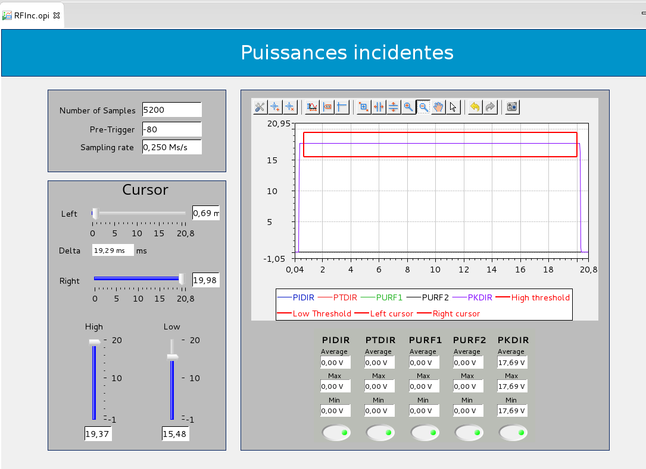
conclusion
We are ready for the coupler
conditioning test
Many thanks to ESS ICS
support and efficiency
| PAGE 13

