Slide 1
Fast Orbit Feedback at the Australian Synchrotron
Andrew Starritt

Slide 2
AUSTRALIAN SYNCHROTRON

Slide 3
FAST ORBIT FEEDBACK - INTRODUCTION
System Overview (Final)
EPICS FPGA Interface
Testing Environment
Beam Quality Monitoring

Slide 4
OVERVIEW
Project 2182: to build an FPGA based fast orbit feedback system for the facility with a bandwidth of up to 300 Hz.
Aim: Damp the RMS transverse beam position motion to less than 10% of one sigma of the transverse beamsize, up to a frequency of 100 Hz.
In the past 3 years we have designed, built and commissioned most of the system except the firmware for the central feedback controller/processor (FPGA based).
Planed completion is January 2017
Project delayed due to departure of FPGA developer.

Slide 5
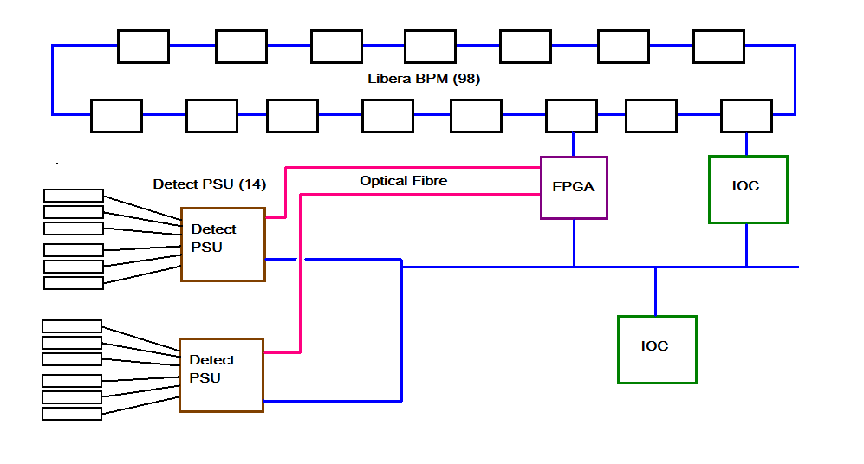
OVERVIEW - SCHEMATIC

Slide 6
OVERVIEW
98 I-tech Libera BPMs
Provides beam position data packet at 10kHz
FPGA – Xilinx Virtex 6
Runs at 10KHz.
Uses inverse response matrix and PI filter to calculate coil corrections.
Transmits corrections over 14 20Mhz optical links
Control data is 12 bit encoding to +/- 1Amp correction
Detect 776 Controller (14)
Each drives six fast correction coils (3 vertical, 3 horizontal)
Optical data converted to RS485 then processed.
Also support network connection for control and monitoring.
Two EPICS IOCs
Primary IOC interfaces to the FPGA and general FOFB control/monitoring
Secondary IOC provides beam quality assessment

Slide 7
VERTICAL FAST CORRECTOR COIL
Vertical Fast corrector coils are tertiary coils.
Primary coils are the sextupole coil windings
Secondary are the slow horizontal corrector coil windings.

Slide 8
HORIZONTAL FAST CORRECTOR COIL
Horizontal Fast corrector coils are tertiary coils.
Primary coils are the sextupole coil windings
Secondary are the slow vertical corrector coil windings.

Slide 9
EPICS IOC to FPGA Interface - Protocol
UDP Interface - simple binary protocol
Standard 6 byte message header
Type, subtype, payload length (< 400), seq number
All numeric values are integer of fixed point.
Fixed size messages (for given message type)
FPGA is server – EPICS IOC connects to the FPGA
No unsolicited messages from the FPGA
All command/request from the IOC get a response
For commands: ACK or NAK
For data/status requests: data/status or a NAK
Main data items sent to/read from FPGA are:
Reference Orbit (2), Inverse Response Matrix (2), PI values (2), System Mode
Secondary data:
Firmware version, serial number, temperature status, test data

Slide 10
EPICS IOC to FPGA Interface
FPGA
Uses built in Ethernet Media Access Controller
Uses a state machine approach for receiving and parsing frames.
Uses FIFO buffer for tx and rx packets
Uses dual access RAM and semaphores to communicate with the “maths” bit.
EPICS
Uses ASYN Port driver
st.cmd: FOFB_FPGA_Configure ("FPGA", "10.42.0.199", 2182)
Three addresses
0 for general communications
1 and 2 for X/horizontal and Y/vertical data respectively
Driver performs all data format conversions (e.g. Floating point to/from fixed point) and data marshalling (e.g. Inverse response matrix [42 x 98] send to/received from FPGA as 42 separate messages.

Slide 11
EPICS IOC to FPGA Interface
Fin IOC, all messages are composed from structs, for example:
#pragma pack (push, 1) // exact fit - no padding
struct Headers { MessageKinds kind; // message kind (type) MessageKinds subkind; // Used as a qualifier or address epicsUInt16 seqNumber; // sequence number epicsUInt16 length; // data length following header };
struct MatrixRowMessages { Headers header; epicsInt32 data [NUMBER_OF_LIBERA]; };

Slide 12
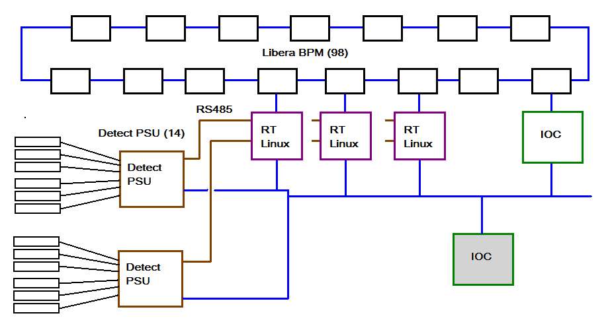
TESING ENVIRIONMENT

Slide 13
TEST ENVIRONMENT
FPGA function provided by 7 Real Time Linux Centos7 boxes.
Each controls 2 sectors/PSU.
Only multiplies-out 6 of the 42 rows of the inverse response matrix.
Communications to PSU is via high speed serial card.
Operates at 5kHz – throws a way every other Libera packet.
Main EPICS IOC present,
Still calculates inverse response matrix
Passively hosts inverse response matrix and reference orbit waveform PVs.
Beam Quality Monitoring IOC still present.

Slide 14
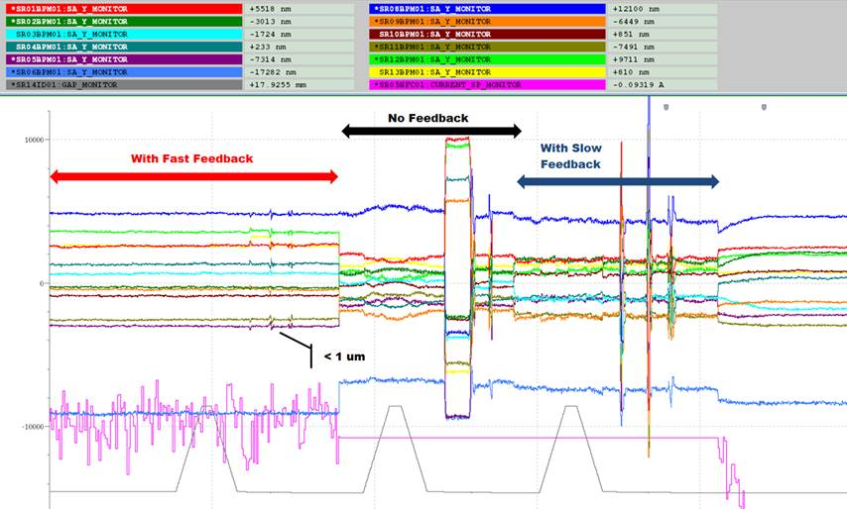
TESING ENVIRIONMENT
Notes:
These results have far exceeded what I thought could be possible with such a system.
Cycle rate: 5 kHz
Bandwidth of the system (unity gain): 320 Hz (H) and 380 Hz (V)
Average integrated RMS noise @ 300 Hz:
Horizontal: 1.6 um (without fb) -> 0.3 um (with fb)
Vertical: 0.55 um (without fb) -> 0.2 um (with fb)
Moved the gap (gray line) and phase of the APPLE2 undulator. Without feedback you see that a portion of the feedforward table did not work (middle of the graph) and led to a large perturbation in the orbit of the beam. Slow orbit feedback cannot keep up with the transition as we change the phase rapidly (2 seconds). The fast orbit feedback is able to cope this all (order of magnitude reduction) of this and keep orbit perturbations to < 1um.
The last little bit with is to show that SOFB and FOFB running together, showing that they are coupling and causing the "DC" to drift.

Slide 15
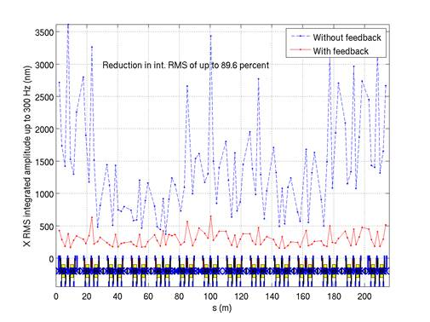
TEST ENVIRONMENT

Slide 16
TEST ENVIRONMENT

Slide 17
BEAM QUALITY MONITORING – REQUIREMENTS 1
Frequency spectra for each BPM for X and Y
High frequency – 0 to 5kHz, 8192 samples at 10kHz
Low frequency – 0 to 312 Hz, 8192 samples at 625 Hz
Each spectra has 4096 elements
Dynamic Orbit Stability
Using low frequency spectra, integrate amplitude up to 110Hz
Inputs:
Threshold value below which spectrum should not be intgrated
Beam size – 1 sigma beam size at each BPM location
Calculate int (x spectra)/ sigma_x, and same for y
Output:
98 element integrated amplitude waveform (x and y)

Slide 18
BEAM QUALITY MONITORING – REQUIREMENTS 2
Orbit Pattern For a Specific Frequency for each BPM, X and Y
Inputs are centre frequency, frequency half span, number of frequencies.
Frequency spectrum calculate using correlation method.
Summed across all frequencies to single 98 element complex vector
Rotated the vector by a single phi value to “rotate the vector”
Phi determined using principle component analysis
Extract the real component of the rotatedvector.

Slide 19
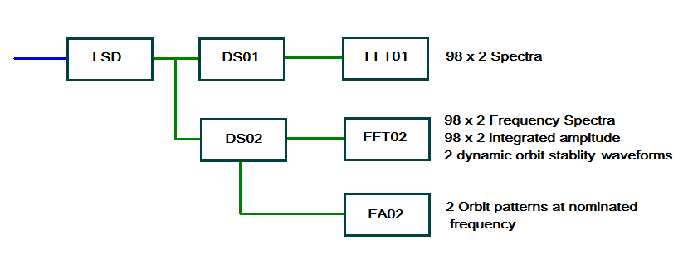
BEAM QUALITY MONITORING – IMPLEMENTATION
Notes:
LSD port – received UDP data packet
DS01/DS02 groups data into 8192 element chunk at 1 second intervals
DS02 also performs low pass filter prior to performing a 1 in 16 decimation.
FFT01/02 perform FFT to generate frequency spectra – in each case the work is divided between 4 threads.
FA02 performs frequency analysis – again work is shared between four threads

Slide 20
BEAM QUALITY MONITORING – IMPLEMENTATION
Flexible configuration via st.cmd file definitions:
liberaSourceDataConfigure ("LSD", "10.9.100.27", 2048)
liberaDataStreamConfigure ("DS01", "LSD", 1, 8192, 1.0, 101)
liberaDataStreamConfigure ("DS01", "LSD", 16, 8192, 1.0, 102)
liberaFourierAnalysisConfigure ("FFT01", "DS01", 8192, 4, 103)
liberaFourierAnalysisConfigure ("FFT02", "DS02", 8192, 4, 104)
liberaFrequencyAnalysisConfigure ("FA02", "DS02", 50.0, 0.5, 11, 4, 106)

Slide 21
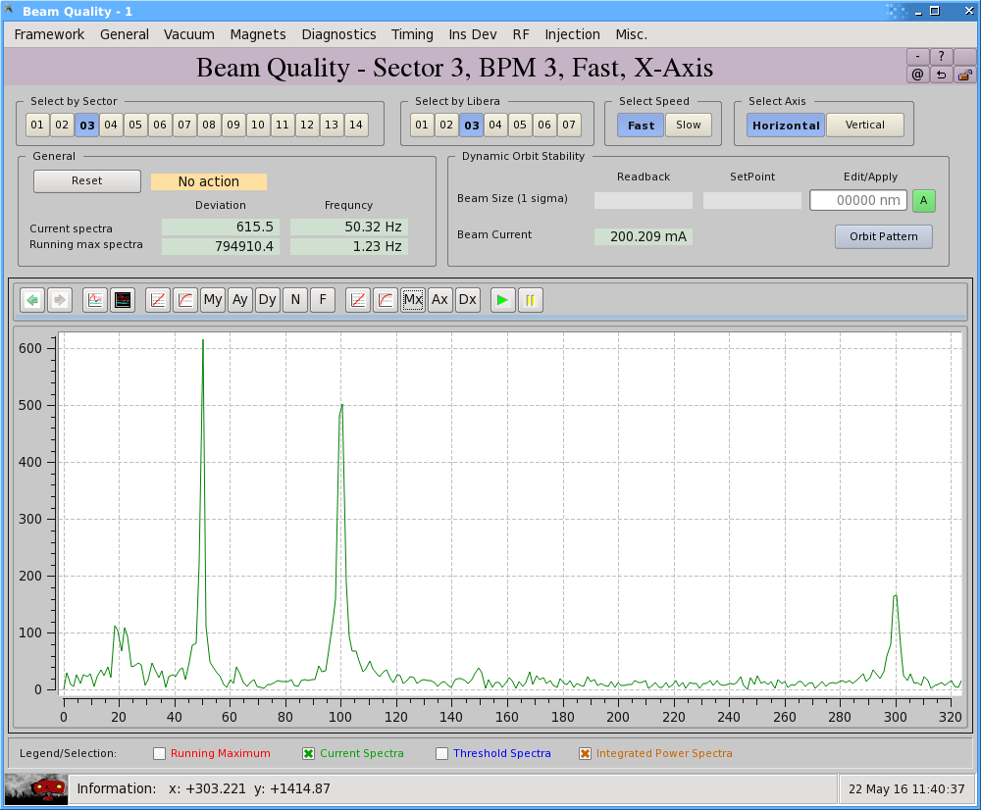
BEAM QUALITY MONITORING – SCREEN SHOTS

Slide 22
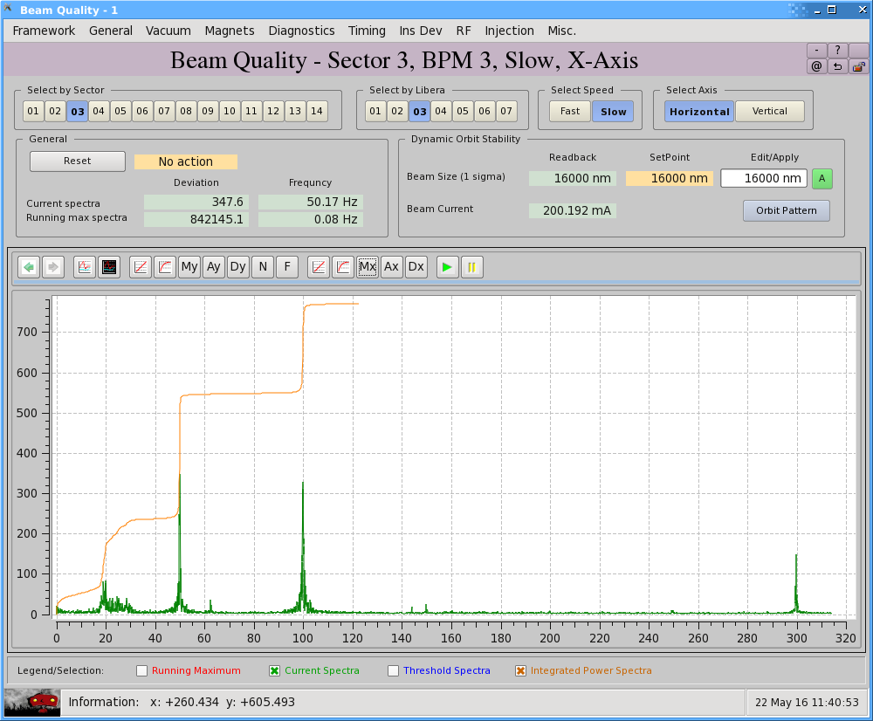
BEAM QUALITY MONITORING – SCREEN SHOTS

Slide 23
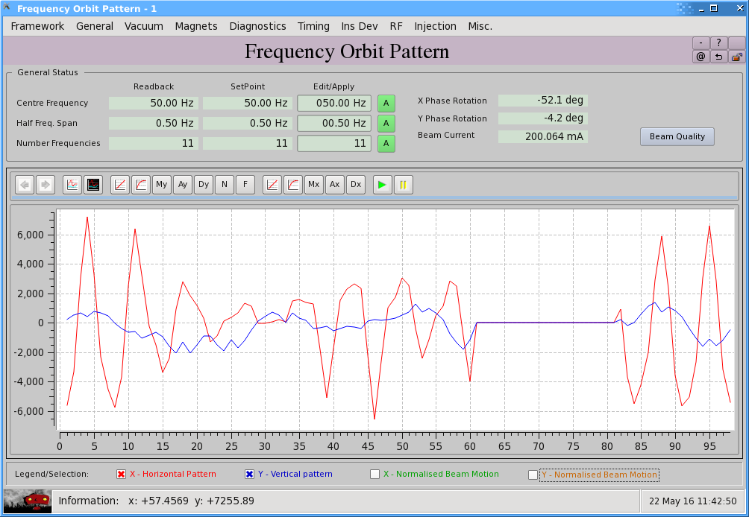
BEAM QUALITY MONITORING – SCREEN SHOTS

Slide 24
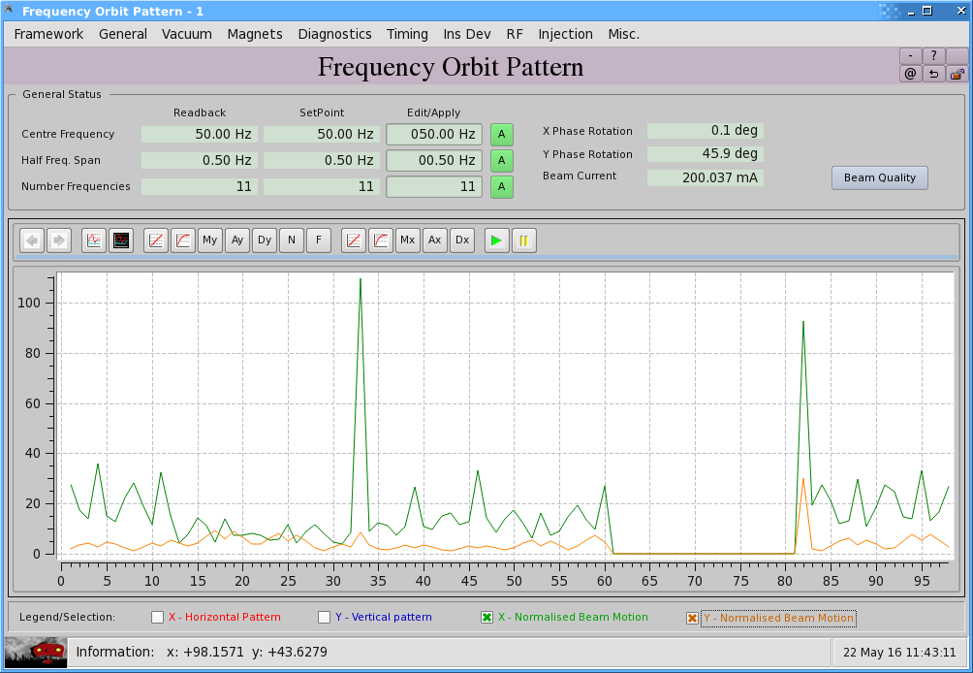
BEAM QUALITY MONITORING – SCREEN SHOTS

Slide 25
Eugene Tan - project manager
Terry Cornall - controls engineer

