Slide 1
PandA/ZEBRA-2: A collaboration to produce a flexible trigger, position-compare and capture box
Chris Turner, Isa Uzun, Tom Cobb

Slide 2
What is ZEBRA?
All-in-one:
Digital signal level converter
Triggering
Position compare
Data acquisition
Developed in 2013 and has been used on numerous beamlines.

Slide 3
What doesn’t ZEBRA do?
Analogue
Signals < 20ns
Absolute encoder protocols
Sequencing
Multi channel Position Compare
Table-based Position Compare
Low latency data transfer
High bandwidth data transfer
Offer more FPGA resources
Notes:
Analogue I/O will be handled by the FMC extension slot in Zebra2
The Zebra1 clock is 50Mhz so the resolution is only 20ns. i.e. it can’t understand anything less than this or produce anything greater than this
The Zebra2 will run at 125MHz (8ns)
Recently people have started using more absolute encoders (higher speed, higher bit rates)
Only allowed for single channel position compare on Z1, Z2 has 4 channels
Table based pos compare allows us to define variable width outputs (defining the start, width, step sizes)
This could be useful for example if we want to examine a particular ROI
TIL input buffer has a propagation delay, for detailed info we can send them the data sheet
Z1 had a RS232 connection, (high latency data transfer). Z2 has gigabit ethernet

Slide 4
PandA Project Collaboration
ZEBRA
SPIETBOX
« PandA » Motion Project
Started in 2015.
SOLEIL → Electronics and Mechanics
Diamond → Firmware, Software and User IF
Notes:
PandA = Position and Compare = collaboration name
Zebra2 will be the name of the commercialised product from Quantum detectors

Slide 5
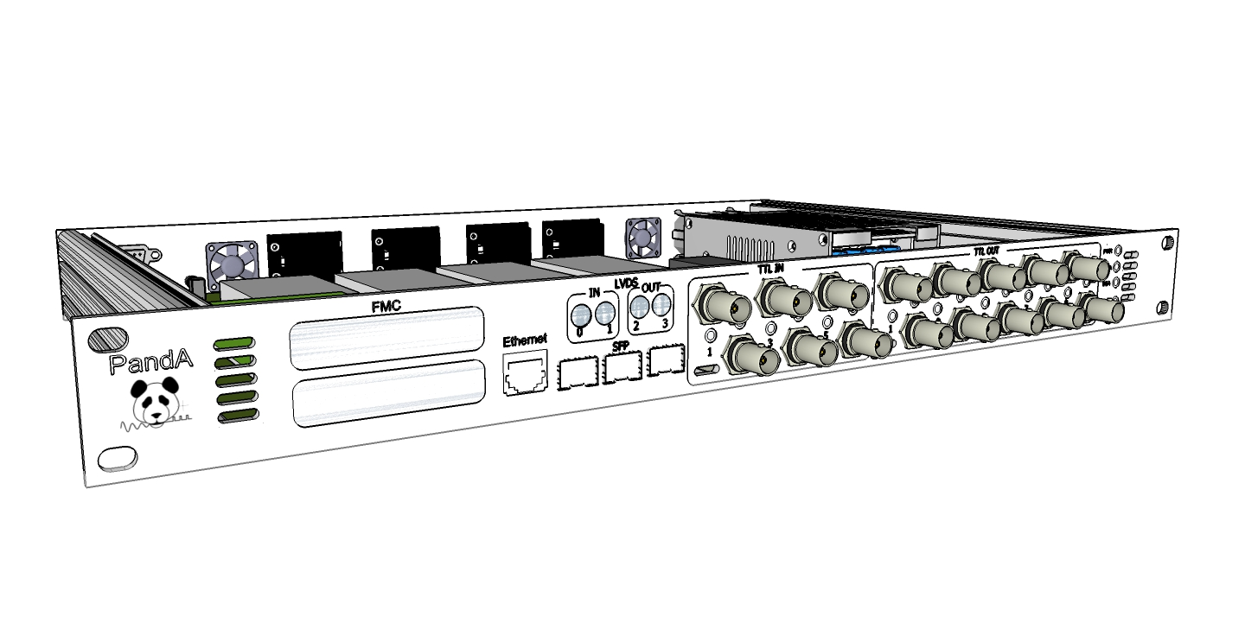
Mechanics - Front
6x TTL Inputs
(Switchable termination)
3x Gigabit Transceivers
(up to 6.5 Gbps)
- Timing/Event Network
- FOFB Comms Network
- Sync Zebra2’s
2x LVDS Input
2x Outputs
1X FMC
Expansion Slot
(up to 68 I/Os)
- Analog I/O
- Digital I/O
10x TTL Outputs
Gigabit
Ethernet
Notes:
TTL = 0->3.3V
Connected / protected via buffer
In the order of 10s of MHz
Depends on cable length
LVDS = Low Voltage Differential Signal
Standard defined impedance (no worries about impedance matching)
Takes out common mode noise
Can run 600-800MHz
Long cables
FMC = expansion slot
Analogue /Digital inputs can be put here
We will support the LPC standard
This is done because Zynq only has 138 pins (LPC is 68 pins, HPC is 200)
We will support (firmware/ software) a DTAC ADC module (8chan, 18 bits, 1meg sample/sec)
We are also making (inhouse) a 24V FMC to interface with the GeoBrick
GigaBit Trancievers = optical signals
Up to 6.8GB/s supported on the Zynq
OTHER:
There was a bit of design work to fit everything on the board. Extra, low cost ‘house keeping’ FPGA used to control things like the LEDs, etc

Slide 6
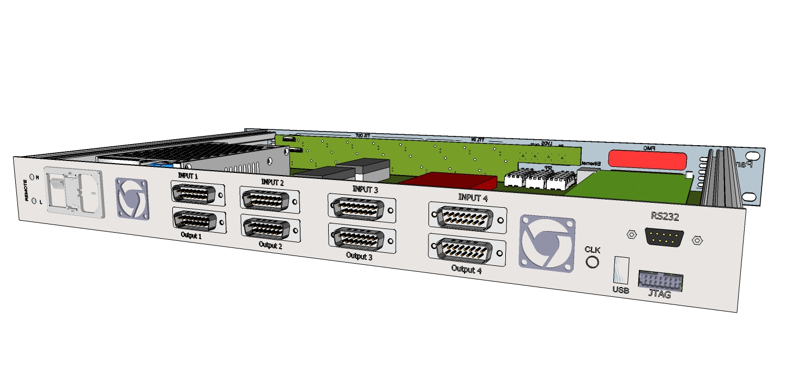
Mechanics - Rear
4x RS-485 Encoder Interface
- Incremental
- SSI
- BiSS and EnDat
External
Clock
RS232
Console
USB
Notes:
RS232 = ‘back door’ interface to ARM processor
Can be used if things go wrong
USB
Also accesses the ARM
Used for e-keying (security)
Also used for installation of packages, firmware, configuration
bIss/ eNdAT, SSI = absolute encoder techniques

Slide 7
FPGA Architecture
Processing
System
Programmable Logic
Software
Layers
IP
IP
IP
IP
Kernel Driver
IP
Linux
IP
AXI
Interconnect
ARM
Dual Cortex-A9
IP
IP
Large set of highly configurable IP Blocks
Fully rewirable (in run-time) architecture
Notes:
IP blocks = “Intellectual property”
These are ‘ACTIVATED’ by the user (going solid)
Own embedded linux kernel
XiLinx kernal + busybox
Uses Zynq (XiLinx) Fpga + ARM
Fixed functionality (IP blocks) we implemented, but you have flexible routing
Flexible routing = wire together different components in a number of different ways
Programmable Logic = Our implementation
AXI INTERCONECT = register interface for ARM processor
ARM BUS interconnect standard

Slide 8
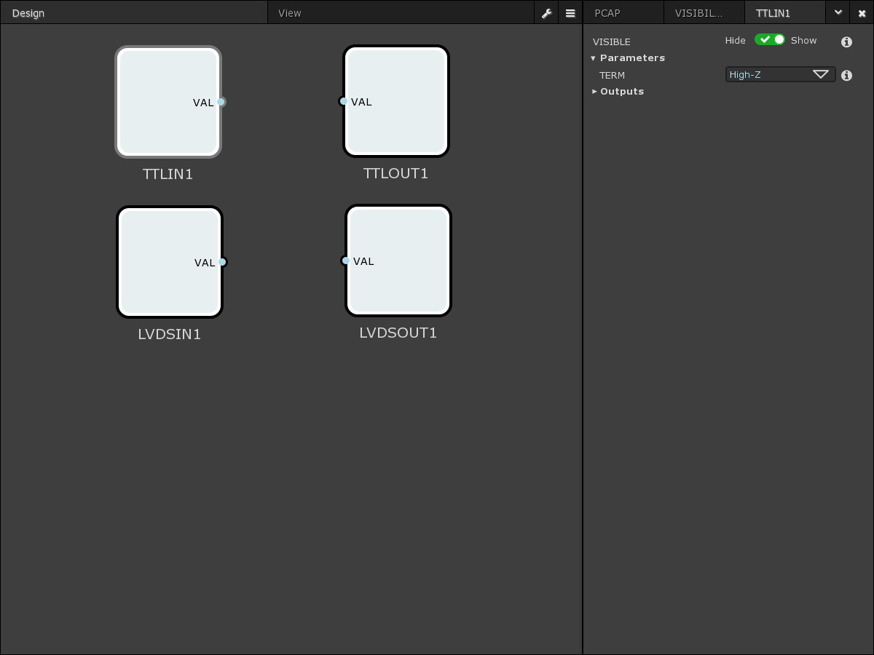
TTL/LVDS IN and OUT
Connections to the outside world via front panel
All registered, synchronous to the system clock
Assigned onto the internal BitBus for rewiring

Slide 9
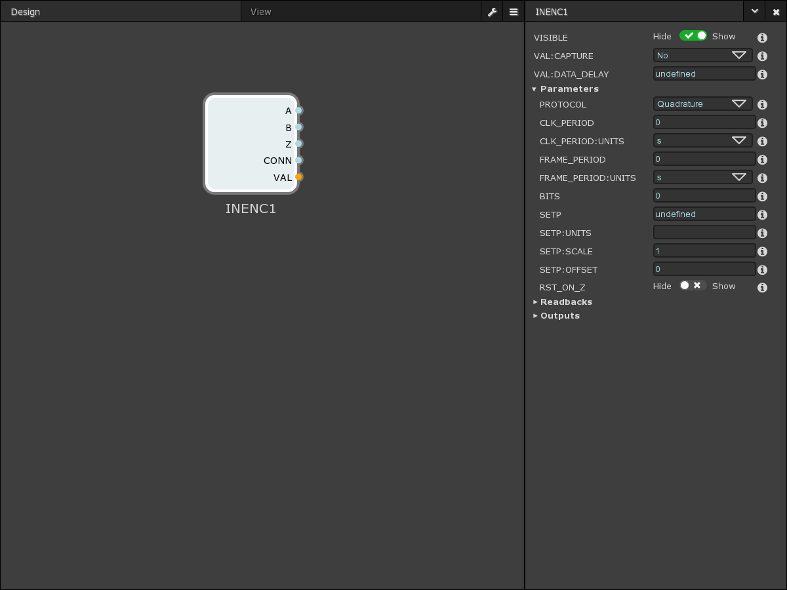
Input Encoder [x4]
Input connections from back panel (RS-485)
Support for Quadrature, SSI, BiSS and EnDat
Run-time protocol, bit-width, rate configuration
Assigned onto the internal Position Bus for rewiring

Slide 10
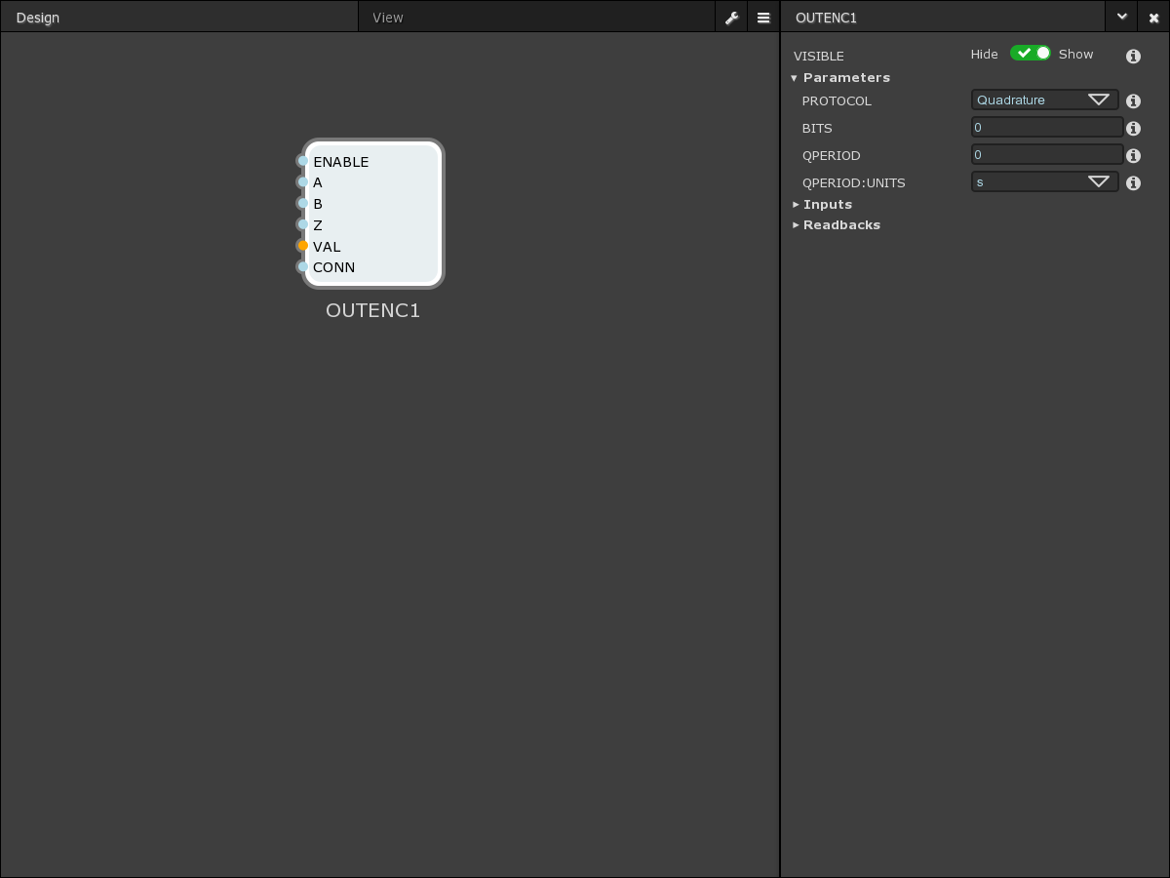
Output Encoder [x4]
Output connections to back panel (RS-485)
Support for Quadrature, SSI, BiSS and EnDat
Run-time protocol, bit-width, rate configuration
Rewired from the internal Position Bus

Slide 11
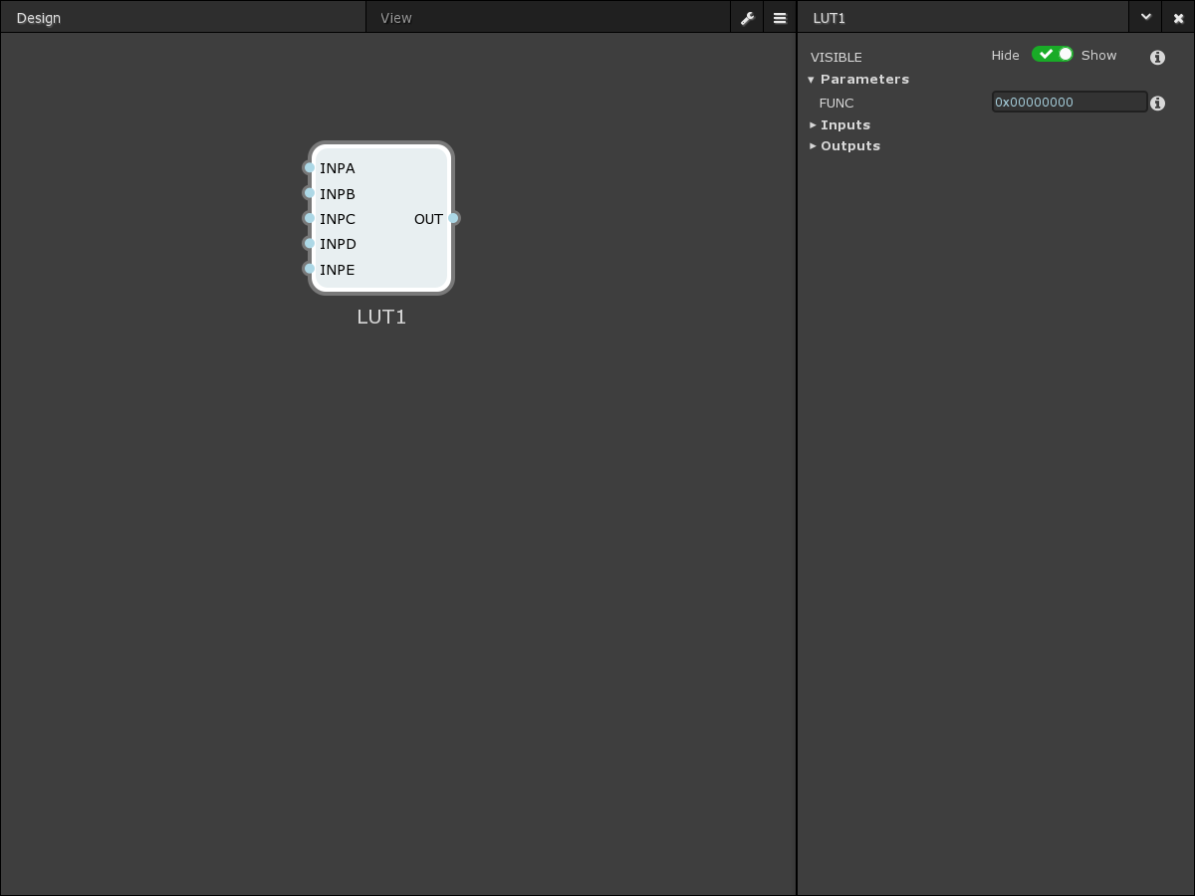
LUT [x8]
Truth tables up to 5 variables.
OUT = (A?B:C)=(A&B|~A&D)
An improvement to fixed AND/OR gates.

Slide 12
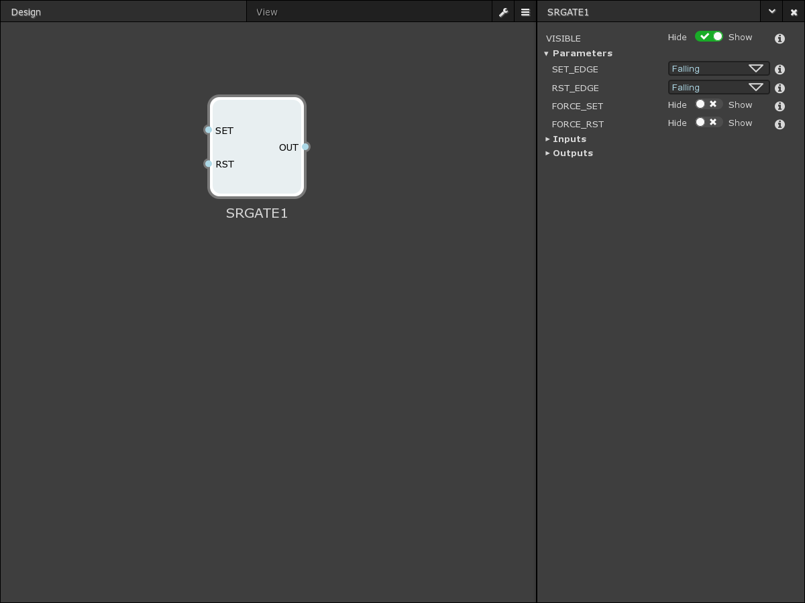
SRGate [x4]
Produces either a ON or OFF output
Soft force inputs
Edge sensitive triggering

Slide 13
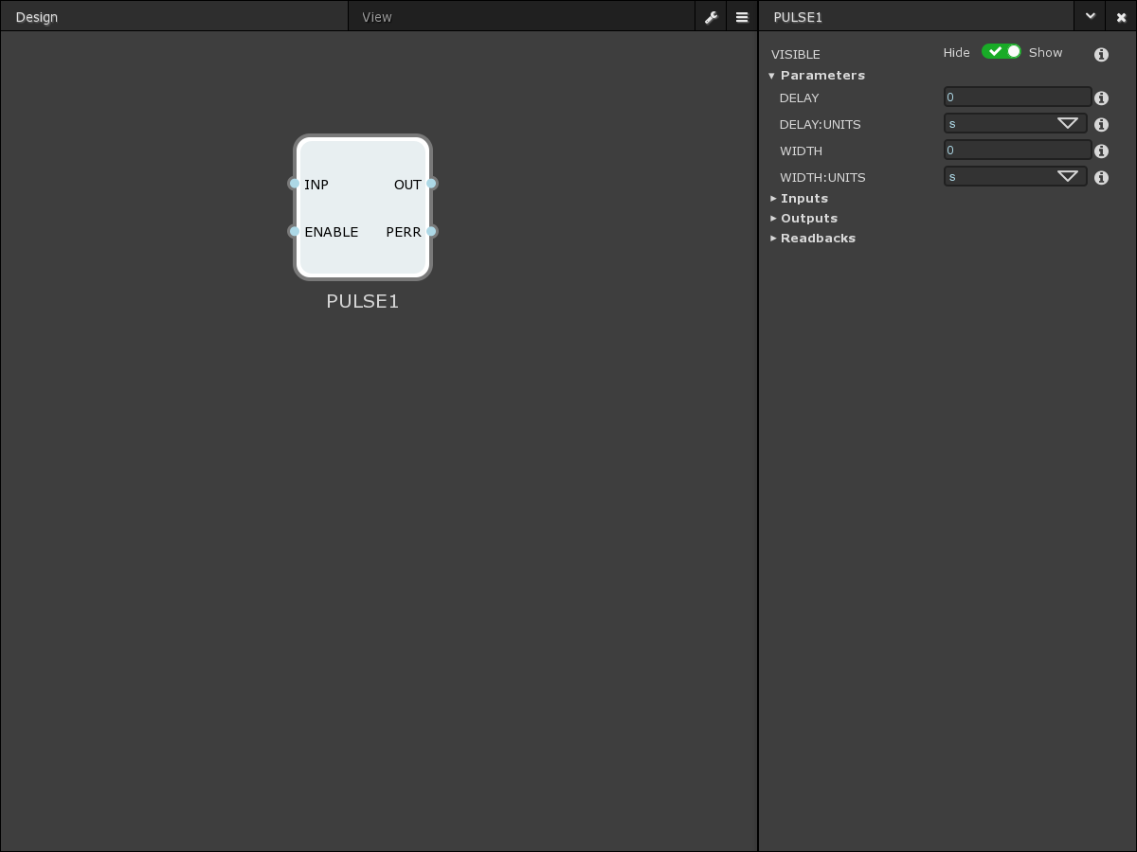
Pulse Generator [x4]
Produces configurable WIDTH output pulses with an optional DELAY
Zero-WIDTH, Zero-DELAY possible
Support for pulse trains (up to 1024 pulses).
Notes:
Modifies input pulse
1 shot pulse generator (needs input to produce pulse)
The 1024 support is for pulses that come in while it is processing a pulse (a queue)

Slide 14
Pulse Divider [x4]
32-bit pulse divider that can divide a pulse train between two outputs
First Pulse output configuration
Notes:
Just divides pulses, does not modify them

Slide 15
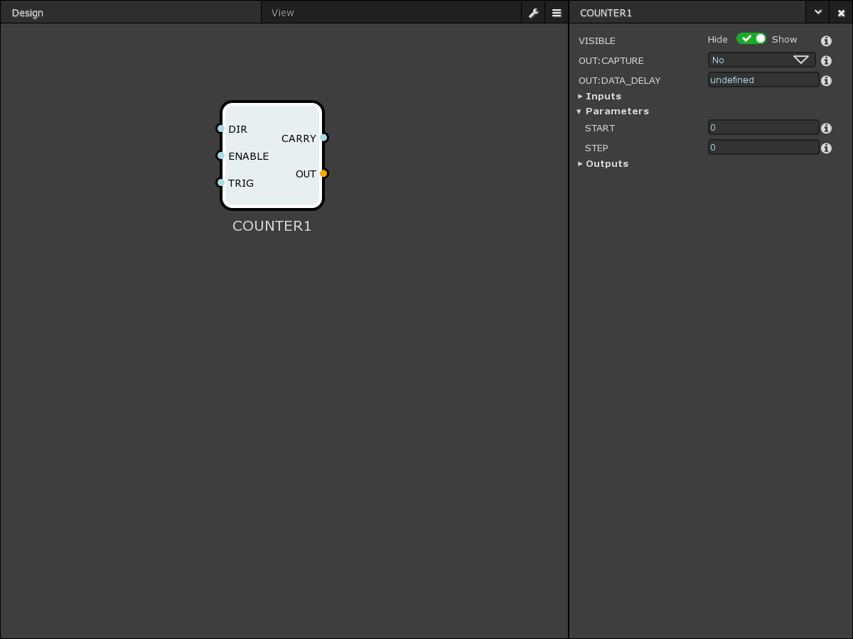
Counter [x8]
Counts Up/Down from START with STEP on the rising edge of trigger input
TRIG input is edge sensitive*

Slide 16
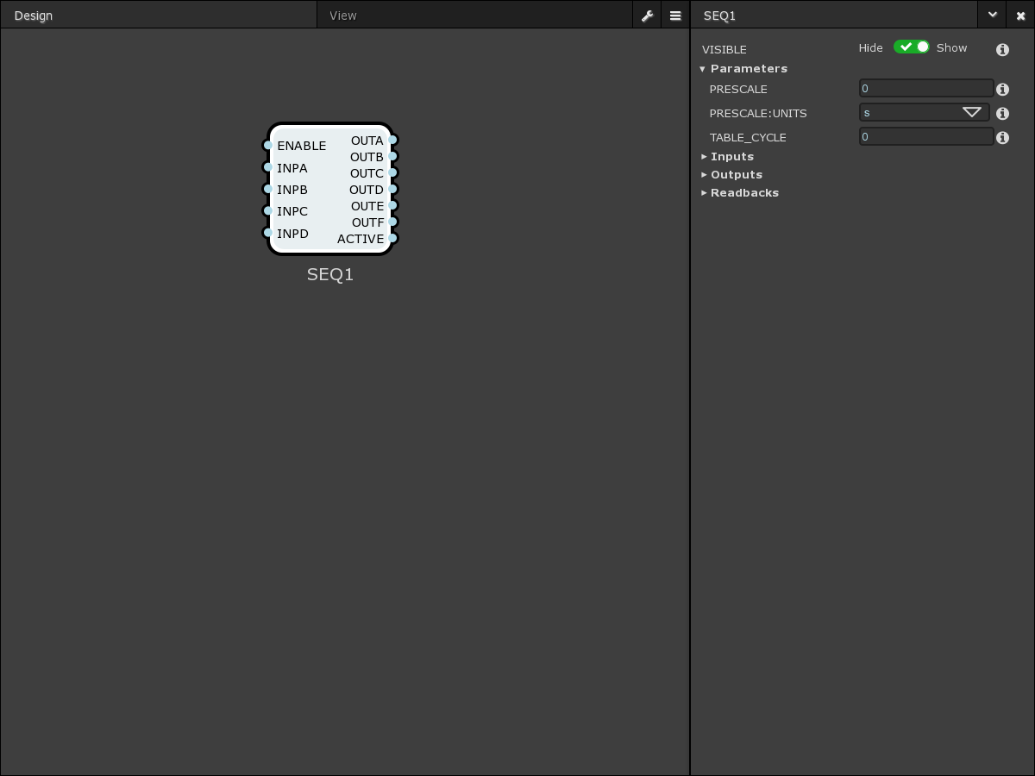
Sequencer [x4]
Performs automatic execution of sequenced frames to produce timing signals
4 Trigger Inputs and 6 outputs with 2 Phases
Supports up to 1024 frames
Notes:
One of the big improvements over the Zebra1
Used for producing time duration pulses from an input pulse
E.g. from a gate signal from a position compare block we can produce a set number of time domain pulses
…

Slide 17
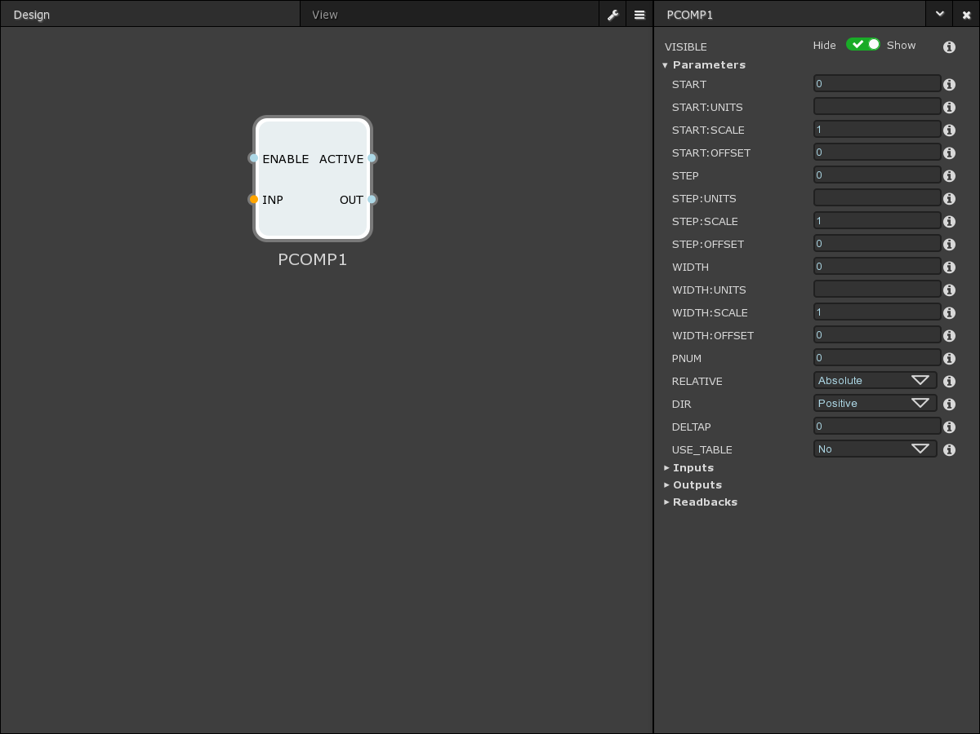
Position Compare [x4]
Rewirable input from Position Bus
Linearly spaced pulse outputs (START, STEP and WIDTH)
Irregular pulse outputs using a user-defined table
Notes:
Used for fly scanning
Used to create triggers
Triggers when a motor matches a predefined START position
Configurable direction

Slide 18
Capture
Can capture EVERYTHING* internal
Capture and Frame modes of operation
Pay attention to data throughput, limited by GigE.
(Trigger Rate x Number of Fields)
Notes:
Used to capture everything that has been selected in configuration
Data capture is transparent to the user, it is made available through TCP server on DATA port
Geth = GigE *DON’T NEED TO MENTION THIS
Limitation = can’t really get all fields @ max trigger rate (can lower trigger rate, or get less fields)
Most important fields: ENC, ADC, COUNT
Triggers don’t have to be external (user defined)
Kernel level driver

Slide 19
ADC
Commercial FMC module
8 Channels, 18-bit @ 1MSps
Average, Sum and Difference modes of operation
Wired through the Position Bus

Slide 20
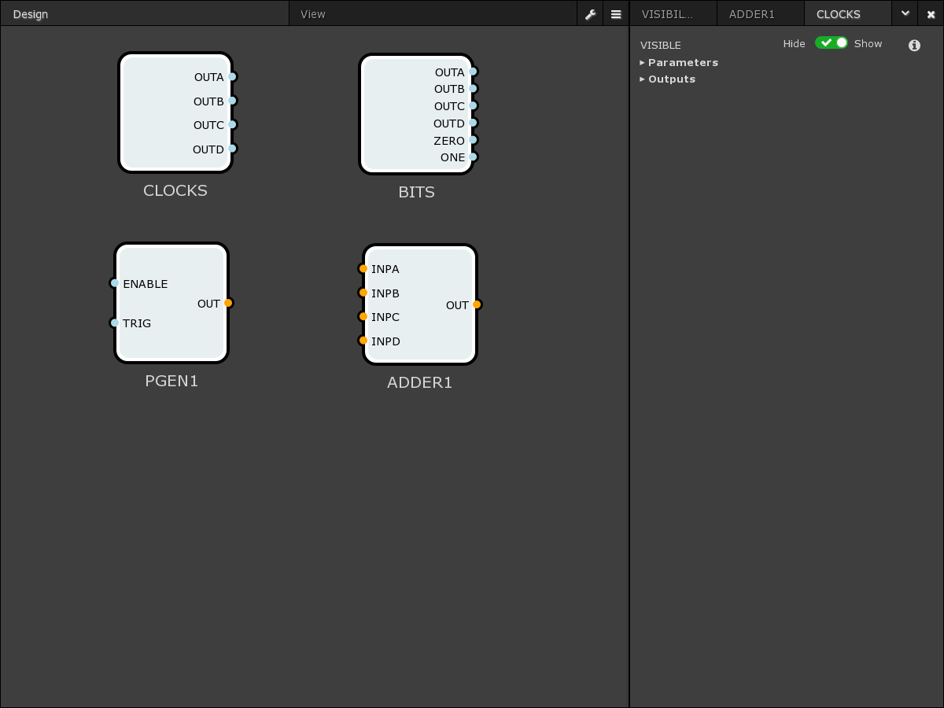
Misc Blocks
[4x] Clocks
[4x] Soft Bits
[2x] Table-based Position Generator
[2x] Position Adder

Slide 21
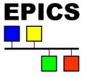
Software Architecture
Setup
Run
Web GUI
EDM /
CS-Studio
HDF File
Websocket
CA
File
Web Server
EPICS
TANGO
TCP
TCP
TCP
TCP
TCP Server
Control
Data
Notes:
Main point to mention here is that it can be run on or off the box. You can create static EDM/CS-STUIO / EPICS applications for particular experments/ configurations (e.g. position capture).
The use case is then – setup via web gui, create static EPICS application for something (e.g. pos capture) exposing only the subset of things to configure that are needed. It then can be used as a position capture box.
Setup via Python based web gui
This gives us the flexible routing options
Fixed configurations at runtime ? (is this the specific screens for specific tasks ?)
Webserver – run on / off box
When run off box allows setup of areadetector plugin chain for file writingSave / load functionality
TCP server – from next slide (don’t need to say much except it has control port for configuring registers, controlling and data for reading data)
EPICS interface
There will be a generic EPICS driver delivered (areadetector)
There will be the possibility to create some fixed, specific databases and screens that use the generic driver
Fixed block setup for common use cases
Static CS-Studio or EDM GUI
Connects to DATA port
areaDetector driver produces NDArrays that are written to HDF file
Used for runtime
TANGO will be similar for SOLEIL
WHAT WILL DIAMOND DELIVER:
Box with webserver and tcp server running

Slide 22
TCP Server
Control
Interfaces to FPGA over registers
Publishes socket endpoint with simple ASCII command response protocol, E.g.
TTLIN1.TERM=50-Ohm
OK
Block structure defined in configuration file
Data
Received from FPGA via DMA using kernel driver
Publishes socket endpoint with ASCII, BASE64 or BINARY data frame encoding
Server

Slide 23
Web Server
Malcolm
Publishes websocket endpoint with JSON protocol
Block structure defined by querying TCP server
Save/Load functionality
Can be run on or off the box
When run off the box allows setup of areaDetector plugin chain for file writing

Slide 24
EPICS Interface
Fixed block setup for common use cases
Static CS-Studio or EDM GUI
Connects to DATA port
areaDetector driver produces NDArrays that are written to HDF file
Used for runtime
TANGO will be similar for SOLEIL

Slide 25
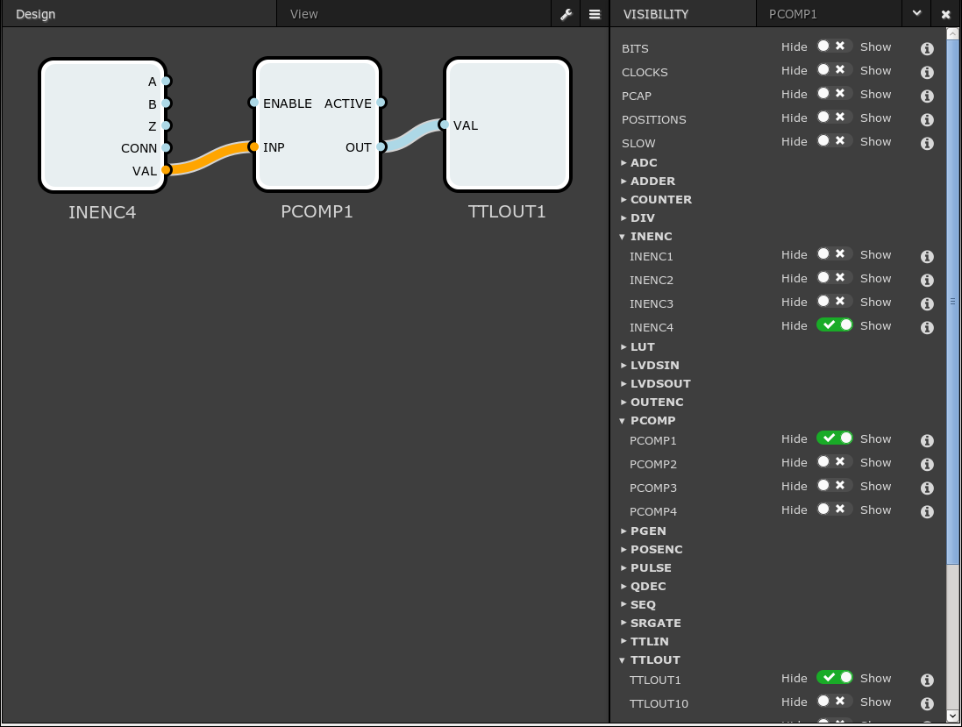
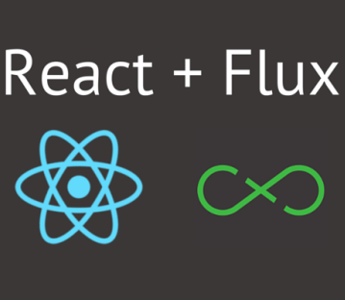
Web GUI
Rewiring of blocks
Setting parameters
Save/Load
Used for setup
Notes:
Orange line = databus
Blue line = Bitbus
Select which blocks you want, these are displayed for editing

Slide 26
Scientific Applications
Proposed use cases:
Snake scan with time based pulses
Averaging ADC values between position based pulses

Slide 27
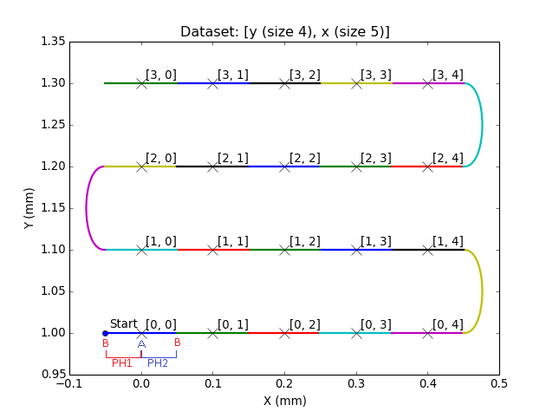
Snake scan with time based pulses
Position compare to start each row
Regularly spaced time based pulses within each row
Reverse alternate rows
Capture motor positions at centre of each frame
Notes:
Position compare blocs are triggered at the start of each run. The sequencer then generates the frame pulses (to trigger the detector on TTLout1) and the capture pulse
Explain what we want to do:
Detect the start of the row, produce time based exposure triggers for camera and capture in the middle of those frames
We want to do this for each row (forwards and backwards)

Slide 28
Snake scan with time based pulses
2 PCOMP blocks produce start of row
SEQ block produces time based pulses
Trigger Detector
Delay ½ (exposure) for PCAP
Notes:
LUT is just an OR (so we get both pulse trains through)

Slide 29
Snake scan with time based pulses
Position compare to start each row
Regularly spaced time based pulses within each row
Reverse alternate rows
Capture motor positions at centre of each frame
Ph1 t | Ph1 Out |  | Ph2 t | Ph2 Out
(ms) | A | B | (ms) | A | B
100 | 0 | 1 | 100 | 1 | 0
Notes:
Position compare blocs are triggered at the start of each run. The sequencer then generates the frame pulses (to trigger the detector on TTLout1) and the capture pulse
Relate back to how we do it with sequencer now

Slide 30
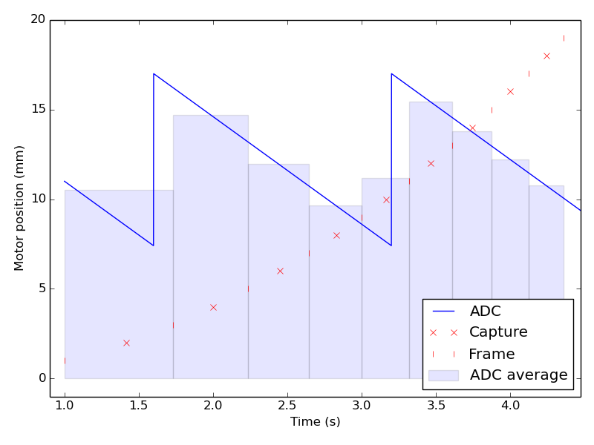
ADC Averaging
Non-linear motor velocity
Regularly spaced position based pulses
Capture motor positions at centre of each frame
Capture average ADC value over frame
Notes:
MAIN POINT HERE is to average ADC over irregular frames
This example when we want to also capture the beam current
Because the current isn’t stable, we want to average it
Frame signals come from one pcomp, capture from other
The pcap averages over the frame if there is a capture signal in it

Slide 31
ADC Averaging
PCOMP1 produces n+1 frame signals
PCOMP2 produces n capture signals
PCAP set to average ADC value over frame
PCAP set to capture Motor

Slide 32
Future upgrades
FMC
In-house 24V I/O (to geobrick)
Commercial ADC
Gigabit Transceivers
Sync multiple Zebra2s.
Timing system interface
Quantum Detectors will commercialise
Notes:
24V I/O FMC for Geobrick interface – developed inhouse
-Potential QUestions:
--NAMING: zebra2 = name of box as comercialised by Quantum Detectors, PandA (Position and Acuqisition..?) = collaboration with Solei
--COMMERCIALISATION: it will be Open hardware, so can build your own, but will also be commercialised by Quantum Detectors - will also provide support
**IF SOME ONE ASKES ABOUT DEVELOPING OWN FMC MODULE
There will be the support for this through Quantum detectors, but there is also the option of using the open hardware platform (with no formal support)
--timing system integration -> uses EVR core and has timing event network ports
---*this is a future plan though and is not fully developed
--COST: we can't give an exact estimate as there are no prototypes yet and we don't know the quantities but it is planned to be in the 1000s of pounds.
AVAILABILITY:
Prototypes under development now
Q2 2017 from quantum detectors
Technical hardware questions, we can send datasheet
Technical TCP server questions, Michael Abbot

Slide 33
Thank you for listening

