Slide 1
Device support for VMIVME-5565 and its usage at KEK
Hiroshi Kaji (KEK) Yuichi Iitsuka (EJIT)

Slide 2
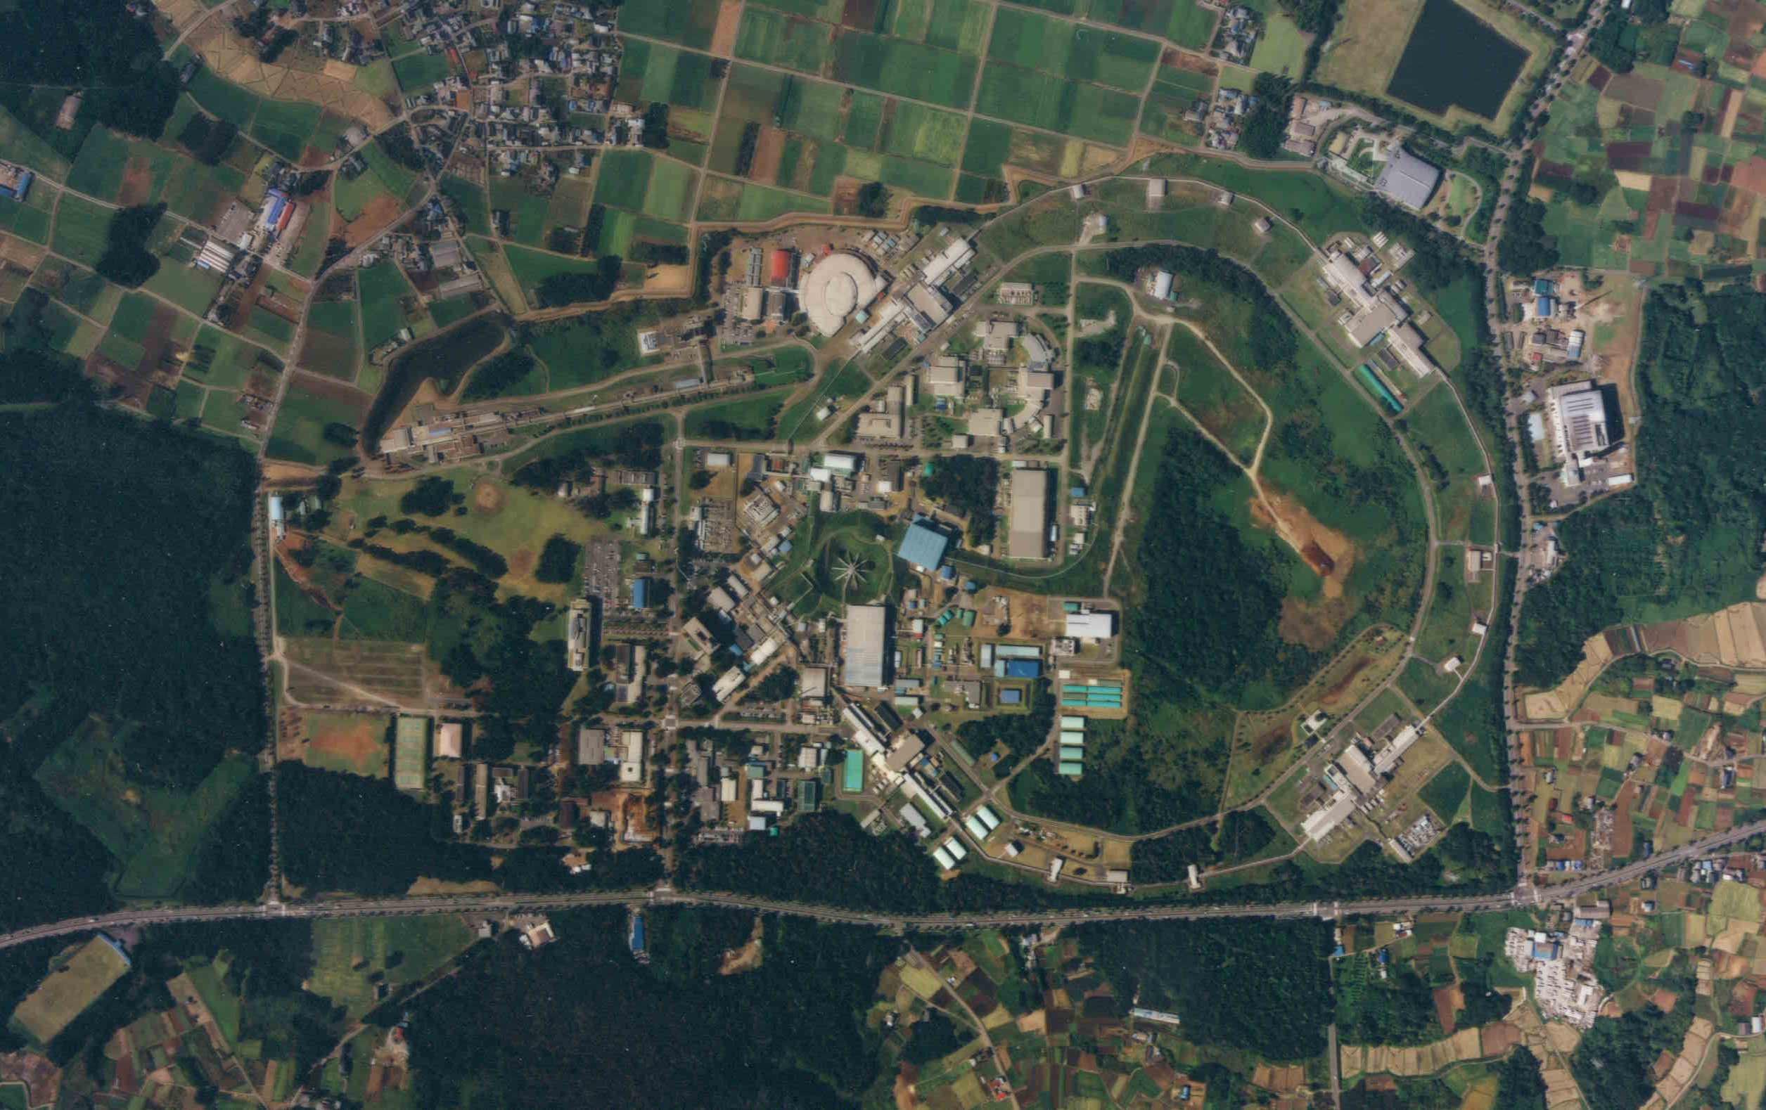
Motivation for Distributed Shared Memory
For Rapid and reliable communication among accelerators complex at KEK Timing of the injector is controlled from Main Ring (CCB) in 50Hz (frequently) to select injection RF-bucket to equalize charges of all bunches
Main Ring
Injector
Main Timing Station
Central Control Building
We used the other distributed shared memory for KEKB era (1999-2010) We are using the reflective memory, VMIVME-5565, for SuperKEKB (2016-)

Slide 3
VMIVME-5565 and Dedicated Optical Connection
Distributed Shared Memory in the VME type. Data written on memory are synchronized on those of all other nodes. Totally 255 nodes are possible.
VME-5565
VME-5565
VME-5565
TX
RX
In our case, the network is configured with three nodes (show them later).

Slide 4
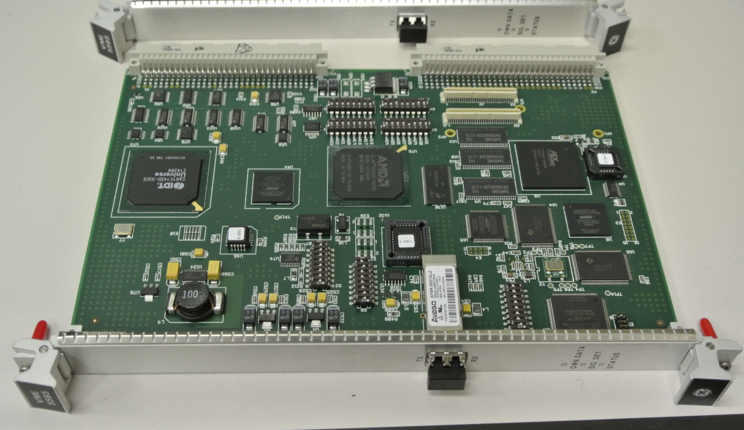
VMIVME-5565
Standard 6U module with distributed shared memory
https://www.abaco.com/products/vme-5565-reflective-memory
Up to 128MB memory Transfer rate ~174MB/s Up to 256 nodes Network interruption VMEbus DMA support
Two LC connectors (TX and RX) single/multi modes possible
We developed the EPICS device/driver support.

Slide 5
EPICS Records for Data Synchronization
The “flexo” record read from the reflective memory. The “flexi” record write to the reflective memory.
Node: N
Node: M
record(flexo,"PV name") {
field(DTYP, "flexo5565")
field(FTVL, "YYY")
field(OUT, "#C0 S0 @0xXXXX")
}
record(flexi,"PV name") {
field(DTYP, "flexi5565")
field(FTVL, "YYY")
field(INP, "#C0 S0 @0xXXXX")
}
The memory address to be read/write is set on “OUT”/“INP” field as offset address. All types of data except for “STRING” can be set on the “FTVL” field.

Slide 6
Network Interruption
The network interruption is launched by one set of “inttx” and “intrx” records. The “intrx” is processed when the “inttx” on the other node is processed.
Node: N
Node: M
record(inttx, "PV name") {
field(DTYP, "inttx5565")
field(OUT, "#C0 SX @")
field(NID, "M")
field(VAL, "Y")
}
record(intrx, "PV name") {
field(DTYP, "intrx5565")
field(SCAN, "I/O Intr")
field(INP, "#C0 SX @") field(VAL, "Y") field(FLNK, "PV name")
}
The four kinds of network interruptions can be defined with X = 1-4. The node to be interruted is set on the “NID” field. If M>255, all other nodes are interrupted. The “VAL” field can be copied when the interruption is launched.
This can be used as the interruption ID.

Slide 7
Software Release Plan
We developed device/driver support and confirmed stability with EPICS ver 3.14.12.1 (possibly works in other versions). We plan to release software and manual soon. (I hope before next collaboration meeting).

Slide 8
Injection Bucket Control at KEK
D7
Main Ring
Injector
We start operation in Feb 2016. No trouble for injection control for 4 months.
Main Timing Station
Central Control Building
Interaction Point
IOC Main Timing Station Adjust injection timing for selecting RF-bucket
IOC Central Control Indicate injection RF-bucket
IOC D7 Measure charge of individual bunches
CPU
EVG
EVR
EVG
EVG
RM
CPU
RM
CPU
BCM e–
RM
BCM e+
Optical Cable

Slide 9
Time chart
One turn of network interruptions in every 20ms (50Hz) Injector ⇒ Main Ring ⇒ Injector
Injector Linac Node
Central Control Node
①Write data into reflective memory (put values on flexo records) AC50Hz phase Ring: e+ or e– and so on … ②Network interruption (process inttx records) ⑥Set delay to EVG (processed by intrx record) (using information in flexi record)
③Decide injection bucket (processed by intrx record) (using information in flexi record) ④Write data into reflective memory (put values on flexo records) delays of LINAC operation and so on … ⑤Network interruption

Slide 10
Summary
We utilize VMIVME-5565 for injection control in the KEK accelerators complex. We develop device support for EPICS. - data synchronization - network interruption We confirmed stable operation for 4 months: - EPICS: 3.14.12.1 - CPU: MVME5500 and MVME6100 - OS: VxWorks6.8.3 We plan to release software and manual. We hope we can announce soon.

