Slide 1
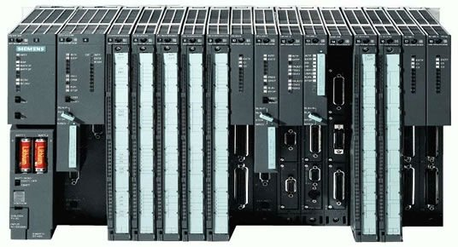
ASYN based S7 PLC Driver
Jignesh Patel
Ralph Lange, Bruno Evrard, Prasad Sawantdesai*
ITER Organization
Control System Division
*Tata Consultancy Services

Slide 2
Contents
Slow Controller development
Slow Controllers : S7 PLCs
Data flow – System Perspective
s7PLCAsyn Driver
Status and Features
Communication Model
CODAC Frame
Redundant PLCs
Event Interface
Standard PLC Software Structure (SPSS)
Development and Integration
PLC Application Development Workflow
SDD Generated Software Unit
Deployment
Plan

Slide 3
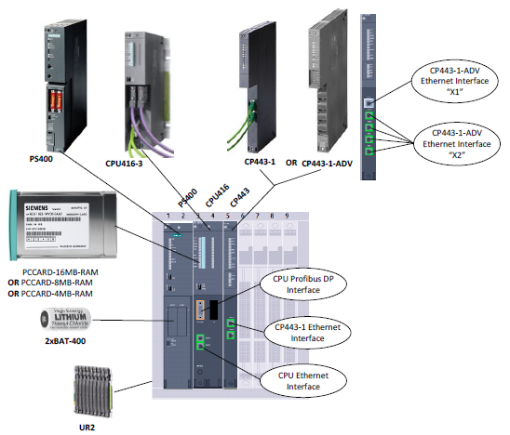
ITER’s Slow Controller: S7
Hardware catalogue defines S7 for Slow Controller
S7-400 & S7-300, Fail Safe (F), High availability(H)
CODAC Core System uses the PSI S7PLC + ITER Extension support and the newly developed s7PLCAsyn support

Slide 4
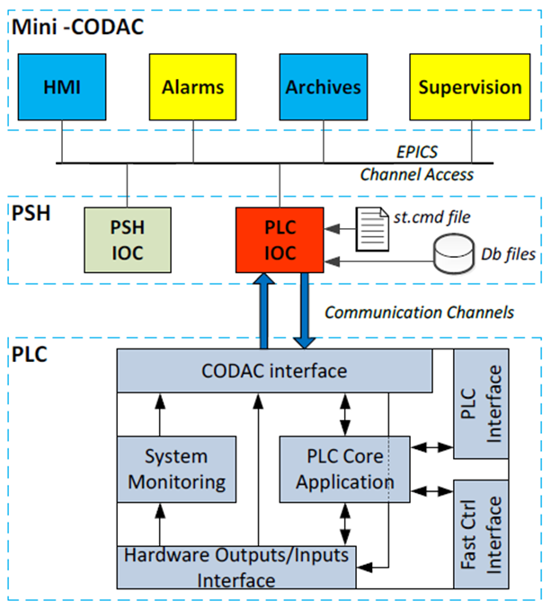
Data Flow

Slide 5
s7PLCAsyn status
Latest release will be v1.3 with CODAC Core System v5.3, in distribution from CCSv5.0
Support existing driver functionality i.e. Block transfer with ITER Extensions, new features
Single PLC
Redundant PLCs
Different communication channels state & configuration, simple command, event
CODAC Frame in block transfer – to support system health monitoring and smooth integration

Slide 6
s7PLCAsyn status
Native S7 protocol support using nodave (Block, single variable)(cont...)
ISO-on-TCP support using interpose layer (cont...)
……
……

Slide 7
s7PLCAsyn Features
Modular design due to ASYN
Generic ASYN device support on top of drvAsynIPPortDriver
Swappable Low level protocol drivers without changing EPICS database
i.e. INP and OUT links are independent from the protocol being used
Scalable for new features and protocols

Slide 8
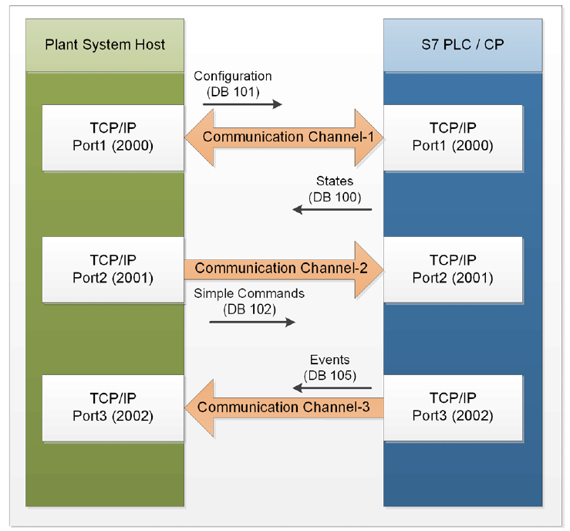
Communication Model

Slide 9
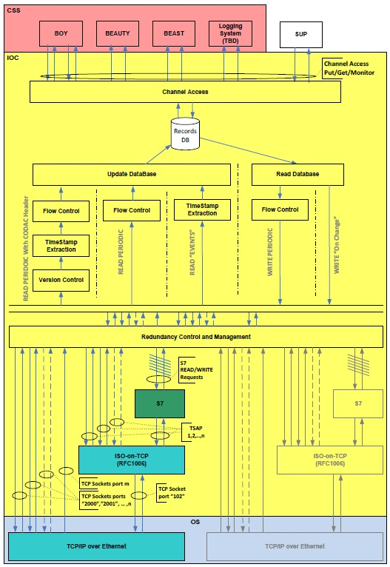
Communication Model

Slide 10
Communication Model – PLC to PLC IOC Interface
States (from PLC)
as fast as possible
50ms for Redundant PLCs
State CODAC Frame
Configuration (to PLC)
Every 100ms, on change
Configuration Control on start of IOC to avoid reset of PLC using auto save functionality
Simple Commands (to PLC)
Every 100ms, on change
Sets a Boolean variable to “TRUE”, using “HIGH” field for reset.
Push-button like functionality
Event (from PLC)
Time-stamped bool events, on change
Captures all changes in PLC with PLC cycle resolution
Event CODAC Frame

Slide 11
Redundant PLCs
Port driver uses two TCP connections to Redundant PLCs using IPPort driver
i.e. state/configuration channel and Simple Command channel
Records get processed from PLC states with latest time stamps, old timestamp ignored.
Online Redundancy management using the redundancy status bits sent from PLC
Configuration and Simple commands always sent to both PLCs if live and active

Slide 12
Event Interface
Its similar to state interface with some special characteristics.
Interface to capture time stamped Boolean events with order of occurrence.
Time stamped with PLC cycle resolution.
Useful for post diagnostics in case of chain of actions happening fast.
Virtually there is no traffic in absence of Events
Heart beat packet sent by PLC to maintain connection status, but does not trigger record processing.

Slide 13
CODAC Frame
Part of State and Event channel block transfer
Supported by SPSS (Standard PLC Software Structure), nothing but standard PLC Application
PLC Timestamps
Communication Block length
Alive counter (states), Frame counter (event), Heartbeat (event)
Application version to ensure consistency between PLC and IOC (states)
Redundancy status i.e. Master, Slave, Active, Valid (states)
Header, Footer
NTP status bit (event) (partial)

Slide 14
Standard PLC Software Structure (SPSS)
SPSS
PLC Software package, deployed on all PLCs
Implements common architecture for the PLC Software
structured communication mechanism between the PLC and the PSH
Implements communication Interface with CODAC
PLC Interface – OpenIE (TSEND, TRECV)
CP Interface – send/receive (AG_SEND, AG_SECV, AG_LSEND, AG_LRECV)
SPSS Packages are part of CCS release
PLC_Interface
CP_Interface
PLCCP_Interface
Redundant_PLC (CP Interface)

Slide 15
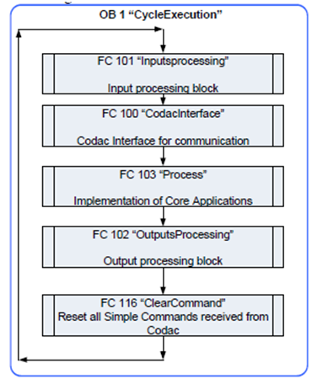
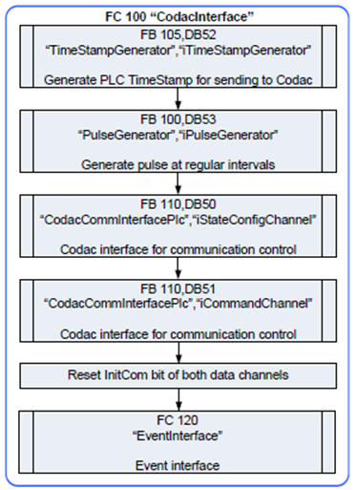
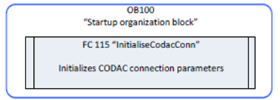
Standard PLC Software Structure (SPSS)

Slide 16
PLC Application Development Workflow
SDD – Self Description Data toolkit

Slide 17
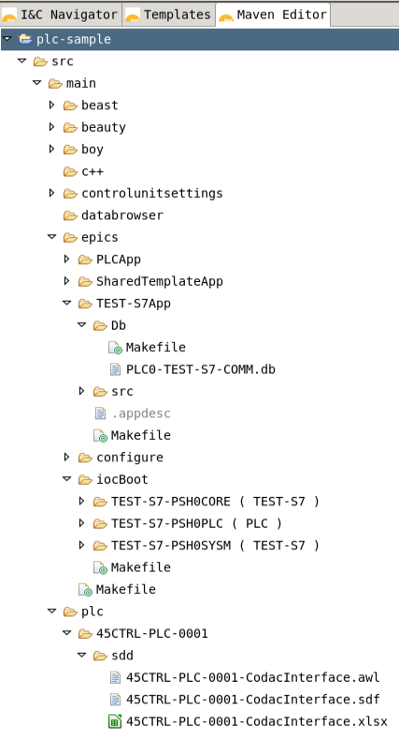
SDD Generated Software Unit
Alarms Configuration
Archives Configuration
Generated HMI
EPICS Records
EPICS PLC IOC
PLC Interface files
awl - interface data blocks
sdf - symbol definitions
xlsx - variable table

Slide 18
Deployment
Mini-CODAC
Mini-CODAC
SDD Editor
Local SDD
Local
File System
OPIs
Alarm
Server
Archive
Engine
SDD Translator:
m-<I&C_Project_Name>/
PLC IOC
(EPICS DB and IOC)
src/main/epics
PSH
PSH IOC
PLC IOC
CODAC Interface Files
(AWL and SDF)
src/main/plc/
PLC
Communication
Processing
SPSS
(S7 Program Standard Template)
/opt/codac/step7/STEP7/<SPSS>.zip
I/O

Slide 19
Plan
Improve redundant driver - lagging tight control/coupling over two IP Port connection made to two redundant PLCs
Complete full featured implementation of S7 protocol support
Solution to overcome 32K data block limit of send/recv communication
To make available pure ASYN S7 driver (independent to CODAC)
….

