Slide 1
EtherCAT at PSI
Dragutin Maier-Manojlovic :: Embedded Systems :: Paul Scherrer Institut
EPICS Collaboration Meeting 2016 – Lund, Sweden

Slide 2
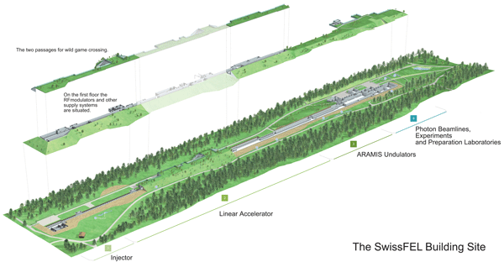
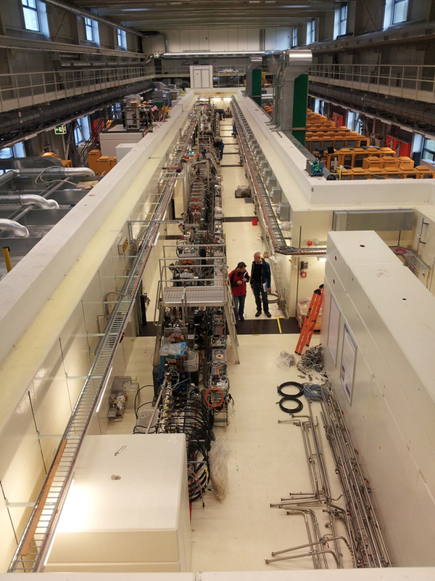
SwissFEL
Swiss Free Electron Laser SwissFEL

Slide 3
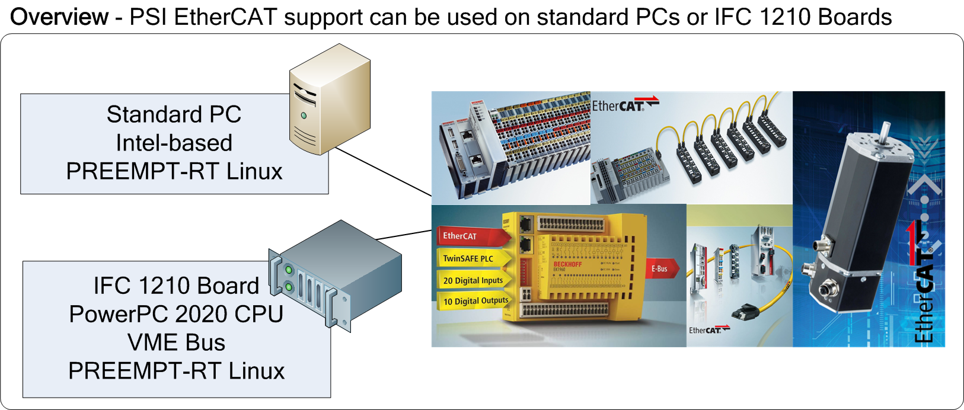
EtherCAT at PSI
At PSI, EtherCAT devices are connected using Beckhoff TwinCAT and Beckhoff IPCs, but also using IgH Etherlab Master (somewhat modified) and in-house EPICS drivers and tools on various platforms – Standard Intel-based PCs for SoftIOC Servers, and Embedded solutions using standard crates and Ioxos IFC 1210 boards.

Slide 4
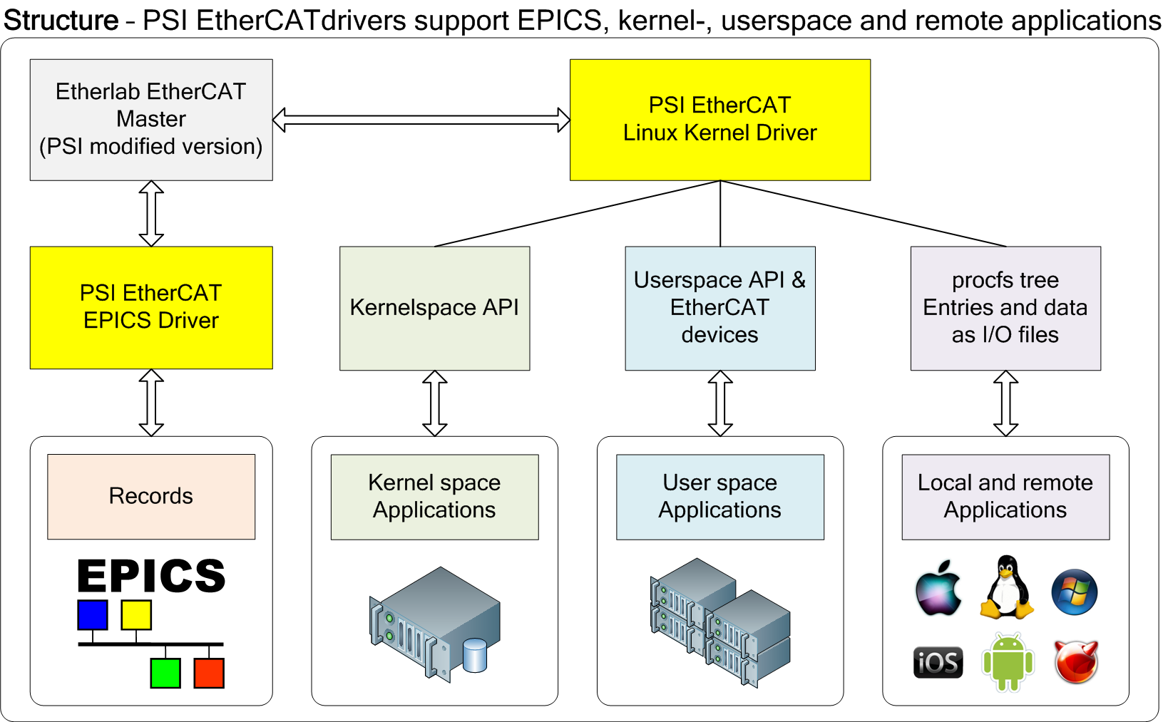
EtherCAT at PSI
EtherCAT driver has two incarnations, userspace based EPICS driver, and Linux kernel driver.

Slide 5
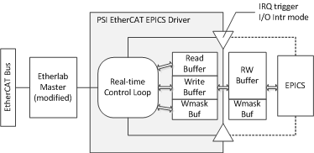
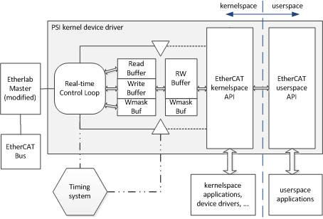
EtherCAT at PSI
PSI EPICS EtherCAT driver and PSI general EtherCAT driver.
Both PSI EtherCAT and Linux drivers support automatic scan and configuration of EtherCAT Modules. There is no need to prepare Beckhoff or other XML configuration files or perform any other setup in advance.
Modules can also be configured statically, either from EPICS or any other application or from the CLI. The static configuration will work even if the modules are not reporting their own configuration (SII missing or wrong).
Optimizations allow for very high EtherCAT rates (up to 5-10 kHz and more on P2020-based IFC, with minimal CPU load (<10% CPU used at 8-10 kHz!), using PREEMT-RT on Ioxos IFC 1210. Running very stable 24/7 for weeks on end, no dropped packets, less than 0.01% of packets with jitter/microdelays, with 1000+ EPICS records set to I/O Intr scan.
No dependency on other drivers (i.e. asyn) or software, aside from Etherlab Master itself.

Slide 6
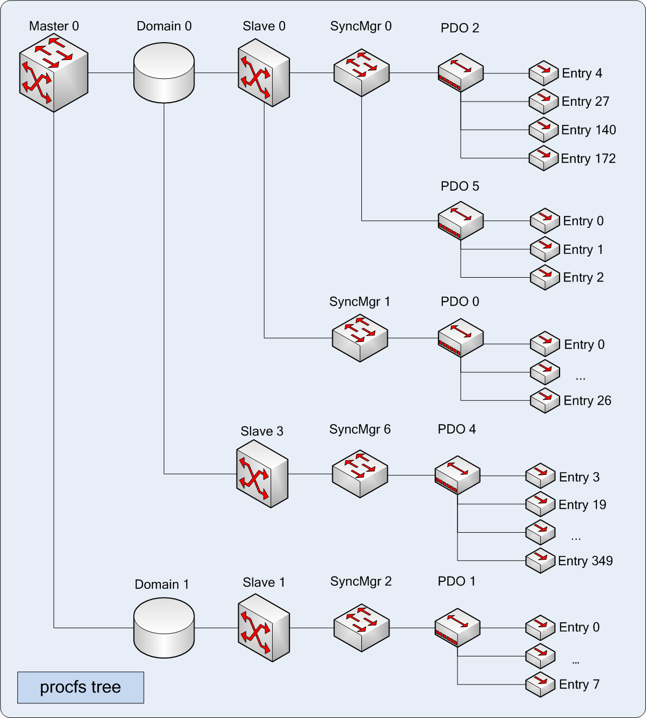
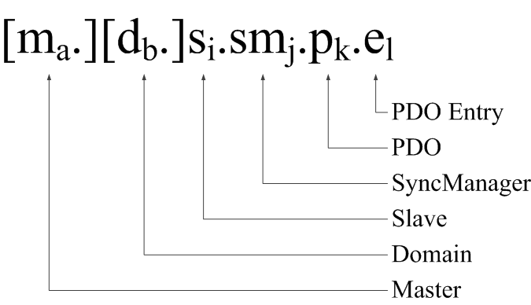
EtherCAT at PSI
To make EtherCAT support at PSI as flexible as possible, special adressing was devised.
Examples (INP/OUT addressing):
s0.sm2.p0.e0
s1.sm0.p14.e22
s5.sm1.p1.e3

Slide 7
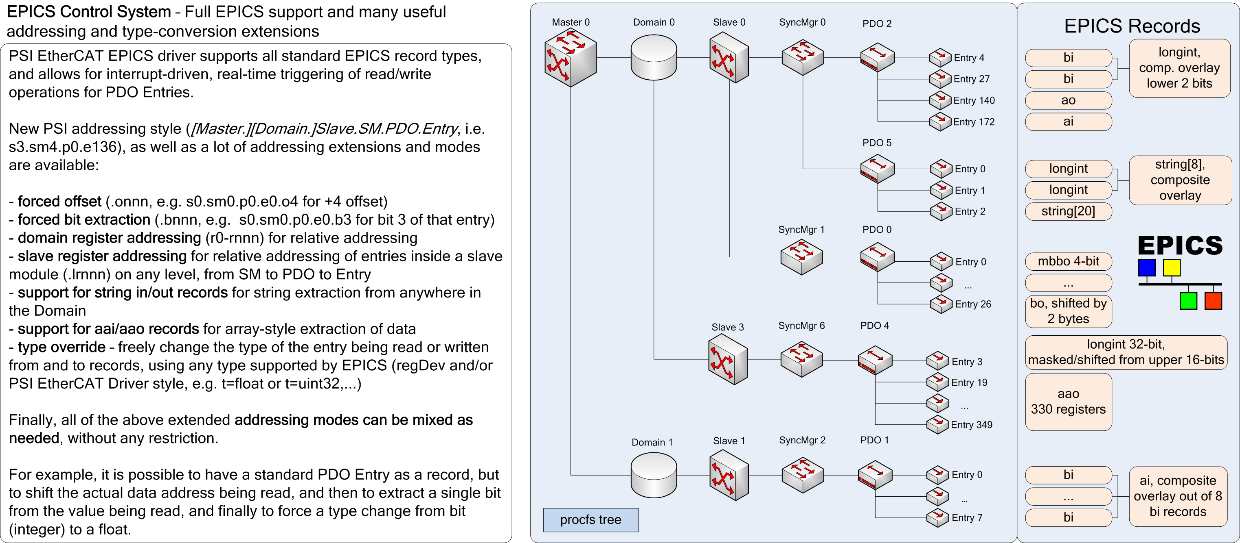
EtherCAT at PSI
To increase flexibility, additional adressing modifiers and modes were introduced, such as: .o, .b, r, .lr, .l, as well as type override (t=<newtype>)

Slide 8
EtherCAT at PSI
Furthermore, programmable EtherCAT modules (such as EL6692, EL6695 and many more) are also supported, as well as slave-to-slave communication

Slide 9
EtherCAT at PSI
All functionality for static configuration and reconfiguration provided by Etherlab Master was added as mini script language, to allow for any configuration needed.
ecat2cfgslave sm - Config Sync Manager
Configures one Sync Manager for the given slave.
ecat2cfgslave sm <slavenr> <smnr> <dir> <wd_mode>
ecat2cfgslave sm_clear_pdos - Clear PDOs of a SM
Clears (i.e. deletes) all PDOs for a given Sync Manager (SM)
ecat2cfgslave sm_clear_pdos <slavenr> <smnr>
ecat2cfgslave sm_add_pdo - Add PDO to a SM
Adds a PDO with index pdoindex to a Sync Manager.
ecat2cfgslave sm_add_pdo <slavenr> <smnr> <pdoindex>
ecat2cfgslave pdo_clear_entries - Clears PDO entries of a PDO
Clears (i.e. deletes) all PDO entries associated with the given PDO.
ecat2cfgslave pdo_clear_entries <slavenr> <smnr> <pdoindex>
ecat2cfgslave pdo_add_entry - Adds a new PDO entry to a PDO
Creates a new PDO entry and associates it with the given PDO..
ecat2cfgslave pdo_add_entry <slavenr> <smnr> <pdoindex> <entryindex> <entrysubindex> <entrybitlen>

Slide 10
EtherCAT at PSI
EPICS command-line tools have been added to allow easy overview of registers, current values, slave-to-slave communication and their connection to respective EPICS records.
dmap
...
[I] 0x2007:0x00 464.0 8 bits r354 = 0x14 @ s0.sm3.p0.e81 [I] 0x2008:0x00 465.0 32 bits r355 = 0x20160303 @ s0.sm3.p0.e82 [I] 0x2009:0x01 469.0 32 bits r356 = 0x4203ef9b @ s0.sm3.p0.e83 [I] 0x2009:0x02 473.0 32 bits r357 = 0x4474577b @ s0.sm3.p0.e84 [I] 0x2009:0x03 477.0 32 bits r358 = 0x41c4b12c @ s0.sm3.p0.e85 [I] 0x2009:0x04 481.0 32 bits r359 = 0x4196e80f @ s0.sm3.p0.e86 [I] 0x2009:0x05 485.0 32 bits r360 = 0x44746b5f @ s0.sm3.p0.e87 [I] 0x2009:0x06 489.0 32 bits r361 = 0x42026b48 @ s0.sm3.p0.e88 [I] 0x2009:0x07 493.0 32 bits r362 = 0x41aba084 @ s0.sm3.p0.e89 [I] 0x2009:0x08 497.0 32 bits r363 = 0x4474523d @ s0.sm3.p0.e90 [I] 0x2009:0x09 501.0 32 bits r364 = 0x42032df5 @ s0.sm3.p0.e91 [I] 0x2009:0x0a 505.0 32 bits r365 = 0x00000000 @ s0.sm3.p0.e92 [I] 0x2009:0x0b 509.0 32 bits r366 = 0x00000000 @ s0.sm3.p0.e93 [I] 0x2009:0x0c 513.0 32 bits r367 = 0x00000000 @ s0.sm3.p0.e94 [I] 0x200a:0x00 517.0 8 bits r368 = 0x07 @ s0.sm3.p0.e95
...
[O] 0x2001:0x20 549.0 8 bits r400 = 0x00 @ s12.sm2.p0.e31 [O] 0x2001:0x21 550.0 8 bits r401 = 0x00 @ s12.sm2.p0.e32 [O] 0x2001:0x22 551.0 8 bits r402 = 0x00 @ s12.sm2.p0.e33 [O] 0x2001:0x23 552.0 8 bits r403 = 0x00 @ s12.sm2.p0.e34 [O] 0x2001:0x24 553.0 8 bits r404 = 0x00 @ s12.sm2.p0.e35 [O] 0x2002:0x01 554.0 8 bits r405 = 0xd4 @ s12.sm2.p0.e36
...

Slide 11
EtherCAT at PSI
EPICS command-line tools have been added to allow easy overview of registers, current values, slave-to-slave communication and their connection to respective EPICS records.
Slave-to-slave communication
[O] 0x2002:0x01 554.0 8 bits r405 = 0xd4 @ s12.sm2.p0.e36 .b0 = 0 <--- s4.sm0.p0.e0 = 0 .b1 = 0 <--- s4.sm0.p1.e0 = 0 .b2 = 1 <--- s4.sm0.p3.e0 = 1 .b4 = 1 <--- s5.sm0.p1.e0 = 1 .b5 = 0 <--- s10.sm0.p13.e0 = 0 .b6 = 1 <--- s5.sm0.p2.e0 = 1 .b7 = 1 <--- s5.sm0.p3.e0 = 1
EPICS records
… [O] 0x2003:0x36 667.0 16 bits r465 = 0x2784 @ s12.sm2.p0.e96 <--- ao TRFCB02-RWVG100-DCP10:REF-ILK-LIML = 0x2784 [O] 0x2003:0x37 669.0 16 bits r466 = 0x2af5 @ s12.sm2.p0.e97 <--- ao TRFCB02-RWVG200-DCP10:REF-ILK-LIML = 0x2af5 [O] 0x2003:0x38 671.0 16 bits r467 = 0x2af5 @ s12.sm2.p0.e98 <--- ao TRFCB02-RWVG300-DCP10:REF-ILK-LIML = 0x2af5 [O] 0x2003:0x39 673.0 16 bits r468 = 0x2a34 @ s12.sm2.p0.e99 <--- ao TRFCB02-RWVG400-DCP10:REF-ILK-LIML = 0x2a34 [O] 0x2003:0x3a 675.0 16 bits r469 = 0x26d8 @ s12.sm2.p0.e100 <--- ao TRFCB02-RILK-RFDET:SPARE-ILK-LIML = 0x26d8
…

Slide 12
EtherCAT at PSI
EPICS command-line tools have been added to allow easy overview of registers, current values, slave-to-slave communication and their connection to respective EPICS records.
Aai live content:
[I] 0x2004:0x02 678.0 8 bits r471 = 0x00 @ s12.sm3.p0.e1 ---> aai TRFCB02-RILK:SPI_DATA_OUT = { 0x1e, 0x00, 0x02, 0x4f, 0x00, 0x00, 0x02, 0xf4, 0x00, 0x00, 0x00, 0x00, 0x00, 0x00, 0x00, 0x00, 0x00, 0x00, 0x00, 0x3a, 0x3b, 0x00, 0x00, 0x00, 0x00, 0x00, 0x71, 0x00, 0x00, 0x00, 0x00, 0x00 }
Stringin live content (with offset and length): [I] 0x2005:0x02 714.0 32 bits r504 = 0x43465254 @ s12.sm3.p0.e34 ---> stringin TRFCB02-RILK:FW-NAME = = 'TRFCB02' (offset +0, length 8) [I] 0x2005:0x03 718.0 32 bits r505 = 0x00323042 @ s12.sm3.p0.e35
Records and slave-to-slave communication: [I] 0x2006:0x01 722.0 8 bits r506 = 0xff @ s12.sm3.p0.e36 ---> b0: bi TRFCB02-RILK:PSYS = 1 ---> b1: bi TRFCB02-RLLE-EVR:ILK = 1 ---> b2: bi TRFCB02-RLLE:WDOG-SUMILK = 1 ---> b3: bi TRFCB02-RILK-RFSW10:RFON = 1 ---> b4: bi TRFCB02-RILK-RFSW20:RFON = 1 ---> b5: bi TRFCB02-RILK:RF-READY = 1 .b6 = 1 ---> s7.sm0.p0.e0 = 1 .b7 = 1 ---> s7.sm0.p2.e0 = 1 [I] 0x2006:0x02 723.0 8 bits r507 = 0x07 @ s12.sm3.p0.e37
.b0 = 1 ---> s7.sm0.p1.e0 = 1
---> b1: bi TRFCB02-RILK:MPS-LEVEL1 = 1 ---> b2: bi TRFCB02-RILK:MPS-LEVEL2 = 1
---> b3: bi TRFCB02-RILK:ANV1-P = 0 ---> b4: bi TRFCB02-RILK:ANV2-P = 0 ---> b5: bi TRFCB02-RILK:ANV3-P = 0 ---> b6: bi TRFCB02-RILK:ANV4-P = 0 ---> b7: bi TRFCB02-RILK:ANI1-P = 0

Slide 13
EtherCAT at PSI
PSI EtherCAT drivers – future plans:
Support for Beckhoff XML configuration DB (forced/static configuration)
Support for SDO transfers from EPICS (slave EEPROM updates and similar)
EtherCAT EPICS driver for Beckhoff IPCs and TwinCAT systems (Windows and Windows-CE based, using Beckhoff TwinCAT API)
Finish support for multiple EtherCAT masters on a single host

Slide 14
Wir schaffen Wissen – heute für morgen
My thanks goes to:
Dr. Markus Janousch, Dr. Elke Zimoch, Babak Kalantari and others from Controls Section and Embedded Software Group at PSI for their support
Roger Kalt und Florian Gärtner from LLRF for testing and ideas
IgH and Dr. Florian Pose for creating and sharing Etherlab Master

