Slide 1
Quo Vadis EPICS?
Elke Zimoch :: Paul Scherrer Institut

Slide 2

Why am I talking about this?
This is not a tech-talk – go to some management conference to present it!
  Unfortunately there is only science conferences as alternatives …
  I want EPICS users, EPICS developers, and EPICS fans in the discussion
«Never touch a running system»
(or similar sayings like «We never needed this the last 30 years»)
  We are building accelerators for 30 years lifetime and control them with computers that have 2 to 5 years of lifetime: change is our business!
Without target and map we will end somewhere
but maybe not were we
want to go or can go…

Slide 3

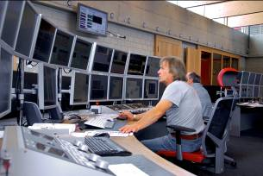
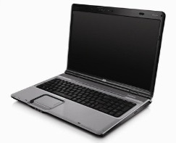

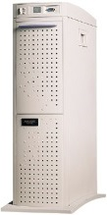
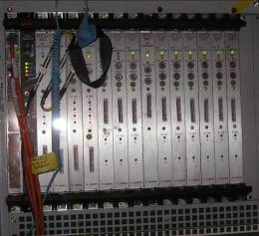

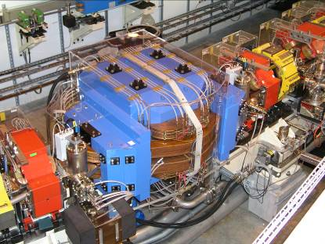
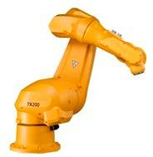
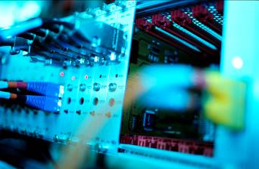
Control System EPICS based
CA Client
CA Client
Client Programs:
alarmhandler
Striptool, caQtDM,
many more …
(user programs)
Control Room
Channel Access:
(UDP/TCP)
Input
CA Server
IOC
Server Programs:
(user programs)
Realtime Control
Records
4th Layer
Hardware: maybe
controllers and PLCs

Slide 4
Control System EPICS based (V4)
CA Client
CA or PV Client
Services that provide additional functionality
Control Room
Input
PV Service 1
PV Service 2
PVaccess included in Servers and IOCs
(still use the same low level driver)
CA/PV Server
IOC

Slide 5
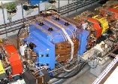

Control System cont.
Software
Repository
Somehow they work together
(most of the time)
Machine (Real) Environment
Development Environment

Slide 6
More about Control Systems
Not yet mentioned
… but
still part of any
Control System
File structure
boot philosophy
Naming convention
Synchronous get and set
DAQ for experiments (large data)
Security of access and data distribution
Hardware choices: for IOCs, Servers, Clients, FPGAs, …

Slide 7
Now what? Were do we want to go?
Nowere – forget this talk, just let us work.
Do what you want (alone) - we do not have time for this.
Let’s write a book.
Collect best practices and share them
Extend EPICS to everything – lets call it EPSCS
(Experimental Physics Super Control System)
Let’s talk about it over coffee…

Slide 8
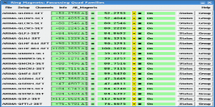
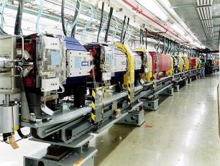
What is an Accelerator Controls System
Definition:
An Accelerator Control System is a computer environment that allows remote access to the accelerator hardware with a lot of different functionality to satisfy the requirements of several different user groups.
In addition a modern
Acclelerator Control System:
tries to unify the access to different
hardware
(one way to rule them all)
0110001010001001

