Slide 1
Welcome to the EPICS 2016 Spring Collaboration Meeting!
Timo Korhonen
Chief Engineer
Integrated Control System Division
www.europeanspallationsource.se
October 25, 2015

Slide 2
Welcome to ESS
We are very happy to have you here!
130 people registered, a few more have been added
Organising committee
Myself (Timo Korhonen)
Susanne Regnell
Anna Gillberg
Many other ESS ICS and other division members
Please do not hesitate to turn to us for help!

Slide 3
Practicalities…
Emergency instructions:
Should there be an alarm…
In this auditorium: please exit through the front doors
Gathering place outside the building, wait for instructions
In the ESS reception (some afternoon workshops)
Use marked exits, gathering at the parking lot outside

Slide 4
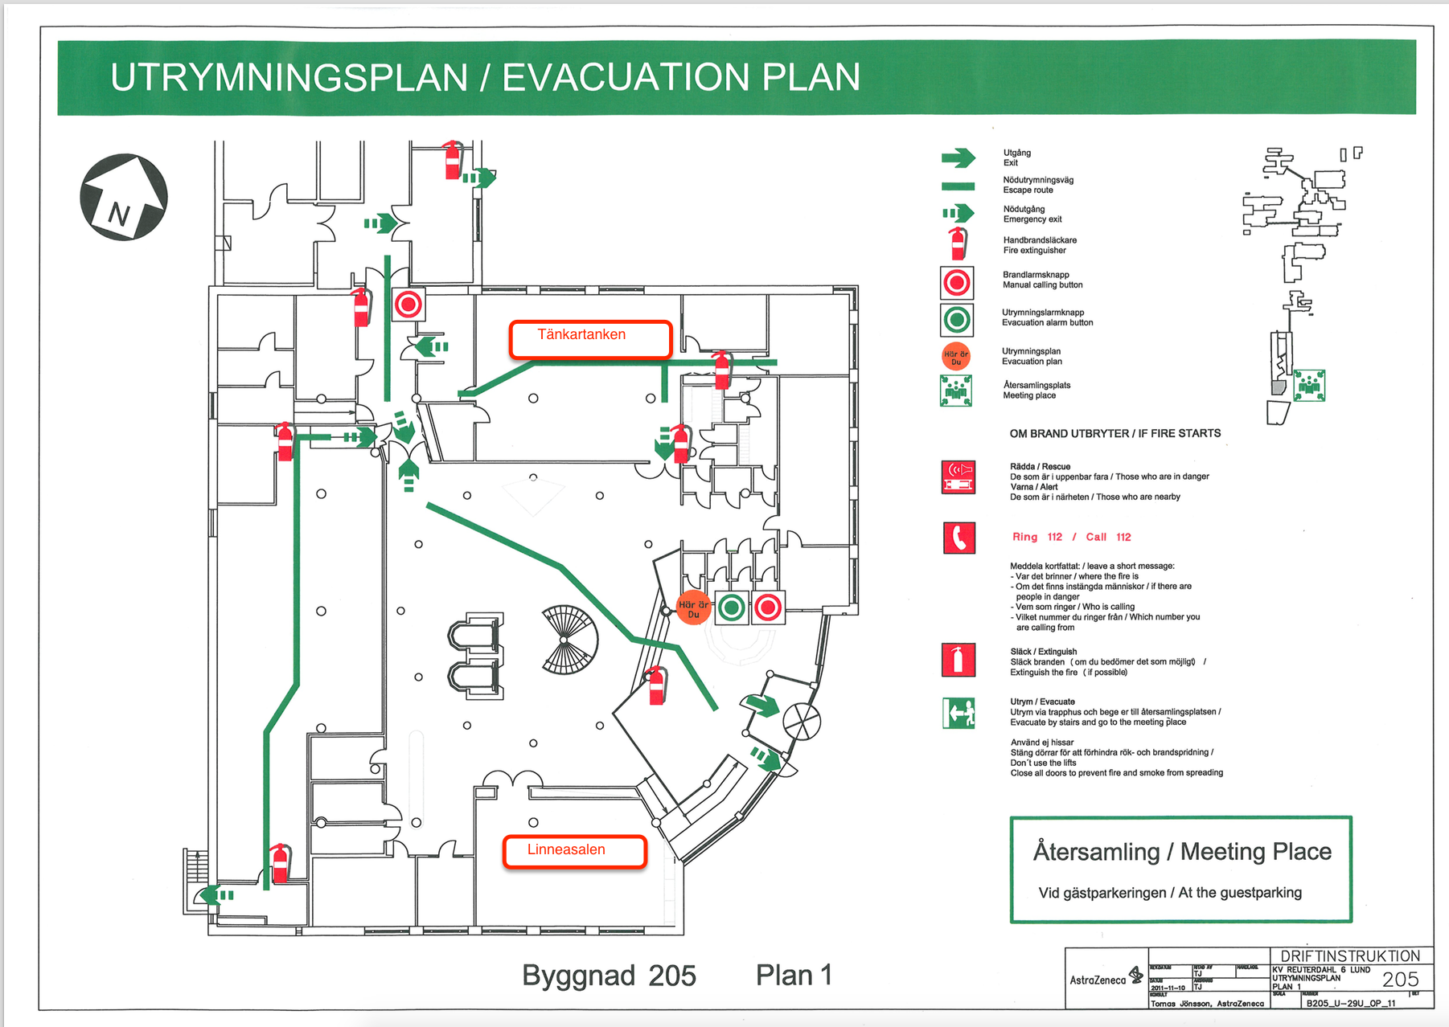
Practicalities…

Slide 5
Practicalities…
Lunch will be served in Inspira (next door) on Wednesday (today) and Thursday
free lunch on both days…
Friday no lunch served
For site tour participants: Due to tight timetable, best is to wait with lunch until after the tour (site tour takes approximately half an hour)
Coffee and cookies served outside the auditorium

Slide 6
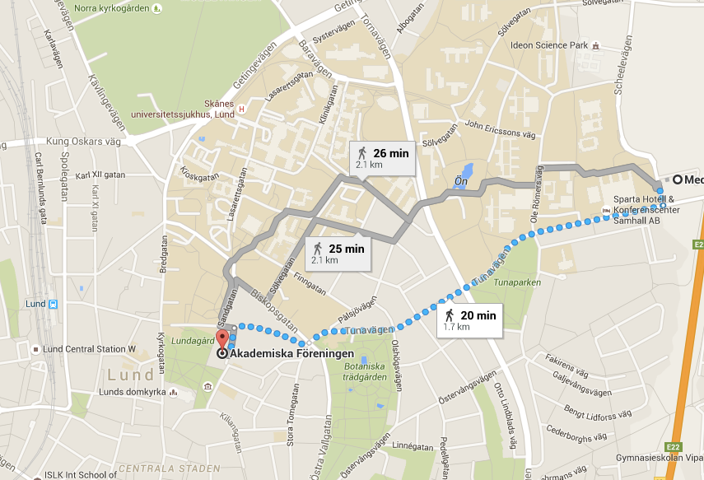
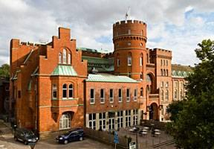
Practicalities…
Workshop Dinner
This evening in Tegnérs Matsalar
Sandgatan 2, Lund
About 20 minutes walk (1,7 km) from here
Starts at 19:00

Slide 7
Practicalities…
Moving around
Most of things are in a walking distance
Public transport works quite well
Please contact local staff for more instructions
Renting a bicycle (see http://lundahoj.se) can also be a nice option
Site tour
Friday afternoon after the meeting is over
More instructions will follow
It is a construction site with a lot of activity and restrictions; thus the packed timetable
Friday program starts at 8:30 so that we can fit the tour (and the talks) in

Slide 8
Practicalities…
Afternoon workshops
We try something new: break out into parallel, interactive special topic workshops
Opportunity to discuss things more in depth than during presentations
Each workshop has a chair to collect the people and lead the discussion
More details later
Presentations
Please upload your slides to the meeting website (Indico), if possible
Otherwise, have them ready to be copied onto a USB stick
Please let us know in advance if you want to use your own computer for the presentation (for a good reason…)

Slide 9
Practicalities…
Photo
We try to organise a group photo; exact time not yet known.
To be announced, be ready 😉
WLAN:
ESS guest network
Or: eduroam for those who are able to use it.

Slide 10
And finally:
Do not hesitate to ask us for help
Please excuse us for any imperfections…
But at least the weather looks good so far!
Please enjoy the meeting!

