Slide 1
Alarm information in CS-Studio

Slide 2
Alarm Datasource
ITER, FRIB, NSLS2

Slide 3
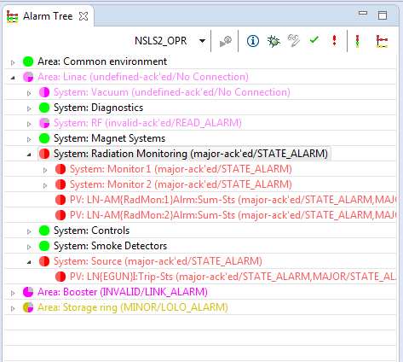
BEAST Toolkit
Alarm Server & configuration database
Handles Alarm logic and state
Stores alarm configuration
Alarm Clients
GUI’s display alarms, organized by the configure hierarchy or status
GUI’s provide tools to handle alarms (enable, acknowledge, open related display, show guidance)
Annunciator
Alarm Message logger

Slide 4
Beast Datasource
Making Beast information accessible as channels
You can create a beast channel for any Alarm Trigger PVs or for any Area, System, Subsystem.
beast://alarm_trigger_pvName e.g. beast://LN{EGUN}I:Trip-Sts
beast://complete_path_to_area e.g. beast://NSLS2_OPR/Linac
beast://complete_path_to_system/sub_system e.g. beast://NSLS2_OPR/Linac/RF

Slide 5
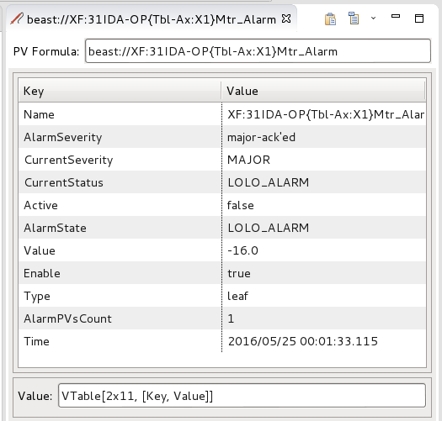
Beast Channels - Introduction
Beast channel representing a system
Beast channel to a single alarm
Notes:
Each active alarm has several properties:
•PV: name of the PV, Area, System.
•AlarmSeverity:The severity of the PV remembered by alarm server. When the PV is configured to "latch", the alarm server remembers the highest alarm severity of the PV until it is manually acknowledged. Current severity of the PV might differ from alarm severity when the underlying alarm PV already recovered but the alarm server was configured to "latch" the alarm until operator acknowledgement.
•CurrentSeverity: The current severity of the PV, like OK, MINOR, MAJOR or Invalid.
•CurrentStatus: alarm status message like HIGH_ALARM or STATE_ALARM.
•Active: true if severity indicates an active alarm, false for acknowledged or OK state.
•AlarmState: Highest or latched alarm message. It would give more information and more human-readable than the raw PV name. It is also used for annunciation.
•Value:
For a alarm PV it has the Value that triggered last status/severity update.
For a channel connected to a area/system.
•Enable: true if the alarm/system/pv is enabled.
•Type: node if the channel is connected to an area or system, leaf if the channel is connected to a pv.
•Time: The time when the alarm happened.

Slide 6
Beast Channels – special channels
In addition of the table it is also possible to create a channel directly to some of the fields of the table
E.g.
beast://channel_Name.Enable
Returns a Boolean value describing if this alarm channel is enabled/disabled
beast://channel_Name.Acknowledge
Returns a Boolean value describing if this alarm channel has been acknowledged
beast://channel_Name.AlarmSeverity
Returns a String representation of the alarm severity (taking into account alarm configuration logic like “latching”)
beast://channel_Name.Active
Returns a Boolean value representing the beast alarm state of this channel
Notes:
In addition of the table it is also possible to create a channel directly to some of the fields of the table
beast://alarm_trigger_pvName.Enable
•Returns a boolean value representing if the Alarm is enabled or disabled.
beast://complete_path_to_area.Acknowledge
•Returns a boolean value representing is the Alarm has been acknowledged.
•true if severity indicates an acknowledged alarm (AlarmSeverity is *-ack'ed).
•false for unacknowledged or OK state.
beast://complete_path_to_system.AlarmSeverity
• The severity of the PV remembered by alarm server. When the PV is configured to "latch", the alarm server remembers the highest alarm severity of the PV until it is manually acknowledged. Current severity of the PV might differ from alarm severity when the underlying alarm PV already recovered but the alarm server was configured to "latch" the alarm until operator acknowledgement.
beast://complete_path_to_system.Active
•Creates a Channel which represents if the alarm is active.
•true if severity indicates an active alarm,
•false for acknowledged or OK state.

Slide 7
Writing to Beast channels
In addition to reading
ack: acknowledge this alarm pv or node.
unack: unacknowledge this alarm pv or node.
enable: enable this alarm pv or node.
disable: disenable this alarm pv or node.
Notes:
Writing
Writing to alarm pv's can be done by using one of the following key phrases.

Slide 8
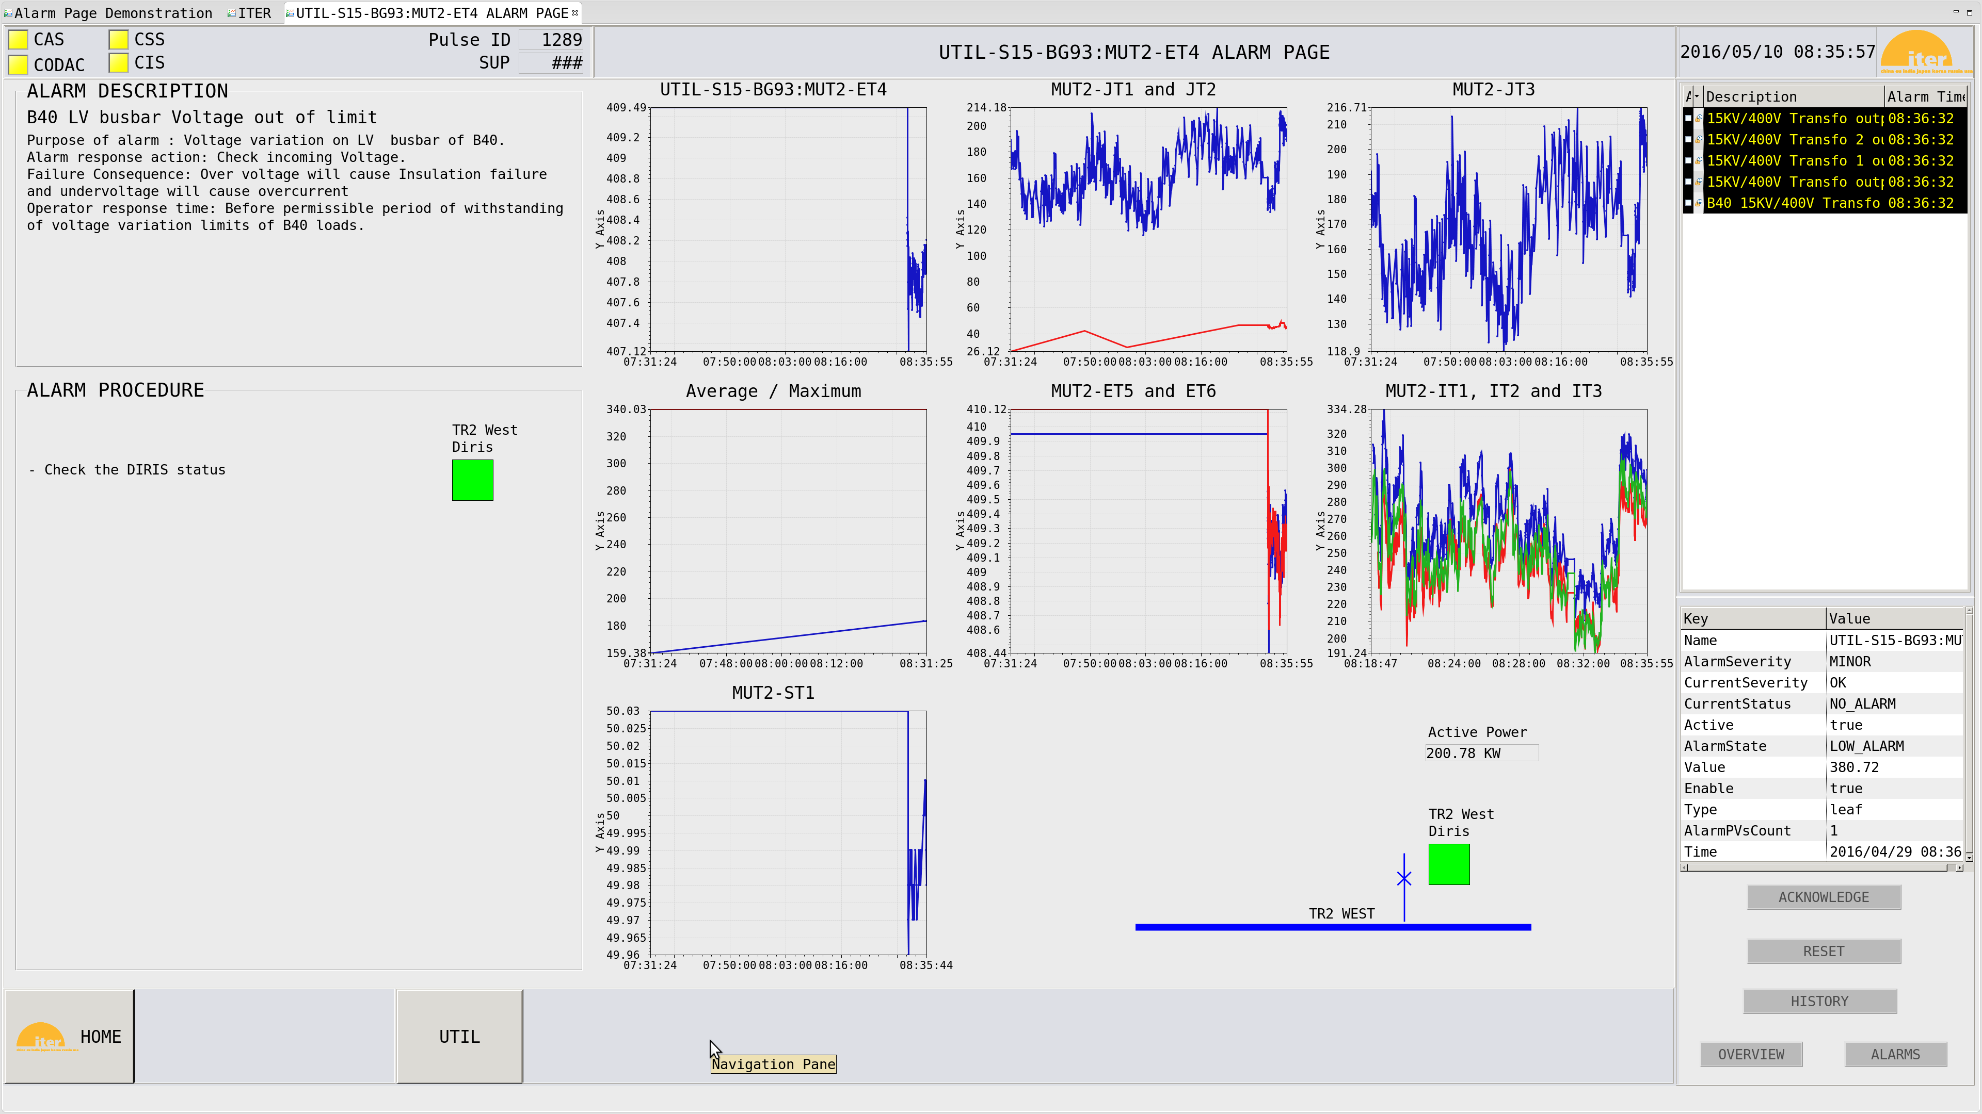

Slide 9
Other examples:
NSLS2: System alarm master screen
FRIB: gas cell alarms
Notes:
The beast datasource can be used to embed beast alarm information into opi screens. The return value from the beast datasource can be easily displayed by using the VTable widget. The example screen below was created with the beast datasource and the VTable widget.

Slide 10
Alarm Message History
ITER, NSLS2, FRIB, RAON

Slide 11
Motivation
To better understand sequence of events following an alarm (when the alarm arrived, when it was acknowledged….was it unacknowledged...)
To be able to produce alarm statistics, to find nuisance alarms
To find alarm patterns and relations between alarm
Solution
We record the alarm history for NSLS2 by logging the jms messages from the BEAST alarm server into elastic.

Slide 12
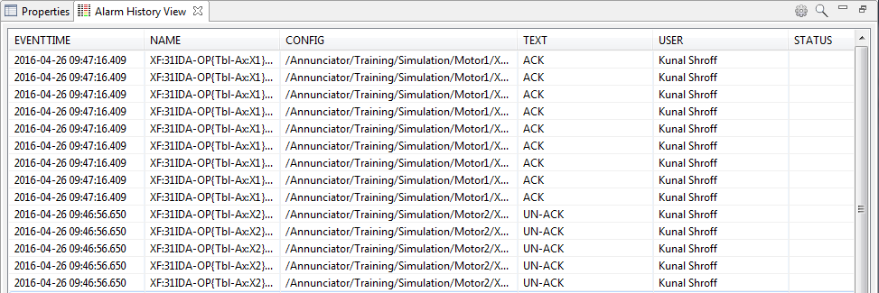
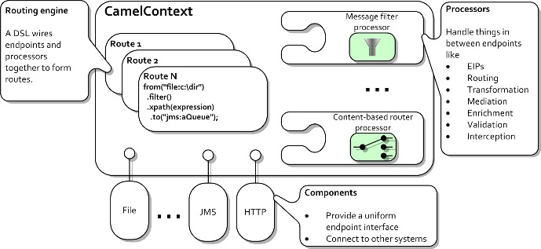
Architecture
CS-Studio
Alarm Tree
Alarm Table
Beast Channels
CS-Studio
BEAST
Kibana
(Web Client)
jms messages
Apache Camel
elastic
Notes:
Architecture
Elasticsearch is a distributed, open source search and analytics engine, designed for horizontal scalability, reliability, and easy management. It combines the speed of search with the power of analytics via a sophisticated, developer-friendly query language covering structured, unstructured, and time-series data.
Kibana is an open source data visualization platform that allows you to interact with your data through stunning, powerful graphics. From histograms to geomaps, Kibana brings your data to life with visuals that can be combined into custom dashboards th
Camel empowers you to define routing and mediation rules in a variety of domain-specific languages, including a Java-based Fluent API, Spring or Blueprint XML Configuration files, and a Scala DSL. This means you get smart completion of routing rules in your IDE, whether in a Java, Scala or XML editor.
Apache Camel uses URIs to work directly with any kind of Transport or messaging model such as HTTP, ActiveMQ, JMS, JBI, SCA, MINA or CXF, as well as pluggable Components andData Format options. Apache Camel is a small library with minimal dependencies for easy embedding in any Java application. Apache Camel lets you work with the same API regardless which kind of Transport is used - so learn the API once and you can interact with all the Components provided out-of-box
at help you share insights from your data far and wide.
Current size 2.7 million messages
Querying for messages based on a time range

Slide 13
CS-Studio Integration
Show Alarm History context menu command
Query based on PVName & Time
Display a chronological list of all associated alarm messages
Prototype Alarm History Viewer
Notes:
Cs-studio clients

Slide 14
Webclient (Kibana)
Rich set of Visualization tools
Trends
Statistics
Table
Configurable Dashboard
Filtering and Querying

Slide 15
Roadmap
Expand the beast datasource to support multiple configurations
Improve the Alarm History View
More routes for other useful pieces of information

Slide 16
Questions? Comments?

