Slide 1
Using EPICS V4 as a container for microservices
Murali Shankar
Greg White
Matt Gibbs

Slide 2
Summary
EPICS V4 with Redis is a lightweight, excellent way to build small microservices.

Slide 3
EPICS V4 RPC
Specifically, talking about the RPCService interface in PVAccess.
Has one method that looks like so
PVStructure request(PVStructure args)
Implement this interface
Register the service
To unpack the arguments in Java/C++, there is a bit of boilerplate
In Python, Sinisa makes it extremely simple. Everything is a dict.

Slide 4
Redis
In-memory key/value store
Actually, the way I look at it, in-memory data structures external to your code.
Very easy to debug your application.
Backup/Replication/Cluster/Messaging
Lightweight

Slide 5
Introduction
At SLAC, we’ve started to use EPICS V4 as a container technology for microservices.
These are small services (a few classes/few 1000 lines of code)
Often SLAC specific.
Almost always in combination with Redis.
V4 with Redis gives us
A lightweight architecture.
A standard communication mechanism
Integrate multiple services using service based interfaces.
Shows up in lists of PVS
Standard help/documentation/management.
Use cram for deployment.
Very robust so far.

Slide 6
Arbo
Replacement for the IRMIS crawler.
Ernest adds some commands to every IOC startup.
iocshCmd("dbl '' RTYP > ${IOC_DATA}/${IOC}/iocInfo/IOC.pvlist")
${IOC}/iocInfo/IOC.pvlist contains lines that look like so.
SIOC:SYS0:ML01:SR_recentlyStr, "stringout”
SIOC:SYS0:ML01:SysReset, "sub”
SIOC:SYS0:ML01:CA001, "waveform"
This is valuable information and can be used by multiple services.
Arbo is a small service that watches these IOC.pvlist files and maintains in Redis.
${IOC} → Current list of PV names for an IOC.
${IOC} → Current list of waveform PV’s for an IOC.

Slide 7
DS
Starts with the list of PV names from Redis.
Also adds in V4 channel names (from file exports).
Adds in data exported from the model (into files)
Devices
Lines
Elements
Z-order
Combines all of this to support a “names” and “tags” V4 service.
Get me names that match a pattern
Get me names that belong to a line.
Get me devices that belong to a line.
Get me names that match a pattern & belong to a line, sorted by Z.

Slide 8
V3 name services
Suite of V3 name services
Route CA Name Searches to an IP/port.
PV Names are grouped into groups
Groups are mapped to IP/ports.
PV Name -> Group -> IP/port.
export EPICS_CA_ADDR_LIST = <NameService>
Intended to be used in front of appropriate applications
For example, archivers etc

Slide 9
V3 Name Service - PVList
Works off the ${IOC}/iocInfo/IOC.pvlist from Redis
PV’s are grouped by IOC.
We pick one PV (the heartbeat PV) and establish a ca_monitor.
This gives you IP/port
PVName -> IOC -> IP/port

Slide 10
V3 Name Service - LoadBalanceWaveforms
Another V3 name service
To be used as a load balancer for gateways.
This takes in a set of gateways (IP/port) for
Waveforms
Non-waveforms
Responds to CA search requests
Uses info in Redis to determine if PV is a waveform or not.
Routes search request to one of the waveform gateways or non-waveform gateways.
Which gateway is based on hash of PV name.
So, all requests for the same PV are sent to the same gateway.

Slide 11
V3 Name Service - PatternMatchAndRoute
Another V3 name service
At SLAC, all PV names follow a naming convention.
This includes the sector (location) in the name
Route sectors to particular gateways
All LI20 PV’s go to gateway X while all LI21 PV’s go to gateway Y.
No information from Redis in this particular case
Variant of this where we route PV’s from a particular IOC to a particular gateway would use this information.

Slide 12
hist
V4 frontend for the EPICS Archiver Appliance.
Sends data back as a table.
This is a new type we are working thru called a NTComplexTable
In addition to serving data, this also exposes some of the archiver BPL thru V4 services.
The search functionality is exposed as V4 RPC calls.

Slide 13
Integrating DS and hist
Would be nice to have knowledge of archived PV’s in the DS.
Get me names that belong to a line that are being archived.
Have the hist V4 service implement a standard “filter” interface.
RPC call that takes in a NTScalarArray of strings and returns a NTScalarArray of strings.
In this case, we return the list of PV names that are being archived.
DS has a list of services that implement filters.
Pick a filter when asking the DS for names.
eget -s ds -a name="%:VRAW" -a filter=hist

Slide 14
NS Performance
Measured using caInfo1 with and without the name service
All times are in ms
# of PVs | Without NS | With NS | Diff
3008 | 140 | 79 | -61
6008 | 155 | 154 | -1
28775 | 696 | 622 | -74
57500 | 1323 | 842 | -481

Slide 15
NS throughput
When the NS terminates, it spits out some profiling statistics.
143762 calls in 696 ms.
Around 20.6 Johnsons.
206K CA searches/second.

Slide 16
DS performance (# of names matched)

Slide 17
DS performance (# of query terms)

Slide 18
DS performance (startup time)
On startup the DS loads data from Redis and other places and builds in-memory indexes.
These themselves can be stored in Redis if needed.
Loads 2.1 million PVs and 3K tags to cross-index 10 million entries in about 43 seconds.
Changes to internal structures are incremental (so not an issue).
So, if you add/delete a PV(s) to/from an IOC, we compute the delta

Slide 19
Standards
Enforce standards for all services.
For example, all of these services implement a help command
eget -s ds -a help
Help often includes sample Python code.
Help can take arguments
For example, more details on a topic.
eget -s hist -a help -a showpythonsample
Many of these services implement management commands.
Refresh the cache, rebuild an index etc.

Slide 20
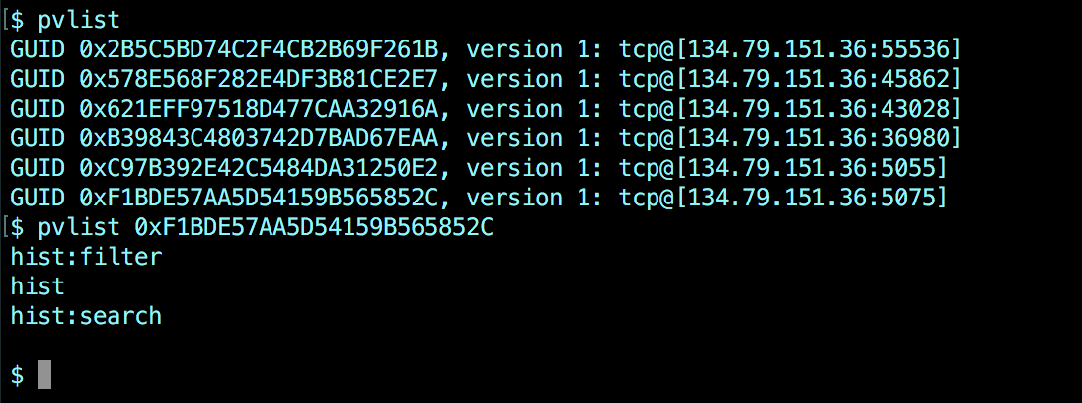
Show up in lists
The “pvlist” gets you a laundry list of your services.
Bit better than trolling thru cron jobs/ps –a etc

Slide 21
Sample client

Slide 22
Deployment
We use a in-house utility called cram to deploy applications.
These are crammable applications
Services in Java use Apache commons daemon
Services in Python use gunicorn.

Slide 23
Summary
EPICS V4 with Redis is a lightweight, excellent way to build small microservices.

