Slide 1
SwissFEL Timing System status & plans
Babak Kalantari :: Large Research Facilities /Controls :: Paul Scherrer Institut
EPICS meeting: 25.05.2016

Slide 2
Outline of the talk
SwissFEL timing system tasks
Timing network architecture
Event system new generation (300-series)
Current status, hardware
Current status, software
Delay switching technique and MPS assistance
Rep rate controls
Future plans

Slide 3
SwissFEL Timing system tasks
Provide precise triggering across the facility
Distribute operation-critical machine parameters
Assist machine/beam synchronized DAQ and controls
Assist Machine Protection System (MPS)
Handle latency and drift issues (delay compensation)
1st phase
2nd phase
Athos 0.7-7nm
Photocathode
RF gun
Linear accelerators
C-Band technology
user
stations
2.6-3.4 GeV
Injector
Linac 1
Linac 2
Linac 3
BC1 0.38 GeV
BC2 2.1 GeV
3.0 GeV
3.0-5.8 GeV
Aramis 0.1-0.7 nm
740m

Slide 4
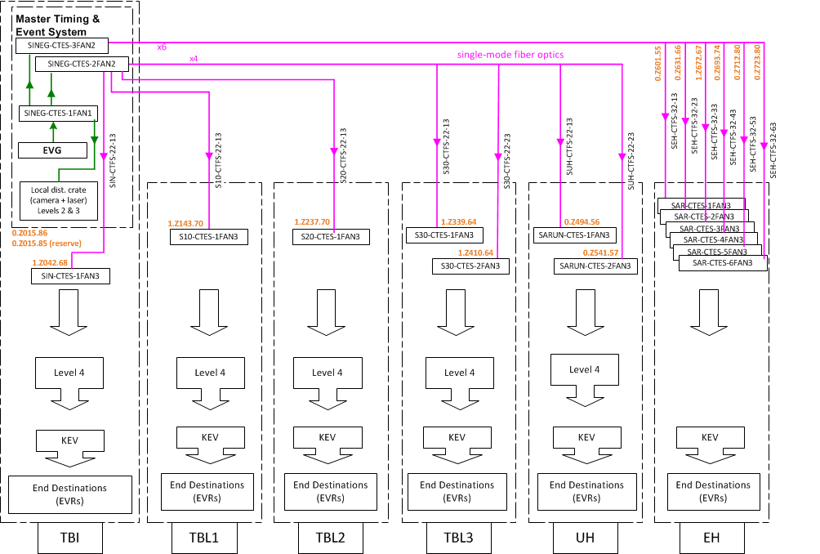
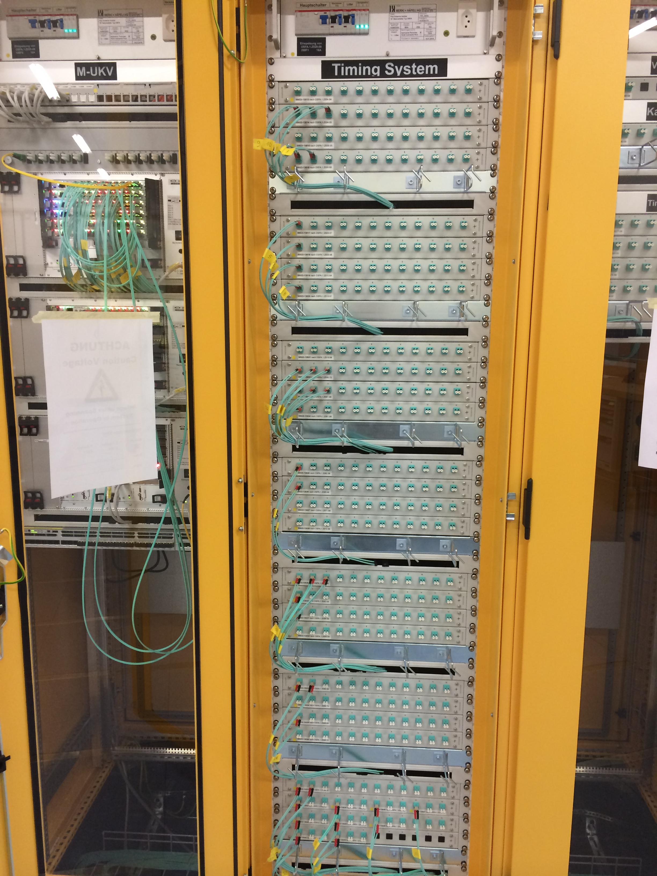
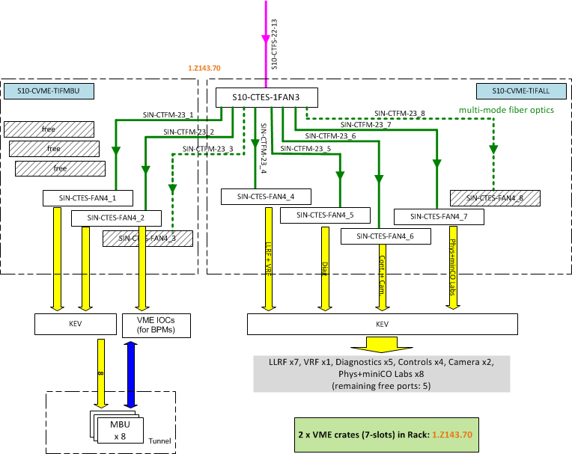
Timing network architecture
Babak Kalantari, Paul Scherrer Institute (PSI)

Slide 5
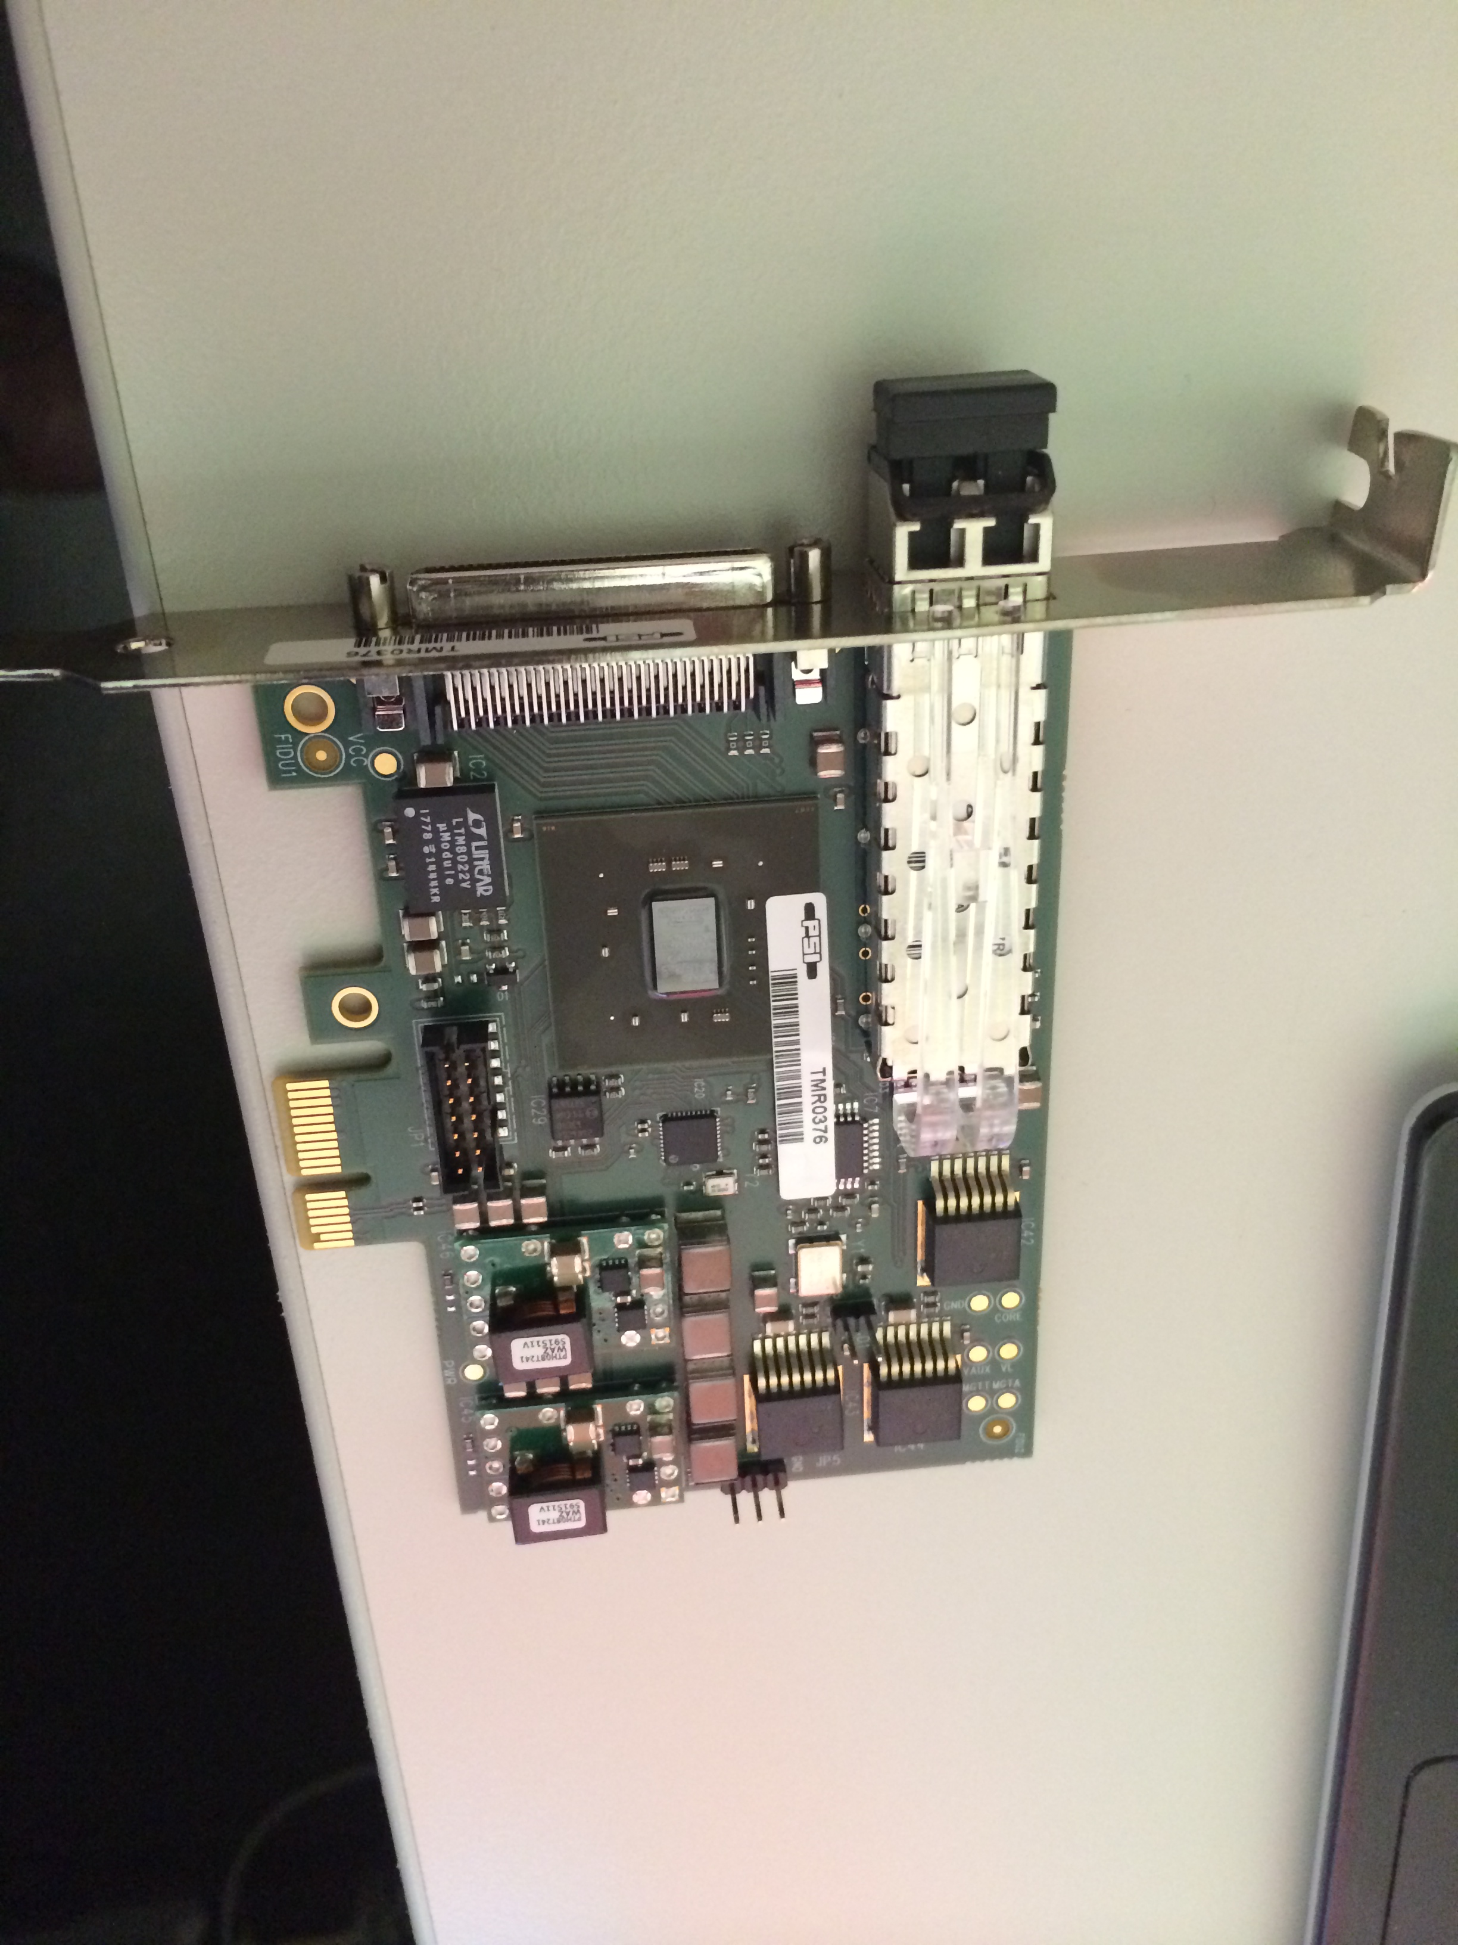
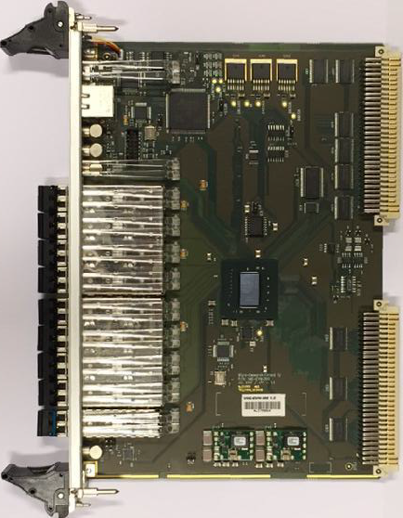
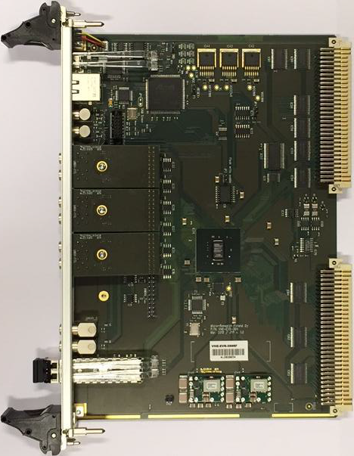
VME-300 event system
VME-EVR-300
Delay compensation
GTX driven Universal I/O Slots
Pulser gating (switching)
dual pulsers outputs
Segmented data buffer
VME-EVM-300
EVG + Fanout/Concentrator
Event clock 142.8 MHz
Masked events in Sequencer
Segmented Data Buffer
Delay compensation
PCIe-EVR-300DC
Delay compensation
Pulser gating (switching)
dual pulsers outputs
Segmented data buffer
Babak Kalantari, Paul Scherrer Institute (PSI)

Slide 6
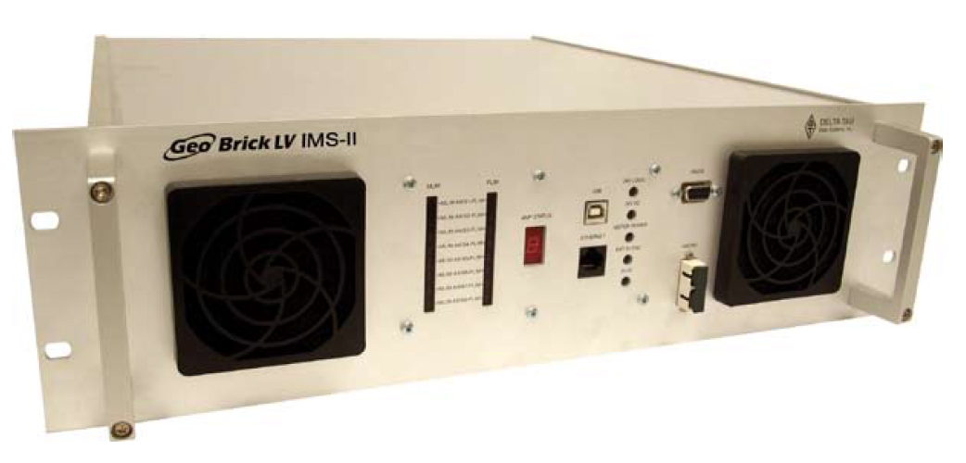
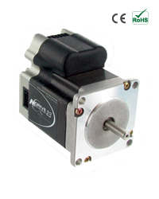
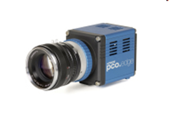
EVR from factors at SwissFEL
Timing network (event/data stream)
PCIe-EVR-300DC
VME-EVR-300DC
LLRF, Laser, Diagnostics, magnets, experiments, …
Timing device | VME-EVM | VME-EVR | PCIe-EVR | Embedded EVR
Total number | 70 | 130 | 70 | 100
Installed | 22 | 54 | 8 | 6
In operation | 15 | 8 | 0 | 6
Camera servers (Windows), Motion systems (embedded Linux on PPMAC of Delta Tau )
embedded-EVR
FPGA event/data decoder: BPMs, FE photonics, detectors
Babak Kalantari, Paul Scherrer Institute (PSI)

Slide 7
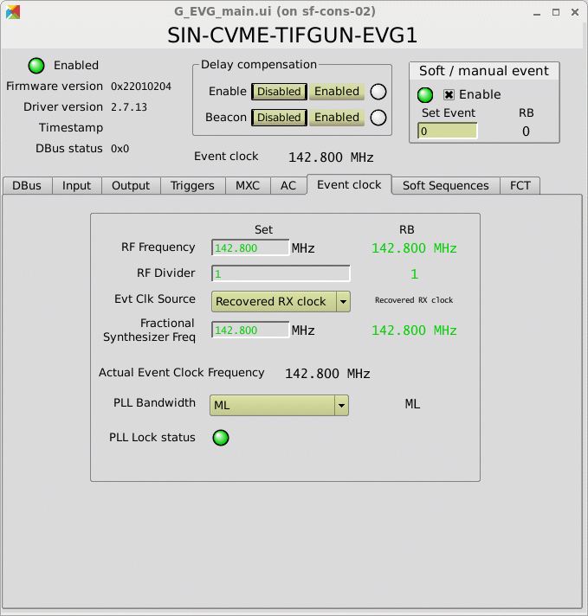
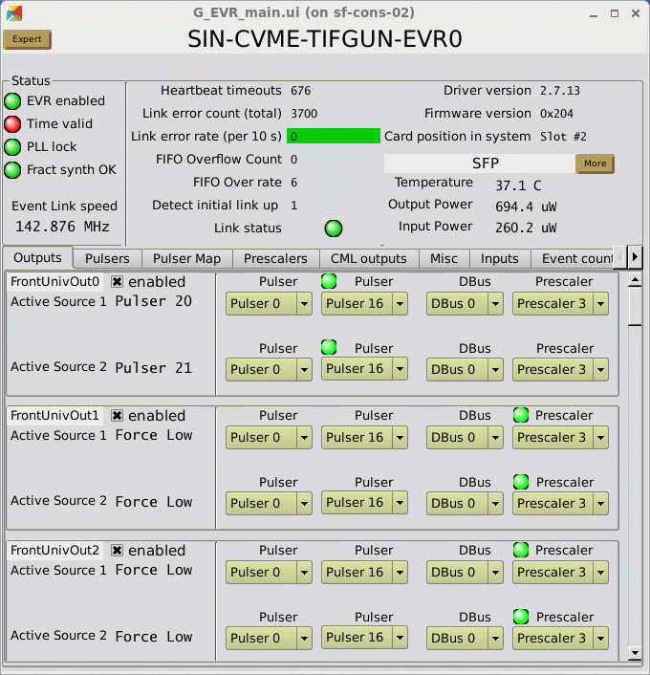
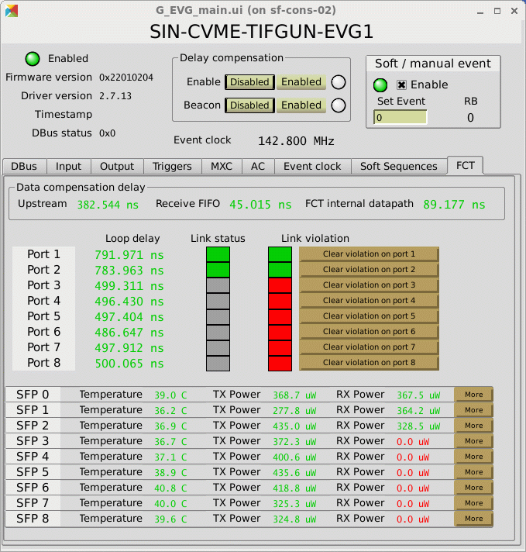
Current status- software
EPICS driver: mrfioc2, we added support for 300-series
  https://github.com/paulscherrerinstitute
  Linux (PowerPC, x86) , Windows (x86), vxWorks (not tested)
  Common templates in central pool, local substitutions
EPICS driver for Data Buffer: mrfioc2_regDev
  implements driver layer for regDev (see Dirk’s talk tomorrow)
  Sends/Receives any data type through standard record types
  We distribute: pulse ID, master EPICS timestamp, more parameters to come
GUI’s
  Standard Qt panels for EVM and EVR (bundled in driver package)
  Provide access to every single feature of EVM and EVR

Slide 8
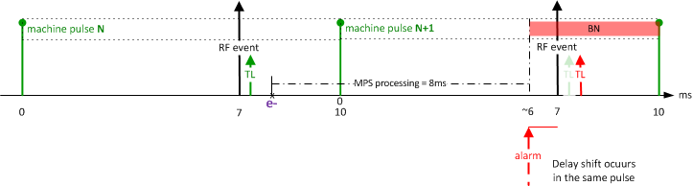
Delay switching mechanism and MPS
pulse with beam
pulse without beam
TL green is the trigger with normal delay: on-beam trigger (Beam Ok)
TL red is the trigger with shifted delay: off-beam trigger (Beam Not ok)
shift of ~ 10 us to RF triggers stops acceleration; continues triggering maintains stability
Hardware implementation:
    A special event is fired upon alarm: RF off-beam event (unmask sequence event)
    Delay switch occurs instantly for selected triggers (pulser gating)
Babak Kalantari, Paul Scherrer Institute (PSI)
Page 8
Notes:
Slow low cost MPS with PLC, has to wait also for inputs from many different system that can be slow too, e.g., vacuum, etc.

Slide 9
Rep rate controls
Rep rate for every event can be set individually
Major events affecting beam rate: 2x RF and 2x Laser events
Operator only tweaks beam rate by controlling delay switching rate
  which is achieved by controlling the RF off-beam event rate
Machine expert can set RF or Laser event rates independent of beam rate
Expected beam rate is co-incidence of RF, laser and off-beam rates
Mains cycle sync can be selected as well
RF trigger | 100 Hz | 50 Hz | 100 Hz | 100 Hz
Gun Laser trigger | 50 Hz | 100 Hz | 25 Hz | 100 Hz
Mains phase | + | - | + | Alternate
Desired beam rate | 50 Hz | 100 Hz | 10 Hz | 100 Hz
Expected beam rate | 50+ | 50- | 5+ | 100

Slide 10
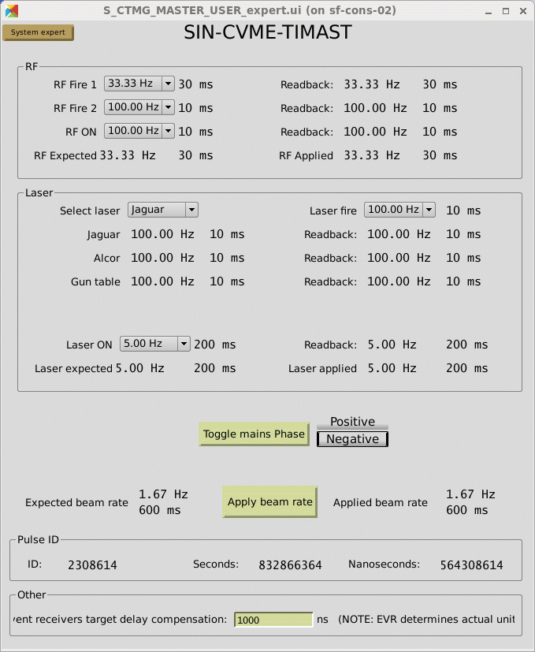
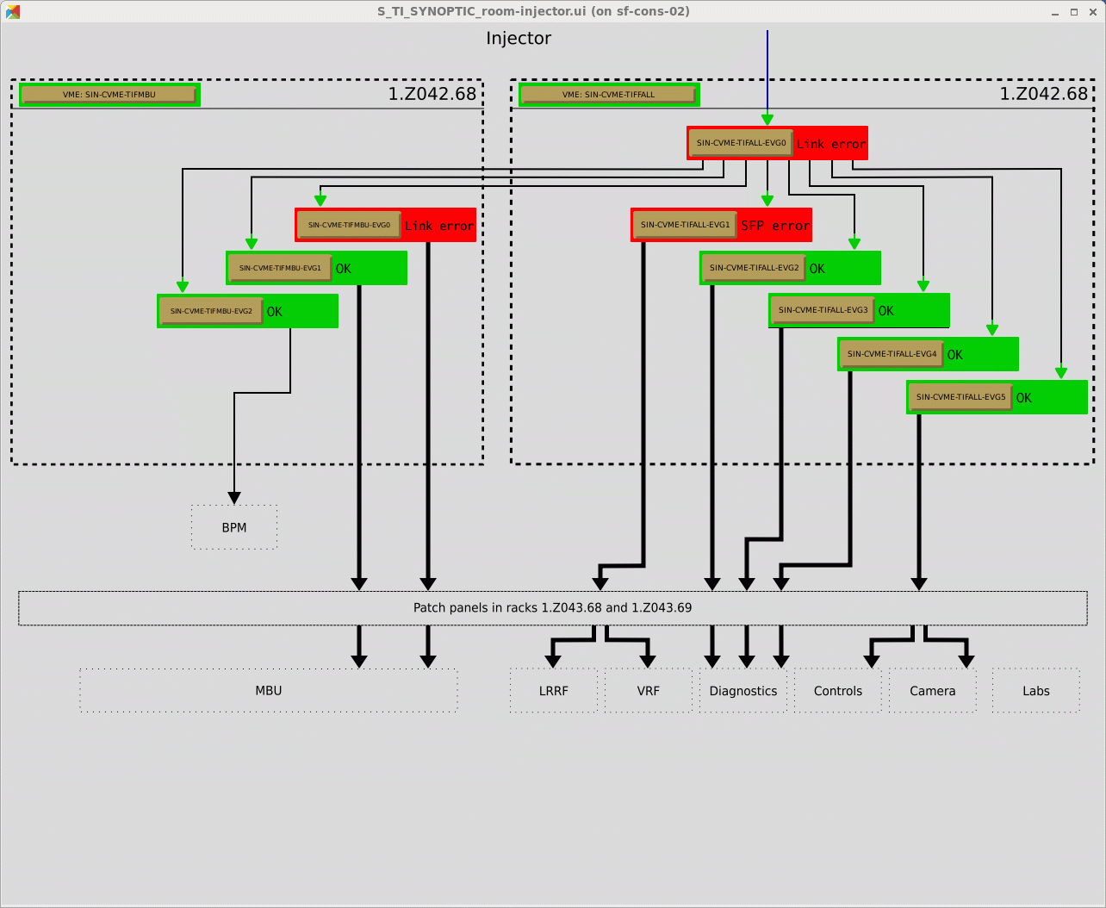
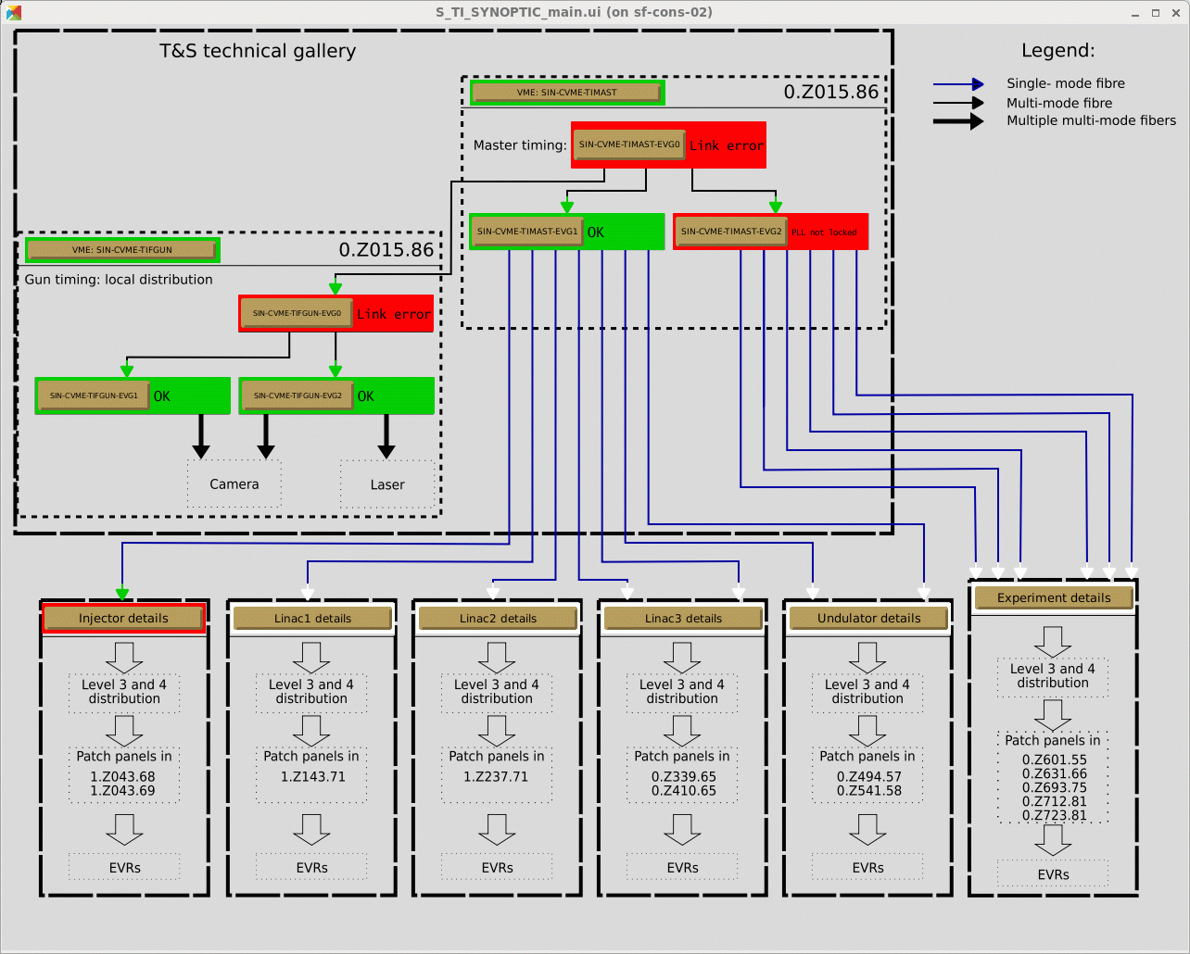
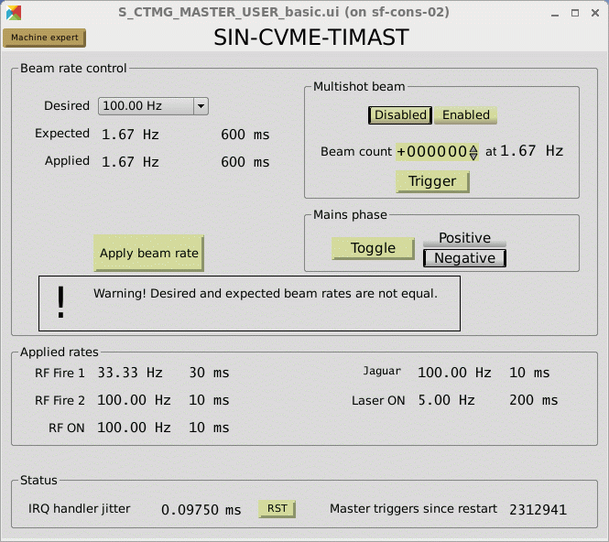
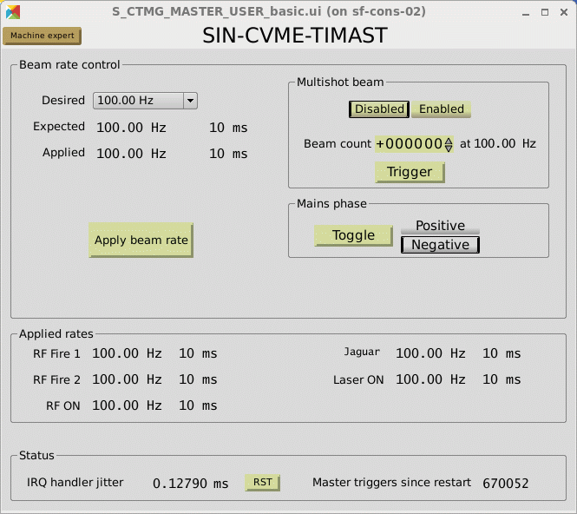
Some look and feel (master app)

Slide 11
Future plans…
Further implementation of the timing network (200 – 750 meter)
  Cabling, EVM/EVR installations on Linac1-3, UH and EH
Focus will move to timing based apps
  New machine timing modes, more involved rep rate controls
  Synchronous DAQ commissioning
  Sync. Machine scans: synchronous write/read across multiple IOCs
  (e.g., fast emmitance measurements)
Generate trigger-acquisition patterns (e.g. pump-probe exp.)
  load/generate complex trigger patterns for multiple components
  apply complex DAQ logic synchronously for generated data
More sophisticated MPS assistance in multi-bunch operation
  Tweak beam rate of selected beamline
  Apply delay switching mechanism to pockels cell of selected bunch

Slide 12
Wir schaffen Wissen – heute für morgen
My thanks go to
Controls members
Other expert groups
Cosylab team at PSI

Slide 13
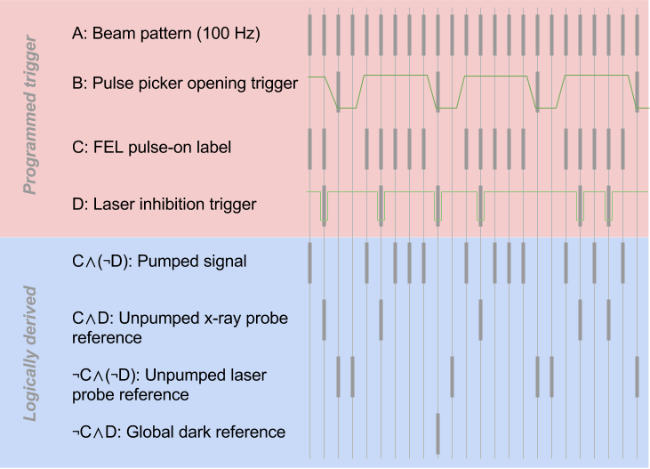
More fancy stuff
Machine synchronous scans (e.g. fast emmitance measurement)
  Parameters must be set synchronously across multiple systems (sync. Write)
  Read relevant beam characteristic synchronously (sync. read; BSread)
Generate trigger-acquisition patterns (e.g. pump-probe exp.)
  Upload well defined trigger pattern and acquisition logic to the timing system
  Upon user’s demand, timing system generates the requested trigger pattern and the required logic for BSread (when to store/drop data)

Slide 14
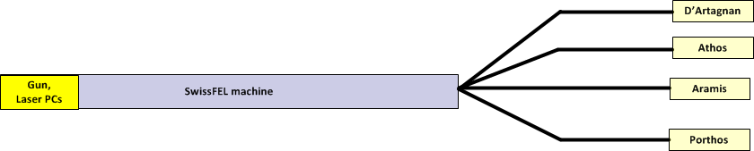
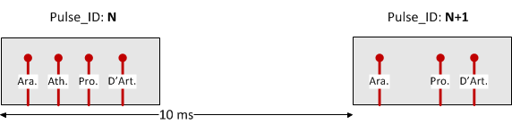

More fancy stuff …
MPS-Timing new L0/L1 alarms
Example: Insert screen monitor in Athos
  MPS raises L0-Athos alarm to the timing system
  Pockels Cell trigger of Athos bunch goes off-beam
L0-Athos alarm

