Slide 1
ITER XML Framework for EPICS Configuration
D.Stepanov, L.Abadie
ITER Organization

Slide 2
Objective
Have entire I&C configuration data represented using a common approach (XML-based format), in order to:
Do detailed modeling before selecting the actual implementation / tool
Exchange similar / related / overlapping data between I&C applications using the same format
Enable consistency checks across different data domains
Be less dependent of particular implementations (but not redo them)
ITER is using a custom framework called SDD to enforce standardization in its I&C configuration.

Slide 3
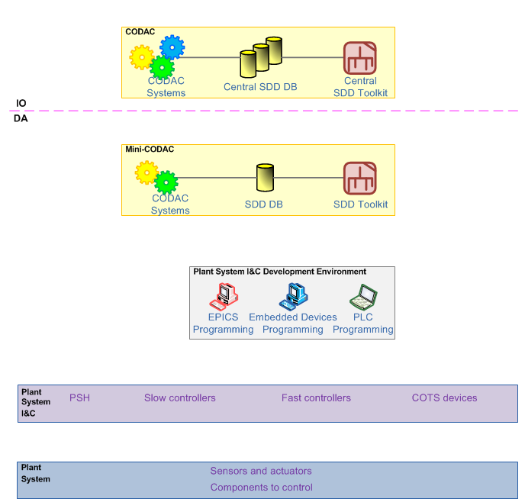
SDD Data Flows (before integration)
SQL
XML (projects)
XML (static data)
SQL
Config. data
Runtime data

Slide 4
How XML is Used
ITER configuration data framework (SDD):
Is initialized with static data definitions
Each configuration module carries a set of XML files describing its properties:
Supported hardware description
EPICS device support description
EPICS templates description
EPICS “base” is counted as a module too (having only DBDs)
Allows defining control interfaces and generation of configuration files from SQL database into application-specific format
When there is a need to export the entire project for exchange/ storage / version control, XML format is used

Slide 5
ITER XML Modeling Approach
XML Data model is described using XSD
Top level schema describes ITER vision of the control system (architecture, data types, key objects, …) and defines a concept of an “I&C project”
Application-specific schemas are plugged into the main schema using “xsd:import” mechanism:
In the case XSD is available – used as is (cases: CS-Studio BEAST/BEAUTY, …)
In the case XSD is not available – it is prepared and maintained by ITER (this is the case for EPICS)
XSDs are used to:
Validate XML files, especially those provided externally
Generate Java API to process XMLs (via JAXB compiler)
Document the model (scope, content, relationships) – automatic tools exist

Slide 6
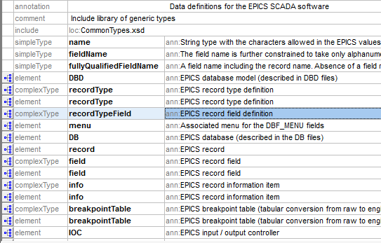
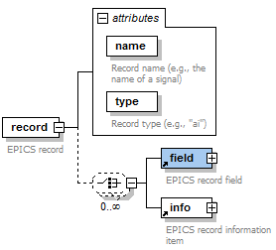
EPICS.xsd
Describes principal EPICS objects (record types, records, fields, DBD files, IOCs, …)
Built on the basis of EPICS record reference manual; not ITER specific
Not 100% complete (only points of interest for ITER have been covered, but can be extended if needed)
Is used as a basis for ITER extensions (ITER-specific markup of EPICS data)

Slide 7
EPICS DB file
XML mapping is straightforward:
record (ai,"TEST-S7-COMM:AI16-JT-CRC")
{
field(DESC, "signed short word")
field(DTYP, "asynInt32")
field(HHSV, "MAJOR")
field(HIGH, "32766")
field(HIHI, "32767")
field(HSV, "MINOR")
field(HYST, "1")
field(INP, "@asyn(P0_cfg 58)INT16")
field(LLSV, "MAJOR")
field(LOLO, "-32768")
field(LOW, "-32767")
field(LSV, "MINOR")
field(PINI, "YES")
field(SCAN, "I/O Intr")
field(TSE, "-2")
}
<record @type="ai" @name="TEST-S7-COMM:AI16-JT-CRC">
<field @name="DESC" @value="signed short word"/>
<field @name="DTYP" @value="asynInt32"/>
<field @name="HHSV" @value="MAJOR"/>
<field @name="HIGH" @value="32766"/>
<field @name="HIHI" @value="32767"/>
<field @name="HSV" @value="MINOR"/>
<field @name="HYST" @value="1"/>
<field @name="INP" @value="@asyn(P0_cfg 58)INT16"/>
<field @name="LLSV" @value="MAJOR"/>
<field @name="LOLO" @value="-32768"/>
<field @name="LOW" @value="-32767"/>
<field @name="LSV" @value="MINOR"/>
<field @name="PINI" @value="YES"/>
<field @name="SCAN" @value="I/O Intr"/>
<field @name="TSE" @value="-2"/>
</record>

Slide 8
Simple Validation
Some constraints can be already defined on this level:
<xs:attribute name="type">
<xs:annotation>
<xs:documentation>Field data type (e.g., "DBF_STRING")</xs:documentation>
</xs:annotation>
<xs:simpleType>
<xs:restriction base="name">
<xs:enumeration value="DBF_STRING"/>
<xs:enumeration value="DBF_CHAR"/>
<xs:enumeration value="DBF_UCHAR"/>
<xs:enumeration value="DBF_SHORT"/>
<xs:enumeration value="DBF_USHORT"/>
<xs:enumeration value="DBF_LONG"/>
<xs:enumeration value="DBF_ULONG"/>
<xs:enumeration value="DBF_FLOAT"/>
<xs:enumeration value="DBF_DOUBLE"/>
<xs:enumeration value="DBF_ENUM"/>
<xs:enumeration value="DBF_MENU"/>
<xs:enumeration value="DBF_DEVICE"/>
<xs:enumeration value="DBF_INLINK"/>
<xs:enumeration value="DBF_OUTLINK"/>
<xs:enumeration value="DBF_FWDLINK"/>
<xs:enumeration value="DBF_NOACCESS"/>
</xs:restriction>
</xs:simpleType>
</xs:attribute>
<xs:simpleType name="name">
<xs:annotation>
<xs:documentation>String type with the characters allowed in the EPICS values and various names, including record names (a-z A-Z 0-9 _ - : . [ ] &lt; &gt; ;)</xs:documentation>
</xs:annotation>
<xs:restriction base="xs:string">
<xs:pattern value="[a-zA-Z0-9_\-:\.\[\]&lt;&gt;;]+"/>
</xs:restriction>
</xs:simpleType>
<xs:simpleType name="fieldName">
<xs:annotation>
<xs:documentation>The field name is further constrained to take only alphanumeric characters</xs:documentation>
</xs:annotation>
<xs:restriction base="name">
<xs:pattern value="[a-zA-Z0-9]+"/>
</xs:restriction>
</xs:simpleType>

Slide 9
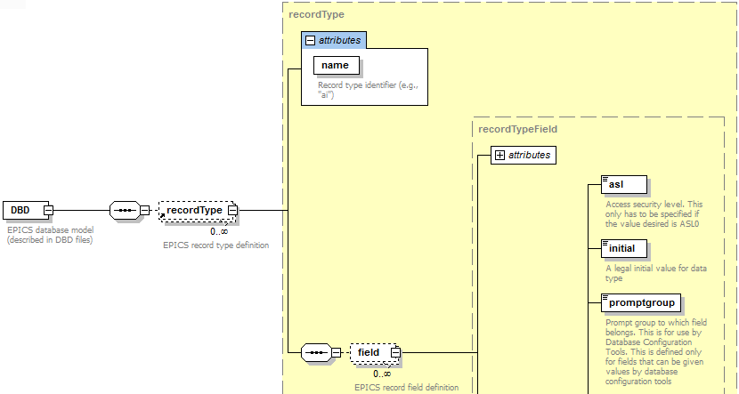
EPICS DBDs
<recordType name="ai">
<field common="true" name="NAME" type="DBF_STRING">
<special>SPC_NOMOD</special>
<prompt>Record Name</prompt>
<size>61</size>
</field>
<field common="true" name="DESC" type="DBF_STRING">
<promptgroup>GUI_COMMON</promptgroup>
<prompt>Descriptor</prompt>
<size>41</size>
</field>
<field common="true" name="ASG" type="DBF_STRING">
<promptgroup>GUI_COMMON</promptgroup>
<special>SPC_AS</special>
<prompt>Access Security Group</prompt>
<size>29</size>
</field>
<field common="true" name="SCAN" type="DBF_MENU">
<promptgroup>GUI_SCAN</promptgroup>
<special>SPC_SCAN</special>
<menu name="menuScan">
<choice name="menuScanPassive">Passive</choice>
<choice name="menuScanEvent">Event</choice>
………
One time conversion to XML is done once we upgrade the EPICS version in CODAC Core System

Slide 10
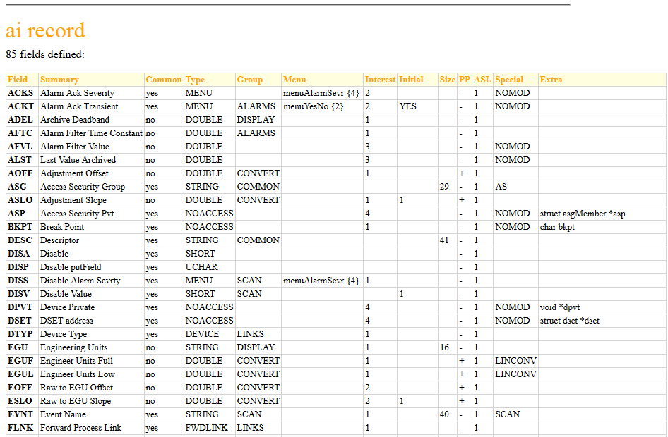
Record Types Documented
With XSL it is easy to get HTML documentation out of structured XML:

Slide 11
Device Support Definition
Used mostly to aid project generation tools like SDD to produce right makefiles, dependencies and some predefined settings
<deviceSupport name="ni6259" description="EPICS device support for NI PXI-6259 cards">
<supportedHardware>NI PXI-6259</supportedHardware>
<prefix>C</prefix>
<systemPath>/opt/codac/epics/modules/pxi6259</systemPath>
<DBDName>pxi6259.dbd</DBDName>
<libraryName>pxi6259-epics</libraryName>
<LinuxDevPrefix>/dev/pxi6259.</LinuxDevPrefix>
<setting recordType="ai" fieldName="DTYP" userConfigurable="true">
<value>ni6259</value>
</setting>
<setting recordType="ai" fieldName="INP" userConfigurable="true">
<value>#C$(MODULEIDX) S$(CHIDX)</value>
</setting>
…
</deviceSupport>

Slide 12
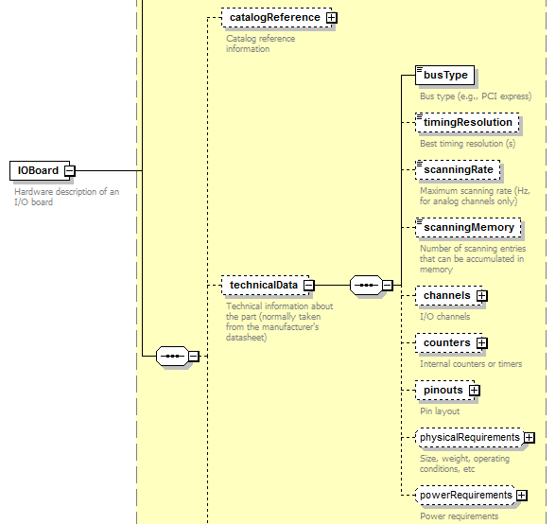
Hardware Definition
Static structured information from equipment manufacturer data sheets
Can be used to configure software which might need this information
All I/O boards from ITER I&C catalogue have such unified descriptor

Slide 13
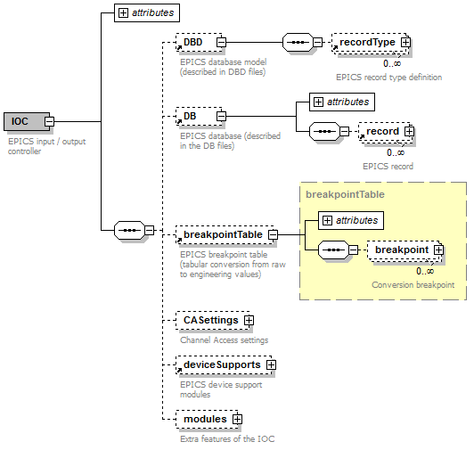
IOC Definition

Slide 14
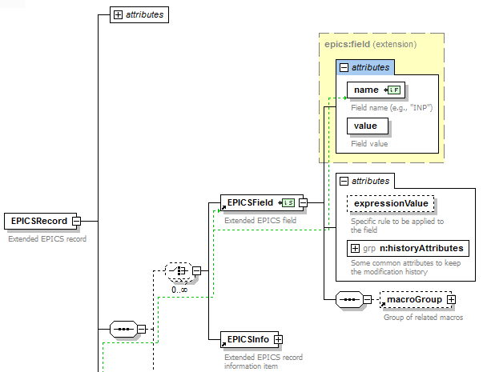
Extending EPICS Definitions
<xs:element name="EPICSField">
<xs:annotation>
<xs:documentation>Extended EPICS field</xs:documentation>
</xs:annotation>
<xs:complexType>
<xs:complexContent>
<xs:extension base="epics:field">
<xs:sequence>
<xs:element ref="macroGroup" minOccurs="0"/>
</xs:sequence>
<xs:attribute name="expressionValue" type="xs:string">
<xs:annotation>
<xs:documentation>Specific rule to be applied to the field</xs:documentation>
</xs:annotation>
</xs:attribute>
<xs:attributeGroup ref="n:historyAttributes"/>
</xs:extension>
</xs:complexContent>
</xs:complexType>
</xs:element>
Standard <xsd:extension> mechanism is used to add additional ITER-specific markup on top of vanilla EPICS records and fields

Slide 15
Variable Definition with EPICS Properties
<variable name="TEST-S7-COMM:AI16-JT-CRC“ description="signed short word“ createdAt="2015-02-06T15:29:45.898Z“>
<direction>state</direction>
<kind>continuous</kind>
<implementsFunction>TEST-S7-COMM</implementsFunction>
<raisesAlarm>true</raisesAlarm>
<!-- ... -->
<EPICSAttributes>
<EPICSRecord name="TEST-S7-COMM:AI16-JT-CRC" type="ai" createdAt="2015-02-06T15:29:45.898Z">
<EPICSField name="HHSV" value="MAJOR"/>
<EPICSField name="HIGH" value="32766"/>
<EPICSField name="HIHI" value="32767"/>
<EPICSField name="HSV" value="MINOR"/>
<EPICSField name="HYST" value="1"/>
<EPICSField name="LLSV" value="MAJOR"/>
<EPICSField name="LOLO" value="-32768"/>
<EPICSField name="LOW" value="-32767"/>
<EPICSField name="LSV" value="MINOR"/>
</EPICSRecord>
</EPICSAttributes>
<BEASTAttributes>
<beast:pv name="TEST-S7-COMM:AI16-JT-CRC">
<beast:description>signed short word alarm</beast:description>
<beast:enabled>true</beast:enabled>
<beast:latching>true</beast:latching>
<beast:annunciating>false</beast:annunciating>
</beast:pv>
</BEASTAttributes>
</variable>
Generic / ITER properties
EPICS properties
CS-Studio BEAST properties

Slide 16
Modifications between CODAC versions
Having EPICS data exported in XML makes some migration changes easier. XSLT can be applied to do automated corrections.
Ex:
<!-- +++ Discard invalid SMOO fields, as 3.1 DB won't allow them to load (bug 3001) +++ -->
<xsl:template match="psic:EPICSRecord[@type = 'ai']/
psic:EPICSField[@name = 'SMOO' and (@value &lt; 0 or @value &gt; 1)]"/>

Slide 17
Advanced Applications
Validation of I&C standards for deliverables from suppliers:
I&C configuration data is systematically converted to XML with known grammar
Many I&C rules expressed in narrative “standards” documents can be re-written using formal statements
Ex: various naming conventions, composition of controllers, protocols used, …
3) Rule checking engine is applied to configuration data. Schematron was tested in prototypes and found promising
Cross-checking data from different domains
Ex: check that a PV used in CS-Studio BOY screen has the corresponding EPICS definition

Slide 18
Conclusion
ITER has developed XML / XSD definitions for EPICS configuration data
Definitions are pretty much stable and have been used since six years now (from CODAC Core v1)
No plans to integrate them directly with EPICS, but …
Should XML use with EPICS be needed in some projects, this could be a basis to start with
Thank you!

