Slide 1
LCLS-II Control System Update
Matt Gibbs, SLAC National Accelerator Laboratory

Slide 2
Outline
Introduction
LCLS-II Operating Parameters
Control System Plans
Mature Systems
New High Performance Systems
Notes:
First, I’ll give an overview of LCLS-II, how it fits into SLAC, and the improvements planned over LCLS 1.
Then, I’ll discuss the control system for the new machine. We plan on re-using as much of the proven LCLS 1 software as possible, but as you’ll see, LCLS-II’s requirements mean we still need many new designs.

Slide 3
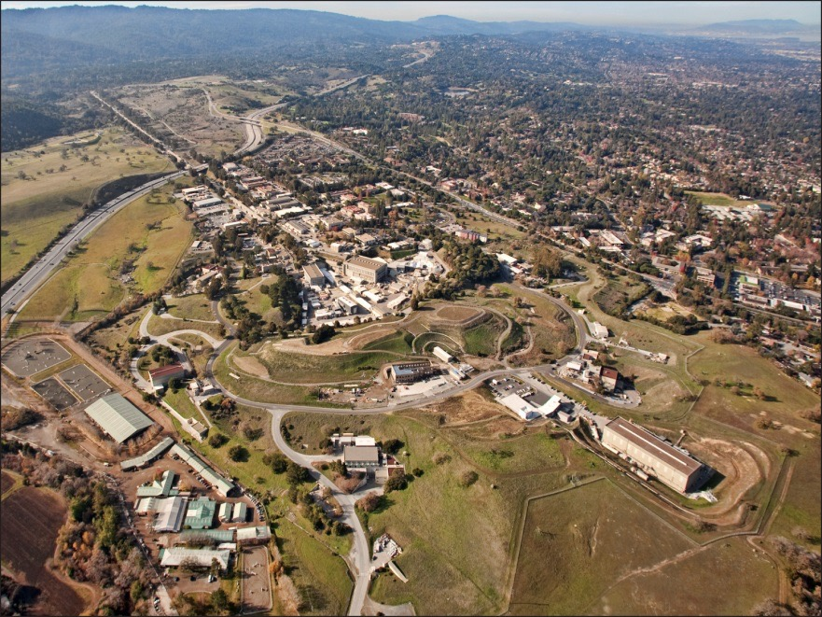
LCLS: World’s First Hard X-Ray FEL
Delivering science since 2009
A billion times brighter than previous sources
Study of ultra-fast and ultra-small phenomena
Can capture images of atoms & molecules in motion
Delivers to ~600
scientists/year
~25% of proposals
are allotted time
SLAC
Notes:
First I’ll mention LCLS 1. It has been delivering to users since 2009, it produces extremely bright, extremely short X-ray pulses, and it is in very high demand - only about a quarter of proposals can get time on LCLS.
Breakthrough scientific results have prompted construction of similar facilities around the world.

Slide 4
LCLS-II Project
proposed
FACET-II
LCLS-I Linac
2.5-15 GeV
LCLS-II Linac
0.2-1.3 keV (1 MHz)
Sec. 11-20
Sec. 21-30
SXU
SCRF
HXU
4 GeV
1-25 keV (120 Hz)
1-5 keV (1 MHz)
New 1 MHz Injector, SCRF linac, and extension installed in Sectors 0-10
Re-use existing Bypass line from Sector 10 to beam switchyard (BSY)
Fast kicker to direct beams to dump, SXR or HXR
Install two variable gap undulators: HXR (replacing LCLS-I) and SXR
Re-use existing transfer line (LTU) to HXR; modify HXR dump
Construct new LTU to SXR and new dump line
Modify existing LCLS-I X-ray optics and build new SXR X-ray line
Notes:
Here are the plans for LCLS-II: A brand new injector developed at Lawrence Berkeley provides electron bunches at 1 MHz. Those bunches are then accelerated with a brand new superconducting linac (replacing the copper accelerating structure we’ve used since the sixties).
After acceleration, the LCLS-II beam will travel in a bypass line through the remaining 2/3rds of the accelerator tunnel. It then merges with the LCLS-1 beam line, and can be kicked into one of two new variable gap undulator lines.

Slide 5
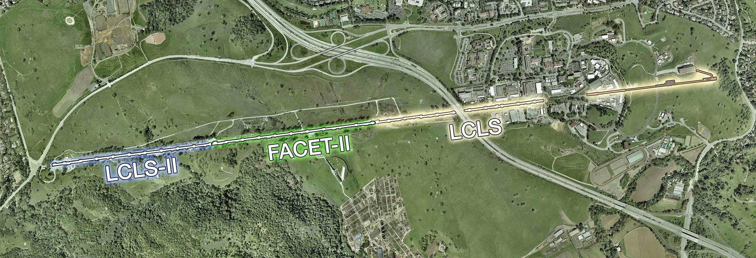
LCLS-II at SLAC
LCLS-II accelerates beam in the first 1km of the linac
Bypass line through FACET-II and LCLS-I
Shares beam switch yard, undulator hall and experiment halls with LCLS-I
Notes:
Here’s a top-down view of the site, showing how LCLS-II fits in with the rest of the linear accelerator. The undulator hall on the far right will be shared between both LCLS 1 and LCLS II.

Slide 6
Project Collaboration
50% of cryomodules: 1.3 GHz
Cryomodules: 3.9 GHz
Cryomodule engineering/design
Helium distribution, including valve boxes
Processing for high Q (FNAL-invented gas doping)
50% of cryomodules: 1.3 GHz
Cryoplant selection/design/installation/commissioning
Processing for high Q
LLRF Controls
Undulators
e⁻ gun & associated injector systems
LLRF Controls
Accelerator physics support
Undulator Vacuum Chamber
Also supports FNAL w/ SCRF cleaning facility
Undulator R&D: vertical polarization
R&D planning, accelerator physics & prototype support
processing for high-Q
e⁻ gun option
LLRF Control
LLRF Control
LLRF Controls
LLRF Control
Notes:
LCLS-II is a big collaboration - Fermilab is building half of the cryomodules, Jefferson Lab is taking care of the other half, as well as building and commissioning the cryoplant. Lawrence Berkeley is building the electron gun, and working on the undulators. Argonne National Lab is also working on the undulator system. Cornell is doing R&D and prototyping.

Slide 7
LCLS-II Parameters
Parameter | LCLS | LCLS-II
Accelerator Type | Normal conducting Cu | Superconducting
Final Electron Energy Range | 2.5 - 15 GeV | 2.0 - 4.5 GeV
Typical Electron Bunch Charge Range | 20 - 300 pC | 10 - 300 pC
Max Repetition Rate | 120 Hz | 929 kHz
Max Electron Beam Power | 540 W | 1.2 MW
LCLS-II’s high repetition rate and beam power present new challenges for the control system.
Notes:
LCLS-II’s most significant new feature is the high repetition rate - its about eight thousand times higher than LCLS 1. This really pushes the requirements of the beam diagnostics and data acquisition systems. The high rep rate also means the average beam power can be about two thousand times higher, which is a big challenge for the beam containment and machine protection systems.

Slide 8
Controls Subsystems
Controls scope includes…
Control & monitoring of beam line components
Data acquisition and analysis for diagnostic systems
Timing, synchronization and event systems
Network and Controls computing infrastructure
Low Level RF and Feedback systems
Machine Protection System
Personnel safety systems
Cryo Interfaces (Cryoplant, Cyro Distribution, Cryomodule)
X-ray Transport and Experiment Systems controls (Mirrors, Solid and Gas Attenuators, Stoppers, Collimators, Imagers)
Controls infrastructure, including racks & cables
Notes:
These are the control system pieces we need to run LCLS-II.
The High Level Requirements are:
* Extend the successful EPICS Controls from LCLS to LCLS-II
* Preserve all the single-pulse control and single-pulse read-back features of a single-pass accelerator
But do so for the CW LCLS-II with a repetition rate up to 1 MHz
Maintain compatibility with the present 120 Hz LCLS

Slide 9
Controls High Level Requirements
Extend LCLS 1’s successful EPICS controls to LCLS-II
Preserve the single-pulse control and single-pulse measurement features needed for the single-pass accelerator
Maintain compatibility with LCLS, which shares electron and photon beam lines with LCLS-II
Notes:
These are the control system pieces we need to run LCLS-II.
The High Level Requirements are:
* Extend the successful EPICS Controls from LCLS to LCLS-II
* Preserve all the single-pulse control and single-pulse read-back features of a single-pass accelerator
But do so for the CW LCLS-II with a repetition rate up to 1 MHz
Maintain compatibility with the present 120 Hz LCLS

Slide 10
What can we re-use?
Mature subsystems that can re-use LCLS-I designs:
High Performance Systems with substantial new requirements:
Network Architecture
Controls Computing Infrastructure
Drive Laser Control
Vacuum Controls
Magnet Power Supply
Personnel Protection
Beam Containment
General Motion Control
Undulator Control
Self-Seeding
Timing & Synchronization
Low Level RF
Diagnostic Systems (BPMs, Bunch Length Monitor, etc.)
Machine Protection
Beam Containment System Fast Shut-off
Cryo Module, Cryo dist, Cryoplant I/F Controls
Notes:
Despite the new machine parameters, we can still re-use a considerable amount of the work we put into LCLS 1. Many of the systems don’t need to work at 1 MHz.
The systems that *do* need new designs are timing, LLRF, beam diagnostics, machine protection, and parts of the beam containment system.
In addition, SLAC doesn’t have much history with cryogenic systems, and we need designs for those.

Slide 11
Mature Subsystems Re-using LCLS-I Designs
♻
Re-using as much as possible from LCLS
Reduce maintenance, training, documentation, and support costs
Sharing EPICS subsystem code base and development environment
Ops software (machine config management, logbooks, etc) will be shared with LCLS-II, and many of the MATLAB physics high level apps will be re-used
Archive Appliance used for both machines (LCLS-II will probably have a separate instance)
Notes:
So the goal is to re-use as much as we can from LCLS - that reduces maintenance, training, documentation, and support.
The “mature” LCLS-II systems can share the same EPICS code base as their LCLS-1 counterparts.
Many high level applications, like operations software and physics apps will be re-used, with slight modifications.
The Archive Appliance will be used for both machines.

Slide 12
Mature Subsystems - New Software
New EPICS v4 services for high level apps (Directory, Name, Model Manager, Archive Appliance, …) will make it easier to build new applications. See Murali Shankar’s talk on Friday for more info.
New Model Manager based on MATLAB and MAD
Evaluating EDM alternatives for GUIs
Notes:
We do plan on some new software, even for the ‘mature’ subsystems. We’ll have many new V4 services available - Murali Shankar will be talking about those on Friday. There are plans to build a new model manager tool, and we are looking at alternatives to using EDM for displays.

Slide 13
New High Performance Subsystems
New timing system, diagnostics (BPMs, Bunch Length Monitors, etc), and beam-based feedbacks needed for 1 MHz repetition rate
New machine protection system, enhanced beam containment system needed to handle 1 MW beam power
Brand New Subsystems
Superconducting RF, ODH, Cryo
Partner Labs involved
Notes:
The new high performance subsystems all have a common challenge: pulse-by-pulse measurement and control at 1 MHz.

Slide 14
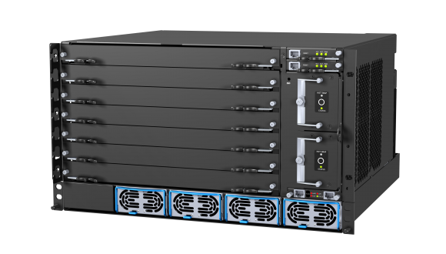
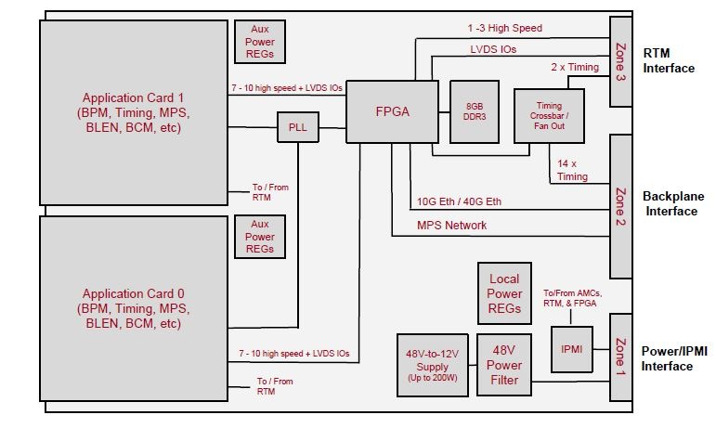
HPS Common Platform Hardware
The high performance systems are built on a common ADC + FPGA platform.
ATCA based
Carrier board hosts up to two application specific daughter boards
Each application card can associate with an IOC running on a Linux host
Notes:
To get to 1 MHz, we need to go to FPGAs. Rather than designing completely different systems, we’re building a common platform that provides ADCs, DACs, and the FPGA. It is based on the ATCA standard. Each high performance system uses a common ATCA carrier board which hosts two system-specific daughter boards.

Slide 15
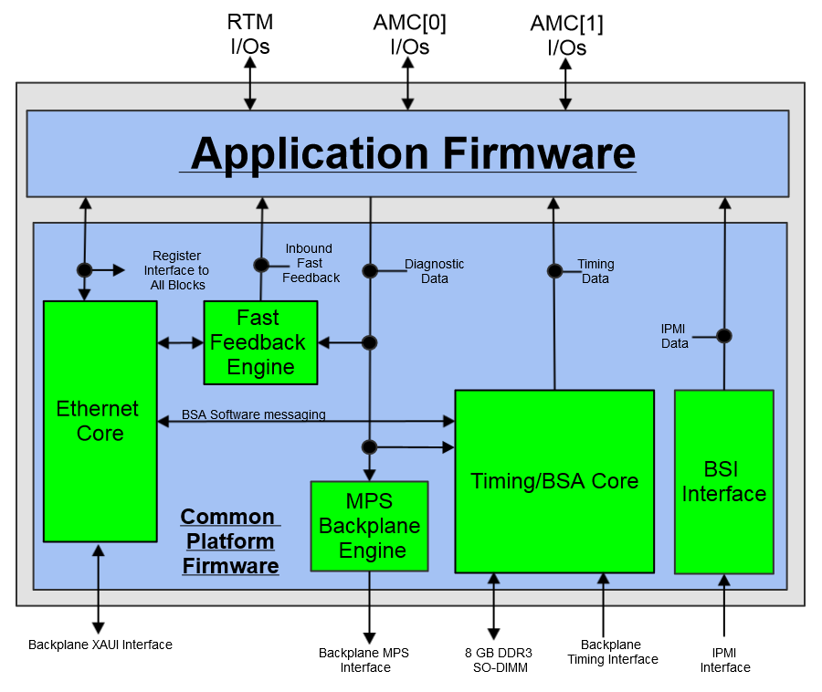
HPS Common Platform Firmware
Common platform firmware provides support for ADC/DACs, networking, timing receiver, BSA data collection, MPS messages, etc.
Application firmware specific to each subsystem is built on top of the common firmware.
Notes:
The firmware is built to be shared too - system-specific firmware is built on top of common platform firmware that handles support for ADCs and DACs, networking, interacting with the timing system, BSA, and MPS.

Slide 16
HPS Common Platform Software
A Common Platform Software (CPSW) framework provides a common interface to the FPGA for all higher-level software.
CPSW is the glue between the common platform firmware and EPICS
EPICS Interface
Asyn
CPSW
Software
Firmware
Hardware
Notes:
We’re also developing a common platform software framework to interact with the system firmware. The common platform software provides the lower-level interface to the hardware, and EPICS support can be built on top of the common platform software framework.

Slide 17
Summary
LCLS-II is a significant advancement over LCLS
Where possible, we plan re-using our existing EPICS software from LCLS in LCLS-II
Some new systems are required due to LCLS-II’s high repetition rate and beam power
Adding new EPICS v4 infrastructure
Development is progressing on the common platform for high performance systems
Final Design Reviews for all controls subsystems will be complete by the end of 2016
Notes:
To conclude, LCLS-II is a big advancement over LCLS 1, but also means many challenges. To be as efficient as possible, we’ll re-use LCLS software when we can, but some new systems are essential.

Slide 18
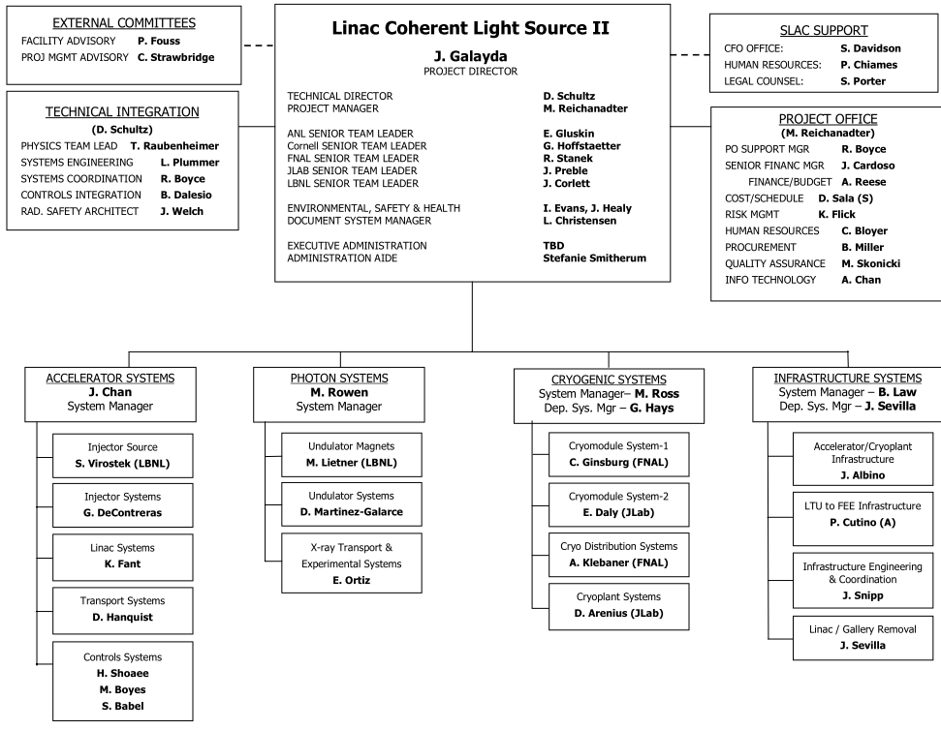
Acknowledgements
Slides provided by:
Debbie Rogind
John Galayda
Larry Ruckman
Mitch D’Ewart
Paul Emma
Matt Weaver
Andrew Young
Hamid Shoaee
Shawn Alverson
Shweta Saraf
Jingchen Zhou
Thanks to everyone working on LCLS-II
And thank you for your attention!

Slide 19
Backup Slides - Subsystem Details

Slide 20
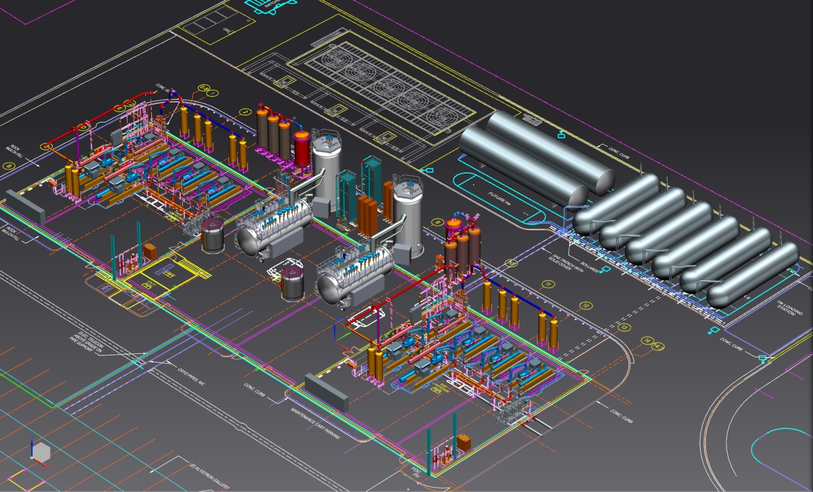
Two Refrigeration Systems in the Cryoplant
A second cryoplant was adopted after the CD3b review to mitigate the risk of the required heat load of cryosystem (2) 4.5K and (2) 2K cold boxes – copy of jlab design

Slide 21
Machine Protection System
Protects machine components from beam based damage by shutting off beam or reducing beam rate
Must be capable of shutting off beam within 100 us to protect collimators from a direct beam strike
Must support simultaneous delivery to multiple users
FPGA-based system
“Link Nodes” collect signals from beam line devices
“Central Node” FPGA processes inputs, mitigates beam

Slide 22
Stripline and Cold Button BPM: Common Platform Design
Two BPMs serviced by a single Common Carrier Board
Common Carrier Board
AMC Board
FPGA
BPM
Front-end
BPMs Vacuum Structure
4
2 x
ADC
370Msps
BPM App. Firmware
Calibration Trigger
AMC Board
Crate Timing Input
Eth/UDP
Common
Platform Firmware
BPM
Front-end
10Gbps Eth/UDP
Zone 2
BPMs Vacuum Structure
2 x
ADC
370Msps
4
BPM App. Firmware
Calibration Trigger
MPS Output
To MPS Board

Slide 23
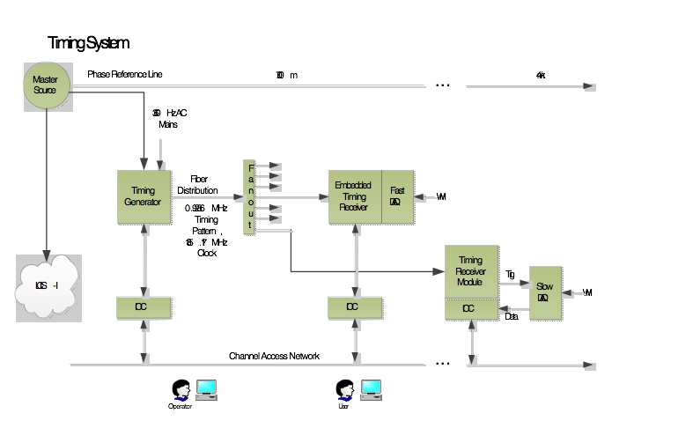
Timing System Block Diagram
HPS
Non-HPS

Slide 24
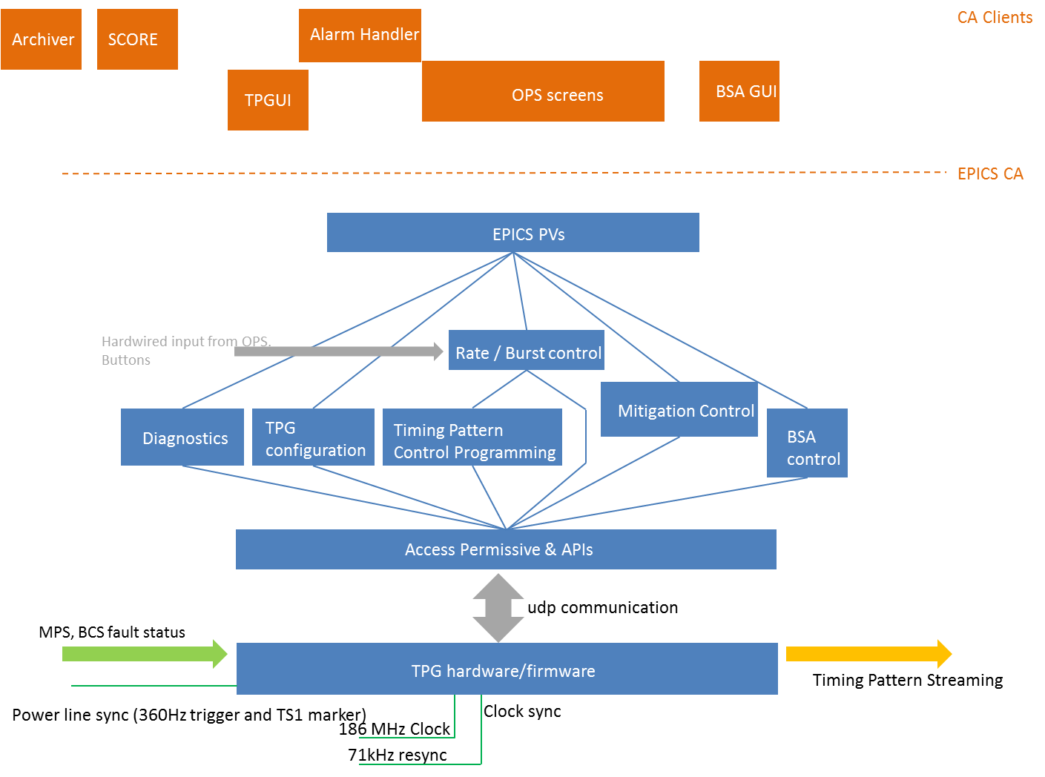
Timing Generator: Software Design
Linux host application

Slide 25
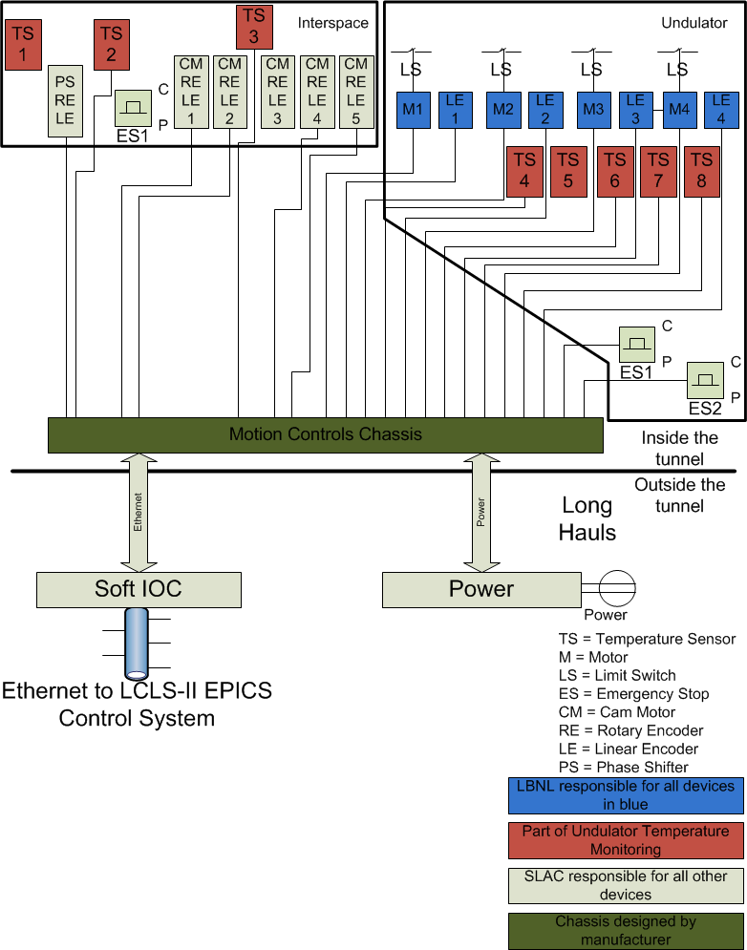
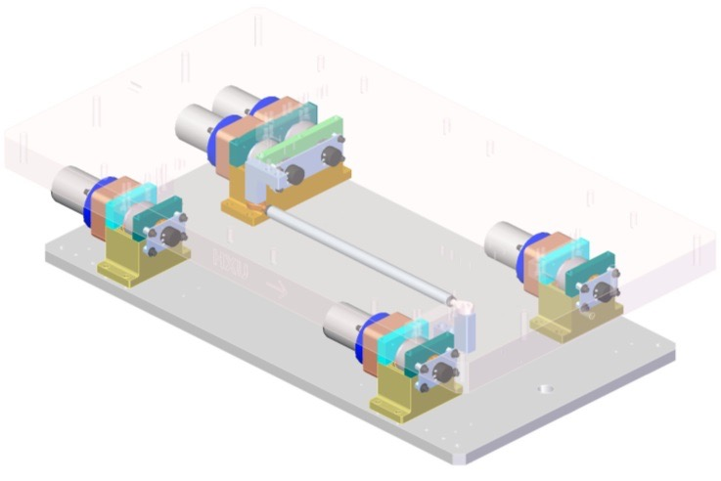
Variable Gap Undulator Motion Control System
Undulator gap control using 4 motors, position encoders & limit switches
Interspace control using 5 cam system, 5 contact points at four corners
Controls for each undulator and interspace will be integrated into a single system that interfaces to an EPICS IOC
Prototype assembly is complete
A temperature monitoring system is also integrated into each control chassis, with sensors on the undulator and interspace

Slide 26
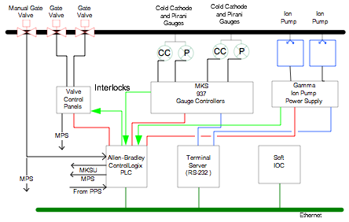
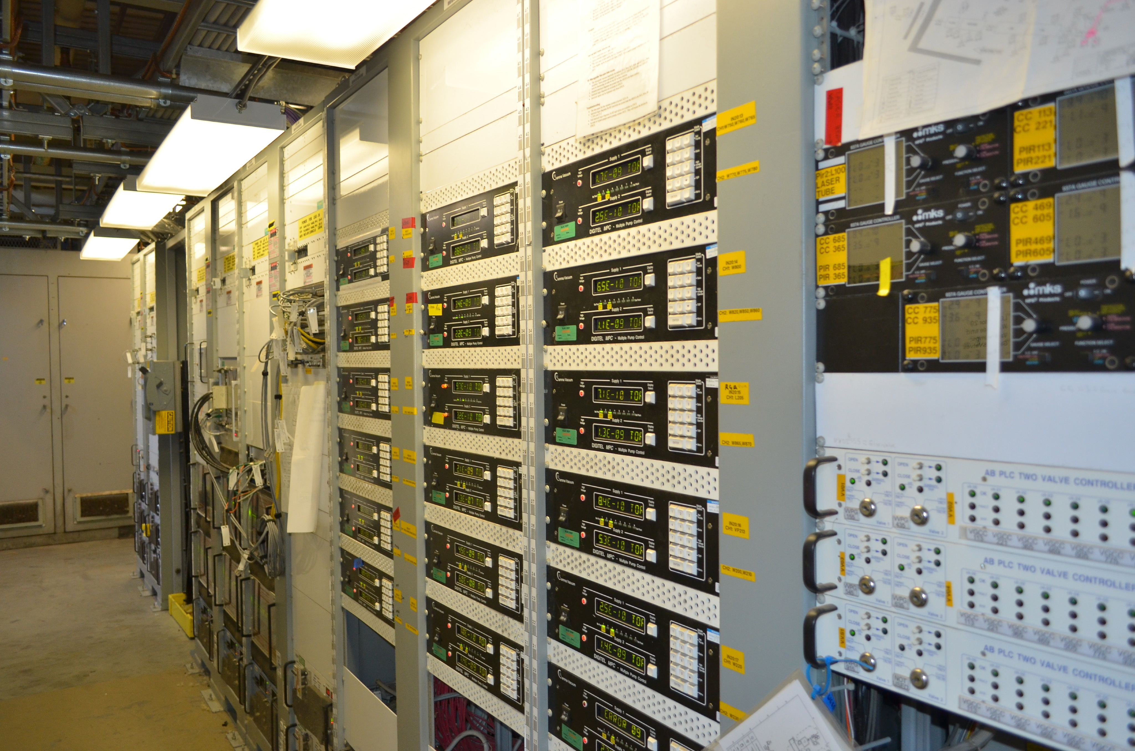
Vacuum controls will use the same proven design as LCLS-I

Slide 27
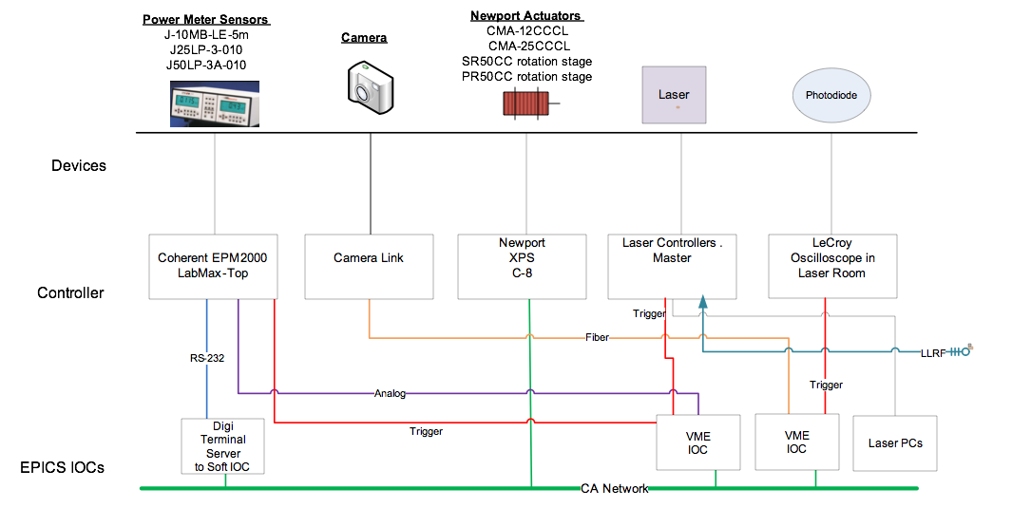
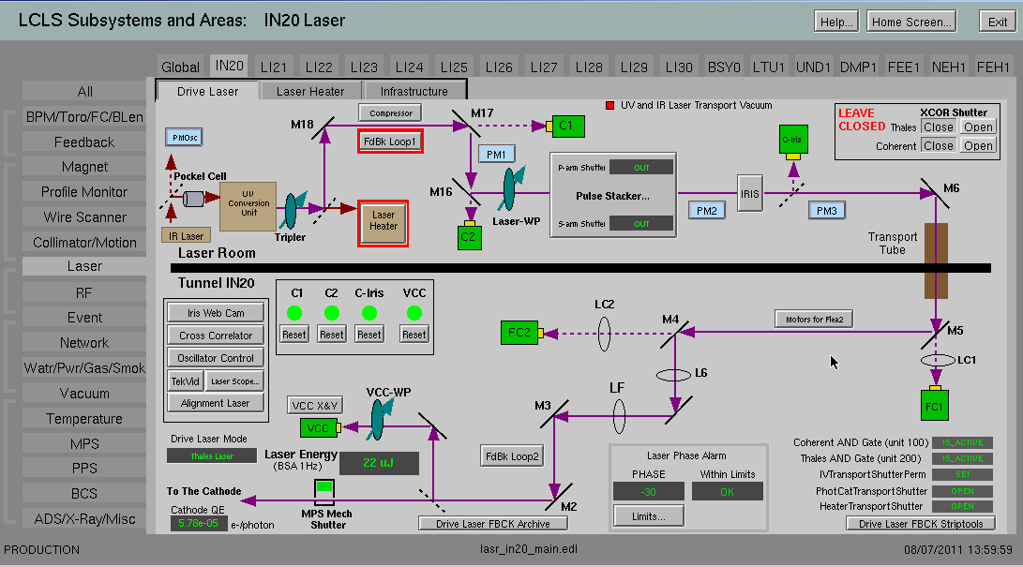
Drive Laser & Laser Heater Controls – Based on LCLS-I Design

Slide 28
Temperature Monitoring System Software Design
EtherIP driver / device support module to communicate with EPICS IOCs for AB CompactLogix PLC
IOC software structure to remain as close as possible to current LCLS-I
Standard EPICS Implementation
Operator displays
Archiving (history plots)
Alarms (inform operators of problems)
Notes:
EtherIP driver for AB PLC
IOC software structure (softiocs) to remain the same or as close as LCLS as possible.
Provide the operator displays, archiving the data as well as alarm configurations to inform operators of problems

