Slide 1
Qt Applications at TRIUMF
Epics Collaboration Meeting – Lund May 2016
Rolf Keitel

Slide 2
EPICS at TRIUMF
20 years EPICS at TRIUMF this January !!!
Thanks to everyone who helped us with
software
advice
reviews
Transitions
Sun/Solaris → x86/Linux
Motorola MV162 / VxWorks → x86/Linux, Arm/Linux
edd/dm → edm
CapfastTM → tdct
EPICS 3.12.2 → EPICS 3.14.12
Constants
EPICS
Trar ASCII archiver
burt
StripTool
Alh

Slide 3
Next Transitions
Motif → ???
CSS? Qt?
Qt
StripTool
Alh

Slide 4
Next Transitions
Motif → ???
CSS? Qt?
Qt
StripTool → TChart
Alh → TAlh

Slide 5
StripTool → TChart
My wish-list
use CA monitors
pan into archived data
write data to file (all – not just display buffer, optional)
retrieve saved data files
retrieve saved data from different TChart instances
retrieve archiver data
use retrieved data as background

Slide 6
TChart
Status
Implementation
uses QCustomPlot Widget (http://qcustomplot.com/)
use CA monitors
pan into archived data
write data to file (all – not just display buffer, optional)
retrieve saved data files
retrieve saved data from different TChart instances
retrieve archiver data
use retrieved data as background

Slide 7
TChart
Status
Implementation
uses QCustomPlot Widget (http://qcustomplot.com/)
use CA monitors
pan into archived data
write data to file (all – not just display buffer, optional)
retrieve saved data files
retrieve saved data from different TChart instances
retrieve archiver data
use retrieved data as background

Slide 8
TChart
Status
Implementation
uses QCustomPlot Widget (http://qcustomplot.com/)
use CA monitors
pan into archived data
write data to file (all – not just display buffer, optional)
retrieve saved data files
retrieve saved data from different TChart instances
retrieve archiver data
use retrieved data as background
Testing
beta - finished
RC1 with operations group

Slide 9
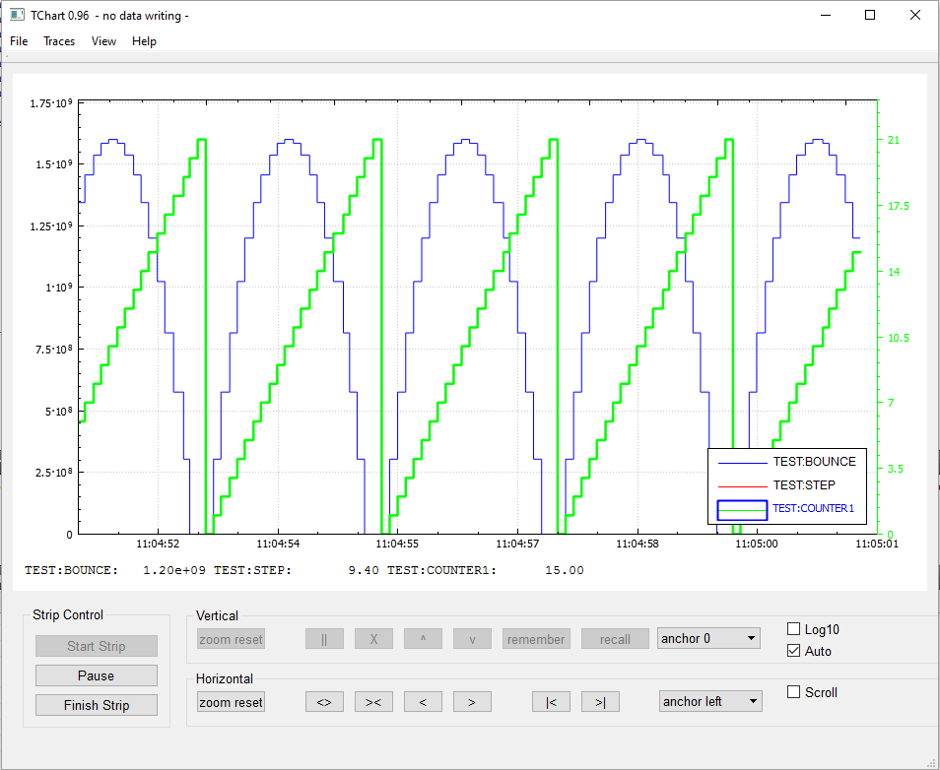

Slide 10
Tchart – next steps
wishful thinking?
make archive retriever a proper plug-in

Slide 11
Alh → TAlh
My wish-list
replacement for Alh (functionality we use at TRIUMF)
improve UI
configuration editor (add/remove/modify alarms)
"channel watcher" - non-permanent

Slide 12
TAlh
Status
Implementation
can fully parse Alh configuration files
replacement for Alh (the way we use Alh at TRIUMF)
improve UI
configuration editor (add/remove/modify alarms)
"channel watcher" – non-permanent

Slide 13
TAlh
Status
Implementation
can fully parse Alh configuration files
replacement for Alh (the way we use Alh at TRIUMF)
improve UI
configuration editor (add/remove/modify alarms)
"channel watcher" – non-permanent

Slide 14
TAlh
Status
Implementation
can fully parse Alh configuration files
replacement for Alh (the way we use Alh at TRIUMF)
improve UI
configuration editor (add/remove/modify alarms)
"channel watcher" – non-permanent
still missing for Alh compatibility:
alarm filters
force PVs
severity PVs
........

Slide 15
TAlh
Status
Implementation
can fully parse Alh configuration files
replacement for Alh (the way we use Alh at TRIUMF)
improve UI
configuration editor (add/remove/modify alarms)
"channel watcher" – non-permanent
still missing for Alh compatibility:
alarm filters
force PVs
severity PVs
........
Testing
beta - finished
RC1 with operations group

Slide 16
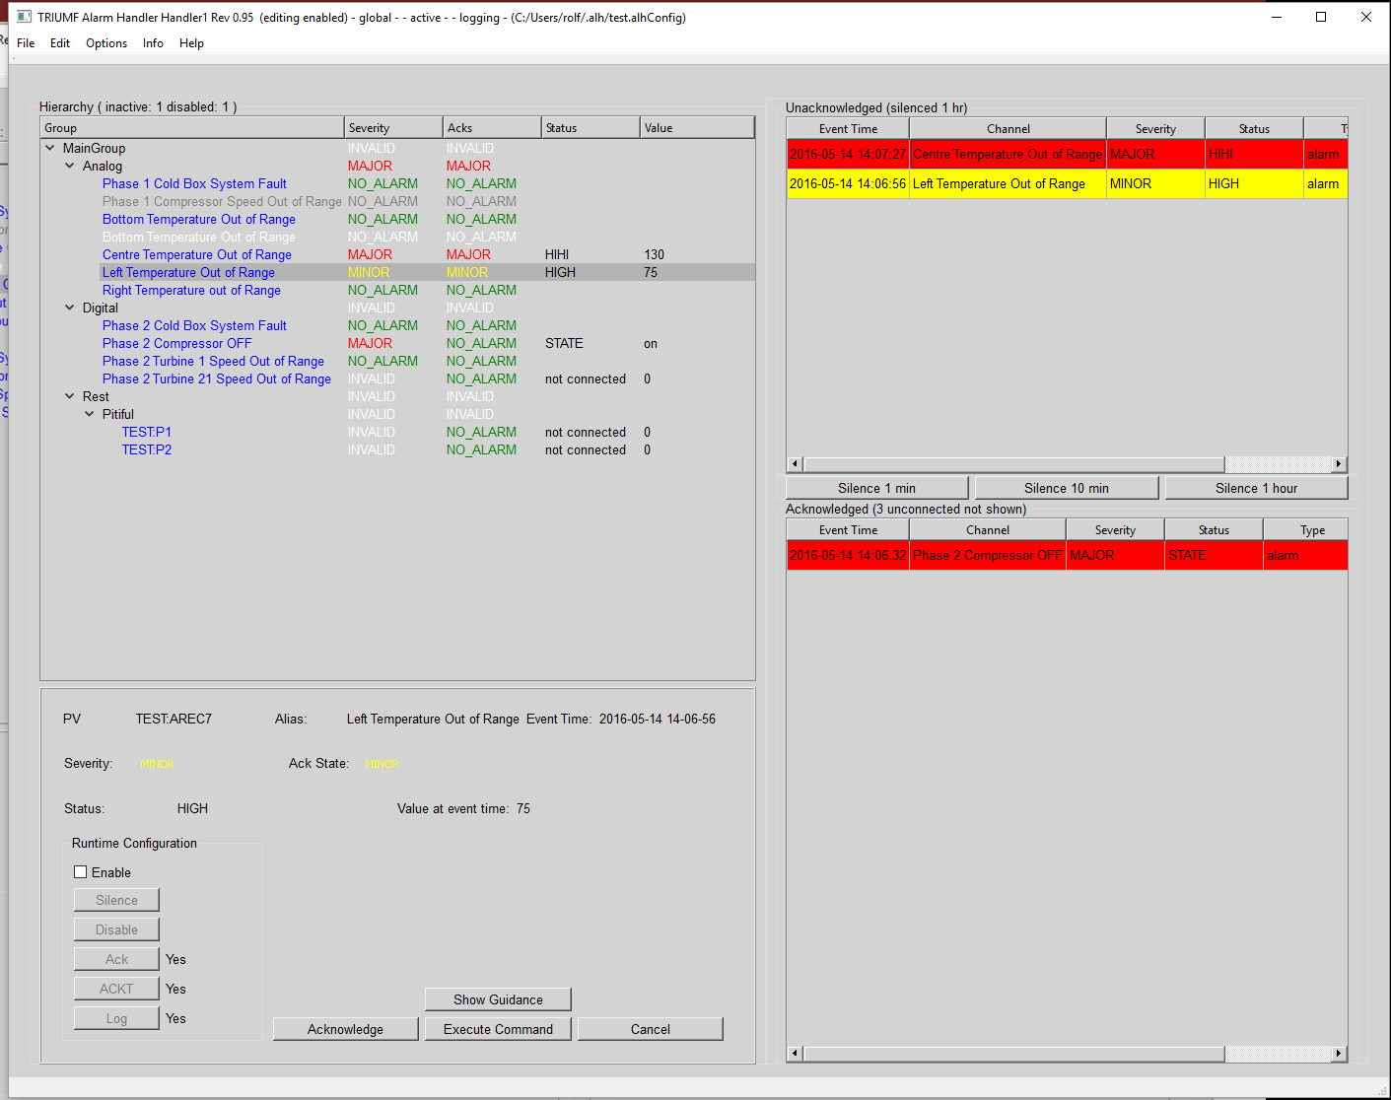
Unacknowledged
Alarm Hierarchy
Acknowledged
Operator

Slide 17
Talh - next steps
wishful thinking ?
separate into alarm GUI – alarm server
log to relational database
make fully Alh compatible - if interest.
alarm filters
force PVs
severity PVs

Slide 18
Experience with Qt
so far so good
used Qt5
QtCreator IDE
Learning curve ok
tested on Debian8, Scientific Linux6, Windows
but: edm
Control system "eco-system" built around
edm functionality. → ???

