Slide 1
DEVELOPMENT OF ADVANCED DATA AND IMAGE ACQUISITION SYSTEMS USING RIO TECHNOLOGY
AND EPICS: INTEGRATION IN ITER
Sergio Esquembri, Mariano Ruiz, J. Nieto, E. Bernal, A. Carpeño, E. Barrera, A. Bustos, D. Sanz and Ralph Lange
^{mariano.ruiz@upm.es}
Universidad Politécnica de Madrid
ITER International Organization

Slide 2
Outline
Motivation
RIO, FlexRIO and cRIO Devices
Development cycle
IRIO Project
  IRIO Library
  NIRIO-EPICS Device Support
  IRIO NDS C++ classes
Design Methodology
Applications
  ITER fission chamber
  Image acquisition system
  Advanced applications: using GPUs for ITER diagnostics
Conclusions

Slide 3
Motivation
FPGAs provide reconfigurable hardware with deterministic data preprocessing capabilities
Graphical tools such as LabVIEW for FPGA reduces development and integration time
The combination of both technologies with EPICS simplifies the development of complex control, data acquisition and processing systems
ITER has a hardware catalog for “fast controller” including FlexRIO and cRIO (only some part numbers)
IRIO is a set of software tools simplifying the integration of RIO devices in EPICS

Slide 4
RIO/FlexRIO Devices
1
2
The developer defines the functionality
programming the FPGA
EPICS connects a custom defined device with PVs for configuration and supervision

Slide 5
Development cycle: LabVIEW for FPGA

Slide 6
Using RIO devices in Linux

Slide 7
IRIO Project: IRIO Library
Identification of the resources implemented in the FPGA
  The Design Rules document describes the rules for the FPGA implementation
Provides an API simplifying the interface with the FPGA.
  Access to FPGA registers
  Analog input
  Digital I/O
  DMA acquisition
  Image acquisition using cameralink
    Serial line for camera configuration
  Signal Generation (DDS)

Slide 8
IRIO Project: EPICS driver using asynDriver
EPICS device driver using asynDriver implementation for RIO devices (FlexRIO and cRIO) using IRIO library
  Automatically connects the PVs with FPGA resources using IRIO library
If the user changes the FPGA design no compilation is needed
ITER SDD generates the complete software unit

Slide 9
Creating an IOC using RIO hardware
Add FPGA resources in app folder, Makefile
  IRIO_FPGA_DIR = <folder>
  IRIO_FPGA += <headerfile>.h
Add nirioinit in st.cmd
  Parameters (RIO device to be used, bitfile and headerfile)
Load templates
  <name>-rio-module.substitution, …
  Templates defined for each type of resource (DMA streams, A/D I/O, …)

Slide 10
IRIO Project: C++ classes for Nominal Device Support
Nominal Device Support approach defines a set of classes and PVs to be used for EPICS driver implementation.
NDS-irio is the set of NDS extended classes to use FlexRIO devices
Simplify the implementation of EPICS device support for FlexRIO using NDS

Slide 11
Design Methodology
Windows Host
Linux Host with CCS
Codac Core System

Slide 12
ITER Fission chamber diagnostic use case application based on FlexRIO technology
Integrates deterministic diagnostic into the FPGA (4 ADC sampling at 125MS/s). Data processing to detect/count pulses, RMS, and campbelling

Slide 13
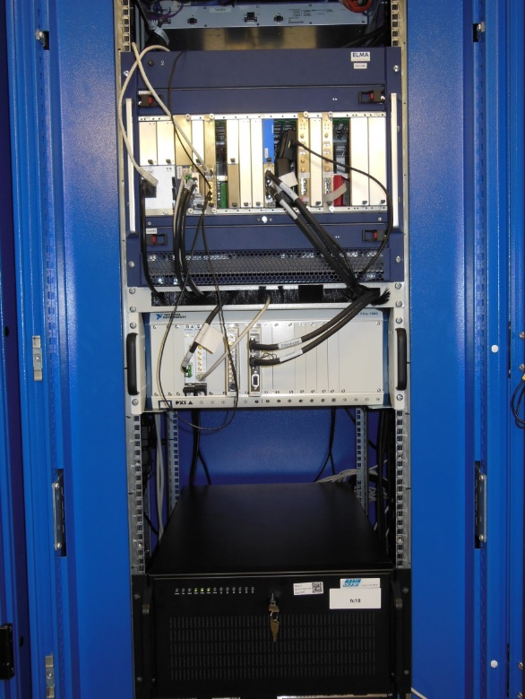
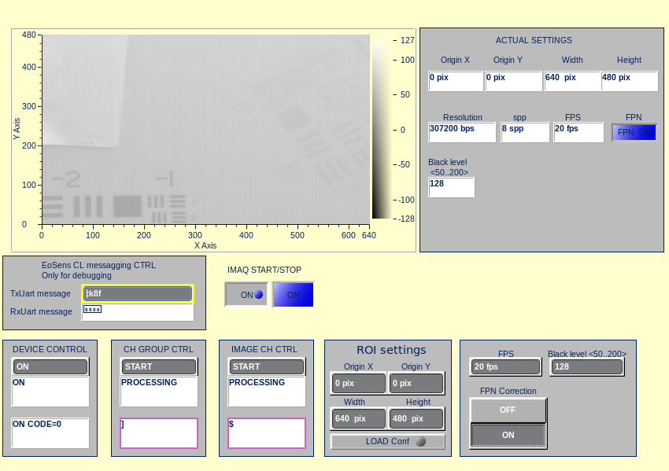
ITER PXIe Fast controller: Image acquisition (cameralink).
Can we add more processing capabilities?
Is it possible to add a GPU?
Readback
Image
Setup
Device PVs
Channel
PVs

Slide 14

FPGA+GPU processing
NI-RIO Linux Device Driver modified to implement direct DMA from FPGA to GPU

Slide 15
Conclusions
We have defined a design methodology for implementing advanced data and image acquisition applications with RIO/FlexRIO devices, integrated with EPICS using IRIO software
We have developed different LabVIEW/FPGA patterns and libraries for RIO devices
It is not necessary to rewrite or even recompile the EPICS device support for every cRIO/FlexRIO configuration
IRIO tools integrated in ITER CODAC Core System V5.2 (February 2016)
IRIO tools are GPLV2
Current users of IRIO:
  ITER Diagnostics use cases, KSTAR project, Russian DA (cRIO)
  ESS Bilbao

Slide 16
DEVELOPMENT OF ADVANCED DATA AND IMAGE ACQUISITION SYSTEMS USING RIO TECHNOLOGY
AND EPICS: INTEGRATION IN ITER
Mariano Ruiz & Sergio Esquembri
Universidad Politécnica de Madrid, Spain
^{mariano.ruiz@upm.es}
Technical University of Madrid
Thank you very much for your attention!!
questions?

Slide 17
IRIO resources mapping
Notes:
Here is just a small example of how the FPGA resources are found, map and used with IRIO library.
REMOVE SLIDE?

Slide 18
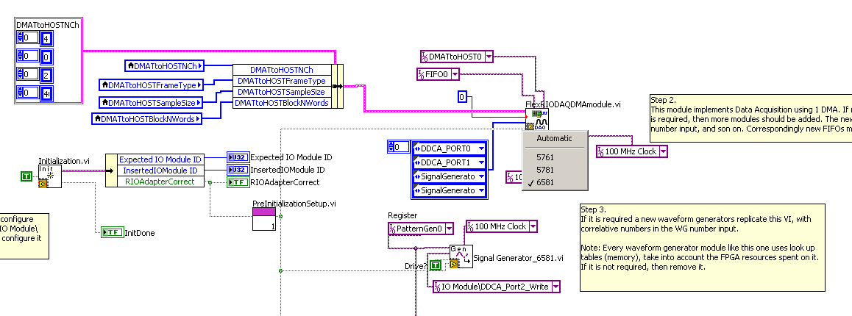
Reducing development time in FPGAs using templates
Notes:
This slide represent the architecture of a possible hardware solution implemented in the FPGA where a signal is sampled in a periodic basis and processed using signal processing algorithm. IRIO provides templates to implement this, where the basic functions have been already done, just need to add the application specific functionality. This is how the application looks in LabVIEW.
This slide represent the architecture of the hardware solution implemented in the FPGA. The user can acquire the signal. It can implement an algorithm for a specific purpose.
This solution is implemented in IRIO with different templates. The user only need to add the specific functionality to the design because the basic “shell” is already done. Have a look to this piece of code in LabVIEW/FPGA!!

