Slide 1
CS-Studio Collaboration Status
Eric Berryman, Kay Kasemir

Slide 2
Overview
Collaboration Statistics
Feedback from Issues
Comments Activity
Issues Activity
Milestone Activity
Milestones Status
4.3.x (testing->stable)
4.4.x (unstable->testing)

Slide 3
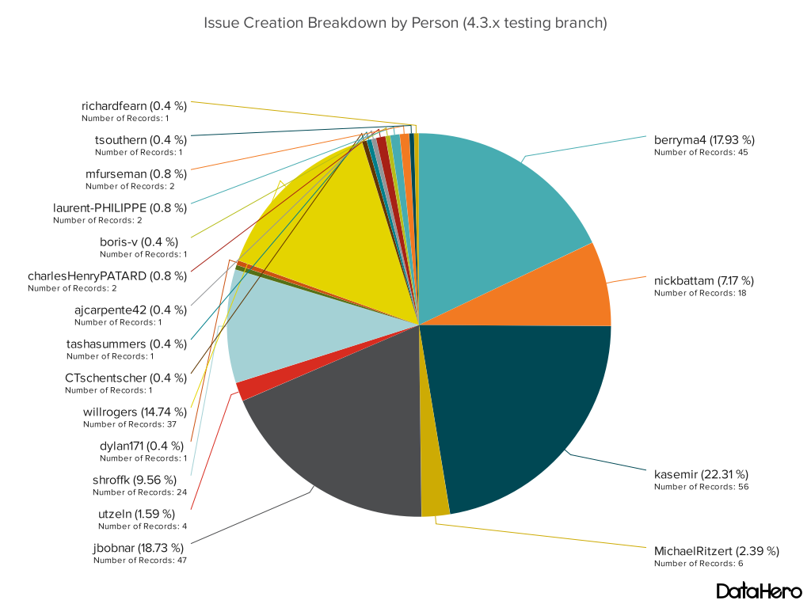
Feedback from Issues

Slide 4
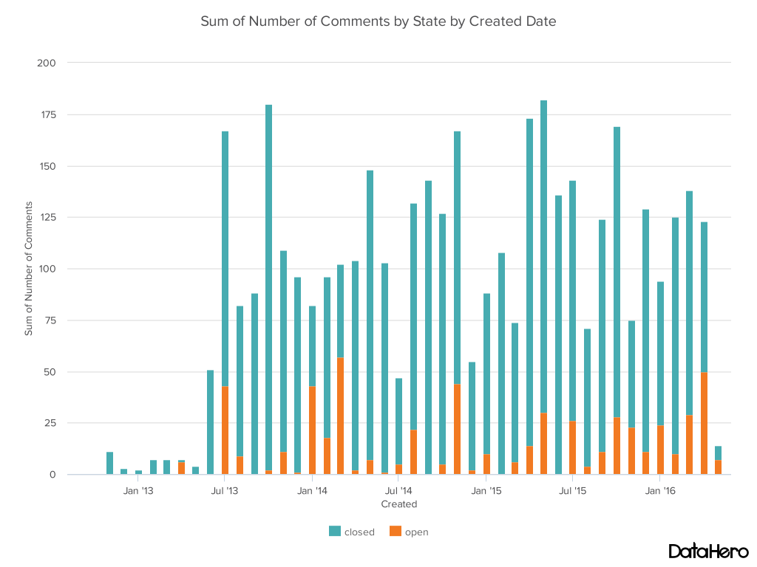
Comments Activity

Slide 5
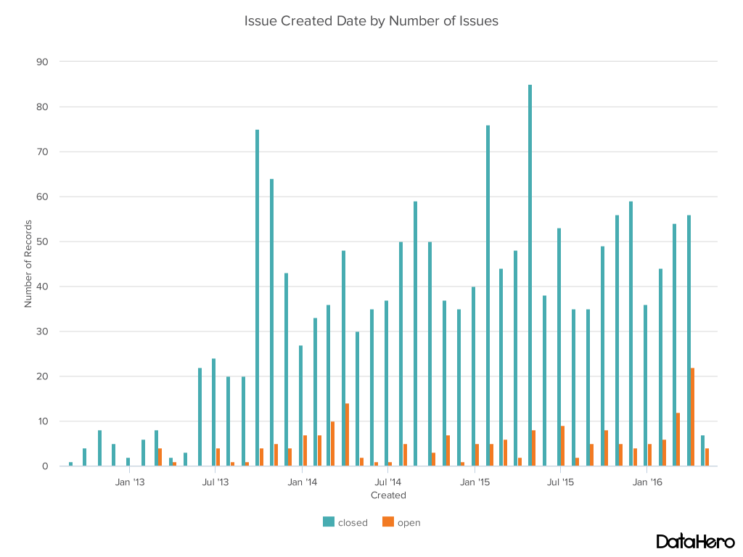
Issues Activity

Slide 6
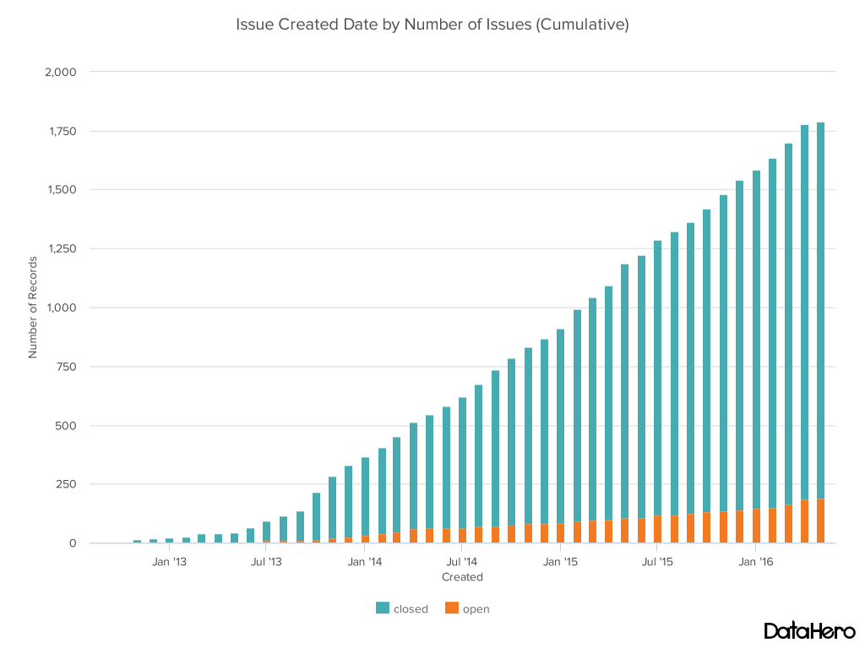
Issues Activity

Slide 7
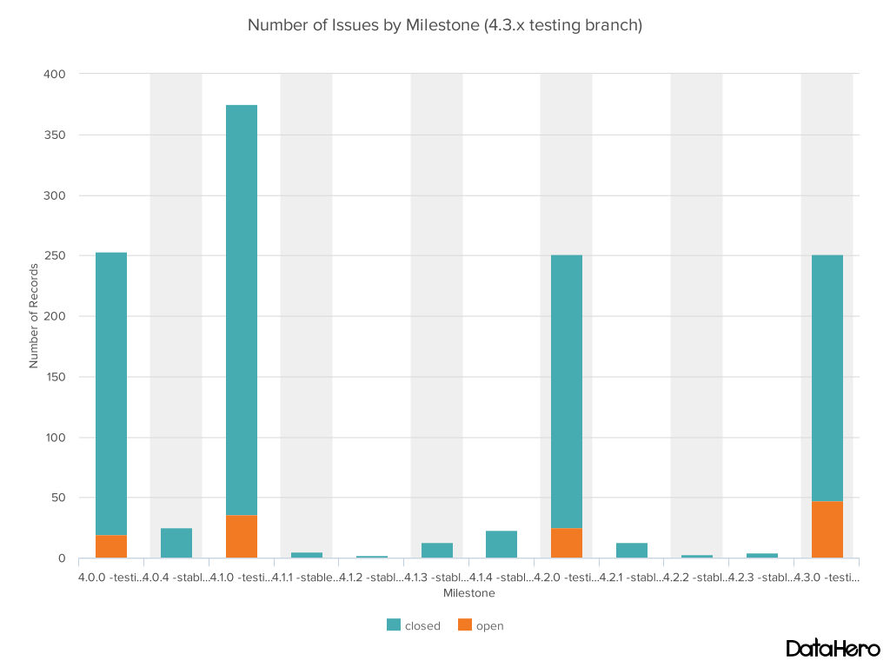
Milestone Activity

Slide 8
Closing 4.3.x (testing to stable)
4.3.x due date end of this month
Simplify users ability to save, load, share, distribute Perspectives
Save set restore UI, interface works with Git and MASAR
PVTable “Measurement” updates by GANIL/Spiral2
Move to Java 8 Time API (Instant, Period)
Unit test cleaned to all passing
BEAST datasource for Diirt
New Display Builder Prototype available for testing

Slide 9
Save Set Restore
Extension for Git and MASAR providers

Slide 10
Display Builder
See GitHub ticket “Display builder update” #1230 for links to
Instructions for installing into CS-Studio
Source code, build instructions
Please join:
Test, report errors
Add support for more widgets & properties

Slide 11
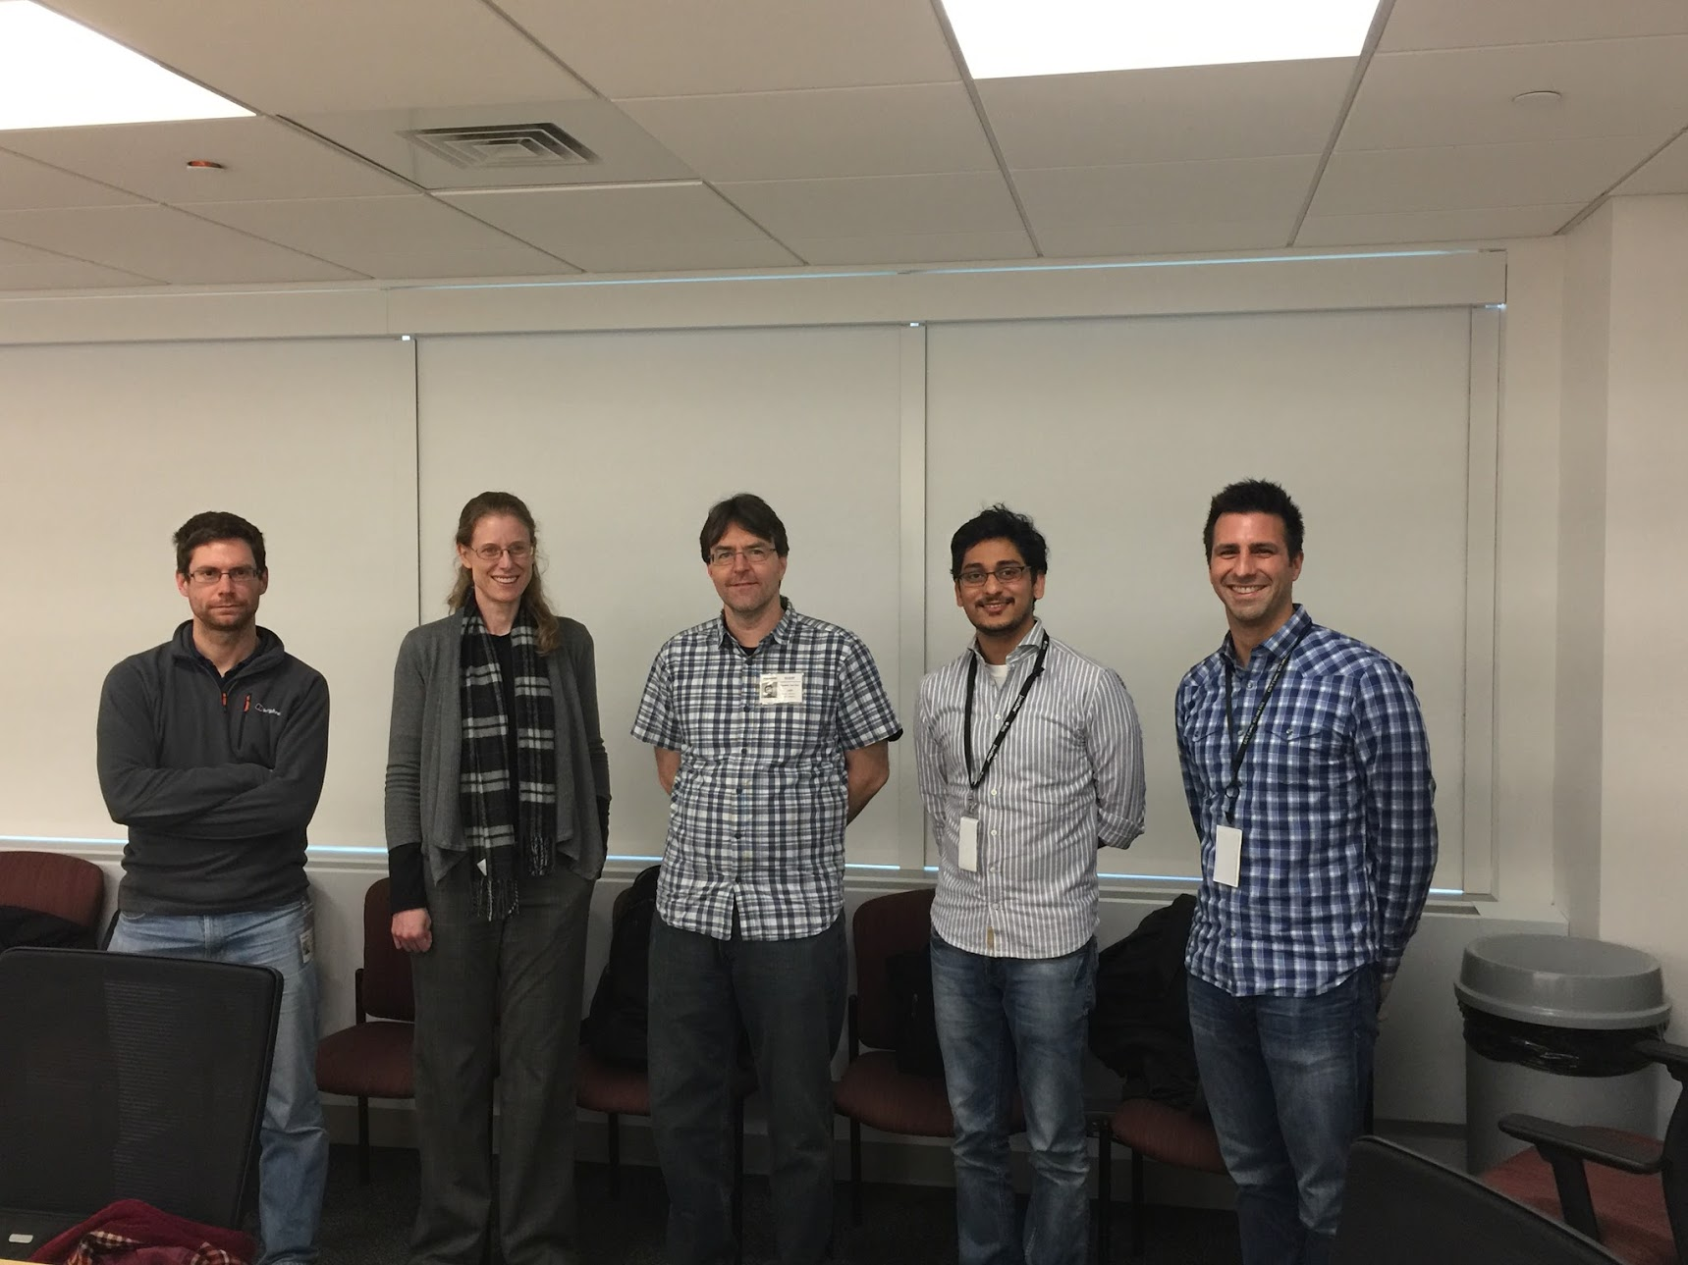
Code a thon
April 4-8 2016 at Brookhaven National Lab

Slide 12
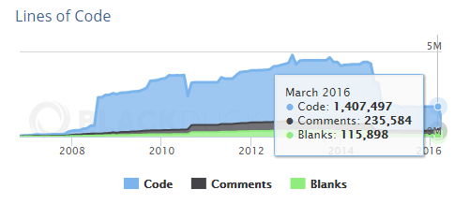
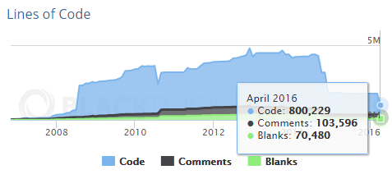
Code a thon
Quality Management Review
Reviewed new Display Builder
Fixed all unit tests (500) to pass
All logging to java.util.logging
Discussed training material
Feedback from NSLS2 Operations
Updated date code to Java8 time
600,000 lines of code removed

Slide 13
4.4.x (testing)
4.4.x due date latest December, projects at the present
New Display Builder prototype available for testing
Investigate CPython in CS-Studio
Improve customer feedback

Slide 14
ISO 9001 Quality Standard
Following as a guideline to improve quality
Management Review
Quality Policy and Objectives
Process Performance and Product Conformity
Status of Corrective and Preventative Actions
Customer Feedback Analysis
Decisions and Actions for improvements
Resource needs
Continual Improvement of the Quality System
Customers
Management Responsibility
Customers
Resource Management
Measurement, Analysis and Improvement
Satisfaction
Requirements
Product Realization
Product
information
activities
taken from ISO 9001

Slide 15
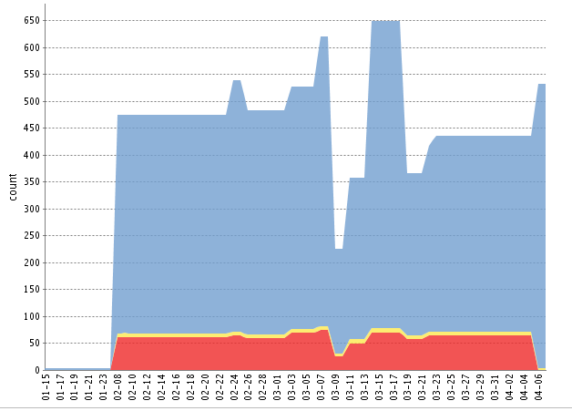
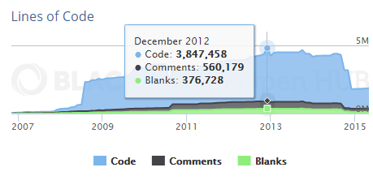
ISO 9001 Quality Standard
Following the ISO 9001 Quality Standard for past 2.5 years
Processes for continuous improvement are well defined
Finished our third Management Review in April
FRIB Quality Engineer will perform second audit in June
Code base has gone from 3.8 to 0.8 million lines of code
Over 500 unit tests, and code format checks, all passing
Collaboration now includes 10 labs that have registered site representatives

Slide 16
Registered Sites
Sites that have given a name and contact as “Site Representative”
CSIRO
CSNS
DESY
Diamond
Facility for Rare Isotope Beams (FRIB) at MSU
GANIL/Spiral2
ISIS
ITER
National Synchrotron Light Source II (NSLSII) at BNL
Spallation Neutron Source (ORNL)

Slide 17
Management Review
Modified Quality Policy and Objectives
Policy:
Through a strategy of continuous improvement and teamwork, the Control System Studio Collaboration is dedicated to supplying control system tools for machine and experiment operator interfaces, automation and service integration to enable our users to achieve their scientific objectives.
The foundation for achieving our commitment is based on:
understanding and meeting the requirements of our users,
continuously improving all processes related to the Control System Studio product,
effectively utilizing the creative talents in the collaboration,
and meeting statutory, regulatory, and other requirements.
Objective:
90% User satisfaction from registered sites with a site representative
90% Developer satisfaction from registered sites with a site representative

Slide 18
Management Review
New project, design and development workflow

Slide 19
Management Review
Create new developer satisfaction survey for new objective
Created new tickets in response to customer survey results and NSLS2 Operations feedback discussion
Data Browser: Allow configuration of 'Area's opacity
Data Browser: add hot keys for zoom in/out
Multiple Data Browser windows that share a time axis

Slide 20
How to Contribute
Fork us Github
https://github.com/ControlSystemStudio/cs-studio
Pick an issue/feature or make one
https://github.com/ControlSystemStudio/cs-studio/issues
Create a branch in your fork with the fix or feature
Make a Pull Request with the issue number in the title
Attend meetings, know the release schedule, subscribe to mailing list

Slide 21
Development Process
Github
Pull Request (must reference issue ticket)
Jenkins
Amazon S3
Product Build
Feature Owner Reviews
Commits as Needed

Slide 22
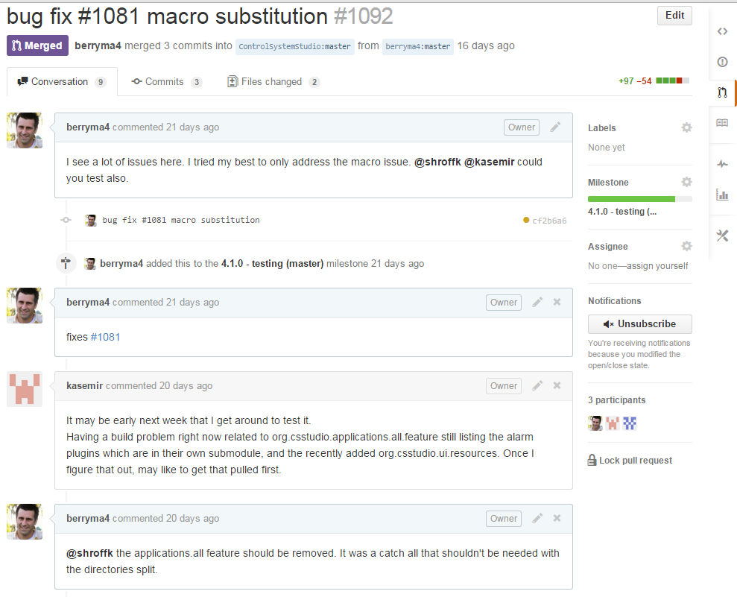
Development Process

Slide 23
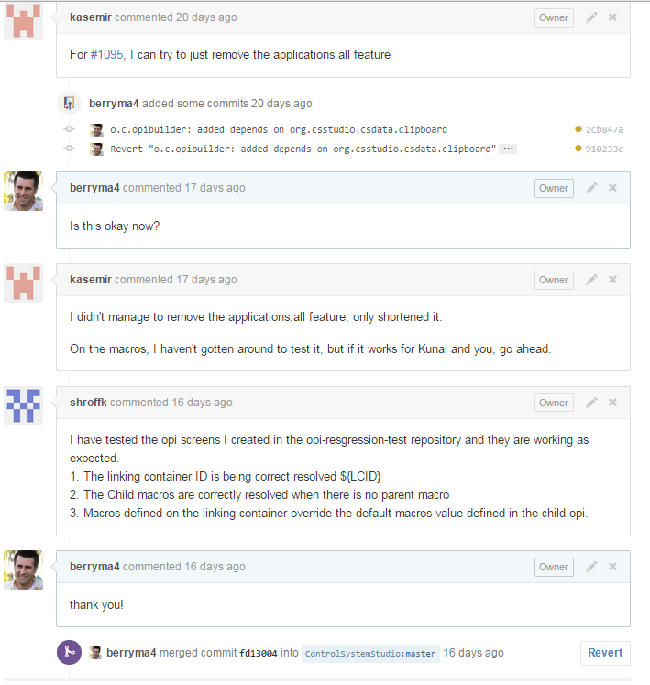
Development Process

Slide 24
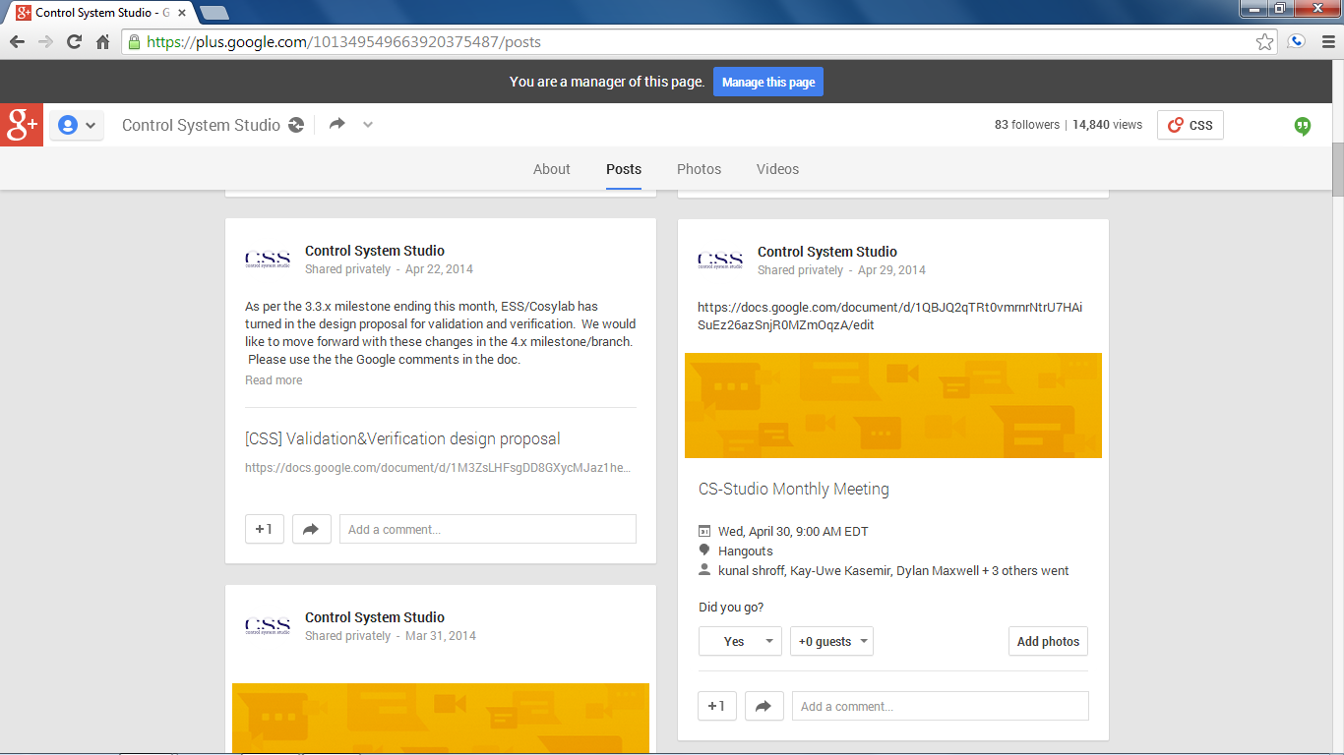
Attend Meetings
We use Google Hangouts to share our progress and discuss issues
Follow us on Google Plus
https://plus.google.com/101349549663920375487/posts
Meetings are posted (viewable after being added to group)
First Wednesday of the month (9am EST)
Project group meet once a week when actively developing

Slide 25
CS-Studio Summary
Established Collaboration
Documented Processes for continuous improvement
About 10 registered Sites
Several active Developers
A lot going on
Feel free to join

