Slide 1
caQtDM: future use of a display manager
Helge Brands, Anton Mezger :: Paul Scherrer Institut, Switzerland
Spring 2016 EPICS Collaboration meeting, Lund, Sweden, May 2016

Slide 2
Outline of the presentation
caQtDM: PSI’s new display manager, Version 4.1.0
  Multiplatform capability
  A new world for .ui file loading using the web
  Multiple control system support through plugins
  Easy integration of new widgets using the cs interface
Latest features
To Do's
Statistics (Downloads)
Conclusion

Slide 3



caQtDM: PSI’s new display manager, V4.1.0
caQtDM is an EPICS display manager written in C++ and uses Qt as graphical user interface:
caQtDM is PSI’s actual successor of MEDM and follows its philosophy regarding widget functionality. It is our synoptic display working horse!!
caQtDM has been developed as a modern display tool (C++, Qt, plugins)
caQtDM has now many new features, that makes it very versatile (multiplatform, multi-CS, easy integration of new widgets, web support, parallelization of camera data conversion)
caQtDM is very reactive to its users (bug fixes and features)

Slide 4





caQtDM: PSI’s new display manager, V4.1.0
Multiplatform capability:
caQtDM runs on Linux's, MS windows, Mac OS X, iOS and Android. In principle on any platform where you find Qt and EPICS.
caQtDM has been tested with Qt4.8 to Qt5.6 with preferentially Qwt6.1.1 (multithreading support) and EPICS 3.14.12 (some users already build caQtDM with EPICS 3.15)
caQtDM will use the local file system when not specified otherwise
caQtDM will need on IOS or Android a WEB server in order to get its description files (.ui). caQtDM will then come then with its start settings display.
Except on Linux, you may be productive the time to download and install it (typically 5 minutes) !!!!

Slide 5
caQtDM: PSI’s new display manager, V4.1.0
caQtDM: a new world for ui file loading using the web
Standard usage is loading a local file: caQtDM [options] filename
Web usage, more and more files are located at a web server and versioning becomes important, caQtDM has to account for this new way of life:
      Actually that is just the way caQtDM is implemented on our handheld devices like tablets and phones.
      Therefore a natural extension used by command line on other platforms
file based:
nfs/smb
local environment
command line needed
http based:
local view
versioning
encapsulated config/environment

Slide 6
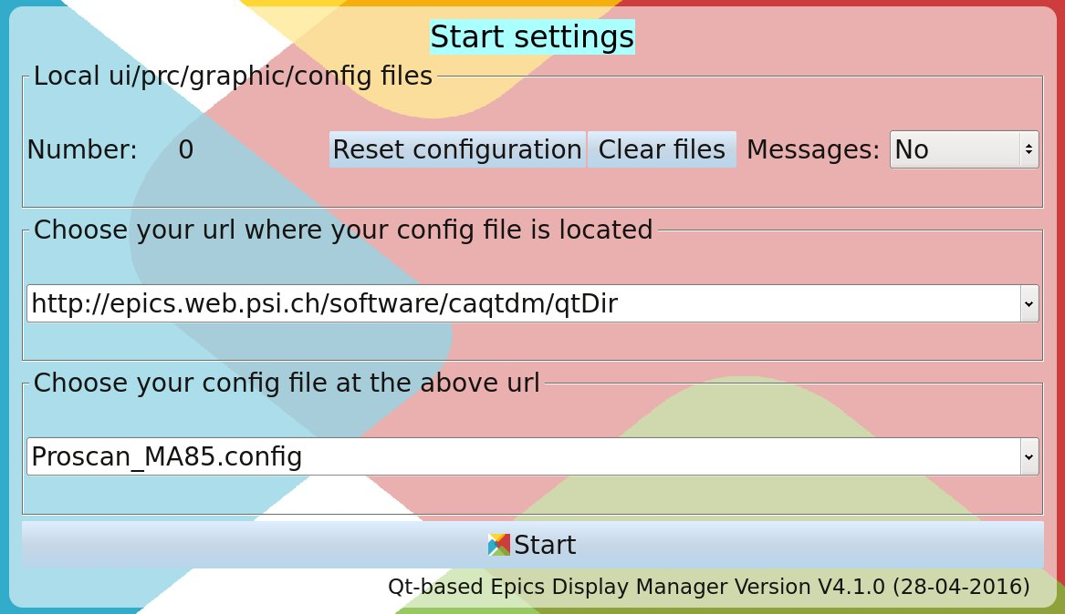
caQtDM: PSI’s new display manager, V4.1.0
caQtDM: a new world for ui file loading using the web (implementation)
caQtDM has multiple ways to get files from a web server:
files will be loaded to its local cache( option –emptycache to clear)
By using a environment variable or the option –url or the option –httpconfig.
Last option is default for handheld devices; caQtDM will popup with:

Slide 7


caQtDM: PSI’s new display manager, V4.1.0
Multiple control system support since version 3.9.4:
An effort was made to fully separate the display part from the data acquisition part by introducing a plugin scheme for the control system support:
    Easy integration of other systems (databases, control systems, any data source)
    Writing a plugin will not need new code in caQtDM and does not need a rebuild.
Actual plugins: EPICS 3.14, BSREAD ( a beam synchronous data acquisition using ∅ MQ), EPICS4 (obsolete old version, not really tested and not used), a demo plugin as simple example.
EPICS
BSREAD
Any Plug-In

Slide 8
caQtDM: PSI’s new display manager, V4.1.0
Easy integration of new widgets (work initiated by Zai Wang and Matt Gibbs):
gives the possibility of an easy integration of widgets, the control system can be addressed from within a widget.
The advantage is to give an user the possibility to integrate its own widget, avoiding that he has to dig into the main code.
A simple demo widget has been integrated that can be used as template for new widgets: caLineDemo. This widget is almost equivalent to caLineEdit, but uses less CPU.

Slide 9
caQtDM: PSI’s new display manager, V4.1.0
caQtDM is continuously updated with new features suggested by its user community; the most important ones:
Piping: it is possible now to pipe the output of some utility to caQtDM giving the possibly to dynamically build ui files for display.
Stylesheets can be used now (option –stylefile). But take care not to disturb basic behavior.
caSlider is behaving now better and has the possibility to display its value (thanks Josh Dassinger from Argonne)
caThermo will display now also its value when requested
caCamera uses now multicore parallelism of calculations for converting a waveform to an image)
Bug fixes and performance optimization
An edl converter (in collaboration with Wang Zai Huai)
Github for issues and collaboration or as display versioning system

Slide 10
caQtDM: PSI’s new display manager, V4.1.0
The to Do's list gets smaller; Users have to trigger new ideas.
Next:
Linux configure script
Integrate ALS modifications to edl2ui
Build with epics 3.15
New widgets (Histogram, …)
CS new Plugins (database, epics4?, Tango?)
Bug fixes
Performance enhancements
https enable
Last but not least: Documentation and complete designer tooltips for property description

Slide 11
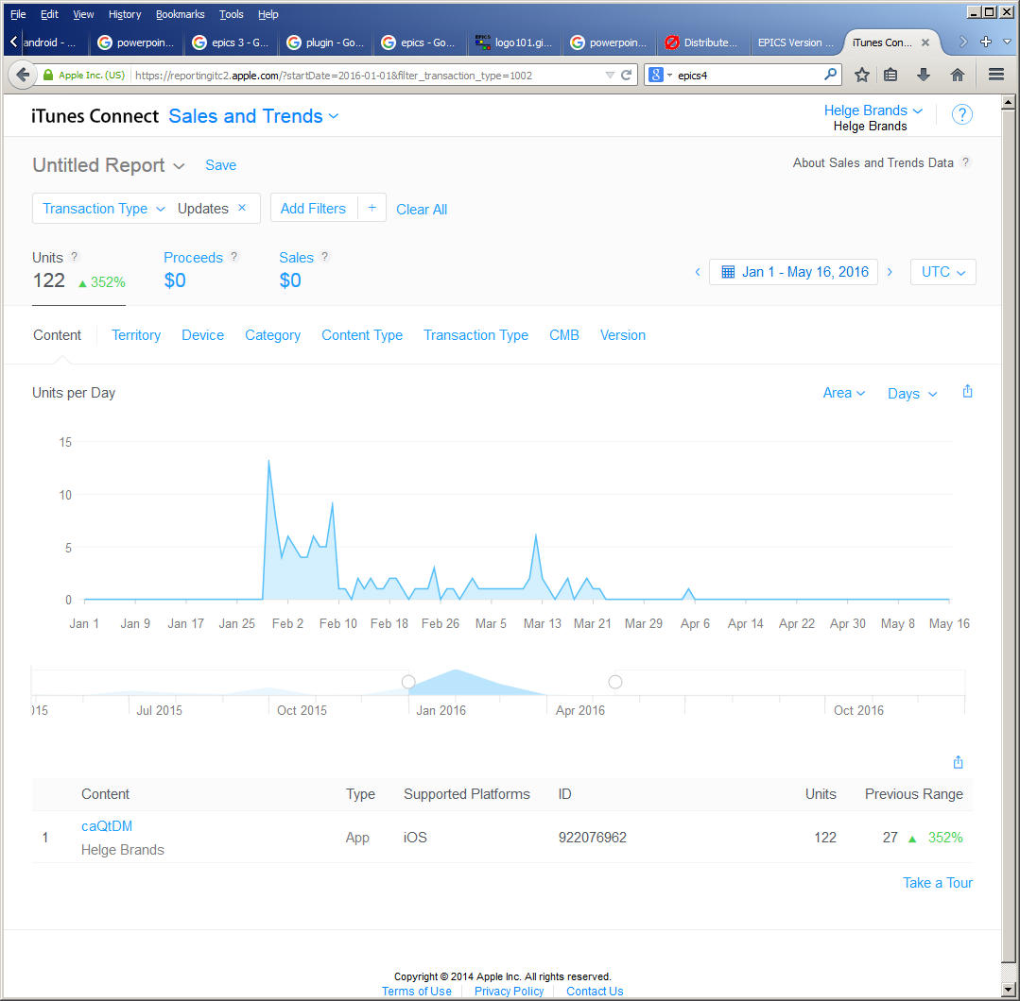
caQtDM: PSI’s new display manager, V4.1.0
Statistics:
Github downloads(17.5.16) | count
caQtDM_4_0_2.msi | 5
caQtDM_4_0_2_x64.msi | 47
caQtDM_4_0_2_x86.msi | 16
caqtdm_4_0_0.apk | 14
caqtdm_4_0_0.dmg | 33
caQtDM_4_0_0.msi | 53
caQtDM_4_0_0_x64.msi | 81
caQtDM_4_0_0_x86.msi | 16
Would also be nice to have some feedback from all these!

Slide 12
Wir schaffen Wissen – heute für morgen
Conclusion:
caQtDM replaced successfully MEDM and follows the demands.
caQtDM very mature now.
caQtDM is well adapted to our needs for all synoptic views
caQtDM is used on all possible platforms at PSI

Slide 13
Wir schaffen Wissen – heute für morgen
My thanks go to
The authors of MEDM for their powerful application
All contributors for their input and code
All users for their suggestions and bug finding

Slide 14
caQtDM: PSI’s new display manager, V4.1.0
Thank you for your attention
and have a look at:
http://epics.web.psi.ch/software/caqtdm/
Downloads:
    Linux: sources (you may also clone github/caqtdm or download a zip)
    MS windows: binary installation package (msi)
    Mac OS X: binary distribution package (dmg)
    iOS : binary distribution package from apple store (iPad and iPhone)
    Android : binary distribution package

