Slide 1
The RF Control System for the SwissFEL
Kristian Ambrosch :: Controls :: Paul Scherrer Institut
Spring 2016 EPICS Collaboration meeting

Slide 2
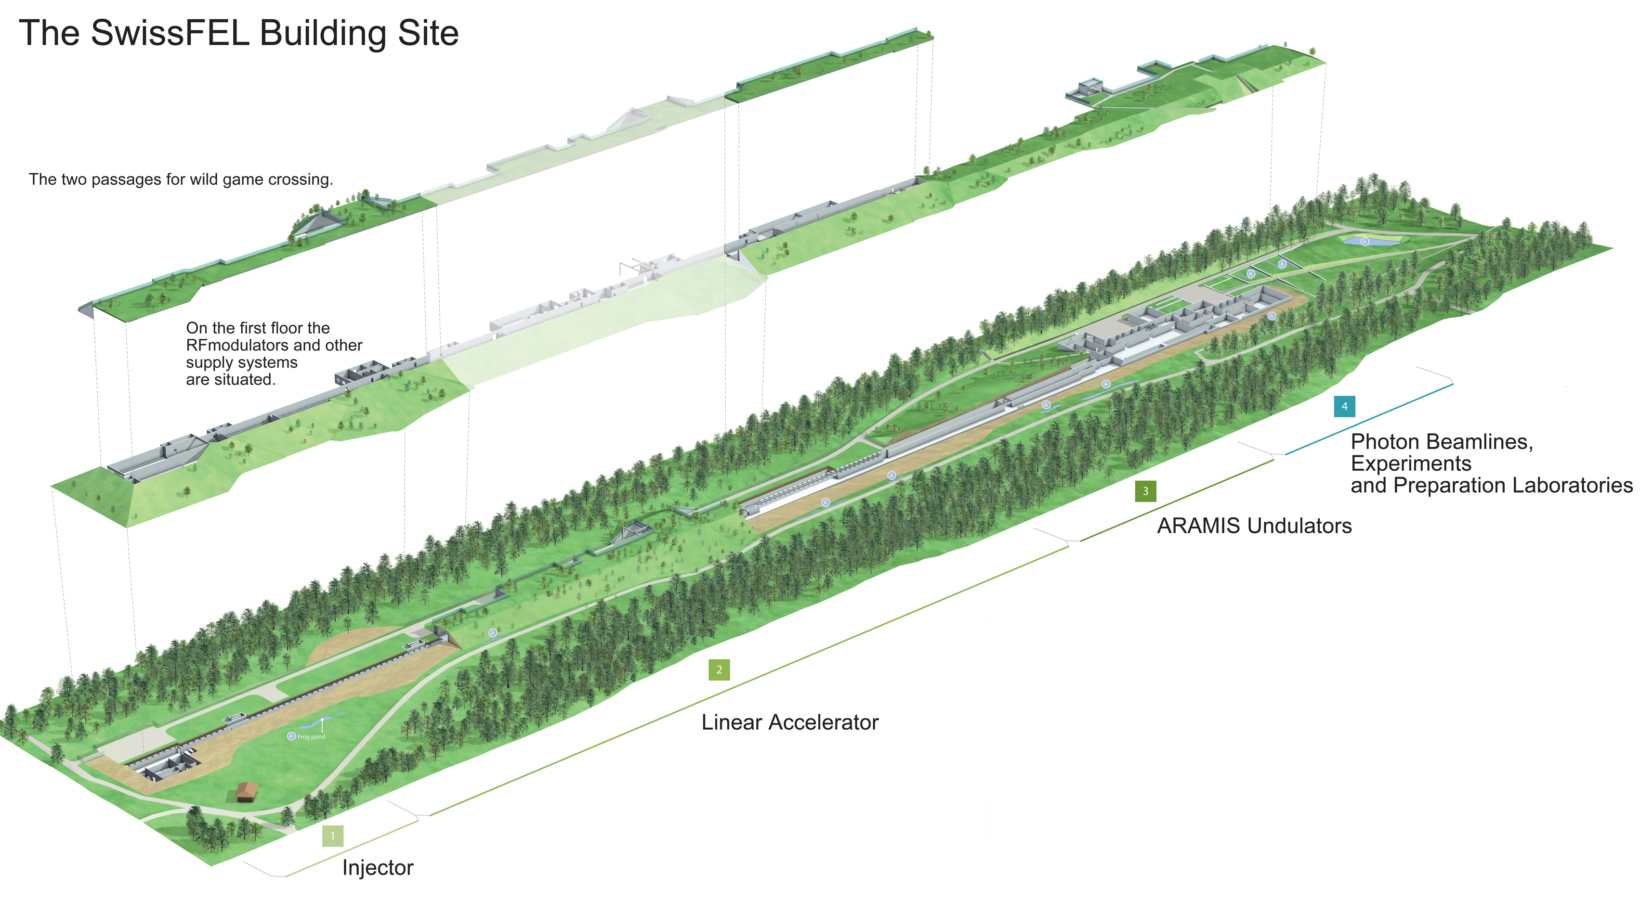
SwissFEL - 6GeV Free Electron Laser

Slide 3
SwissFEL RF - Overview
Injector
  6 S-Band Modulator – ScandiNova, Old Control System
  1 X-Band Modulator – ScandiNova, Old Control System
LINAC 1+2
  13 C-Band Modulators – Ampegon
LINAC 3
  13 C-Band Modulators – ScandiNova, New Control System
→ 4 different types for 33 Modulators

Slide 4
S-Band Modulators
Internal Controls System:
  Old proprietary control system
  Asynchronous to the pulse mode
  Control system operates at max. 9 Hz
  Pulse Shape delivered by external ScopeRecorder
Communication Protocol
  Proprietary ASCII over TCP/IP Protocol
  Most common readouts sent via „pings“
  Direct access of variables may slow down the system
State Machine
  4 set states
  13 internal states
  No states for filament heating while rectifier is off

Slide 5
X-Band Modulator
S-Band Control System
Different Vacuum Chambers

Slide 6
C-Band Modulators ScandiNova
Internal Controls System:
  Synchronous to the pulse mode
  100 Hz
  Pulse Shape measured internally
Communication Protocol
  Modbus for Acc. Control System
  Ethercat for LLRF
State Machine
  6 set states, including filament heating and blackheating
  21 internal states

Slide 7
C-Band Modulators Ampegon
Internal Controls System:
  Beckhoff PLC
  Synchronous to the pulse mode
  100 Hz
  Pulse Shape measured internally
Communication Protocol
  S7PLC for Acc. Control System or internal EPICS IOC
  Ethercat for LLRF
State Machine
  6 set states, including filament heating and blackheating
  6 internal states with sub-states
    Off, Transition, Ready, Fault

Slide 8
Generic Interface
Idea: Provide a generic interface that makes the modulator type transparent to the operator
  Modulator Soft-IOCs provide a standard set of PVs
  RF requests again a different state machine for operation
    6 different states for all modulators
      5 sub states for Off, Transition, Interlocked, Ready and Error
      S-Band state machine is extened by two states:
        Rectifier is either controlled by IOC or by MPS override
        Heating current is controlled by IOC for BH and FIL Heating
        IOC has to detect if a state change is allowed or prohibited by an interlock

Slide 9
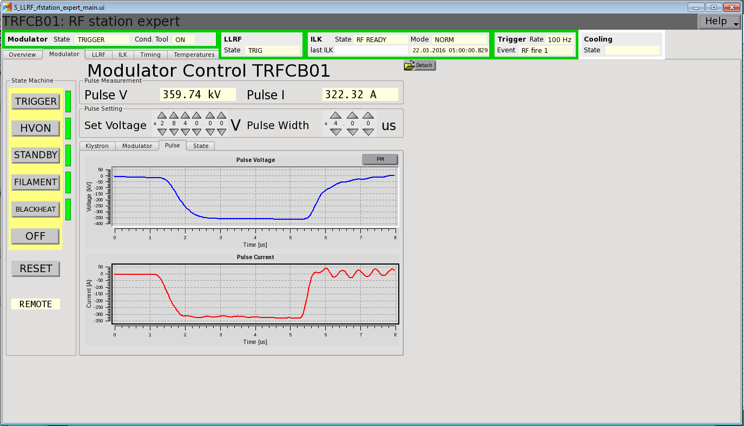

Slide 10
Master State Machine
RF conditioning of the acceleration structures is required before beam operation
  Conditioning creates arcs that help to clean the structures
  Before beam operation, structure has to be conditioned first
    For SLS this has to be performed manually
    For SwissFEL no operation without prior conditioning shall be possible
      State Machine shall automatically condition the structures to predefined voltage before beam operation
      Reduced risk for „On beam conditioning“
  → PM: Why not create an entire Master State Machine that controls each sub system automatically?

Slide 11
Generic Master State Machine
Graphics from LLRF MSM Design Concept

Slide 12
Generic Master State Machine
Master FSM
Modulator
LLRF
Cooling
Cond. Tool
Interlock
RFONBEAM
TRIG
Normal
PHASECALIB
TRIG
Normal
RFONDELAY
TRIG-DLY
OFF
Conditioning
COND
TRIG-DLY
ON
Conditioning
TRIGGER
TRIGGER
OFF
OFF
Trigger
HVON
HVON
STANDBY
STANDBY
FILAMENT
FILAMENT
BLACKHEAT
BLACKHEAT
ON
OFF
OFF
OFF
Graphics from LLRF MSM Design Concept

Slide 13
Conclusion
SwissFEL RF Control System
  Generic interface for 4 modulator types
  Generic state machine
  Interlock monitoring
  Automatic restart functionality
Upcoming challenges:
  C-Band Prototype from Ampegon will be reused in LINAC 1
  S-Band Modulators to be replaced in 2017/2018

Slide 14
Thank you!

