Slide 1
Open Source Motion Control
Based on the Etherlab open source EtherCAT master (www.etherlab.org)
Anders Sandström
Torsten Bögershausen
ESS Motion Control and Automation Group
www.europeanspallationsource.se
Notes:
Hello, my name is Anders Sandström. I work here at ESS in the MCAG group as Motion Control Engineer.
I will talk about Open Source Motion Control based on the open source EtherCAT master from Etherlab, like from the interesting talk from yesterday.

Slide 2
Outline
Architecture
Axis Object
Trajectory Object
Monitoring Object
Basic Kinematics
Acknowledgments
2
Notes:
This is the outline of my talk. Beginning explaining an overview of the architecture and then more detailed..

Slide 3
Architecture
HMI (CSS, BOY)
EPICS (Channel Access)
EPICS IOC
(Linux Controller)
Motion Control (ECMC)
(Linux Controller)
TCP/IP
Model 3 driver, Asyn
Igh open source EtherCAT master
(www.etherlab.org)
EtherCAT
EtherCAT Terminals
EtherCAT Terminals
EtherCAT Drive
Analog
Analog
Digital
Digital
Drive
XXXX
Drive
XXXX
3
3
Notes:
This slide shows an overview of our current system architecture.
Mainly we have divided the functionality into two controllers running linux, one running the EPICS IOC and one running the motion control algorithms and linking to hardware. Currently we use an TCP/IP interface between the two controllers. We choose this architecture since we have experience with the TwinCAT 3 system. Basically we copied the architecture and reused the same Epics driver.
Ofcource the software packages could run on the same controller aswell. We are also right now looking into tighter integration between the motion control algorithms and EPCIS.
The Motion Control algorithms then links to the open source EtherCAT master from Etherlab (which I guess most of you heard an interesting presentation yesterday).
The EtherCAT master is used for configuring the ethercat bus and sending/reciving data from EtherCAT slaves. Typical slaves could be drives (stepper BLCD, pulse direction, analog or digital data)

Slide 4
Motion Controller
Controller (Linux)
Motion Controller
Communication Thread
To EPICS TCP/IP
TCP/IP - Command parser
Motion Thread (1kHz)
Axis 1
Axis 2
Axis N
EtherCAT master
(Igh open source EtherCAT master http://www.etherlab.org)
EtherCAT Hardware
4
Notes:
This slide shows some details about the threads running in controller used for executing Motion Control algorithms.
First, on top, you can se the communication thread running a command parser, handling the communication with EPICS (over TCP/IP).
Then the Motion thread, the real time thread executing motion control algorithms receives commands from the command parser.
The Motion thread also recives data from the EtherCAT terminals by reading and writing to the process image of the EtherCAT master.

Slide 5
Motion Thread
Motion Thread (1kHz)
Axis 1
Encoder
Trajectory
PID-Control
Monitor
Drive
Axis 2
Encoder
Trajectory
PID-Control
Monitor
Drive
Axis 3
Encoder
Trajectory
PID-Control
Monitor
Drive
Axis N
Encoder
Trajectory
PID-Control
Monitor
Drive
Notes:
The Motion thread, which is the realtime thread executing the motion control algorithms can be configured to control a number of axis. Each axis in turn contains certain objects!

Slide 6
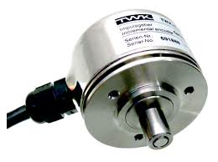
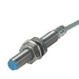
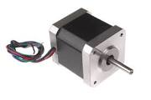
Structure: Axis object
Axis
Types: Normal, Virtual, Trajectory, Encoder
“Cfg.CreateAxis(…)”
Encoder
Trajectory
PID-Control
Monitor
Drive
ECPdoEntry
Transform / Expression
Transform /Expression
ECPdoEntry
ECPdoEntry
ECPdoEntry
ECPdoEntry
ECPdoEntry
ECPdoEntry
ECPdoEntry
ECPdoEntry
Encoder Y
Trajectory Z
EC master
Optional link:
Sync. External
Optional link:
Sync. Trajectory
EC master
EC master
Executes and links objects:
Encoder
Trajectory Generation
PID-Controller
Monitor
Drive
Sequences
Homing (different types)
6
Notes:
Like I said, the axis object links and executes certain other objects like Encoder, trajectory, PID-control, monitor and Drive.
The encoder typically links to an analog input value from a slave. Could be an encoder, analog input or any input.
The Trajectory object generates trajectory setpoints for the motion.
The PID- controller controls based on the error between the trajectory generated setpoint and the actual value from the encoder object.
The monitor object monitors the motion and the drive links to an output value of a slave. Could be a stepper module or analogoutput, pulse direction.
Different versions of axis object have been implemented: Normal, Virtual, Encoder, Trajectory.

Slide 7
Trajectory object
Trapezoidal trajectories
Feed Forward (position and velocity set-point)
Motor Record Support
Constant velocity
Relative positioning
Absolute positioning
Homing
Hard and soft limits
Synchronization / Kinematics
Absolute/Relative
Gear
Expressions
Other axis encoder
Other axis trajectory set-point
Axis x
Trajectory x
Transform /Expression
Transform /Expression
Encoder Y
Trajectory Z
Optional link:
Sync. External
Optional link:
Sync. Trajectory
Notes:
Like I said the trajectory object main functionality is to generate setpoint trajectories guiding the motion.
Both position setpoint and velocity setpoints are calculated. The velocity setpoint is used for FF in order to improve performance.
Basically the object implements the different functionalities for Epics motor record support like …..
Additionally the trajectory object can handle synchronization functionalities to other axis actual values (encoders or setpoints).
The synchronization can be made in an absolute or relative way and with gear ratios.
Synchronization can also be made via expressions. Will talk about that later..

Slide 8
Monitor object
Position lag monitoring
“At Target” Monitoring
Limit switches
Over Speed Monitoring
Axis
Monitor
ECPdoEntry
ECPdoEntry
ECPdoEntry
Notes:
The monitoring object is responsible for supervision of the motion.
For instance the position lag can be monitored ensureing that the difference between the trajectory setpoint and actual value is not getting to high due to for instance mechanical blocikng.
The object also can supervice that the motion reaches the target position.
Supervising limit switches. Non normal situations like both limit switches activated simultaneously will interlock motion.
Then the object also supervises that the speed of the motion is not to high.

Slide 9
Kinematics
Synchronization of axes by expressions (exprTK*)
Set-points
Actual values
Amplifier enable
Interlocks (stop at problem)
Update of expression at runtime possible
Expressions evaluated in 1kHz (synchronization)
trajx = Trajectory generated setpoint for axis x
encx = Actual position of axis x
enx = Enable of axis x
ilx = Interlock of axis x
Example:
traj1:=10*sin(traj2+enc3);
il1:=il2 and il5 and enc4>enc3;
9
*http://www.partow.net/programming/exprtk/)
Notes:
A functionality to synchronize, interlock and enable axis through equation expressions have been included.
A software package called expressionTK is used for parsing and compiling equations. This parsing tool includes support for most math operations and also if, while statements..
Variables that can be used in these equations is…
An example of an expression could be: the setpoint for axis1 is related to the sinus of axis 2 and the feedback of axis 3.
The interlock variable lets you control interlocking of an axis based on states or position of other axis. This could be useful for prevention of collision.
All the equations can be updated at runtime resulting in an very flexible and powerful way of synchronizing axes..
The expressions are then evaluated in the realtime cycle (1kHz) resulting in true synchronization.

Slide 10
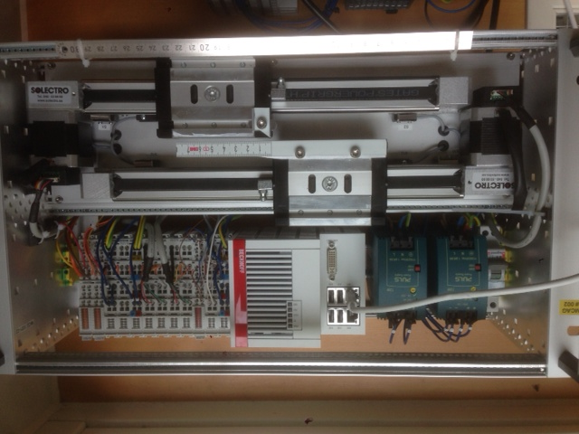
Kinematics Example: 2 axes slit set
2 virtual axes
Slit center position
Slit gap
2 normal axes (blade positions)
Forward Kinematics:
traj3:=traj1-traj2/2;
traj4:=traj1+traj2/2;
Inverse Kinematics:
enc1:=(enc3+enc4)/2;
enc2:=(enc4-enc3);
Amplifier enable:
En3:=En1 or En2;
En4:=En1 or En2;
Axis 1 (Virt: Center position)
Axis 2 (Virt: Gap)
Axis 3 (Normal: Blade position)
Axis 4 (Normal: Blade position)
Blade
Axis 3
Blade
Axis 4
Notes:
For example a slit set with two virtual axes defining the slit center position as one axis and the slit gap as one axis.
As you see in the picture then. Axis 1 and 2 is virtual and axes 3 and 4 is Normal kinked to hardware.
‘To these axis 4 motor records can be connected.
Forward kinematics:
If we move axis 1 or 2 we need to move both axes 3 and 4.
The relation could easily be calculated..
The setpoint for the normal axis 3 is the centerposiiton minus half the gap.
The setpoint for the normal axis 4 is the centerposiiton plus half the gap.
The inevrse kinematics then can be calculated:
Actual position of axis 1 is the act 3 + act 4 diveded by2
And for axis 2 the actual value will be the differnce of the normal axes 3 and 4.
Since the expressions are evaluated in the realtime loop the movements can be done on both the virtual axis simultaneously if needed and still ensuring a proper synchronization during the movement.
Which then could result in sweeps with a different gap at different center positions for instance.
An additional feature is that the enable of the amplifiers also can be linked between the axis by expressions. In this way when any axis is moved the amplifier for the normal axis will be enabled.

Slide 11
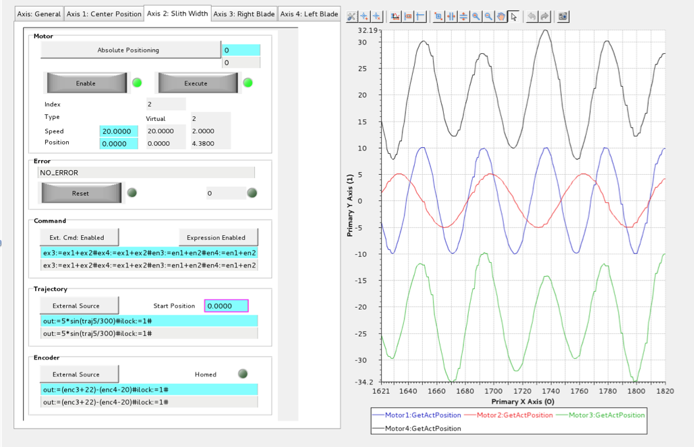
Kinematics Example: 2 Axes slit set
Axis 4
Axis 1 (Centre)
Axis 2 (Gap)
Axis 3

Slide 12
Acknowledgments
Igh open source EtherCAT master (www.etherlab.org)
EPICS community (base, motor, asyn, stream device)
ExprTK C++ Mathematical Expression Library
(www.partow.net/programming/exprtk)
Questions?
12
Notes:
Thanks

Slide 13
Encoder object
Actual position value links to any input process value in EtherCAT process image.
Scaling
1-64bit
Handles over/under flow (1-63bit)
Calculates velocity
Filter
Axis
Encoder
ECPdoEntry
ECPdoEntry
ECPdoEntry
EC master

Slide 14
Controller object
PID controller
Feed forward functionality
Setpoint from trajectory object
Actual value from encoder object
Axis
Controller

Slide 15
Drive object
Link Velocity Setpoint to EtherCAT process image
Link Enable to EtherCAT process image
Scaling
1-64bit
Axis
Drive
ECPdoEntry
ECPdoEntry
ECPdoEntry

Slide 16
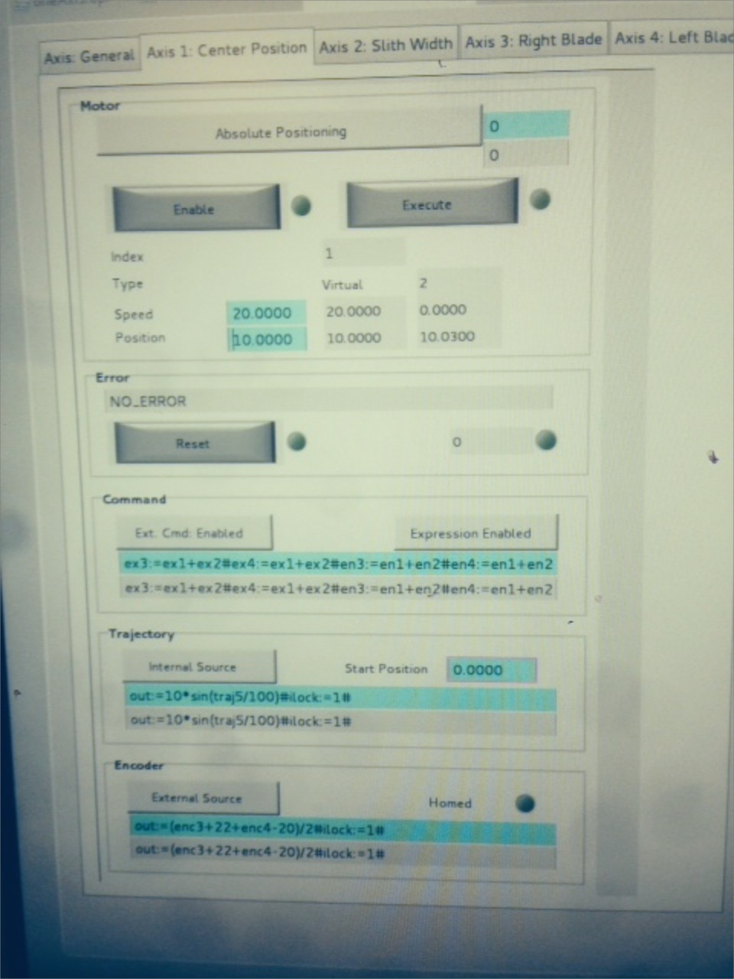
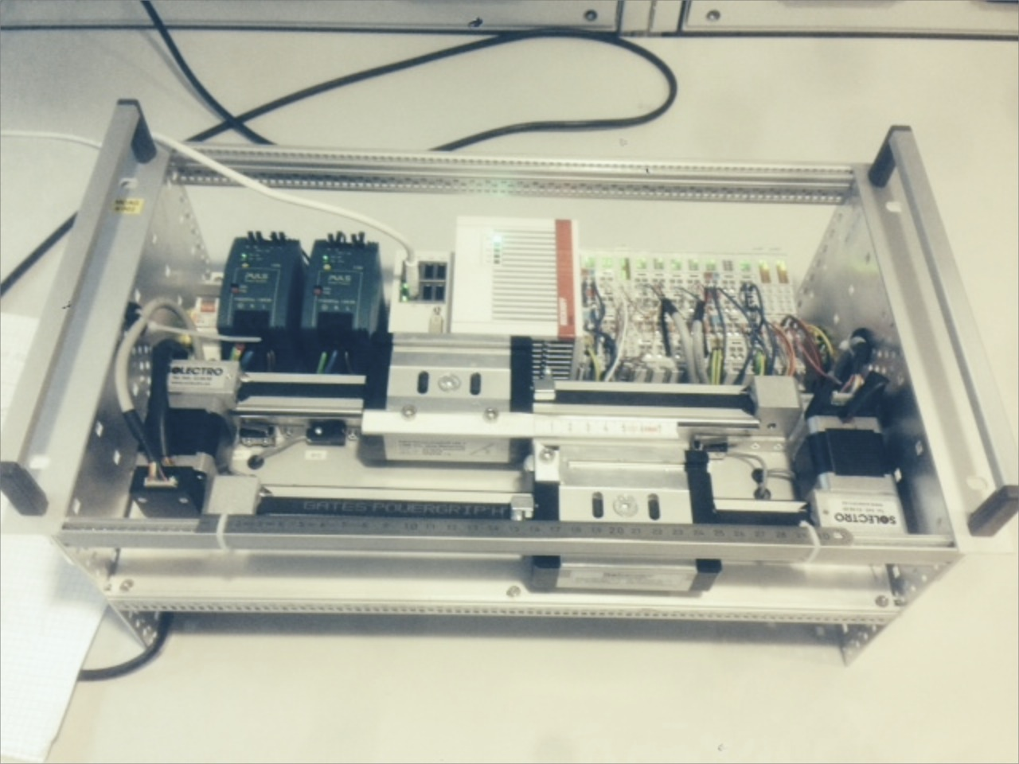
Example Application
HMI (CSS, BOY)
EPICS (Channel Access)
EPICS IOC
Motion Control
(Linux)
EtherCAT
EtherCAT
EtherCAT
EtherCAT Drive
Drive
Analog
Digital
XXXX
Drive
Analog
Digital
XXXX
Slit blades

Slide 17
Overview of EtherCAT Fieldbus
EtherCAT = Ethernet for Control Automation Technology
Open fieldbus standard originally developed by Beckhoff GmbH
Maintained by EtherCAT Technology Group (www.EtherCAT.org).
Hardware requirements:
Master: standard computer hardware (NIC)
Slaves: need dedicated hardware, EtherCAT Slave Controller (ESC)
Masters: Several commercial and open source masters available
Slaves: Several 100 manufacturers of slaves (drives, I/O, sensors, robots)
Topologies: Line, Star, Ring
Media: Cat 5 cable, plastic fibre, glass fibre
Supports Distributed Clock (DC) in slaves
Bandwidth utilization: 80%-97% (100 Mbit/s , Ethernet, Full-Duplex)
Applications: Motion, large or long distance systems, synchronized systems
Cycle times > 50μs
Notes:
Abbrevation
General
Released 2004 (stable standard from the beginning=> hardware from 2004 is still compliant)
Opened up and maintained by EtherCat Technology Group (www.ethercat.org)
10 year old standard
Commercial and open source masters:
Commercial: Beckhoff, ABB, Aerotech, Vipa, Omron (at least 100 suppliers)
Open Source: EtherLab, SOEM (Simple Open EtherCat Master)
Topoligies:
Line
Star (hot swap fuctionality of slaves)
Ring (for redundancy).
Typical Applications:
Motion (real-time, synchronization, robotics)
Large systems (theoretical max 65535 slaves)
Systems with high demands of speeds and reaction times (compared to other PLC systems).
Cycle times > 50micro sec (default in most masters is 1ms )
Comment time to transfer at 100mbit one frame 1500b rougly 100micro sec
NIC= Network interface cards
Time-Sensitive Networking
AVB
17

Slide 18
EtherCAT Motion: Control Modes
Velocity mode
Controller
Control:
-Pos.
Act. position
Velocity setp.
Control:
Velo.
Torque

Slide 19
EtherCAT Hardware Configuration Tree
EC Master
“Cfg.EcAddSlave(…)”
EC Slave 0
EC Slave N
EC Slave …
“Cfg.EcAddSyncManager(…)”
EC SM 0
EC SM 1
EC SM X
“Cfg.EcAddPdo(…)”
EC PDO 0
EC PDO 1
EC PDO 0
EC PDO 1
EC PDO Y
EC PDO Z
“Cfg.EcAddPdoEntry(…)”
ECPdoEntry
ECPdoEntry
ECPdoEntry
ECPdoEntry
ECPdoEntry
ECPdoEntry
ECPdoEntry
ECPdoEntry
ECPdoEntry
ECPdoEntry
ECPdoEntry
ECPdoEntry
EC PdoEntry
EC PdoEntry
EC PdoEntry
EC PdoEntry
EC PdoEntry
EC PdoEntry

