Slide 1
quadEM: New Beam Position Monitor & Electrometer Hardware and Software
Mark Rivers
GeoSoilEnviroCARS, Advanced Photon Source
University of Chicago

Slide 2
Outline
Hardware
TetrAMM from CaenEls
NSLS_EM from Peter Siddons at BNL
SYDOR SI-EP-B4 4, same as NSLS_EM with bias supply
AH401B, AH501D from CaenEls
Older technology, device is 1 Mb/s serial, internal 10/100 MB Ethernet Lantronix terminal server
EPICS software
Support for TetrAMM
Using new NDPluginTimeSeries
Using new NDPluginFFT
Jan Marjanovicfrom CaenEls are here today

Slide 3
Hardware: Common Features
4-channel electrometers for measuring currents in the pA to mA range.
Main application reading x-ray beam positions using 4 photodiodes or split ion chambers.
Compact electrometer box, can be placed close to the position monitor hardware
Keep signal leads short!
Outputs digital data at high-speed (~1-10 kHz) over Ethernet
Digital interface allows reliable data transmission over long distances, for example from a BPM in an experiment station to a VME crate in the FOE, where feedback to a monochromator crystal can be implemented.
No analog signal runs over long distances!
For example, TetrAMM (~$9,000) replaces with much higher speed:
4 SRS570 current amplifiers (~$10,000)
4 ADCs, or 4 V/F converters and 4 scaler channels (~$2,000)
Programmable high-voltage power supply (~$2,000)

Slide 4
TetrAMM
Based on transconductance amplifier
Another model based on current integration is in development
2 ranges: +-125uA, +-125nA
IEEE 64-bit float data (amps)
Programmable bias power supply (up to 4kV)
Programmable number of channels (1,2,4)
Ethernet TCP interface
100 kHz fixed sampling rate
On-board averaging
Minimum # samples to average=5 (20 kHz) in continuous mode
Data rates can burden slow VME crates – need to average
Very flexible gating and triggering modes
Can be used for beam position, monitoring, or data acquisition with ion chambers or photodiode detectors

Slide 5
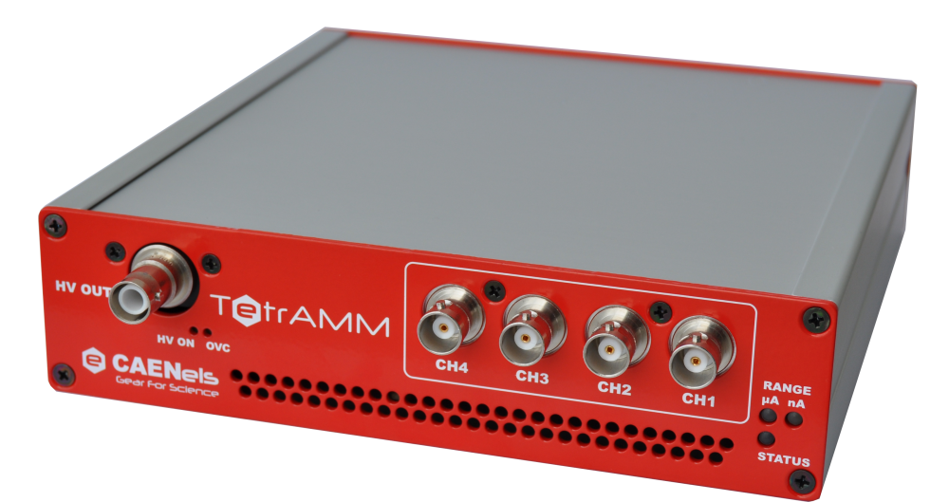
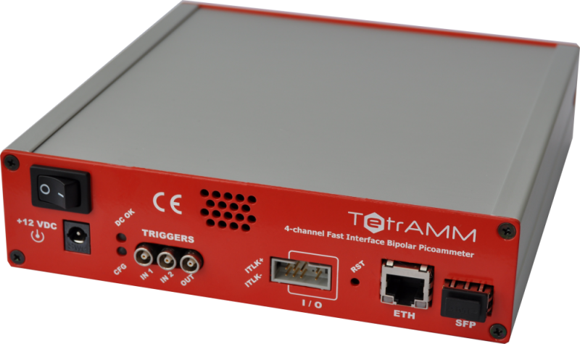
TetrAMM

Slide 6
quadEM Driver
drvQuadEM
C++ base class, inherits from asynNDArrayDriver
Exports data as NDArrays so all areaDetector plugins can be used
Can stream data to disk, do time-series, FFTs, etc.
drvNSLS_EM
Derived class for NSLS/Sydor electrometer
drvAHxxx
Derived class for AH401 and AH501 series
drvTetrAMM
Derived class for TetrAMM

Slide 7
Common Controls
Acquire – Start and stop acquisition
AcquireMode (Continuous, Multiple, Single)
Range (sensitivity)
Geometry (Diamond, Square)
Reset (allows power-cycling device without rebooting IOC)
ValuesPerRead (on-board TetrAMM, driver software on others)
Reduces CPU time when bandwidth is not needed
Reduces number of asynOctet read operations
Limits maximum rate of time series and fast feedback
AveragingTime (averaging done in NDPluginStats)
Current offset and scale (software)
Position offset and scale (software)
Time-series (via NDPluginTimeSeries)
FFT (via NDPluginFFT)
All commonPlugins from areaDetector

Slide 8
Hardware Specific Controls
Integration Time (NSLS_EM, AH401, charge integration models)
PingPong (NSLS_EM, AH40)
Read Format, Binary/ASCII (AH401, AH501, TetrAMM)
Number of Channels (AH501, TetrAMM)
Resolution (16 or 24 bits) (AH501)
External Trigger/Gate (AH401, AH501, TetrAMM)
Trigger Polarity (TetrAMM)
Bias Supply Enable and Voltage (AH501C, AH501D, TetrAMM)
Bias Interlock (TetrAMM)
Voltage Readback (TetrAMM)
Current Readback (TetrAMM)

Slide 9
Analog Input Records
Input offset and scale are applied
Position offset and scale are applied
Uses NDPluginStats to do averaging
Separate plugin for each of 11 values (4 positions, 3 sums, 2 differences, 2 positions)
Driver accumulates NumAverage readings in buffer
When NumAverage readings have arrived it calls the NDPluginStats plugins to compute the mean, standard deviation, etc.

Slide 10
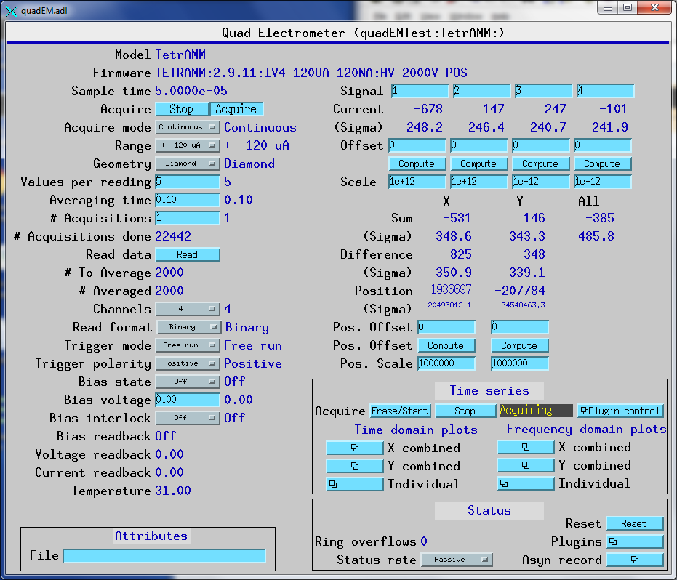
medm Control

Slide 11
TetrAMM Acquisition Modes
TriggerMode | AcquireMode | Description
Free Run | Continuous | Values acquired and averaged each time the AveragingTime is reached.
Free Run | Multiple | Same as above. Repeats NumAcquire times and then acquisition stops. Plugins called NumAcquire times, each time with NumAverage samples.
Ext. Trig. | Continuous | Fixed number of samples (NumAverage, based on AveragingTime) acquired starting on each rising edge external trigger input. AveragingTime must be less than the time between trigger pulses.
Ext. Trig. | Multiple | Same as above. Repeats NumAcquire times and then acquisition stops.

Slide 12
TetrAMM Acquisition Modes
TriggerMode | AcquireMode | Description
Ext. Bulb | Continuous | Samples acquired while external trigger input is asserted. On trailing edge of external trigger signal plugins are called. ValuesPerRead must be set to a value less than (external trigger asserted time * 1e5).
Ext. Bulb | Multiple | Same as above, repeated NumAcquire times and then acquisition is stopped.

Slide 13
TetrAMM Acquisition Modes
TriggerMode | AcquireMode | Description
Ext. Gate | Continuous | Samples acquired while external trigger input is asserted. When NumAverage samples have been acquired the plugins are called. Actual averaging time between calling the plugins will be longer than AverageTime, controlled by the duty cycle of the external gate signal. The trailing edge of the gate pulse is ignored in this mode.
Ext. Gate | Multiple | Same as above When the plugins have been called NumAcquire times then acquisition is stopped.

Slide 14
Conclusions
Fast electrometers permit:
High-frequency diagnostics of beam motion
High-frequency feedback to compensate for beam motion (or deliberate steering)
Data acquisition with ion chambers or photodiode detectors
EPICS quadEM software is part of synApps
Home page:
http://cars.uchicago.edu/software/epics/quadEM.html
Documentation:
http://cars.uchicago.edu/software/epics/quadEMDoc.html
github repository
https://github.com/epics-modules/quadEM
Thanks for your attention!

