Slide 1
Closing Remarks
Wednesday 21 September 2016
David C Anderson
Oak Ridge National Laboratory
Neutron Sciences Directorate

Slide 2
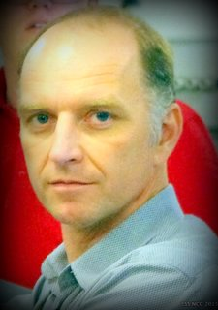
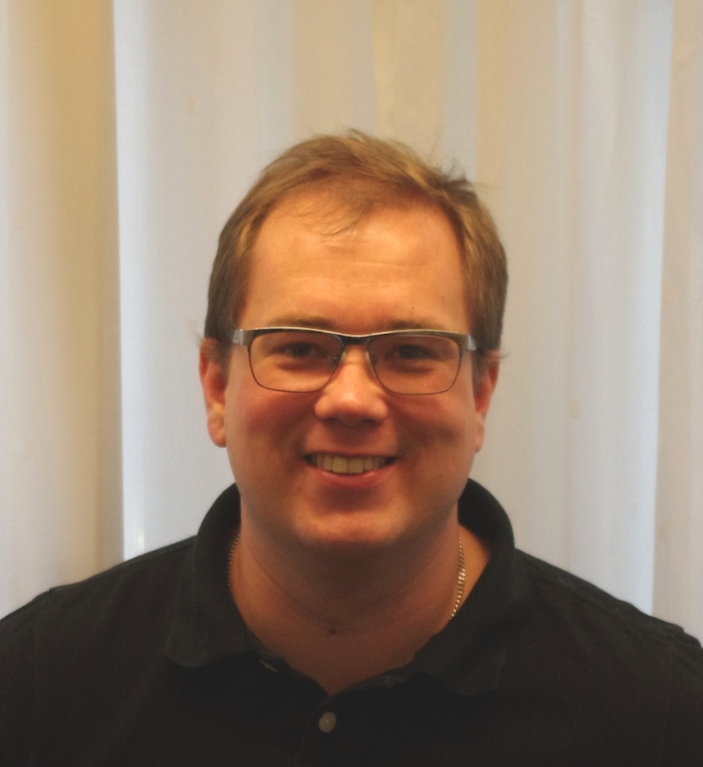
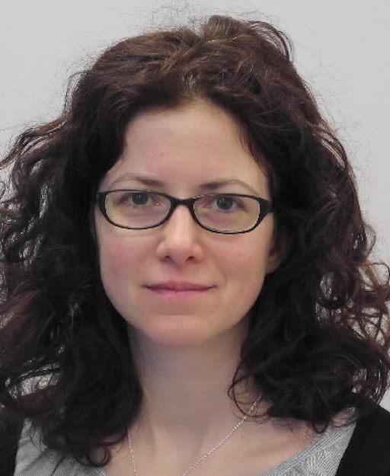
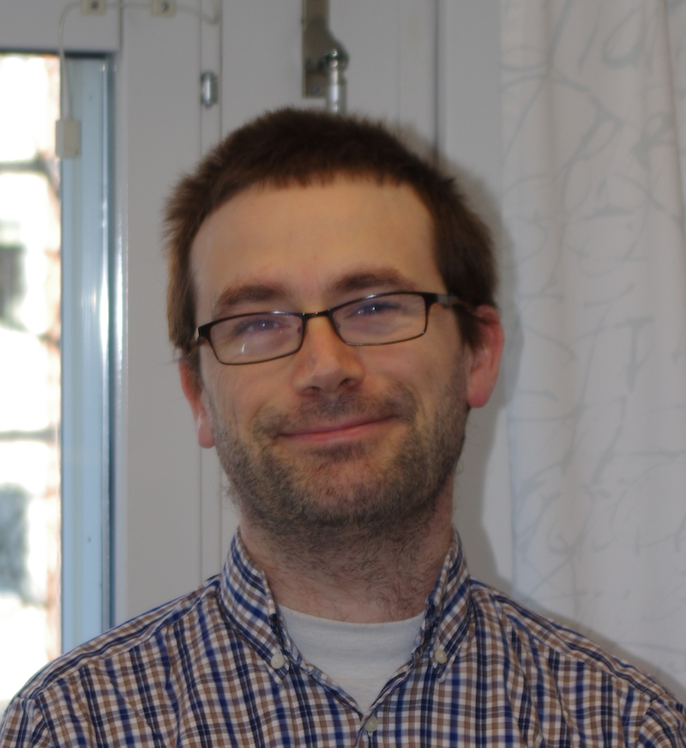
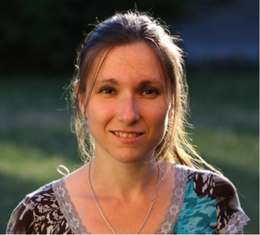
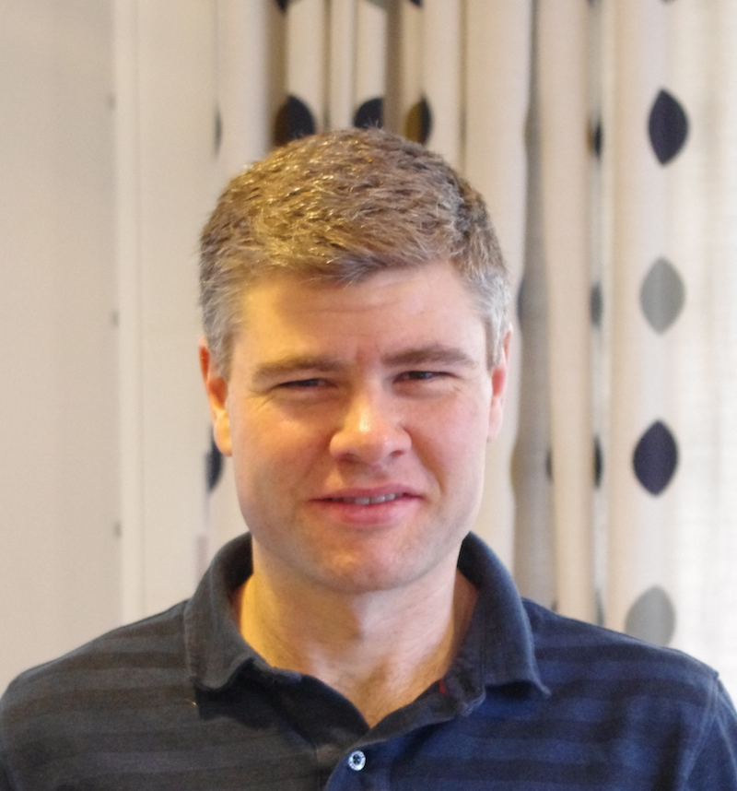
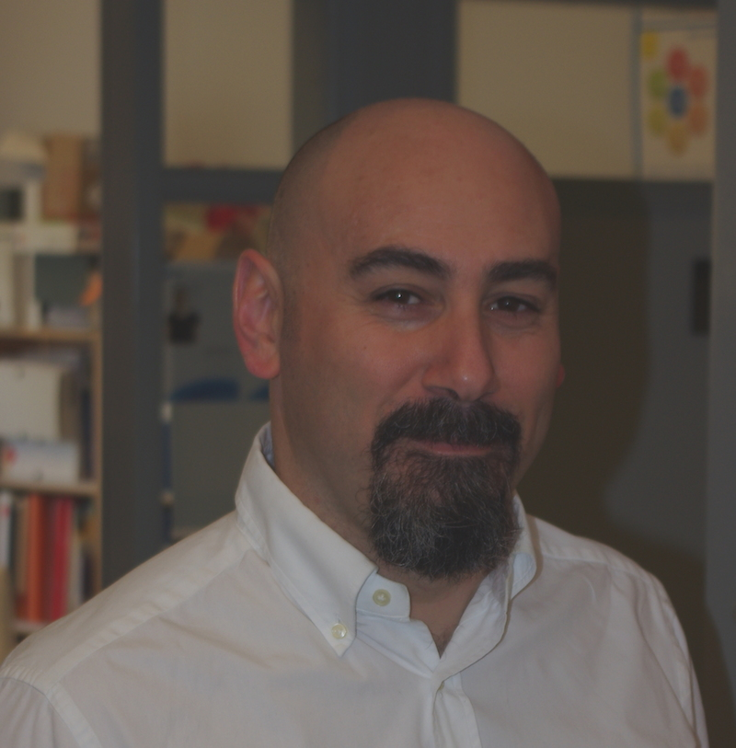
DENIM 2016
Iain Sutton
Erik Nilsson
Zsuzsa Helyes
Damian Martin Rodriguez
Anna Gulyachkina
Tusen tack !
Paul Barron
Giuseppe Aprigliano

Slide 3
DENIM 2017
DENIM 2017 will be held at Australian Centre for Neutron Scattering at ANSTO

Slide 4
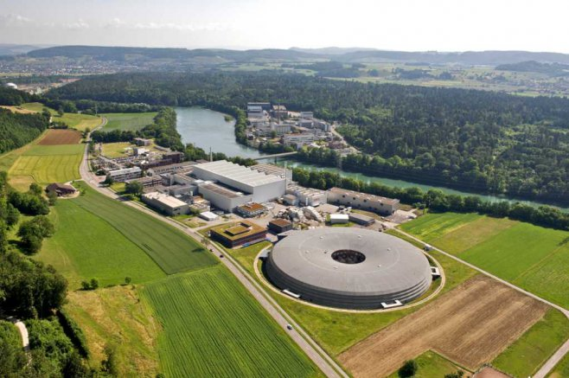
DENIM 2018
DENIM 2018 will be held at SINQ: The Swiss Spallation Neutron Source at PSI

Slide 5
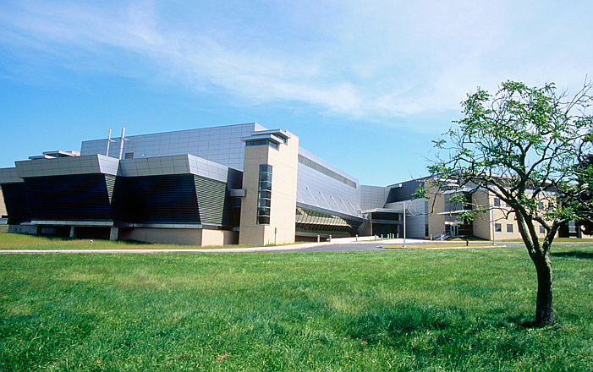
DENIM 2019
DENIM 2019 will be held at the NIST Center for Neutron Research (NCNR) at NIST in Gaithersburg, Maryland in the U.S

Slide 6
DENIM 2020
DENIM 2020 will be in ???

Slide 7
The International DENIM Committee (IDC)
If you are from a facility not shown on this list, please contact me
First Name | Last Name | Facility | Telephone | e-mail | title
Paris | Constantine | ANSTO | (+61) 2 9717 3613 | prc@ansto.gov.au
Scott | Olson | ANSTO |  | sol@ansto.gov.au
Fuzi | Janos | BNC |  | fuzi.janos@wigner.mta.hu | Lead Engineer of Wigner Research Center - BNC
Yanyan | Wu | CSNS | 0086-010-88236470 | wuyy@ihep.ac.cn
Piet | van der Ende | Delft |  | p.vanderende@tudelft.nl
Iain | Sutton | ESS | +46 46 888 31 33 | Iain.Sutton@esss.se | Senior Engineer responsible for the technical coordination of ESS Neutron Scattering Systems
Elbio | Calzada | FRM II | (+49) 89 2891 4611 | elbio.calzada@frm2.tum.de
Lars | Drescher | HZB | 0049-30-806243050 | drescher-l@helmholtz-berlin.de
Jerome | Beaucour | ILL | (+33) 4 76 79 77 | beaucour@ill.eu | Head of Neutron Distribution & Mechanics Department
Stephen | Harrison | ISIS |  | stephen.harrison@stfc.ac.uk | Instrument Design Group Leader
Kevin | Jones | ISIS | 01235 778192 | kevin.jones@stfc.ac.uk | Phase II Instruments DesignGroup Leader
Wataru | Kambara | J-Parc |  | kambara.wataru@jaea.go.jp
Mihaly | Pap | Jülich | (+49)2461615046 | m.pap@fz-juelich.de | Dipl.-Ing., Head of Team Projectmanagement at ZEA1
Guido Heinz | Vehres | Jülich | +49 2461 61 2498 | g.vehres@fz-juelich.de
Sylvain | Désert | LLB | (33)-1-69 08 64 76 | sylvain.desert@cea.fr | head of the Instrumental Development Group
Nancy | Hadad | NIST |  | nancy.hadad@nist.gov
Mike | Murbach | NIST |  | mike.murbach@nist.gov
Donald | Pierce | NIST | (301) 975 - 6965 | donald.pierce@nist.gov
Peter | Keller | PSI |  | peter.keller@psi.ch | Engineering Manager
David | Anderson | SNS | 865-576-9036 | andersondc@ornl.gov | Instrument Engineering Group Leader
andersondc@ornl.gov

Slide 8
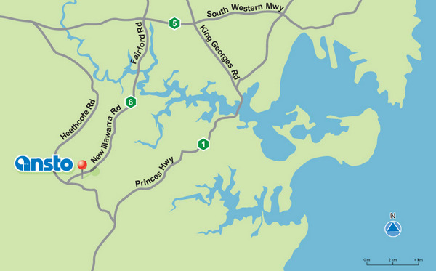
See you next year at ANSTO!

