Slide 1
Nordic Neutron Science Program
ESS Partner Day, Riga June 2nd, 2016
Fredrik Melander, Danish Agency for Science, Technology and Innovation

Slide 2
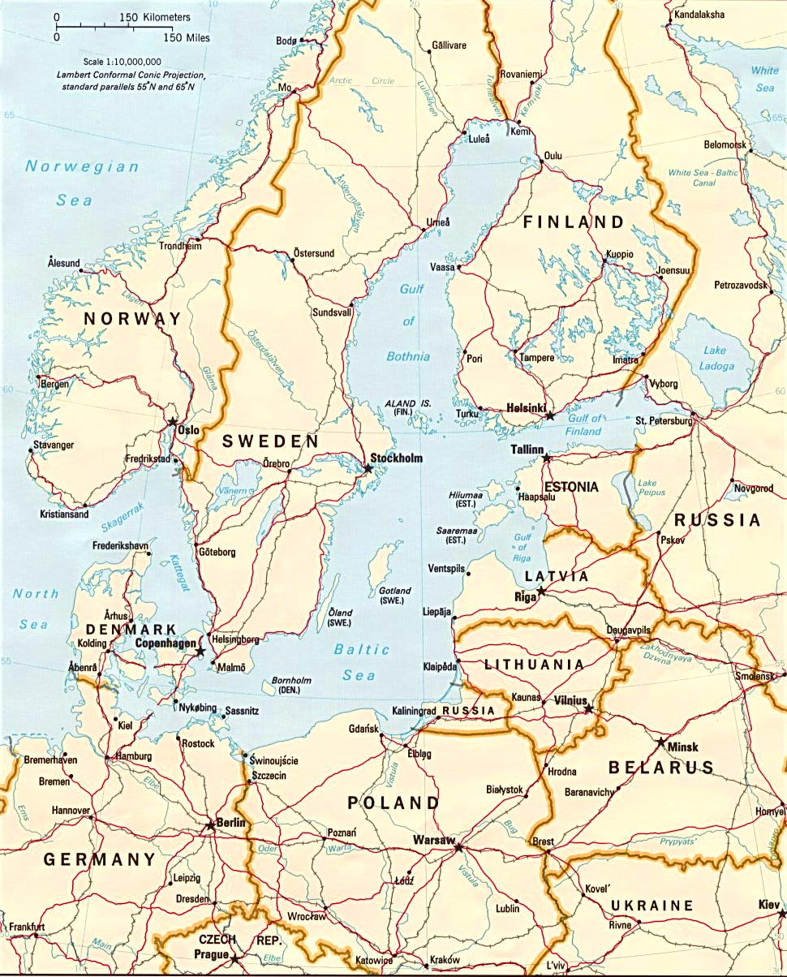
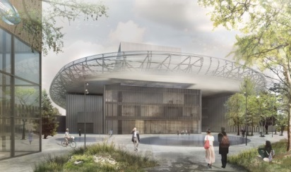

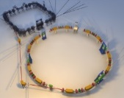
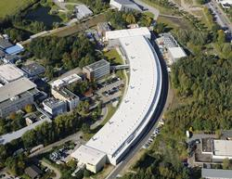
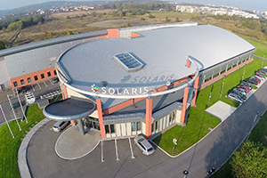

The Big Picture!
ESS
Astrid2
Petra III
Petra III
Solaris

Slide 3
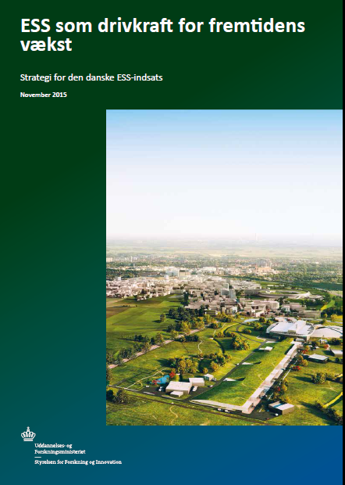
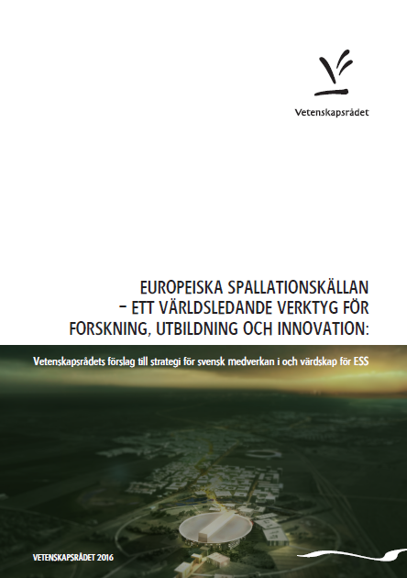
New Danish ESS-strategy adressing challenges/opportunities
Long-term goals, targets and actions relating to:
- Capacity building
- Lighthouse environments
- Bridgebuilding with ESS
- Industrial acces and involvement
- High-tech supplier market
- Anchoring ESS in Denmark

Slide 4
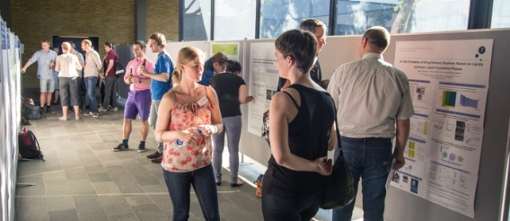
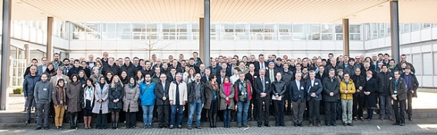
What do we know about the Noridc-Baltic neutron science community?
Danscatt, SNSS, NoNSA
JEEP II at Kjeller

Slide 5
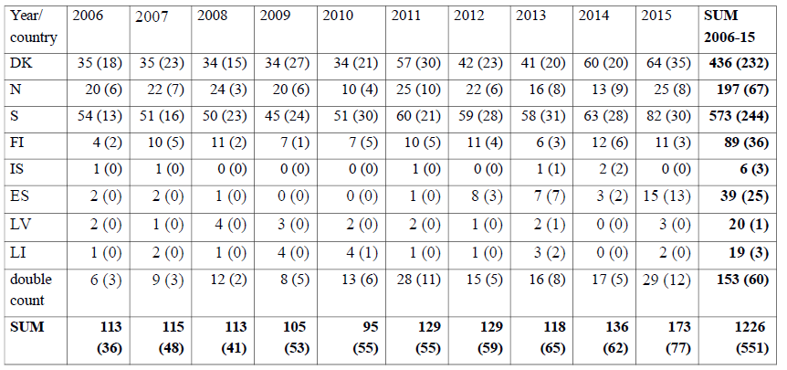
Nordic-Baltic community: publications

Slide 6
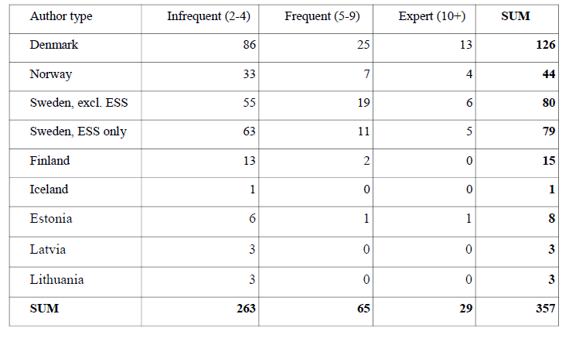
Users (~ 10-15 % annual growth)

Slide 7
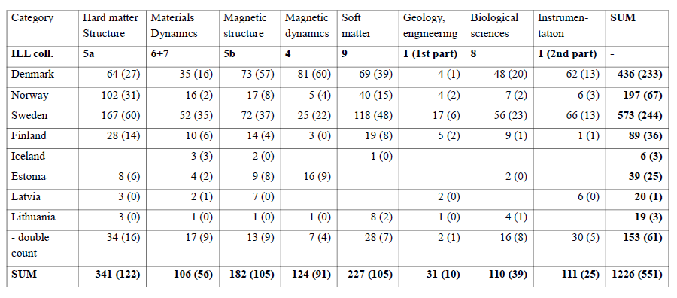
Scientific themes – different focus areas

Slide 8
Overcoming challenges by working together
Small user-community in the Nordic-Baltic Region with around 350 users in relatively few areas….
…. but, in different focus areas, with access to different instruments on current facilities and already established collaboration
Potentials for added value through collaboration

Slide 9
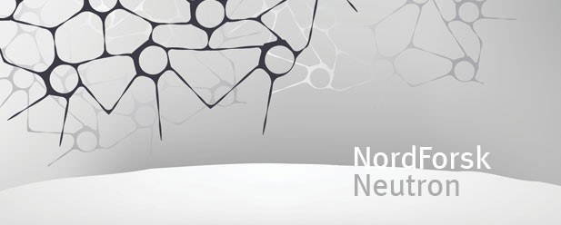



Nordic Neutron Research Program (2015-2019)
The overall goal of the program is to increase the number of neutron users and increase competence in neutron scattering in the region with a special focus on young scientists, and new user fields and communities.
Current budget approximately 60 MNOK
Many thanks to DanScatt/DANSSK, SNSS, NoNSA and NYNNES!

Slide 10
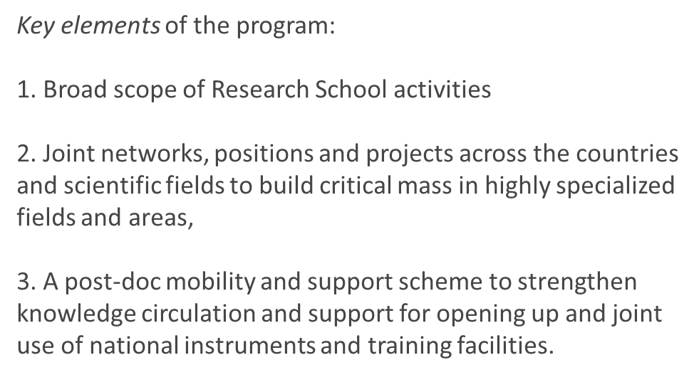
Elements and actions
First investment: Nordic-Baltic researcher networks
Open call: Research School and Research projects to build capacity [spring 2016]
The Research School is expected to start activities in spring 2017, core course to be held both at Kjeller and in Estonia.

Slide 11
The Networks
Aim: Topical networks, connecting research communities across the region to build critical mass in specialized fields and areas.
• Scientific exchange between active research groups, and between academia and industry, to stimulate knowledge transfer within the Nordic/Baltic region.
• Outreach activities to broaden the use of neutron scattering to new research environments and scientific fields.
Funding: 2 MNOK over the next 3 years

Slide 12
Network theme | Leader
Soft and biological materials (66 senior participants). | Reidar Lund, University of Oslo
Functional materials (78 senior participants). | Mogens Christensen, Aarhus University
Magnetism and superconductivity (42 senior participants). | Pascale Deen, ESS
Engineering, processes and real-space imaging (33 senior participants). | Luise Theil Kuhn, Danish Technical University
Low dimensional structures (27 senior participants). | Christoph Frommen, IFE, Norway
Network for Young Nordic Neutron Scatterers (NYNNeS). | Maja Hellsing, Uppsala University
Welcome to join!

Slide 13
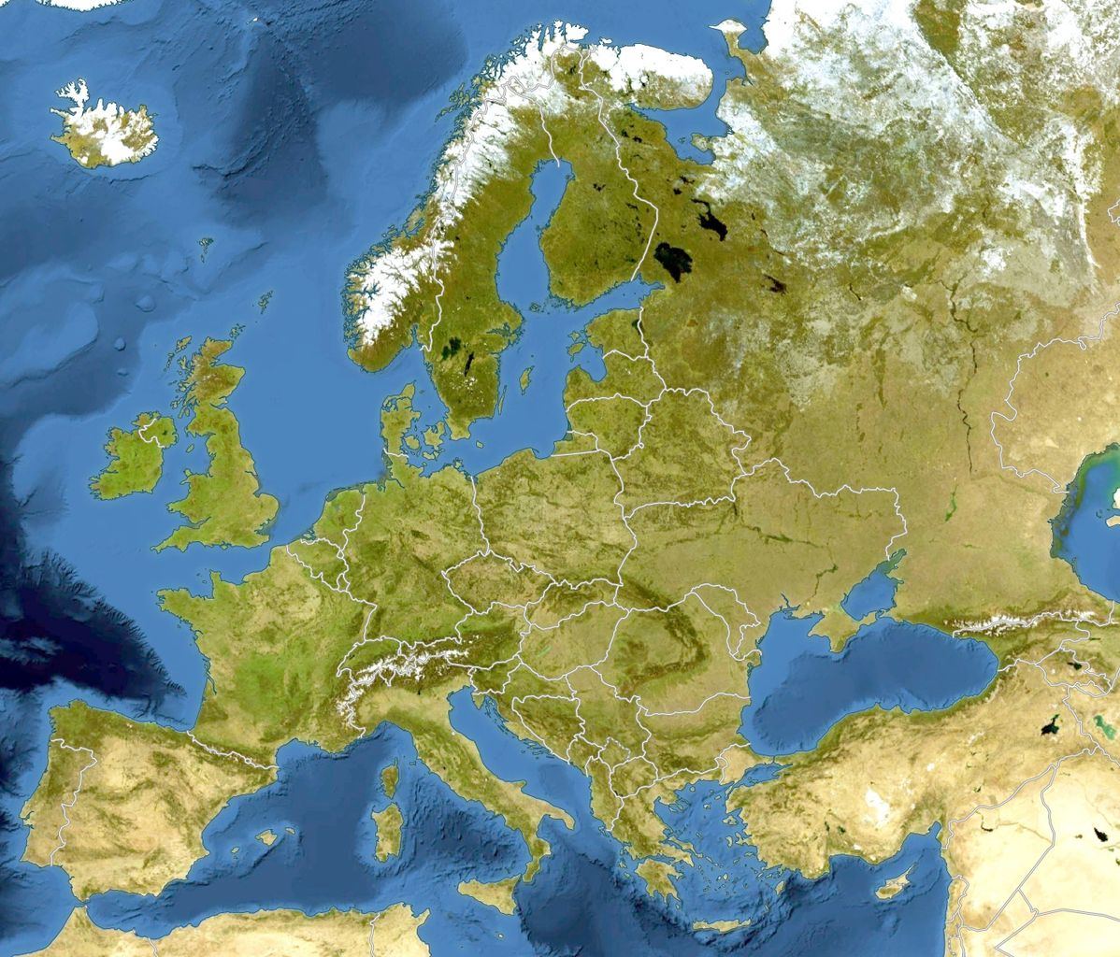

Exicting programmes – basis for collaboration
ESS & Max IV: Cross border science and society
NRCP-FI
Baltic Science Network
Baltic TRAM
(Baltic Sea Interreg)
Nordic Neutron program
SSF Research School
CAROTS
ARISE
(Central Europe Interreg)
Oasis
(Alpine Interreg)
Notes:
Vor 5 Jahren RAC, 3 ½ Jahre SL, jetzt
Gesellschaftliche Herausforderungen
Experimentelle Entwicklung von Lösungen
Entwicklung der Community ILO€ARI und Industrienutzer

