Slide 1
Introduction to the ESS
Integrated Control Systems
Henrik Carling
ESS/ICS
Date: 2016-06

Slide 2
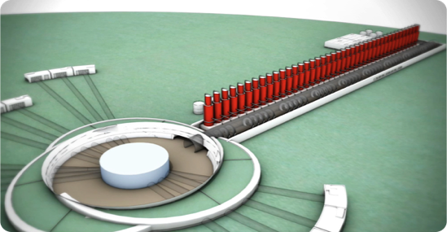
What is ICS about?
The ESS facility is a large and complex machine with very, very much equipment that needs to work in synchronization - and with well-known configurations
For this purpose almost all equipment at the ESS facility is connected to the Integrated Control System
The control system is the ”central nervous system of ESS”
Examples:
  Voltage supplies for magnets
  Vacuum systems
  Cryogenic equipment
  RF equipment
  Air conditioning in the tunnel
An estimated 1.5 million
control points will be needed

Slide 3





ICS Project scope
Work package 01 Management and administration
Work package 02 Software Applications
Work package 03 Software core
Work package 04 Hardware core
Work package 05 Machine protection
Work package 06 Equipment
Work package 07 Control system infrastructure
Work package 08 Physics
Work package 09 Personnel safety systems
Work package 10 Integration - Accelerator
Work package 11 Integration - Target
Work package 12 Integration - Instruments
Work package 13 Integration - Conventional facilities
Work package 14 Test Stands
Work package 20 Installation
Software
Electronics
Infrastructure
Safety & protection

Slide 4
Technology scope for ICS
The span of technical scope and the competencies needed in ICS is enormous
From analog signals to Java-based high-end, big-data GUI:s in high performance, high availability
PLC systems
Safety and protection systems
Infrastructure: networking, data centre, control room
Systems integration, Installation
Project management and administration
Databases
Availability, performance
Applicatoins (GUI, Web, Services)
EPICS
Industrialization, maintenance
Development environments
Kernel drivers
Operating systems (RT)
CSS/Eclipse
Digital communication
Test and validation
PCB, packaging
Test and validation
Analog electronics
Digital electronics
FPGA firmware
Electronics hardware
Software
PLC
Infrastructure
Safety and protection

Slide 5
ESS ERIC
BOARD OF DIRECTORS
DIRECTOR GENERAL
MACHINES DIRECTORATE
SCIENCE DIRECTORATE
PROJECT SUPPORT & ADMINISTRATION DIRECTORATE
CONVENTIONAL FACILITIES
ACCELERATOR
NEUTRON INSTRUMENTS
GENERAL SERVICES
Operations, ES &H and QA
TARGET
NEUTRON TECHNOLOGIES
HUMAN RESOURCES
Communication
SYSTEMS ENGINEERING
SCIENTIFIC ACTIVITIES
FINANCE
INTEGRATED CONTROL SYSTEM
SCIENTIFIC PROJECTS
COMMUNICATIONS & EXTERNAL RELATIONS
ENGINEERING & INTEGRATION SUPPORT
DATA MANAGEMENT SOFTWARE CENTRE
INFORMATION TECHNOLOGY
LEGAL
SUPPLY, PROCUREMENT & LOGISTICS

Slide 6
ICS Organization
2016-05-01
Henrik Carling
Division head
Anna Gillberg
Team assistant
?
IT/Infrastructure ?
(Vacant?)
Annika Nordt
Safety and protection
Daniel Piso
Hardware and integration
Hector Novella
Deputy project manager
Susanne Regnell
Control Software
Timo Korhonen
Chief engineer
Angel Monera
FPGA Engineer
Benedetto Gallese
Integrator
Ben Folsom
PhD student
?
Deputy chief engineer
(Vacant)
Denis Paulic
PLC Engineer
David Brodrick
Integrator
Emanuele Laface
Accelerator physicist
Julen Etxeberria
Intern
François Bellorini
Integrator
Karin Rathsman
Senior scientist
Manuel Zaera-Sanz
PLC Engineer
Javier Cerejo
PhD Student
Leandro Fernandez
Senior software engineer
Morteza Mansouri
Safety Engineer
Jeong Han Lee
Integrator
Claudio Rosati
Software engineer
Riccard Andersson
PhD student
Nick Levchenko
Integrator
Ricardo Fernandes
Senior software engineer
Stuart Birch
Senior safety engineer
Vacant
Software engineer
Remy Mudingay
Infrastructure engineer
Yong Kian Sin
IEC61508 engineer
Alexander Söderqvist
Integrator
Thilo Friedrich
PhD Student
Vacant
Engineer?
Niklas Claesson
Integrator
Consultants
Vacant
Engineer?
Vacant
Engineer?
Vacant
Engineer?
Employee
Consultant
Vacant
Engineer?
Vacant
Engineer?
Temporary employee
Consultant
off-site
Position under consideration

Slide 7
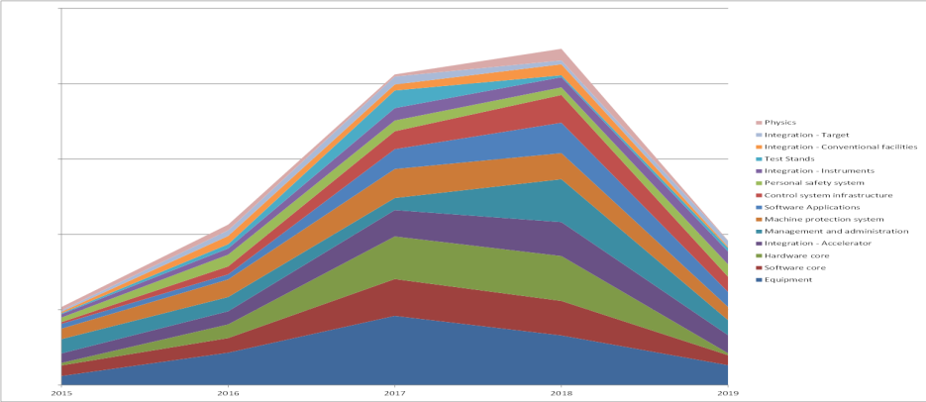
ICS - construction phase value envelope (tentative)
2016 2017 2018 2019
The ICS value envelope for the construction phase shows the aggressive project schedule
A majority of the ICS value is labor based effort (i.e. not equipment)
The ICS estimated headcount envelope reveals large in-kind/supplier opportunities

Slide 8
ESS In-kind Goals
Construction cost: € 1.84 Billion
In-kind: € 747.5 Million
€ 510 M
€ 350 M
€ 155 M
€ 73 M
ICS
M€

Slide 9
ICS In-kind partners
Partner Institutes
Atomki, Hungary
CEA, France
CNRS, France
Elettra, Italy
ESS Bilbao, Spain
IFE, Norway
INFN Catania, Italy
INFN Legnaro, Italy
PSI, Switzerland
Tallinn Technical University, Estonia
ÚJV Řež, Czech Republic
University of Łódź , Poland
Uppsala University, Sweden
ZHAW, Switzerland
Agreement signed
Agreement waiting for signature
Early discussions
Collaboration agreement
Notes:
Projects can put small dots wherever they have a partner.

Slide 10
Commercial procurements within ICS
The overwhelming majority of value within ICS’s scope is represented as manual labor
Over the construction phase we see a strong need for skilled personnel to be recruited, in-kinded and contracted for work within ICS
We see a strong need to fill transient positions with consultants
  New framework agreements are being created for
    Software development services ~5 M€ Closed
    Hardware development services (electronics) ~1.2 M€ Q2 2016
    PLC programming services ~2.9 M€ Q3 2016
    ”Integration” >4 M€ Q2 2016
The ICS equipment procurement plan is still realtively immature - to be presented in break-out sessions

Slide 11
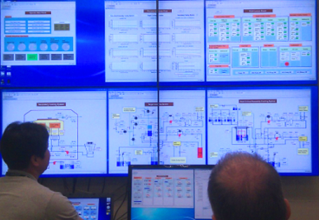
ICS SOFTWARE ACTIVITIES

Slide 12
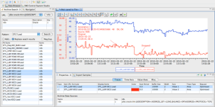
Software team scope description
Controls configuration tools
  Controls Configuration Database (CCDB)
  Naming Server for naming convention
  Cable Database (CDB)
  IOC Factory
  CS Entry
  Role Based Access Control (RBAC)
Clients
  Alarm Handling
  E-logbook
  Archiving System
  Save, Compare & Restore
  Scenario management
  GUI/HMI (Control System Studio)
Core controls software
  Development/contributions to core EPICS
  Timing applications
  Post-mortem diagnostics
Physics modelling
  Open XAL
  ESS Linac Simulator
  Beam Physics Applications
Operation tools – Scripting frameworks
  iPython
  Scripting Execution Environment
  Macroserver
Software development environment
  Vagrant for virtualization
  Ansible for automation of deployment and configuration of our software infrastructure
  Jenkins for continuous integration support

Slide 13
Software team status
The software scope is being reworked
When the scope definition has matured, we believe that significant parts of the software development scope can be packaged for in-kind contributions
A call for tender for software development services is ongoing
Collaboration within open communities are very important for ICS going forward.

Slide 14
ICS Hardware platforms

Slide 15


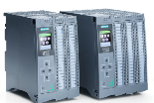
Three layer strategy - control systems at ESS
Signal speed
A custom made microTCA board with a powerful FPGA and a CPU. A FPGA framework constitutes the development environment. The CPU runs EPICS
ICS has adopted a three layer strategy for implementing the control system based on signal speed
  A custom made platform based on microTCA for applications with data acquisition exceeding 100 kHz
  The CPU will run EPICS and the FPGA will have a complete application development environment
  For slower signals, EtherCAT will be used as a real-time fieldbus with good price/performance ratio
  Synchronization and event information are key for applications where a full custom platform solution would be too costly
  Low speed signals are handled with commercially available PLC systems from Siemens
  This is a cost-effective solution that addresses ESS reliability and maintainability requirements
  The PLC:s will be connected to EPICS for further integration into the control system
10 MHz
1 MHz
100 kHz
Electronic front-end platform
10 kHz
1 kHz
EtherCAT I/O modules that are connected to commercial or open-source EtherCAT master controllers which are in turn connected to the EPICS based control system
100 Hz
EtherCAT
10 Hz
Slower signals are handled by industrial automation (PLC) for reliability and cost reasons. The standardized platform for ESS applications comes from Siemens
1 Hz
0.1 Hz
Industrial automation (PLC)

Slide 16
“Other” I/O
ICS is trying to standardize control solutions wherever possible
  Serial devices
    Use MOXA – almost de-facto standard
  Ethernet-based devices
    Ethernet as a fieldbus connected to EPICS
  Detectors
    EPICS AreaDetector supports a large device base
  Motion control
    Working together with our NSS colleagues

Slide 17
Hardware development status
Development of the high-end electronic platform is started as an in-kind activity with Switzerland
Development of EtherCAT-specific modules for ESS/ICS usage is being initiated as an in-kind activity with Estonia
More in-kind opportunities exist for development of microTCA electronics and platform management
A call for tender for hardware development services and automation software development services will open soon

Slide 18
SAFETY AND PROTECTION

Slide 19
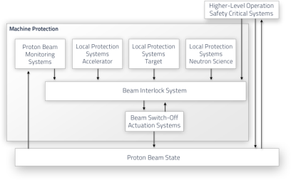
Personnel safety and Machine protection
Machine protection shall prevent and mitigate damage to the machine in accordance with beam and facility related availability requirements
Machine protection shall protect the machine from unnecessary beam-induced activation having a potential to cause long-term damage to the machine or increase maintenance times
The Personnel safety system shall prevent and mitigate any risk for damage or danger to personnel as identified by risk analyses and assessments
The Personnel safety system shall be designed and implemented in compliance with safety standards such as IEC61508

Slide 20
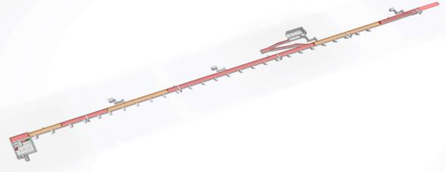
Safety and protection status
The Personnel safety system is nearing design completion and implementation of subsystems has started. The PSS will be an ESS in-house activity
The machine protection architecture is being enhanced and clarified as recommended by an external review committee in 2015-12
Meanwhile, parts of the Machine protection system, and the Fast beam interlock system in particular, is being developed as an in-kind collaboration with Switzerland
We are looking for a solution
for radiation monitors and
oxygen depletion monitors
ZONE 7
ZONE 6
ZONE 5
ZONE 4
ZONE 2
ZONE 3
ZONE 1

Slide 21
Control SYSTEM
INFRASTRUCTURE

Slide 22
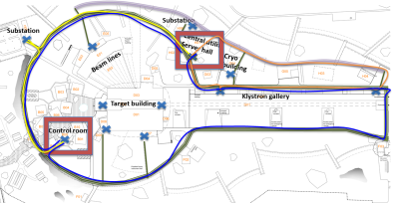
Control system infrastructure
In the scope for the control system infrastructure is infrastructure required for the Control System to operate
A centralized ESS Control Room, which allows the entire facility to be controlled from the same location
Operations consoles, servers and file storage required for operation
Networks between Control boxes, Timing system units, Control Room, Data Centre and other control equipment
Efforts and material required for connecting devices to the ICS

Slide 23
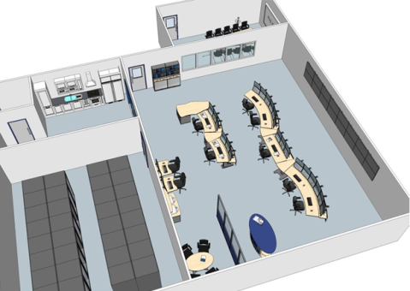
Control system infrastructure status
The design and implementation of the control room has been initiated as an in-kind collaboration with Norway
We are investigating possibilities of creating in-kind collaborations for the data centre associated to the control system
Design and planning of the control system network is ongoing. Some specialized tasks such as cyber security issues may be possible to implement as in-kind contributions

