Slide 1
Evaluation of radioactivity induced in various components of PET- cyclotron
Hiroshi Matsumura¹
Akihiro Toyoda¹
Kazuyoshi Masumoto¹
Go Yoshida¹
Toshiyuki Yagishita²
Takayuki Nakabayashi²
Hiroyuki Sasaki²
Kazuhiro Matsumura²
¹High Energy Accelerator Research Organization (KEK)
²Japan Environment Research Co.,Ltd.
Notes:
Thank you chair !

Slide 2
Outline
Introduction
Cyclotron
    Specification and generated radioisotopes
Sampling
  Drilling and core boring
Results and Discussion
    Depth distribution of radioactivity
Conclusion
Notes:
This is the outline of my presentation.
We determined depth distribution of radioactivity in various metal components of cyclotron.
Sampling were obtained by drilling and core boring, this is very unique method.
Today, I will introduce a brief report of this work.
OK, let’s move on to presentation.

Slide 3
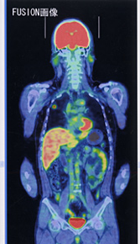
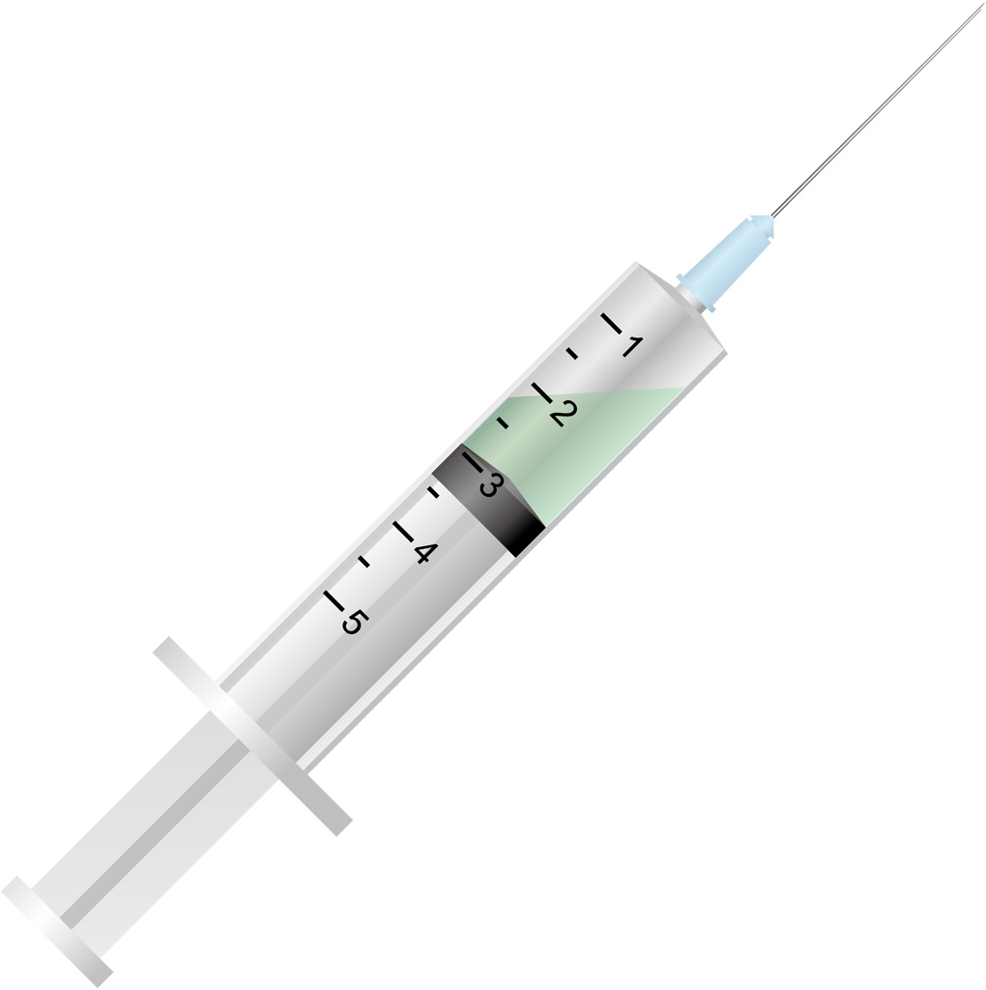
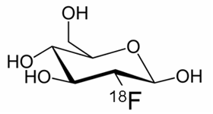
Introduction
©Jichi medical Univ. Japan
Cancer diagnosis by positron emission tomography (PET)
Cyclotron
Radiopharmaceutical
Diagnosis (PET-CT)
Many cyclotron facilities are getting old.
In case of decommissioning, amount of radioactive wastes will become a social problem.
Aim of this work
Investigation of radionuclides which were induced in a cyclotron and determination of their depth distribution.
⇒ drilling and core boring method
Notes:
In Japan, many small scale cyclotron facilities have been established for generation of radiopharmaceutical which is used in positron emission tomography (PET).
But, some facilities are getting old and it is expected that the number of decommissioning will increase radically in the future.
There is concern that it will become a social problem.
Radioactive wastes which are generated by decommissioning of cyclotron must be strictly（厳密に） controlled and expenses for processing are much high.
It was already known that Co-60 and Mn-54 are generated in components of a cyclotron, such as Sector magnet, Coil, and York, but their activities and distribution have not been comprehended （理解） yet.
In this work, in order to obtain fundamental data for decommissioning, we examined radionuclides which were generated in components of a cyclotron and determined depth and area distribution.
Samples were taken by drilling and core boring from the cyclotron which had actually been operated.

Slide 4
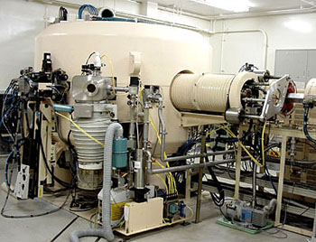
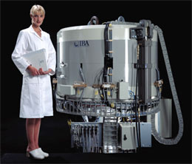
Cyclotrons
There are two types (proton acceleration and H⁻ acceleration).
 | BC1710, JSW(Japan) | CYCLONE 10/5, IBA(Belgium)
Maximum energy | 17 MeV (p), 10 MeV (d) | 10 MeV (H⁻), 5 MeV (D⁻)
Maximum current | 50 μA (p), 50 μA (d) | 60 μA (H⁻), 35 μA (D⁻)
Operation time period | 2003/4~2016/4 | 2003/3~2011/11
Total operation time | 3400 [h] | 2598 [h]
Sampling date | 2016/7/25 | 2016/5/24
Radionuclides were measured in the two cyclotron facilities.
Notes:
In this study, two types of cyclotrons were examined.
One is proton acceleration type, another is H- acceleration type.
The former one is BC1710 made by JSW japan.
It had been used from 2003 to 2016, total operation time is 3400 hour.
We took samples from this cyclotron at July 25th in 2016.
The latter one is CYCLONE 10/5 made by IBA Belgium.
This type accelerates hydrogen negative ions and stripped all electrons by a carbon foil just before injection to a target.
It had been used from 2003 to 2011, total operation time is about 2600 hour.
We took samples from this cyclotron at May 24th in 2016.
This model is relatively new and smaller than BC1710.
It was covered by self shield concrete at operation.
Both models were mainly used for F-18 production as Radiopharmaceutical for PET.
We examined radionuclides from each component of these cyclotrons in detail.

Slide 5
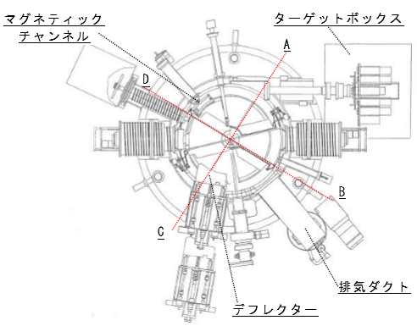
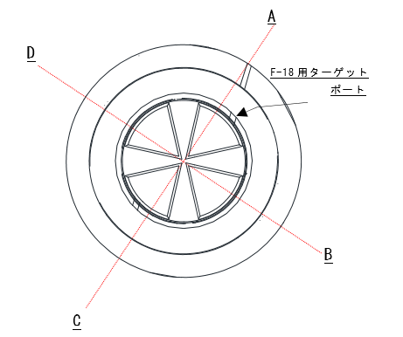
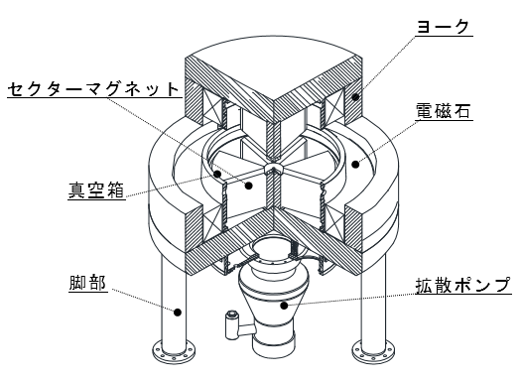
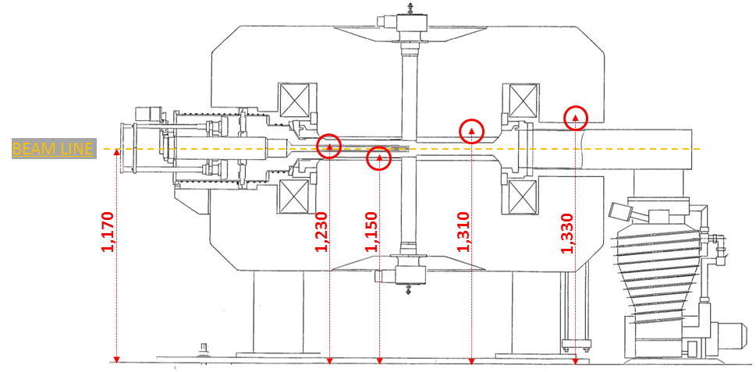
Major radionuclides in the cyclotron components
Cyclotrons were decomposed and each components were measured by Ge detector.
Co-60, Mn-54 were mainly detected in the components.
CYCLONE 10/5
“Vacuum chamber” (Stainless steel)
Mn-54, Co-60, Co-58, Zn-65, Co-57, Co-56
“Sector magnet” (Iron)
Co-60, Mn-54, Zn-65
BC1710
“York” (Iron)
Co-60, Mn-54
“York” (Iron)
Mn-54, Co-60,
Fe-59, Co-58
“Vacuum chamber” (Aluminum)
Co-60
Notes:
Both cyclotrons were decomposed into the each component, and measured gamma-rays from the generated nuclides by Ge detector.
Representative components and detected nuclides were shown in here.
Mainly, Co-60 and Mn-54 were detected in the vacuum chamber, York, and Sector magnet.
We focused on the York and the Sector magnet, and extracted core samples in order to determine the depth distribution of nuclides.

Slide 6
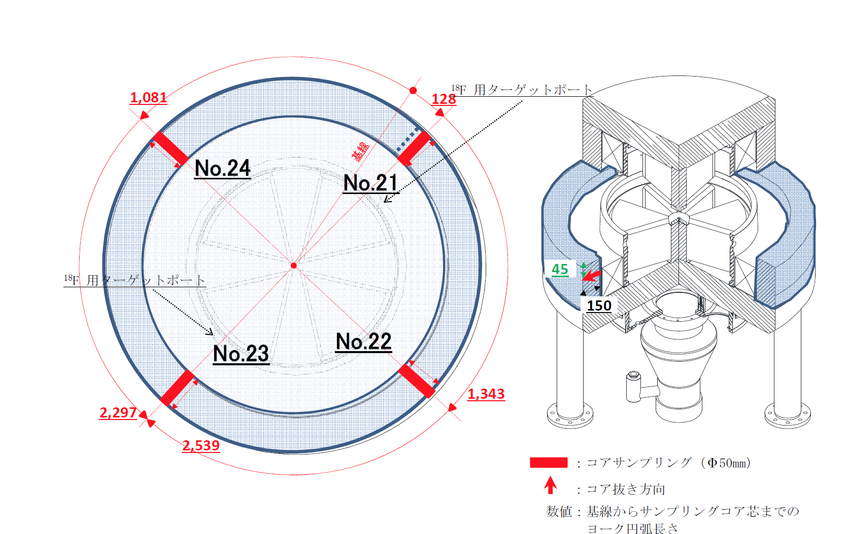
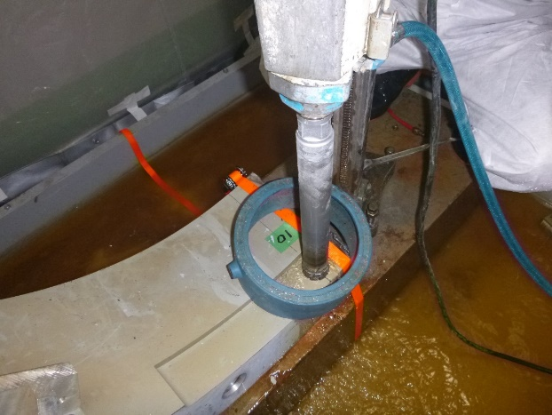
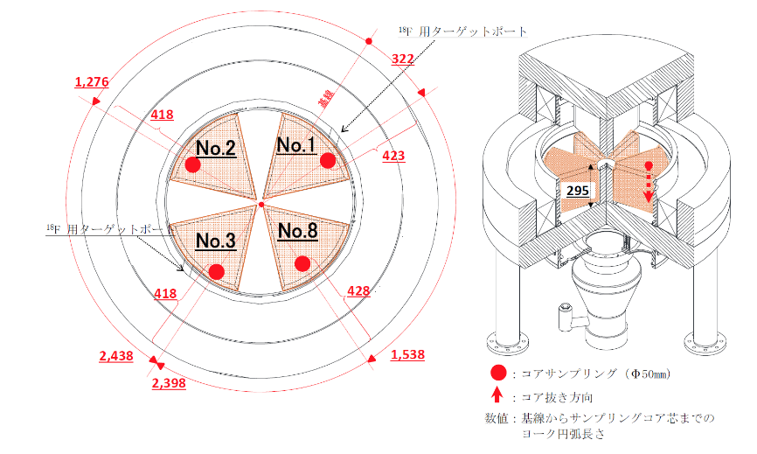
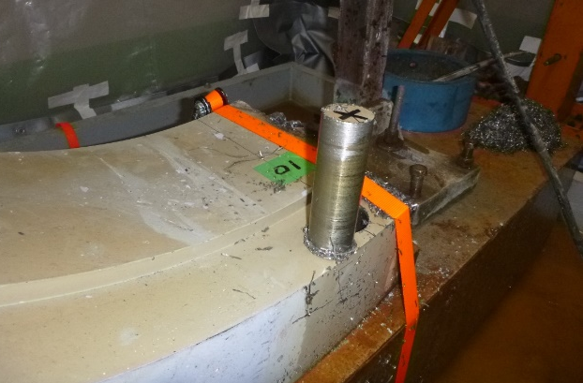
Sampling
Core boring
Core samples were obtained by core boring method.
This work is the first case of core sampling from cyclotrons (medical purpose).
York
Sector magnet
Notes:
Core samples were obtained（得られた） by core boring method.
More than four cores were extracted from each component as shown in here.
Close to the target, opposite to the target, and vertical sides.
This work is the first case of core sampling from the small scale medical purpose cyclotron.

Slide 7
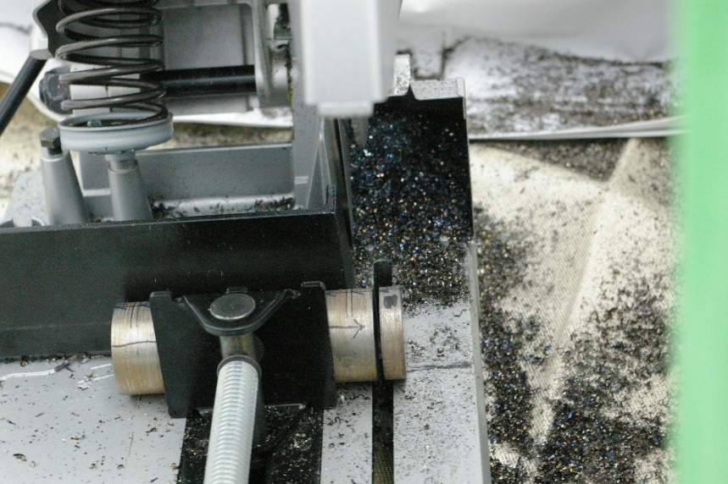
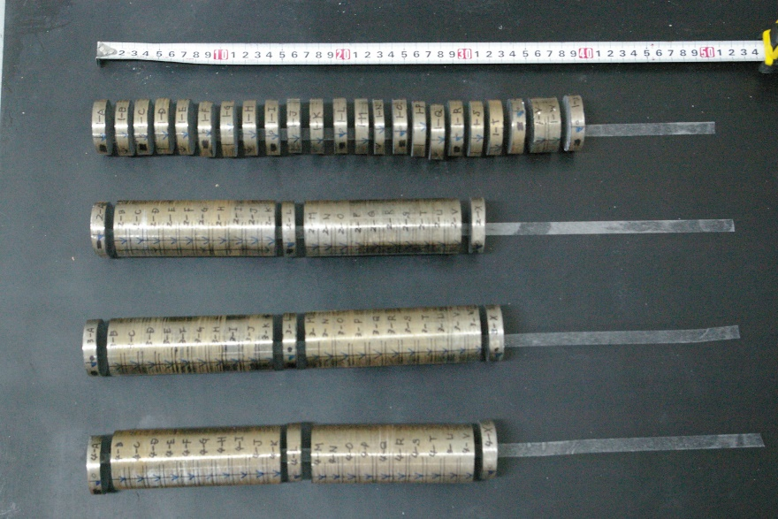
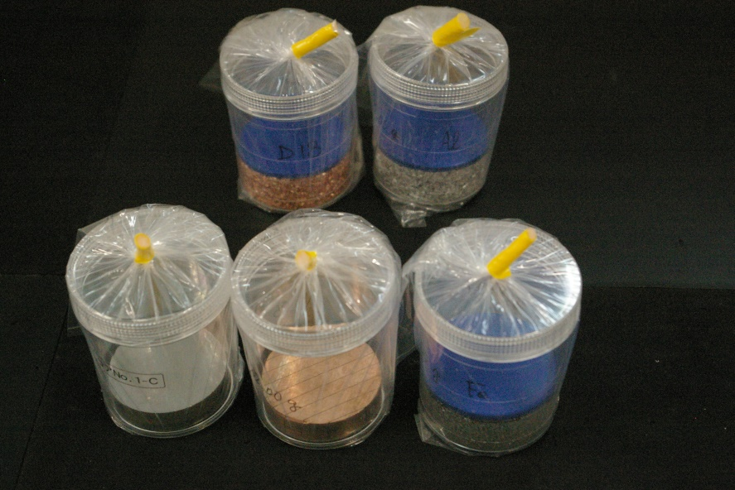
Sampling
Preparation of test piece
The core samples were sliced to 10 mm.
A sliced pieces were packed in a container (U8 type) .
Activity was determined by Ge detector measurement.
Slicing the core sample
Test pieces
(sliced core sample)
Containers for gamma-ray measurement
Notes:
The core samples were sliced to 10 mm and test pieces were prepared.
A test piece was packed in a plastic container (U8 type) and obtained gamma-ray spectrum by Ge detector measurement.

Slide 8
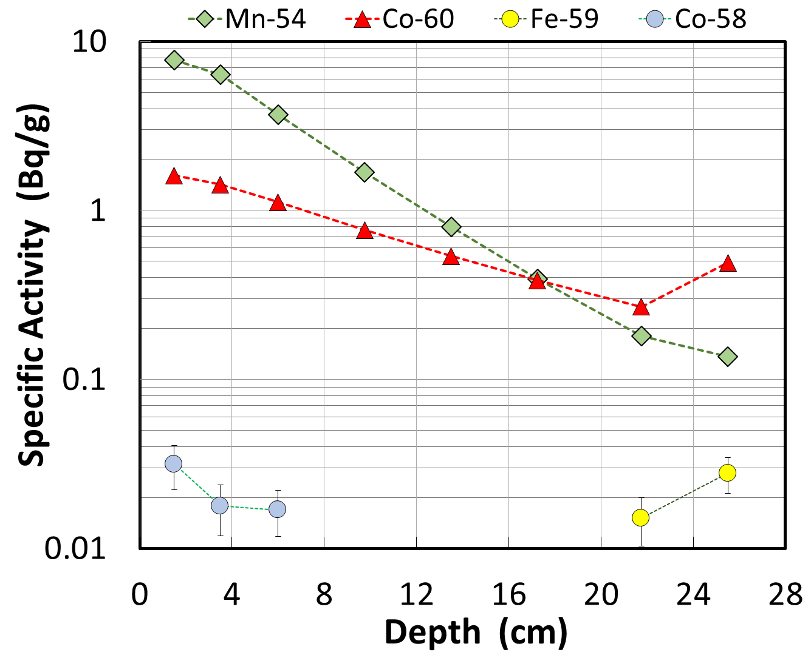
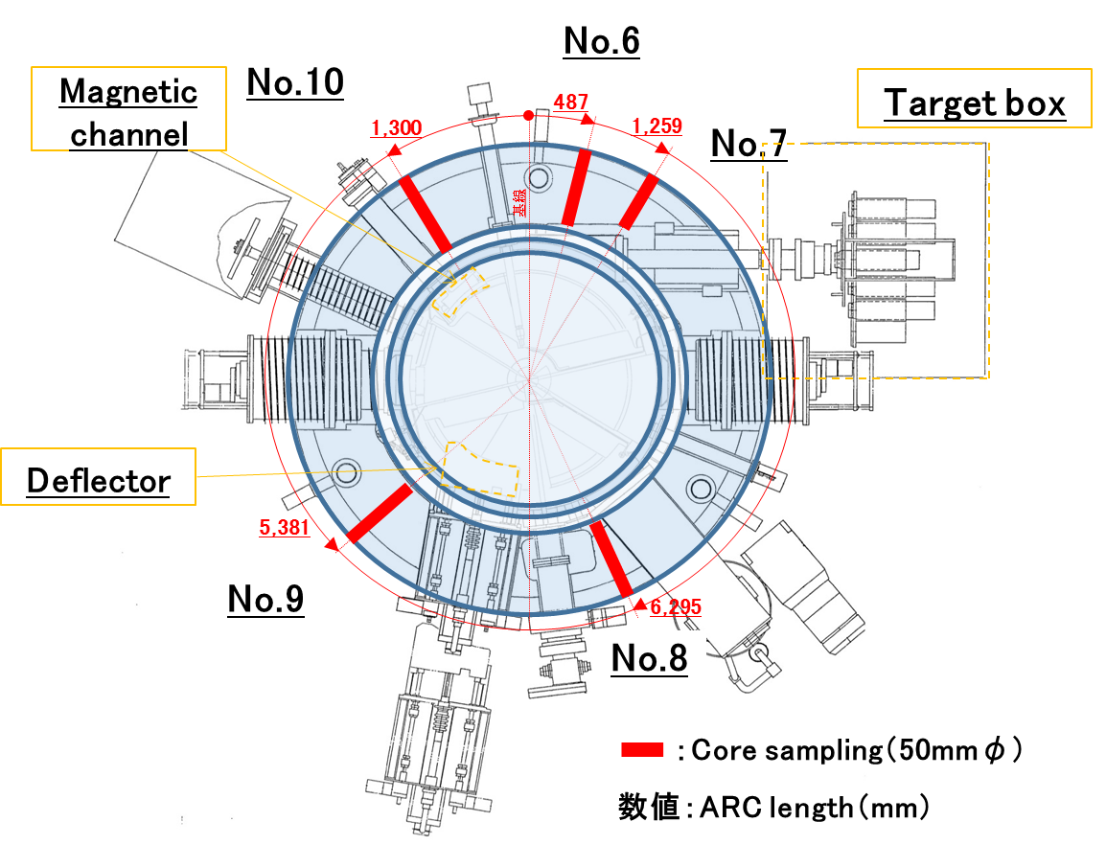
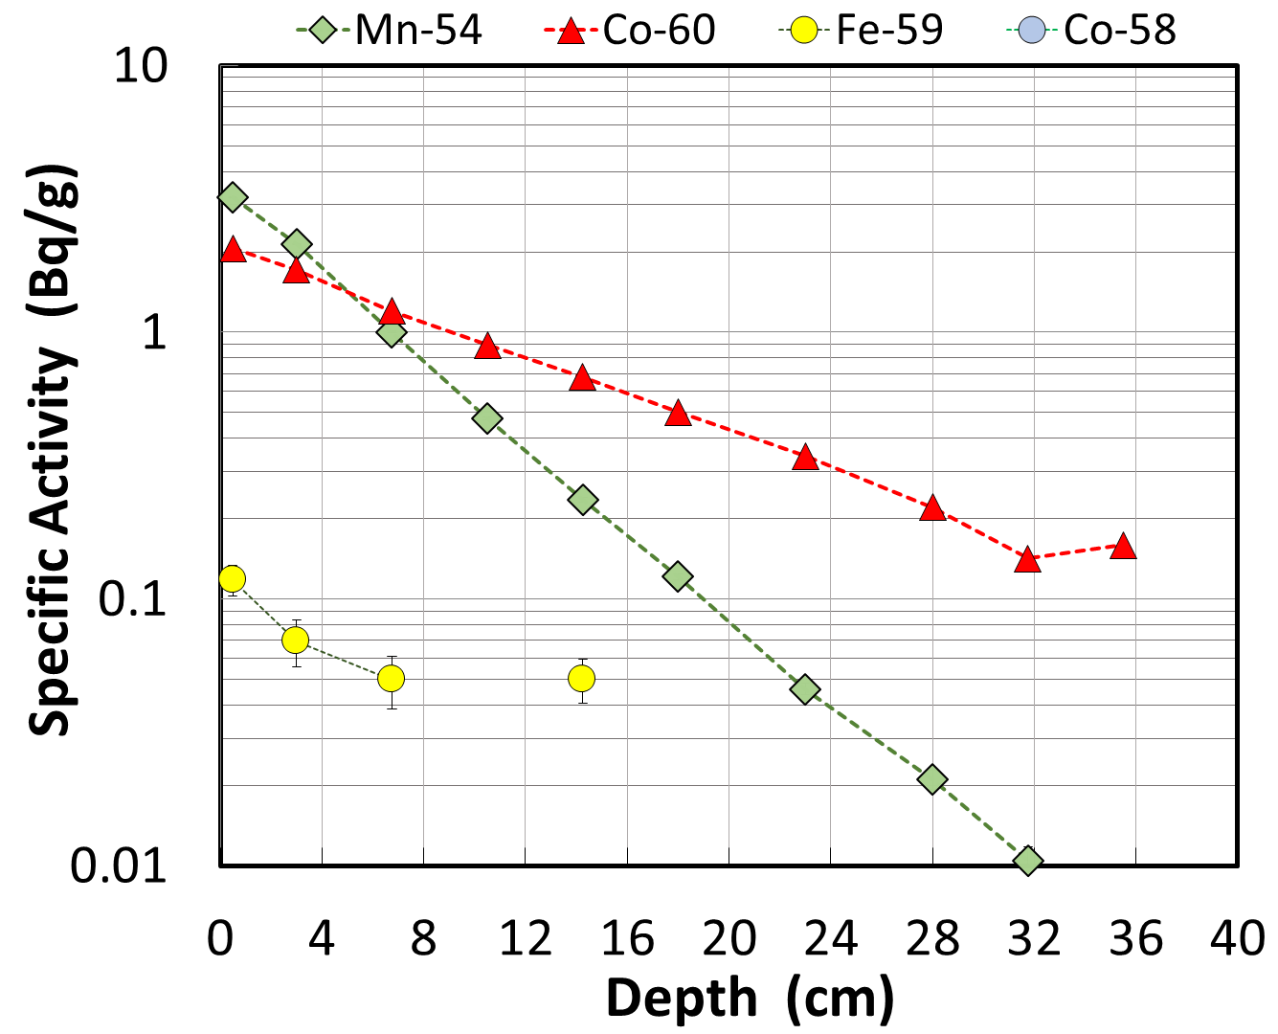
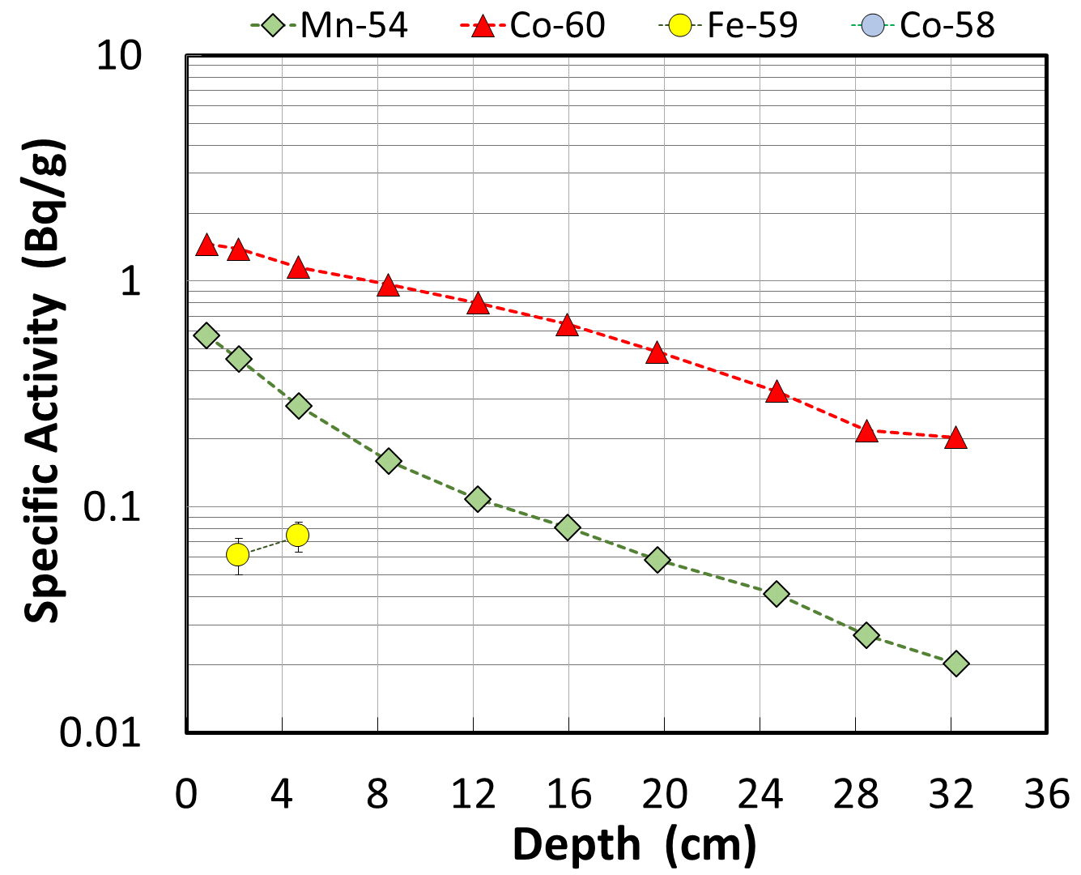
Results
Target side (No.7)
BC1710 ,York (Bottom)
Deflector side (No.9)
Exhaust side (No.8)
Mn-54 and Co-60 were detected.
Mn-54 rapidly decreased with depth.
Co-60 more slowly decreased with depth.
Notes:
OK, let’s move on to the results.
First, I’d like to explain the York of BC1710.
This is a overview of cyclotron, the York is blue shaded area.
Sample cores were extracted through red line.
As a representative, No.7 target side, No.8 exhaust side, and No.9 deflector side were described.
Horizontal axis express core sample depth, the center to out direction.
Vertical axis means Specific activity of nuclides at each depth.
In, No.7, No.8, and No.9, Mn-54 (green diamond) and Co-60 (red triangle) were detected.
Mn rapidly decreased with depth, on the other hand, Co more slowly decreased.
Mn-54 was generated by fast neutron, but Co-60 was generated by thermal neutron.
Such production process difference might influence the activity at each depth.
In the three graphs, Red lines are decreasing with depth but slightly increasing at the end point of core sample.
This is Caused by reflected neutrons by the shield wall which is just outer the York.

Slide 9
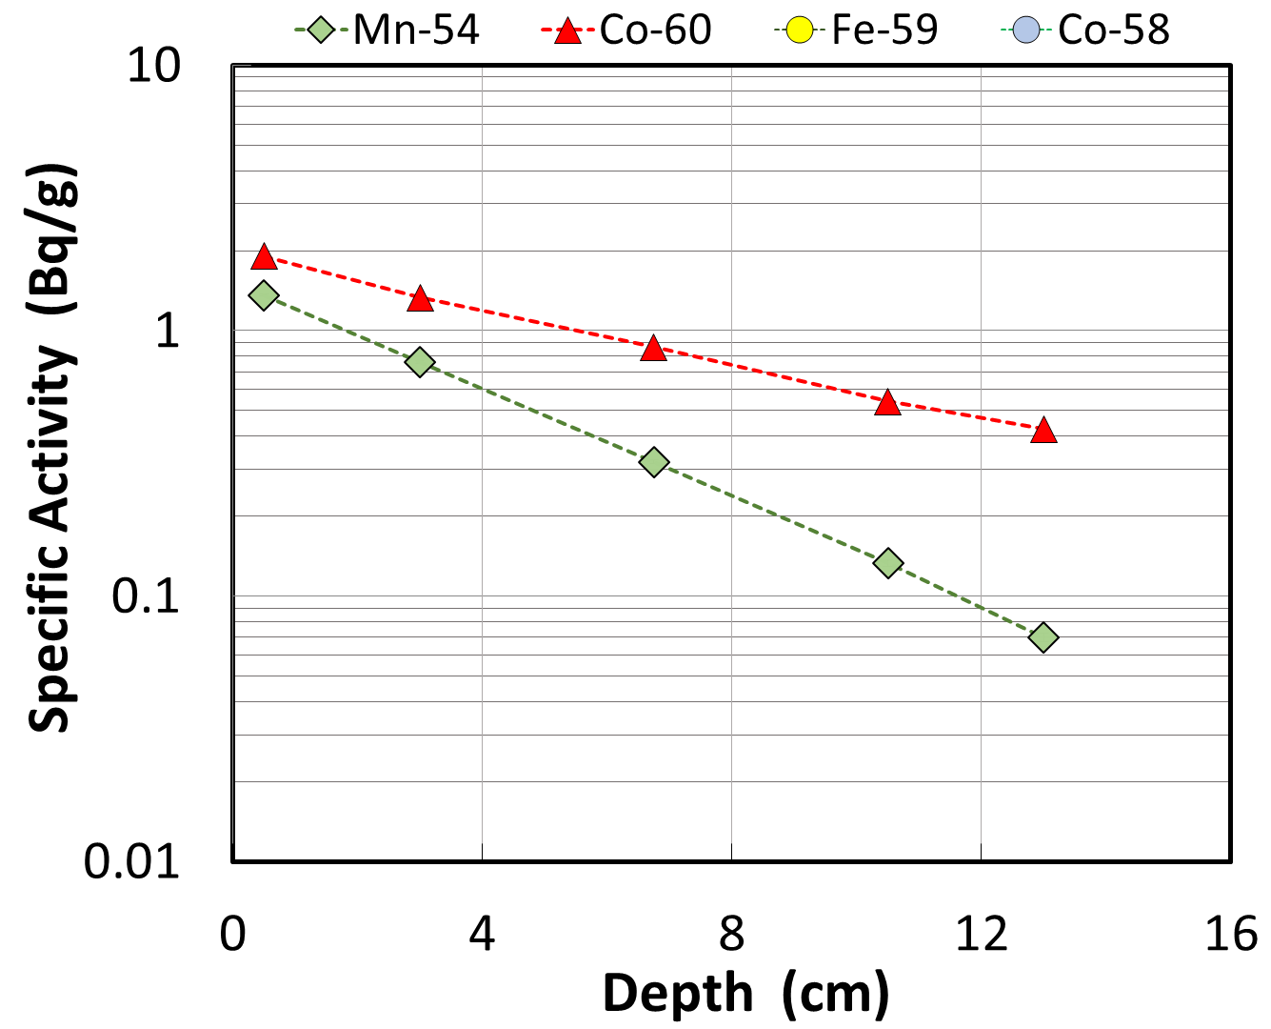
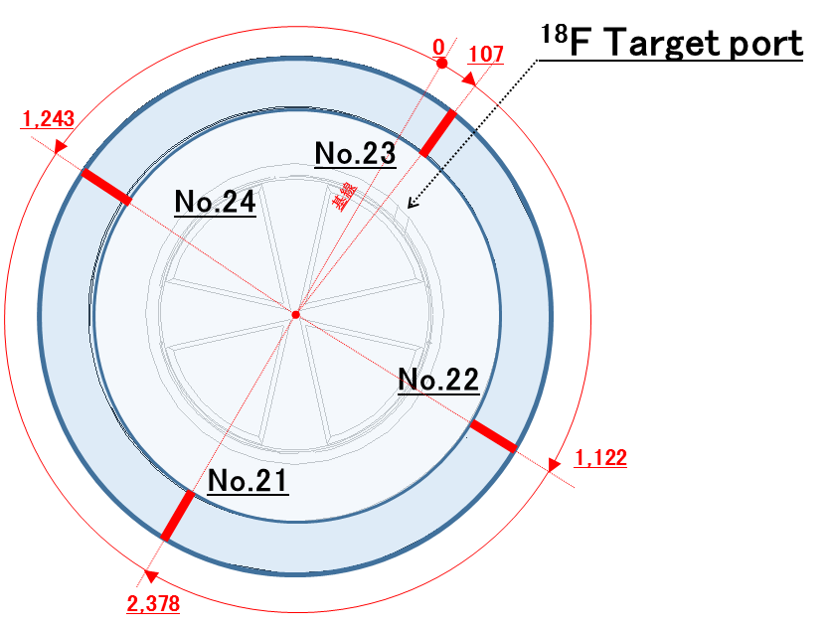
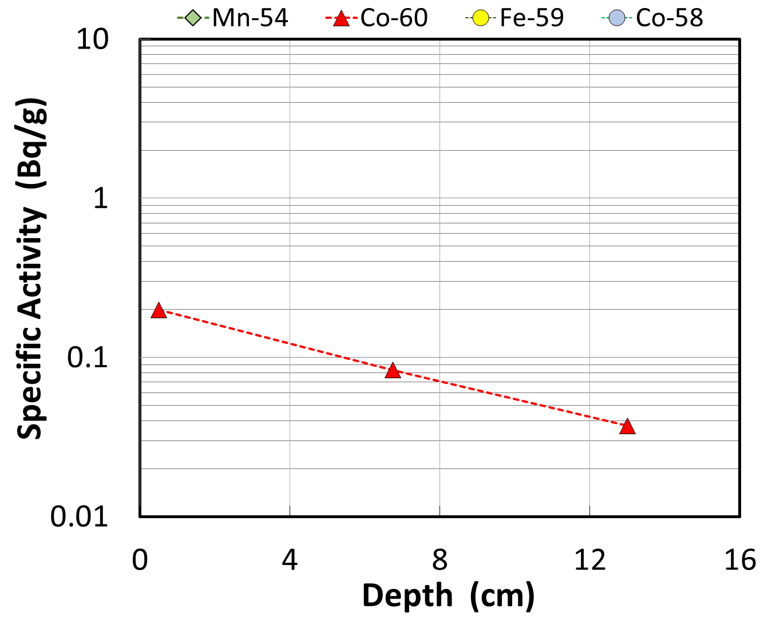
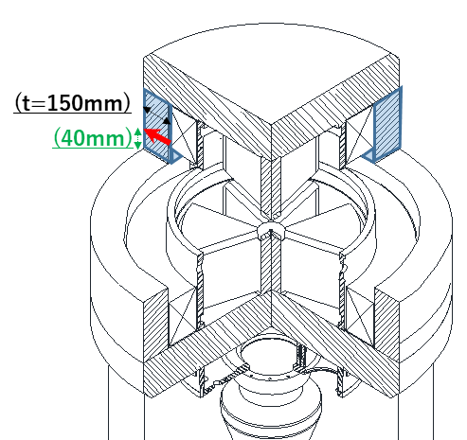
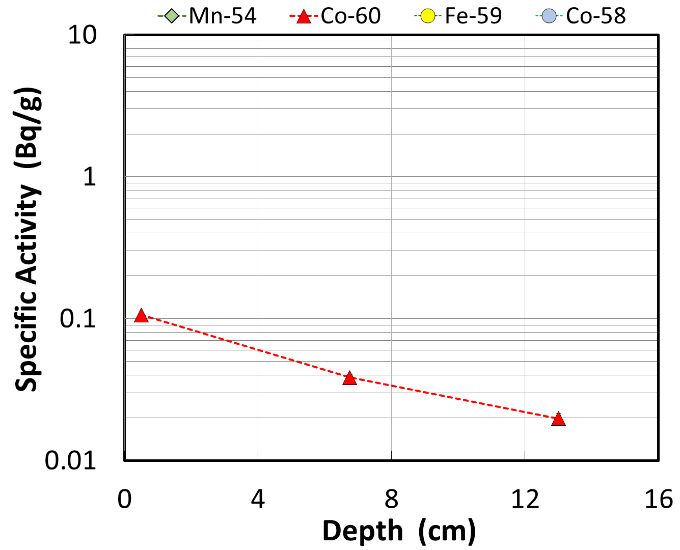
Results
CYCRONE ,York (second stage)
Target side (No.23)
Vertical side (No.24)
Opposite side (No.21)
close to the target port
rapidly decreased
Mn-54
through the whole parts
slowly decreased
Co-60
Notes:
Next, I’d like to explain the York of CYCRONE.
Same as BC1710, this is a overview of cyclotron.
The York is blue shaded area, and red line means sample cores.
As a representative（代表）, No.23 target side, No.21 opposite side, and No.24 vertical side were described.
Co-60 was detected in three parts, but Mn-54 was detected in the target side only.
Same as BC1710, Mn rapidly decreased with depth, Co more slowly decreased.
Activity level of Co-60 was almost same to the York of BC1710, but level of Mn-54 was quite lower.

Slide 10
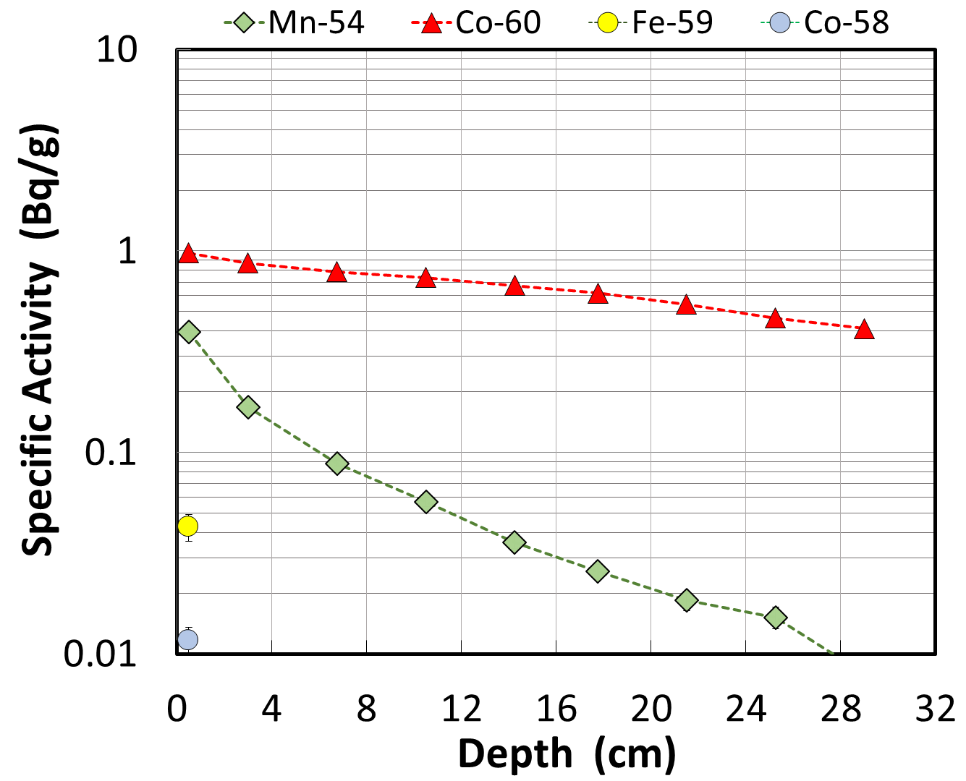
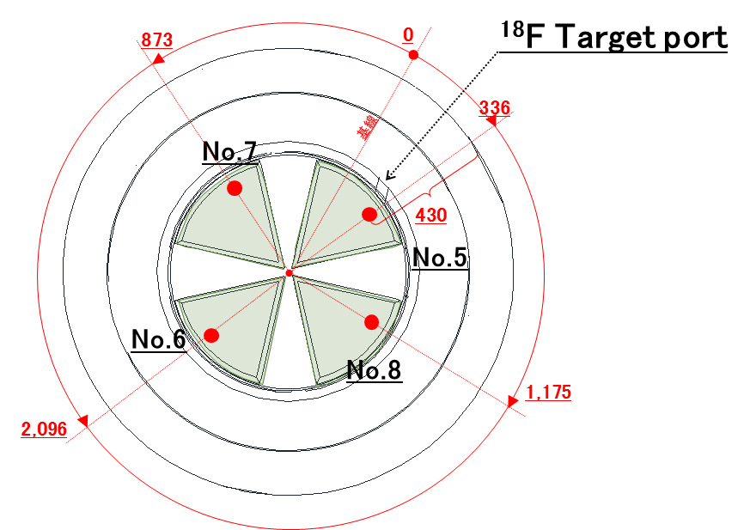
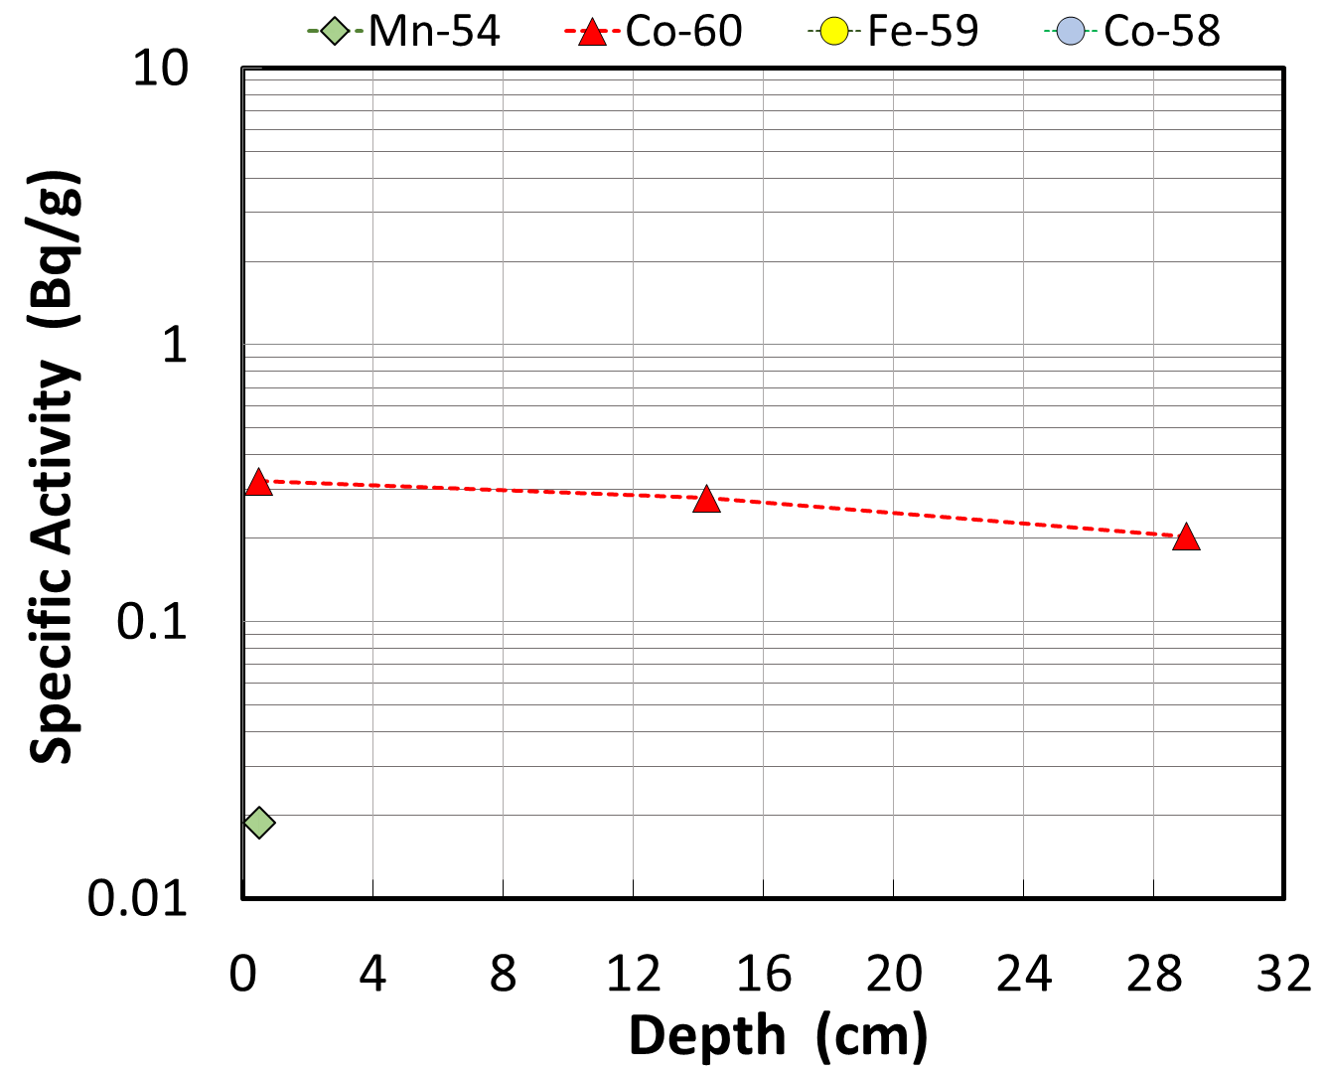
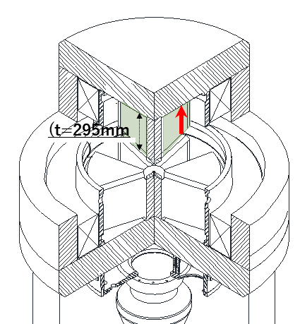
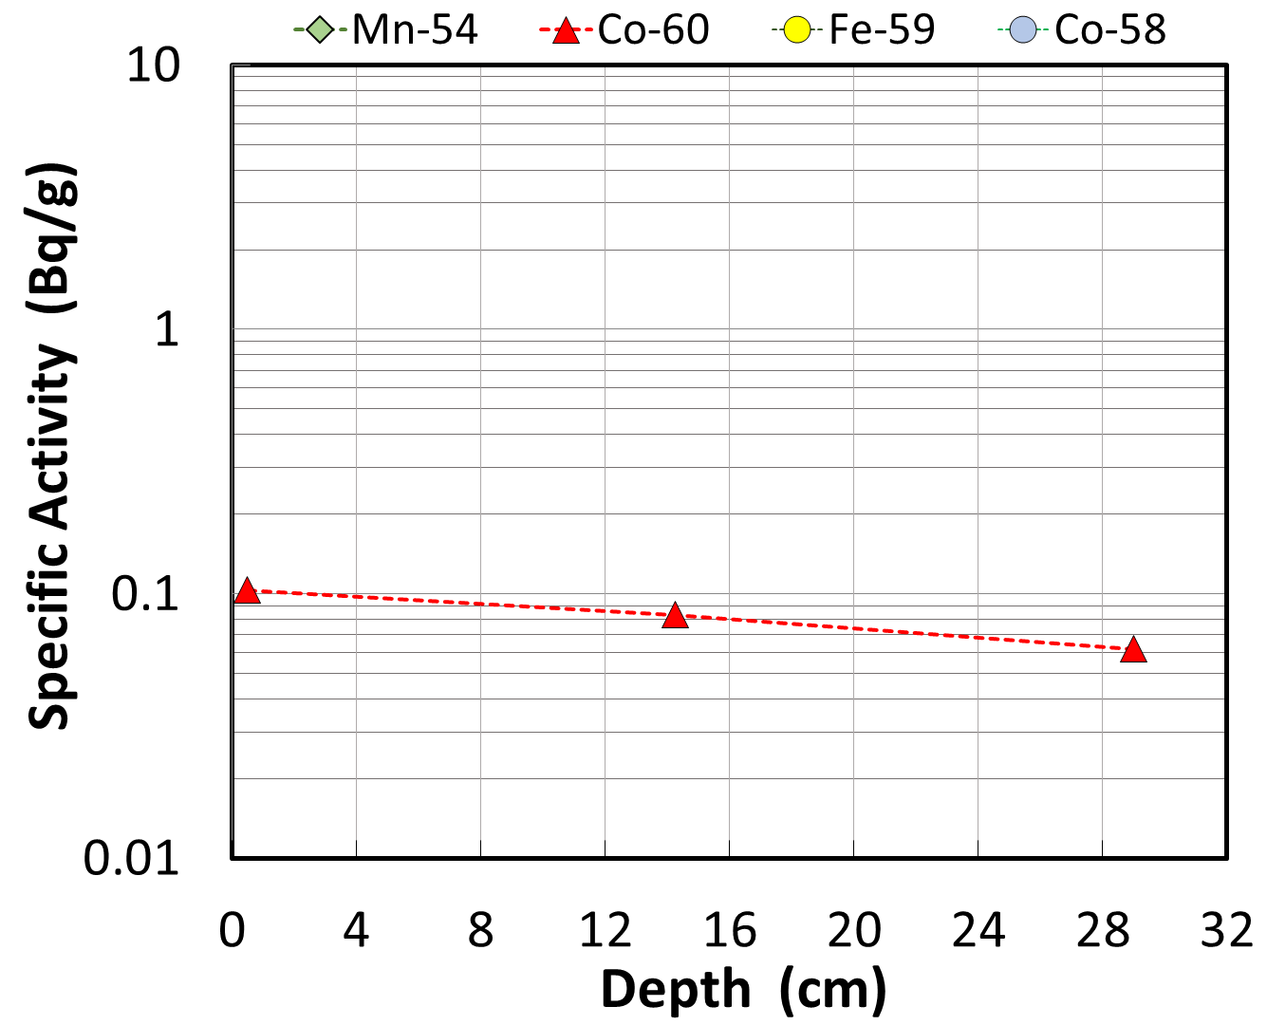
Results
CYCRONE ,Sector magnet (top)
Target side (No.5)
Vertical side (No.7)
Opposite side (No.6)
close to the target port
rapidly decreased
Mn-54
through the whole parts
hardly decreased
Co-60
Notes:
Finally, the Sector magnet of CYCRONE.
The sector magnet is green shaded area, and red dot means sampling point.
Samples were extracted through the direction of bottom to top.
As a representative, No.5 target side, No.6 opposite side, and No.7 vertical side were described.
Co-60 was detected in three parts, but Mn-54 was detected in the target side only.
And, Mn rapidly decreased with depth.
This is a same trend to the York of CYCRONE.
As a unique trend of sector magnet, Co hardly decreased with sample depth.
It was expected that thermal neutrons distributed in whole body of sector magnet at the operation.
Activity level of Co-60 was almost same to the York of CYCRONE, but level of Mn-54 was lower.

Slide 11
Discussion
Detected activity and Clearance level (C.L.)
 | BC1710, York | CYCRONE, York | CYCRONE, Sector magnet
High activity sample
Low activity sample
Target side (No.7)
Target side (No.23)
Target side (No.5)
Higher than C.L. at all depth
C.L.
C.L.
C.L.
Exhaust side (No.8)
Opposite side (No.21)
Opposite side (No.6)
C.L.
C.L.
C.L.
Notes:
In the previous talk, Masumoto-san explained the clearance level in Japan.
As you already know, radioactive wastes must be lower than clearance level in order to treat as normal wastes.
This part, I’d like to discuss the detected activity based on the clearance level.
The results are summarized in this table.
From left side, BC1710, CYCRONE York, and sector magnet.
High activity samples are listed in the second row, High activity samples are listed in bottom row.
Clearance level of Mn-54 and Co-60 are both 0.1 Bq/g, and described as blue line.
In four samples, the activity is higher than the Clearance level at all depth.
In a case of the highest sample, it is expected that 30 years or more over times are necessary to become the activity level below clearance level.
Left two samples, the activity is partly lower, but not enough low.
From these fact, almost cyclotron components cannot be treated as normal waste.
These must be controlled as radioactive waste.

Slide 12
Conclusion
We took core sample from two types of medical purpose cyclotrons.
Depth distribution of radioactivity were determined.
Mn-54 was detected close to a target, and rapidly decreased with depth.
Co-60 was detected in all parts, and slowly decreased with depth.
The difference between cyclotron type was very small.
The metal components must be treated as radioactive waste, because the activity is expected to be much higher than the clearance level.
Notes:
OK, I conclude the presentation.
We took core sample from two types of medical purpose cyclotrons.
We examined radioactivity of nuclides which is generated in the metal components of cyclotron, and determined depth distribution.
As a representative nuclides, Mn-54 and Co-60 were detected.
Mn-54 was mainly detected close to the target port, and rapidly decreased with depth, because made by fast neutrons.
Co-60 was detected in all parts, and slowly decreased with depth, because made by thermal neutrons.
The difference between cyclotron type was very small.
The metal components of cyclotron such as York and sector magnet must be treated as radioactive waste, because the activity is expected to be much higher than the clearance level.

Slide 13
Thank you for your attention

Slide 14
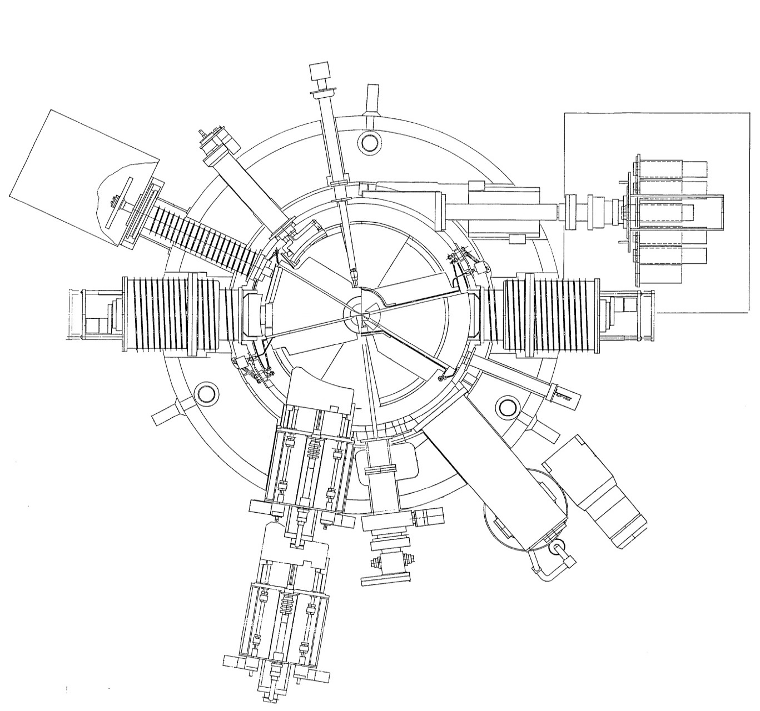
西陣病院 JSW（BC-1710）
No.6
Magnetic channel
No.10
Target box
487
1,300
1,259
No.7
基線
Deflector
5,381
No.9
6,295
No.8
：Core sampling（50mmφ）
数値：ARC length（mm）
ヨーク下段（No.6～No.10）

Slide 15
三重大学 IBA（CYCLONE10/5）
0
107
¹⁸F Target port
1,243
(t=150mm)
No.23
(40mm)
No.24
基線
No.22
No.21
1,122
2,378
：Core sampling（50mmφ）
：direction of extraction
数値：ARC length（mm）
ヨーク2段目 （No.21～No.24）

Slide 16
三重大学 IBA（CYCLONE10/5）
873
0
¹⁸F Target port
336
No.7
基線
(t=295mm)
430
No.5
No.6
No.8
1,175
2,096
：コアサンプリング（50mmφ）
：コア抜き方向
数値：基線からヨーク外周に沿った円弧の長さ（mm）
セクターマグネット上段 （No.5～No.8）

