Slide 1
Radionuclide yields of proton-induced reactions on Bismuth up to 100 MeV
Leila Mokhtari Oranj
N.S. Jung, A. Lee, M. Bakhtiari, H.S. Lee
Radiation Protection Team Pohang Accelerator Laboratory, POSTECH, Korea

Slide 2
Outline
1
Large Accelerator Facilities Status in Korea
2
Motivation of This Work
3
A Fast look at the KOMAC Facility
4
Experiment & Measurement
5
Results & Conclusion

Slide 3
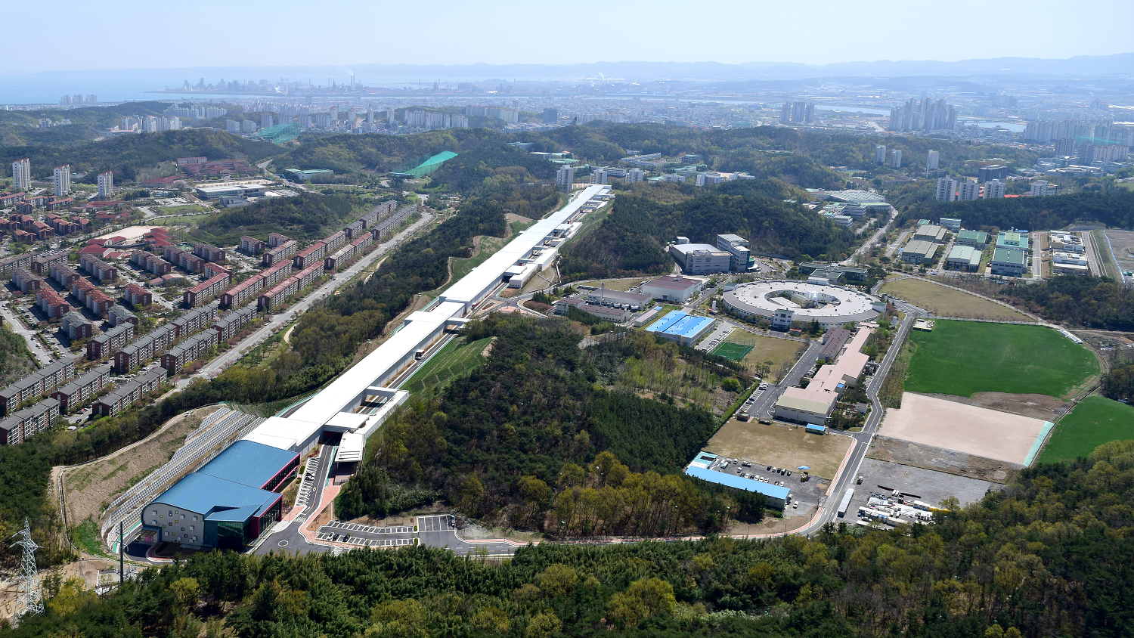
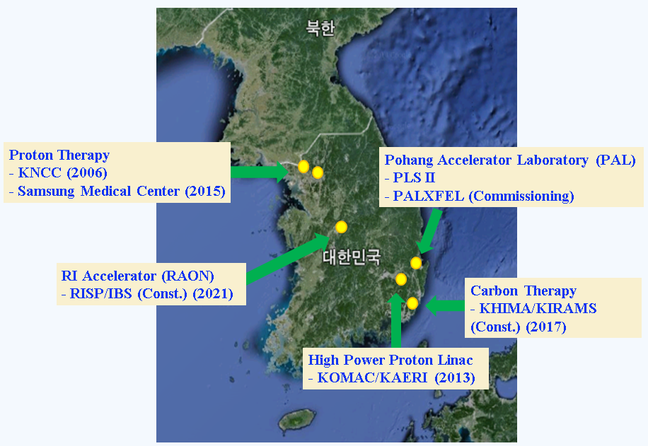
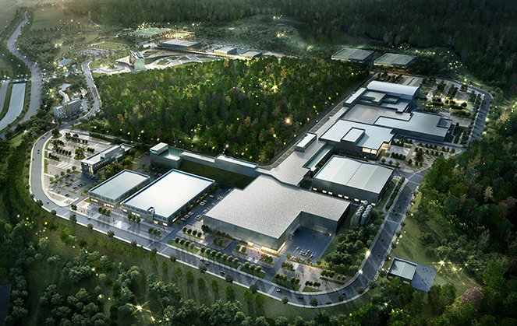
Large Accelerator Facilities Status in Korea
PAL-XFEL 10.0 GeV
RAON heavy ion accelerator

Slide 4
Motivation of this Work
Nuclear Safety and Security Commission (NSSC) of Korea
Development of Core Safety Technology for Large Accelerator Facility
Our Idea for Above-mentioned Project
Extending Nuclear Data
- Experimental : High-Z material - Theoretical: TALYS, TENDL
Benchmarking of Activation Calculations by MC codes
FLUKA- MARS- PHITS- MCNPX
Po and Bi yields of proton-induced reactions on Bi up to 100 MeV were measured. Activation calculations were performed by FLUKA, MARS and PHITS and compared with measured data for benchmarking study.

Slide 5
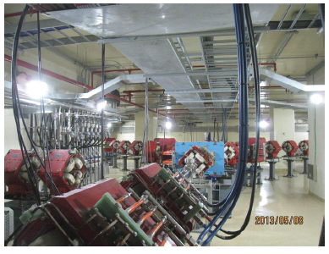
KOMAC Facility
Features of 100 MeV proton beamline target room
Target Room | Application Field | Repetition rate [Hz] | Max.Average Beam Current [μA]
TR101 | Isotope | 60 | 600
TR102 | Medical science | 7.5 | 10
TR104 | Basic science | 7.5 | 10
TR105 | Neutron source | 60 | 1600
100 MeV beamline
Features of the 100 MeV proton linac
50 keV injector
3 MeV RFQ
20 & 100 MeV DTL
RF Frequency: 350 MHz
5 beamlines for 20 MeV & 100 MeV

Slide 6
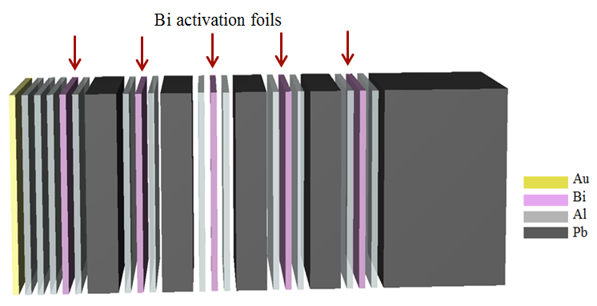
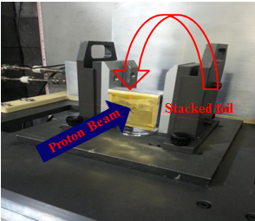
Target Assembly
Target assembly
Ep = 100.5 MeV 91.8 MeV 82 MeV 72 MeV 60 MeV
103 MeV proton beam
Total thickness of irradiated target was designed to be 1.8 cm which is larger than the range of 100 MeV protons in the target, 1.4 cm, calculated by SRIM-2010.
Target Material | Application | Thickness | Size
Au | Monitoring | 30 μm | 5 cm × 5 cm
Al | Monitoring Protection | 100 μm
Bi | Activation | 50 μm
Pb | Proton beam energy degrader | 2 & 9 mm

Slide 7
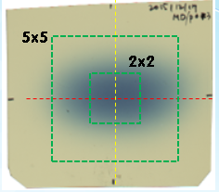
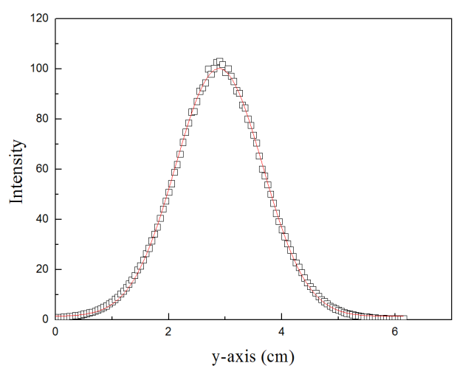
Determination of Proton beam flux
Dosimetry method: Gafchoromic film
• Image of proton beam on the Gafchoromic film
Activation analysis method: monitor reactions
¹⁹⁷Au(p,pn)¹⁹⁶Au
¹⁹⁷Au(p,p3n)¹⁹⁴Au
²⁷Al(p,3pn)²⁴Na
• Beam profile obtained by the Gafchromic film
D: Absorbed dose
Φ: Proton flux
dE/dx: Stopping power
dt/$ρ$: Irradiation time/density

Slide 8
Determination of Proton Beam Flux
Beam flux measurements using various monitor reactions are consistent.
Comparison between the results from monitor reactions and Gafchromic film show a good agreement.
Method |  | Irradiation time | Activation yield [Bq] | Monitoring cross section [mb] | Beam flux [protons.cm⁻².s-¹]
Activation analysis | ¹⁹⁷Au(p,pn) ¹⁹⁷Au(p,p3n) ²⁷Al(p,3pn) | 2 min | 535.8 ± 1.5 1937.8 ± 26.2 1652.3 ± 28.3 | 135 120 11.73 | (5.9 ± 0.6) E+09 (6.2 ± 0.6) E+09 (6.7 ± 0.7) E+09
Dosimetry | Gafchromic |  |  |  | 6.4 E+09

Slide 9
Radionuclide Yields Measurement
If no precursors contribute to the formation of the investigated radionuclide, the activity is:
$$A_{0}= \frac{Ap λ}{ε Γ\left(e^{−λt1}−e^{−λt2}\right)}$$
$Ap$ = Net count of produced radio-nuclei from t₁ to t₂
$A_{0}$ = Activation of produced radio-nuclei at the end of irradiation
t₁ = Measuring start time from end of irradiation
t₂ = Measuring end time from end of irradiation
Γ = Branching ratio of gamma
$ε$ = efficiency
$λ$ = decay constant
²⁰⁹Bi(p,xn)^{207,206,205,204,203}Po
If a radionuclide is produced directly from a nuclear reaction as well as from the decay of a parent nucleus, the activity would be:
P + ²⁰⁹Bi
P +4n + ²⁰⁵Bi
²⁰⁹Bi(p,pxn)^{207,206,205,204,203}Bi
P + ²⁰⁹Bi
5n + ²⁰⁵Po
²⁰⁵Bi
Notes:
The inundation occurred in J-PARC accelerator tunnel for two weeks and Al pre-amplifier boxes were corroded. (March 11, 2011)
Vapor pressure & melting point of copper, aluminum, steel are much higher than 450 ℃
따라서 녹는점이 충분히 높아, 대개의 경우 내부의 금속전선은 녹지않음.
더불어 주변의 금속은 역시 녹지 않은 표면이 산화, 페이트가 연소.

Slide 10
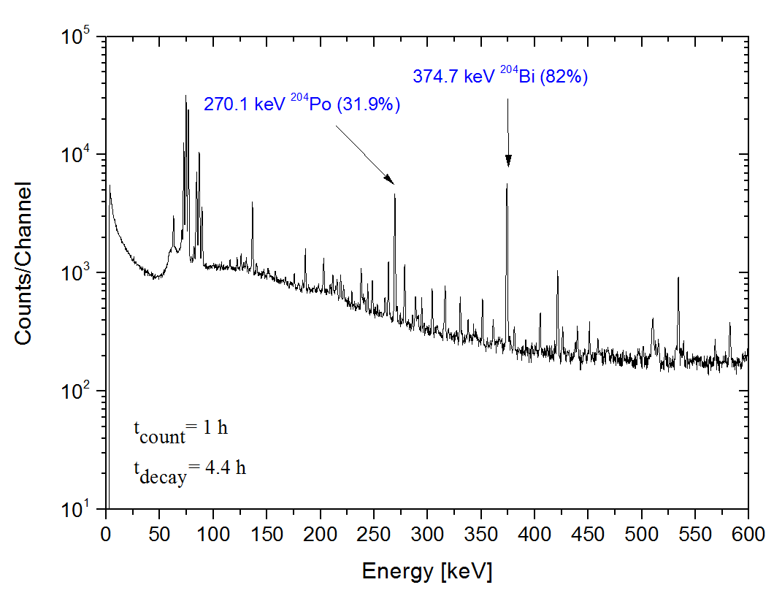
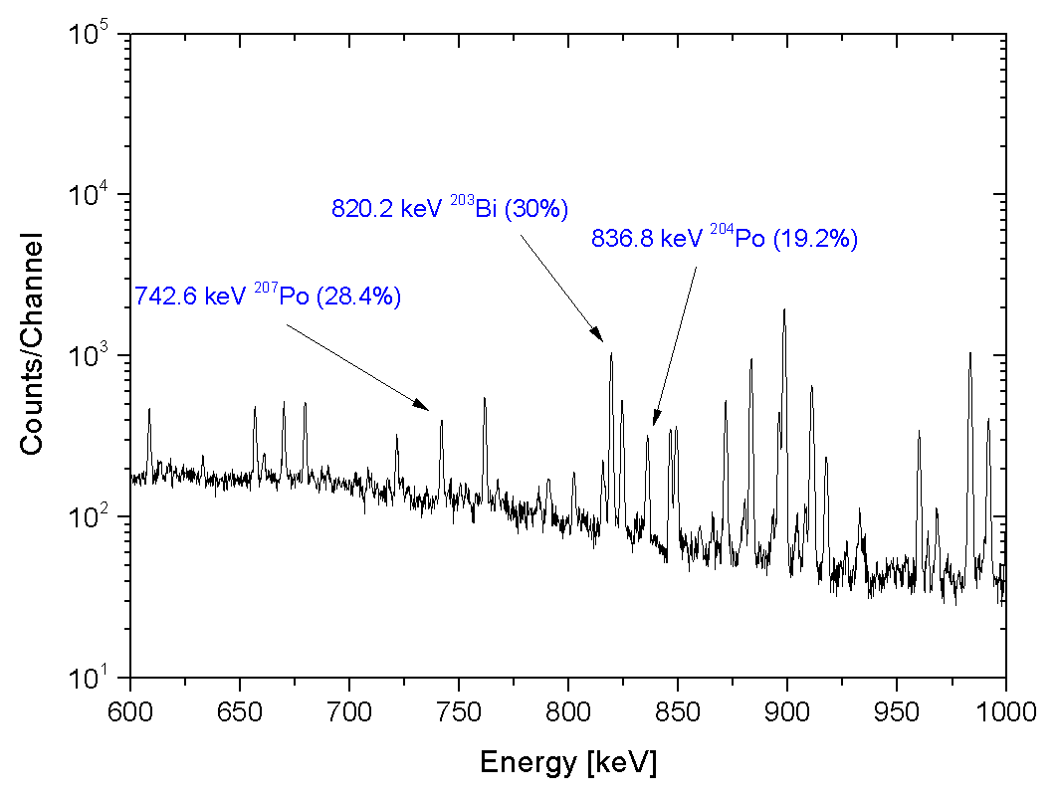
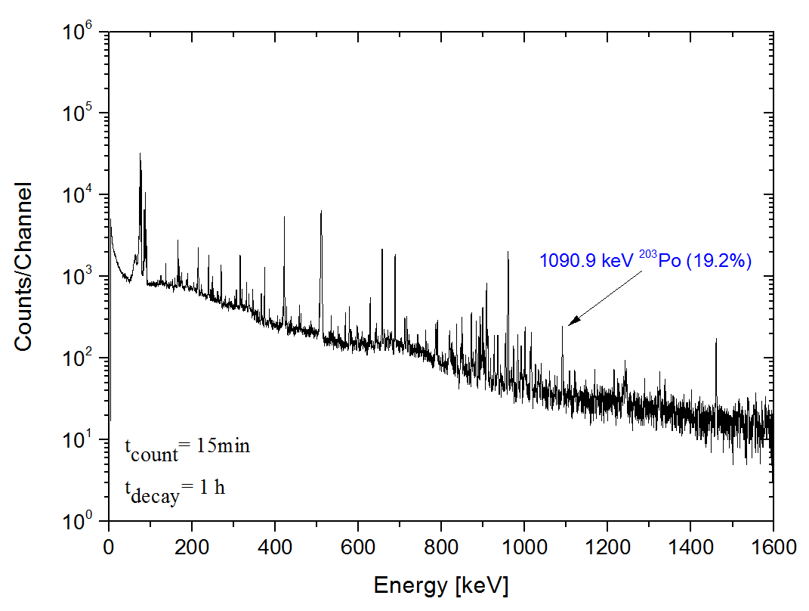
Examples of γ-ray spectra after the end of irradiation
Various radionuclides with half-lives ranging from 36 minutes to 31 years were measured.
Notes:
The inundation occurred in J-PARC accelerator tunnel for two weeks and Al pre-amplifier boxes were corroded. (March 11, 2011)
Vapor pressure & melting point of copper, aluminum, steel are much higher than 450 ℃
따라서 녹는점이 충분히 높아, 대개의 경우 내부의 금속전선은 녹지않음.
더불어 주변의 금속은 역시 녹지 않은 표면이 산화, 페이트가 연소.

Slide 11
Monte Carlo Codes
Simulation were performed by FLUKA, MARS, and PHITS codes and compared with the measurements to verify nuclear data libraries in the codes
FLUKA 2011.2c (default option, PEANUT)
PHITS-2.64 (INCL 4.6 model) & DCHAIN-SP2001
MARS-15 (CEM)
Nuclide | Half-life | Contributing reactions | Q-value (MeV)
²⁰⁷Po | 8.8±0.1 d | ²⁰⁹Bi(p, 3n) ²⁰⁷Po→²⁰⁷Bi | -18.04
²⁰⁶Po | 1.74±0.08 h | ²⁰⁹Bi(p, 4n) ²⁰⁶Po→²⁰⁶Bi | -25.07
²⁰⁵Po | 3.519±0.012 h | ²⁰⁹Bi(p, 5n) ²⁰⁵Po→²⁰⁵Bi | -33.82
²⁰⁴Po | 36.7±0.5 m | ²⁰⁹Bi(p, 6n) ²⁰⁴Po→²⁰⁴Bi | -41.05
²⁰³Po | 8.8±0.1 d | ²⁰⁹Bi(p, 7n) ²⁰³Po→²⁰³Bi | -50.16
²⁰⁷Bi | 31.55±0.04 y | ²⁰⁹Bi(p, p2n) | -14.35
²⁰⁶Bi | 6.243±0.003d | ²⁰⁹Bi(p, p3n) | -22.44
²⁰⁵Bi | 15.31±0.04 d | ²⁰⁹Bi(p, p4n) | -29.48
²⁰⁴Bi | 11.22±0.10 h | ²⁰⁹Bi(p, p5n) | -37.97
²⁰³Bi | 11.76±0.05 h | ²⁰⁹Bi(p, p6n) | -45.16

Slide 12
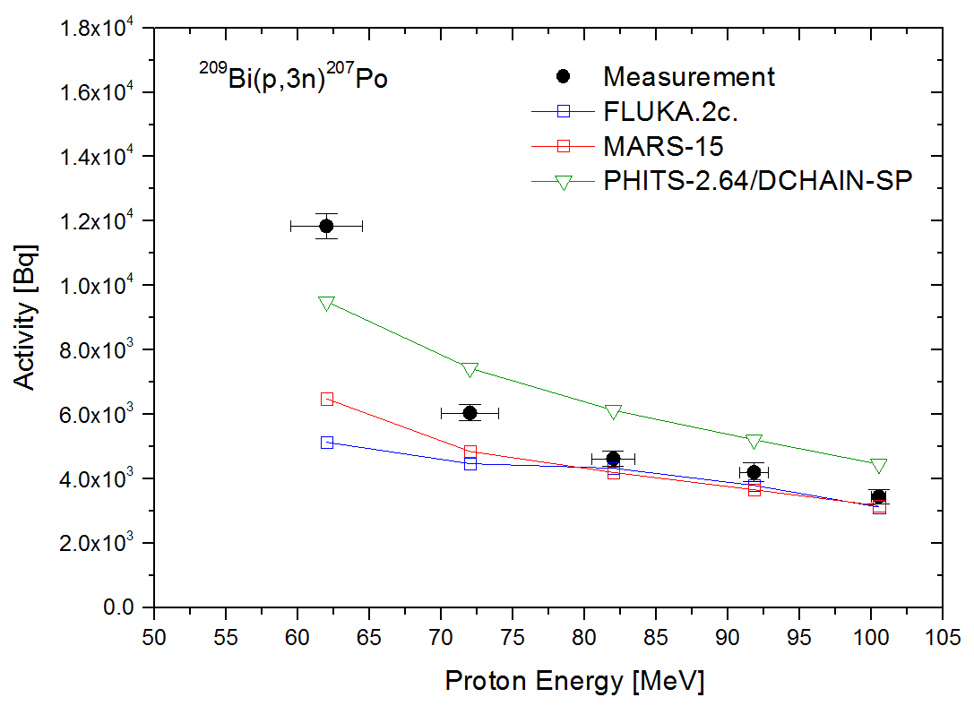
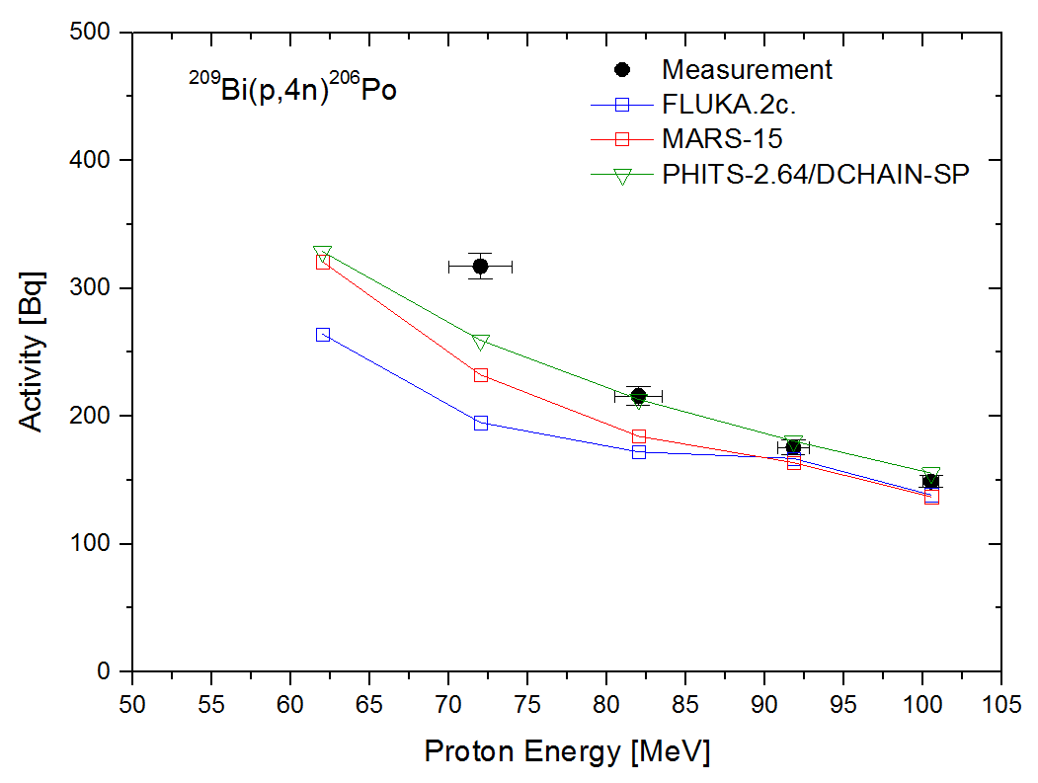
Results: ²⁰⁹Bi(p,3n)²⁰⁷Po & (p,4n)²⁰⁶Po Reactions
FLUKA and MARS predict the activity well apart from the last Bi foil. However, PHITS overestimates measurements.
PHITS results are consistent with the measurement except for the forth Bi foil.
FLUKA and MARS results are in agreement with the measured data for the first two bismuth foils, underestimating the activity in the other foils.
Notes:
The inundation occurred in J-PARC accelerator tunnel for two weeks and Al pre-amplifier boxes were corroded. (March 11, 2011)
Vapor pressure & melting point of copper, aluminum, steel are much higher than 450 ℃
따라서 녹는점이 충분히 높아, 대개의 경우 내부의 금속전선은 녹지않음.
더불어 주변의 금속은 역시 녹지 않은 표면이 산화, 페이트가 연소.

Slide 13
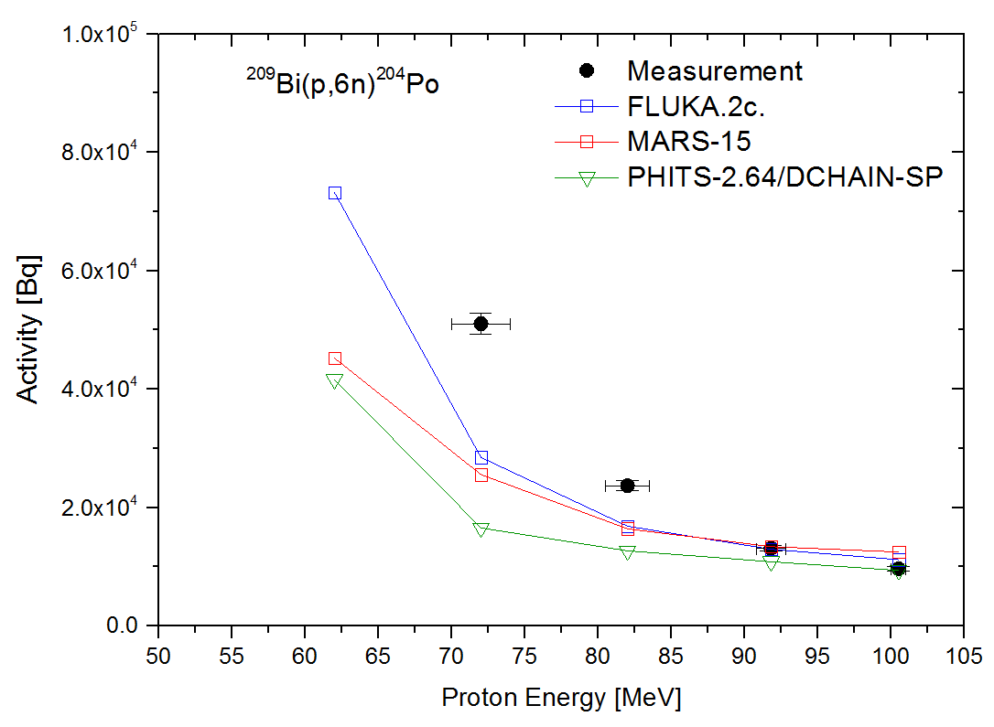
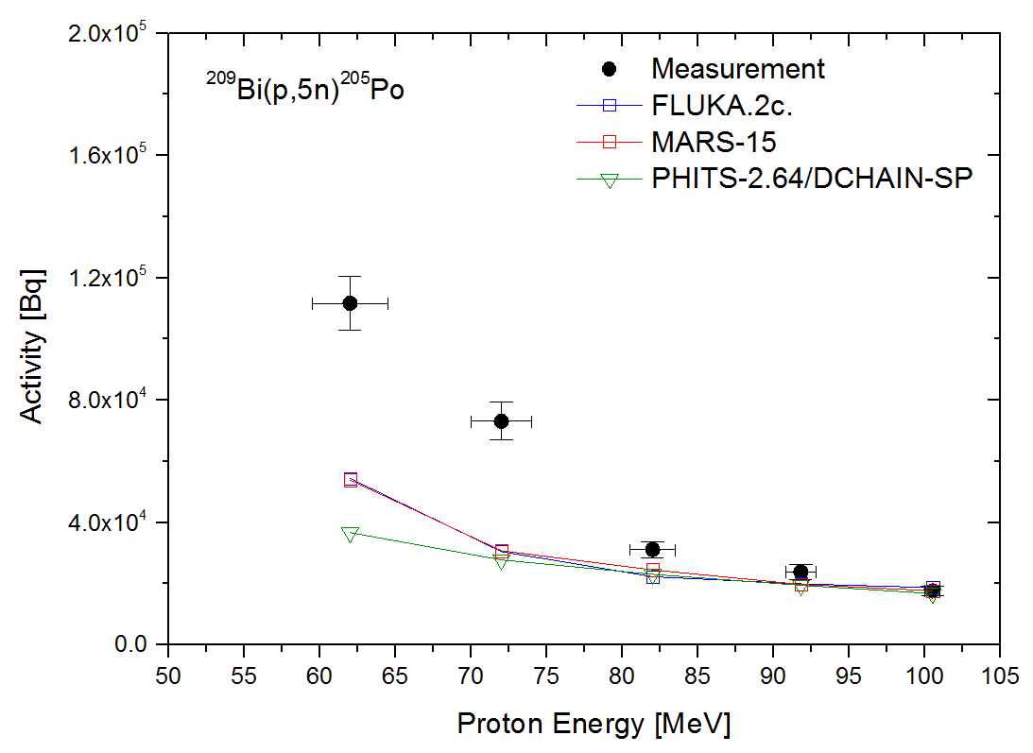
Results: ²⁰⁹Bi(p,5n)²⁰⁵Po & (p,6n)²⁰⁴Po reactions
For ²⁰⁴Po and ²⁰⁵Po radionuclides, all codes results are in agreement with the measured data for the first three bismuth foils, underestimating the activity in the other foils.
In the Case of ²⁰⁵Po, FLUKA and MARS calculations are almost similar.
Notes:
The inundation occurred in J-PARC accelerator tunnel for two weeks and Al pre-amplifier boxes were corroded. (March 11, 2011)
Vapor pressure & melting point of copper, aluminum, steel are much higher than 450 ℃
따라서 녹는점이 충분히 높아, 대개의 경우 내부의 금속전선은 녹지않음.
더불어 주변의 금속은 역시 녹지 않은 표면이 산화, 페이트가 연소.

Slide 14
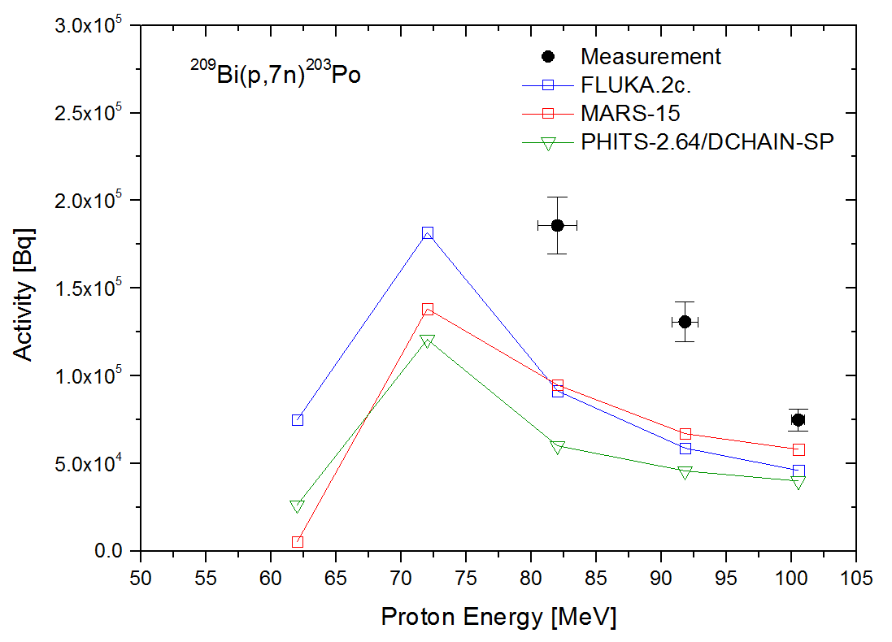
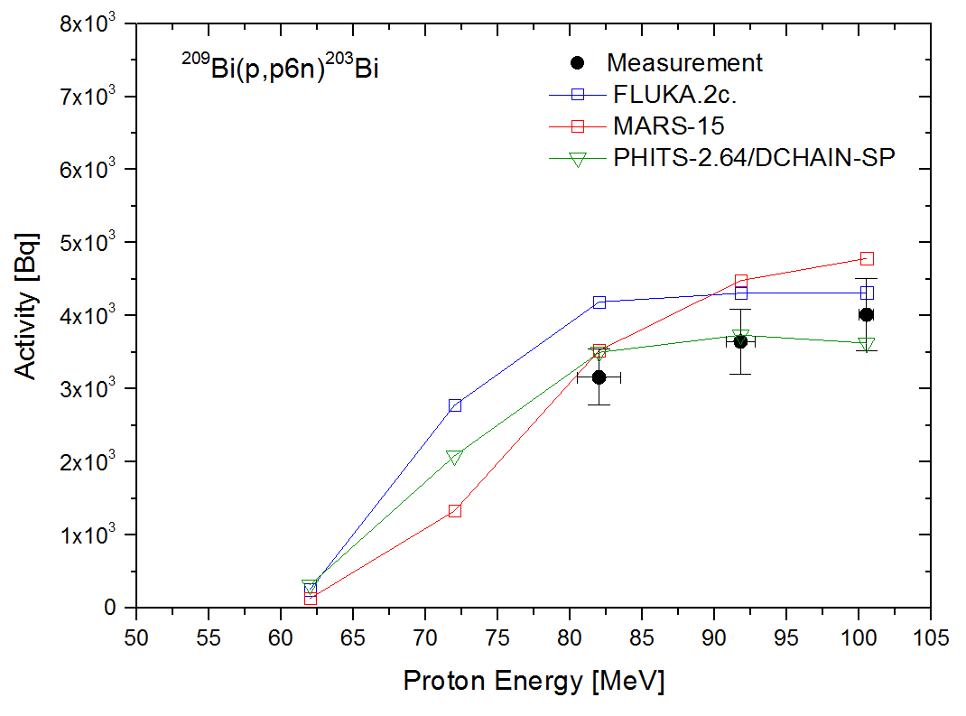
Results: ²⁰⁹Bi(p,7n)²⁰³Po & (p,p6n)²⁰³Bi reactions
t_{1/2}=36 min
All Monte Carlo calculations underestimate the activity of ²⁰³Po.
t_{1/2}=36.7 min
PHITS results are consistent with the measurement.
FLUKA and MARS results overestimate the measured activity for ²⁰³Bi.
Notes:
The inundation occurred in J-PARC accelerator tunnel for two weeks and Al pre-amplifier boxes were corroded. (March 11, 2011)
Vapor pressure & melting point of copper, aluminum, steel are much higher than 450 ℃
따라서 녹는점이 충분히 높아, 대개의 경우 내부의 금속전선은 녹지않음.
더불어 주변의 금속은 역시 녹지 않은 표면이 산화, 페이트가 연소.

Slide 15
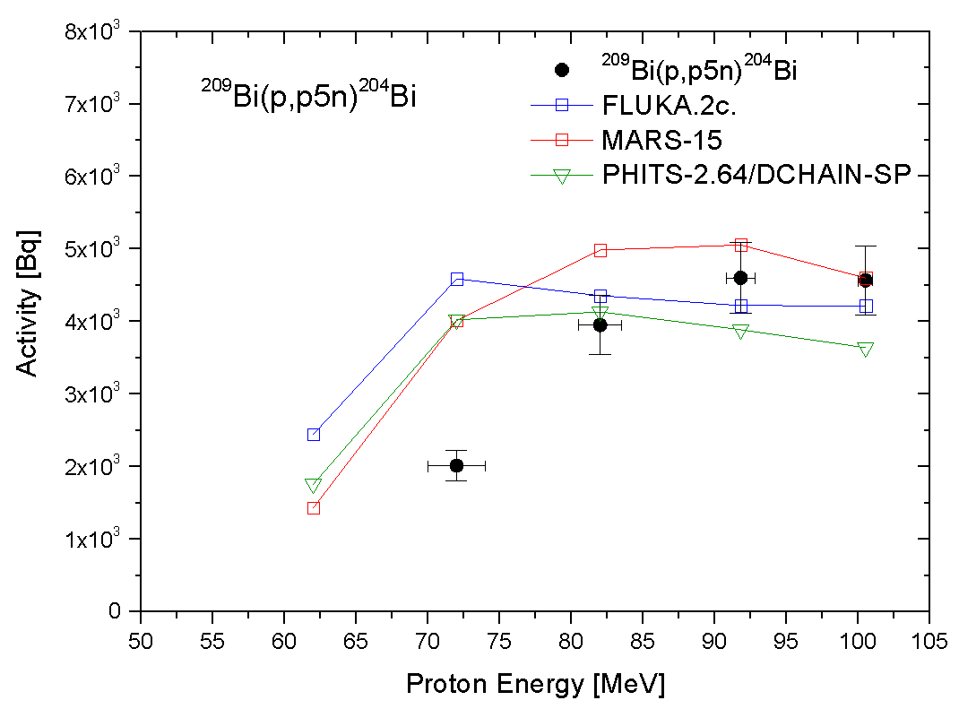
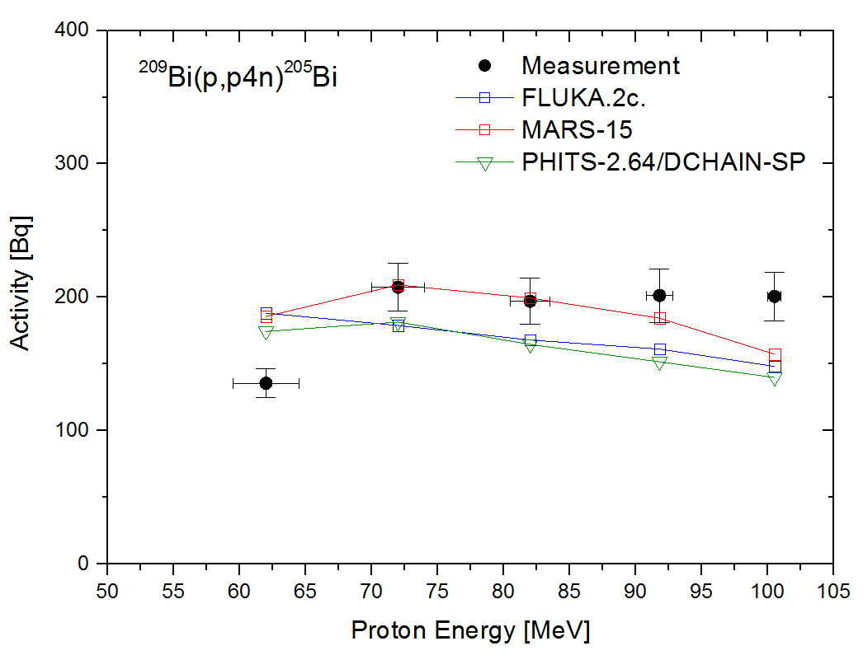
Results: ²⁰⁹Bi(p,6n)²⁰⁴Po & (p,p4n)²⁰⁵Bi reactions
Overall, all codes were not able to reproduce the measured activity. It might be due to high emitted number of neutrons.
For ²⁰⁹Bi(p,p4n)²⁰⁵Bi reaction, MARS code shows better agreement with the measured activity than other codes.
Notes:
The inundation occurred in J-PARC accelerator tunnel for two weeks and Al pre-amplifier boxes were corroded. (March 11, 2011)
Vapor pressure & melting point of copper, aluminum, steel are much higher than 450 ℃
따라서 녹는점이 충분히 높아, 대개의 경우 내부의 금속전선은 녹지않음.
더불어 주변의 금속은 역시 녹지 않은 표면이 산화, 페이트가 연소.

Slide 16
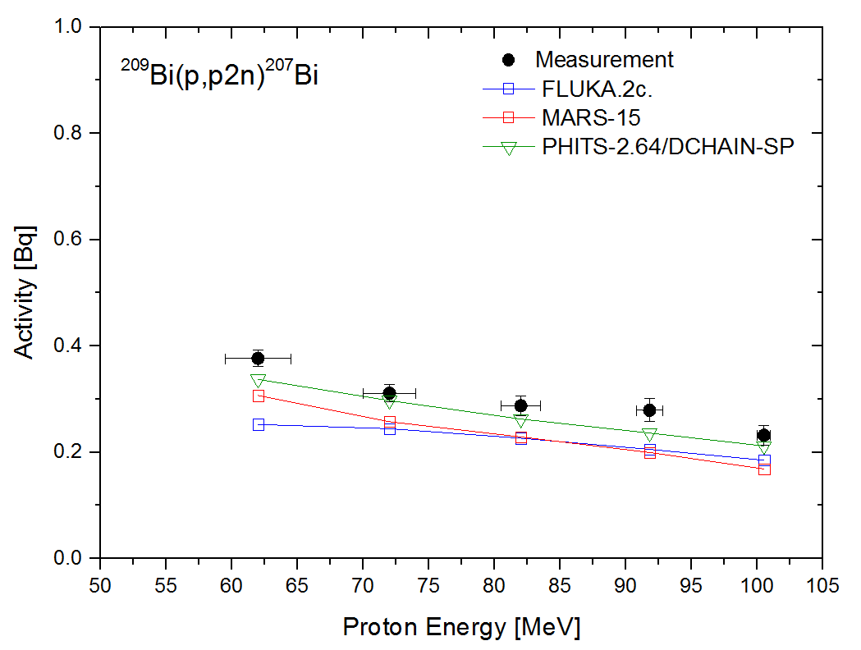
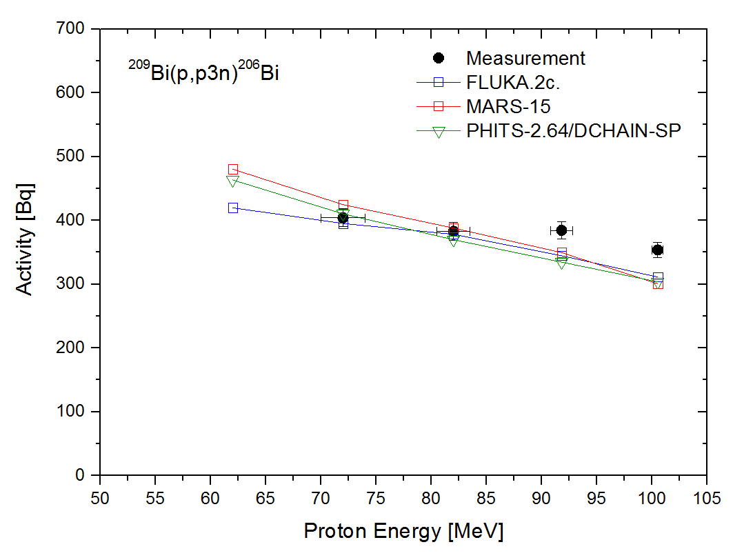
Results: ²⁰⁹Bi(p,p2n)²⁰⁷Bi & (p,p3n)²⁰⁶Bi reactions
For ²⁰⁹Bi(p,p4n)²⁰⁷Bi reaction, PHITS code shows better agreement with the measured activity than other codes.
t_{1/2}=31.5 y
All Monte Carlo calculations predict well measured data.
Notes:
The inundation occurred in J-PARC accelerator tunnel for two weeks and Al pre-amplifier boxes were corroded. (March 11, 2011)
Vapor pressure & melting point of copper, aluminum, steel are much higher than 450 ℃
따라서 녹는점이 충분히 높아, 대개의 경우 내부의 금속전선은 녹지않음.
더불어 주변의 금속은 역시 녹지 않은 표면이 산화, 페이트가 연소.

Slide 17
Conclusion
Proton energy [MeV] | Activity ratio [calculation/measurement]
 | ²⁰⁷Po |  |  | ²⁰⁶Po |  |  | ²⁰⁵Po |  |  | ²⁰⁴Po |  |  | ²⁰³Po
 | FLUKA | MARS | PHITS | FLUKA | MARS | PHITS | FLUKA | MARS | PHITS | FLUKA | MARS | PHITS | FLUKA | MARS | PHITS
100.5±0.5 | 0.91 | 0.92 | 1.29 | 0.93 | 0.92 | 1.04 | 1.06 | 1.0 | 0.95 | 1.16 | 1.29 | 0.97 | 0.62 | 0.78 | 0.54
91.8±1.0 | 0.90 | 0.87 | 1.24 | 0.95 | 0.93 | 1.03 | 0.84 | 0.83 | 0.82 | 0.99 | 1.02 | 0.83 | 0.45 | 0.52 | 0.35
82±1.5 | 0.94 | 0.91 | 1.32 | 0.80 | 0.85 | 0.99 | 0.72 | 0.79 | 0.74 | 0.71 | 0.69 | 0.54 | 0.49 | 0.52 | 0.33
72±2.0 | 0.74 | 0.80 | 1.23 | 0.61 | 0.73 | 0.82 | 0.42 | 0.42 | 0.38 | 0.56 | 0.50 | 0.32 | -- | -- | --
60±2.5 | 0.43 | 0.55 | 0.8 | -- | -- | -- | 0.49 | 0.48 | 0.33 | -- | -- | -- | -- | -- | --
Proton energy [MeV] | Activity ratio [calculation/measurement]
 | ²⁰⁷Bi |  |  | ²⁰⁶Bi |  |  | ²⁰⁵Bi |  |  | ²⁰⁴Bi |  |  |  | ²⁰³Bi
 | FLUKA | MARS | PHITS | FLUKA | MARS | PHITS | FLUKA | MARS | PHITS |  | FLUKA | MARS | PHITS | FLUKA | MARS | PHITS
100.5±0.5 | 0.80 | 0.73 | 0.91 | 0.88 | 0.85 | 0.86 | 0.74 | 0.78 | 0.70 |  | 0.92 | 1.01 | 0.80 | 1.07 | 1.19 | 0.90
91.8±1.0 | 0.74 | 0.72 | 0.85 | 0.90 | 0.91 | 0.87 | 0.80 | 0.91 | 0.75 |  | 0.91 | 1.10 | 0.85 | 1.18 | 1.23 | 1.02
82±1.5 | 0.79 | 0.80 | 0.91 | 0.99 | 1.01 | 0.97 | 0.85 | 1.01 | 0.84 |  | 1.1 | 1.26 | 1.05 | 1.32 | 1.12 | 1.11
72±2.0 | 0.78 | 0.83 | 0.96 | 0.98 | 1.05 | 1.01 | 0.86 | 1.0 | 0.87 |  | 2.28 | 1.99 | 2.0 | -- | -- | -
60±2.5 | 0.67 | 0.81 | 0.90 | -- | -- | - | 1.4 | 1.37 | 1.29 |  | -- | -- |  | -- | -- | -

Slide 18
Conclusion
Po and Bi yields of proton-induced reactions on Bi up to 100 MeV were measured. Activation calculations were performed by FLUKA, MARS and PHITS and compared with measured data.
The ratios of the results of calculations to the measured activity of Po radionuclides did not exceed 1.3 over the whole beam range. In the case of Bi radionuclides, ratios were less than 1.4 except for ²⁰⁴Bi radionuclide of which was 2.3.
Calculation of yields of radionuclide by FLUKA, MARS, and PHITS codes underestimate the measured data at the end of target.
A satisfactory agreement was found between our measurements and results of simulation.
Discrepancy between FLUKA, MARS, and PHITS codes was not considerable.

Slide 19
Thank you for your attention. Questions? Comments
Notes:
Thank you for listening.

