Slide 1
FISPACT-II High Energy Treatment
Michael Fleming*, Jean-Christophe Sublet, Mark Gilbert
UK Atomic Energy Authority
Culham Science centre
Abingdon, Oxfordshire, OX14 3DB

Slide 2
Motivation
The number of reaction channels and quantities of interest for various nuclear simulations become impractically large
  For example, in fission and fusion activation-transmutation, burnup, etc., we may couple a Monte-Carlo code with an inventory code
  The inventory code typically considers many channels, decay processes, source term data, responses, etc.
  These may include millions of rate equation matrix elements
Attempting to converge all of the reaction rates for all channels throughout a model is difficult
  We achieve this by converging incident particle spectra and collapsing with evaluated nuclear data libraries

Slide 3
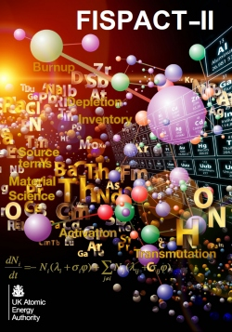
FISPACT-II: a snapshot
FISPACT-II & libraries platform has been developed by UKAEA to provide nuclear observables, using the most advanced nuclear reaction physics, for a wide variety of applications
  Fine grid data for 5 incident particles, nFY, s/oFY
  Any major decay data
  All ENDF/B-VII.1, JENDL-4.0, JEFF-3.2 ENDF-6 data including full processing of TENDL-2015
  Full variance-covariance treatment
  Modern LSODES-2003 solver
  Resolved and unresolved self-shielding through PT
  DPA, kerma, PKA, gas production, yields up to GeV
  Monte-carlo sensitivity analysis
  Multi-irradiation/cooling step pathway analysis
  Thin/thick target yields
  Temperatures from 0K to 1200K (Reactor) and above to kT=5, 30, 100 keV (Astrophysics)

Slide 4
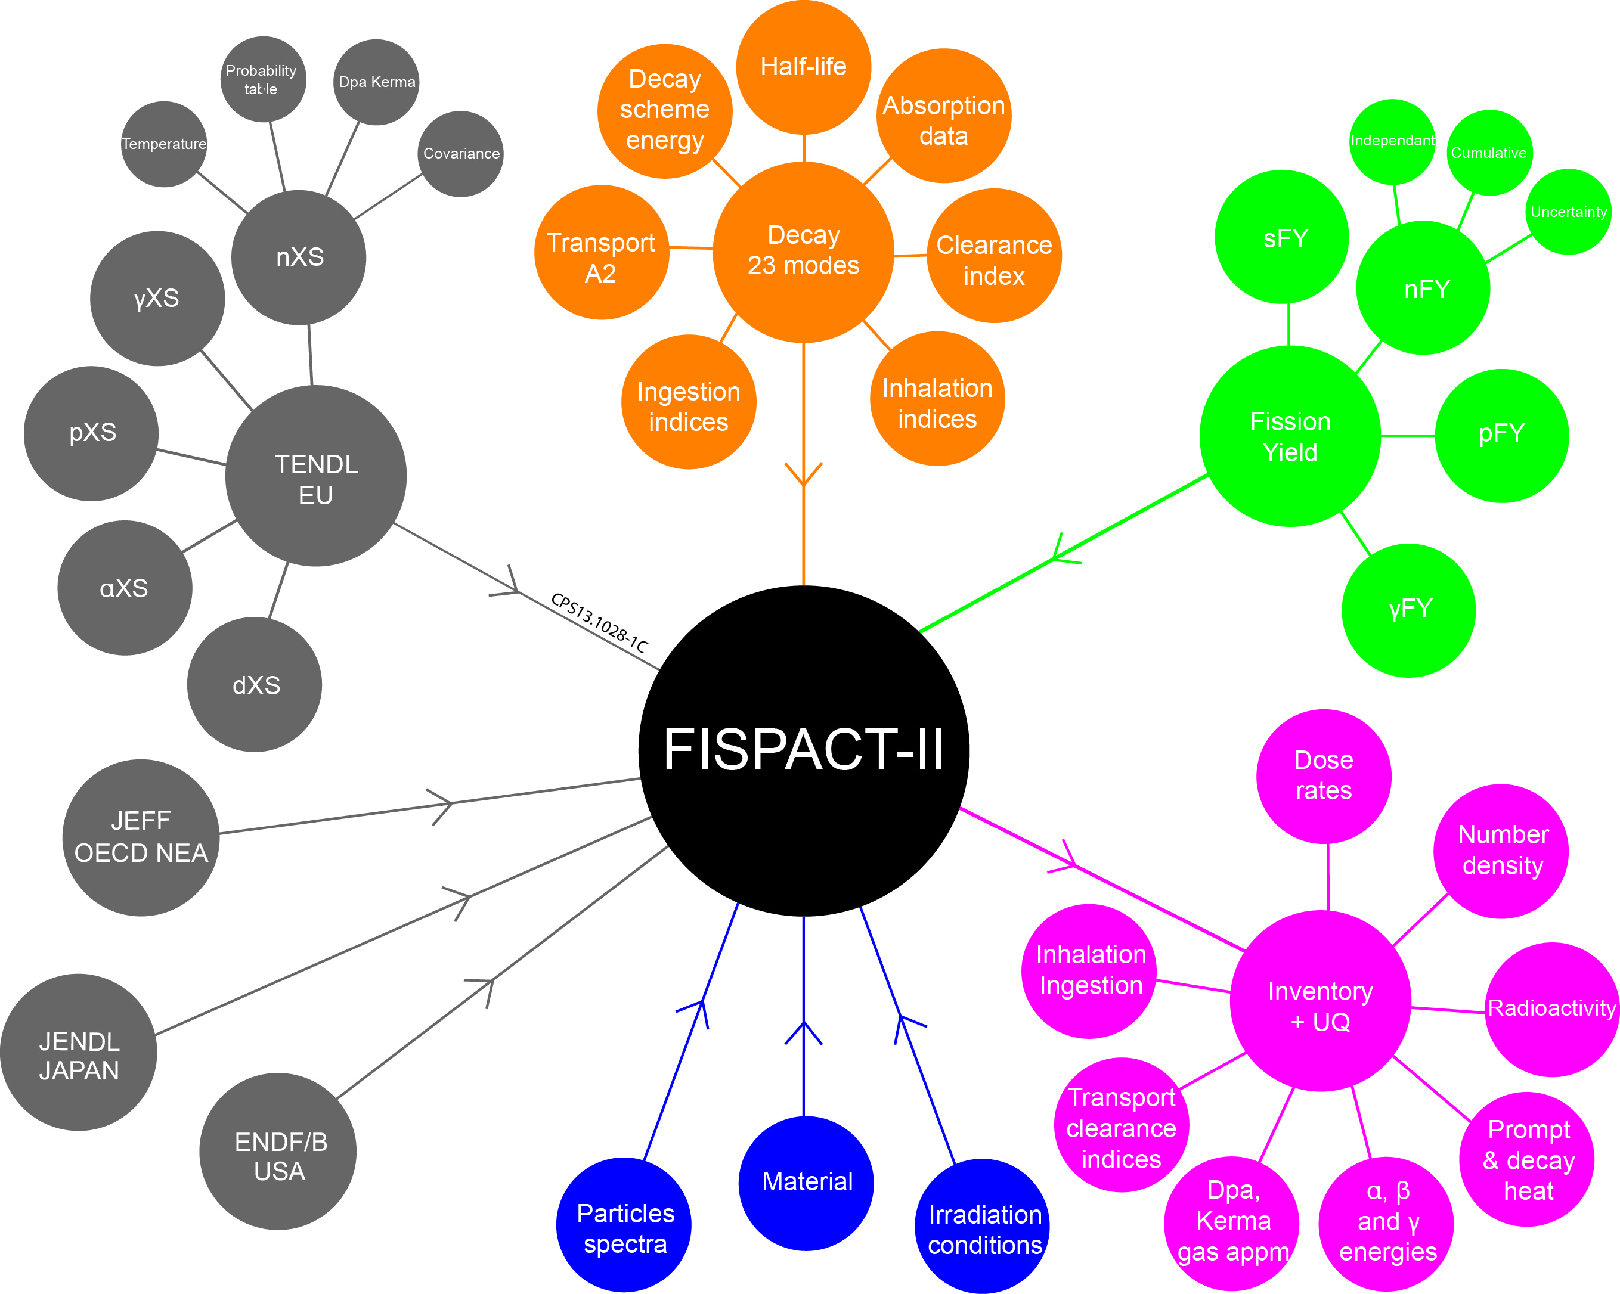
FISPACT-II flowchart
High-Energy extension data

Slide 5
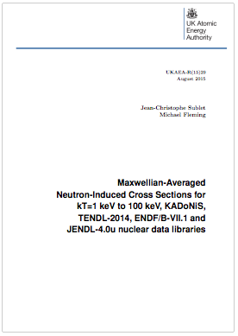
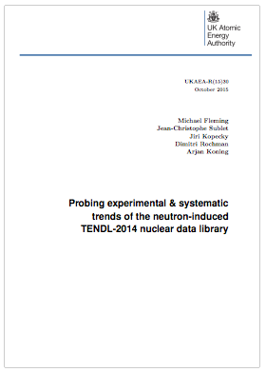
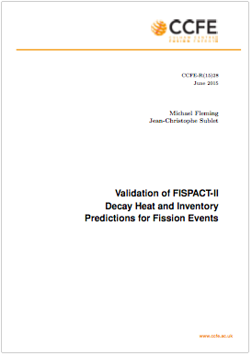
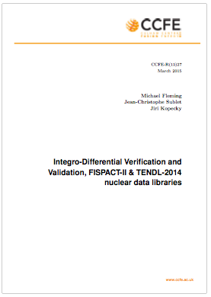
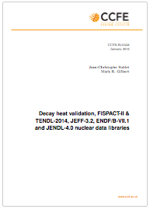
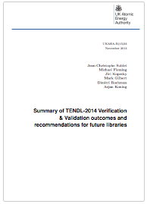
General validation
FISPACT-II and libraries are subject of various validation reports:
  CCFE-R(15)25 Fusion decay heat
  CCFE-R(15)27 Integral fusion
  CCFE-R(15)28 Fission decay heat
  UKAEA-R(15)29 Astro s-process
  UKAEA-R(15)30 RI/therm/systematics
  UKAEA-R(15)35 Summary report

Slide 6

FNS SS316 decay heat validation

Slide 7
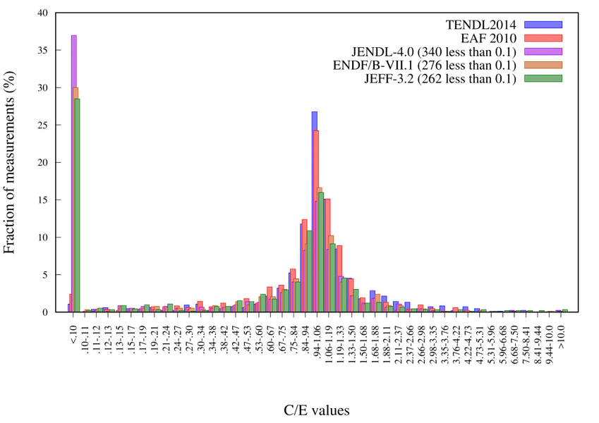

Integro-differential results
TENDL has outperformed all libraries, including EAF, which is tuned to these experiments
Legacy libraries miss 1/3 of the channels
EAF mean = 0.850 while TENDL = 0.993 – asymmetry implies underestimations

Slide 8
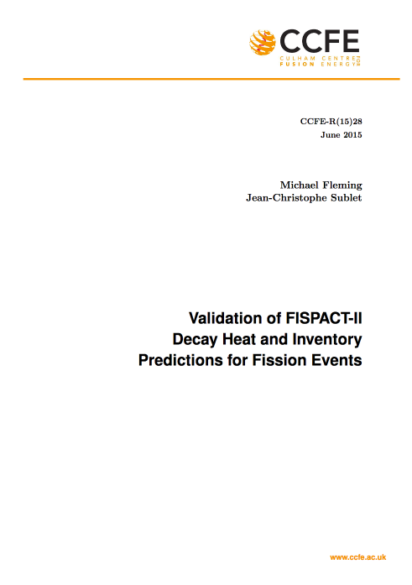
Fission decay heat benchmarks
Subject of recent UKAEA validation report
M. Fleming, J-Ch. Sublet. Validation of FISPACT-II Decay Heat and Inventory Predictions for Fission Events. CCFE-R(15)28
Series of decay heat measurements from fission ‘pulses’ and longer duration irradiations
  Calorimetric, beta, gamma, measurements, many techniques, varying quality
  Statistical meta-analysis (eg Tobias, ANSI/ANS-5.1) with selection of experiments and human weightings

Slide 9
Standard pulse simulations
Top (left to right): thermal U5, P9, P1 total and gamma heat
Bottom (left to right): fast U3, U8, P9 total and gamma heat

Slide 10
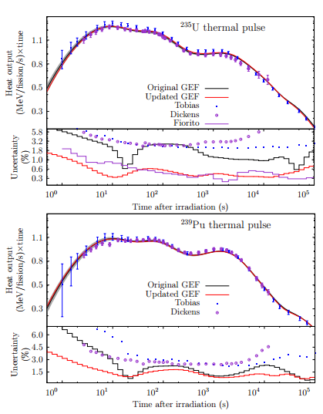
Advanced application examples: UQP
Uncertainty quantification and propagation using input semi-empirical model parameter variation, then sample files
Cumulative correlations and covariances from GEF
*A Bayesian Monte Carlo method for fission yield covariance information, D. Rochman, O. Leray, A. Vasiliev, H. Ferroukhi, A.J. Koning, M. Fleming and J.C. Sublet, Annals of Nuclear Energy, May 2016

Slide 11
Recap
FISPACT-II is a completely re-engineered inventory code, taking with it all of the strengths of FISPACT-2007/2010, but:
  Fully object-orientated F90, modular, professionally developed and maintained
  Takes all (properly produced) ENDF-6 nuclear data – not limited to legacy, deprecated data files (!)
  Validated with a robust and wide-ranging set of experimental data
  Provides novel uncertainty quantification and propagation methods
  Much, much, more…
But how to use FISPACT-II with high(er)-energy applications above 200 MeV?

Slide 12
An approach
Many users rely upon Monte-Carlo codes with built-in models to sample residual nuclide production, which is extracted and passed into inventory codes
  What checks exist for convergence of these reaction rates, for all residual products in all locations?
  How validated are these models for each target, product, energy? How can a user check and/or select the most appropriate?
  How might a user perform uncertainty quantification and propagation?
  If you converge all reaction rates, is this an efficient use of resource?
From other fields, we instead converge the incident particle spectra and rely upon validated, complete nuclear data

Slide 13
FISPACT-II and high(er) energies
FISPACT-II now handles a set of high-energy data, splicing/interfacing with the general-purpose library
This requires complete nuclear data files, based on the best INC+ models
  Written in full ENDF-6 files
  May be fed into full V&V system
  Users with particle spectra have results on the order of seconds
  Greater confidence in results
  Uncertainty may be quantified?

Slide 14
What do we have today? [200 MeV]
HEAD-2009

Slide 15
What do we have today? [200 MeV]
JENDL-2007/HE

Slide 16
What do we have today? [200 MeV]
W3000

Slide 17
What do we have today? [800 MeV]
HEAD-2009

Slide 18
What do we have today? [800 MeV]
JENDL-2007/HE

Slide 19
What do we have today? [800 MeV]
W3000

Slide 20
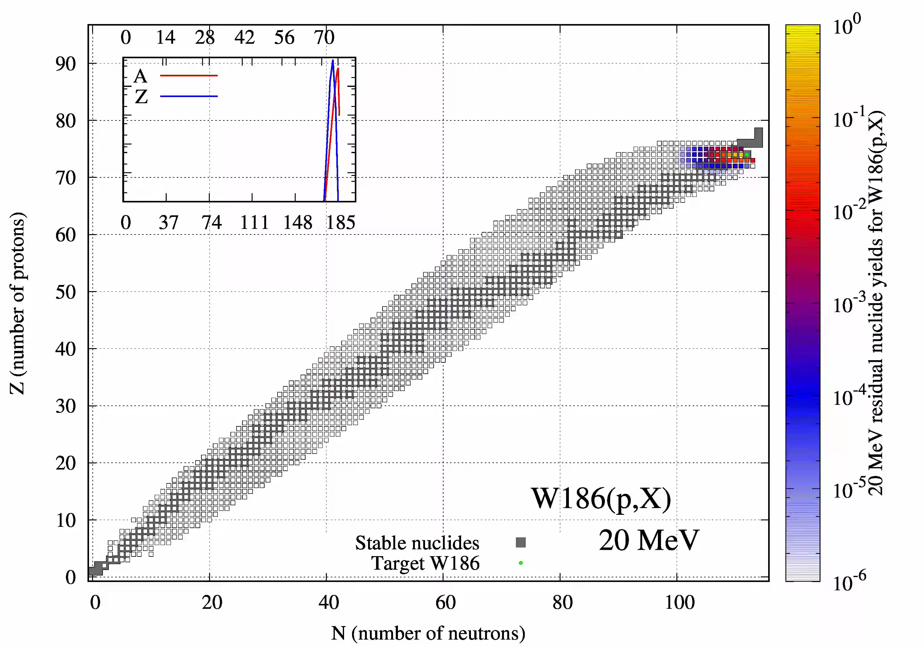
Systematics: SPACS
"SPACS: A semi-empirical parameterization for isotopic spallation cross sections"
C. Schmitt, K.-H. Schmidt, A. Kelic-Heil Phys. Rev. C 90 (2014) 064605

Slide 21
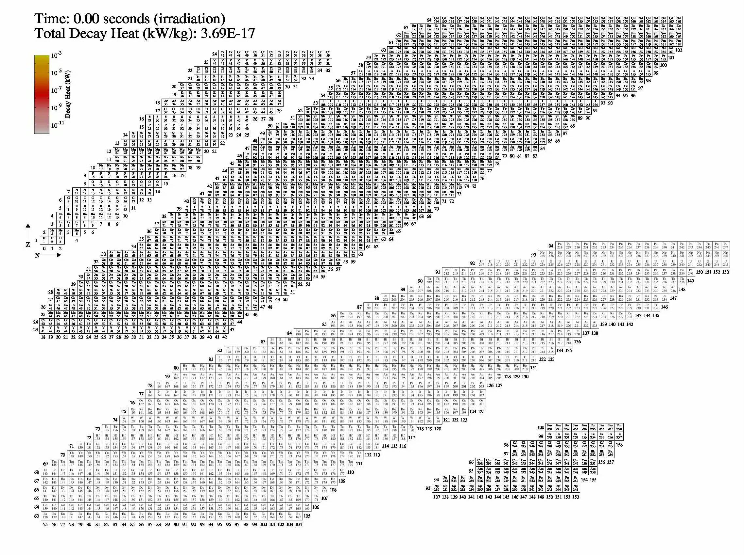
1 GeV W FISPACT-II

Slide 22


FISPACT-II distribution
FISPACT-II used extensively with dozens of commercial customers and hundreds of users in over 30 countries
US Oak Ridge RSICC and OECD-NEA distribute version 3-20 (Dec 2016) with license agreement
http://www.oecd-nea.org/tools/abstract/detail/nea-1890/
https://rsicc.ornl.gov/codes/ccc/ccc8/ccc-836.html

Slide 23
Online resources
Online resources have been developed and launched:
  Main page http://fispact.ukaea.uk
  Wiki/e-manual http://fispact.ukaea.uk/wiki
  User forum http://fispact.ukaea.uk/forum
Users please join and submit queries through the forum

Slide 24

What is needed?
Nuclear data files for high-energy applications that are:
  Complete (covers all reaction mechanisms from target to proton without omissions)
  Fully ENDF-6 compliant
  Consistent
  Reproducible
  Traceable (all methods, codes, parameters)

