Slide 1
Study of the collimators for curved beamline at ESS
V. Santoro D. Di Julio, P. Bentley,
S. Ansell, G. Muhrer
ESS

Slide 2
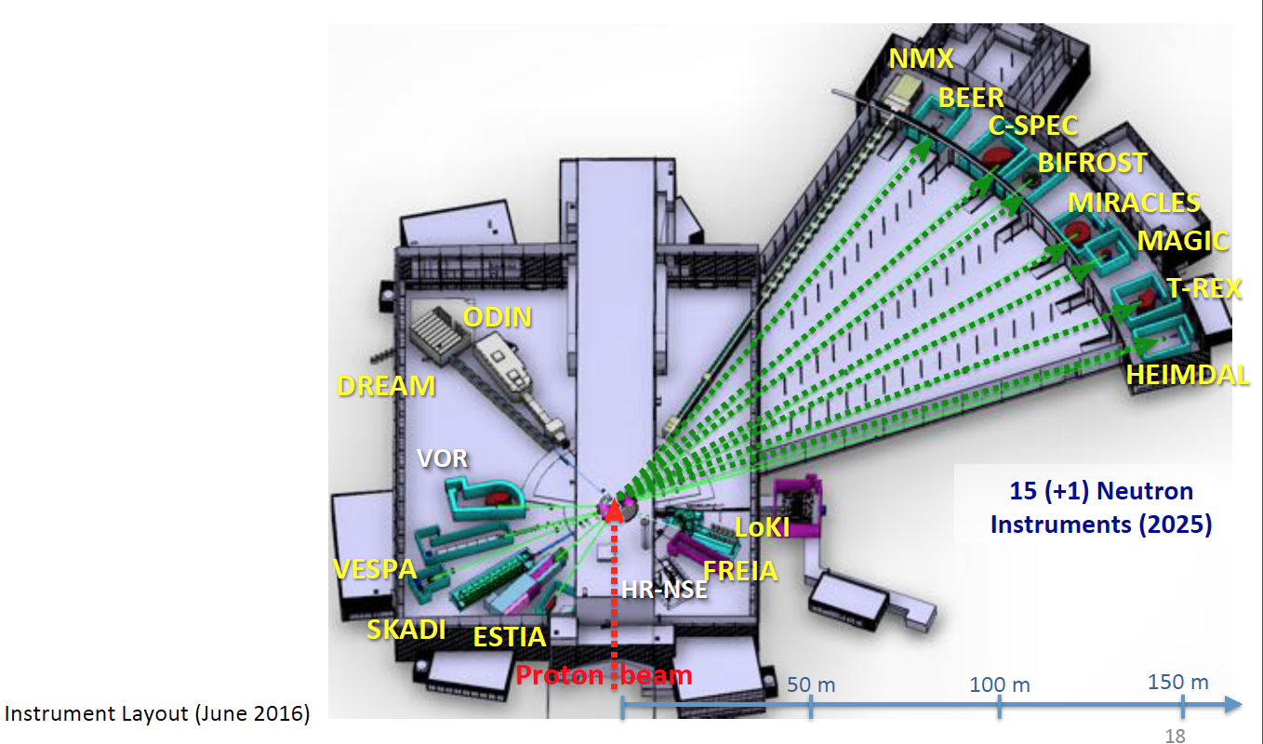
The ESS instrument suite

Slide 3
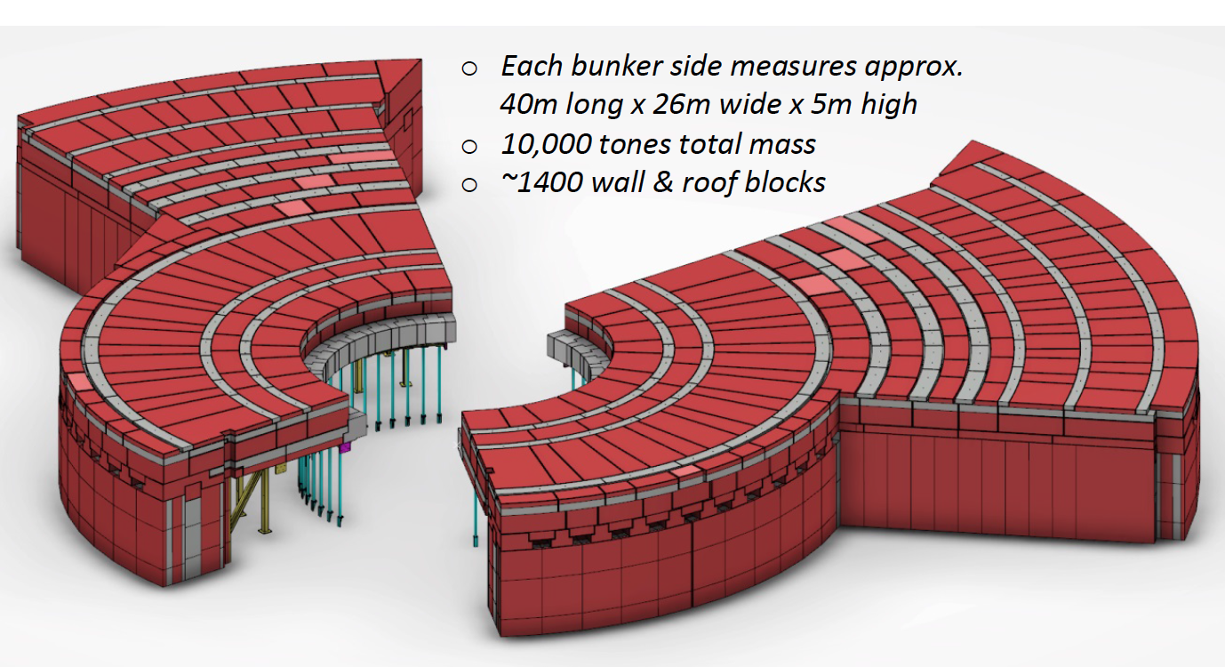
The ESS bunker (I)
The ESS bunker is a common shielding structure, which extends from the outer surface of the monolith, located at 5.5m from the target, to 15 m for the short instrument sector and to 28m in the long instrument sectors
The Bunker is filled of components, metallic guides, chopper, shutter collimators.
We would like to have
access to the inside of the
bunker during maintenance
in steady operation

Slide 4
The ESS bunker (II)
Bunker Wall
Bunker Wall
Bunker
Bunker
Target
Proton Beam

Slide 5
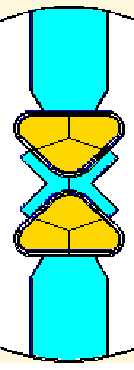
Straight and curved instrument
Sample position
Source
High Energy Neutrons
Cold / thermal Neutrons
Source
Sample position

Slide 6
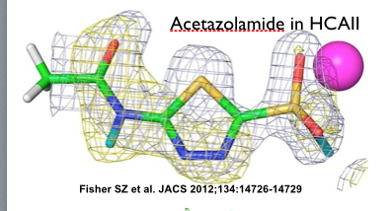
The NMX instrument
The NMX instrument is a time-of-flight (TOF) quasi-Laue diffractometer optimised for small samples and large unit cells.
NMX is dedicated to the structure determination of biological macromolecules by crystallography.
The scientific driver is to locate the hydrogen atoms
Where are the hydrogen important?
Enzyme Mechanism
Protein-ligand interactions
Proton transport across membranes

Slide 7
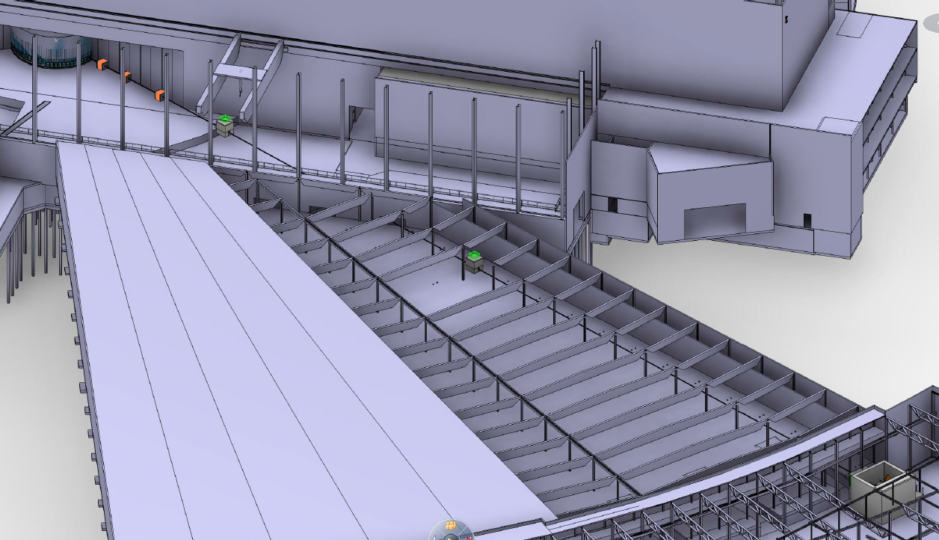
NMX Original Design

Slide 8
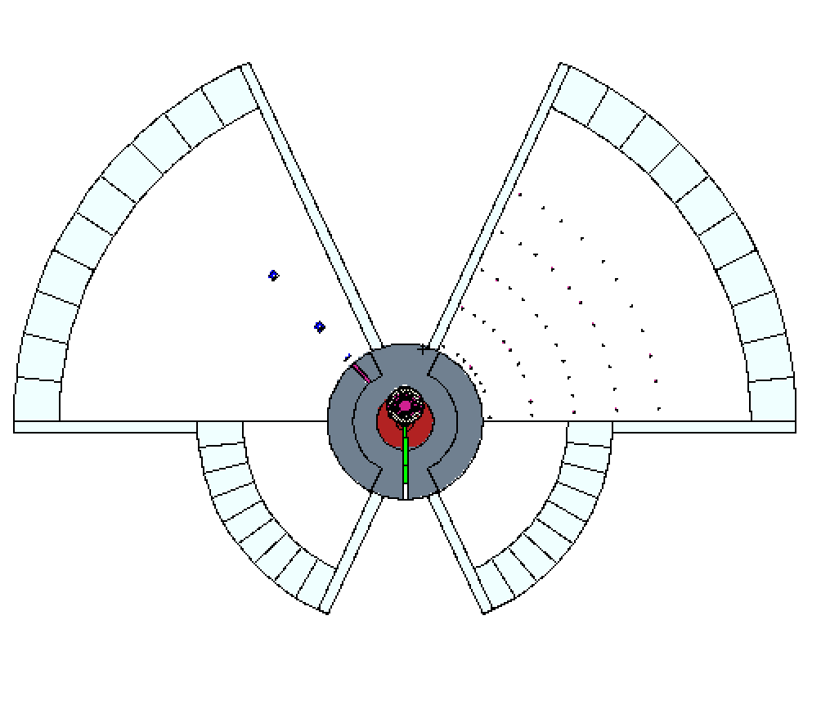
ESS MCNP model
Engineering Model
MCNP Model
SOUTH
WEST
EAST
NORTH
MCNP Model for target +Bunker+instrument hall +instrument cave
produced with Comblayer package developed by Stuart Ansell
https://github.com/SAnsell/CombLayer

Slide 9
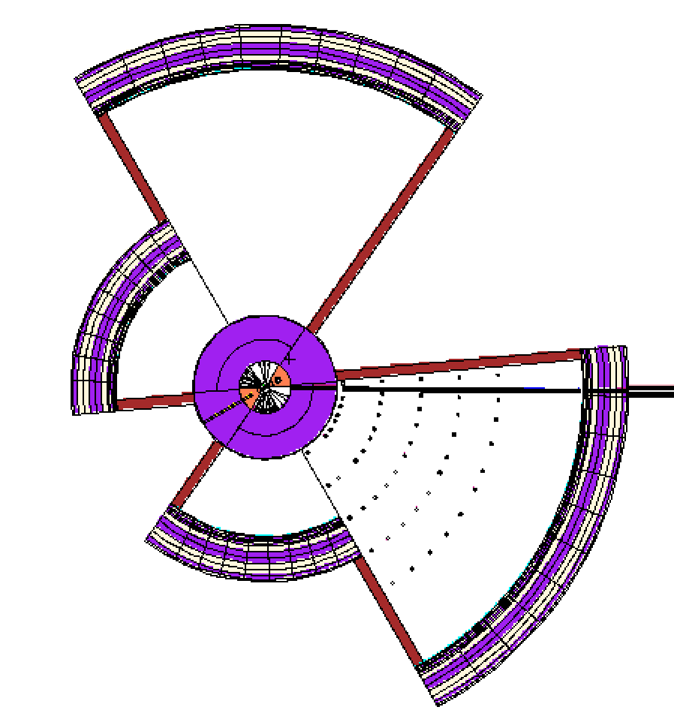
GEOMETRY of the NMX Beamline (1)
NMX (W1)
Bunker Wall
Long sector
Long sector
Short sector
Short sector
4th International Workshop on Accelerator Radiation Induced Activation

Slide 10
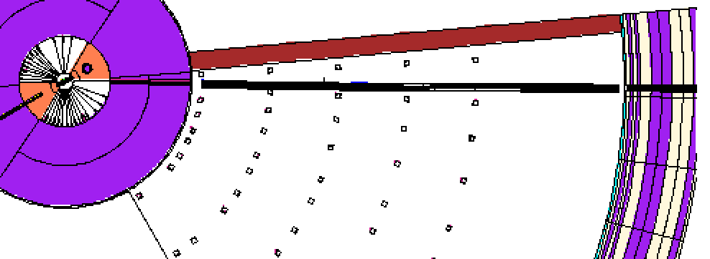
GEOMETRY of the NMX Beamline (2)
Moderator
Guide in the Monolith
Width 4.5 cm (@2m) 3.5 cm @ 5.5 m
Height 4.5 cm (@2m) 4.5 cm @ 5.5 m
Copper Substrate
Guide in the Bunker
Width 4.5 cm (@6 m) Height 3.0 cm (@ 6 m)
Aluminum Substrate
The guide bends with 1.2km radius of curvature

Slide 11
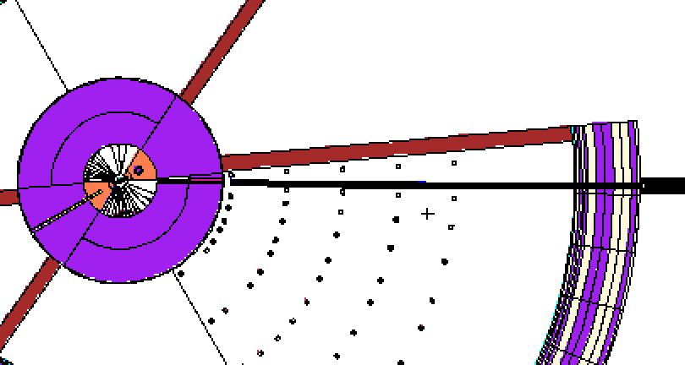
GEOMETRY of the NMX Beamline (3)
Out of the bunker wall ~ 28m from the moderator
Moderator
What we are trying to achieve:
after the bunker wall the fast neutron background will be almost negligible and the beam will be composed only by thermal and cold neutrons

Slide 12
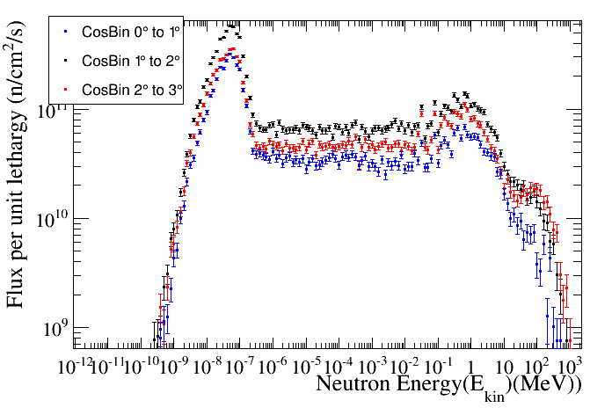
Source term @ 2m position (1)

Slide 13
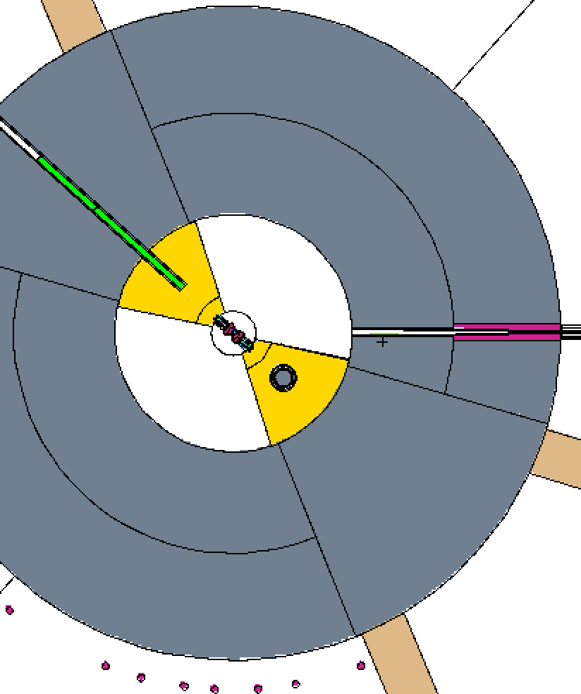
Source term @ 2m position (2)
Proton Beam
Zoom of the BeamLine in in the target region
Monolith
Beam Line
Moderator
2m from the moderator entrance of the beam line

Slide 14
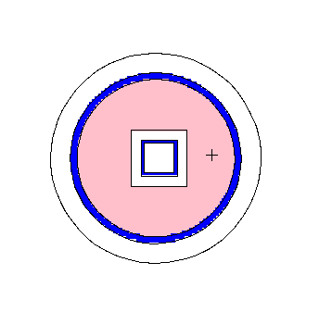
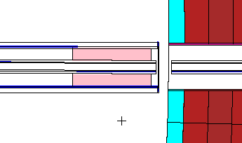
50 cm W collimator around 16m
50 cm W or Cu collimators at 16m and 24m
Bunker Wall
Monolith
50cm Cu/W around 16m
50cm W/Cu ~ 24m
Guide Substrate

Slide 15
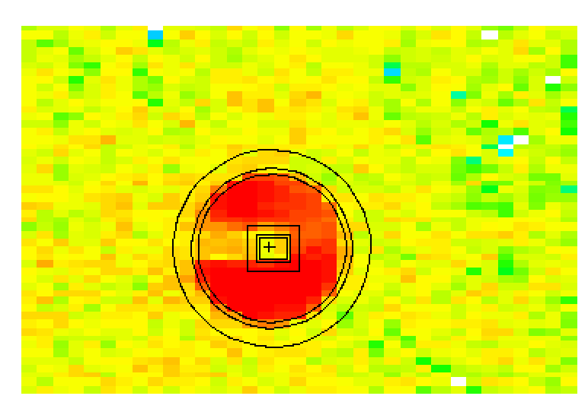
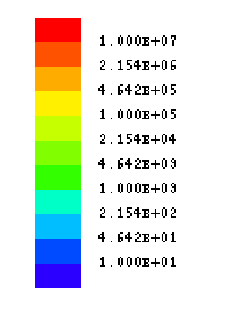
DOSE MAP for NMX before the bunker wall without collimator
μSv/h
Main Beam
somewhere here
Before the Bunker wall x=2419, y -29.6 z=13.93

Slide 16
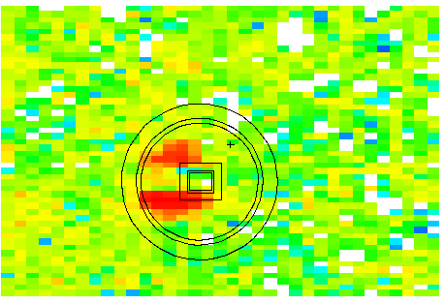
DOSE MAP for NMX before the bunker wall with a W collimator
μSv/h
Main Beam
somewhere here
Before the Bunker wall x=2419, y -29.6 z=13.93

Slide 17
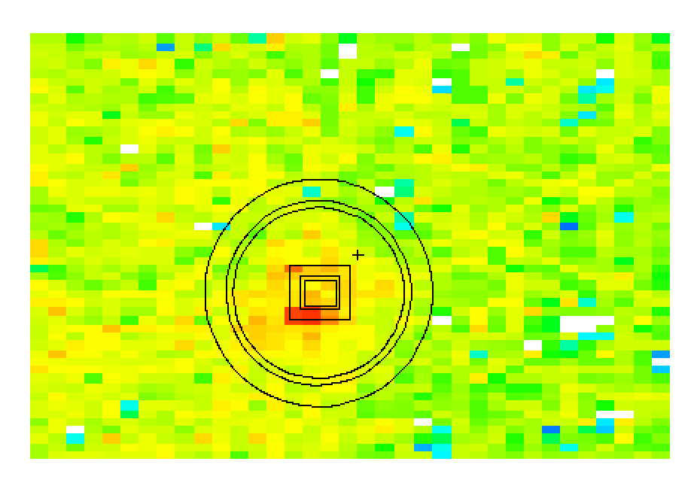
DOSE MAP for NMX before the bunker wall with 2 W collimators
μSv/h
Main Beam
somewhere here
Before the Bunker wall x=2419, y -29.6 z=13.93

Slide 18
Collimators in the bunker(I)
μSv/h
First collimator
Second collimator

Slide 19
Collimators in the bunker(II)
Out of the bunker wall ~ 28m from the moderator
Moderator
Position of the first collimator

Slide 20
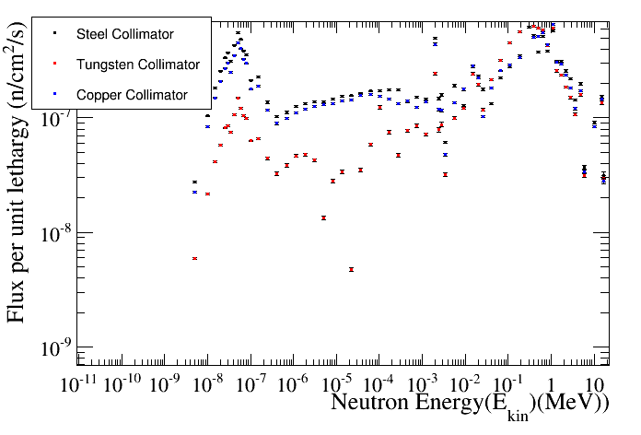
Neutron energy spectrum in the collimator for different materials

Slide 21
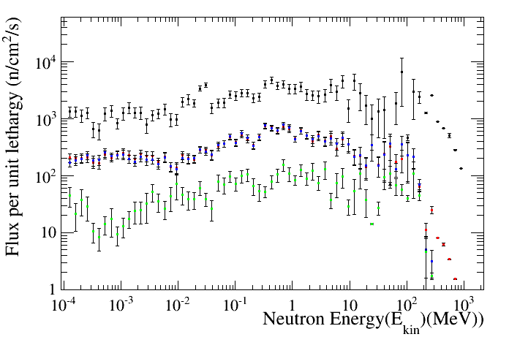
Neutron Energy Spectrum Out Bunker (28m)

Slide 22
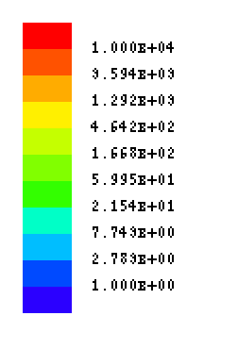
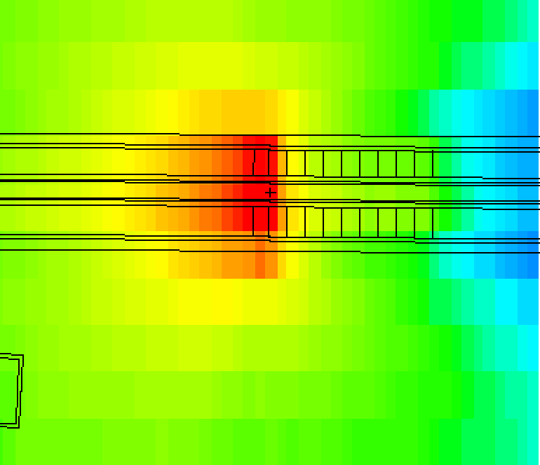
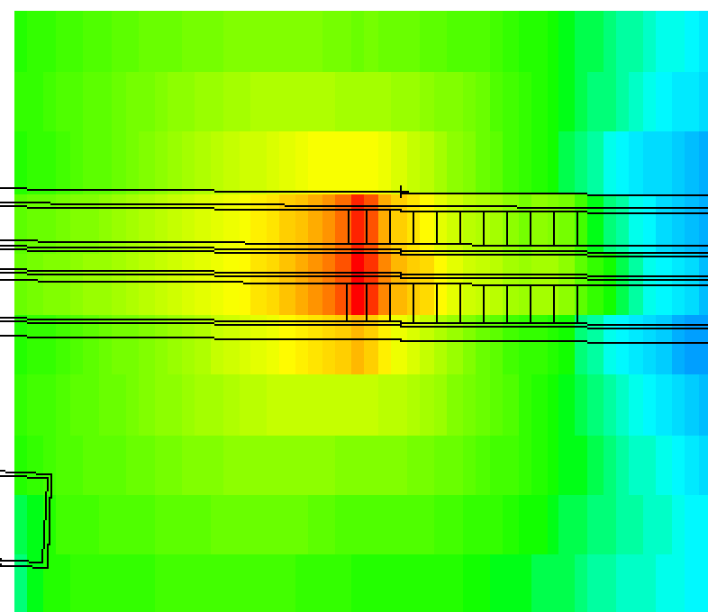
W and Copper Collimator Activation
1 day of cool –down
Tungsten
Copper
μSv/h
1000 μSv/h
400 μSv/h
After 10 years of operation

Slide 23
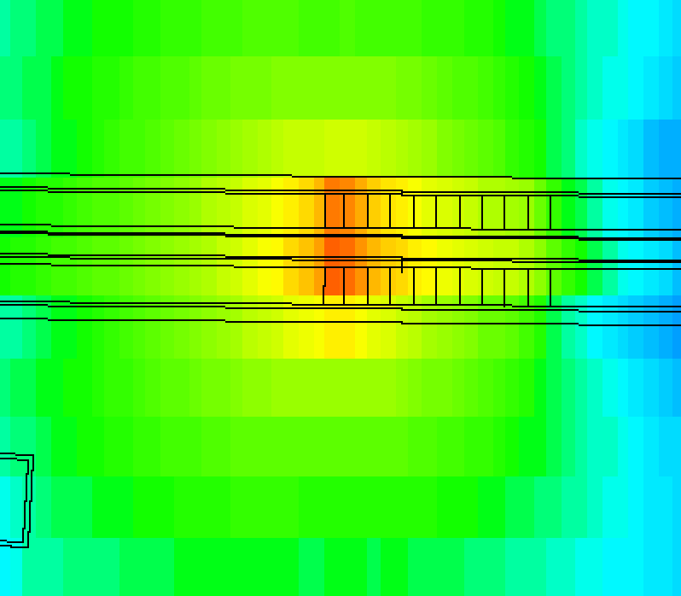
Steel Collimator Activation
1 day of cool –down
μSv/h
Mild Steel
250 μSv/h
After 10 years of operation

Slide 24
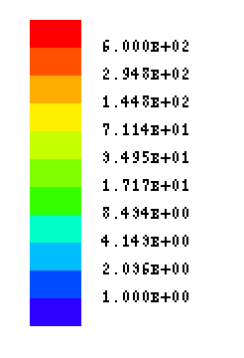
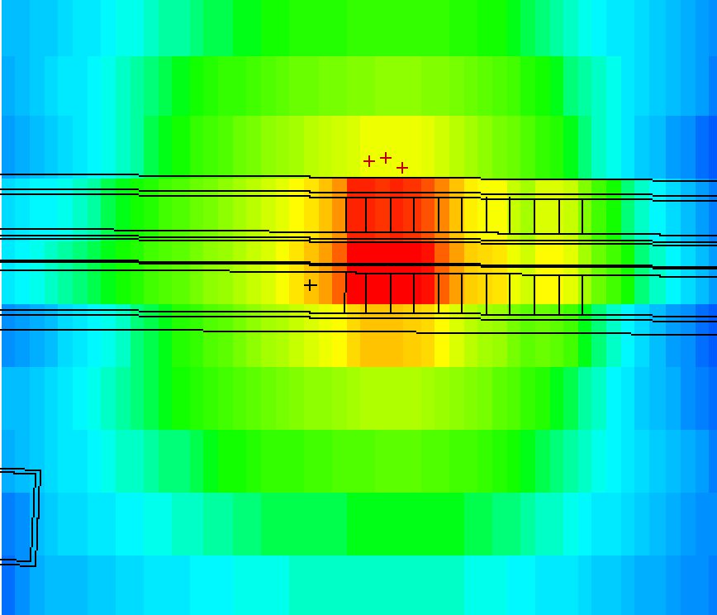
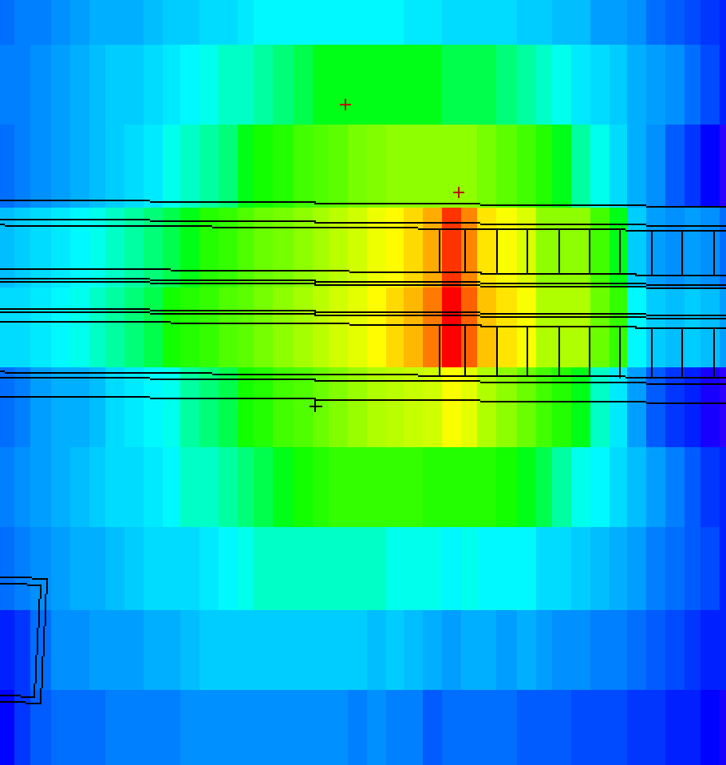
W and Copper Collimator Activation
7 days of cool –down
Tungsten
Copper
μSv/h
26 μSv/h
60 μSv/h
After 10 years of operation

Slide 25
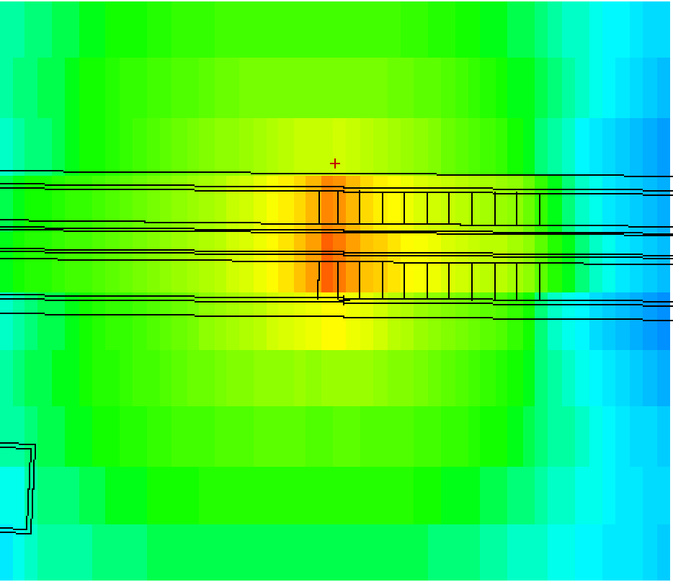
Steel Collimator Activation
7 days of cool –down
μSv/h
Mild Steel
240 μSv/h
After 10 years of operation

Slide 26
Conclusions
We have performed neutronic calculation of the NMX instrument at ESS
W or Cu Collimators significantly decrease the dose outiside the bunker (very low high energy component)
W or Cu collimators are a better choice than steel collimators due to the activation considerations

Slide 27
BACK-UP SLIDES

Slide 28
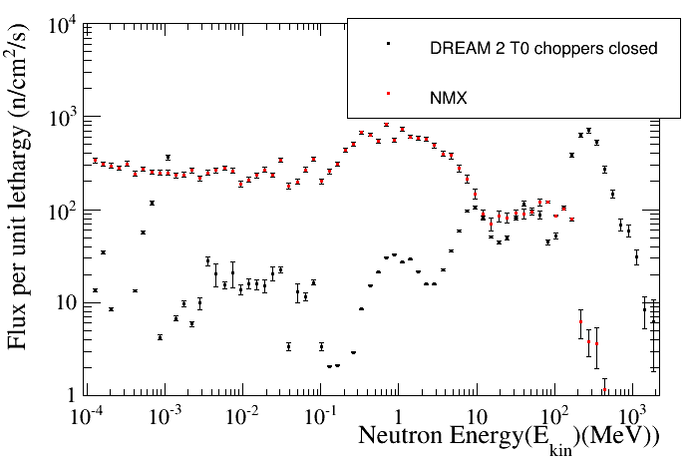
Comparison between Straight and curved guide

Slide 29
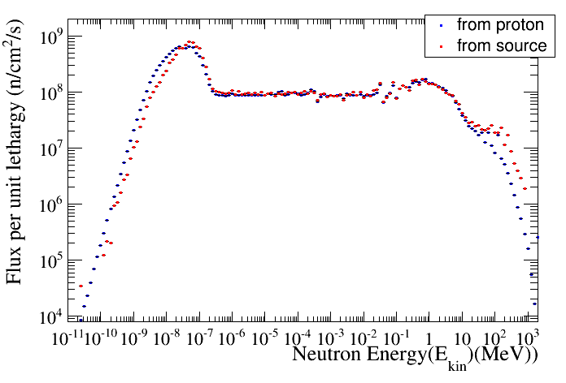
Comparison of the neutron energy spectrum at 5.5 starting from proton and from neutron source at 2m

Slide 30
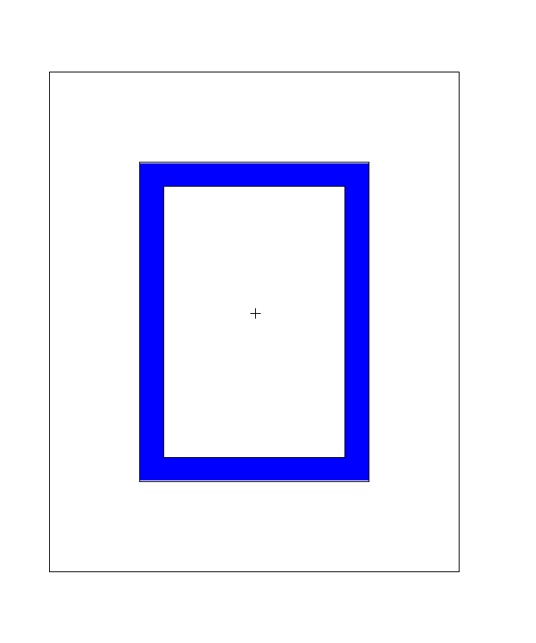
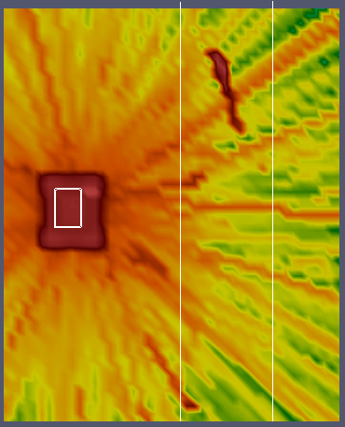
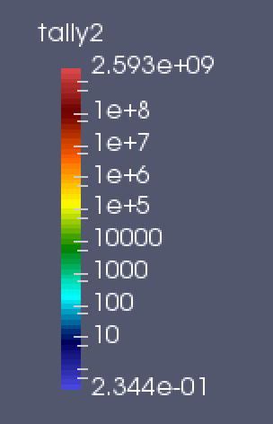
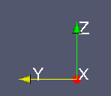
Slice of the beam line at 6m
Neutrons Energy > 0.1 keV
Guide
Neutron Flux
n/cm²s

Slide 31
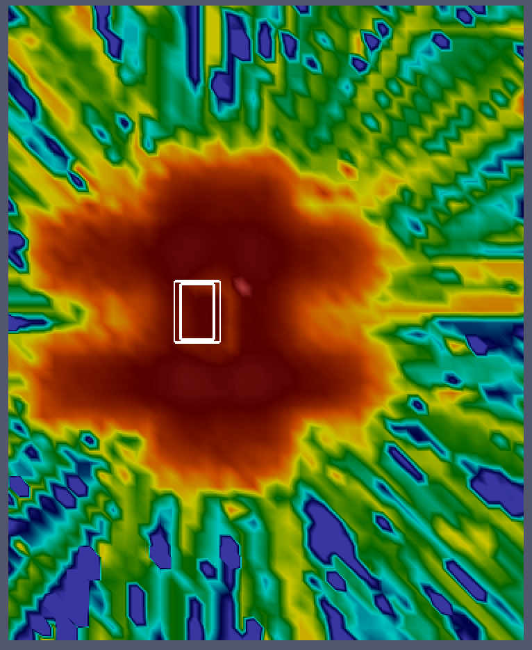
Slice of the beam line at 12m
Neutrons Energy > 0.1 keV
Guide
Neutron Flux
n/cm²s

Slide 32
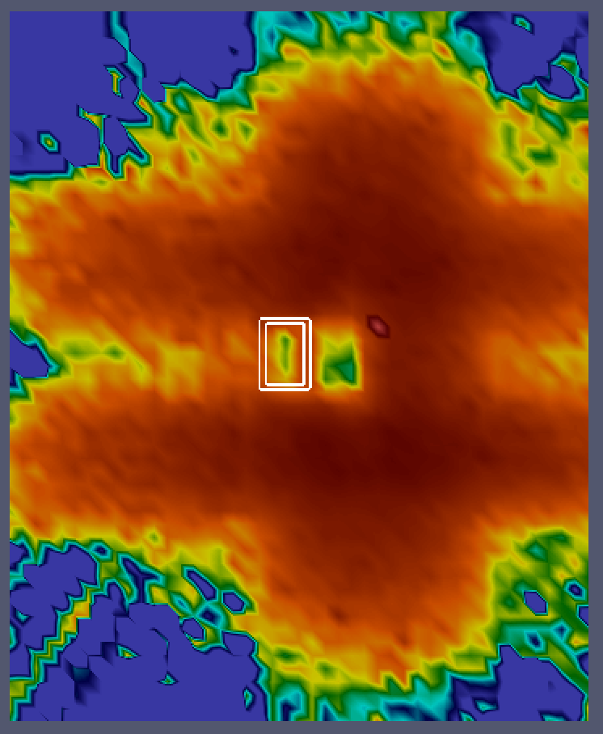
Slice of the beam line at 18m
Neutrons Energy > 0.1 keV
Guide
Neutron Flux
n/cm²s

Slide 33
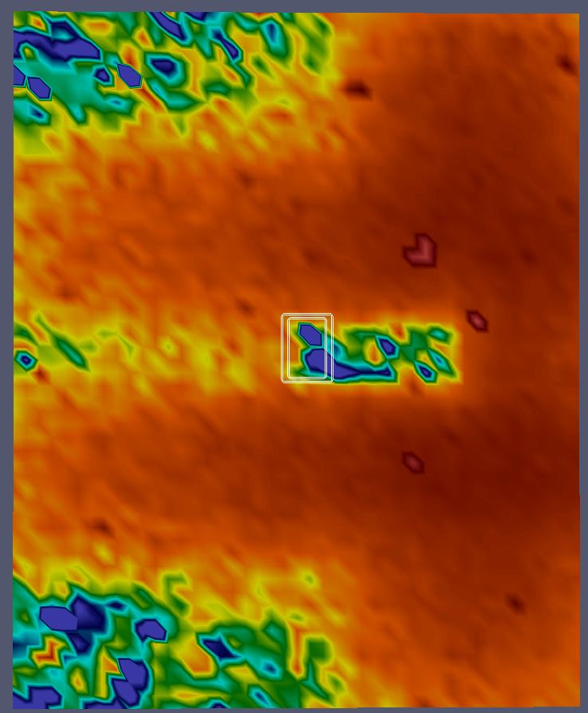
Slice of the beam line at 2399 m
Neutrons Energy > 0.1 keV
Guide
Neutron Flux
n/cm²s
Main Beam
somewhere here

Slide 34
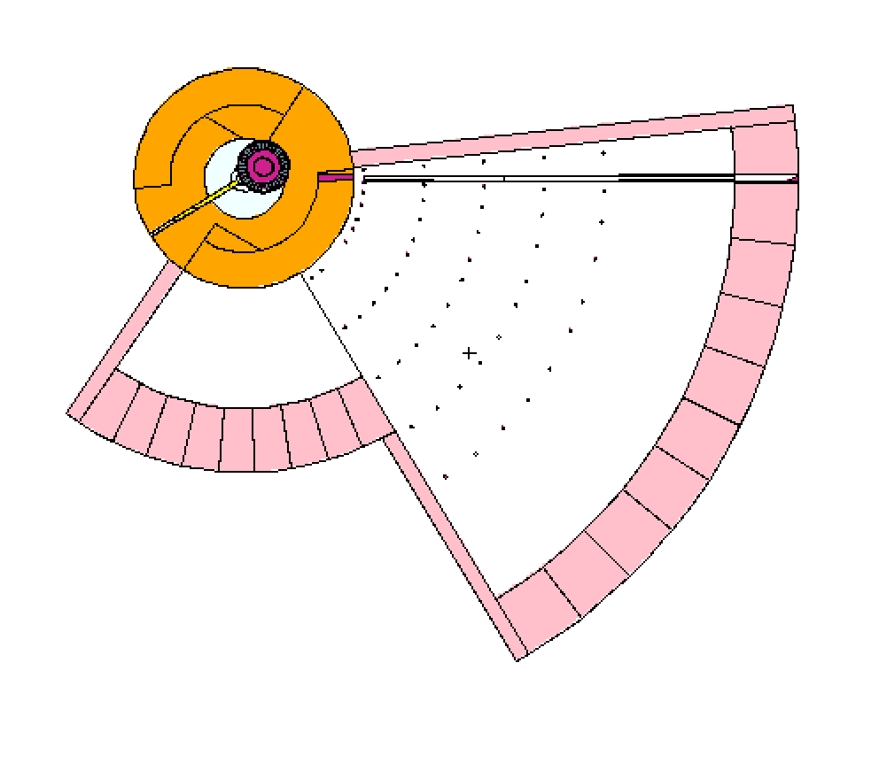
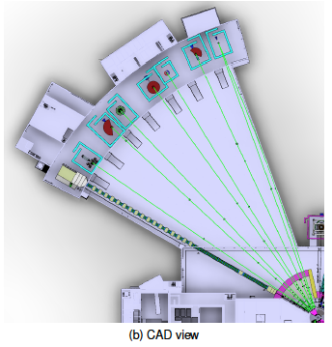
NMX in the Bunker
LONG INSTRUMENT SECTOR
Proton Beam
W1
NMX
11.5 m
24.5 m
SHORT INSTRUMENT SECTOR
NMX
CAD view
3.5 m
NMX Original Design

Slide 35
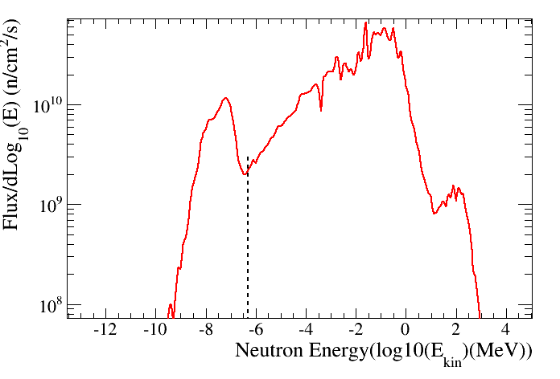
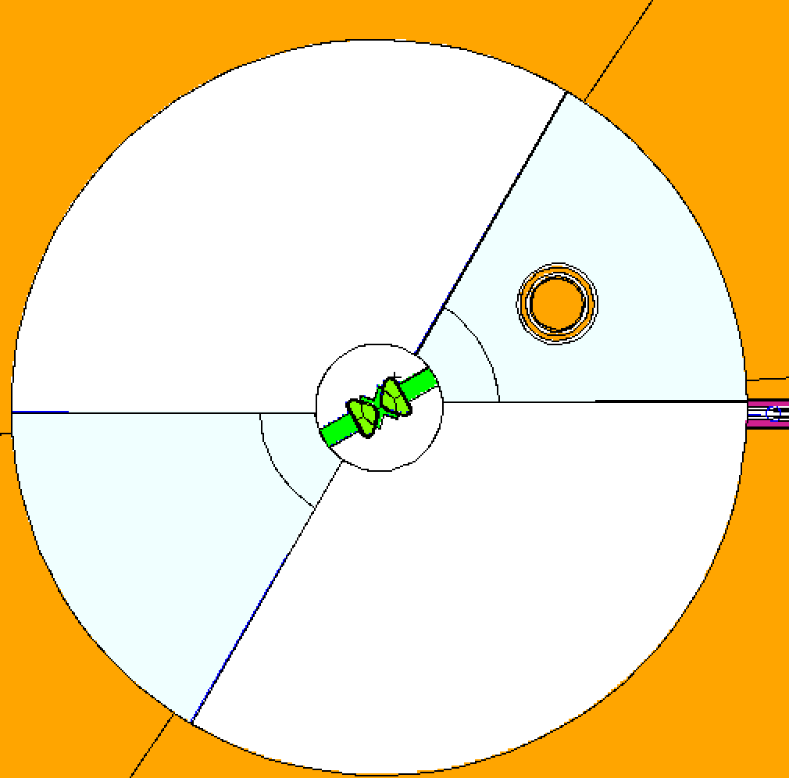
NMX in the Bunker: 2m from the Moderator
Neutron Energy Spectrum
2m from the moderator
1 eV
W1
NMX Original Design

Slide 36
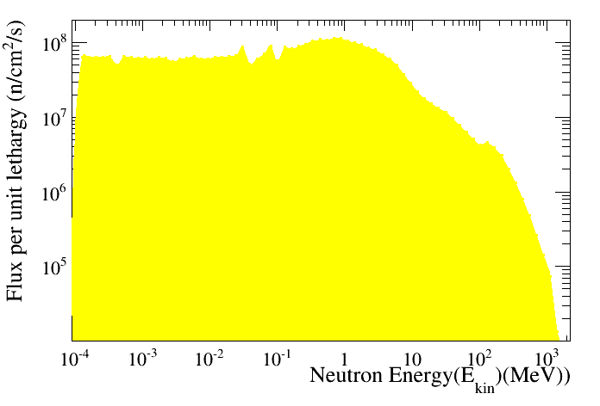
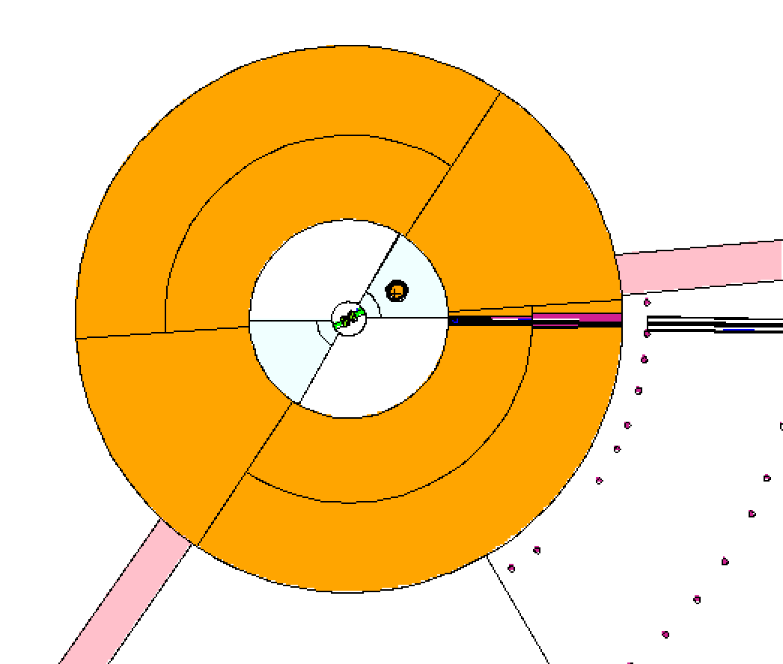
NMX in the Bunker: 6m from the moderator
Neutron Energy Spectrum
6m from the moderator
W1
NMX Original Design

Slide 37
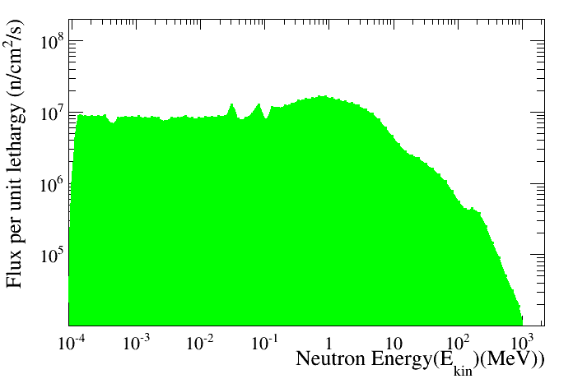
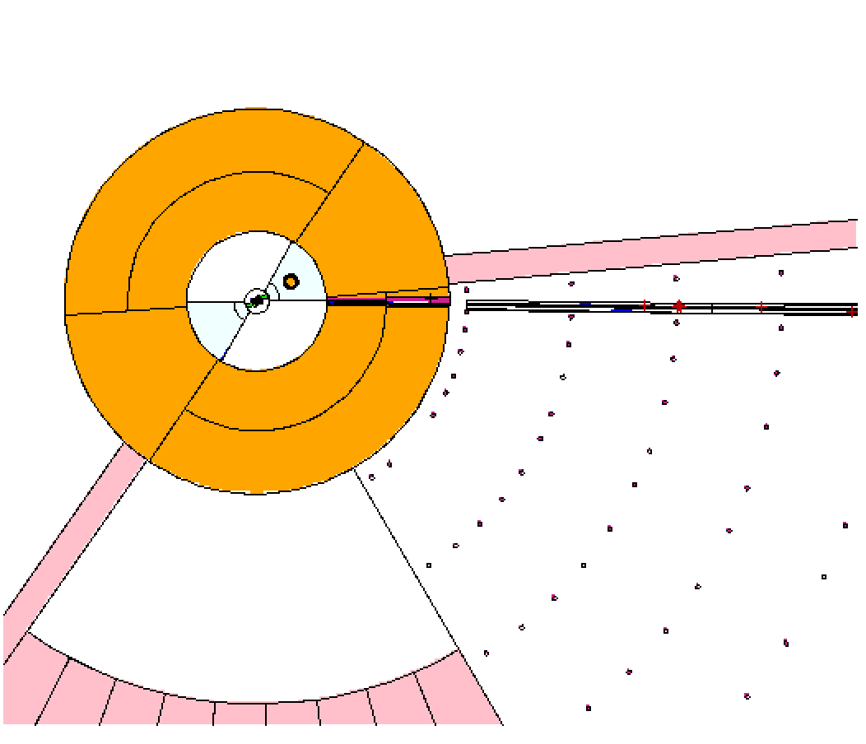
NMX in the Bunker: 12m from the moderator
Neutron Energy Spectrum
12m from the moderator
W1
NMX Original Design

Slide 38
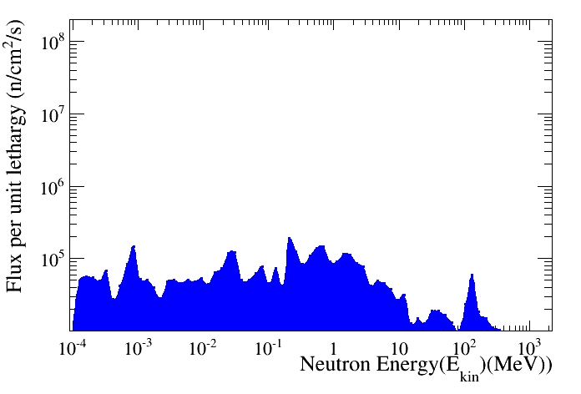
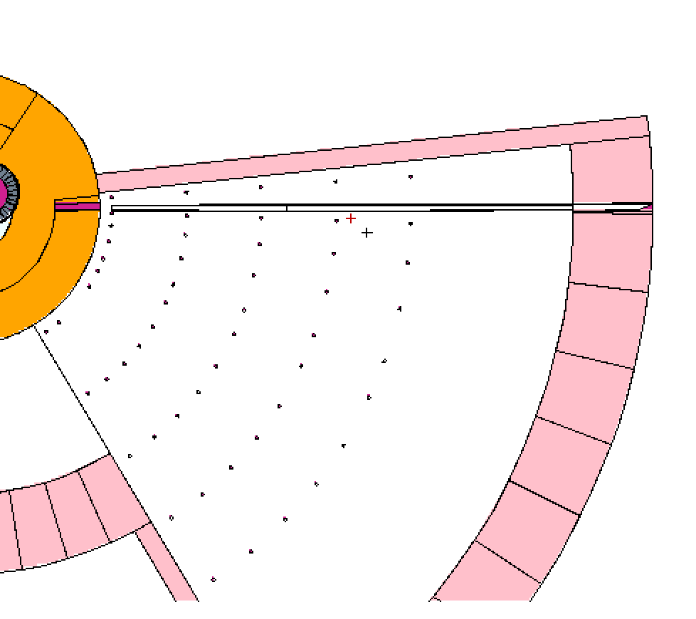
NMX in the Bunker: 18m from the moderator
Neutron Energy Spectrum
18m from the moderator
W1
NMX Original Design

Slide 39
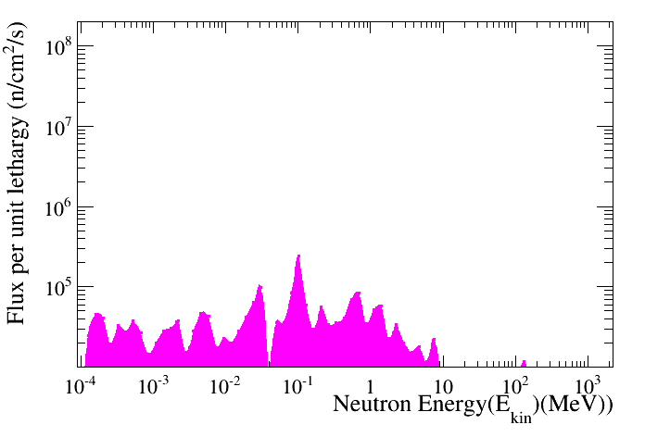
NMX in the Bunker: 24m from the moderator
Neutron Energy Spectrum
24m from the moderator
W1
NMX Original Design

Slide 40
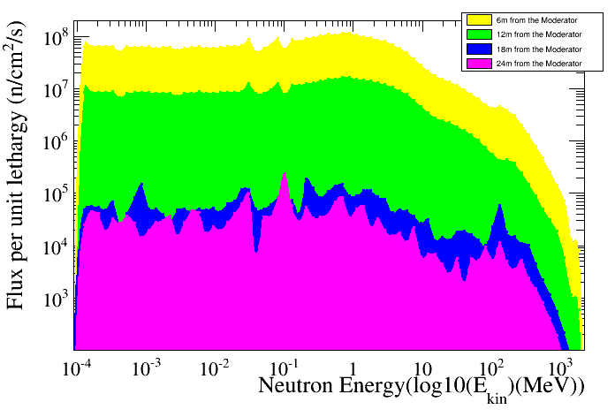
NMX Energy Spectra
NMX Original Design
MCNP entries/divided by Bin Width

