Slide 1
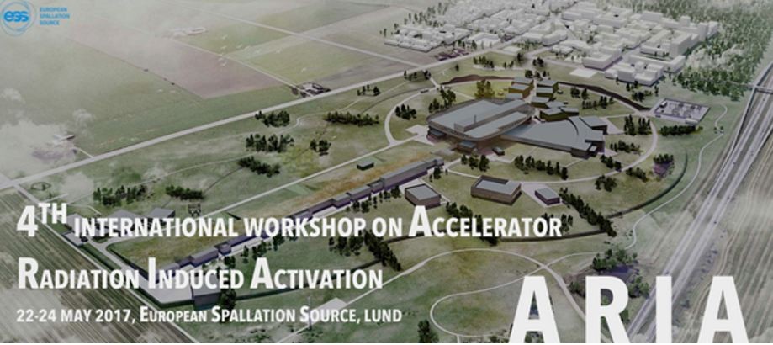


Activation of the ISIS TS-1 and TS-2 targets
- Simulations vs. experimental results -
Goran Škoro*
* On behalf of: S. Ansell, F. Burge, D. Ashcroft, G. Burns, D. Findlay…

Slide 2
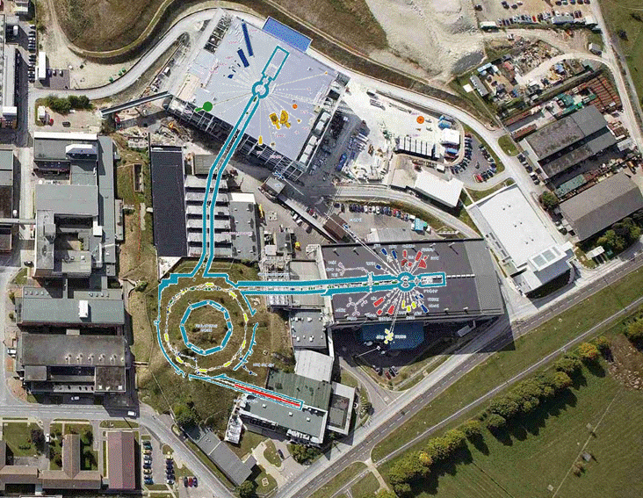
ISIS Target Stations
BEAM PARAMETERS
800 MeV protons
50 Hz
Short pulse (~0.5 µs)
160 µA – TS1
40 µA – TS2
TS2
ISIS TARGETS
DATES FITTED - REMOVED
TS1
…
TANTALUM #2 OCT 1994 – FEB 1995
URANIUM #9 MAY 1995 – JUN 1995
TANTALUM #2 JUN 1995 – SEP 1996
TANTALUM #3 NOV 1996 – APR 1999
TANTALUM #4 MAY 1999 – MAR 2001
TUNGSTEN #1 MAY 2001 – AUG 2005
TUNGSTEN #2 SEP 2005 – APR 2009
TUNGSTEN #3 APR 2009 – SEP 2014
TUNGSTEN #4 MAR 2015 –
TS2
TUNGSTEN #1 AUG 2008 – FEB 2010
TUNGSTEN #2 FEB 2010 – JUN 2010
TUNGSTEN #3 MAR 2011 – NOV 2012
TUNGSTEN #4 NOV 2012 – JUN 2014
TUNGSTEN #6 JUL 2014 – JUL 2015
TUNGSTEN #7 SEP 2015 –
TS1

Slide 3
TS-1 target(s)
Uranium target
Tungsten target
Tantalum target

Slide 4
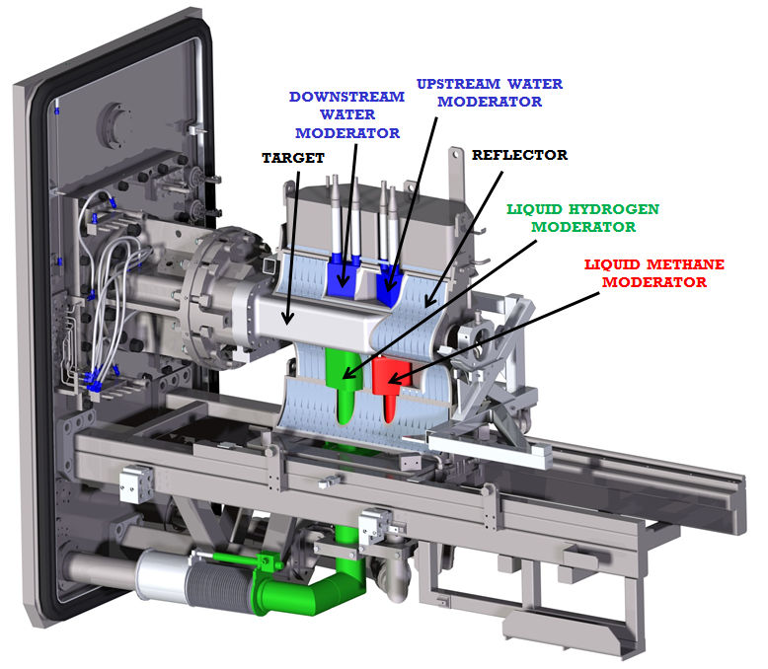
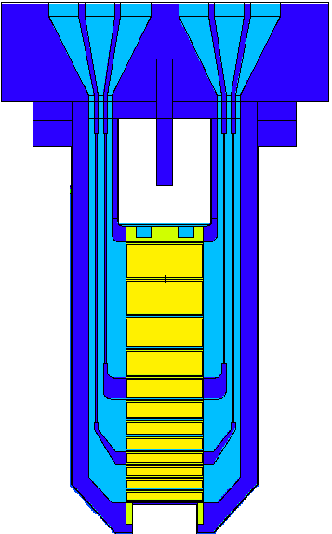
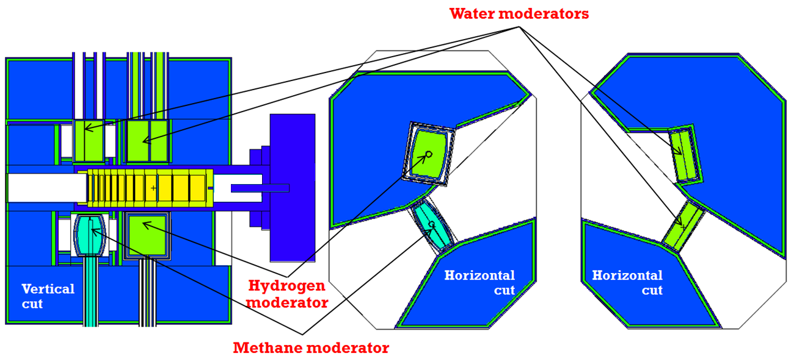
TS-1 TRaM (MCNPX model)
Tungsten target

Slide 5
TS-1 target activation
Simulations vs. experimental results
- long cooling times -
800 MeV protons (50 Hz)

Slide 6
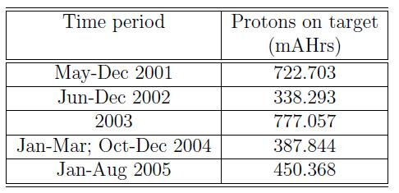
TS1 tungsten target inventory
TS1 W2
TS1 W1
TS-1 target(s) activation: initial calculation done in 2012
Nuclide Halflife,s 0.00E+00 s 1 year 2 years 2.9 years 6.6 years
_______ __________ __________ __________ __________ __________ __________
H 3 0.3888E+09 0.1393E+14 0.1316E+14 0.1244E+14 0.1183E+14 0.9773E+13
Na 22 0.8211E+08 0.4344E+11 0.3329E+11 0.2550E+11 0.2006E+11 0.7487E+10
Ar 39 0.8489E+10 0.2270E+10 0.2264E+10 0.2258E+10 0.2253E+10 0.2231E+10
Ca 45 0.1406E+08 0.1947E+12 0.4106E+11 0.8660E+10 0.2134E+10 0.6737E+07
Sc 44 0.1414E+05 0.3260E+13 0.1382E+11 0.1362E+11 0.1344E+11 0.1273E+11
Sc 46 0.7240E+07 0.4278E+13 0.2085E+12 0.1016E+11 0.6697E+09 0.9350E+04
Ti 44 0.1493E+10 0.1403E+11 0.1382E+11 0.1362E+11 0.1344E+11 0.1273E+11
V 49 0.2920E+08 0.7943E+13 0.3756E+13 0.1776E+13 0.9050E+12 0.5663E+11
Mn 54 0.2697E+08 0.2640E+14 0.1173E+14 0.5213E+13 0.2512E+13 0.1249E+12
Fe 55 0.8615E+08 0.6199E+14 0.4809E+14 0.3731E+14 0.2968E+14 0.1160E+14
Co 57 0.2348E+08 0.1019E+14 0.4025E+13 0.1586E+13 0.6857E+12 0.2185E+11
Co 58 0.6127E+07 0.2679E+14 0.7579E+12 0.2134E+11 0.8586E+09 0.1575E+04
Co 60 0.1664E+09 0.3142E+12 0.2755E+12 0.2416E+12 0.2146E+12 0.1319E+12
Ni 59 0.2367E+13 0.5318E+10 0.5318E+10 0.5318E+10 0.5318E+10 0.5317E+10
Ni 63 0.3159E+10 0.6269E+12 0.6229E+12 0.6185E+12 0.6146E+12 0.5991E+12
Ba133 0.3320E+09 0.8378E+11 0.7844E+11 0.7343E+11 0.6920E+11 0.5423E+11
Ce139 0.1189E+08 0.3759E+13 0.5974E+12 0.9493E+11 0.1814E+11 0.2009E+08
Pm143 0.2290E+08 0.5254E+13 0.2021E+13 0.7777E+12 0.3292E+12 0.9608E+10
Pm144 0.3140E+08 0.4744E+10 0.2364E+10 0.1178E+10 0.6293E+09 0.4780E+08
Pm145 0.5586E+09 0.5257E+12 0.7705E+12 0.8668E+12 0.8926E+12 0.8226E+12
Pm146 0.1745E+09 0.4507E+10 0.3976E+10 0.3508E+10 0.3134E+10 0.1971E+10
Sm145 0.2938E+08 0.9499E+13 0.4662E+13 0.2214E+13 0.1133E+13 0.7206E+11
Eu149 0.8040E+07 0.1386E+14 0.1050E+13 0.6914E+11 0.5976E+10 0.2539E+06
Eu150 0.1130E+10 0.1150E+10 0.1128E+10 0.1106E+10 0.1087E+10 0.1012E+10
Eu152 0.4206E+09 0.3977E+11 0.3776E+11 0.3584E+11 0.3421E+11 0.2822E+11
Eu154 0.2711E+09 0.1037E+11 0.9566E+10 0.8825E+10 0.8208E+10 0.6089E+10
Gd148 0.2354E+10 0.3080E+12 0.3051E+12 0.3023E+12 0.2998E+12 0.2897E+12
Gd151 0.1071E+08 0.1364E+14 0.1784E+13 0.2315E+12 0.3683E+11 0.1925E+08
Gd153 0.2087E+08 0.9389E+13 0.3348E+13 0.1174E+13 0.4573E+12 0.9470E+10
Tb157 0.4734E+10 0.2407E+12 0.2396E+12 0.2385E+12 0.2375E+12 0.2335E+12
Tb158 0.4734E+10 0.4398E+10 0.4377E+10 0.4357E+10 0.4339E+10 0.4265E+10
Dy159 0.1248E+08 0.1675E+14 0.2902E+13 0.5026E+12 0.1037E+12 0.1580E+09
Ho163 0.1442E+12 0.7770E+10 0.7769E+10 0.7767E+10 0.7766E+10 0.7762E+10
Tm170 0.1111E+08 0.4034E+12 0.5633E+11 0.7866E+10 0.1337E+10 0.9181E+06
Lu172 0.5790E+06 0.3379E+14 0.1621E+14 0.1119E+14 0.8015E+13 0.2033E+13
Lu173 0.4320E+08 0.3548E+14 0.2147E+14 0.1294E+14 0.8205E+13 0.1261E+13
Lu174 0.1045E+09 0.2037E+13 0.1664E+13 0.1352E+13 0.1120E+13 0.5164E+12
Lu174* 0.1227E+08 0.1430E+12 0.2404E+11 0.4044E+10 0.8130E+09 0.1110E+07
Hf172 0.5900E+08 0.2326E+14 0.1605E+14 0.1108E+14 0.7937E+13 0.2013E+13
Hf175 0.6048E+07 0.4209E+14 0.1145E+13 0.3075E+11 0.1187E+10 0.1831E+04
Ta179 0.5745E+08 0.1682E+15 0.1150E+15 0.7855E+14 0.5576E+14 0.1363E+14
Ta182 0.9887E+07 0.8883E+16 0.9721E+15 0.1064E+15 0.1452E+14 0.4047E+10
W 181 0.1047E+08 0.2366E+15 0.2932E+14 0.3630E+13 0.5540E+12 0.2439E+09
W 185 0.6489E+07 0.6758E+15 0.2322E+14 0.7976E+12 0.3838E+11 0.1470E+06
Target geometry - very detailed model; surrounding area geometry – not really (just the reflector – no moderators, flightlines, decouplers, pipes, etc…)
Detailed model of the TS-1 did not exist (details of the TS-1 TRaM geometry just started to be collected). Activation calculation was required for a new license for disposal of the first tungsten target so it was important not to underestimate the target activity.
MCNPX/CINDER90
CEM03
TS1-W1
Total: 2676 mAhrs
* - Expected large contribution to the gamma dose rate

Slide 7
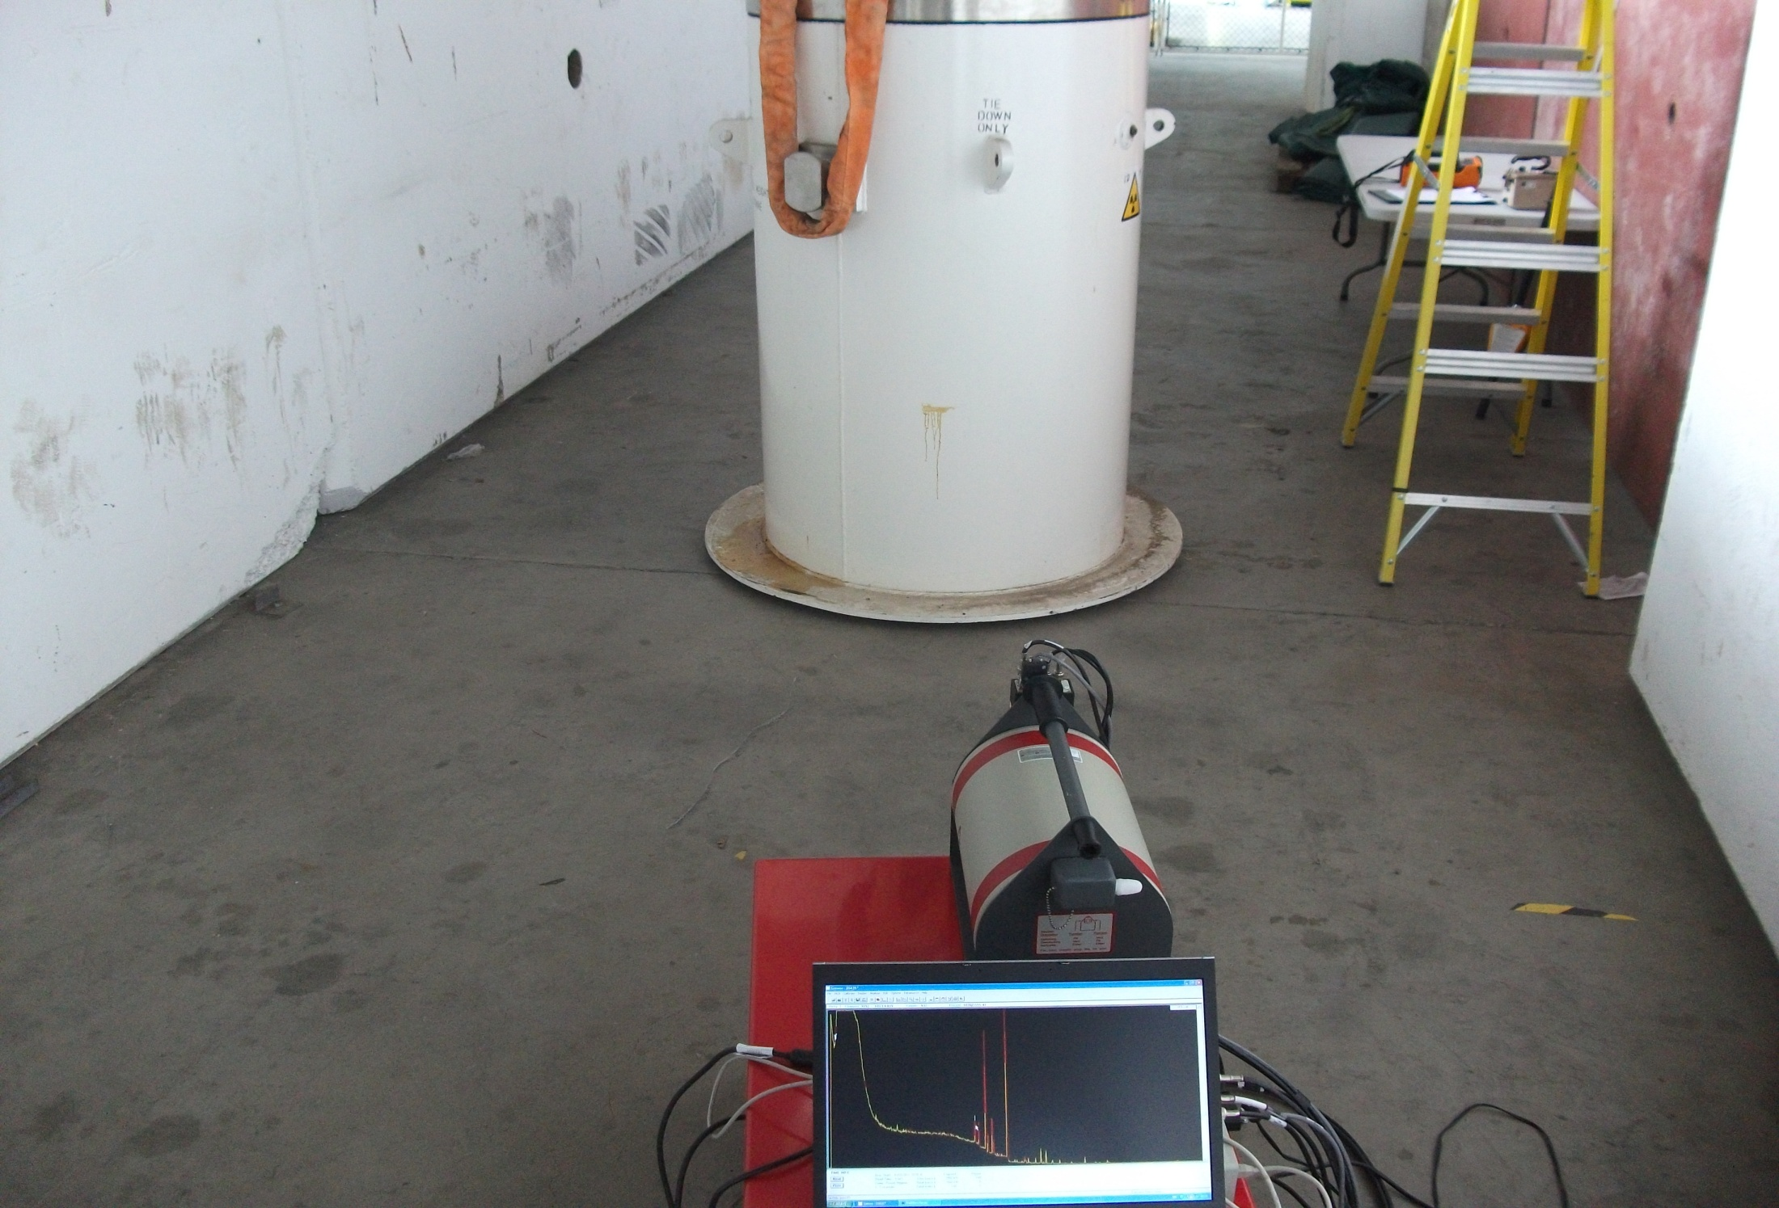
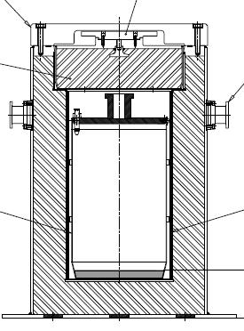
~17 cm Pb
hottest spot
4 cm Pb
March 2012
Gamma spectrometry
- Target in the flask -

Slide 8
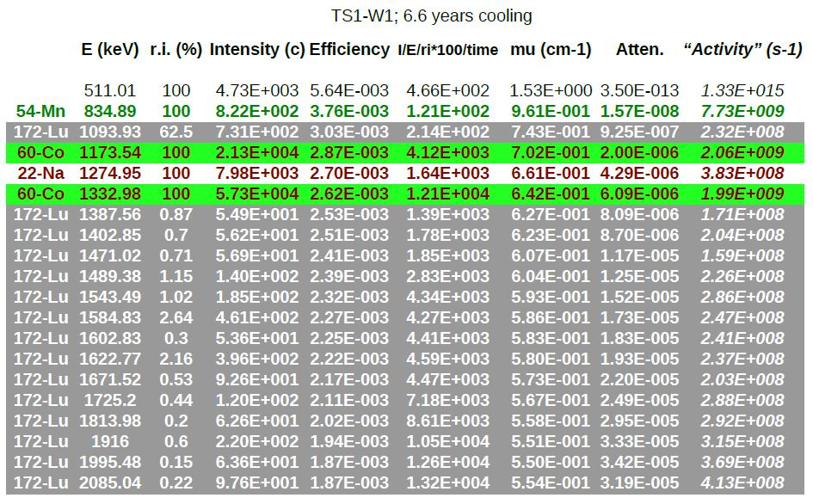
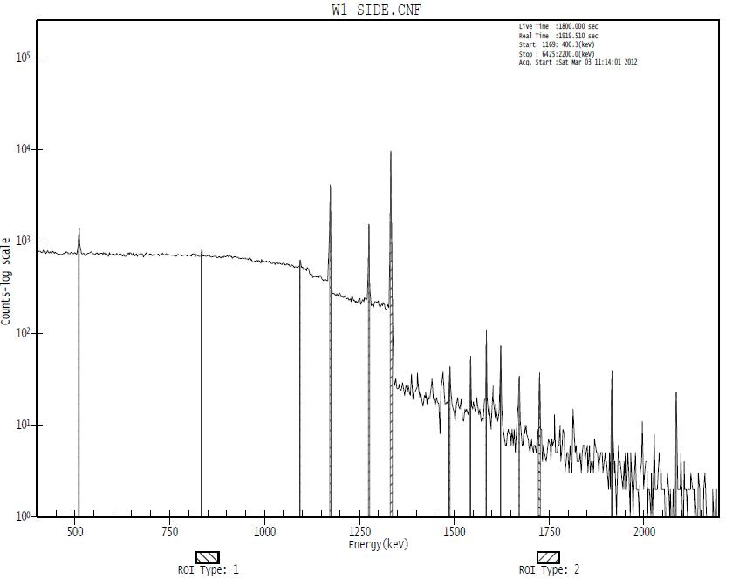
TS-1 targets:
Gamma spectrometry
TS-1 W1
2676 mAhrs
6.6 years cooling
Co-60; Lu-172

Slide 9
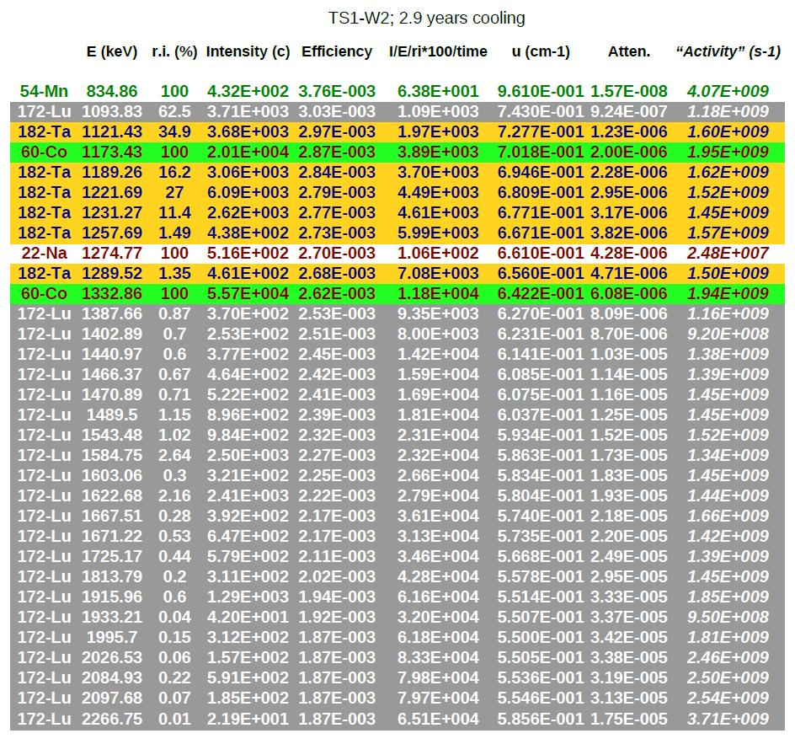
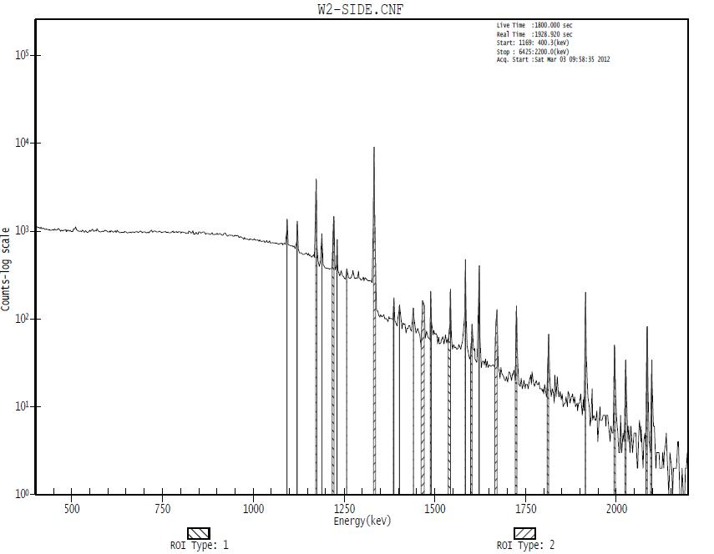
TS-1 targets:
Gamma spectrometry
TS-1 W2
1947 mAhrs
2.9 years cooling
Co-60; Lu-172;
+ Ta-182

Slide 10
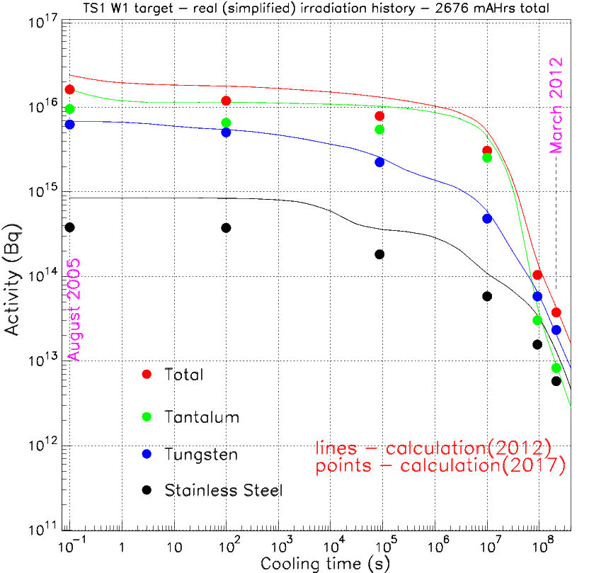
TS-1 target(s) activation: new calculation done in 2017
Very detailed model of complete TS-1 TRaM (part of the latest TS-1 neutronics model);
Target cooling water is a mixture: 80% D₂O - 20% H₂O (pure D₂O in previous calculations)…
Comparison between old (2012) and new (2017) results
Total activity
A few comments
Tungsten: “practically” no change;
Tantalum: 30% drop at the end of irradiation; small drop for very long cooling times;
Steel: factor of 2 drop for all cooling times;
800 MeV protons (50 Hz)
The effect (total activity reduction) is decreasing when going from outside to the centreline of the target: reflected neutrons contribution is reduced in new calculations!
Conclusion
Previous calculation has overestimated the total activity (particularly at short cooling times).

Slide 11
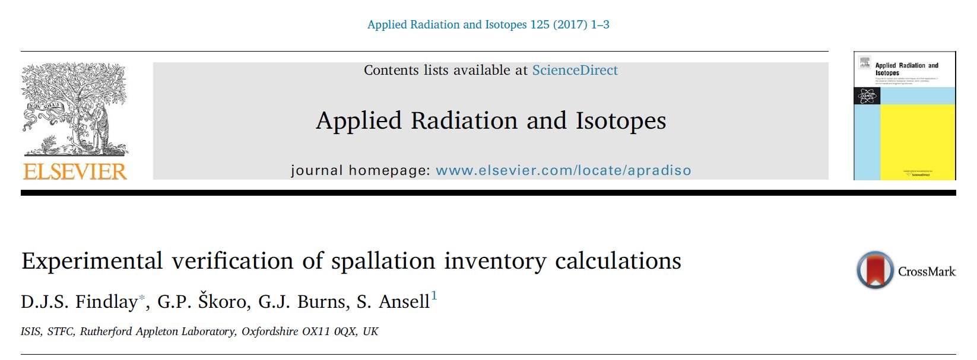
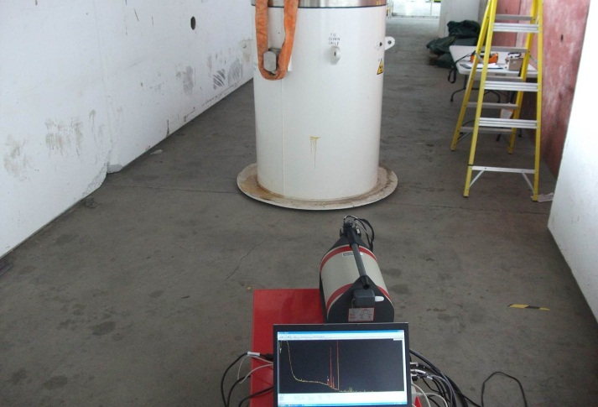
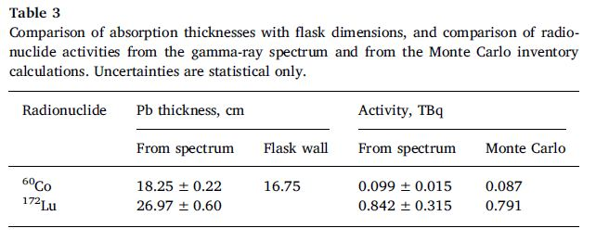
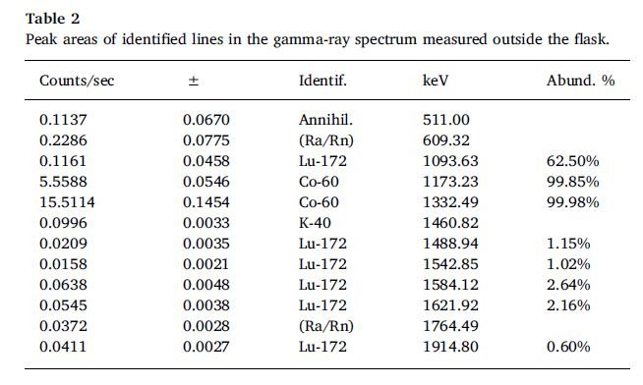
Gamma spectrometry – new measurements
same idea…
TS-1 W2 target; 1946 mA-hours in fifteen irradiation ‘campaigns’ each ~30–50 days long; cooling time = 7.63 years – to coincide with the date on which the gamma-ray spectroscopy measurements were made.

Slide 12
TS-1 target activation
Simulations vs. experimental results
- short cooling times -
800 MeV protons (50 Hz)

Slide 13
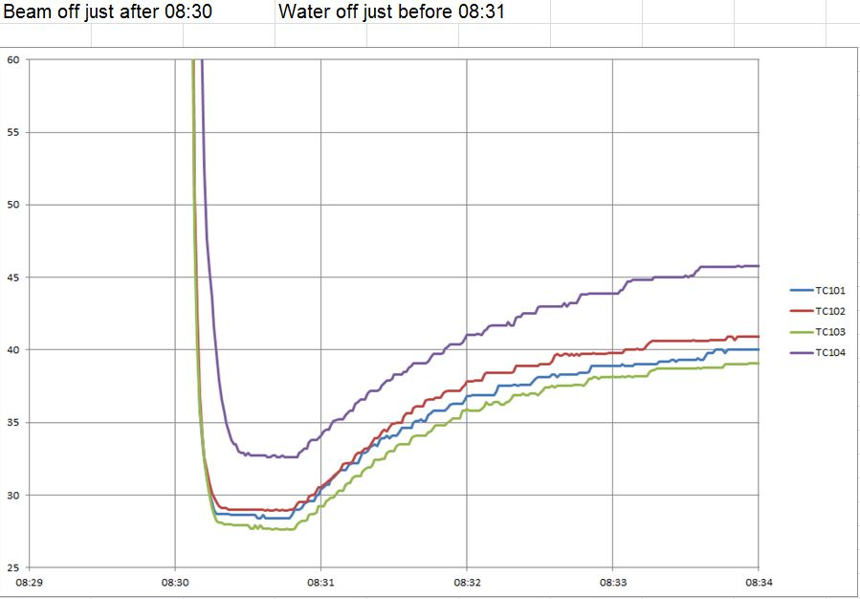
TS-1 W4 target
Decay power and temperature measurement
30. 11. 2016.
Temperature [°C]
800 MeV protons (50 Hz)

Slide 14
Beam Status | Number of days | Integrated current [mA-hours] | Beam energy [MeV]
on | 47 | 171 | 700
off | 30
on | 42 | 162 | 700
off | 44
on | 38 | 139 | 700
off | 16
on | 43 | 142 | 800
off | 61
on | 16 | 53 | 800
on | 22 | 72 | 700
off | 17
on | 38 | 138 | 800
off | 112
on | 15 | 41 | 800
on | 30 | 83 | 700
off | 17
on | 16 | 39 | 700
TS-1 W4 target:
irradiation history
Cycle: 2014/03
800 MeV protons (50 Hz)
Cycle: 2016/04
up to 30-Nov-2016
For short cooling times, (average) current in the last cycle is very important (equally important as total integrated current over the target life).

Slide 15
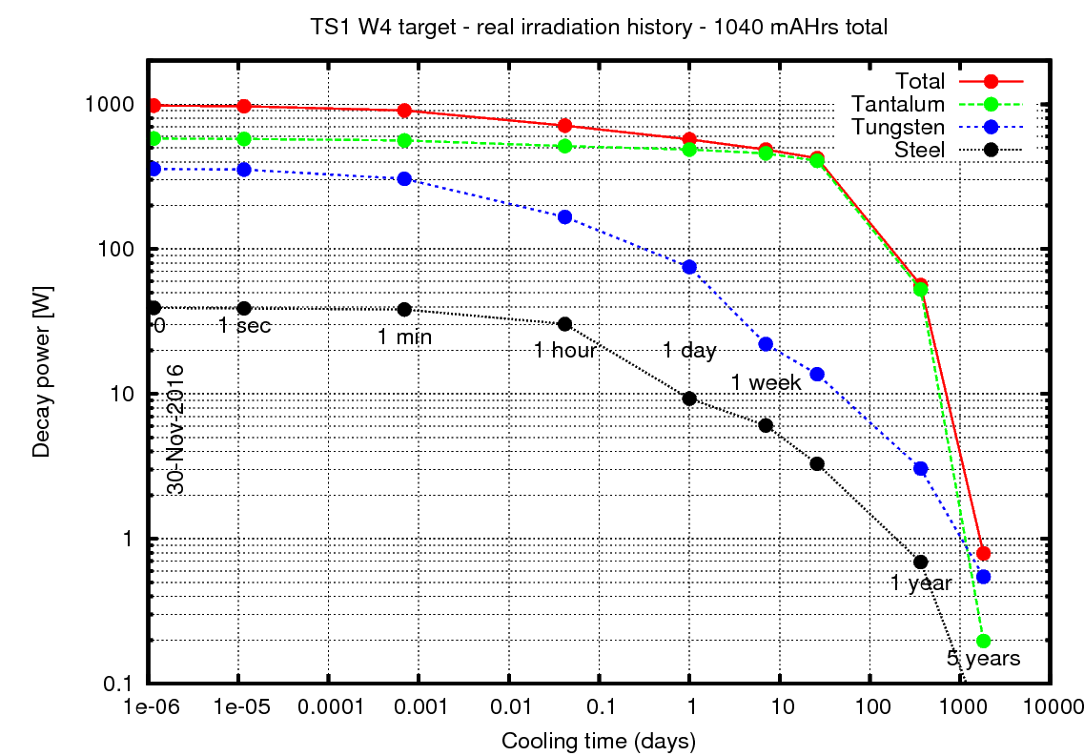
TS-1 W-4 target decay power
MCNPX/CINDER90 calculations
Decay power on 30 November 2016 (when the beam was switched off ) is ~ 1 kW.
For short cooling times, (average) current in the last cycle is very important (equally important as total integrated current over the target life). In this case, during first 2 weeks of 2016/04 cycle, average current was pretty low (102 µA).

Slide 16
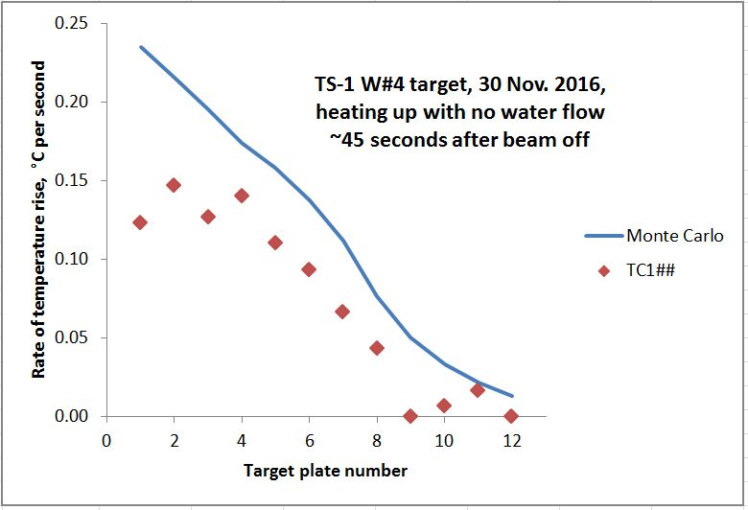
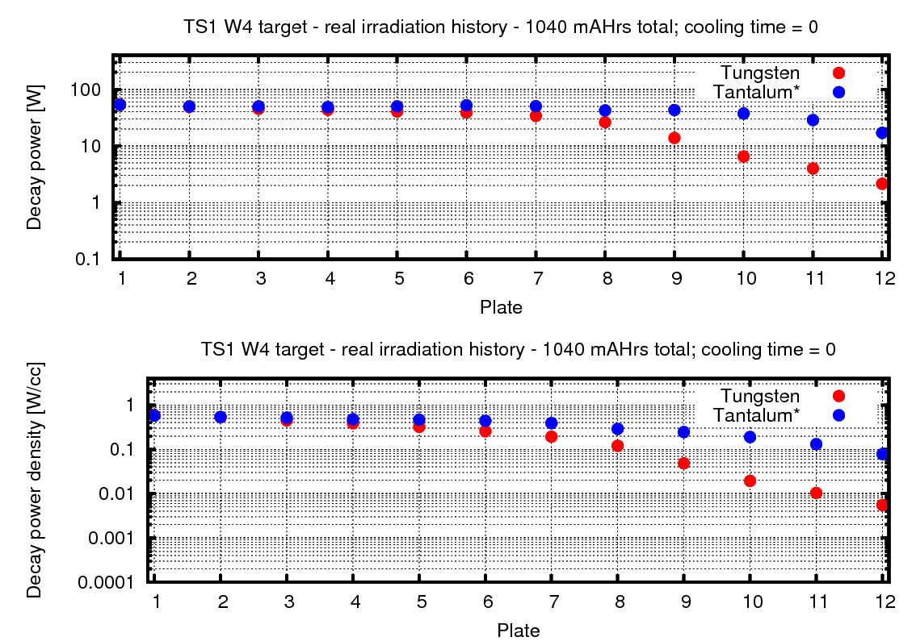
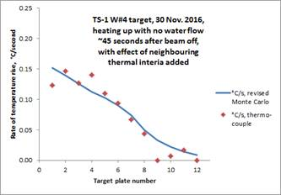
Rate of the temperature rise – simulation vs. measurement
*
Distribution of decay power along
the target (30 November 2016)
*
MCNPX/CINDER90 calculations
* D. J. S. Findlay, private communication, 2017.

Slide 17
Appendix
TS-2 target
800 MeV protons (50 Hz)

Slide 18
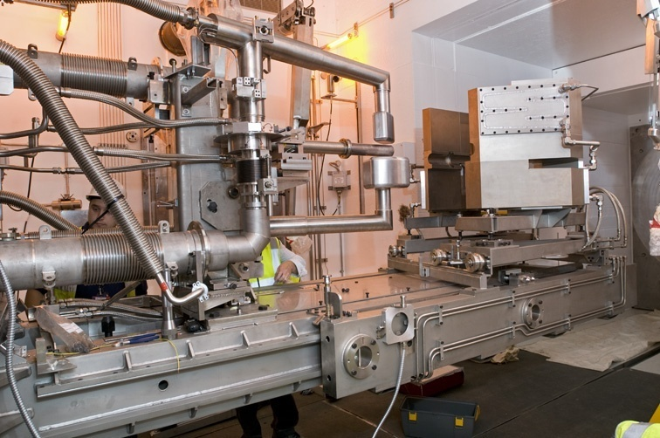
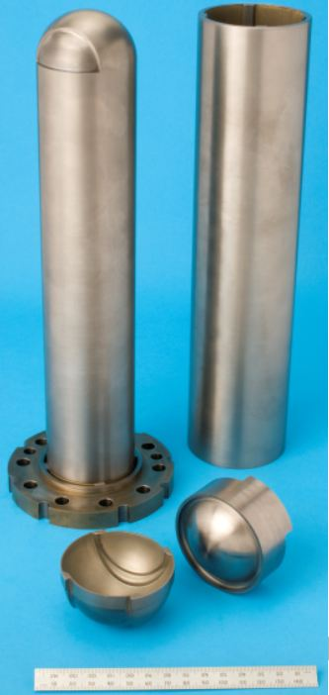
TS-2 target
  Solid methane
  Solid Be
  Liquid hydrogen
Current target – tungsten cylinder (tantalum cladding)
Typically 40 µA (800 MeV protons)

Slide 19
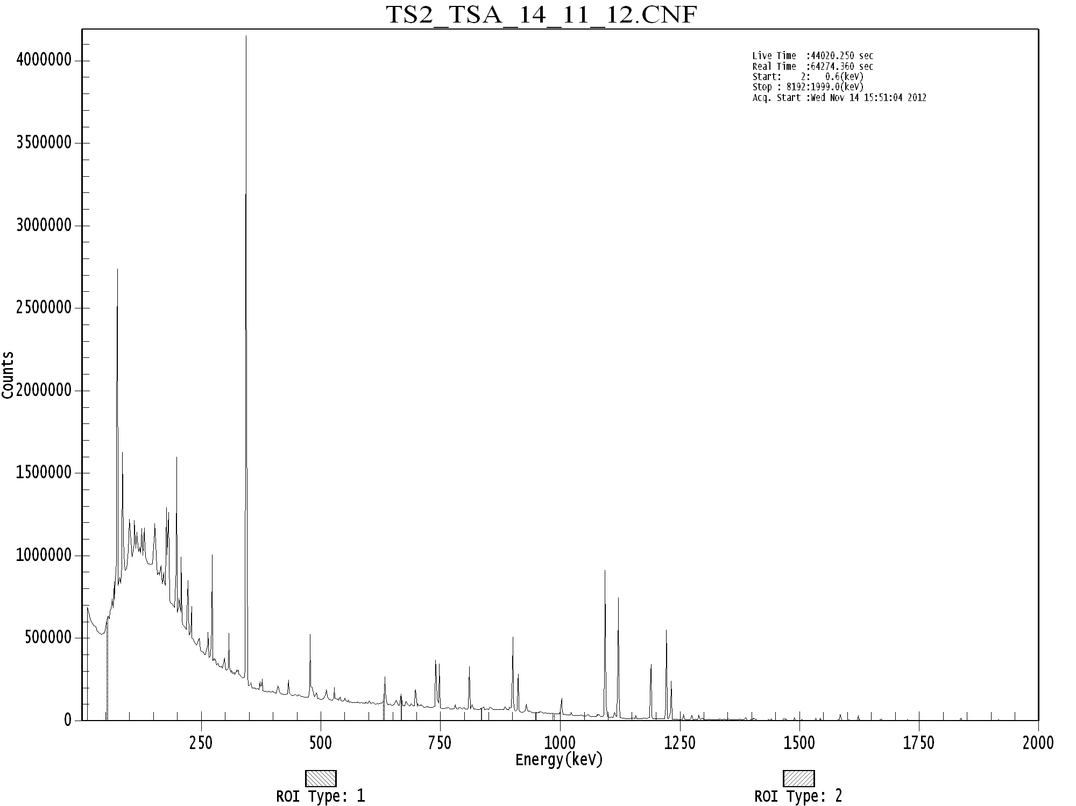
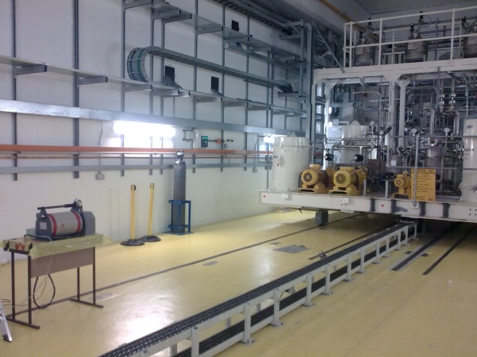
Gamma spectrum of TS2 cooling system filter – 10 days after beam off
November 2012
¹⁷²Lu
¹⁸²Ta
1093 keV; 62%
1121 keV; 35%
901 keV; 30%
1222 keV; 26%
810 keV; 17%
1189 keV; 16%
912 keV; 15%
1231 keV; 11%

Slide 20
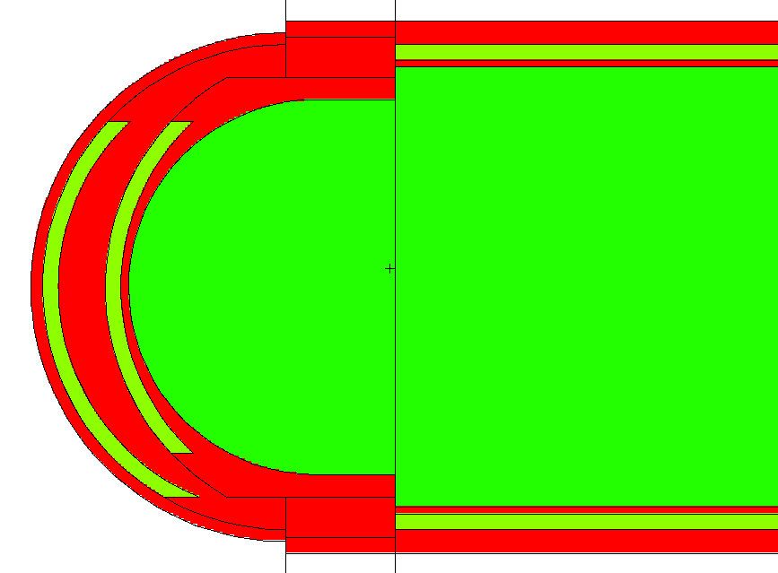

Ratio of ¹⁷²Lu and ¹⁸²Ta activity in different regions of TS-2 W3 target (MCNPX/CINDER90 calculations*)
A(¹⁷²Lu)/A(¹⁸²Ta)
1/2000
Water
1/400
1/4
1/200
Water
Conclusion:
Strong indication that radioactive material in the TS2 water cooling system is predominantly Tungsten.
Water
5/7
Tungsten
Tantalum
* Irradiation = 215.7 mA-hours; cooling time = 10 days

Slide 21
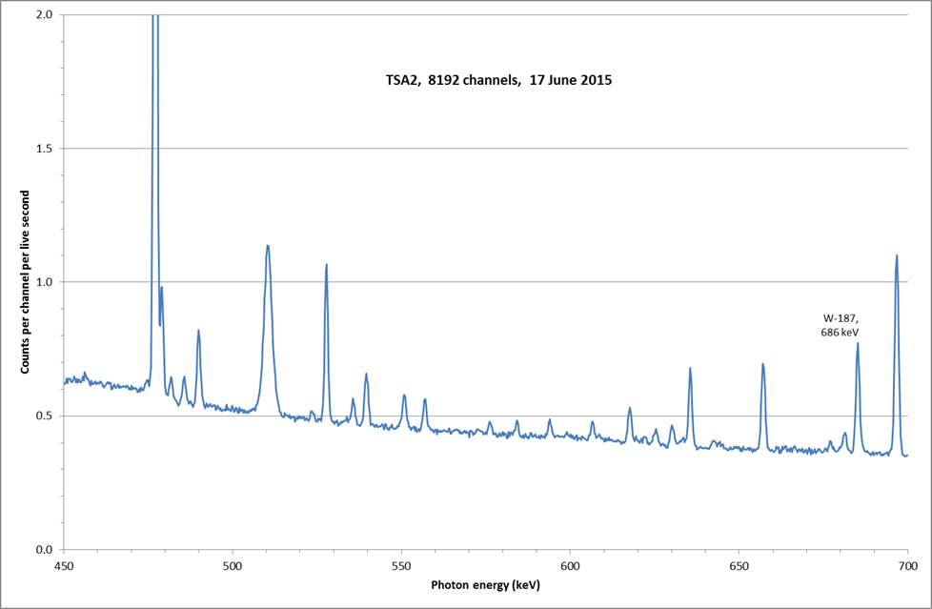
Direct confirmation: ¹⁸⁷W – next cycle, and one after that, and one after that, ..
¹⁸⁷W: T_{1/2} = 1 day

