Slide 1
Proton induced activity in graphite – comparison between measurement and simulation
Daniela Kiselev, R. Bergmann, D. Schumann, V. Talanov, Michael Wohlmuther:
Paul Scherrer Institut, Switzerland
ARIA 2017, Lund, Sweden, 22-24.5.2017

Slide 2
Motivation
Disposal of radioactive waste (specially targets)
Authorities need complete (calculated) nuclide inventory of long-lived
isotopes (T1/2 > 60 d)
- Predictions have to be (partly) validated
Radioisotopes in (pure) activated graphite: H-3, Be-7, Be-10, C-14
Be-7(T_{1/2} = 53 d): determines high dose rate
H-3: problem of outgassing as graphite is porous (during operation or later)
C-14 (T_{1/2} = 5730 y): long-lived
candidate for migration in the final repository
→ special measures for disposal of radioactive graphite
(also due to the presence of Cl-36)
590 MeV protons on (quite) pure graphite:
simple system → well suited for benchmarking
Here: MCNPX2.7.0 + BERTINI-Dresner-RAL & INCL4.6/ABLA07
Measured isotopes: H-3, Be-7, Be-10, C-14, Na-22, Al-26, Ti-44, Mn-54

Slide 3
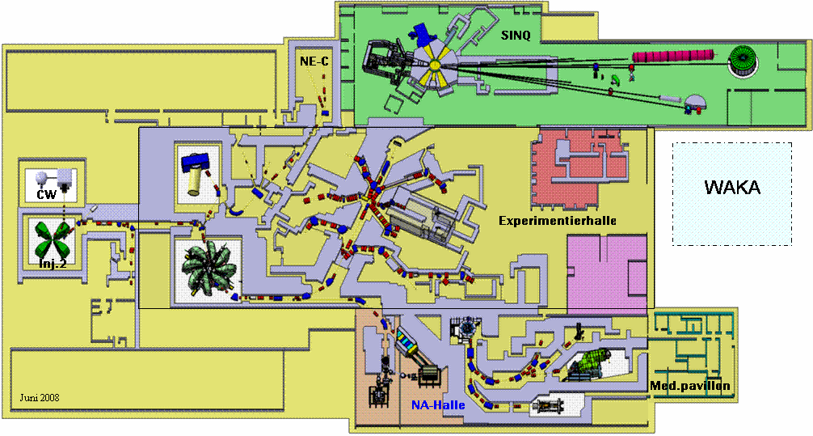
PSI Proton Accelerator Facilities
OPTIS
SINQ
Injector 1
Target E
Gantry 3
Injector 2
Ring cyclotron
590 MeV
OPTIS 2
Target M
Gantry 2
at present:
Nominal 2.2 mA (approval for 2.4 mA)
Max. integral charge/year: 10 Ah on Target E
UCN
Gantry 1
PROSCAN
Comet: 250 MeV
Target E: World’s highest intensity c.w. surface muon beams > 10⁸ µ/s
Notes:
surface muons at Jparc?

Slide 4
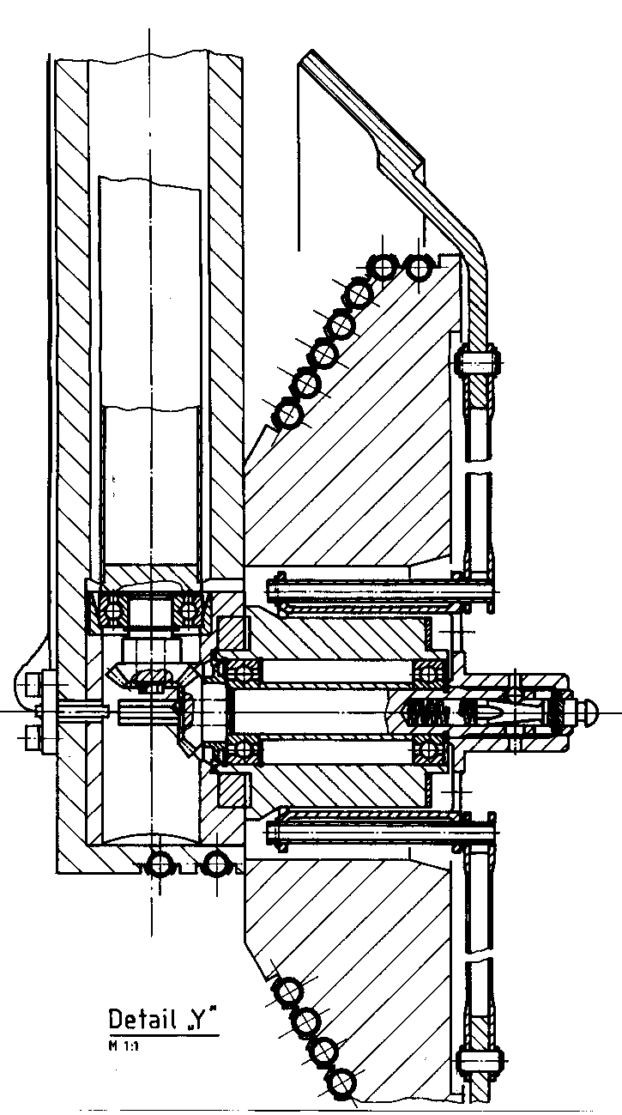
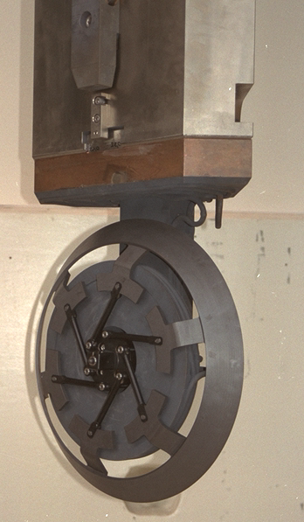
Target-E design
motor
Drive shaft
TARGET CONE
Mean diameter: 450 mm
Graphite density: 1.8 g/cm³
Operating Temperature: 1700 K
Irradiation damage rate: 0.1 dpa/Ah
Rotational Speed: 1 Turn/s
Target thickness: 60 / 40 mm
10 / 7 g/cm²
Beam loss: 12 / 8 %
Power deposition: 30 / 20 kW/mA
SPOKES
To enable the thermal expansion of the target cone
p-beam
BALL BEARINGS *)
Silicon nitride balls, coated with MoS2
Rings and cage silver coated
*) GMN, Nürnberg, Germany
wheel cooled by radiation
Notes:
cooled by radiation: → loss of thermal conductivity due to irradiation does not matter

Slide 5
Targets and graphite
All 3 targets made from SGL-CARBON graphite but different grade.
E92: grade R6510
E83: grade R6400
years | Ah
0.5 | 6.6
0.5 | 6.3
0.7 | 7.4
0.7 | 8.5
3.8 | activity measurement
years | Ah
0.2 | 1.8
7.3 | activity measurement
Material analysis from
ICP-OES & GDMS
ppm | avg./range
N | 15
Na | 13-77
Al | 6-25
Cl | 1.1
Ti | 0.4 -1.0
Mn | ~ 0.1
total charge: 28.8. Ah
E79: grade EK94
years | Ah
0.6 | 6.6
9.9 | activity measurement
Notes:
GDMS Gas discharge mass spectrometry

Slide 6
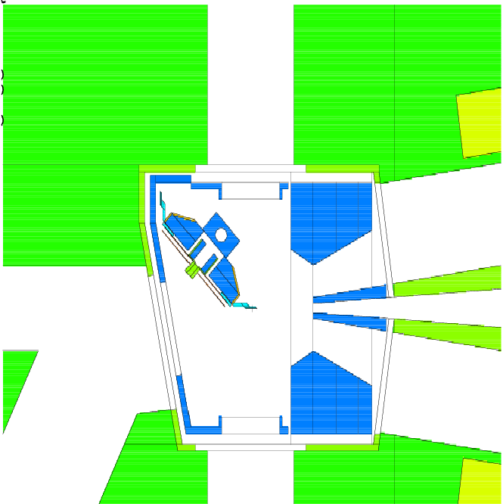
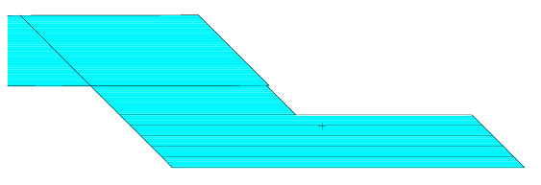
Geometry in MCNPX model
copper collimators
full geometry models to
take backscattering of
e.g. neutrons in account
590 MeV
protons
iron shielding
conical graphite wheel
sliced in 5 pieces
pencil beam

Slide 7
Applied technique for waste estimate
Monte Carlo particle transport program : n,p,γ,α,π,d,³H....
Input: dedicated geometry, material compositions,
cross sections: for n<20MeV ENDF-BVI, otherwise models
Output: n-fluxes (E<20 MeV), residual nuclei production rates
with rnucs-card (former active htape) in *.o file
- avoids huge histp file (can be several GB)
- developed by F. Gallmeier & M. Wohlmuther
- patch in the Cinder2008 release on RSICC
MCNPX2.7.0
activation script
M. Wohlmuther et al.,
Proc. AccApp 2007,
Pocatello, p. 226.
F.X. Gallmeier, dito, p. 207
Cinder
or
SP-Fispact + EAF2010
or
Orihet3
+ c.s. library
+ irradiation history
option «impurity» used:
scattering of all particles at each isotopes of the material composition
→ nuclide inventory

Slide 8
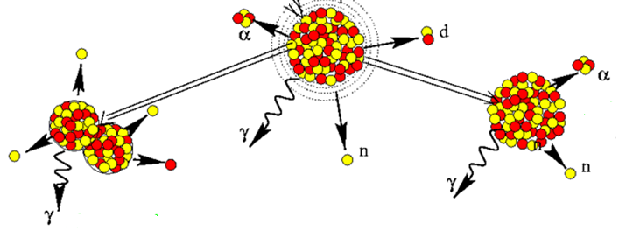
Selected physics models in MCNPX
1) Intra-Nuclear Cascade:
2. Evaporation/Fission
1) MCNPX default option:
for n & p: < 3.5 GeV
BERTINI (INC) + Dresner (evaporation) + RAL (fission):
- BERTINI: based on Serber‘s model, spacelike realization
- DRESNER: EVAP-A, based on Weisskopf‘s statistical model
- RAL (Atchison): fission in between of the evaporation stages
for light ions (d, t, α): < 1 GeV
ISABEL (INC) + Dresner + RAL:
- ISABEL: based on Serber‘s model, timelike realization
Notes:
INC: primary particle is followed through the nucleus, classical collisions
ISABEL: Y.Yariv and Z. Fraenkel, Phys. Rev. C 24 (1981) 488

Slide 9
Selected physics models in MCNPX
INCL4.6 + ABLA07: implemented in MCNPX2.7.0
Large improvements compared to INCL4.2+ABLA
implemented in standard version of MCNPX2.7.0
INCL4.2 | n, p, π
ABLA | n, p, α
INCL4.6 | n, p, π, d, t, ³He, α and A ≤ 8
ABLA07 | n, p, d, t, ³He, α and clusters (IMF)
no ³H (t)
INCL4.6: allows for incident clusters
coalescence in phase space → emitting clusters
Newest MCNPX2.7.0 INCL4.6/ABLA07 version:
handles also metastable isotopes according to data from file (PHTLIB)
INCL4.6: A. Boudard et al., Phys. Rev. C. 87, 014606 (2013)
ABLA07: M. V. Ricciardi, A. Kelić, K-H. Schmidt, Joint ICTP-IAEA Advanced Workshop on Model Codes for Spallation Reactions„ held in Trieste, Italy, 4-8 January 2008, p. 181
J. –Ch. Davide: habilitation (2. Phd thesis)

Slide 10
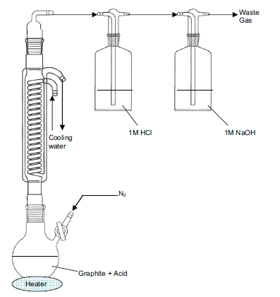
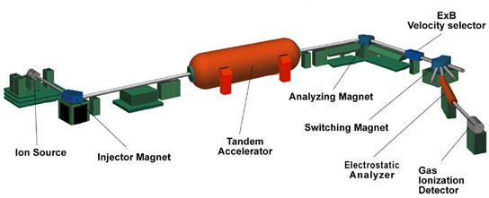
Exp. determination of specific activities
1) Wet digestion:
waste gas
H-3 via LSC measurement
adsorption vessels
1M HCl
1M NaOH
N₂-flux
C-14 via LSC measurement
~20 mg graphite+acid (H2SO4/HNO3/HClO4 (2:1:1))
heater
2) AMS: Accelerator mass spectrometry
Hönggerberg, ETHZ
for long-lived isotopes:
Be-10
3) HPGe detector for γ’s

Slide 11
Comparison exp.data and MC (pure carbon)
E92: particles transported: neutrons, protons, pi+/-/0, d, t, He-3, α
Remarks:
+15 ppm N₂ (measured in Ek94):
BERTINI: → 88 Bq/g (+ 35%)
INCL4.6/ABLA07 →5568 Bq/g (+ 30%)
2) BERTINI-Dresner-RAL: neutrons, protons, pi+/-/0: 58 Bq/g
3) INCL4.6/ABLA07:
neutrons, protons, pi+/-/0: 80 Bq/g
……… + tritons : 2529 Bq/g ( 59 % of 4270 Bq/g))
……… + deuterons : 1100 Bq/g (26 %)
……… + alphas : 592 Bq/g (14 %)
……… + He-3 : 122 Bq/g ( 3 %)

Slide 12
Cross sections with tritons and deuterons
INCL4.6
Cross sections in BERTINI much smaller than in INCL
C-12(t,p)C-14: almost non-existend in BERTINI
C-12: 98.9 % C-13: 1.1 %
C-12(d,X) C-14 ~ 0 for both models

Slide 13
Deuteron and triton spectra
Both models show quite similar spectra for d and t:
INCL4.6/ABLA07: with tail from 100 MeV on
More tritons in BERTINI-Dresner-RAL compared to INCL4.6/ABLA07
for < 100 MeV
Notes:
tail in INCL: high energetic particle due to forward emission

Slide 14
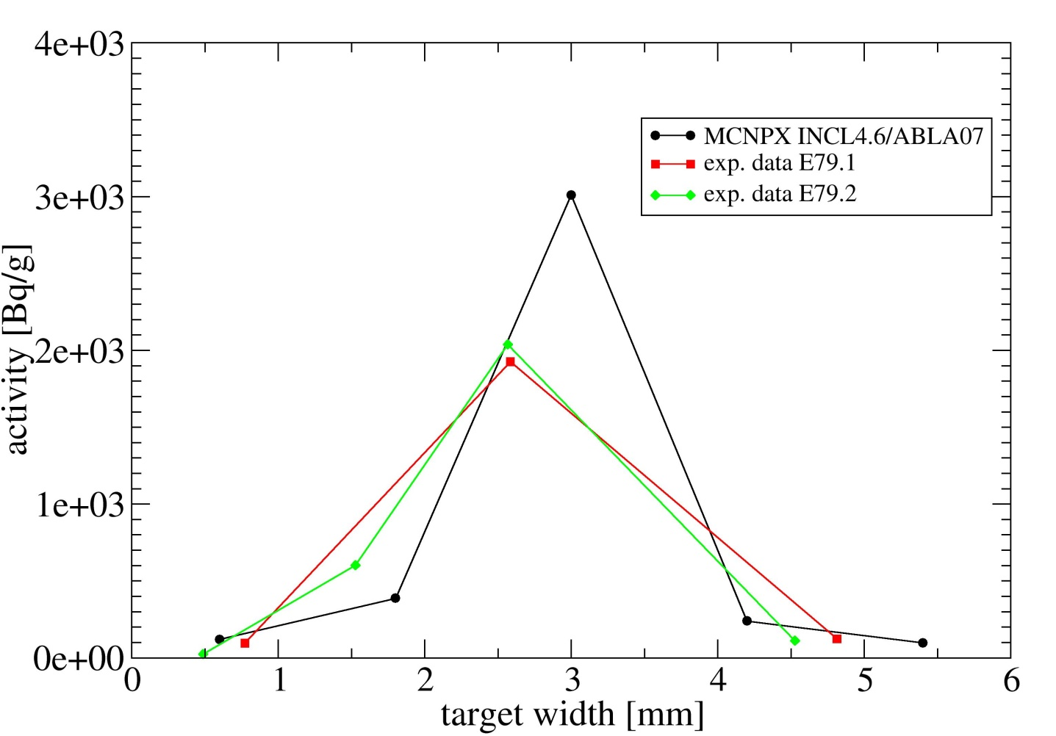
E79: Tritium in slices
pencil beam
Typical Gaussian Sigma:
0.5 - 1mm
→ depends on the beam optics
exp. data
(3-4 slices)
INCL4.6/ABLA07
(5 slices)
Results are not corrected for
different binning
good agreement for H-3
exp. data for C-14:
average of results in slices
due to material loss
result might have larger
uncertainty
Notes:
C-14: max. exp. Fehler: 15 %

Slide 15
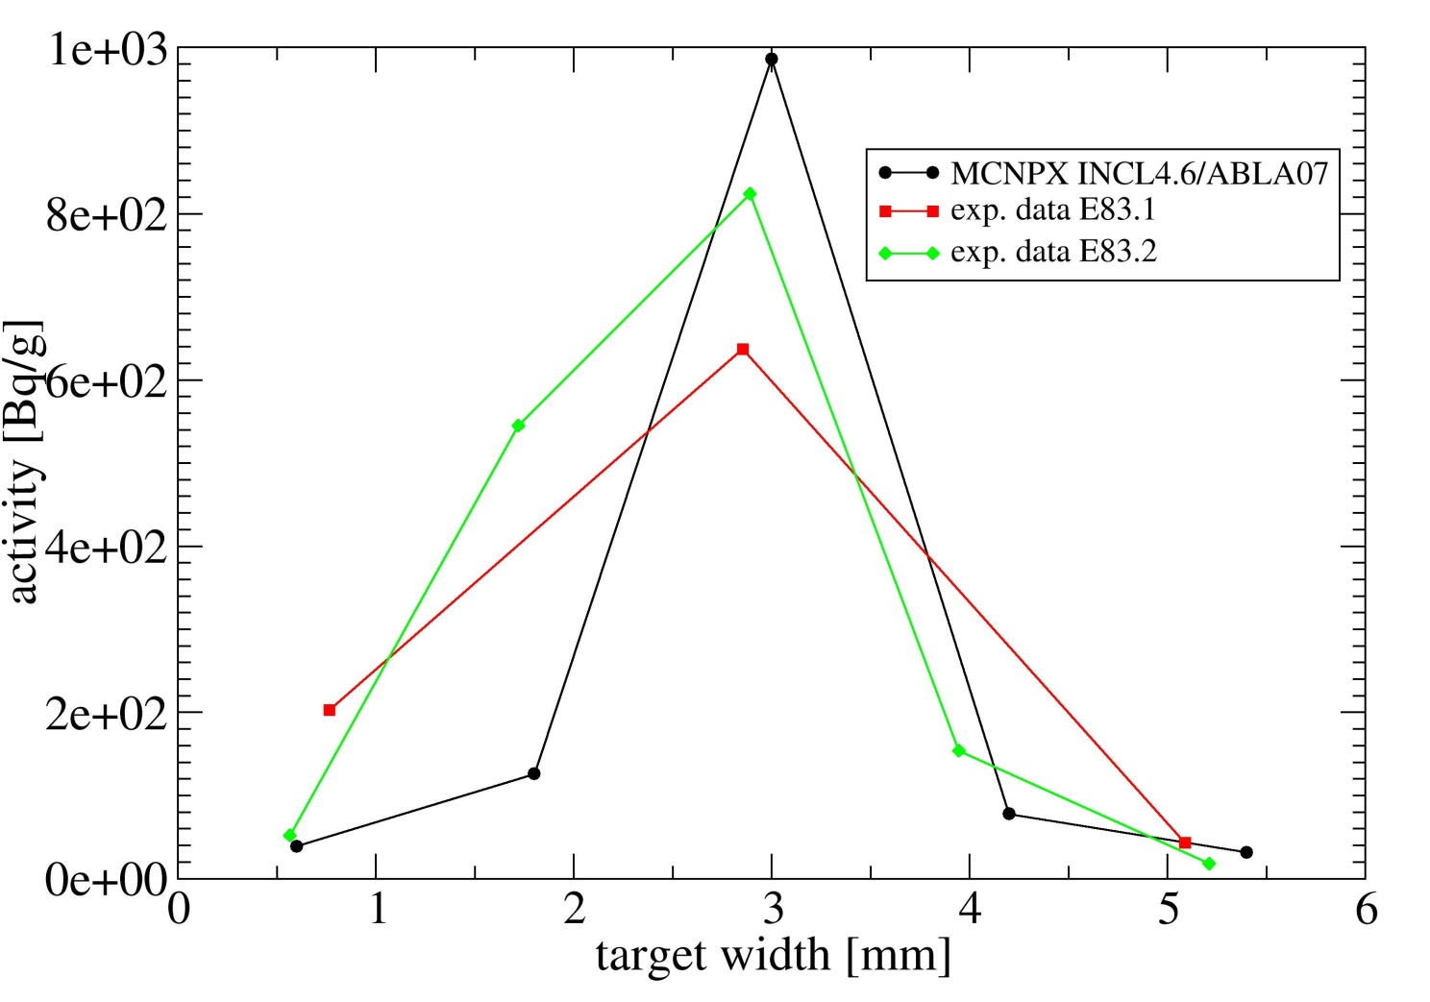
E83: Tritium in slices
exp. data
(3-5 slices)
INCL4.6/ABLA07
(5 slices)
Results are not corrected
for different binning
good agreement for H-3

Slide 16
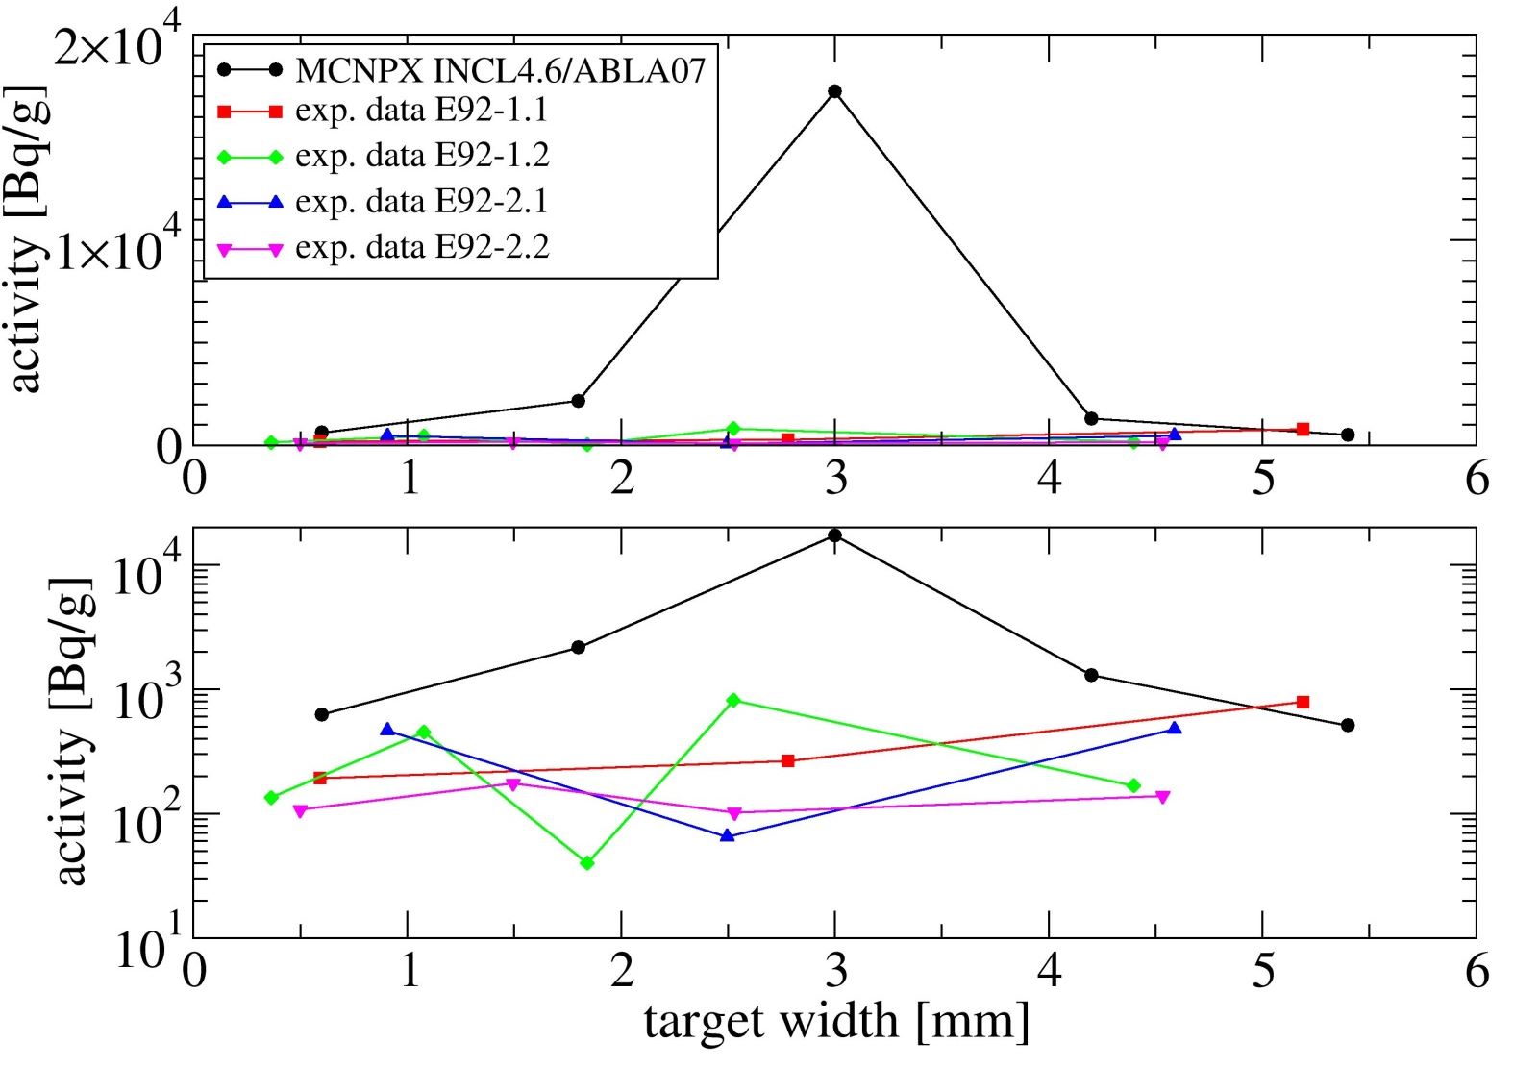
E92: Tritium in slices
INCL4.6/ABLA07
(5 slices)
Results are not
corrected for
different binning
exp. data
(3-5 slices)
no clear peak shape in the H-3 data
ratio INCL4.6-ABLA07/measured H-3 = 12
→ 90 % missing!
Target E is hot: ~1500 ºC
→ outgassing of H-3 possible

Slide 17
What about Na-22, Al-26, Ti-44, Mn-54
Measured impurities seem to be much to high for measured activities
E92:
Bq/g | exp. data
Na-22 | 52 | C + 10 ppm Na
Al-26 | 0.3 | C + 10 ppm Al
Ti-44 | 16 | C + 10 ppm Ti
Mn-54 | 2.5 | C + 10 ppm Mn
Impurity derived from comparing simulation and measurement:
Assumption: Production of e.g. Ti-44 by Mn neglected
ppm | from MC/exp. | ICP-OES [R6510] | ICP-OES/MC
Na-22 | 0.0034 | 13 | 3805
Al-26 | 1.61 | 5.8 | 4
Ti-44 | 0.11 | 0.66 | 6
Mn-54 | 0.0012 | 0.12 | 103
Na: Chemists know that Na appears everywhere as impurity
small amount of Mn might be hidden by small contamination during measurement

Slide 18
Wir schaffen Wissen – heute für morgen
Nuclide inventory of quite pure graphite targets:
C14: (very) good agreement with INCL4.6/ABLA07
triton & deuteron reactions important
required good statistics: 10⁸ primary protons
H-3: good agreement in Tg79 and Tg83 but 90 % missing in E92
→ peaked distribution in the center indicates that it is likely
not a temperature effect
other speculations:
- different graphite grades but E92
- radiation damage: E92 ~30 Ah (others 2-7 Ah)
Comparison of radionuclides Z > 6 with simulation indicates that graphite is much purer than measured by ICP-OES
(probably biased by natural impurities and small contamination)

Slide 19
Wir schaffen Wissen – heute für morgen
Acknowledgement
Jean-Christophe DAVID for INCL4.6/ABLA07 and support during implementation in MCNPX

Slide 20
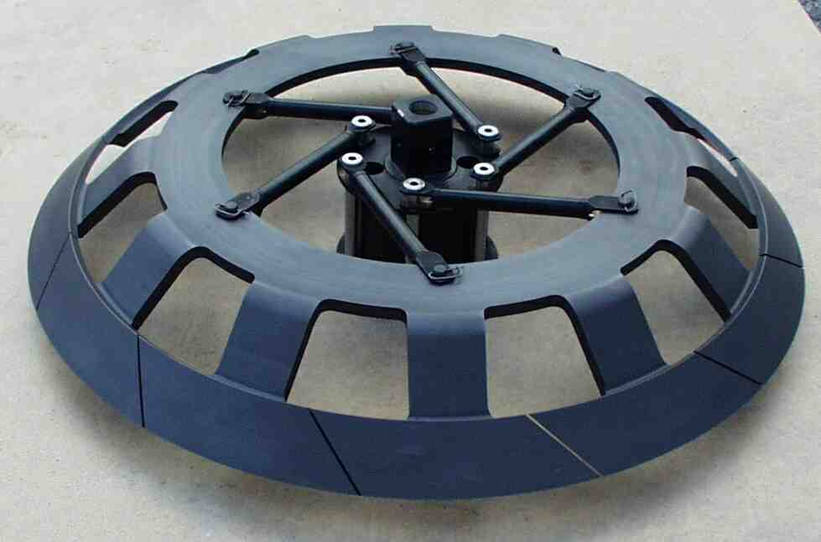
A new design of graphite wheel: 2003 - now
12 segments: 1mm wide gaps
at 1700 K: 0.5 mm gaps
intensity variation: < 0.2%
The gaps allow unconstrained dimensional changes of the irradiated part of the graphite.
Record:
Integrated beam current: ~33.5 Ah
Irradiation damage rate: ~3.4 dpa

Slide 21
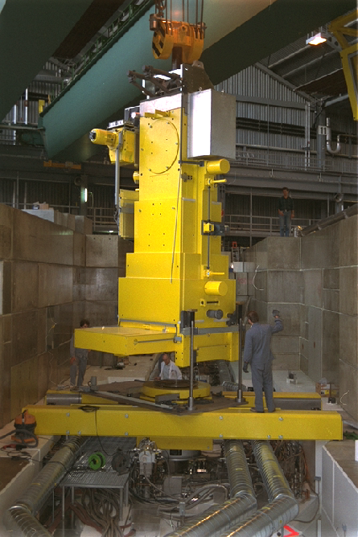
Meson Production Area
Access to working platform after removing 3-4 m of concrete roof shielding
Use of remotely controlled shielded exchange flasks to remove defective components.
Repair work done in a hot cell.

