Slide 1

24 May 2017
Leakage of radioactive materials
from particle accelerator facilities
by non-radiation disasters
Arim Lee*, Nam-Suk Jung,
Leila Mokhtari Oranj, Hee-Seock Lee
Radiation Protection Team
Pohang Accelerator Laboratory / POSTECH, Korea

Slide 2
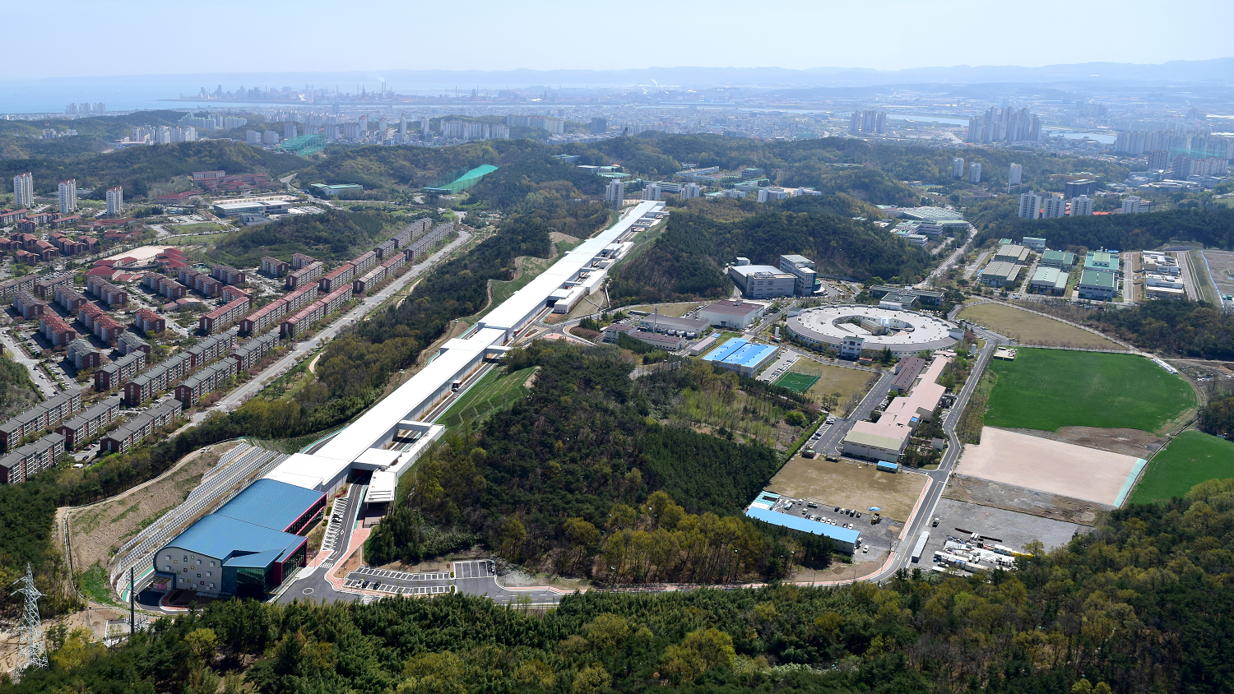
Introduction
Present requirements about fire/inundation to get operation permit
• In Korean Law
<Location of Use Facilities>
The use facilities and conservation facilities of radiation generating devices should be installed at a place with the less risk of a fire, inundation
or ground subsidence.
- To apply the same level of regulation; non-nuclear or nuclear facilities?
- In the case of accelerate facilities, different beam particle?
- How to estimate the impact of non radiation disasters (fire/inundation)?
Application of law is ambiguous !!
PAL-XFEL 10.0 GeV, 0.06 nm

Slide 3
Introduction
Purpose
To suggest reasonable application of regulations on fire/inundation(flood)
1) Review the possibility of the leakage of radioactive materials
due to fire/flood at accelerator tunnel
2) Estimation of the activation level/radionuclide production
Method
Case study
- Fire/flood occurred at acc. Facilities
- Select the five common material
inside of accelerator tunnel
Review on leakage of radioactive material
to the environment
- Based on the properties of
interested materials
Activation calculation of five interested materials
* Initial condition
- Beam : electron, proton
Carbon, Uranium
- Energy : 100. 430, 600,
1000 MeV
- Used Monte Carlo codes
(FLUKA, PHITS, MCNPX)
Investigation on properties
of interested materials
* Interested materials
1. Dust 2. Insulator
3. Concrete 4. Metal 5. Paint

Slide 4
Case study: Fire at Acc. facilities
Facility | Nations | Information |  |  |  | Leakage of Radioactive material
Fermilab- 150 GeV - 400 kW | U.S | Date | October 3, 1987 | Incident region | 34 wire ribbon cable | Not described
 |  | Cause | Over-current in a cable
SLAC - 15 GeV - 0.15 nm | U.S. | Date | May, 2013 | Incident region | Beam switching yard | Not described
 |  | Cause | Magnet in the beam switching yard
 |  | Date | June 25, 2014 | Incident region | Klystron gallery | Not described
 |  | Cause | Electrical fire from switchgear cabinet.
Cornell's electron synchrotron | U.S. | Date | September 16, 2009 | Incident region | Underground storage ring of Wilson Synchrotron Laboratory | Not described
 |  |  | October 14, 2009
 |  | Cause | Old power supply
Moscow nuclear institute | Russia | Date | February 5,2012 | Incident region | the Alikhanov Institute of Theoretical and Experimental Physics | No (Acc. was shut down.)
J-PARC - 3 GeV, - 1000 kW | Japan | Date | July, 2014 | Incident region | No information | No
 |  | Cause | Diesel generator
 |  | Date | 16 January, 2015 | Incident region | Muon D-line area | No
 |  | Cause | Problem on the circuit of newly installed transformer
Fired parts/components
: Magnet, power supply, switchgear cabinet, diesel generator, cable/cable tray
→ Materials : Metals (stainless, iron, etc.), Insulators (Carbon compounds)

Slide 5
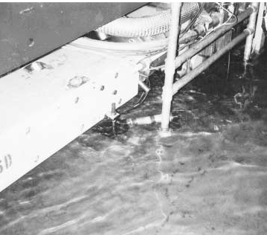
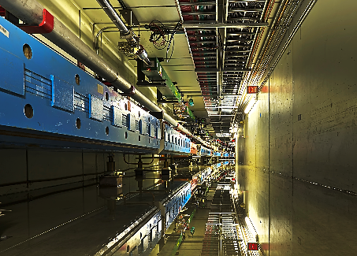
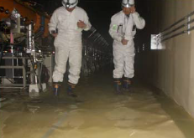
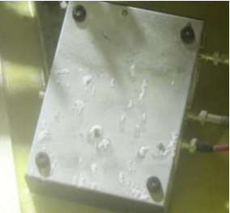
Case study: Flood at Acc. facilities
Facility | Nations | Information |  |  |  | Leakage of Radioactive material
Fermilab - 150 GeV - 400 kW | U.S. | Date | July 17-18, 1996 | Incident region | Main ring tunnel | No
 |  | Cause | Rainfall (45.72 cm)
 |  | Date | April 18, 2013 | Incident region | No information | Not described
 |  | Cause | Rainfall
J-PARC - 3 GeV, - 1000 kW | Japan | Date | March 11, 2011 | Incident region | Linac tunnel | No
 |  | Cause | Lose of power for water pumping system → Max. depth of water reached 10cm (March 24)
 |  | Date | September, 2014 | Incident region | Muon facility | No
 |  | Cause | Valve connection problems
Flooded components/parts
: Preamplifier box (placed on floor @J-PARC), girder, floor
→ Materials : Metals (stainless, iron, aluminum, etc.), Concrete, Paint
Fermilab
Fermilab
J-PARC
J-PARC

Slide 6
Issued point of fire/flood event
• In the case of Fire,
- Flammability, Melting point, etc.
Ignition temperature of insulator : 450 ℃
According to flammability experiment of horizontal/vertical cable tray, ceiling temperature of opened tunnel : 250 ℃
⇒ 450 ℃ is set as a standard for combustibility in the accelerator tunnel.
The insulator is assumed to be a material that is likely to start burning.
• In the case of Flood,
- Solubility, resistance to water and alkaline, etc.
Through the flood occurred in J-PARC, we considered the resistance to the alkaline due to the reaction between concrete and water.

Slide 7
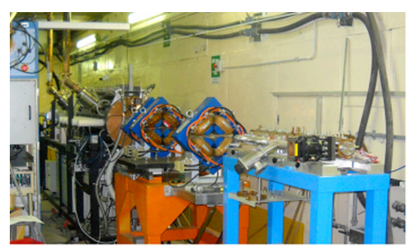
Properties of concerned materials in Acc. tunnel
1) Dust
Dust
Dust
Location | Information
Surface of tunnel wall & accelerator devices | Radioactive dust in accelerator tunnel normally found is mainly produced by natural erosion and by work of radioactive machine part.
Considered events | Considerable properties | Possibility to leakage
Fire | Can move following the air. | Moveable/ Possible
Flood | Can be solved into immigrated water or move following water. | Soluble / Possible

Slide 8
Properties of concerned materials in Acc. tunnel
2) Insulator
Dust
Insulator
Dust
Insulator
(Carbon compounds)
Composition | Information
Carbon compounds | Type: Polyvinylchloride(PVC), Kapton(polyimide), Teflon(PTFE) Used in the accelerator tunnel as insulating materials for control/signal processing cable or wire.

Slide 9
Properties of concerned materials in Acc. tunnel
2) Insulator
Considered events | Considerable properties |  | Possibility to leakage
Fire | Polyvinylchloride (PVC) | Self-extinguishing material. Melting point : 154 ~ 213 °C Flash-ignition : 330 ~400 °C / Self-ignition : 385 ~400 °C | Combustible / Possible
 | Teflon (PTFE) | Flammability(UL94) : V-0 Flash-ignition : 560 °C / Self-ignition : 580 °C
 | Kapton (polyimide) | Flammability : V-0 Maximum service temperature, Air : 400 ℃
Flood | Polyvinylchloride (PVC) | Water absorption: 0.02 - 0.400 % Good alkaline and water resistance. | Insoluble / Impossible
 | Teflon (PTFE) | Water absorption : 0.21 - 0.49 % Excellent chemical resistance.
 | Kapton (polyimide) | Water absorption : 2.8 % Greater resistance to water, resistant to organic solvents.

Slide 10
Properties of concerned materials in Acc. tunnel
3) Concrete
Dust
Dust
Concrete
Location | Information
Tunnel, shielding material | Concrete is the main material for tunnel and shielding. Concrete shield is important to solid activation.

Slide 11
Properties of concerned materials in Acc. tunnel
3) Concrete
Considered events | Considerable properties | Possibility to leakage
Fire | Changes on the properties depends on temperature 1. 100 ℃ or higher: free pore water release 2. 100 ~200 ℃: physically adsorbed water is released. Safety ensured. 3. 300 or higher: cement hydrate in the concrete chemically altered 4. 400 ℃ ↑ : release chemical combined water 5. 500 ℃ ↑ : calcium hydroxide(Ca(OH)₂) is thermally decomposed, 50% reduction in strength by heating 6. 600 ~ 800 ℃ : Cement paste shrink. 80% reduction in strength 7. 1,000 ~ 1,200 ℃, ↑ : Concrete Spalling, melting | Incombustible / Impossible
Flood | C₂S is the most frequent among the cement compound. This reacts with water to produce calcium hydroxide (Ca(OH) ₂) and the calcium silicate hydrate (C-S-H) → water is changed into high alkaline | Soluble / Possible
Concrete is a nonflammable material.
Over 500 ℃, phenomena will not be appear.
⇒ Concrete need to be considered for a flood event.

Slide 12
Properties of concerned materials in Acc. tunnel
4) Metal
Metal
Dust
Dust
Concrete
Metal
Location | Information
Accelerator devices | Types: Aluminum, Steel(iron), Stainless steel, Copper Accelerator components are largely made of metals. Irradiated accelerator components are related with residual activity.

Slide 13
Properties of concerned materials in Acc. tunnel
4) Metal
Considered events | Considerable properties |  | Possibility to leakage
Fire | Aluminum | Vapor pressure: 2,517 ℃ (100 kPa) Melting point: 660 ℃ / Boiling point : 2519 °C | Incombustible / Impossible
 | Steel(Iron) | Vapor pressure: 3,132 K (2,859 ℃, 100 kPa) Melting point : 1535 °C / Boiling point : 2861 °C
 | Stainless steel | Boiling point : 1400 ~ 1455 °C
 | Copper | Vapor pressure : 2,563 ℃ (100 kPa) Melting point : 1083 ~ 1084 °C/ Boiling point : 2,324 ~ 2,595 ℃
Flood | Aluminum | Solubility: Insoluble in water, dissolved in alkaline, hydrochloric acid | Insoluble(water) Soluble(alkali) / Possible
 | Steel(Iron) | Solubility: Insoluble in water, dissolved in alkaline, alcohol, ether, dilute acid
 | Stainless steel | Solubility: Insoluble in water, soluble in alkaline
 | Copper | Solubility: Insoluble in water, soluble slowly in alkaline
According to experiment using tray,
max. temperature of cable on fire : 700~800 ℃, (400 ℃↓, 500~1000s)
According to NUREC, fire on tray : extinguished in 1000~3000s, no melting.
fire on cabinet : extinguished within 38 min.
⇒ Metals need to be considered for a flood event.

Slide 14
Properties of concerned materials in Acc. tunnel
5) Paint
Metal
Dust
Paint
Insulator
Dust
Concrete
Paint
Insulator
(Carbon compounds)
Metal
Type | Information
Acrylic resin-based paint, Epoxy resin-based paint | Acrylic resin-based paint for Acc. tunnel wall. Epoxy resin-based paint for Acc. components & tunnel floor.

Slide 15
Properties of concerned materials in Acc. tunnel
5) Paint
Considered events | Considerable properties | Possibility to leakage
Fire | Acrylic resin-based paint Easy to burn, combustion is continued even after deletion of flame Flash point: 36 ℃ / Self-ignition: 480 ℃ | Combustible / Possible
 | Epoxy resin-based paint NFPA* rating number of flammability hazard : 2 (Must be heated or high ambient temperature to burn) : 3 (Can be ignited under almost all ambient temperatures), Flash point: 23~26 ℃
Flood | Acrylic resin-based paint Solubility: Soluble in organic solvents/ Resistant to alkaline and acids. Chemical Resistance: Excellent for 5% NaOH, H₂SO₄ | Insoluble / Impossible
 | Epoxy resin-based paint Solubility: Insoluble in water Water, acid, alkaline excellent resistance . Excellent durability.
Acrylic resin-based paint (ACRYDIC A-846)
Epoxy resin-based paint (Epocoat210, NUKOPOX PRIMER EP103, NUKOPOX TOPCOAT ET597)
*NFPA 704 : Standard maintained by the U.S.-based National Fire Protection Association
Paint is combustible.

Slide 16

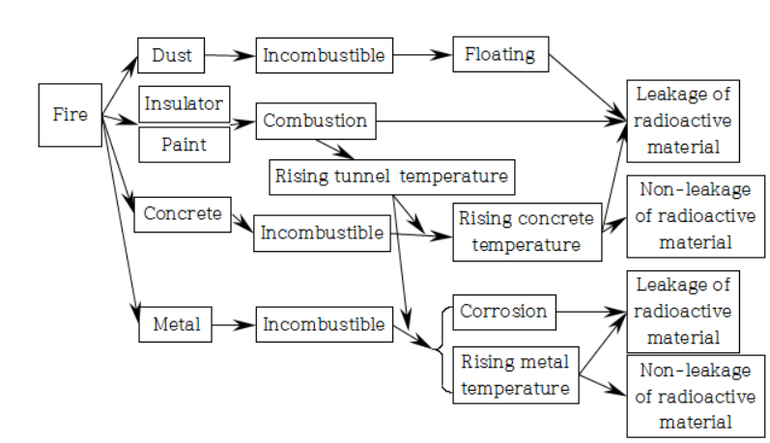
Assumed leakage path of radioactive material
Assumption of fire case occurred at accelerator facilities
For fire events,
Dust, insulator, paint should be considered
Consider
activation level !!

Slide 17

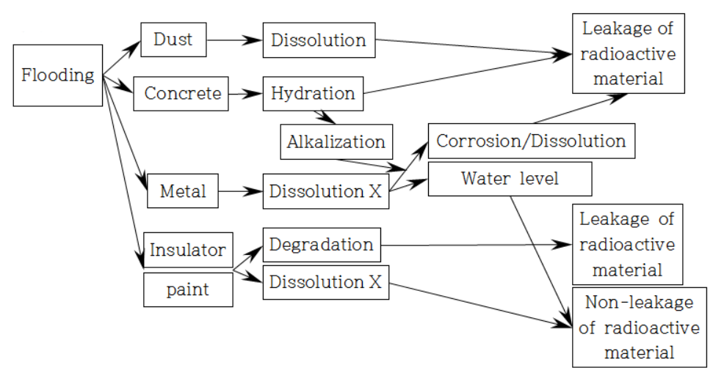
Assumed leakage path of radioactive material
Assumption of flood case occurred at accelerator facilities
For flood events,
Dust, concrete, metal should be considered
water
Consider
activation level !!

Slide 18
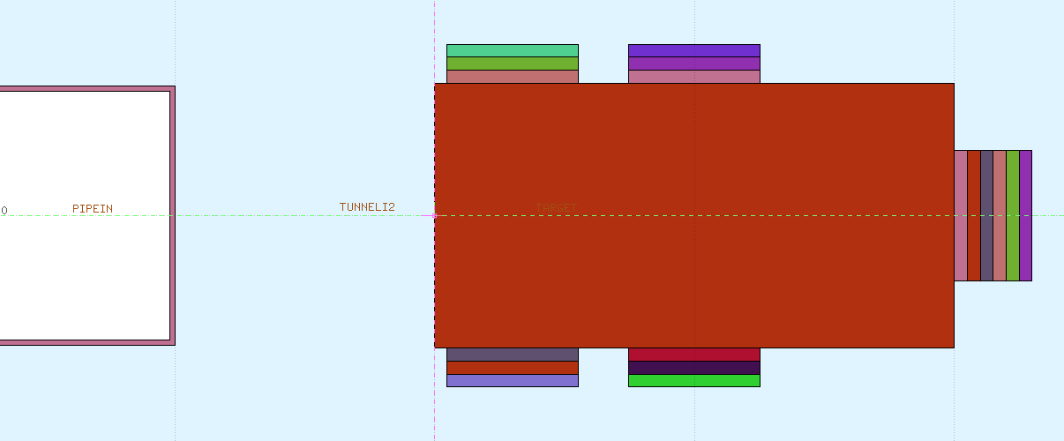
Activation calculation using MC codes
Assumption for calculation using MC codes
Codes
1) MCNPX 2.7+SP-FISPACT 2007 2) FLUKA 2011.2c 3) PHITS 2.64+DCHAIN-SP 2001
Beam & Target condition
Geometry & Samples
Beam particles : electron, proton, carbon, uranium
Beam energy : 100, 430, 600, 1,000 MeV or MeV/nucleon, (Beam Intensity : 1kW)
Irradiation: 10 days, Cooling: No-cooling, 30 min, 1 hour, 1 day, 1month
Target material : Copper
Sample size : Φ2.5 cm x 0.5 cm (10 cm³)
Sample materials :
1) Metal 2) Concrete 3) Insulator 4) Paint
Beam
Copper target

Slide 19
Comparison of MC calculations
Total specific activity calculated by codes
- Heavy ions case : FLUKA > MCNPX+FISPACT > PHITS+DCHAIN-SP
- Proton : MCNPX+FISPACT ≒ FLUKA > PHITS+DCHAIN-SP

Slide 20
Activity ratio of MC codes vs FLUKA
- Beam : 430 MeV/n Carbon, Cooling time : 1 day
<Major isotopes>
ST304L
: ^{44,44m,47}Sc, ^{48,49}V, ⁵¹Cr, ^{52, 54}Mn, ⁵⁵Fe, ^{58,58m}Co, ⁵⁷Ni
Concrete(ANSI-ANS)
: ⁷Be, ²⁴Na, ³¹Si, ³²P, ³⁷Ar, ^{42,43}K, ^{45,47}Ca, ⁵¹Cr, ^{55,59}Fe
Kapton
: ³H, ^{7,10}Be, ^{11, 14}C
Epoxy
: ³H, ^{7,10}Be, ^{11,14}C

Slide 21
Comparison of specific activity
Total specific activity from Carbon beam on interested materials calculated using FLUKA code
- Activation : Metal, Concrete > Insulator, Paint

Slide 22
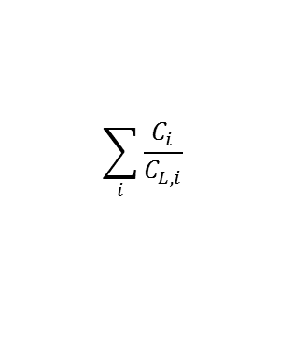
Comparison of clearance index
Clearance index of concerned materials
- Irradiation : 10 days, beam power : 1 kW
- Activation : Metal, Concrete > Insulator, Paint
$$\sum_{i}{\frac{C_{i}}{C_{L,i}}}$$
*Clearance Index :

Slide 23
Conclusion
- In order to review the radiological protection for non-radiation disasters (fire, flood),
case study and the leakage path of radioactive materials was investigated.
⇒ Fire events : dust, insulator, paint / Flood events : dust, concrete, metal
- The activation calculations were carried out using different MC codes for various
beam particles and energy.
⇒ Induced activities by electron beam was the lowest. It was 10² – 10⁵ times less
than uranium beam case.
- Safety regulation should be applied regarding beam particle type and beam energy

Slide 24
Thank you.
Notes:
Thank you for listening.

