Slide 1


Science Directorate Update
Andreas Schreyer
European Spallation Source ERIC
Instrument Collaboaration Board
Malmö
June 22, 2016

Slide 2
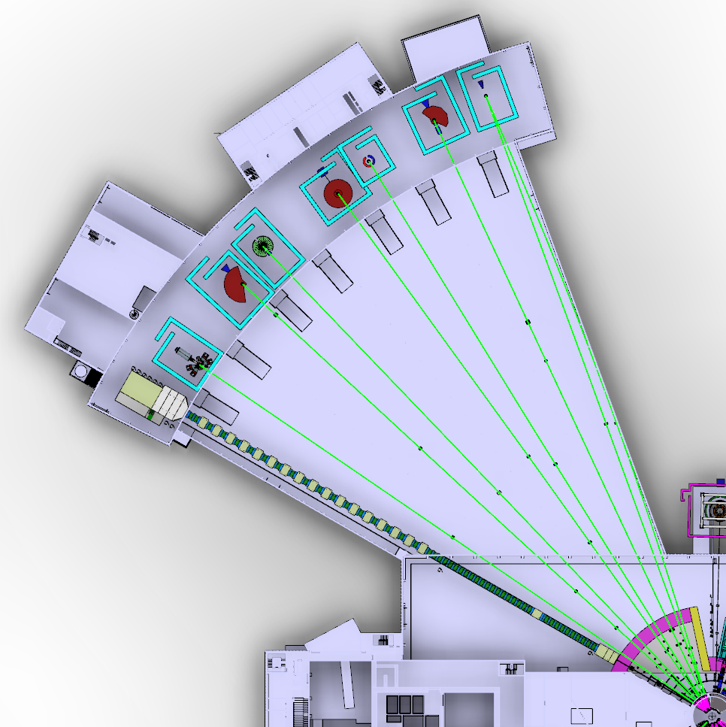
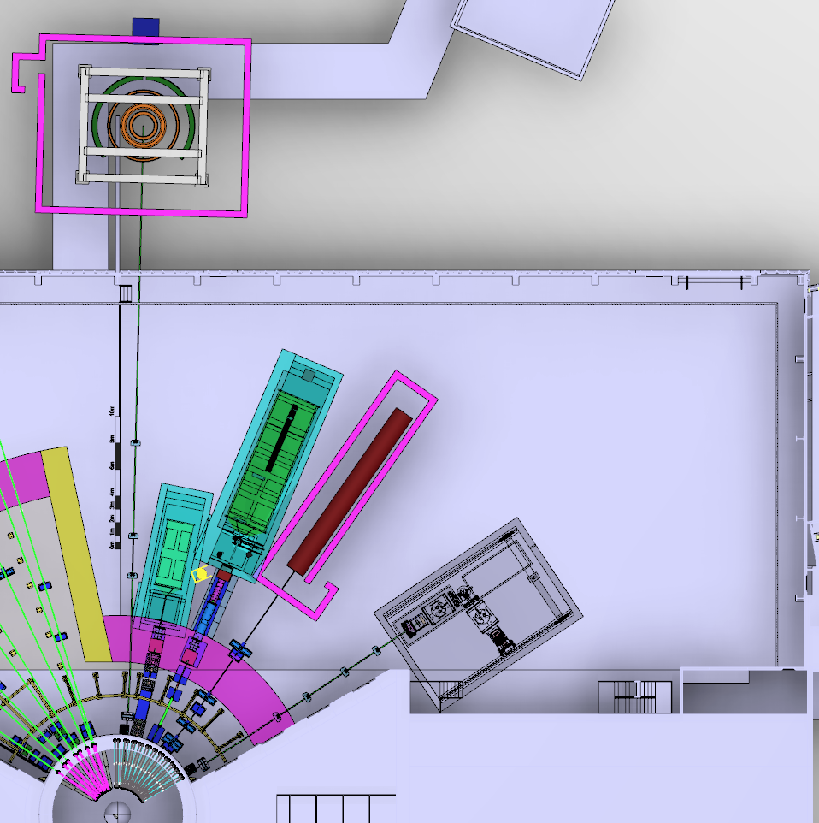
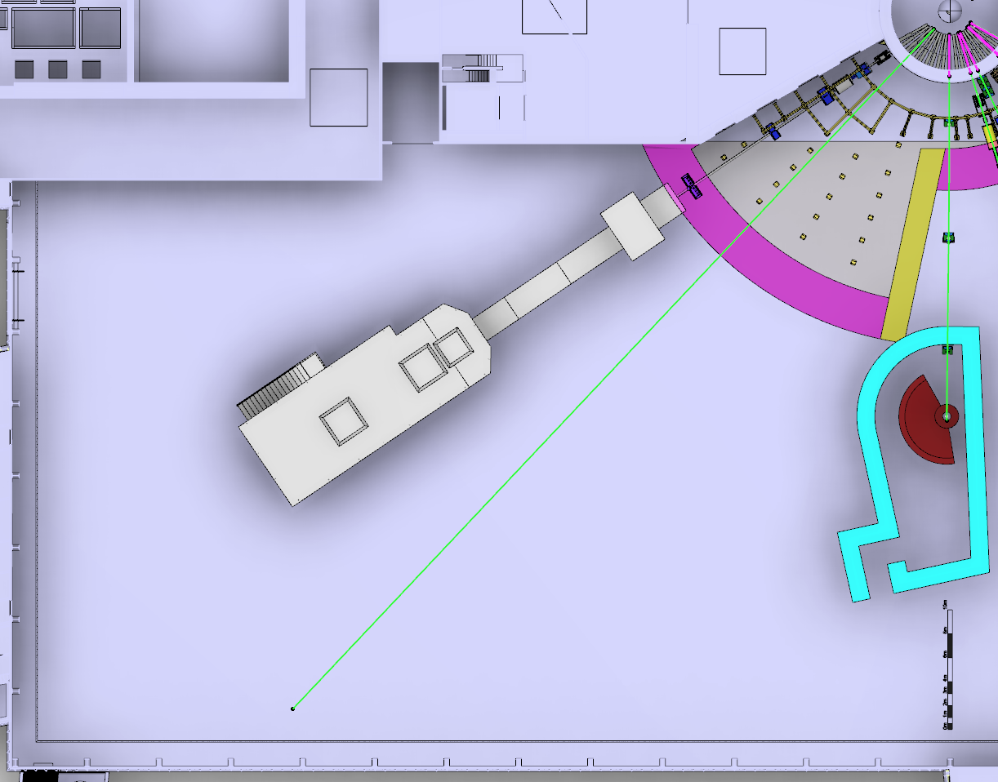
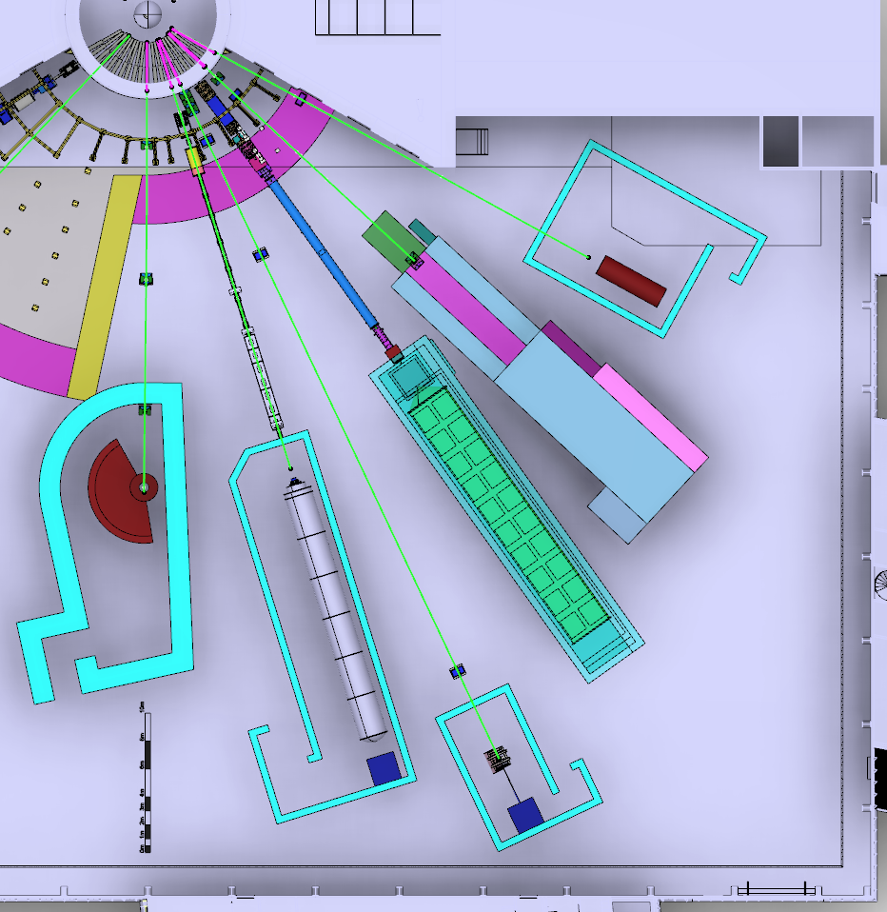
NSS: Where we stood in March 2016
TREX
HEIMDAL
MAGIC
MIRACLES
Decisions on the first 16 instruments
Baseline where to place 15 instruments
- minimize mechanical interfaces
- maximize number of usable beam
ports in the future
- 16th instrument (HR-NSE, VOR)
BIFROST
CSPEC
BEER
NMX
Focus on Bunker project
Funding delays for some
in-kind partners (65% in kind)
Entering
new instruments into phase1
(prel. engineering design)
LOKI
FREIA
HR-NSE
Baseline Layout of the NSS Neutron Beam Instruments
(January 2016)
ESTIA
ODIN
DREAM
VOR
SKADI
VESPA

Slide 3
NSS: Priorities for 2016
TREX
HEIMDAL
MAGIC
MIRACLES
Align the instrument budgets with the
NSS budget, reavaluate NSS budget
Develop a realistic schedule for all
instruments ensuring early science
success in line with available in-kind
resources and partner capabilities
BIFROST
CSPEC
BEER
NMX
Propose which instruments
are to be operational first
Proposal to Council in
December 2016 on how to
fund instruments plus
everything else required for
early science success within
budget of 350 MEUR
LOKI
FREIA
HR-NSE
Baseline Layout of the NSS Neutron Beam Instruments
(January 2016)
ESTIA
ODIN
DREAM
VOR
SKADI
VESPA

Slide 4
2016 | Jan | Feb | Mar | Apr | May | Jun | Jul | Aug | Sep | Oct | Nov | Dec
LOKI
SKADI
ESTIA
FREIA
NMX
MAGIC
HEIMDAL
DREAM
BEER
ODIN
C-SPEC
BIFROST
MIRACLES
T-REX
VESPA
2014
10/5
20
14-15/6
20
2014
22-23/6
Schedule for 2016
agreed with
Instrument
Collaboration
Board (ICB) and all
Instrument teams
17/6
12-13/9
my arrival
Annual Review
COUNCIL
IKON 11
ICB
SAC
COUNCIL
STAP
(Scientific & Technical
Advisory Panel)
scope-setting meeting
Tollgate 2
(Decision: design and construction)

Slide 5

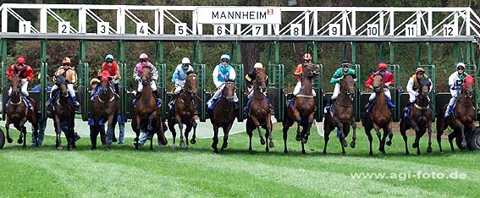
2016 | Jan | Feb | Mar | Apr | May | Jun | Jul | Aug | Sep | Oct | Nov | Dec
LOKI
SKADI
ESTIA
FREIA
NMX
MAGIC
HEIMDAL
DREAM
BEER
ODIN
C-SPEC
BIFROST
MIRACLES
T-REX
VESPA
2014
10/5
20
14-15/6
20
2014
22-23/6
Schedule for 2016
agreed with
Instrument
Collaboration
Board (ICB)
Schedule for 2016
agreed with
Instrument
Collaboration
Board (ICB)
17/6
12-13/9
my arrival
Annual Review
COUNCIL
IKON 11
ICB
SAC
COUNCIL
STAP
(Scientific & Technical
Advisory Panel)
scope-setting meeting
Tollgate 2
(Decision: design and construction)

Slide 6
Mon | Tue | Wed | Thu | Fri | Sat | Sun
2016 October |  |  |  |  | 1 | 2
3 | 4 | 5 | 6 | 7 | 8 | 9
10 | 11 | 12 | 13 | 14 | 15 | 16
17 | 18 | 19 | 20 | 21 | 22 | 23
24 | 25 | 26 | 27 | 28 | 29 | 30
ODIN
C-SPEC
HEIMDAL
BIFROST
BEER
FREIA
MAGIC
MIRACLES
Operations Review
VESPA
T-REX
provisional:
STAP
Scope-Setting
TG2 Review
agreed:
STAP
Scope-Setting
TG2 Review

Slide 7
Potential order of commencement of operation of first 8 instruments (August 2023)
2nd Annual Review Recommendation (0.5)
Prioritisation of instruments within budget must ensure that the first tranche of instruments (8) is ready to deliver world-class science at the start of user operations (2023)
Matching early success in delivery of scientific outputs with the capacity of Lead In-Kind partners to deliver on schedule (ISIS, PSI, FZJ, LLB, HZG/NPI, TUM/PSI, TUM/LLB & DTU lead consortium).
Instrument Class | Sub-class | Candidates
Large Scale Structures | Small Angle Scattering | LOKI (ISIS) or SKADI (FZJ)
 | Reflectometry | ESTIA (PSI) or FREIA (ISIS)
Diffraction | Powder Diffraction | DREAM (FZJ) or HEIMDAL (ÅU)
 | Single crystal diffraction | MAGIC (LLB) or NMX (ESS)
Engineering | Strain scanning | BEER (HZG/NPI)
 | Imaging and tomography | ODIN (TUM/PSI)
Spectroscopy | Direct Geometry | C-SPEC (TUM) or T-REX (FZJ)
 | Indirect Geometry | BIFROST (DTU), MIRACLES (Bilbao), VESPA (CNR)
Instruments in Bold type to be operational by Aug 2023
DRAFT

Slide 8
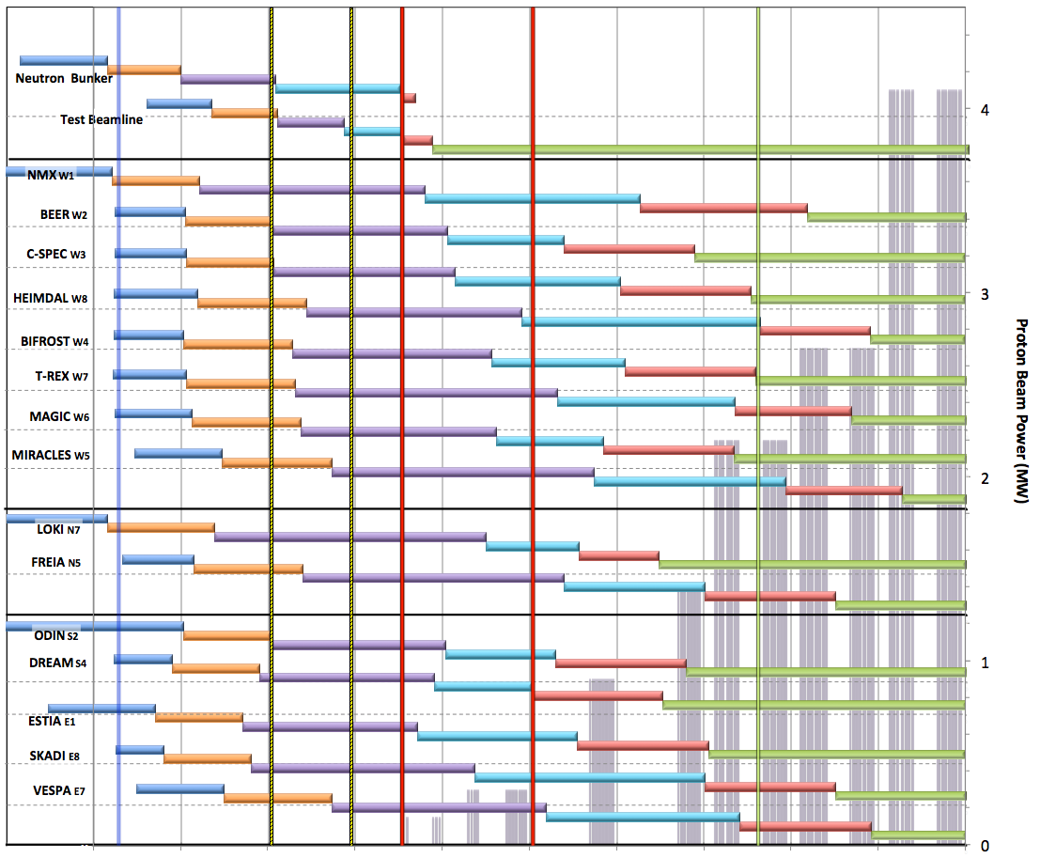

Neutron Beam Instrument Draft Schedule
V1.6, 7th April 2016
Current date
Early Access D01/D03
Full Access D01/D03
Beam on Target / 1st spectrum
Start Hot Commission
User instruments
Start User Program
Commissioning of test beam – to demonstrate performance and inform instrument projects
Notes;
The order of completion 1- 8 chosen for science and deliverability
Shift 9-16 to focus on 1-8 for early science success
Hot Commissioning start;
  E ≥ 200 MeV
  P ≥ 200 kW
  January 2021
DRAFT
West sector
North sector
Preliminary Design
Detailed Design
Manufacturing & Procurement
Installation & Integration
Hot Commissioning
Operation
East and South sectors
2016 2017 2018 2019 2020 2021 2022 2023 2024 2025

Slide 9
NSS Project Instruments
MOU Status
MOU Current Status (April-2016)
MOU Signed
MOU Can be Signed
Partners waiting for funding
class | Instrument | In-kind Partners (% contribution) | Cost Book (M€) | Cost Target (M€) |  | % IK | Cash (M€)
Large scale structures | LOKI broadband SANS | UK (ISIS) | 12.2 |  |  | 90% | 3.66
 | SKADI general-purpose SANS (note 1) | DE(FZJ 50%) + FR(LLB 50%) |  | 12 |  | 100%
 | ESTIA focusing reflectometer | CH(PSI) |  | 9 |  | 95% | 0.45
 | FREIA liquids reflectometer | UK (ISIS) |  | 9 |  | 95% | 0.45
Diffraction | NMX macromolecular crystallography | ESS (<30%) + HU (Wigner and Centre for Energy Research) + FR (LLB) + NO (Bergen Uni) | 11.7 |  |  | 70% | 3.50
 | DREAM powder diffractometer (bispectral) | DE(FZJ 75%) + FR(LLB 25%) |  | 12 |  | 95% | 0.60
 | HEIMDAL hybrid diffractometer | DK(AU 30%) +CH(PSI) +NO (IFE) |  | 12 |  | 70%
 | MAGIC magnetism single-crystal diffractometer | FR (LLB 65%) + DE (FZJ 20%) + CH (PSI 15%) |  | 12 |  | 100%
Engineering | BEER engineering diffractometer | DE (HZG 50%), CZ (NPI 50%) |  | 12 |  | 100%
 | ODIN multi-purpose imaging | ESS -> DE(TUM 50%) +CH (PSI 50%) |  | 9 |  | 95% | 0.45
Spectroscopy | C-SPEC cold chopper spectrometer | DE(TUM 50%) + FR(LLB 50%) |  | 15 |  | 100%
 | BIFROST extreme-environments spectrometer | DK(DTU/KU 30%) +CH(PSI) + HU(Wigner) +NO (IFE) + FR(LLB) |  | 12 |  | 70%
 | T-REX bispectral chopper spectrometer | DE (FZJ 75%) + IT (CNR 25%) |  | 15 |  | 95% | 0.75
 | VESPA vibrational spectroscopy | IT (CNR) + UK (ISIS) |  | 12 |  | 100%
 | MIRACLES backscattering spectrometer | ESS(Bilbao) + HU (Wigner) + DK (KU) + ESS |  | 12 |  | 95%
 | 16th Spectrometer (VOR or Spin-Echo, Decide 2018) | Wigner Institute (HU) for VOR or Juelich and TUM for Spin-Echo |  | 12 |  | 95% | 0.60
 | 16 instruments | cost | 188.9 |  |  | 90.3% | 18.3
 | neutron guide bunker | CZ, IT, D, F,… |  |  | 14.6 | 80.0% | 2.92
 |  | total cost (with bunker) |  |  | 203.5 | 89.6% | 21.2
9

Slide 10
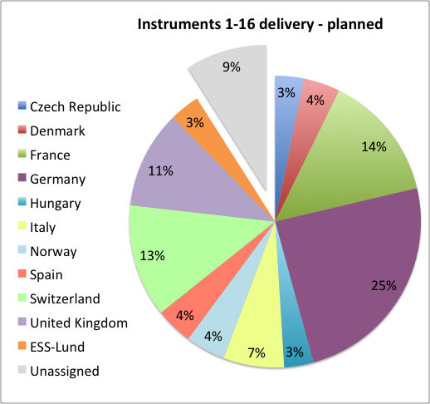
NSS Project Instruments
MOU Status
MOU Current Status (April-2016)
MOU Signed
MOU Can be Signed
Partners waiting for funding
class | Instrument | In-kind Partners (% contribution) | Cost Book (M€) | Cost Target (M€) |  | % IK | Cash (M€)
Large scale structures | LOKI broadband SANS | UK (ISIS) | 12.2 |  |  | 90% | 3.66
 | SKADI general-purpose SANS (note 1) | DE(FZJ 50%) + FR(LLB 50%) |  | 12 |  | 100%
 | ESTIA focusing reflectometer | CH(PSI) |  | 9 |  | 95% | 0.45
 | FREIA liquids reflectometer | UK (ISIS) |  | 9 |  | 95% | 0.45
Diffraction | NMX macromolecular crystallography | ESS (<30%) + HU (Wigner and Centre for Energy Research) + FR (LLB) + NO (Bergen Uni) | 11.7 |  |  | 70% | 3.50
 | DREAM powder diffractometer (bispectral) | DE(FZJ 75%) + FR(LLB 25%) |  | 12 |  | 95% | 0.60
 | HEIMDAL hybrid diffractometer | DK(AU 30%) +CH(PSI) +NO (IFE) |  | 12 |  | 70%
 | MAGIC magnetism single-crystal diffractometer | FR (LLB 65%) + DE (FZJ 20%) + CH (PSI 15%) |  | 12 |  | 100%
Engineering | BEER engineering diffractometer | DE (HZG 50%), CZ (NPI 50%) |  | 12 |  | 100%
 | ODIN multi-purpose imaging | ESS -> DE(TUM 50%) +CH (PSI 50%) |  | 9 |  | 95% | 0.45
Spectroscopy | C-SPEC cold chopper spectrometer | DE(TUM 50%) + FR(LLB 50%) |  | 15 |  | 100%
 | BIFROST extreme-environments spectrometer | DK(DTU/KU 30%) +CH(PSI) + HU(Wigner) +NO (IFE) + FR(LLB) |  | 12 |  | 70%
 | T-REX bispectral chopper spectrometer | DE (FZJ 75%) + IT (CNR 25%) |  | 15 |  | 95% | 0.75
 | VESPA vibrational spectroscopy | IT (CNR) + UK (ISIS) |  | 12 |  | 100%
 | MIRACLES backscattering spectrometer | ESS(Bilbao) + HU (Wigner) + ESS |  | 12 |  | 95%
 | 16th Spectrometer (VOR or Spin-Echo, Decide 2018) | Wigner Institute (HU) for VOR or Juelich and TUM for Spin-Echo |  | 12 |  | 95% | 0.60
 | 16 instruments | cost | 188.9 |  |  | 90.3% | 18.3
 | neutron guide bunker | CZ, IT, D, F,… |  |  | 14.6 | 80.0% | 2.92
 |  | total cost (with bunker) |  |  | 203.5 | 89.6% | 21.2
NSS instrument
In kind budget
Unassigned
Main unassigned scope
16th Instrument (6th Spectrometer)
25% each of VESPA & MIRACLES
6% of NMX
10

Slide 11
NSS other In-Kind Contributions
Country Summary
Main IK items outside of Instrument delivery
Experiment control systems (PSI) 1.5 M€
BandGEM detectors (CNR) 0.5 M€
Data reduction & streaming (STFC) 3.3 M€
Detector readout system (STFC) 3.0 M€
User Laboratories (STFC) 1.0 M€
Other contributions (EE, DK…) 2.1 M€
Total value 11.4 M€
5 April 2016

Slide 12
NSS In-Kind Contributions under Discussion
Country Summary
Main IK items under discussion
16th Instrument 12 M€
25% VESPA 3 M€
25% MIRACLES 3 M€
6% NMX 0.7 M€
Neutron Guide Bunker 12 M€
Other non-instrument ~ 4.5 M€
Total IK Value assigned = 176.5 M€
Value of IK contributions under discussion = 35.2 M€
______________________________________________
Total (assigned + discussed) = 211.7 M€
This would bring NSS to ~ 93 % of target (enough for this stage of the project).
Plan to keep ~7 % in contingency, and reassess later.
12 April 2016

Slide 13
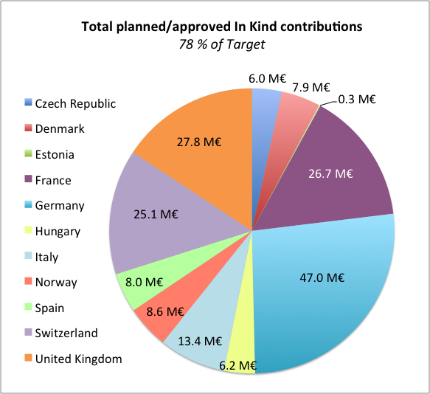
NSS total In-Kind Contributions
Country Summary
Partner Country | Potential value (M€) | Committed to NSS (M€) | % of potential commitment to NSS
Czech Republic | 11.3 | 6.0 | 53%
Denmark | 7.9 | 7.9 | 100%
Estonia | 0.5 | 0.3 | 53%
France | 35.0 | 26.7 | 76%
Germany | 93.0 | 47.0 | 51%
Hungary | 8.0 | 6.2 | 77%
Italy | 20.1 | 13.4 | 67%
Norway | 12.0 | 8.2 | 68%
Spain | 32.5 | 8.0 | 25%
Switzerland | 41.0 | 25.1 | 61%
United Kingdom | 31.4 | 27.8 | 89%
total | 292.6 | 176.5
Assigned value for instruments = 165.1 M€
“ for other contributions = 11.4 M€
Total In-Kind Value assigned = 176.5 M€
12 April 2016

Slide 14
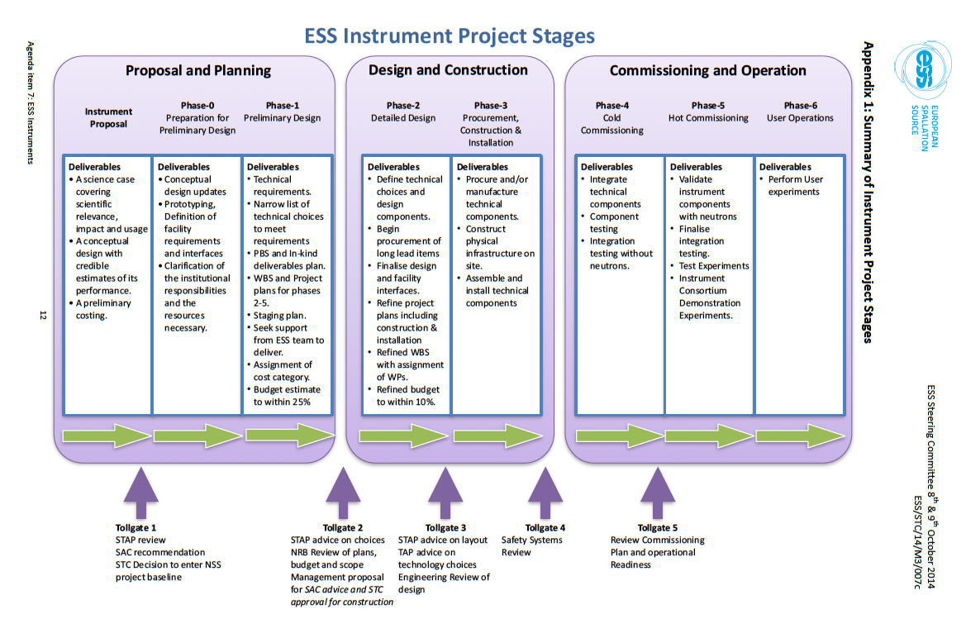
NSS delivery model approved by ESS STC (Oct. 2014)

Slide 15
Procedure for Decisions on Construction of Instruments
So far two step process: Council decisions to enter Phase 1, preliminary design and then individual decisions on the construction baseline, a cost book value and to enter the Phase 2, construction for each individual instrument.
The proposal to Council in Dec. 2016 will include a strategy for early science success, which instruments should be the first eight in user operation in 2023 and, as far as possible, cost book values for 13 of the instruments in phase 1 (2 other instruments already have assigned values).
In Dec. 2016 most instruments will not have finished Phase 1
It is proposed to add an intermediate step which provides an overall view of the breakdown of the ringfenced NSS construction budget including cost book values and the preliminary schedule for the instrument program.

Slide 16
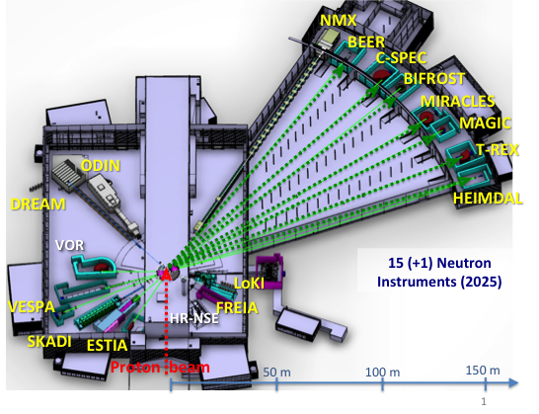
Procedure for Decisions on Construction of Instruments
This approach has the great advantage that it will be possible to propose an overall strategy and close to complete view for the 16 instruments which are in the scope of NSS within the ringfenced NSS construction budget.
Therefore it is proposed to allow the provision of a cost book value before the completion of phase 1 (Tollgate 2) to allow an overall view and alignment of the NSS construction budget. The final Council decision to construct an instrument will take place after Tollgate 2 as agreed previously.

Slide 17
Procedure for Decisions on Construction of Instruments
This approach has the great advantage that it will be possible to propose an overall strategy and close to complete view for the 16 instruments which are in the scope of NSS within the ringfenced NSS construction budget.
Approved by Council on June 10th
Therefore it is proposed to allow the provision of a cost book value before the completion of phase 1 (Tollgate 2) to allow an overall view and alignment of the NSS construction budget. The final Council decision to construct an instrument will take place after Tollgate 2 as agreed previously.

Slide 18
Conclusions I
Scope, budget and schedule for 13 remaining instruments to be agreed with all instrument teams before end of October
Similar to the instruments, cost targets have been set for sample environment, DMSC, detectors, etc. trying to free resources for instruments
Requires hard work by NSS and in-kind partners to meet the deadlines
After involvement of ICB and SAC
Proposal to council on
- updated overall budget
- sequencing of instruments
- how to insure early science success
Strategic decision by council on instrumentation at ESS in December 2016

Slide 19
Conclusions I
Scope, budget and schedule for 13 remaining instruments to be agreed with all instrument teams before end of October
Similar to the instruments, cost targets have been set for sample environment, DMSC, detectors, etc. trying to free resources for instruments
Requires hard work by NSS and in-kind partners to meet the deadlines
After involvement of ICB and SAC
Proposal to council on
- updated overall budget
- sequencing of instruments
- how to insure early science success
Strategic decision by council on instrumentation at ESS in December 2016
Communicated to and supported
by Council

Slide 20
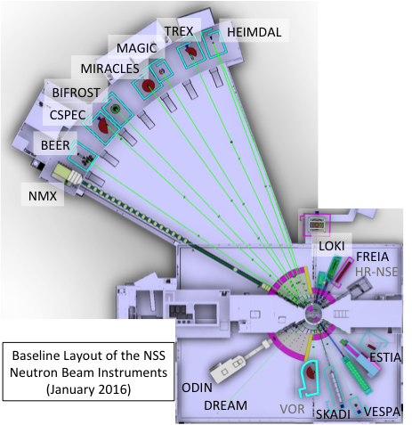
Conclusions II:
ESS plans foresee funding for upgrading instruments 1-16 to their full scope and for the instruments 17-22 in the pre-operations and operations budget
Decision by council on the pre-operations and operations budget
This initiative comes at the right time to ensure that funding is available for 22 instruments
It will hardly be possible to construct 16 instruments from the ringfenced NSS budget if no funding for further investment into those instruments is available from pre-operations and operations budget.

Slide 21
Conclusions II:
ESS plans foresee funding for upgrading instruments 1-16 to their full scope and for the instruments 17-22 in the pre-operations and operations budget
Decision by council on the pre-operations and operations budget
This initiative comes at the right time to ensure that funding is available for 22 instruments
It will hardly be possible to construct 16 instruments from the ringfenced NSS budget if no funding for further investment into those instruments is available from pre-operations and operations budget.
Communicated to Council
Council decision on operations budget
foreseen for June 2018

Slide 22
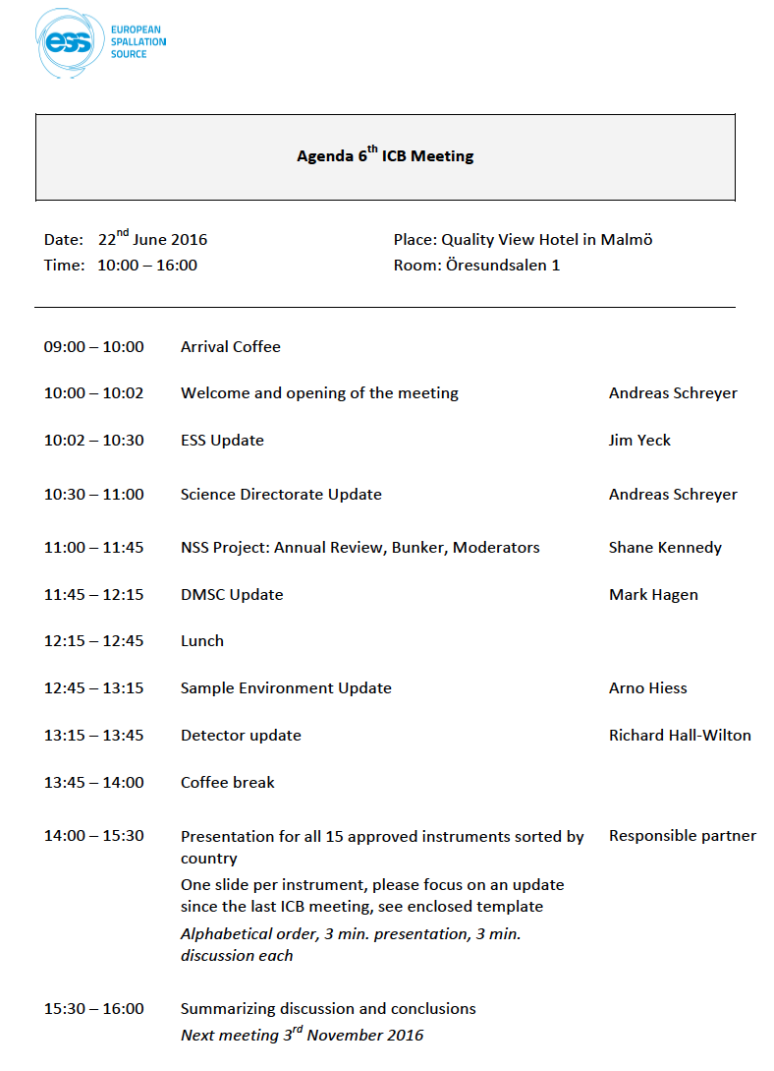

Slide 24
Backup

Slide 25
Mon | Tue | Wed | Thu | Fri | Sat | Sun
2016 September |  |  | 1 | 2 | 3 | 4
5 | 6 | 7 | 8 | 9 | 10 | 11
12 | 13 | 14 | 15 | 16 | 17 | 18
19 | 20 | 21 | 22 | 23 | 24 | 25
26 | 27 | 28 | 29 | 30
DREAM SS
Spectroscopy STAP
NSE STAP
IKON 11
ESTIA TG2
SKADI TG2
provisional:
STAP
Scope-Setting
TG2 Review
agreed:
STAP
Scope-Setting
TG2 Review

Slide 26
The instrument budget challenge
Instrument proposals were optimized for scientific quality to convince SAC/STAP
Instrument proposals: visionary, no incentive to design to budget
Not enough funds available to cover the full scope of all 16 instruments within the ring-fenced NSS construction budget of 350 Mio EUR (65% in-kind)
Sum of the “as proposed” budget for all 16 instruments: ≅ 250 Mio EUR
Current NSS budget for instruments: 188.9 Mio EUR
Pressure to increase instrument budget
Scenario: increase up to 202 Mio EUR would require cuts of approx. 20% for sample environment, DMSC, technology groups,…
still 48 Mio EUR missing (19 % of proposed budget for 16 instruments)
(certain costs for shielding, vacuum, etc. have been moved into the central NSS budget)
Decrease individual instrument budget AND increase NSS instrument budget

Slide 27
The way forward
In general the day one version of any instrument does not need to contain all “bells and whistles" as proposed: day one scope < full scope
Requires intense discussions with all partners on the budget for the day one version (phase 1, scope setting meetings before Dec. 2016)
Instrument budget estimates require better understanding of the shielding requirements (phase 1)
We must make sure that the day one version of any instrument delivers early scientific success (even if the accelerator is not yet at full power)
Early scientific success also requires good sample environment, data analysis tools, detectors etc.
We must also ensure that we have the funds for scope upgrades of instruments as we go along (pre-operations budget)

Slide 28
The NSS Instruments Collaboration
Science Advisory Committee (SAC)
ERIC Council
In-kind Review Committee
ESS Director General
Director for Science
NSS Project Leader
Instruments Collaboration Board (ICB)
Chair: Director for Science
Scientific and Technical Advisory Panels (STAPs)
NSS Project
Management and Project Reporting
Collaboration Management and Reporting
In-kind contract workflow
Advisory
Key
Science Support (SS)
Instrument
Technologies (IT)
DMSC
Instrument
Projects
Instrument Consortium 1
Instrument Consortium 2
Instrument Consortium n
In-Kind SS
In-Kind IT
In-Kind DMSC
Notes:
Collaboration model in place. Neutron instrument building community not used to working in the fashion but is taking ICB seriously.

