Slide 1

Data Management and Software Centre
Mark Hagen
www.europeanspallationsource.se
Instrument Collaboration Board, June 22nd, 2016

Slide 2
Outline
Scope & Group/Work Package organization
Domain & interfaces
Strategy
Distributed software development & Core software frameworks
For each of the DMSC Groups description of work & in-kind partnerships:
  Data Management Group
  Instrument Data Group
  Data Analysis and Modeling Group
  Data Systems and Technologies Group
  (Scientific Coordination and User Office software is part of DST)
Summary
2

Slide 3
DMSC’s scope
Construction Phase of ESS (2014 – 2019) & Neutron Beam Instruments (2014 – 2025)
  Software for the Inst. Control & Data Management (Acq., Reduction, etc.)
  Software for Data Analysis
  Software framework to do Live and Automated Data Reduction/Analysis
  Software for managing the scientific user program
  Hardware for data storage and data reduction/analysis (inc. remote)
Operations Phase of ESS & Neutron Beam Instruments (2019 – 2067)
  Maintenance and development of all of the above software
  Emphasis on Data Analysis, Modeling & Simulation for ESS Users/Science
    Supporting ESS Users with Data Analysis, Modeling & Simulation
    Integration of simulation/modeling techniques (e.g. Molecular Dynamics
    and Density Functional Theory) into calculation of neutron scattering
    cross sections & data analysis
3

Slide 4
DMSC’s Group/Work Package Organization
DMSC
Management & Admin.
(Mark Hagen)
13.04.01
Data Systems
& Technologies
(Sune Bahn)
13.04.02
Data
Management
(Tobias Richter)
13.04.06
Inst. Data (Control
& Reduction)
(Jon Taylor)
13.04.03
Data Analysis
& Modeling
(Thomas Rod)
13.04.04
Copenhagen Data Centre
DMSC servers in Lund
Clusters, Workstations
Disks, Parallel File System,
Database Servers
Networks (incl. Lund – CPH)
Data transfer, Back-up & Archive
External Servers
Web Interfaces
User Program Software –
- User, Training, Sample Databases
- Proposal & Scheduling Systems
Data Capture/Acquisition
(EPICS, detectors, monitors, SE)
Streaming data
Dataflow Management &
Monitoring
File writers (NeXus)
Messaging Services
Data Catalogues
Framework for automated–
-- Reduction
-- Analysis
Instrument Control User
Interfaces (EPICS read/write)
Live Visualization
Data reduction (MANTID)
Analysis codes (e.g.
SANSview, Rietveld,…)
MCSTAS support + dev.
Live feedback to
Inst./Expt. control
MD + DFT integration
4

Slide 5
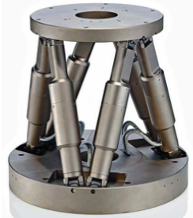
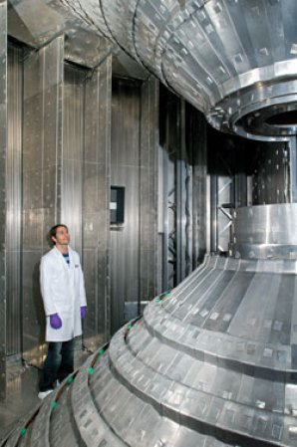
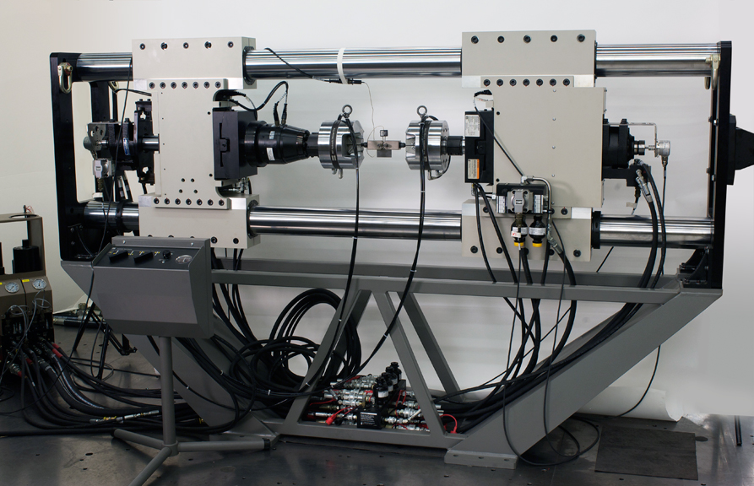
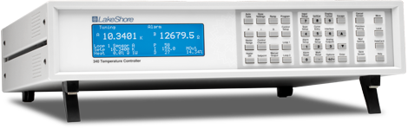
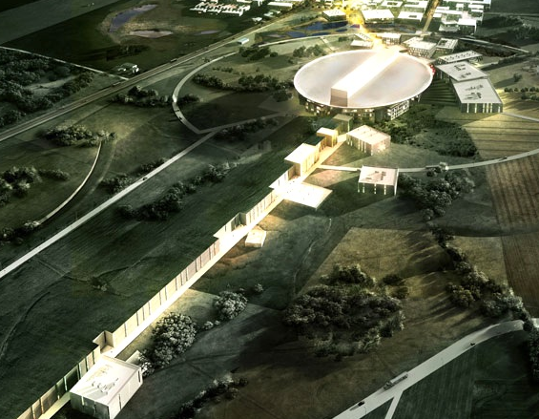
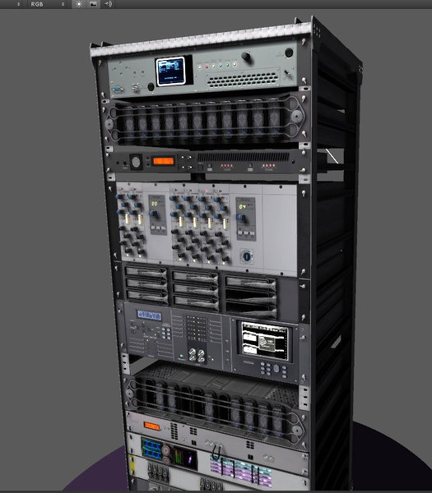

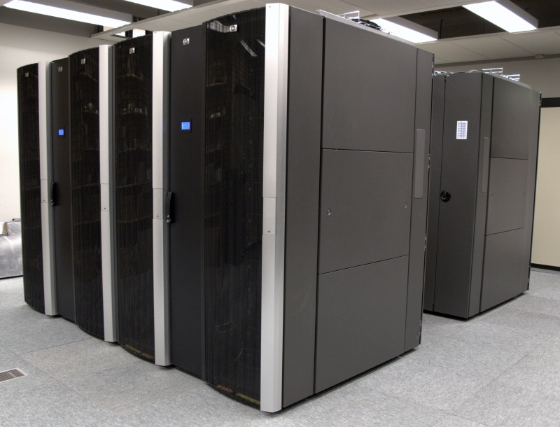


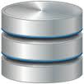
DMSC’s Domain and Interfaces
INSTRUMENT TECHNOLOGIES
Choppers
Motion Control
Sample Environment
Fast Sample
Environment
Detectors
& Monitors
Timing
Fast Data Electronics
Fast Data
Readout
Event formation
DATA MANAGEMENT &
SOFTWARE CENTRE
INTEGRATED
CONTROL SYSTEMS
Control Box
Data Aggregator
& Streamer
User Control
Interface
Automated
Post Processing
Live, Local & Remote
Data Reduction
Data Analysis Interfaces
Instrument Control Room
ESS Server Room
DMSC Server Room
5

Slide 6
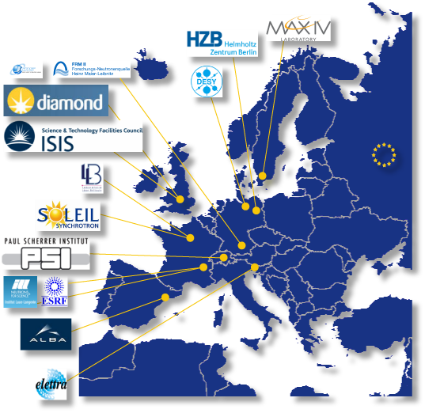
Strategy
75% of DMSC’s work is software development, 25% hardware
Basic strategy for construction is:
  Small core teams at DMSC (integration, coordination + work!)
  In-kind teams working on software development packages
  Evolutionary approach from existing software
Leverage In-Kind contributions to DMSC across the entire
suite of ESS instruments
Leverage the experience, knowledge and skills from European
neutron scattering facilities & universities
Leverage software developments at neutron facilities
Leverage software developments from EU projects
Software developments from/for DMSC/ESS can feedback to the current facilities
The core teams are important:
  The integration of the software projects with each other & instruments & ESS (ICS, etc.)
  The smooth continuation from Construction into Operations

Slide 7
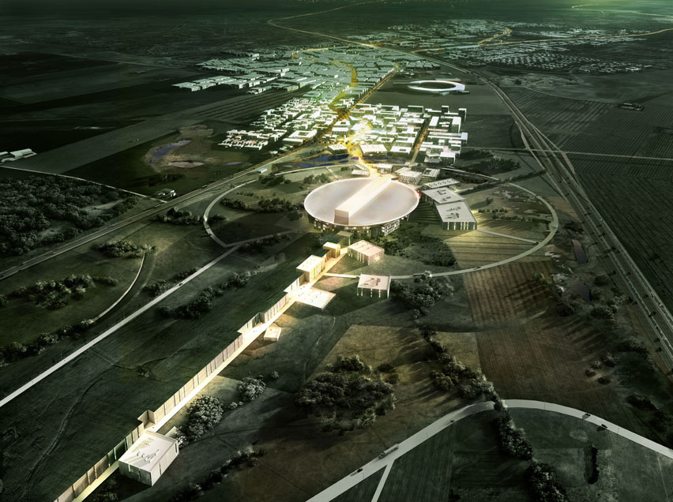
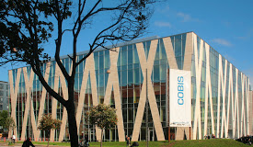
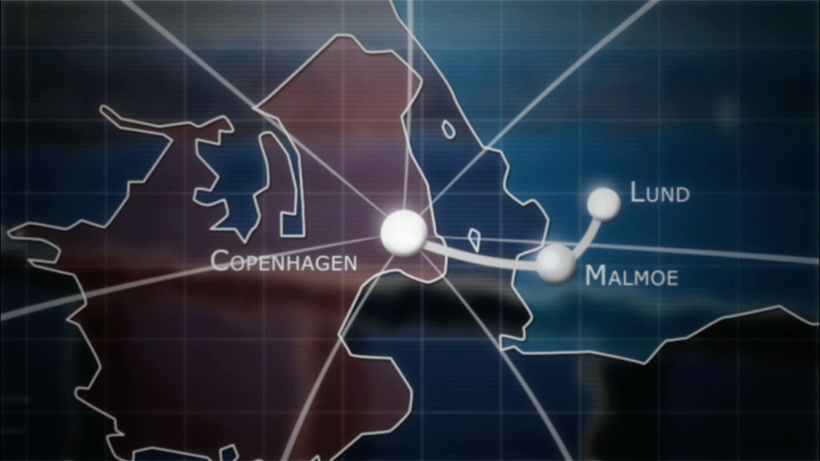
Distributed Software Development
Common software repository (local copies/mirrors)
Build servers, automated testing, bug trackers
Used by Microsoft, Intel, Google etc. etc.
Also MANTID, MCSTAS, SASVIEW…
During cold/hot commissioning have to come to Copenhagen/Lund (2018 onwards)
Human Communication !!
Weekly team meetings via Skype
Project manager
(Extended) Visits
Code camps/developer meetings
7

Slide 8





Core Software Frameworks (+ In-Kind)
(Live) Data Analysis
Instr.
LOKI, SKADI – ESTIA, FREIA
C-SPEC, TREX – BIFROST, MIRACLES, VESPA
DREAM, HEIMDAL – MAGIC, NMX – BEER
ODIN
Instr.
Class
Large Scale Structures
(SANS - Reflectometry)
Spectroscopy
(Direct – Indirect)
Diffraction
(Powder – Xtal – Eng)
Imag
-ing
(Live) Data Reduction Framework
Instr.
Class
Large Scale Structures
(SANS - Reflectometry)
Spectroscopy
(Direct – Indirect)
Diffraction
(Powder – Xtal – Eng)
Imag
-ing
NeXus
ICAT
ZeroMQ
(Live) Data Management
Experiment Control Framework
NICOSII
Instr.
Class
Large Scale Structures
(SANS - Reflectometry)
Spectroscopy
(Direct – Indirect)
Diffraction
(Powder – Xtal – Eng)
Imag
-ing
Instrument Data Group
8
Data Management Group
Data Analysis Group

Slide 9
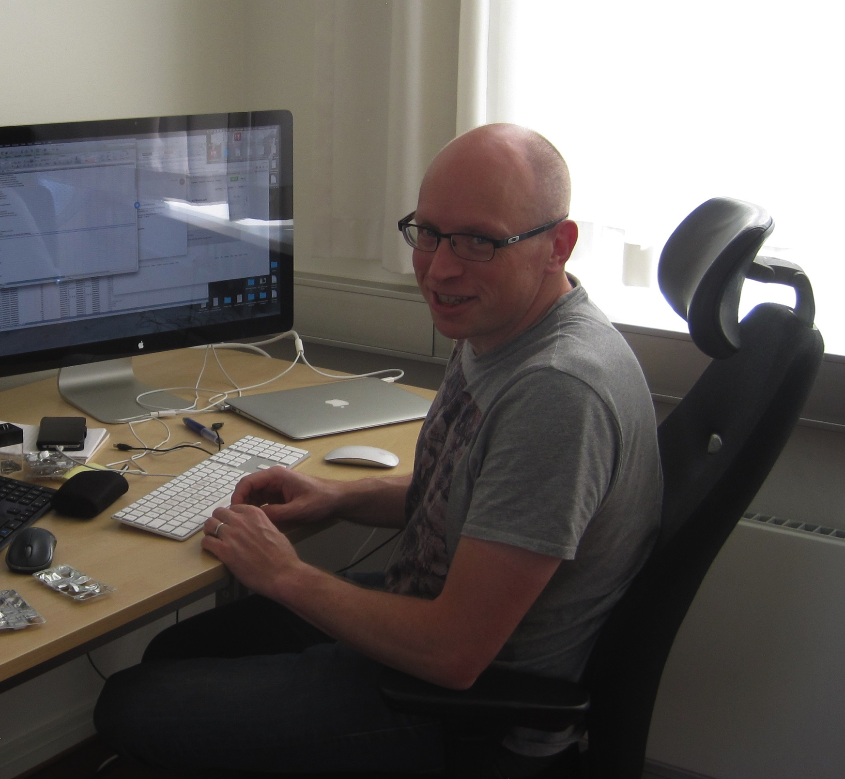
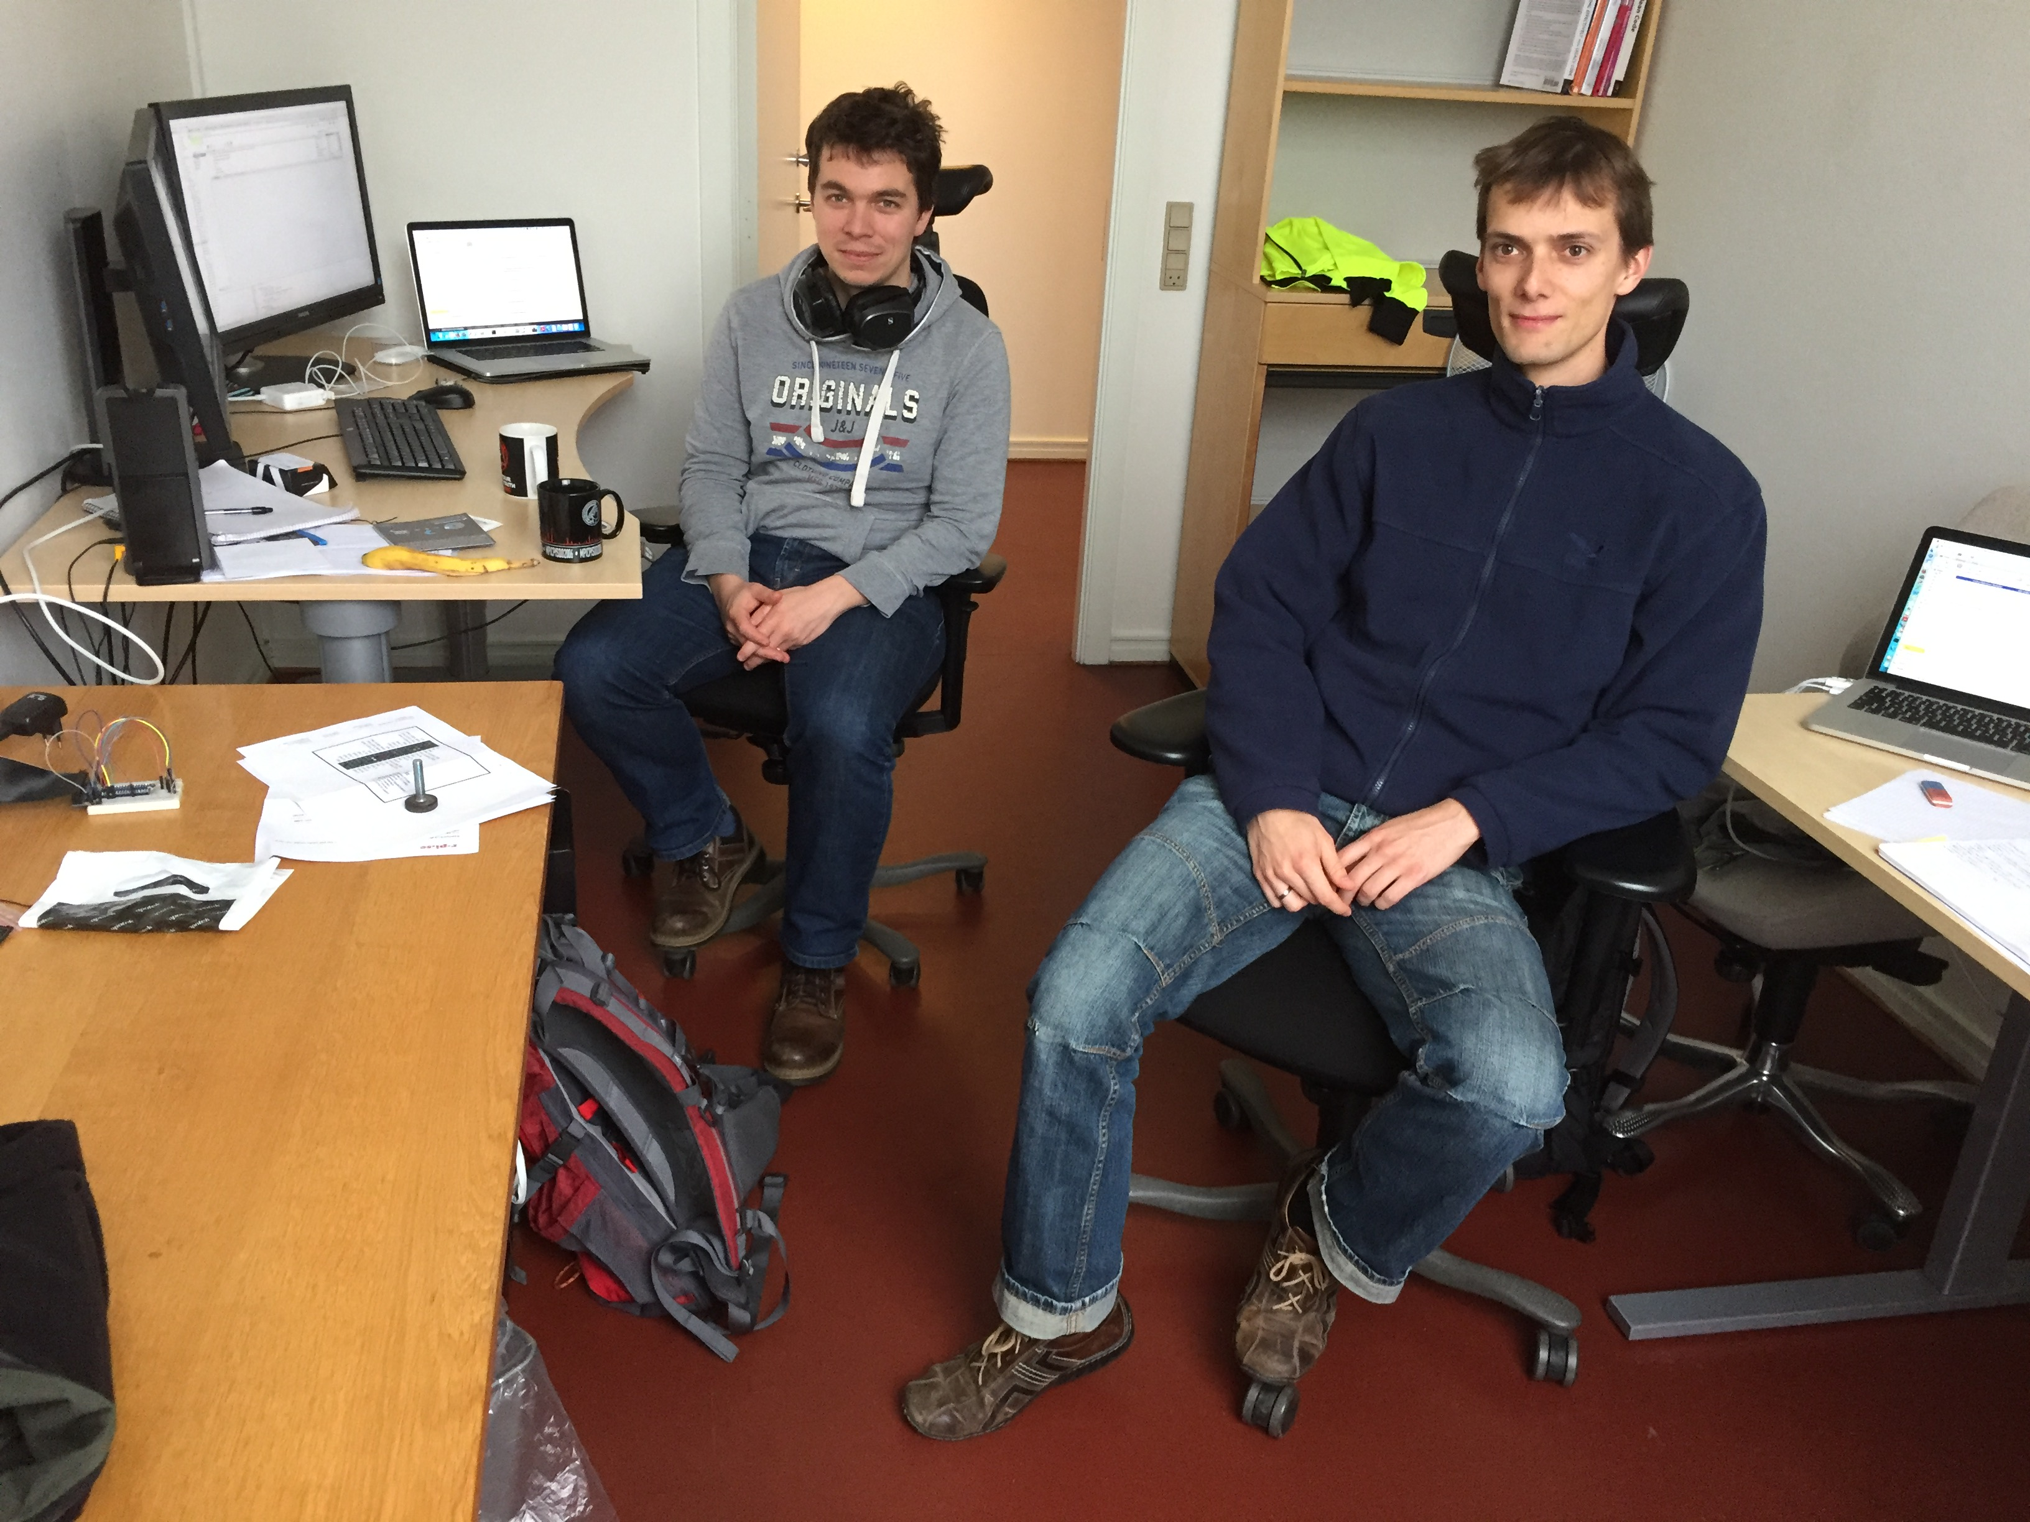
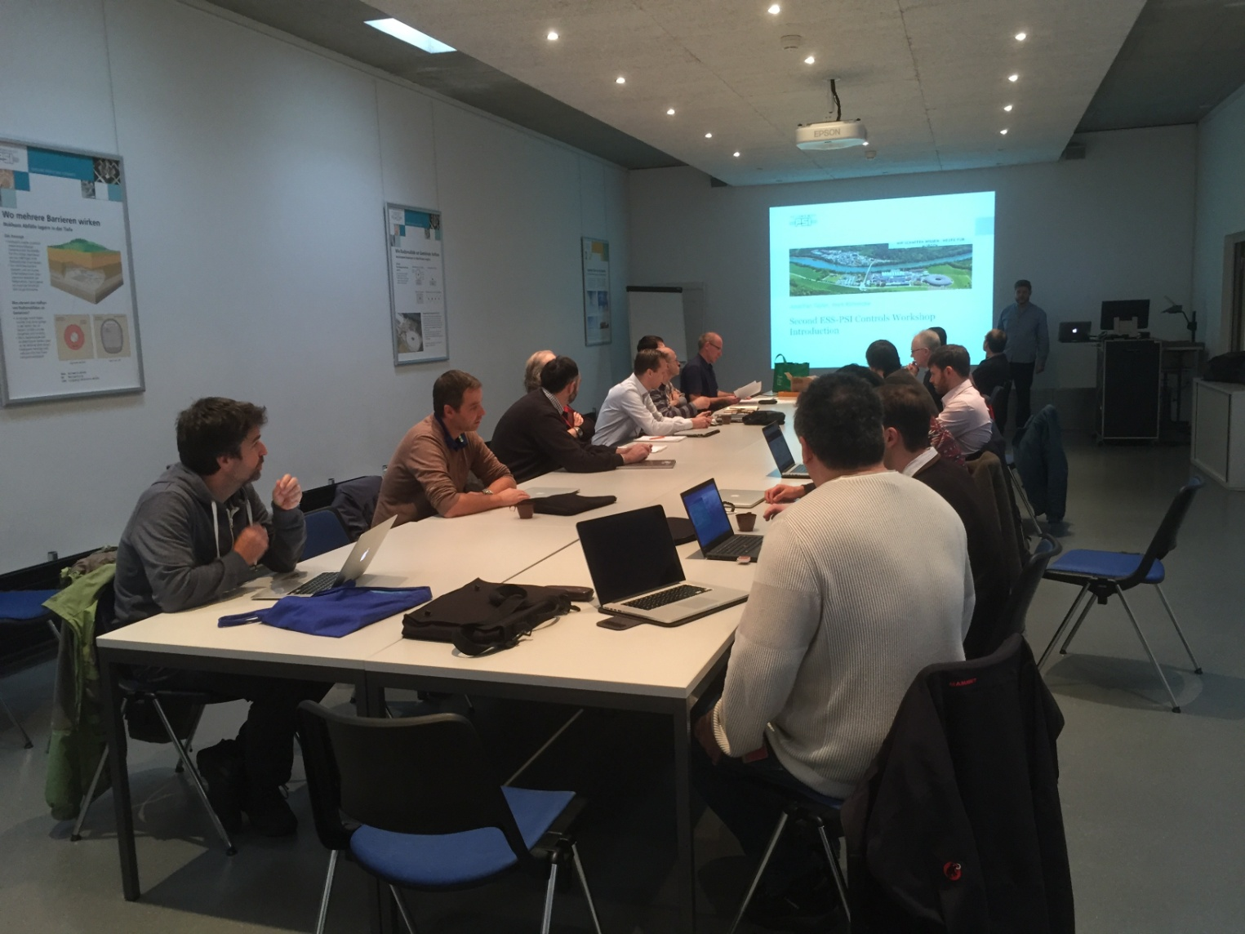
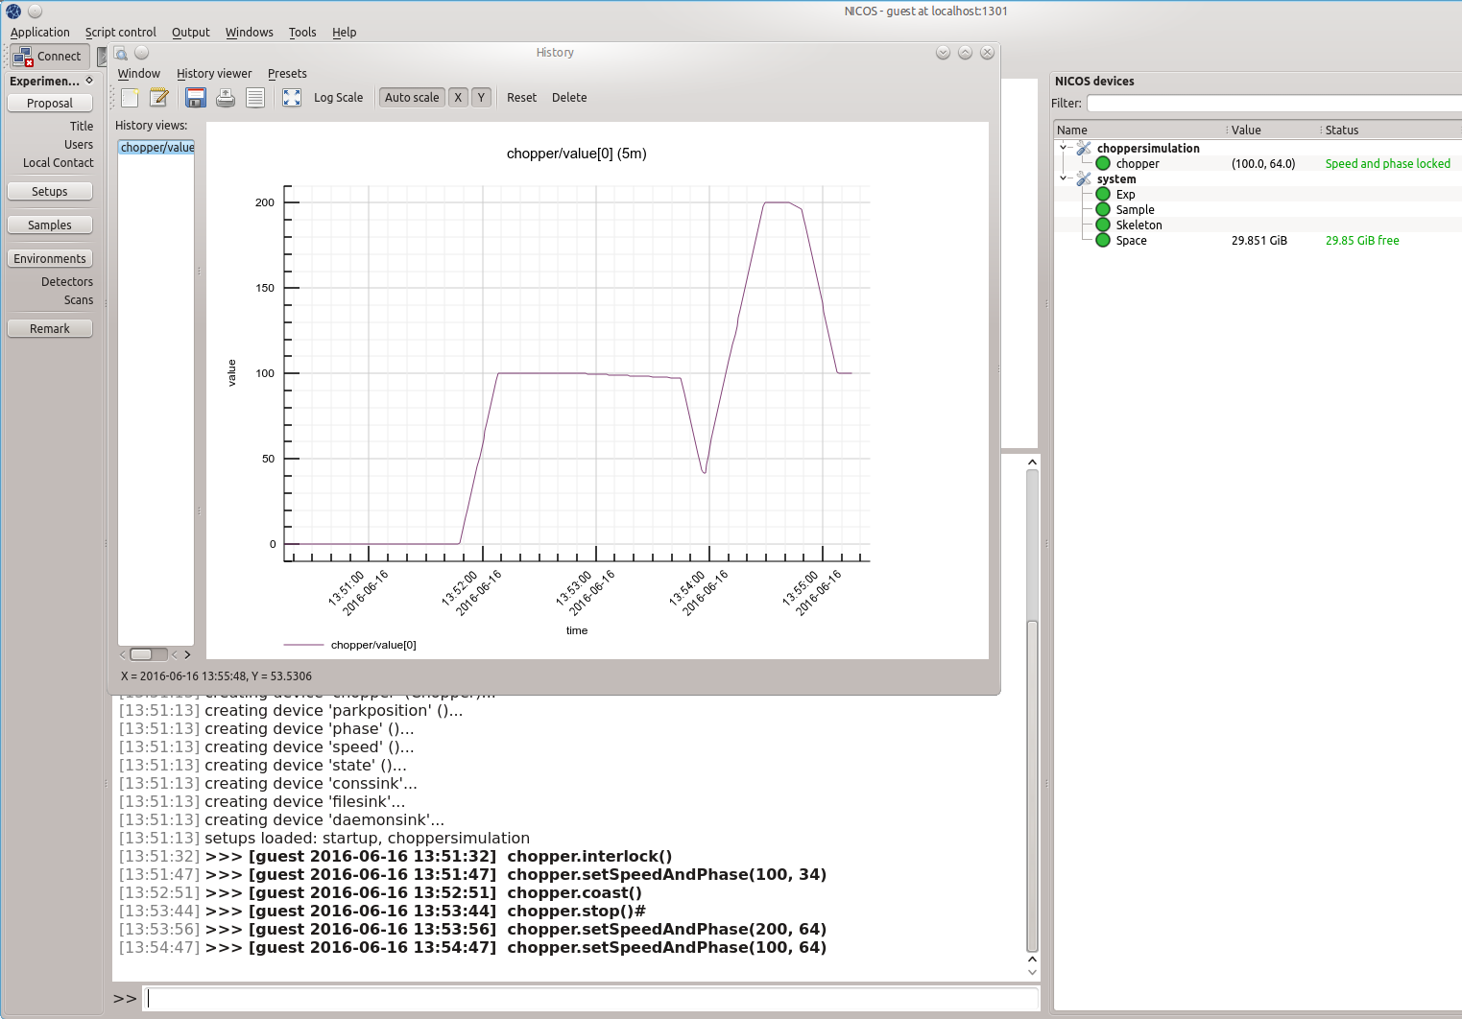
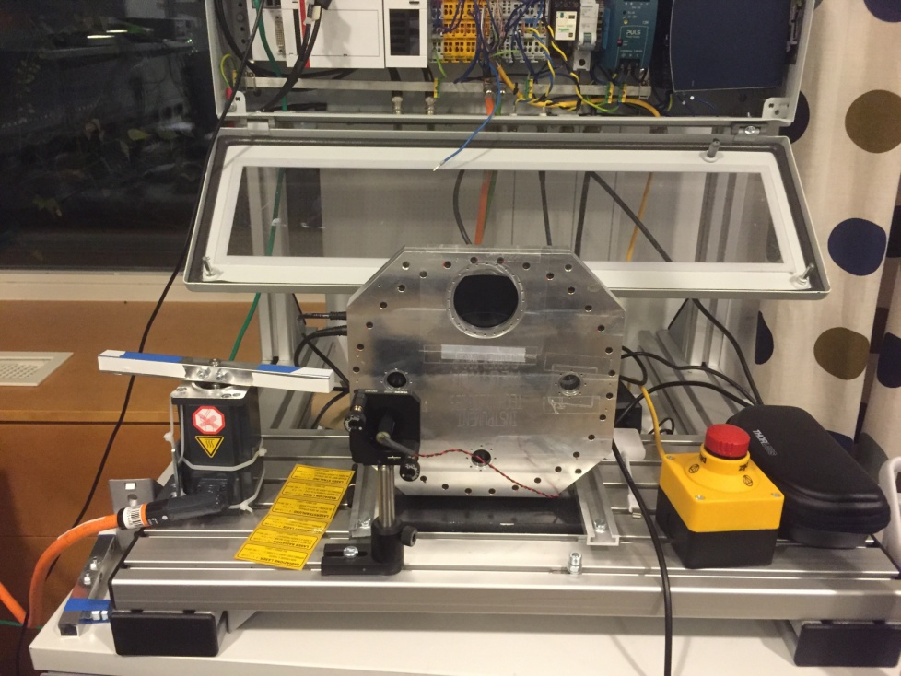

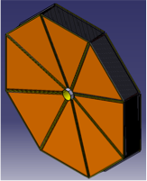
Instrument Data Group
Core Team
Jon Taylor (GL), Michael Wedel,
Simon Heybrock
Core improvements to MANTID for ESS.
Complex inst/detector geometries
MPI optimisation for event mode
Integration of NICOSII – EPICS, CHIC
Integration meetings weekly w/ ICS & NT
Integration workshop (ESS, PSI, ISIS)
Data reduction & Visualisation
  Data reduction platform for
  on/offline for all instruments
  Technique/instrument specific
  Using MANTID framework
Experiment Control
  Technique/instrument specific
  Using NICOSII framework (FRMII)
  Control of instrument hardware, configuration, acquisition
  Integration of external services provided by:
    DM group, DST group, ICS, Detectors, choppers, MCA
  Tight integration with reduction/analysis, experiment planning
IKC 2.01M€
IKC 1.5M€

Slide 10
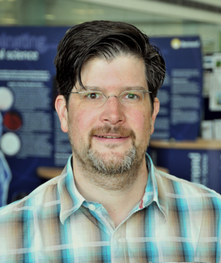



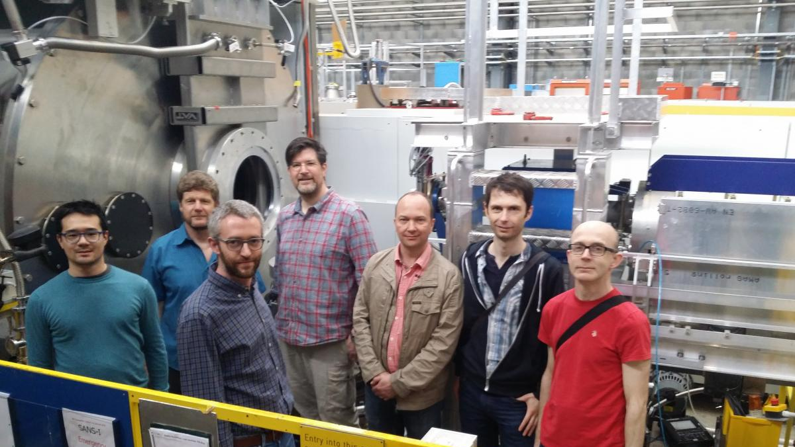

Data Management Group
Core Team
Tobias Richter (GL)
Neutron Event Formation
Detector Interface
Trace Processing
Fast Sample Env. Capture
Event Formation
Data from detector trials at
IFE/R2D2 are being classified
and analysed
Baseline algorithms for NMX
Investigated
Capabilities of ESS readout
chain being explored
Steaming part of BrightnESS with
PSI/Elettra initiated
Data Steaming
Completed project to evaluate Apache Kafka,
zeroMQ, and EPICS v4 as transport technology
Decision made on wire format serialization
(Google Protocol Buffers, BSON/JSON, Flat Buffers)
Reviewed first results from event generator tests
Initiated procurement of 10GB network
test equipment for ESSIIP integration lab project
Data Curation
Refined Work Package Structure and in kind
delivery with PSI
Agreement signed by Swiss Partners and
ready for submission to IKRC
(H2020) 2.2M€
Data Streaming
Fast Data Readout, EPICS Integration
Data Aggregator, NeXus File Writing
(IKC) 1.3M€
Integration workshop held at PSI
Catalogues and Databases
Data Catalogue
Download, Archive and Logistics
Processing Software Infrastructure
(IKC) 0.6M€
Apache
Kafka
V4
10

Slide 11
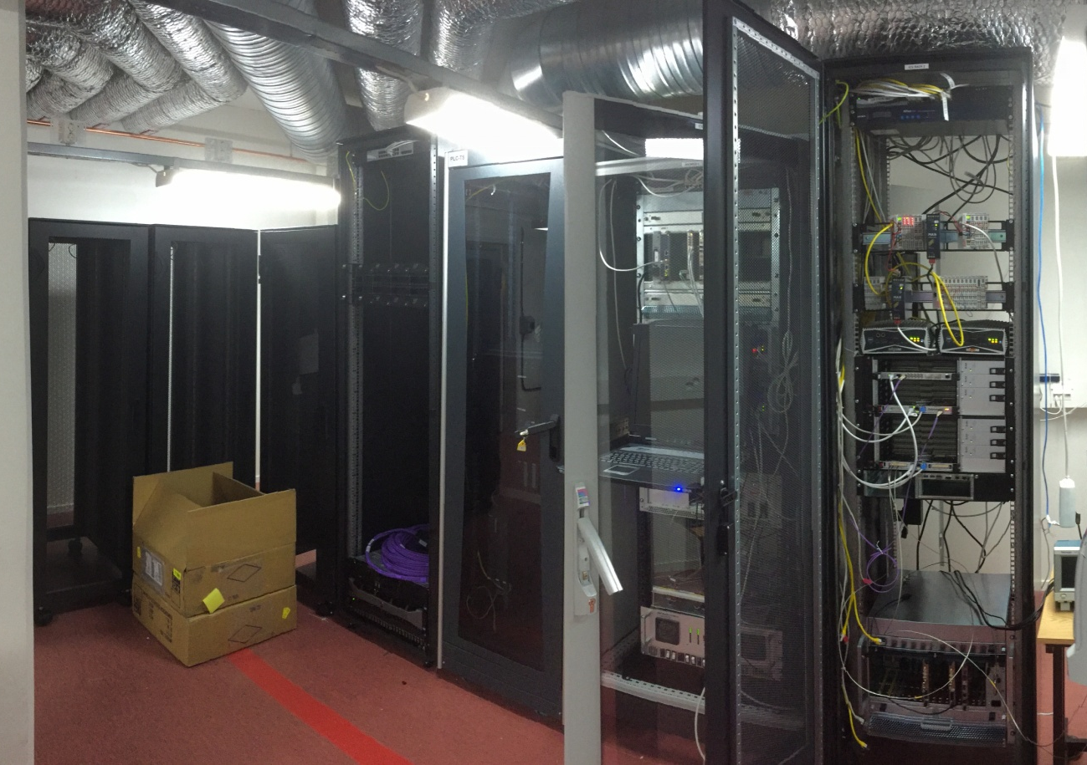
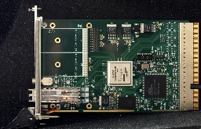
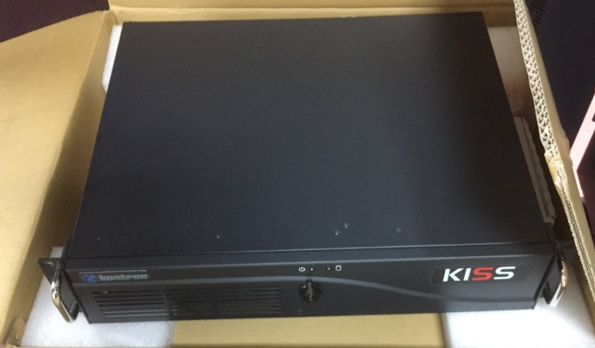
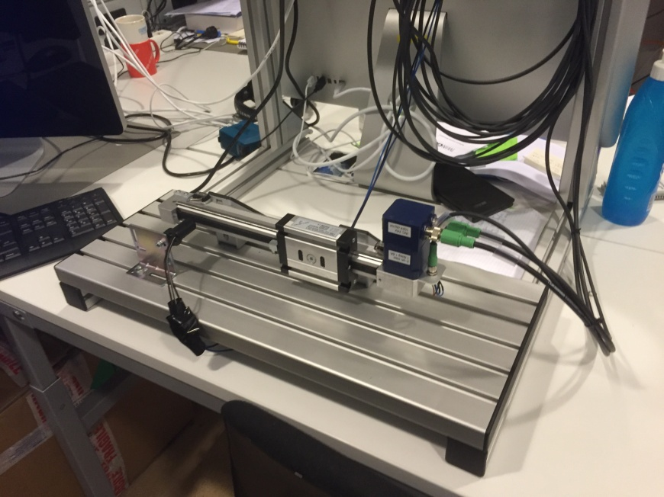
Facilities for Testing Software with Hardware
ESSIIP (ESS Instrument Integration Project) Lab.
Integration and testing facility in Lund
Integrates ICS DMSC and NT groups into a full stack control system implementation
Uses ESS timing system
ICS CCDB IOC factory and naming service
Example SE & chopper demonstrator is installed
Will include detectors and MCA systems
ESS TEST BEAMLINE at HZB, Berlin
In-kind partner facilities:
Event receiver card
Control box PC
Timing System

Slide 12
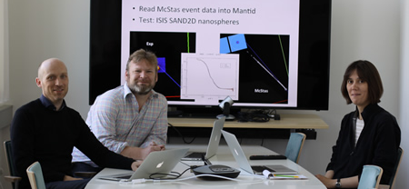
Data Analysis and Modeling Group
User-expectations are extremely high!
Scope in construction has been limited to:
  Basic (model fitting) data analysis software
  Enable users to leverage ESS special features
  Live-analysis
  User-friendly, sustainable, maintainable,
  reliable, easily installable, and extensible software
Core team: Torben Nielsen,
Thomas Rod (GL),Celine Durniak
Imaging
Imaging
Large-scale
SANS Reflect.
Not in scope of construction budget
Co-analysis (e.g. diffraction + SANS)
Analysis beyond basic analysis (e.g. integration of MD simulations).
Many users also expect support for advanced analysis!
Seek external funding for advanced analysis to increase impact from ESS and stay competitive with other facilities
Diffraction
Engineering Powder diffr Single crystal Macromol.
Spectroscopy
Molecular QENS INS

Slide 13
Data Analysis and Modeling Group
In kind contributions under discussion
Facility | Technique | Comment
PSI (471 k€) | Imaging | Leverages SINE2020 and PSI in house development. Links to ODIN team.
MLZ/FZJ (1,139 k€) |  | Benefits from professional software development group servicing all MLZ instruments.
 | Reflectometry | Leverages 3-4 years of effort in SINE2020 and ~12 years of effort of MLZ in house development.
 | QENS | Leverages to some extent SINE2020 and J. Wuttke’s domain knowledge. Links to T-REX and C-SPEC teams.
 | Engineering diffraction | Leverages MLZ in house development. Links to BEER team.
ESSB (944 k€) | Powder and single crystal diffraction | Leverages development (30-100 years of effort on Fullprof) and Bilbao Crystallographic Centre domain knowledge.
TBD (512 k€) | INS | Looking for partner
13

Slide 14






Synergy with SINE2020 to achieve more
2.2 MEUR for providing inter-operable data treatment software (WP10)
DMSC Data Analysis and Modeling GL is WP leader for WP10
Pan-European consensus on the software to focus on for data analysis.
WP10 is being executed now and until end 2018.
Opportunity to leverage WP10 in some case by aligning IKC.
 | Lead partner
Technique | SINE2020 | ESS/In kind
Imaging | PSI ( +LLB + ESS) | PSI
SANS | ESS | ESS
Reflectometry | FZJ | FZJ
Spectroscopy | ILL / ISIS | TBD
Diffraction |  | ESS Bilbao
Alignment
14
Notes:
Observers are: TUM, TUD, DTU, and HZB

Slide 15
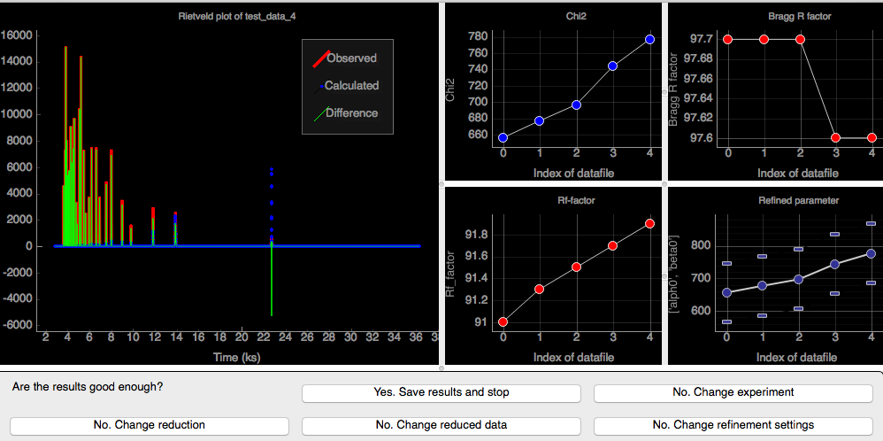
Status
IKC discussions for all techniques except INS & Aligned with SINE2020
Requirements gathered for all instruments (except VESPA)
Roadmaps for imaging, LSS, and diffraction
New developments in McStas for instrument teams
SINE2020 project on track
  Alignment (standardization) across major European facilities
  SasView converted to maintainable and extensible code
Fullprof tutorial/reference doc
Proof of Concept for Live Neutron
Data Analysis (LiNDA) for SANS
and powder diffr.
15

Slide 16
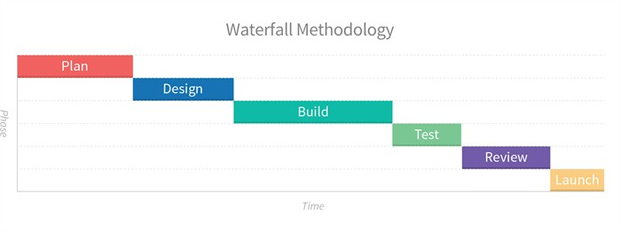
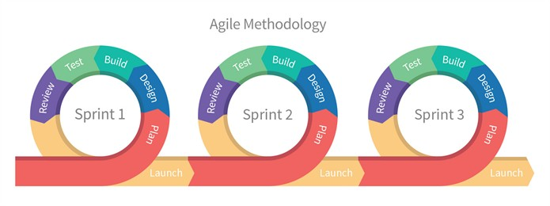
Integration with instrument teams
Synchronizing with instrument construction schedule
So far work has been generic core in nature
As instrument schedule becomes clearer we can construct specific software development schedules
Note: First ~8 instruments cover ~all instrument classes so need all software classes
Mindful: No. 2 in an instrument class cannot be ignored because No.1 is built first
Points of Contact/Integration
Instruments can/will have contact with all DMSC groups/developers but… special Points of Contact:
Thomas Holm Rod: Imaging & Engineering instruments, Diffraction instruments
Jonathan Taylor: SANS instruments, Reflectometry instruments, Spectroscopy instruments
Agile software development approach
Involves continuous engagement with/of instrument teams
Agile method – loops of limited requirements/specifications, development, tests then repeat
16

Slide 17
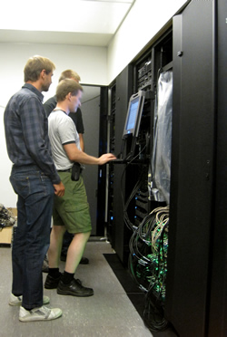
Data Systems and Technologies Group Interim Data Centre Operations
  Operate a cluster providing a grand total of 2 TFLOPS, 3.4 TB memory
  Used for: Target, moderator, and bunker simulations (MCPNX and Geant)
  Instrument design (McStas) and Shielding (requests for scope setting)
About 250 ESS and IKC/external users (~50 ‘active’ users)
  4 main ESS user groups: Instruments, Detector, Target, Neutron Optics
Cluster nodes: R410: 38 x 12 cores, 48GB; C8220: 24x 16 cores, 64GB
Two main storage systems: ZFS home dir – 40TB; Lustre fast storage – 60TB
Backup: 40TB ZFS based off site at DTU
  Utilization Q1 2016: Storage capacity is 80% utilized, Jobs completed 18932
  (Express queue: 4.88%, Long queue: 89.65%, Very long queue: 93.43%)
  Cluster nodes & storage were procured in 2011 – 2012 (Pre-Construction Phase)
  Will need replacement circa ~2018
Core team: Sune Bahn (GL),
Brian Lindgren Jensen,
Jesper Rude Selknaes,
Kareem Galal
17

Slide 18
Data Systems and Technologies Group Constructing the ESS Data Centre
Used to:
Store neutron (+meta) data from instruments
  Process (reduce and analyze) the neutron data
  Give users (remote) access to the data
  Continue target, moderator and instrument simulations
Hosted in Lund and Copenhagen linked by 10 Gbit/s fiber:
  1.9 Pb of storage in Lund and Copenhagen
  20 Node VM host for user access, experiment control, and catalogue data
  105 Node compute cluster for live analysis,
  post analysis, simulation and modeling.
Instrument (beamline) compute hardware:
  Fiber network to instrument
  Event formation (computer) hardware
  Instrument user client hardware
Looking for an in-kind partner:
Hardware: 3.2M€
System Admins: 0.6M€
18

Slide 19
Scientific Coordination and User Office software
Develop and install software supporting the user office
  User data base
    Keep track of visitors and their association
  Sample handling
    Keep track of samples, including toxicity, radioactivity etc.
  Proposal handling
    Keep track of submission and review process
  Beam scheduling
    Ensure available beam time is used efficiently
  Admin support and training
    Ensure financial aspects and safety training in place for visitors
  Publications and reports
    Keep track of scientific impact
Looking for an in-kind partner:
Software development: 1.6M€

Slide 20
Questions
QUESTIONS
20

Slide 21
Title

Slide 22
Title

Slide 23
13.4.4: PSI in kind contribution - Imaging
Imaging. Will leverage PSI (A. Kaestner) in house developments for MuhRec and KipTool and use SINE2020 for pump priming. PSI is partner in ODIN.
IKC | Examples of Tasks
Partner: PSI | Convert MuhRec & KipTool to open source Standard imaging analysis Spectral (energy resolved) imaging analysis User interfaces (GUI + scripting) Documentation and tutorials Live-analysis and visualization
Value: 471 k€
Staffing | 2016 | 2017 | 2018 | 2019
Post doc | PSI SINE2020 100% |  | PSI IKC 100% |  |  | Integrated Testing
Scientist | PSI IKC 50%
23
Additional 12 person months for imaging in SINE2020 shared between LLB and ESS
Notes:
Example of staffing is shown here because there is space on the slide for imaging (and not for MLZ) and because it is rather simple to illustrate for imaging. However, same story applies to MLZ

Slide 24
13.4.4: FZJ in kind contribution – Reflect-ometry, QENS, and Engineering Diffraction
Reflectometry. Leverages 3-4 years of effort in SINE2020 and ~12 years of effort of MLZ in house development for BornAgain, which is born with GUI + scripting but focuses on GISAS.
Engineering diffraction. Leverages MLZ in house developments of SteCa software for STRESS-SPEC jointly operated by TUM and HZG, a BEER partner.
QENS. The head of the MLZ scientific computing group has extensive domain knowledge, and MLZ contributes to both C-SPEC (TUM) and T-REX (FZJ).
IKC | Examples of Tasks
Partner: FZJ | Extend BornAgain to conventional reflectometry (MotoFit functionality with SasView like interface) Capability to handle polarized data lambda dependent absortion for reflectometry Live-analysis for at least reflectometry Improve SteCa user interfaces (GUI and CLI, requires refactoring) Develop user-friendly QENS analysis software, possibly based on Mantid/Vates Enable multi-dimensional fitting Integrated Testing
Value: 1,139 k€
24
Notes:
Staffing is aligned with SINE2020 like imaging

Slide 25
13.4.4: ESSB in kind contribution – Powder and Single Crystal Diffraction
Powder and single crystal diffraction. Working on IK agreement with ESSB centered around staff at the Bilbao Crystallographic Server at the University of the Basque Country and ILL. Will leverage decades of development of Fullprof (30-100 years of effort) and secure its continued existence for ESS users.
IKC | Examples of Tasks
Partner: ESSB | Convert Fullprof to open source software New user-friendly GUI Python scripting interface 2D (ToF) Rietveld analysis incl. lambda-dependent resolution functions Live-analysis Magnetic CIF files for commensurate and incommensurate magnetic structures Documentation and tutorials Integrated Testing
Value: 944 k€ (Under discussion)
25

Slide 26
13.4.4: In kind contribution to INS
Inelastic Neutron Scattering. Requirements for this area are still quite premature. It is at the core of a neutron scattering facility, at the same time data are hard to analyse presumably resulting in the publication rates. PSI has shown interest in this WU.
IKC | Examples of Tasks
Partner: TBD | Develop user-friendly analysis software with GUI and scripting interface, possibly based on Mantid/HORACE Integrate SpinW Multi-dimensional fitting Integrated Testing
Value: 512 k€
26

Slide 27
Integration with instrument teams
Synchronizing with instrument construction schedule
So far work has been generic core in nature
As instrument schedule becomes clearer we can construct specific software development schedules
Note: First ~8 instruments cover ~all instrument classes so need all software classes
Mindful: No. 2 in an instrument class cannot be ignored because No.1 is built first
Points of Contact/Integration
Instruments can/will have contact with all DMSC groups/developers but… special Points of Contact:
Thomas Holm Rod: Imaging & Engineering instruments, Diffraction instruments
Jonathan Taylor: SANS instruments, Reflectometry instruments, Spectroscopy instruments
What have we done so far?
Instrument Data has met with all instrument teams in phase 1
Collected requirements for instrument controls, Collected requirements for data reduction
Working to get ESSIIP lab set-up so that we can use it to demonstrate to instrument teams
Data Analysis Used Confluence to collect requirements information…
Contacted instrument teams for input on requirements (so far from all teams except Vespa)
Contacted some other stakeholders as well (end users and developers of existing analysis software)
Developed first versions of data analysis roadmaps in Confluence for imaging, SANS, reflectometry, and diffraction (Spectroscopy coming up soon).
27

Slide 28
Integration with instrument teams
An Agile software development approach
Involves continuous engagement with/of instrument teams
Waterfall method – extensive requirements gathering, long development phase then testing
Agile method – loops of limited requirements/specifications, development, tests then repeat
Open source repositories, automated build servers with tests, use of “golden data”
Testing at existing facilities
Many instrument teams are based around existing neutron facilities in Europe
Many DMSC in-kind contributors are from existing neutron facilities in Europe
Working with instrument teams we can test on instruments and/or data at existing neutron facilities
Cold and Hot Commissioning
During instrument cold commissioning we need time for DMSC “integrated systems testing”
During hot commissioning have DMSC “computational scientist” to work with instrument team
28

