Slide 1





Multi-Blade tests @ BNC/WIGNER
Preliminary results
Francesco Piscitelli
ESS Detector Group
22 - March - 2016

Slide 2
The Multi-Blade detector
Calculated Efficiency
5 degrees
Efficiency 45% at 2.5Å
A single Boron layer inclined at 5 degrees
The intensity is spread over a wider surface
(5 degrees = factor x10)
substrate
¹⁰B₄C
neutrons
θ

Slide 3
The Multi-Blade detector
neutrons
wires X
Multi-Blade
sample
substrate
¹⁰B₄C
neutrons
strips Y
θ

Slide 4
The Multi-Blade detector
cassette
neutrons
substrate
wires X
¹⁰B₄C
strips Y

Slide 5
Electric field modeling
neutrons
substrate
wires X
¹⁰B₄C
strips Y

Slide 6
Materials evaluation
Old Design New Design
cassette
cassette
neutrons
neutrons
substrate
substrate
wires X
¹⁰B₄C
strips Y
strips Y
¹⁰B₄C
wires X

Slide 7
Materials evaluation
Old Design
scattered or absorbed flux
cassette
neutrons
strips Y
substrate
¹⁰B₄C
wires X
Any material holding the strips at 5deg scatters too much!

Slide 8
Materials evaluation
New Design
Substrate as thick as necessary
Kapton (strips) shielded by ¹⁰B₄C
cassette
Efficiency saturated (5degrees)
neutrons
At 5deg not much survives to the ¹⁰B₄C
substrate
wires X
¹⁰B₄C
strips Y

Slide 9
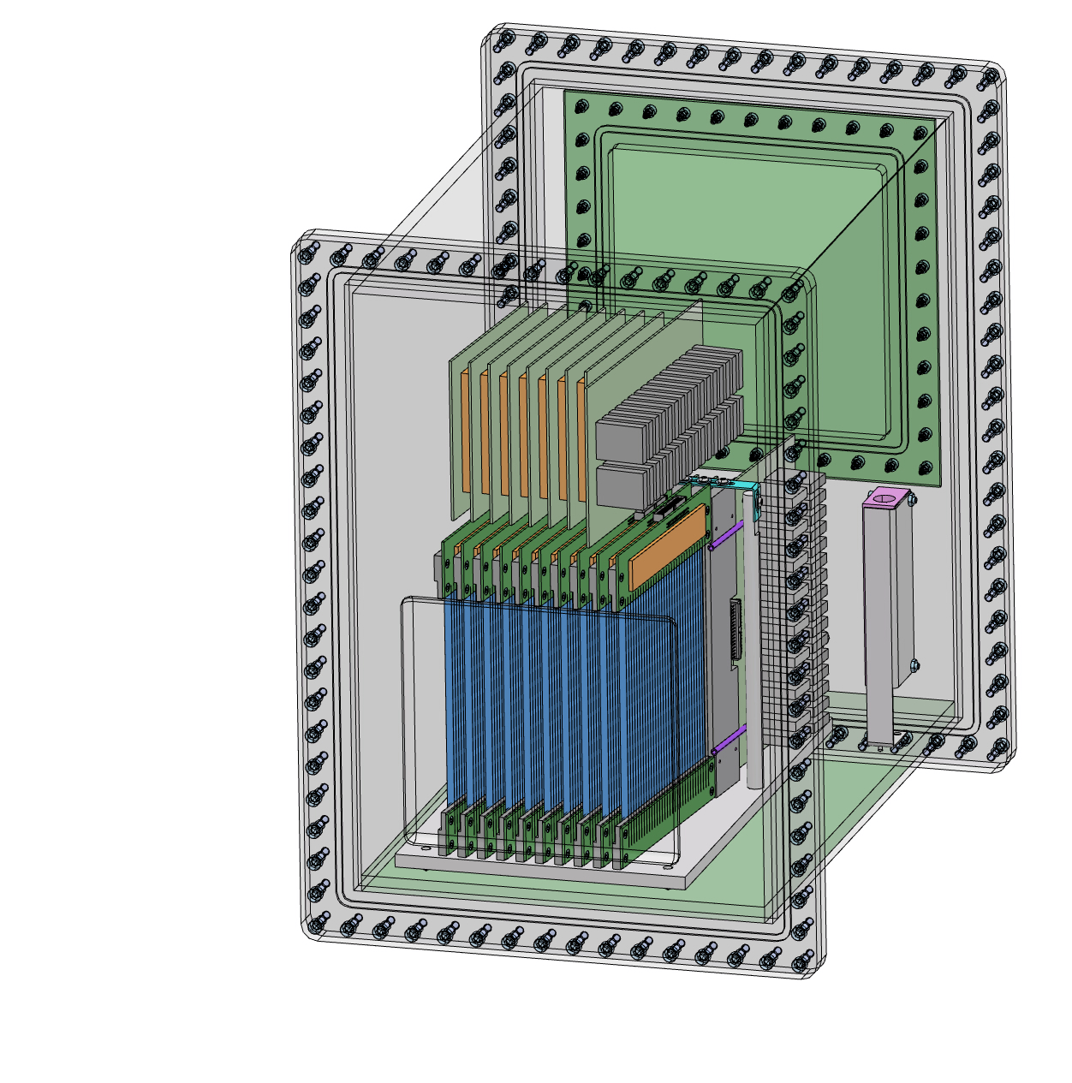
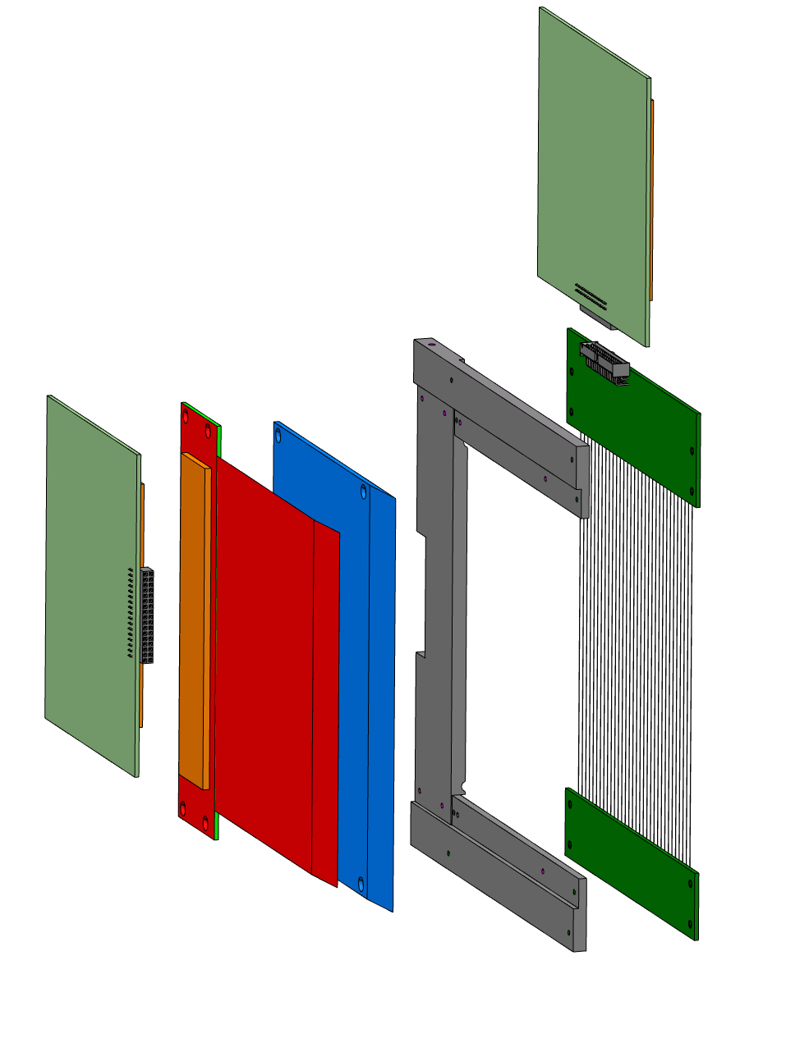
Multi-Blade mechanical design
10x10cm² demonstrator
amplifier board
¹⁰B₄C substrate
amplifier board
cathode strips
holding frame
anode wires
neutrons

Slide 10
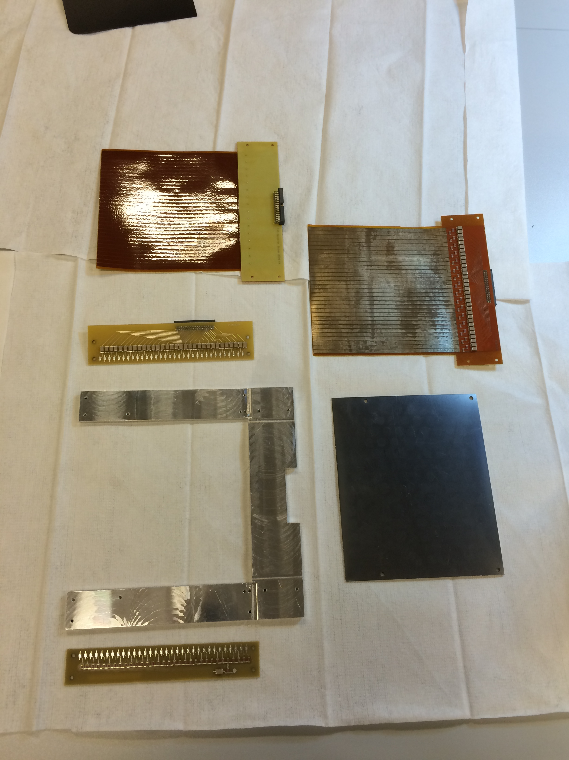
amplifier board
¹⁰B₄C substrate
holding frame
¹⁰B₄C substrate
amplifier board
cathode strips
cathode strips
holding frame
anode wires
cathode strips

Slide 11
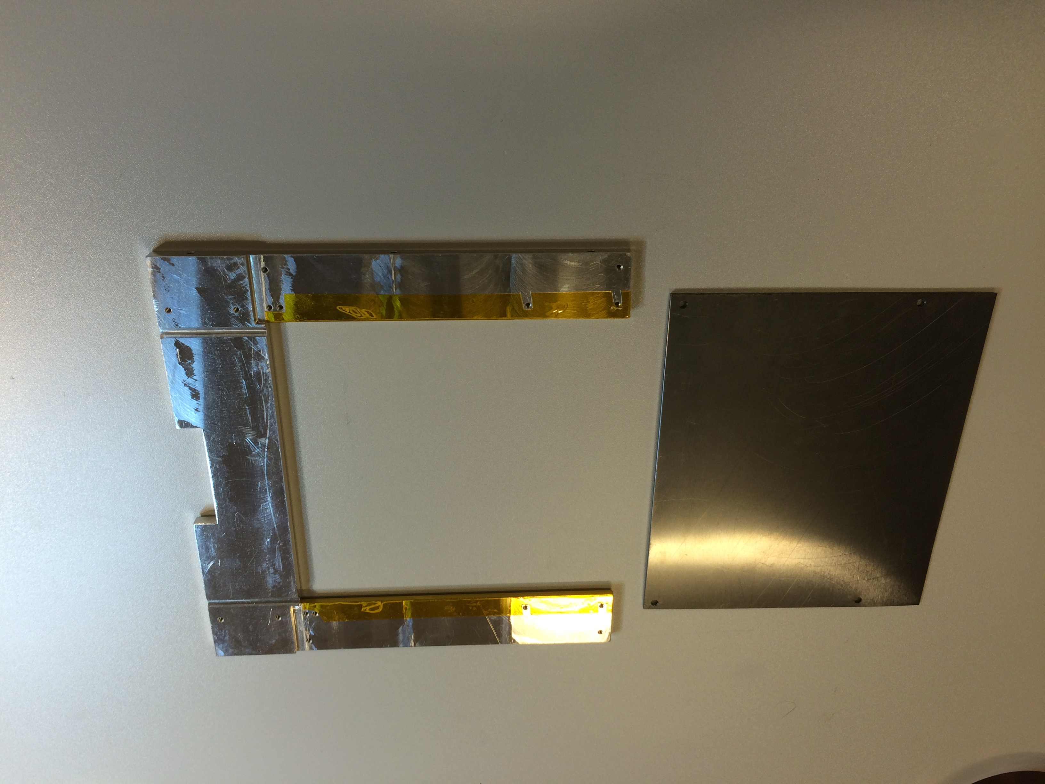
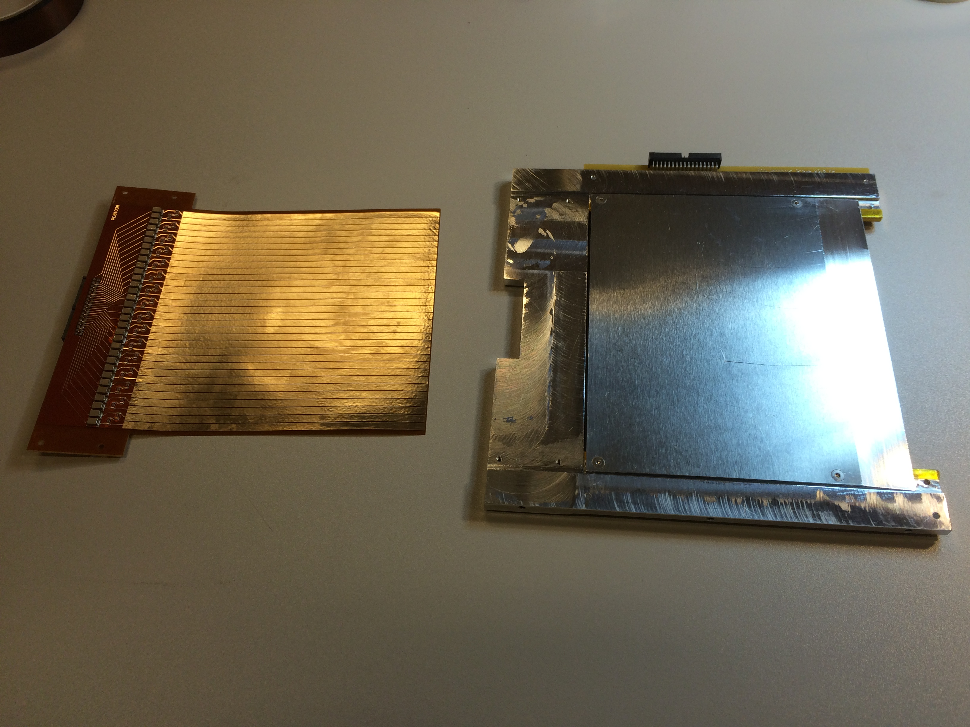
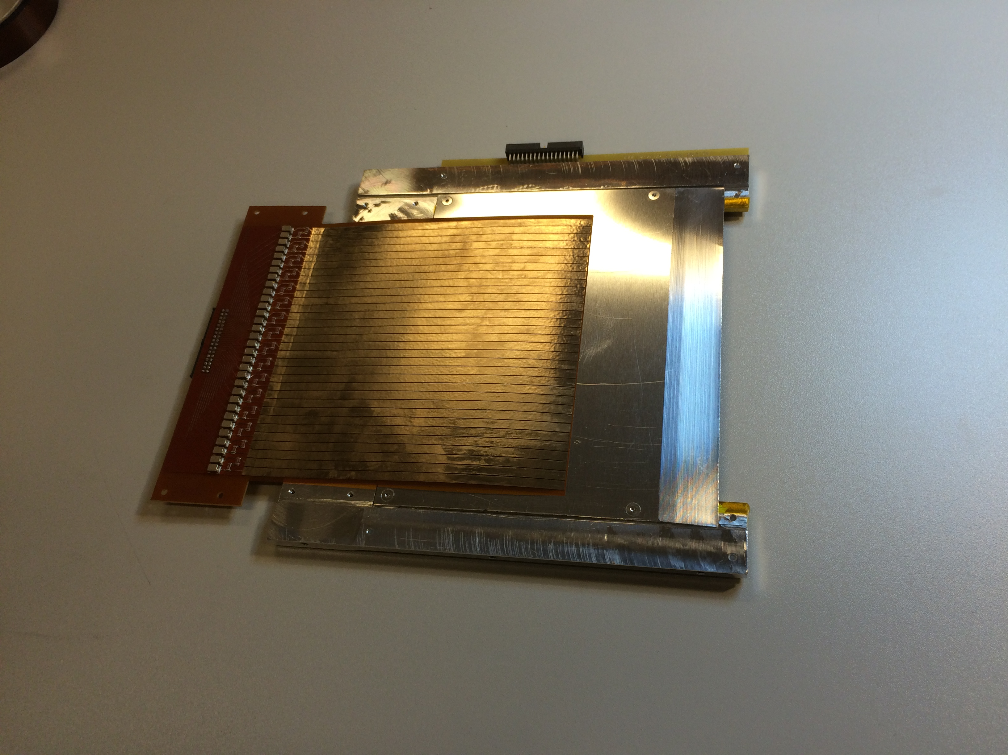
¹⁰B₄C substrate
holding frame
cathode strips
cathode strips

Slide 12
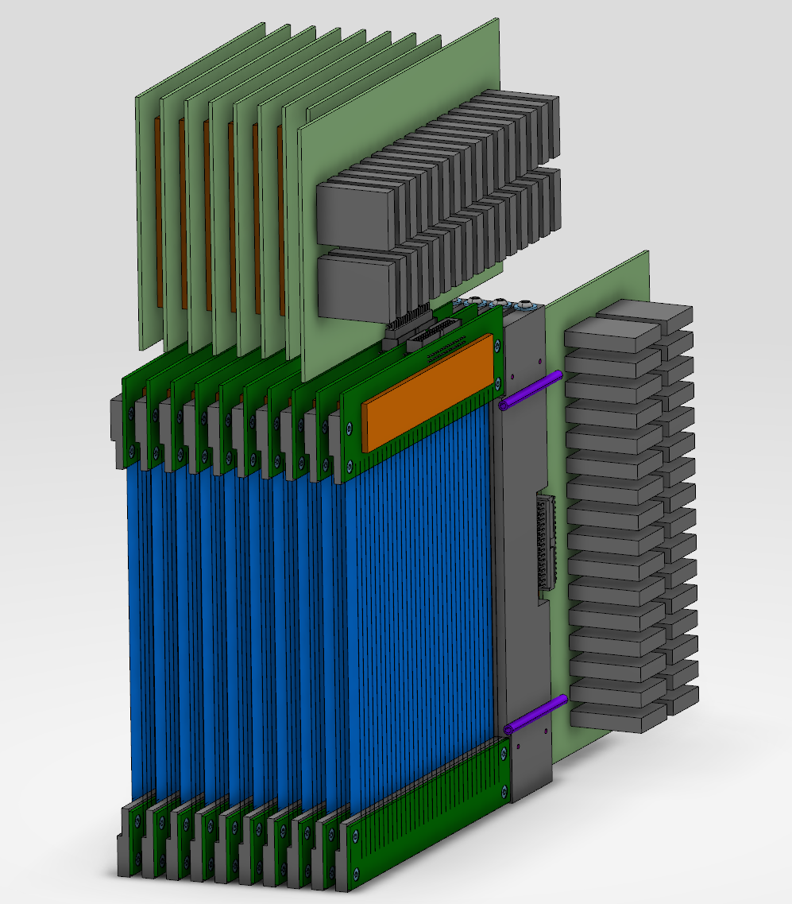
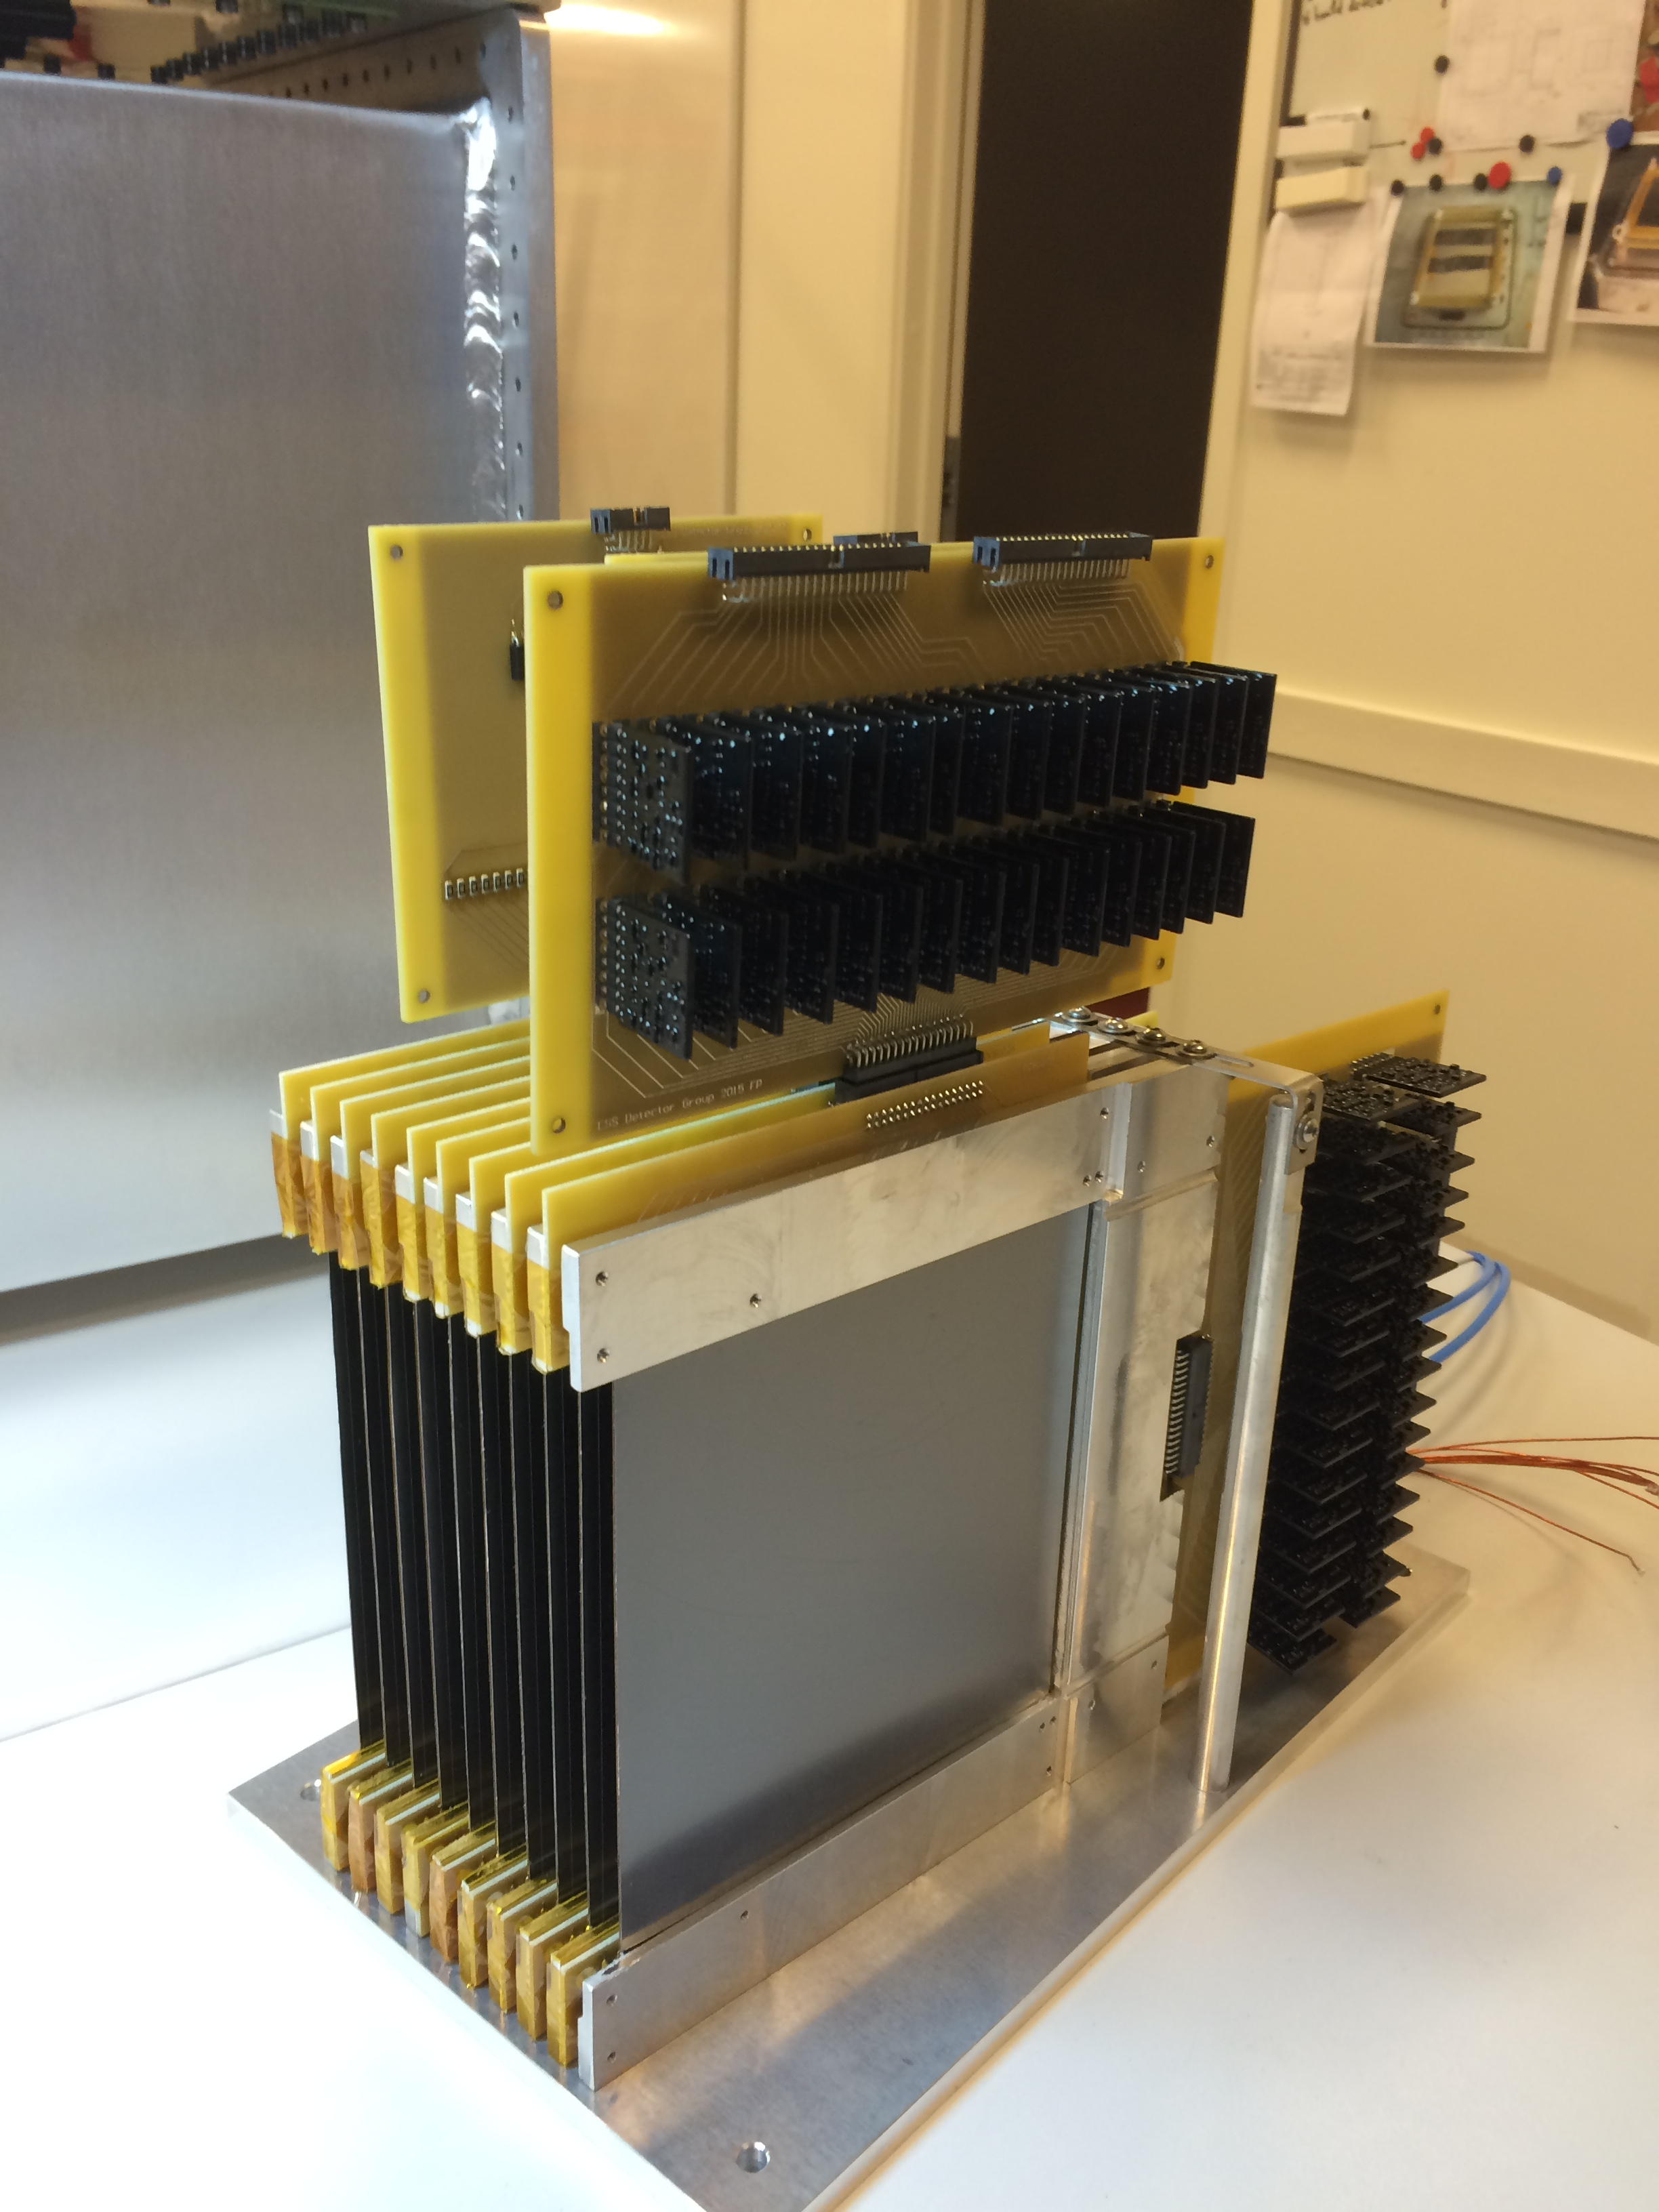

Slide 13
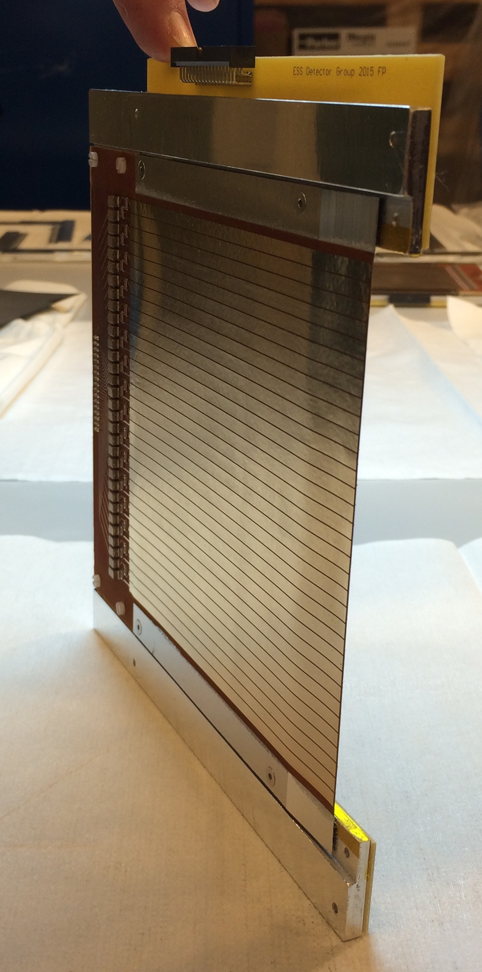
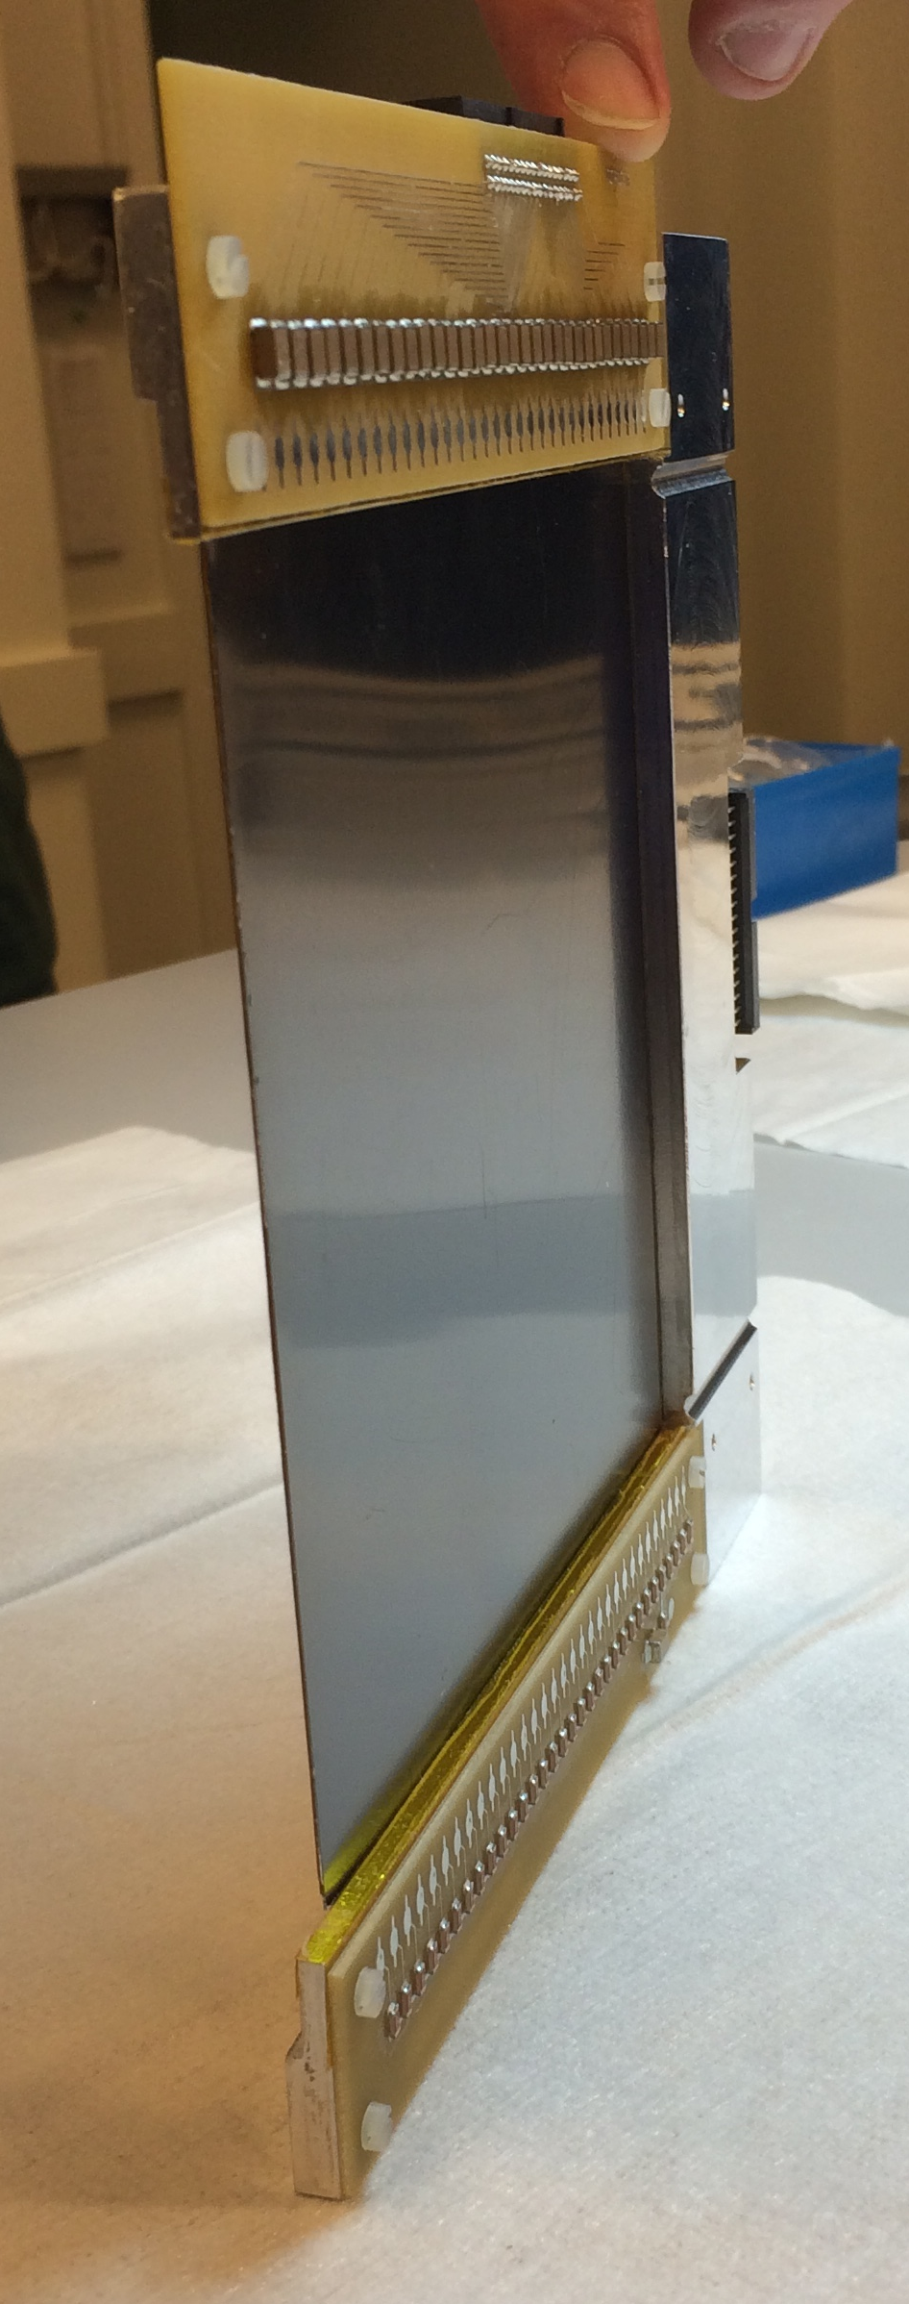
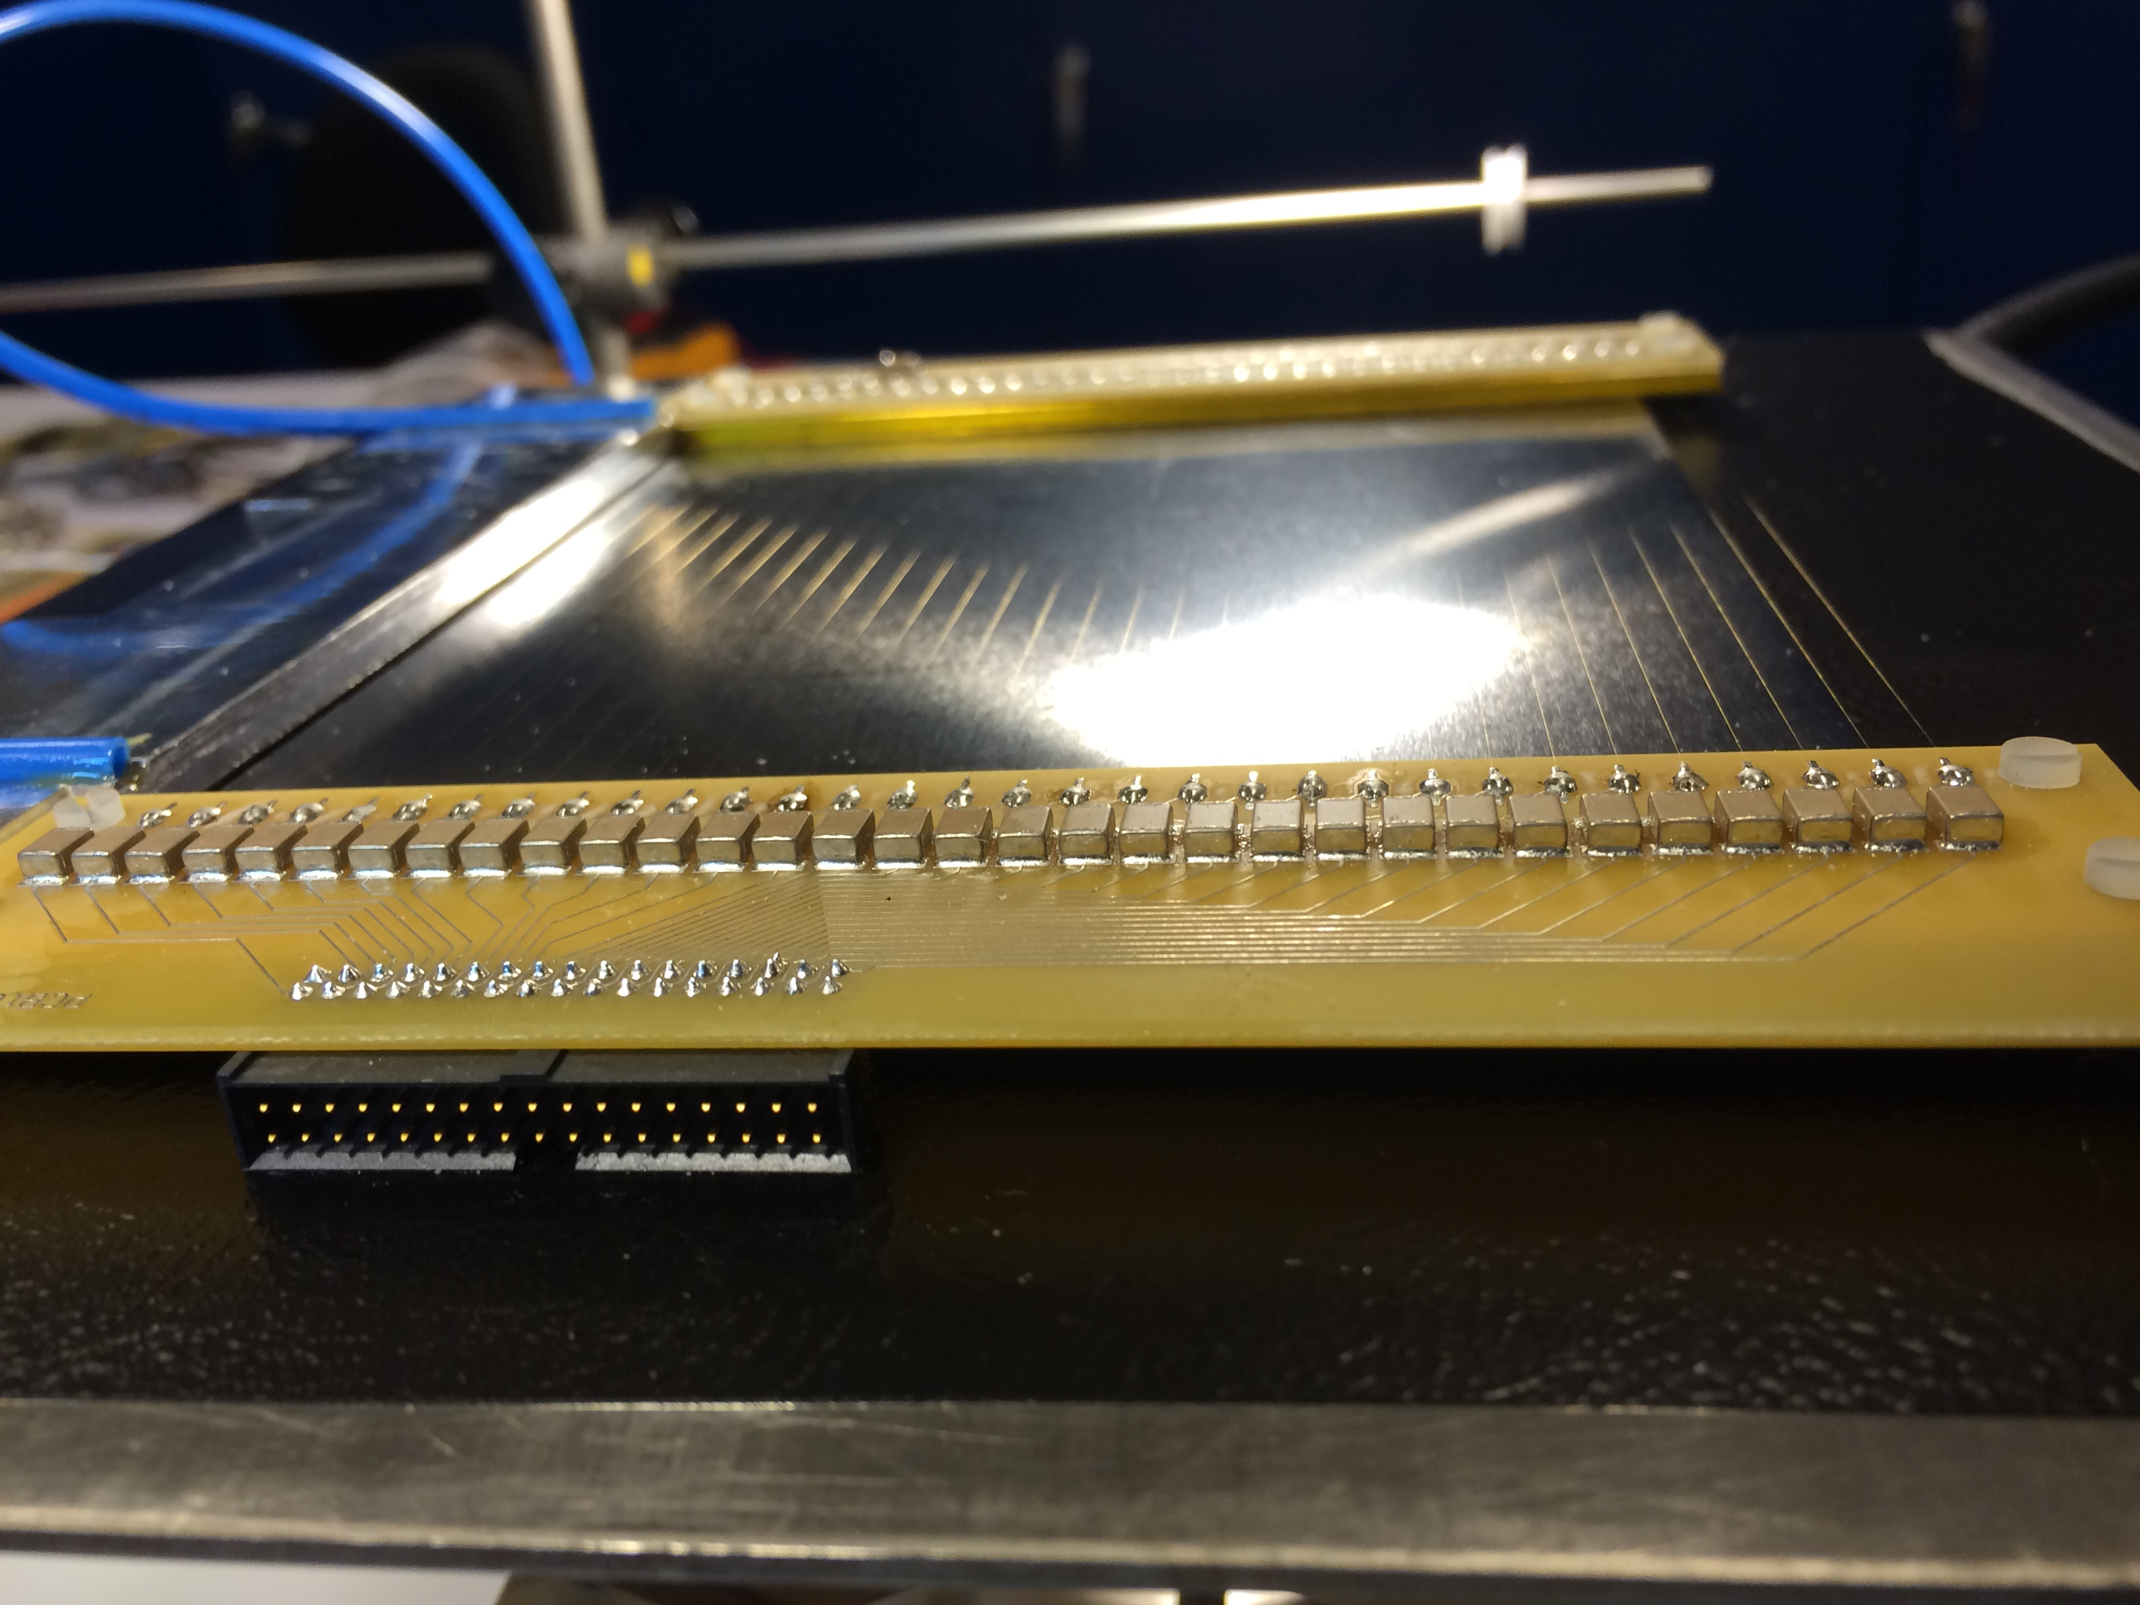
sputtered ¹⁰B₄C layer
cathode strips
substrate
anode wires
y-axis (strips)
x-axis (wires)

Slide 14
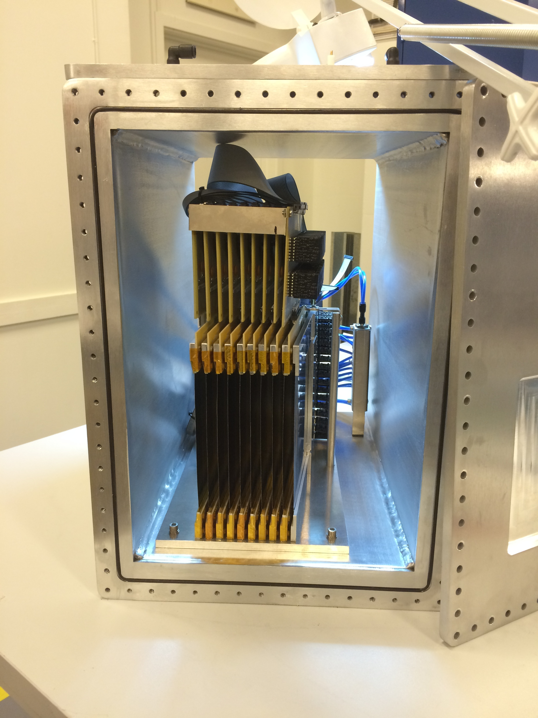
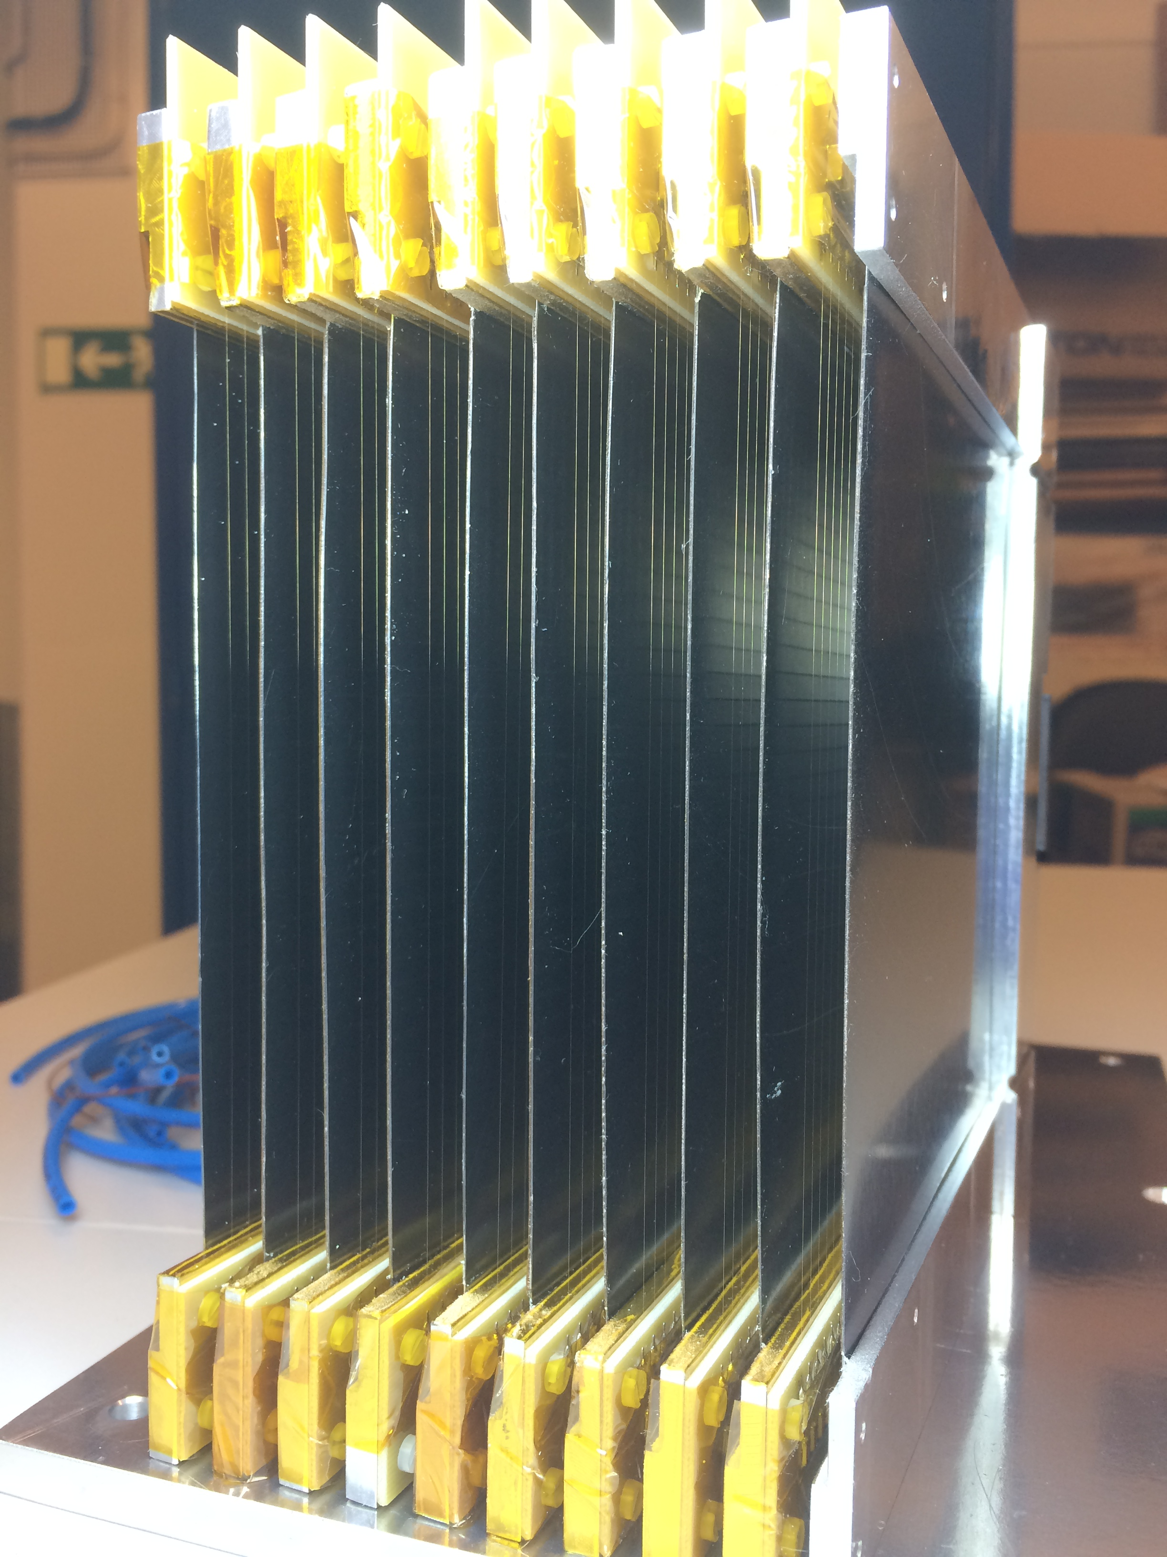
The Multi-Blade detector
140mm
100mm
neutrons
9 Cassettes inclined at 5 degrees with respect to the neutron beam
1 Individual readout (32 wires+32 strips) + 8 charge division (32 channels)
neutrons
Multi-Blade

Slide 15
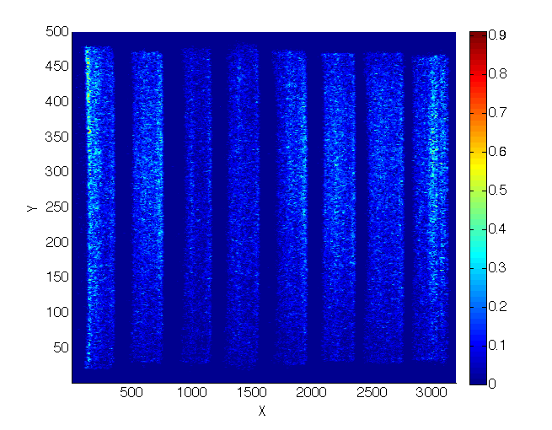
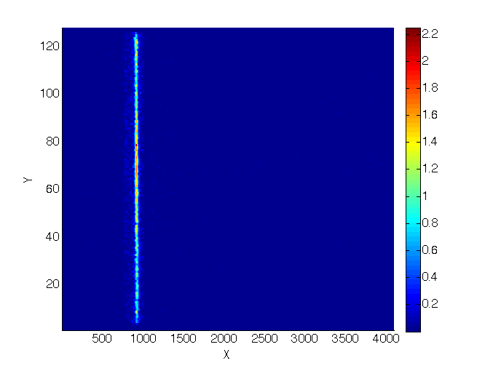
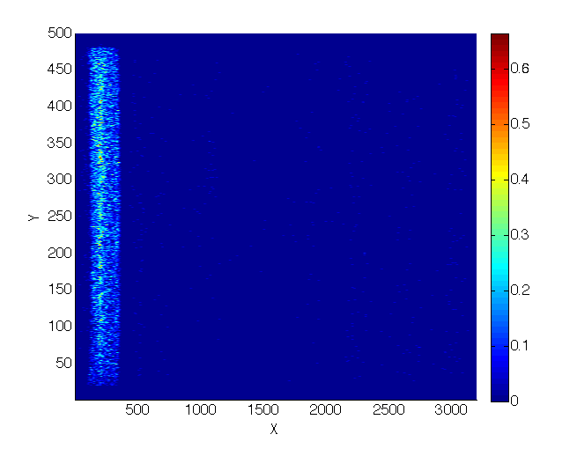
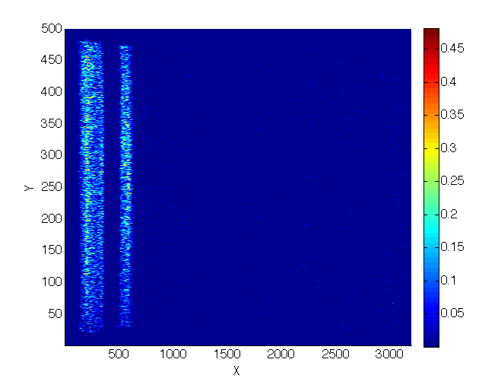
Uniformity and overlap
uniformity
shadow
shadow
neutrons
overlap
substrate
wires X
¹⁰B₄C
strips Y

Slide 16
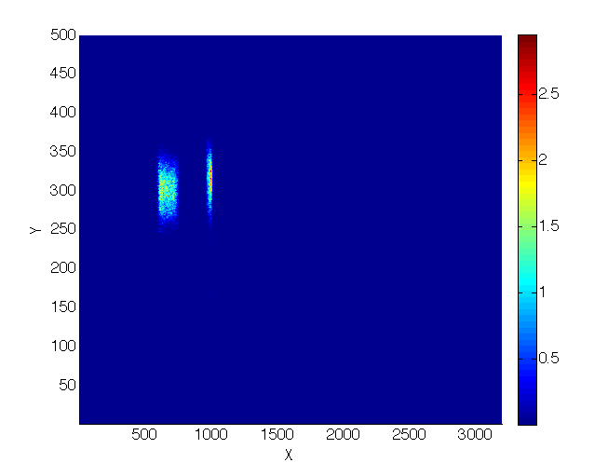
Uniformity and overlap
uniformity
shadow
shadow
neutrons
overlap
substrate
wires X
¹⁰B₄C
strips Y
cassette N
cassette N+1
Edge (knife) cassette N

Slide 17
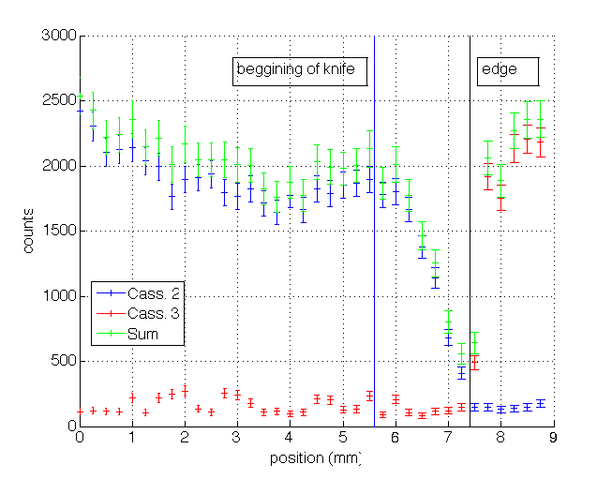
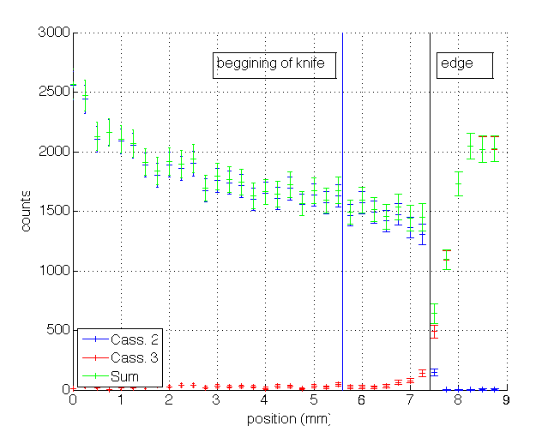
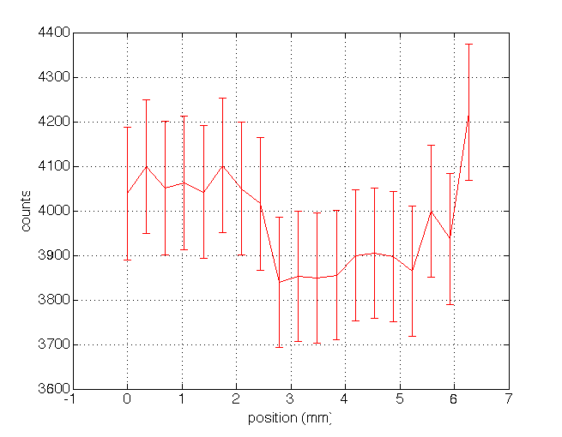
Uniformity and overlap
uniformity
Knife gain not corrected
shadow
neutrons
overlap
Knife gain corrected
substrate
wires X
¹⁰B₄C
strips Y
Individual readout

Slide 18
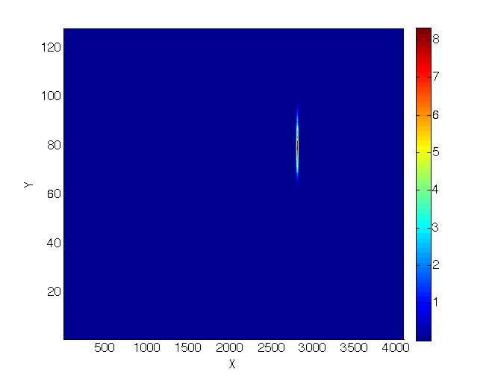
Spatial resolution X – wires

Slide 19
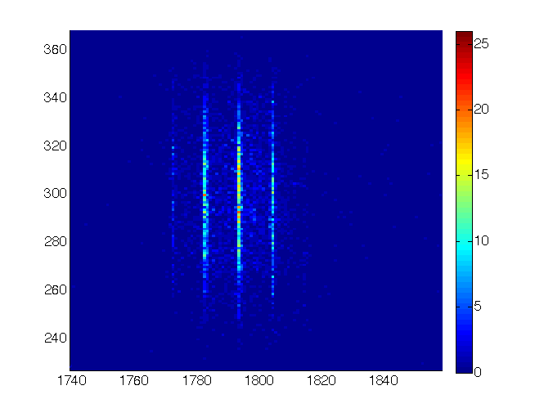
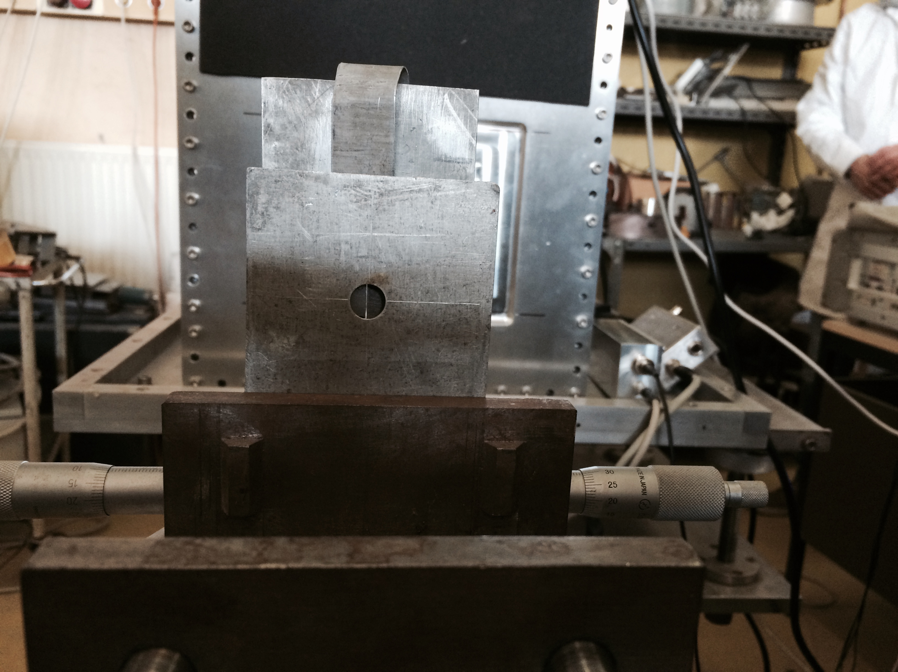
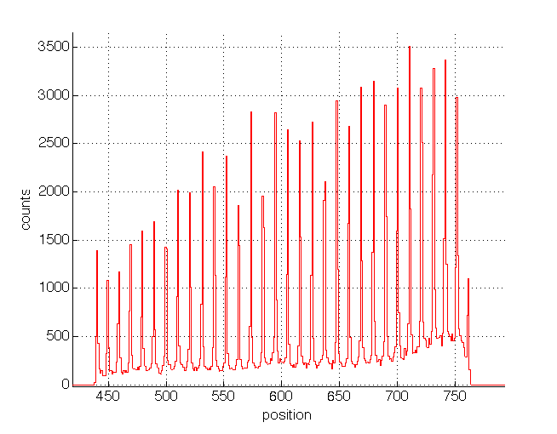
Spatial resolution X – wires

Slide 20

Spatial resolution X – wires

Slide 21
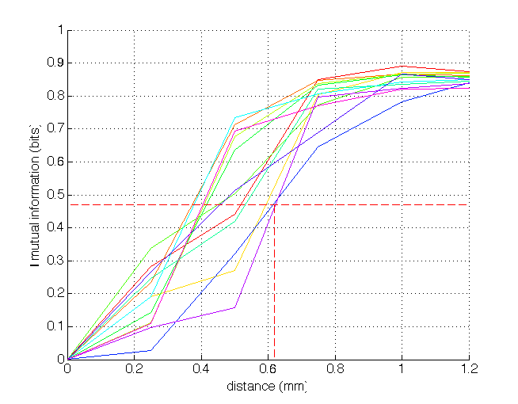
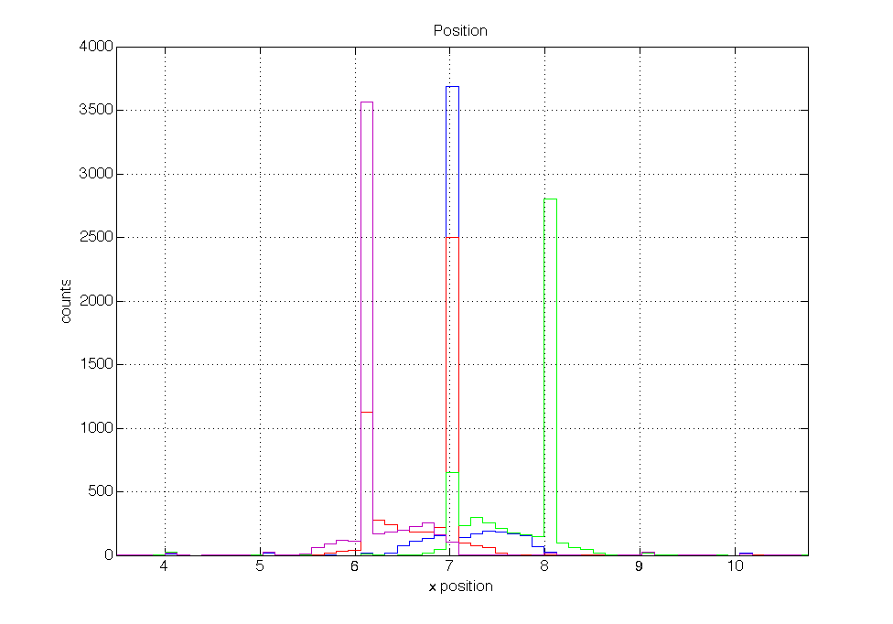
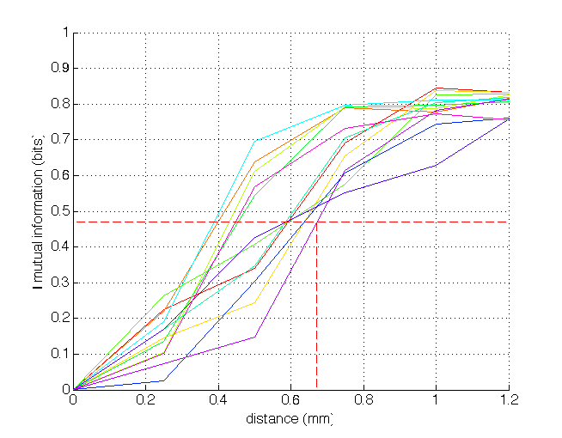
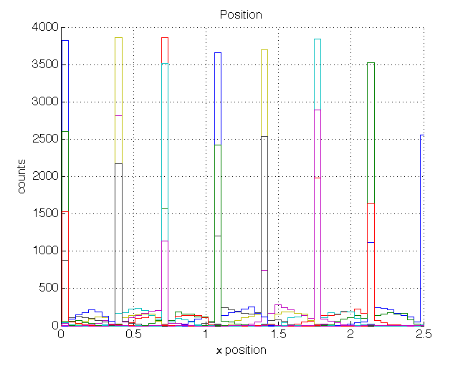
Spatial resolution X – wires
Mutual Information
Wire 2
CoG Algorithm
Wire 1
Wire 3
Resolution FWHM
~ 0.61mm
Single Wire Algorithm
Step 0.25mm
Resolution FWHM
~ 0.67mm

Slide 22
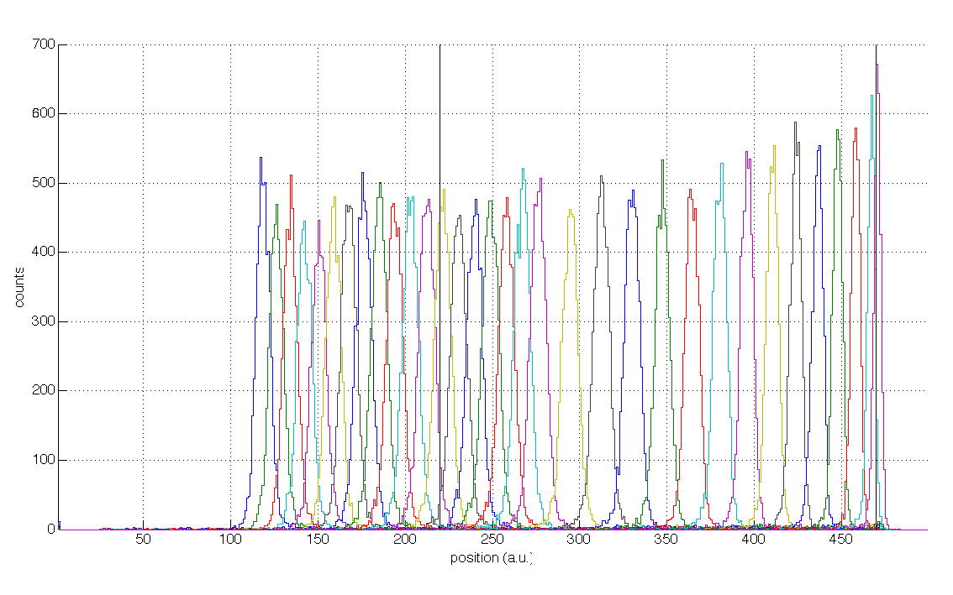
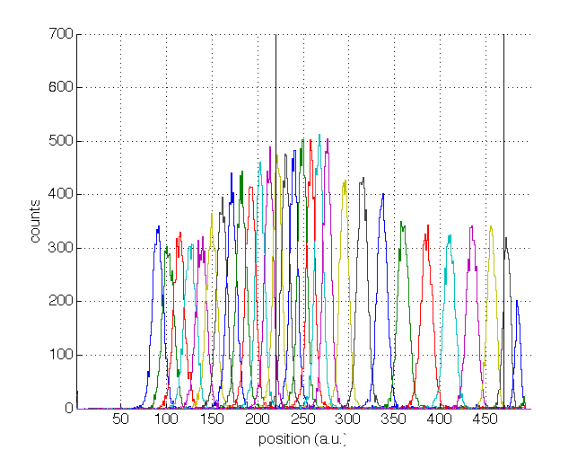
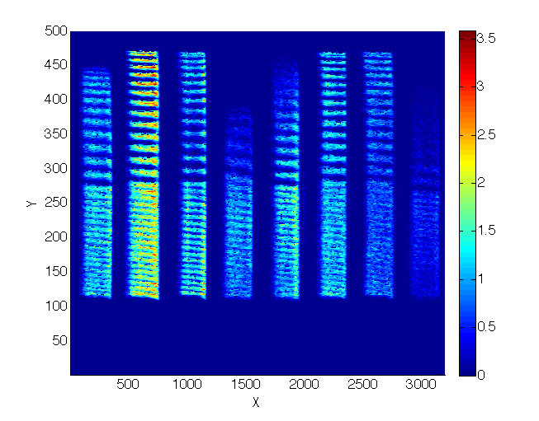
Spatial resolution Y – strips
Cassette edge
Cassette edge
Cassette center
Cassette center
MAX Algorithm
SUM Algorithm
Step 2mm
Step 4mm
Step 4mm
Step 2mm
Non-linear at edges
(expected and due to parasitic C of strips)

Slide 23
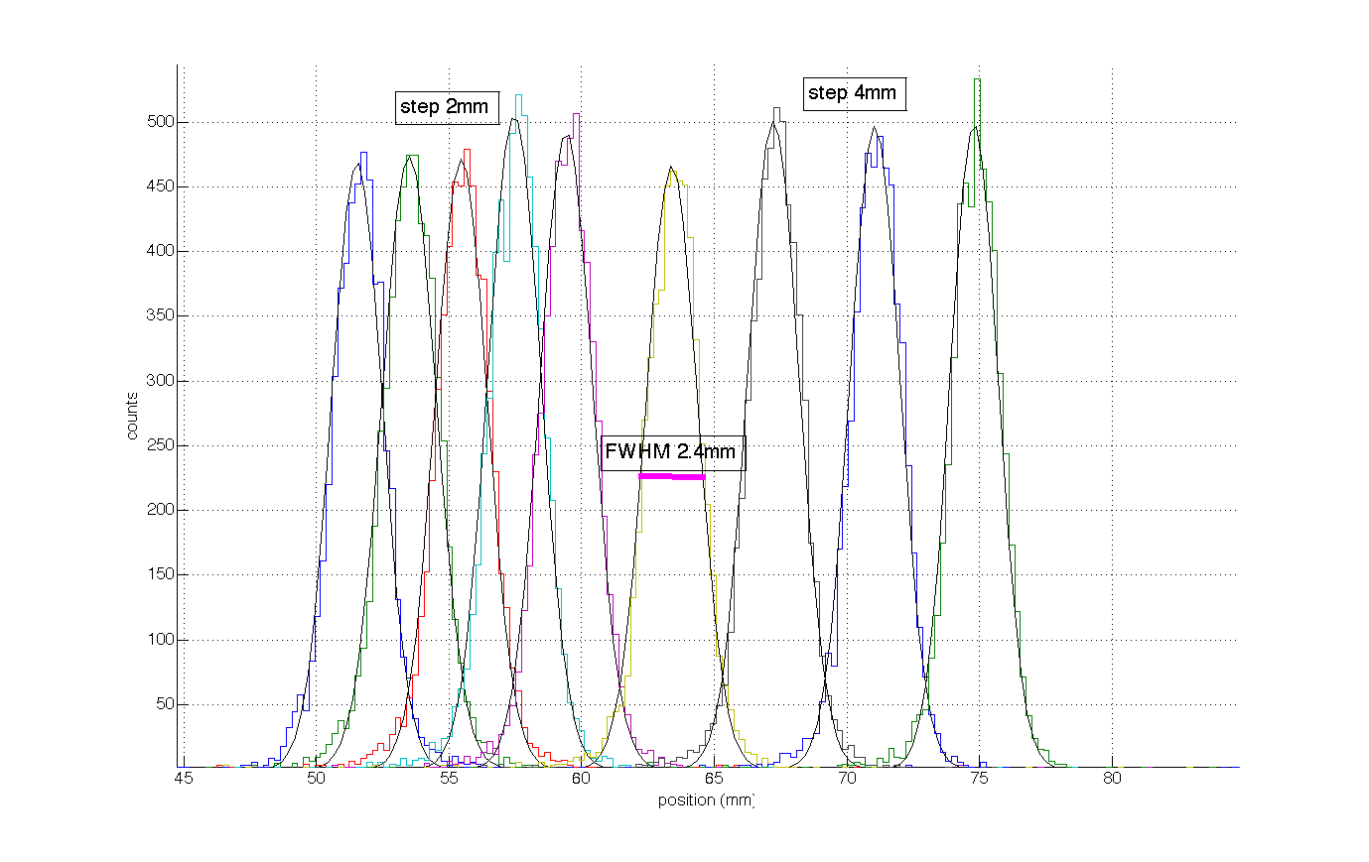
Spatial resolution Y – strips
Step 4mm
Step 2mm
FWHM ~ 2.4mm

Slide 24
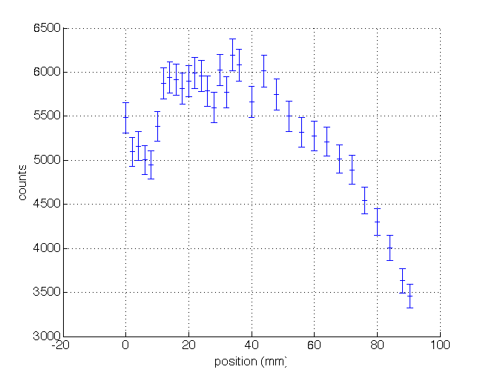
Uniformity Y – strips
Cassette center
Cassette edge

Slide 25
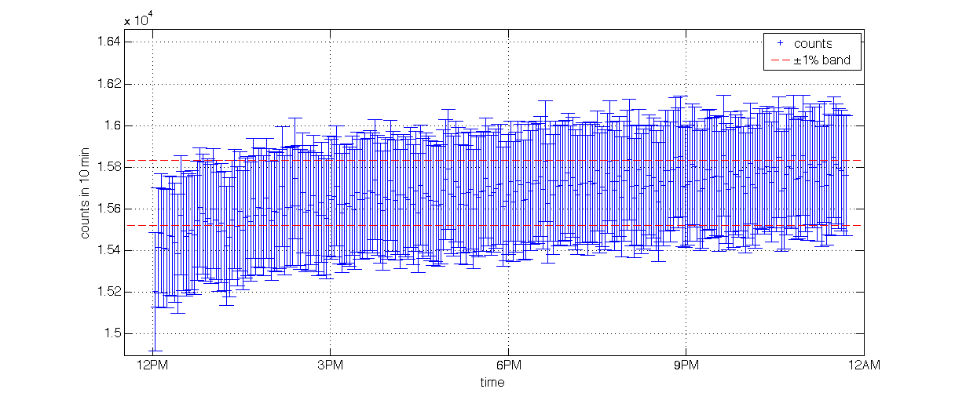
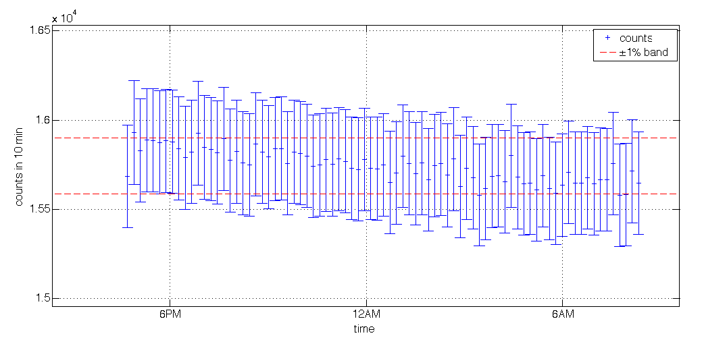
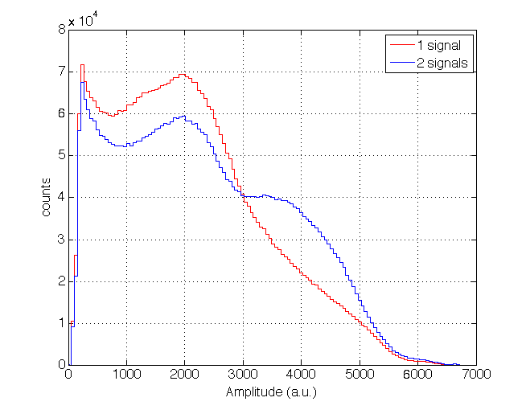
Stability

Slide 26
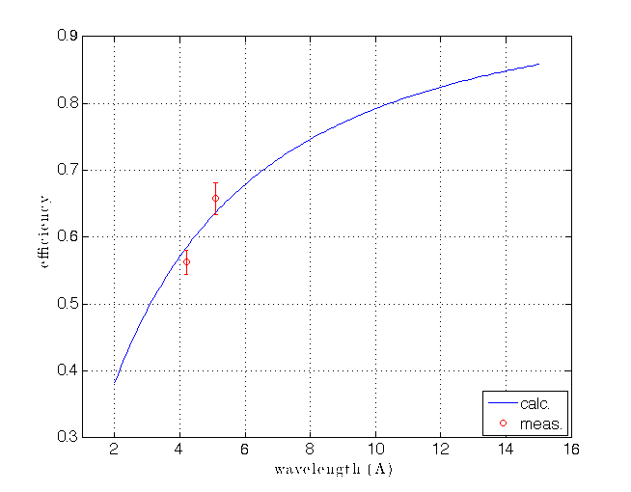
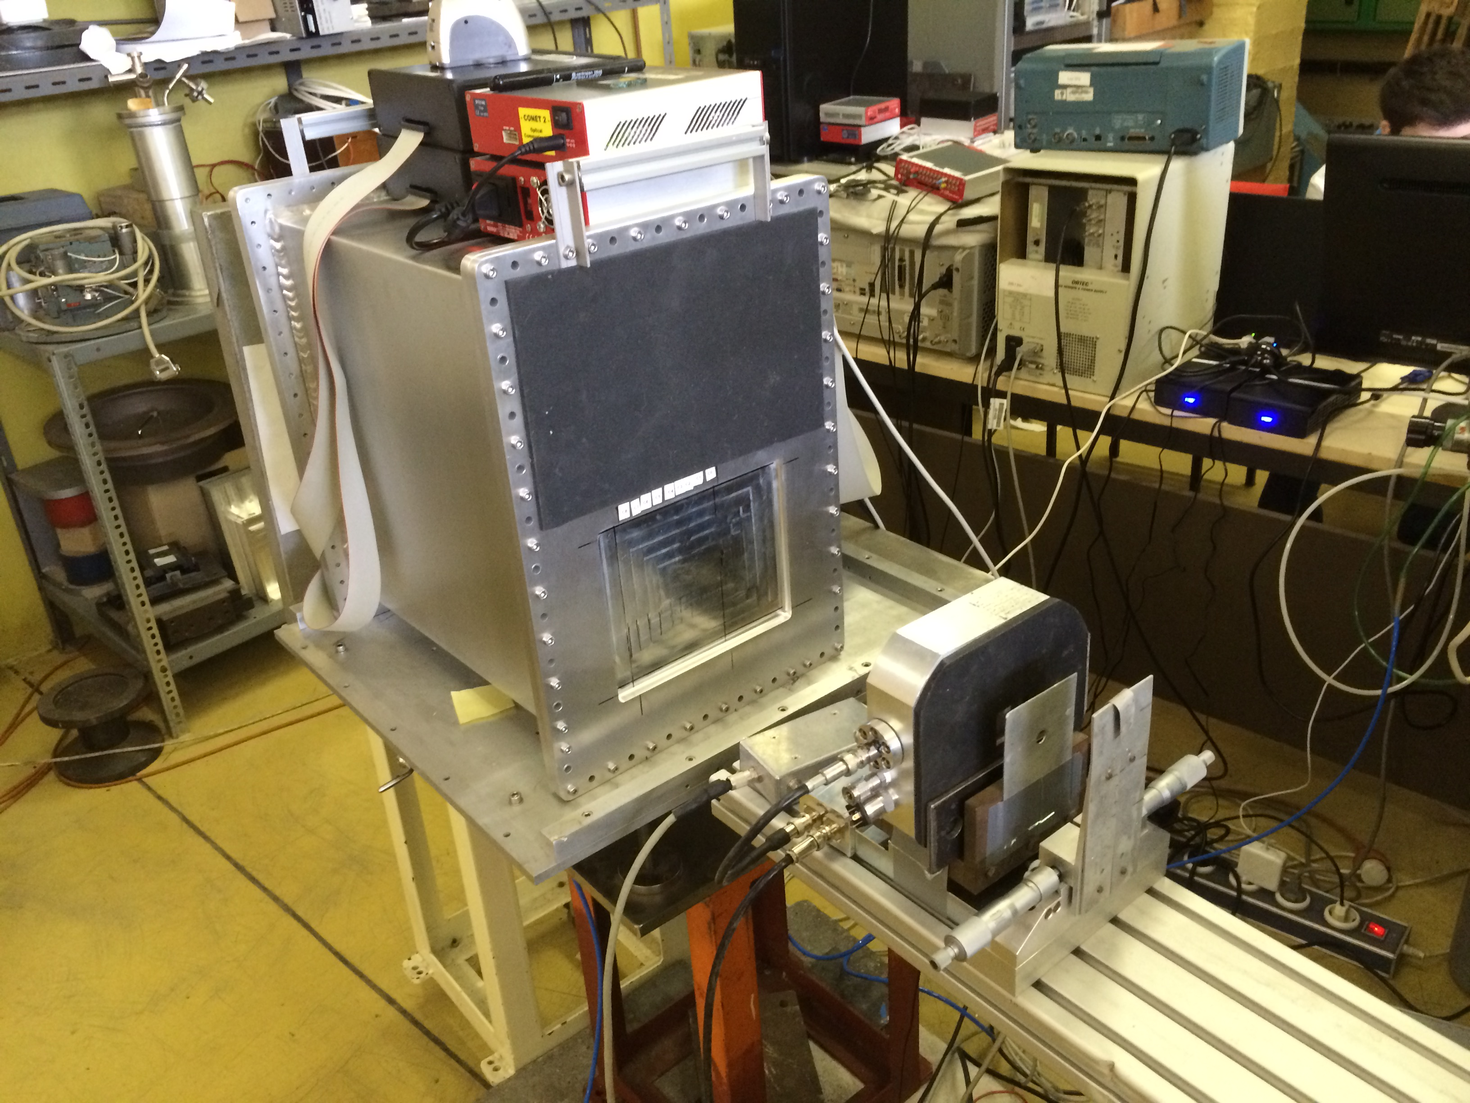
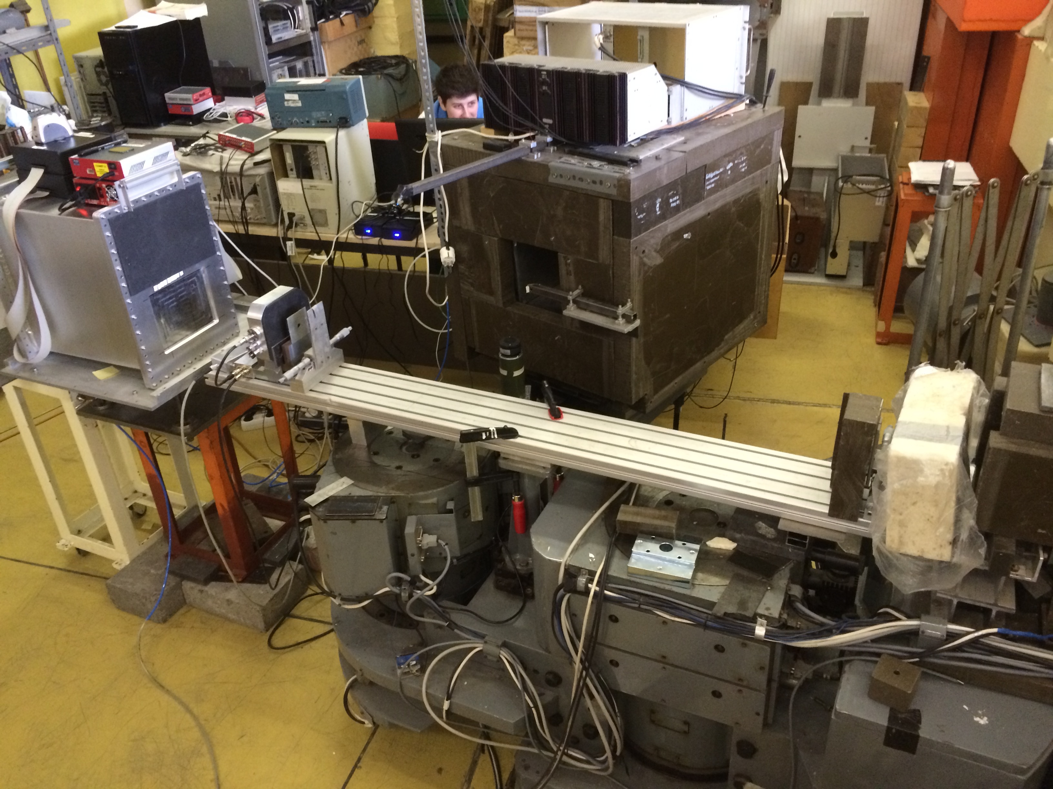
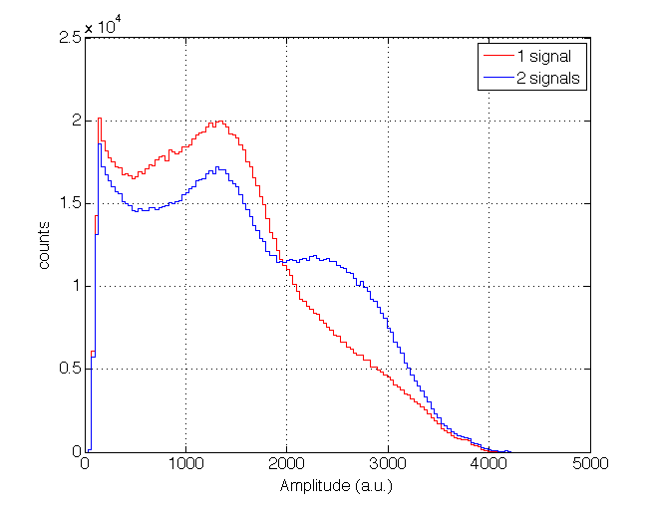
Efficiency
~55% at 4.1Å, ~65% @ 5.1Å (5 degrees)
calculated
measured
PHS

Slide 27
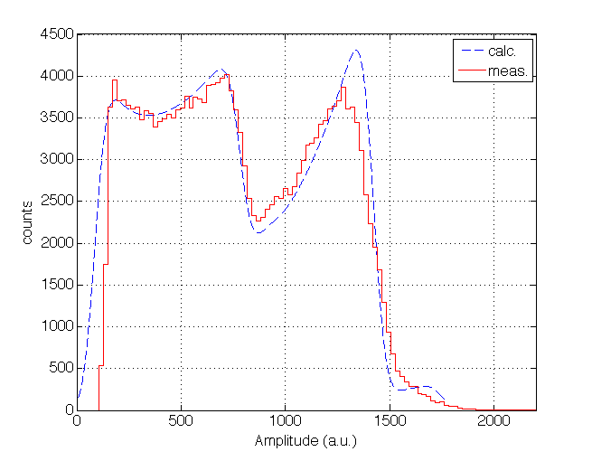
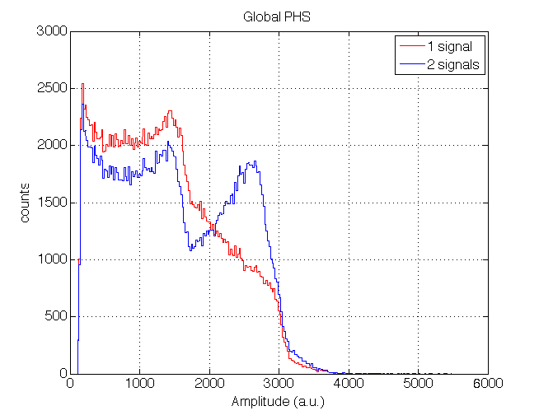
PHS and Gain
calculated
measured
@ 4.1Å 5 degrees
Energy Resolution ~50 KeV
Energy Threshold ~100 KeV
Gas Gain ~ 10 - 20

Slide 28
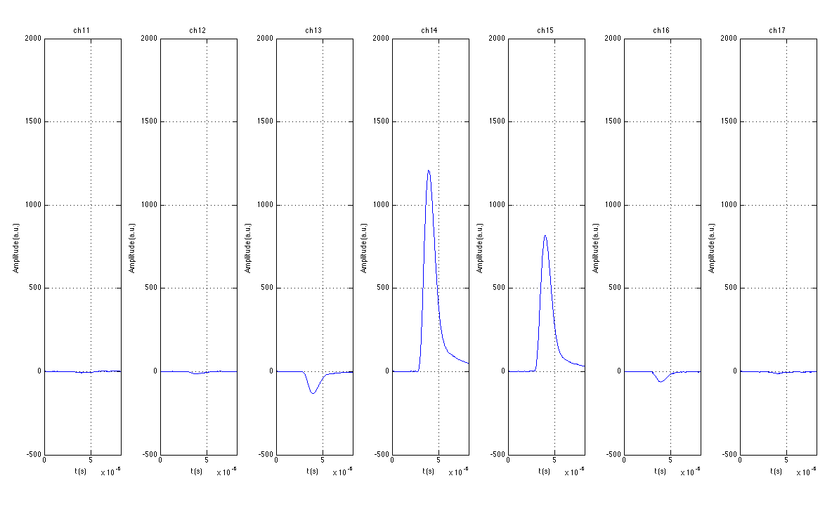
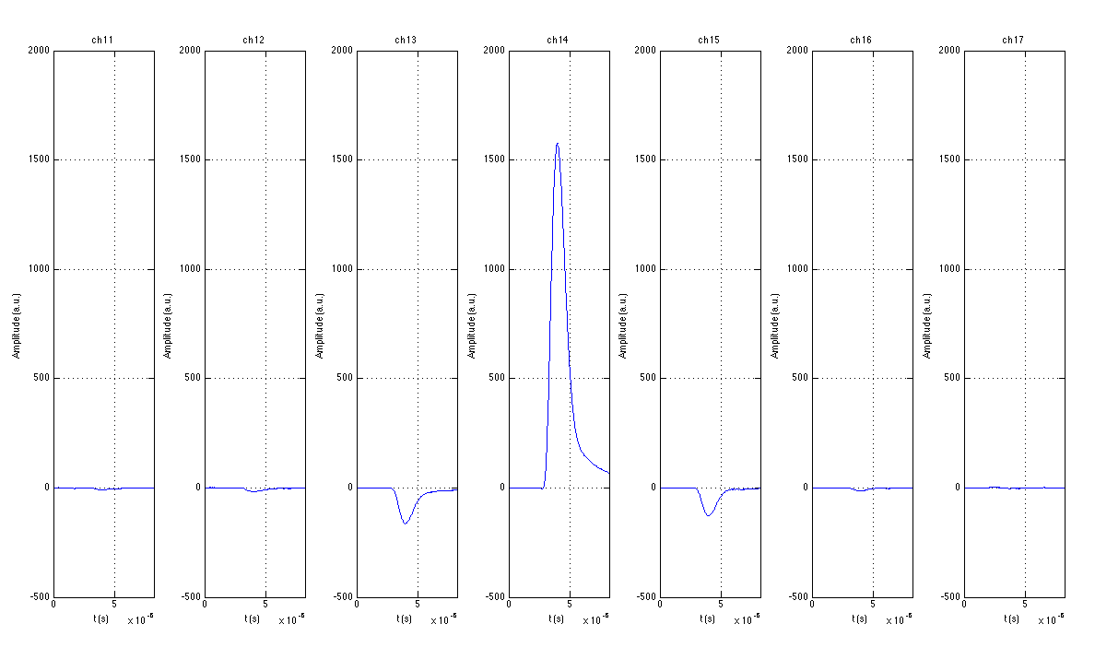
PHS
Wire 11 12 13 14 15 16 17
Integral is the same,
just higher energies shifted to lower energies.
Event 1
When the alpha escapes the layer almost orthogonally, it hits the opposite cassette and does not release the full energy.
Event 2

Slide 29
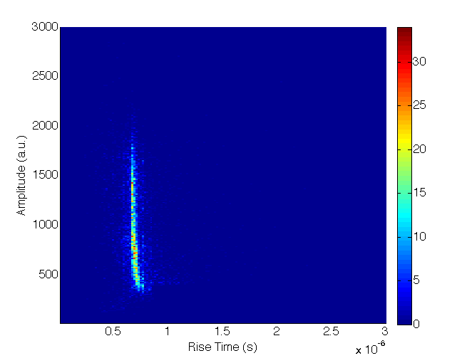
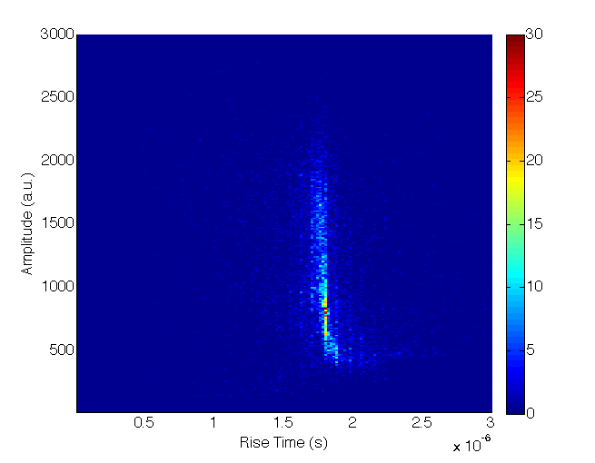
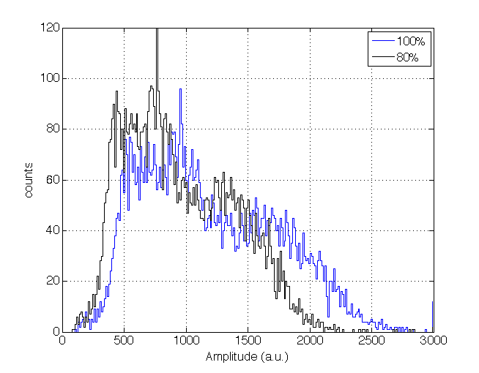
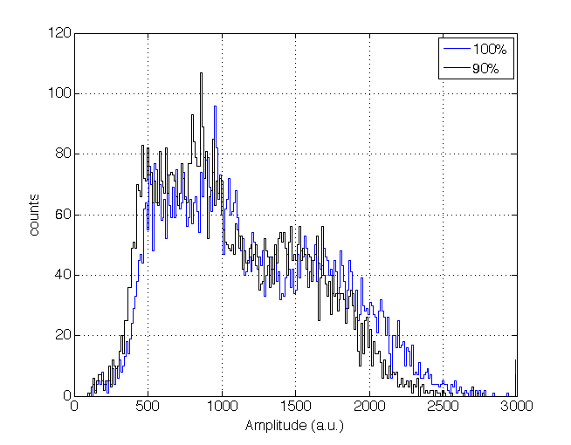
Rise time
Time to go from 10% to 80%
Time to go from 10% to 90%
PHS
PHS
No shaper – Pre-amplifier signals

Slide 30
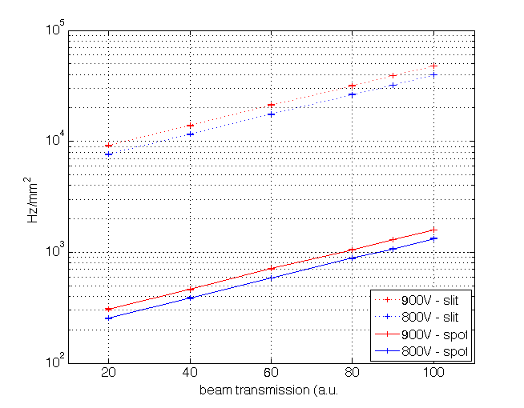


Counting rate capability
Rate in the slit
Spot
Rate per mm²
If we assume the same charge of the slit concentrated in one mm², rate is above 40KHz/mm^{2.} (Attention: It is not exactly the same!)
Slit
No space charge saturation observed up to ~ 2kHz/mm²

Slide 31



Images

Slide 32
Images

Slide 33



Images

Slide 34
Images

Slide 35
Summary
 | Multi-Blade 2013 | Multi-Blade 2015 (actual status) |  | Goal | What to do next
Uniformity X | 15% | 20% (measured in Charge Div. 1350V) | - | <5% | Mech. Improvements and new meas. at lower gain 800V and individual r/o
Uniformity Y | 15% | 20% (measured in Charge Div. 1350V) | - | <5% | Mech. Improvements and new meas. at lower gain 800V and individual r/o
Overlap | 2mm gap 50% loss | 0.7mm gap 50% loss | o | ≤1xResoltution (≤0.5mm) | Mech. Improvements and new meas.
Spatial Res. X | 0.3mm | 0.6mm (wire pitch can be adjusted) | + | 0.5mm | Nothing – Matches the goal
Spatial Res. Y | 4mm | 2.5mm | + | 2-3mm | Nothing – Matches the goal
Stability | Not measured | ~1% (over 12h) | + | 1% (over days) | Longer tests
Efficiency | Measured 26% @ 10deg 2.5Å Extrapolated 43% @ 5deg 2.5Å | >44% @ 2.5Å Measured 55% @ 5deg 4.1Å Measured 65% @ 5deg 5.1Å | + | >40% @ 2.5Å | Nothing – Matches the goal
Low gain operation | Gain ~60 | Gain ~20 | + | -- | Nothing – Matches the goal
Counting Rate Cap. | Not measured (dead time limited by electr. 2us) | > 2 KHz/mm² (>40KHz/mm² extrapolated) | o | 500 KHz/mm² (4 MHz/mm²) | Needs to be measured
Gamma sensitivity | Not measured | Not measured (but full eff. with 100KeV Threshold) | o | <10⁻⁶ | Needs to be measured, but in principle is already good due to the threshold used, not different from what measured on other prototypes.
Dynamic range | Not measured | Not measured | o | 10⁹ - 10⁰ | Needs to be measured
Self Scattering | Not measured | Not measured | o | ≤10⁻⁴ | Needs to be measured
Fast neutrons sensitivity | Not measured | Not measured | o | <10⁻⁶ | Needs to be measured
Reproduce scientific output | Not measured | Not measured | o | -- | Needs to be measured

