Slide 1
Accelerator project
Mats Lindroos
Head of accelerator at ESS
Adjunct Professor at Lund University, Physics
And the ESS accelerator collaboration
www.europeanspallationsource.se
September 2016

Slide 2
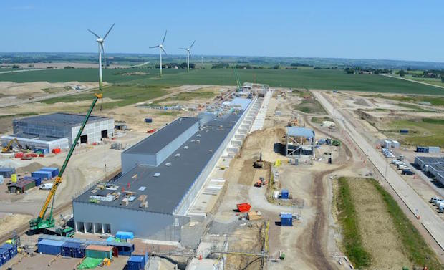
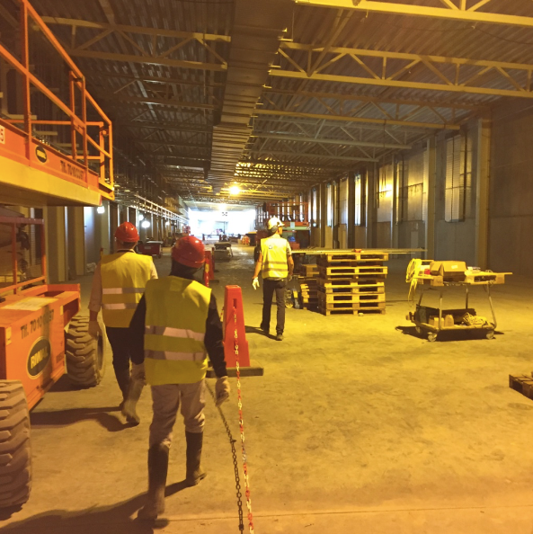
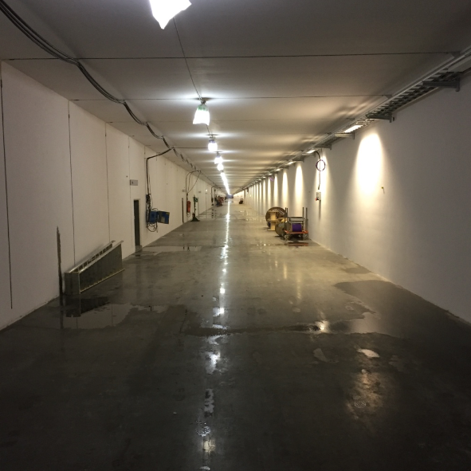
Accelerator buildings

Slide 3
Accelerator Division – Scope
Accelerator Technical performances
Key parameters:
    -2.86 ms pulses
    -2 GeV
    -62.5 mA peak
    -14 Hz
    -Protons (H+)
    -Low losses
    -Minimize energy use
    -Flexible design for mitigation and future upgrades
Design Drivers:
High Average Beam Power
5 MW
High Peak Beam Power
125 MW
High Availability
352.21 MHz
704.42 MHz
2.4 m
4.6 m
3.8 m
39 m
56 m
77 m
179 m
Target
Source
LEBT
RFQ
MEBT
DTL
Spokes
Medium β
High β
HEBT & Contingency
75 keV
3.6 MeV
90 MeV
216 MeV
571 MeV
2000 MeV
First beam at 572 MeV in June 2019
5 MW capacity for 2023
RF sources for HB part is the scope contingency for accelerator

Slide 4



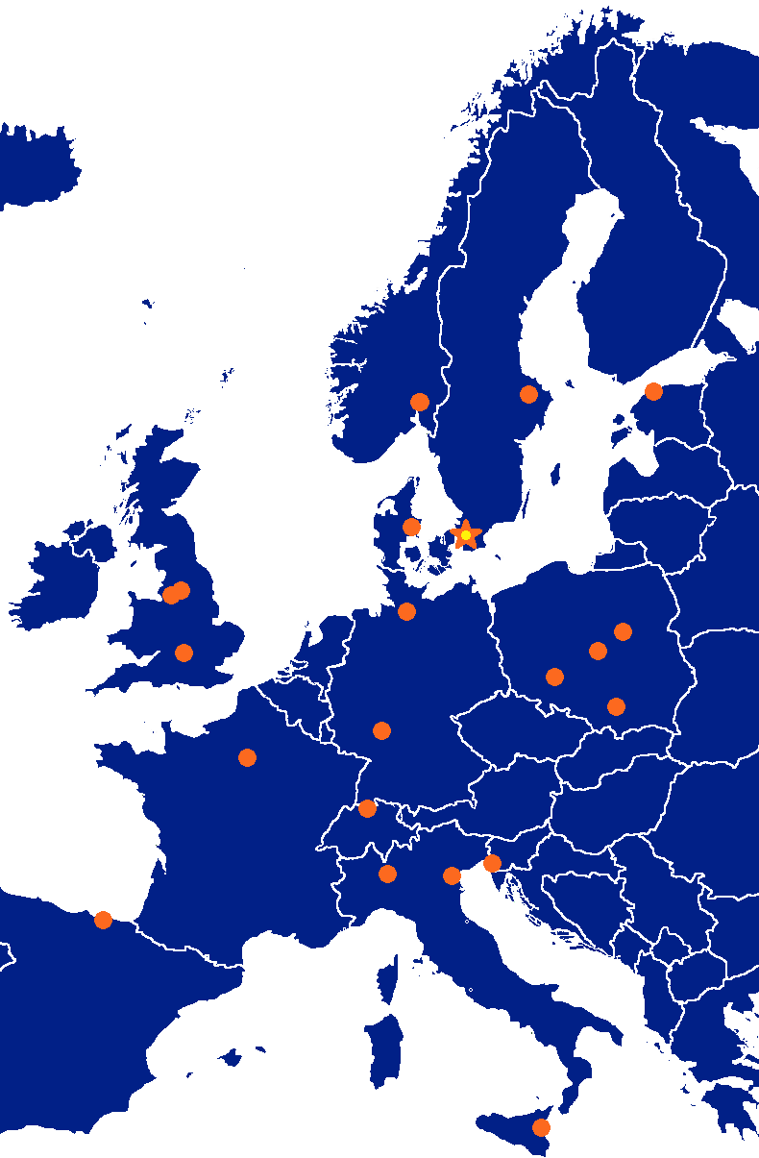



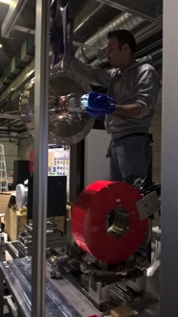




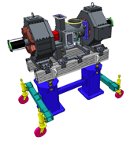


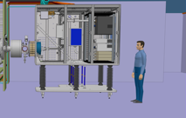



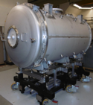
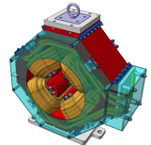

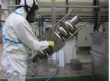

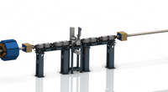




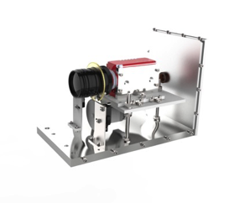
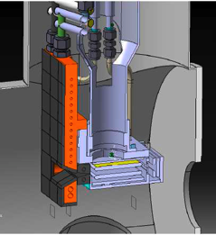
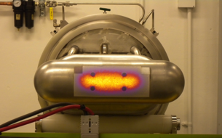

Accelerator Collaboration - Accelerator
352.21 MHz
704.42 MHz
2.4 m
4.6 m
3.8 m
39 m
56 m
77 m
179 m
Target
Source
LEBT
RFQ
MEBT
DTL
Spokes
Medium β
High β
HEBT & Contingency
75 keV
3.6 MeV
90 MeV
216 MeV
571 MeV
2000 MeV

Slide 5

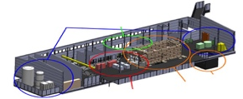



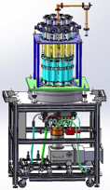
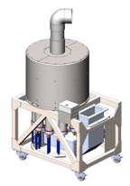



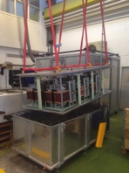
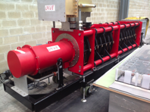
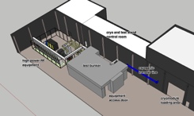
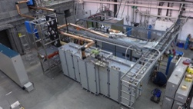
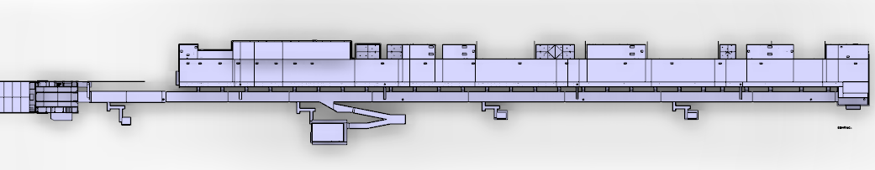









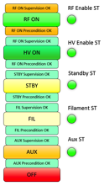


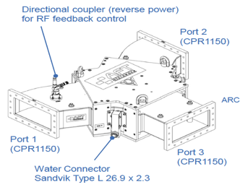
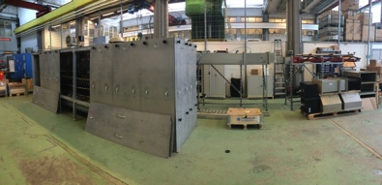
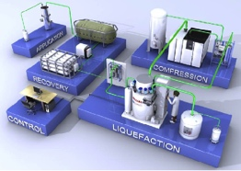

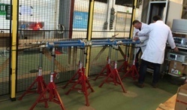

Accelerator Collaboration – RF and STS
Concept, courtesy of GRE (UK)

Slide 6
In-Kind Number of TAs under development or negotiation/Number of TAs signed
Tot TA 49
TA assigned to a partner 41
TA seeking partner 8 (
TA signed 4
TA to present at IKRC 20
Collaborations Agreements 11
Signed 9

Slide 7
High Level Schedule – ACCSYS Project
2016
2017
2018
2019
2020
2021
2022
NCFE
RFI ISRC & LEBT
RFI
MEBT
START RFQ MACHINING
RFI
RFQ
RFI
DTL5
SC LINAC
2 GeV
READY
SPOKE CM
TESTING STARTS
Spoke & Elliptical
cavities and cryomodules
SPOKE & MB CM
PRODUCTION
LAUNCHED
MB CM
TESTING STARTS
1-11 HB CM INSTALLED
12-21 HB CM INSTALLED
SC LINAC
570 MeV
READY
TOSHIBA/CPI/THALES KLYSTRON
PROTOTYPE DELIVERED
TECHNICAL STOP
TECHNICAL STOP
RF
CPI/THALES AND L3 IOT
PROTOTYPES DELIVERED
DECISION IOT OR
KLYSTRON FOR HB LINAC
RF SYSTEM
FOR MB
READY
TOTAL: 519 M€
CDS INSTALLATION
STARTS
Cryogenics
ACCELERATOR
CRYOPLANT
COMM./READY
CDS COMMISSIONED
BEAM COMM. COMPLETED FOR NCFE but DTL5
Commissioning
START RFQ COMMISIONING
BEAM COMM. COMPLETED FOR ISRC-> MEBT
FIRST PROTONS ON TARGET
1370 MeV PROTONS
AVAILABLE
2 GeV PROTONS AVAILABLE

Slide 8
Risk Status
Event | Potential Impact* | Probability | Mitigation measures | Retirement date
In-kind contributors do not meet scope and schedule requirements | Quality Schedule | 4 | communicate regularly with IKC inform work status to the project Yearly formal audit of WP progress
Unidentified design faults are not prototyped and fail in production | Schedule Quality | 4 | PDR/CDR prior to manufacturing All WPs undergo a yearly audit
Suppliers do not deliver on time with right quality/quantity, e.g. klystrons, modulators, CMs, | Quality Schedule | 4 | PDR/CDR prior to manufacturing Make sure QA/QC plans are in place
Inadequate ability to deal with on-site adjustments during construction as well as during operations | Quality Schedule | 3 | Improve installation planning Follow up on needed space for workshops on site
Expected value of ACCSYS cost risk = 8.8 M€

Slide 9
Highlights
First Medium Beta SRF Cavity (CEA) tested and exceeds ESS specifications
Prototype LWU delivered to ESS (STFC)
First plasma in Ion Source (INFN - Catania)
First two elliptical cavity couplers conditioned at CEA
First spoke coupler conditioned by CNRS
First MB-IOT tube tested successfully at L3
Site organization planning
2017 budget planning near completion
Preparation for Operations Cost review

Slide 10
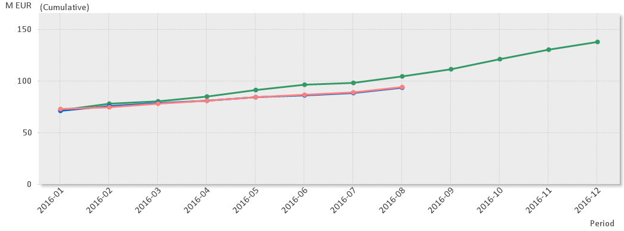
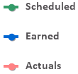

EV Graph
Current Status
Cumulative cost variance = -626k€. The main negative contributors are: Power Converters and Beam Delivery Systems.
Cumulative schedule variance = -10.8M€. The main negative contributors are: Power Converters, Normal Conducting Front End and RF. Meeting of June 2019 milestone is still expected.
CV is more or less stable around -600k€ since a few months. SV continues to slip. But not as much as before. -500k€ SV for August follows the trend (except for July where we actually improved).

Slide 11
Issues being addressed with goal to maintain RFI dates
DTL manufacturing
  Recover delays in procurement through In-house resources at Legnaro, change of tank assembly order and parallel assembly in Lund of final tanks
Ion source
  Recover delays caused by unclear ownership of interfaces: second ion source is used to fasten assembly in Lund and test in Catania are shortened. Possible second LEBT could save long term test
CNRS for spoke cavities
  Delay in procurement due to lack of staff at CNRS so additional staff hired at CNRS for procurement of ESS material
Spoke Cryomodule test postponed in Uppsala due to broken couplers
  Coupler conditioning process modified and new (identical) couplers ordered
Thales/CPI klystrons and IOT
  Delay in delivery of prototypes
  Still working towards a maintained RFI date with orders for klystrons now being prepared.
  The IOT decision is scheduled for early 2018
  Discussion with CERN on reason for delay with IOT test stand and how to avoid further delays
Orders in Italy for Nb and for tetrode amplifiers
  Delay in procurement process due to new public procurement law in italy and lack of signatures on IK agreement
  Accelerator IK manager working with IK support, the concerned labs and authorities to have all TAs signed ASAP
Modulators for NC linac
  Discussion on-going on how to harmonize installation plan and RFI dates
Qualification of high beta SRF cavity manufacturers
  Working with STFC to define the qualification process

Slide 12
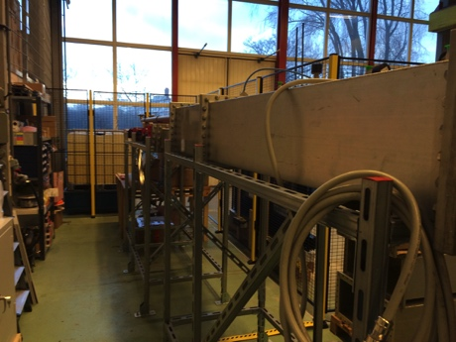
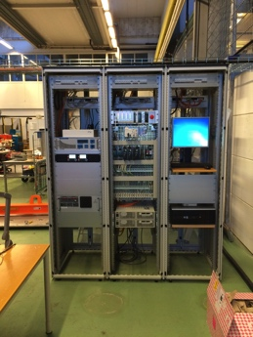
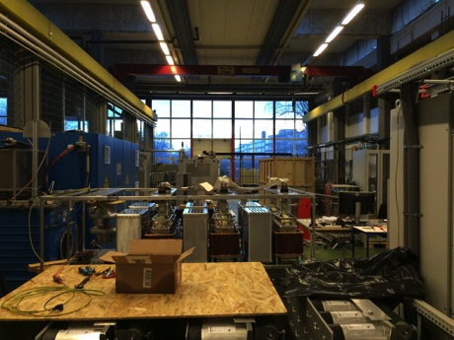
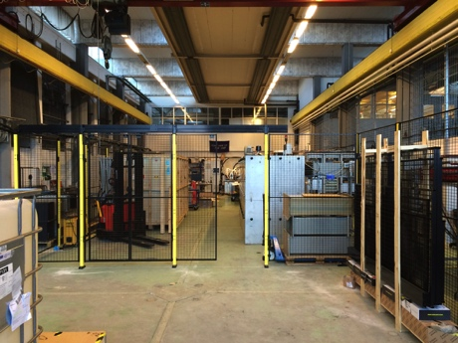
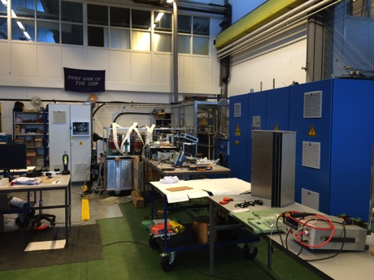
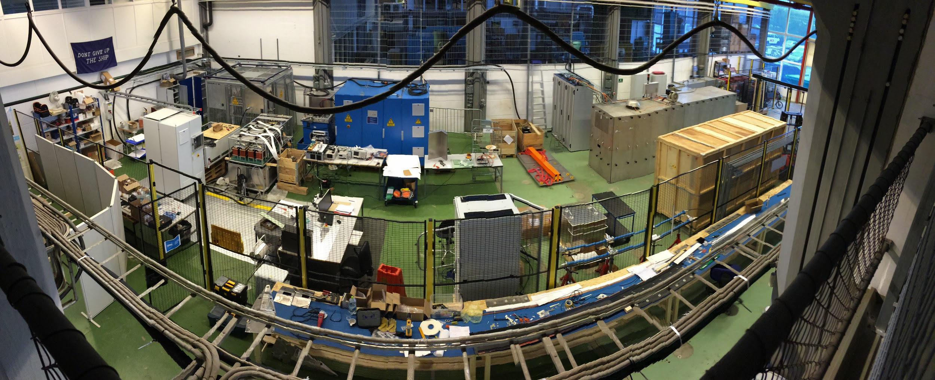
Integration Test Stand – Getting our hands dirty!
The ESS Accelerator division has grown from 2 staff to almost 90 staff since 2009
Starting technical work in Lund has been a key recommendation from the TAC and Annual Review since the beginning
The integration test stand is the first major technical installation done by the ESS accelerator division. Other labs for BI and vacuum has been taken into operation in parallel but focuses on specific areas.
The challenges at the test stand has been mainly linked to process e.g. safety, permits to start equipment generating ionizing radiation, logistics, procurement etc.
The work initiated at all levels at ESS by the TS will serve the accelerator project very well for the start of installation on site.

Slide 13
TAC and Annual Review Recommendations
In April of 2016, two reviews were held at ESS that recommended more involvement of ESS staff at In-Kind (IK) partner sites. Specifically:
  “Send your staff (to the extent possible) to learn and to train on IK deliverables, for example, the Ion Source at INFN Catania.”
    ESS 2016 Annual Review Recommendation ACC-3
  “Have ESS central team staff spend more time at IK facilities (esp. during during key demonstrations) to be able to take ownership of these components at ESS.”
    ESS April 2016 TAC Review Recommendation ATAC-A1

Slide 14
Response to Recommendations
To address these recommendations, the Engineering Resource Group (ERG) in the Accelerator Division (AD) proposes to institute an In-Kind Intern (IKIT) program. The purpose of this program is to
  Further improve communications between ESS headquarters and IK partners.
  Provide a smooth transition from IK deliverables to installation and operations at ESS by learning the specifics of IK deliverables.
  Spot potential technical interface conflicts in IK deliverables
  Add extra expert resources needed at IK partner institutions
Members of the ERG group will alternate going on extended intern assignments to IK partners.
  The visits will have a duration of a minimum of 1 week to a maximum of 1 month.
  Intervals back at ESS headquarters will have a minimum duration of 2 weeks.
  The alternation of ERG members will ensure 100% coverage of leadership of the Integration Test Stand (the other main ERG responsibility).

Slide 15
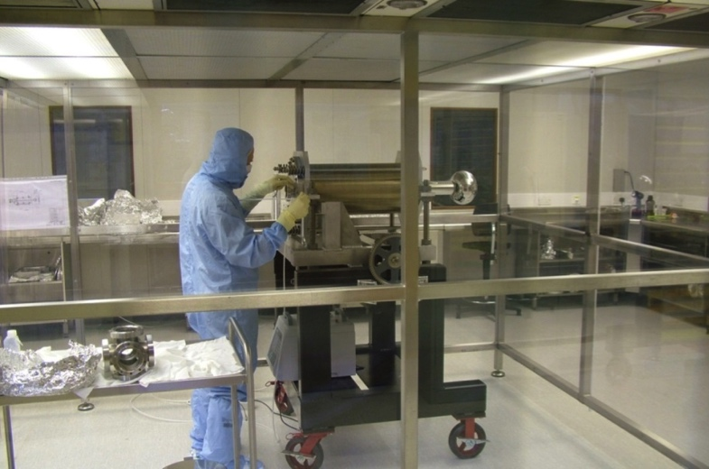
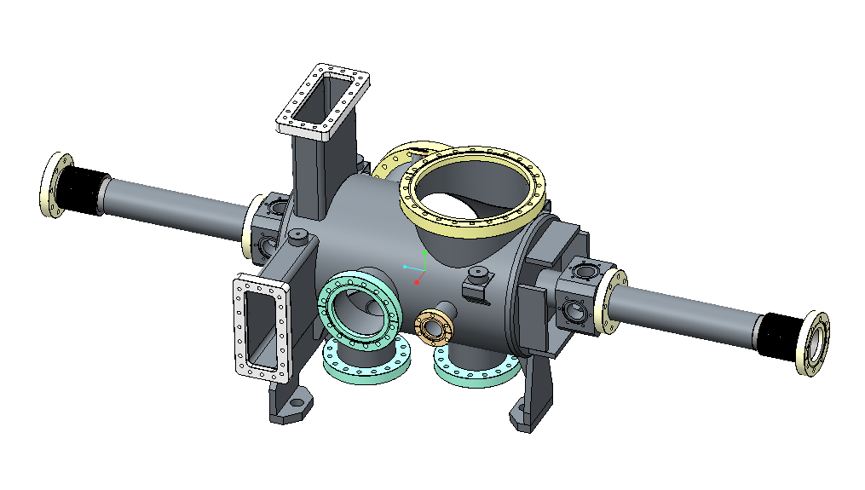
Training of technicians at partner labs:
ESS staff training at STFC/Daresbury Lab.
As per TA:
“ ESS Staff at the Partner’s location
In order to achieve the necessary experience level for personnel, ESS will send eight technicians to the Partner’s site in order for the staff to be trained in handling and assembling particle free chambers. It is ESS’ preference to that the staff is split into teams of 2 to 4 people and each team should spend a training period of a maximum of 4 weeks at the Partner’s Daresbury location during the build phase (i.e. between the time period April 17 and October 19 2017, subject to agreement by the Parties). The Partner will supply all equipment and all other required supplies to enable ESS personnel to undertake and complete the aforementioned training at the Partner’s site. ESS will cover the living expenses of these staff.”

Slide 16
Examples from staff exchange with IK partners for RF
ATM Atomki spent long time here in Lund with 1-2 persons, collaborating with ESS personnel to contribute and to learn about system design.
ESS Bilbao has had one person work with the LLRF people at LU for 1-2 weeks, to facilitate knowledge transfer
ESS-Bilbao sent a vacuum person for one week working in the ESS Vacuum Laboratory
LU personnel working with LLRF have spent 1-4 weeks in Uppsala working with the FREIA people
Warsaw University will have people in Lund making measurements on our phase reference line prototype during October 2016
Carlos Martins of WP 17 has spent a lot of time at ESS Bilbao to discuss and work on the modulator design

Slide 17
Accelerator Division
ACCELERATOR DIVISION
Mats Lindroos
Beam Physics, Operation & Beam Diagnostics
Andreas Jansson – GL
Engineering Resources
David McGinnis – GL
Eugene Tanke
Nick Gazis
Carl-Johan Hårdh (C)
Daniel Lundgren (C)
Mats Pålsson (C)
LINAC
Håkan Danared – GL
Radio Frequency
Anders Sunesson - GL
Admin & QA
Caroline Prabert
Inga Tejedor
Abril Qaraeen
Matthew Conlon
Peo Gustafsson (C)
Safety
Lali Tchelidze – GL
Duy Phan
Enric Bargalló
Eder García Etxearte (I)
Frank Kornegay (C 15%)
Mikael Motyka (S)
Konstantin Batkov (C 50%)
Spec. Technical Services
John Weisend II – GL
Wolfgang Hees
Anton Lundmark
Evangelia Vaena
Frithiof Jensen
Emilio Asensi
Gunilla Jacobsson
Akif Coku (C)
Björn Henriksson (C)
Jörgen Jönsson (C)
Beam Physics
Mamad Eshraqi - SL
Marc Munoz
Renato de Prisco
Ryoichi Miyamoto
Yngve Levinsen
Saeid Pirani (at INFN)
Ciprian Plostinar (2017-04-03)
Alexander Lauge Pedersen (S)
Beam Diagnostics
Tom Shea – SL
Benjamin Cheymol
Cyrille Thomas
Hooman Hassanzadegan
Hinko Kocevar
Irena Dolenc Kittelmann
Maurizio Donna
Rafael Baron
Charlotte Roose
Ebbe Malmstedt (C)
Thomas Grandsaert (C)
Johan Norin (C)
Linac Hardware
Vacant - SL
Christine Darve
Georg Hulla
Walter Wittmer
Felix Schlander
Oystein Midttun (IK)
Nuno Elias (EIS)
Frank Hellström (C)
Fredrik Håkansson (C)
Accelerator Integration
Stephen Molloy – SL
Aurélien Ponton
Edgar Sargsyan
Iñigo Alonso
Power Converters
Carlos Martins – SL
Göran Göransson
Marko Kalafatic
Paulo Jose Torri
Anders Andersson (C)
RF Sources
Morten Jensen – SL
Rihua Zeng
Rafael Montano
Bruno Lagoguez
Chiara Marrelli
Rutambhara Yogi
Staffan Ekström
Stevo Calic
Iñigo de la Fuente
Cryogenics
Philipp Arnold – SL
Jaroslaw Fydrych
John Jurns
Xilong Wang
Xiaotao Su
Ila Sjöholm (C)
Piotr Tereszkowski (C)
Vacuum
Marcelo Juni Ferreira – SL
Hilko Spoelstra
Simone Scolari
Christophe Jarrige
Fabio Ravelli
Kristell Barthélemy
Peter Ladd (C 50%)
Henrik Felding (I)
Planning
Lena Gunnarsson
Magnus Israelsson
Luisella Lari (C)
Håkan Danared – Deputy Head of Division
John Weisend II – Deputy Head of the Project
68 employees (2016-10-01)
Consultants, IK, Students, Interns and empl from
Eng Integr Sup Div, in Yellow + Planners = 28 people
Caroline Prabert 2016-10-01
Notes:
§

Slide 18
Accelerator Division (AD)
– Site Organization
BAS-U
ESS installation manager
Open Points:
Definition of the accelerator site roles and responsibilities
High level installation coordination between accelerator, target, ICS, ESS central services (e.g. logistics) etc.
Working on cost, AD site personnel and detailed planning for tooling, installation services etc.
Goal:
Bring site organization to a maturity so the Accelerator Area Managers can sign the Work Orders per area from Jan.2017 onwards
Accelerator installation manager
Nick Gazis
Deputy: Edgar Sargsyan
Area Manager Gallery
E. Sargsyan
Area Manager Tunnel and FEB
N. Gazis
Area Mana ger Cryobuildings
W. Hees
Area Manager Test stand
W.Hees
AD and ESS central installation services
RATS and logistics
(Central function)
Planning coordination – Edgar Sargsyan
Quality – Matthew Conlon
System Responsible 1
System Responsible 3
System Responsible 3
…
System Responsible 1
System Responsible 2
System Responsible 3
…
System Responsible 1
System Responsible 3
System Responsible 3
…
System Responsible 1
System Responsible 3
System Responsible 3
…
Safety Team– Duy Phan, Skanska safety and ES&H

Slide 19
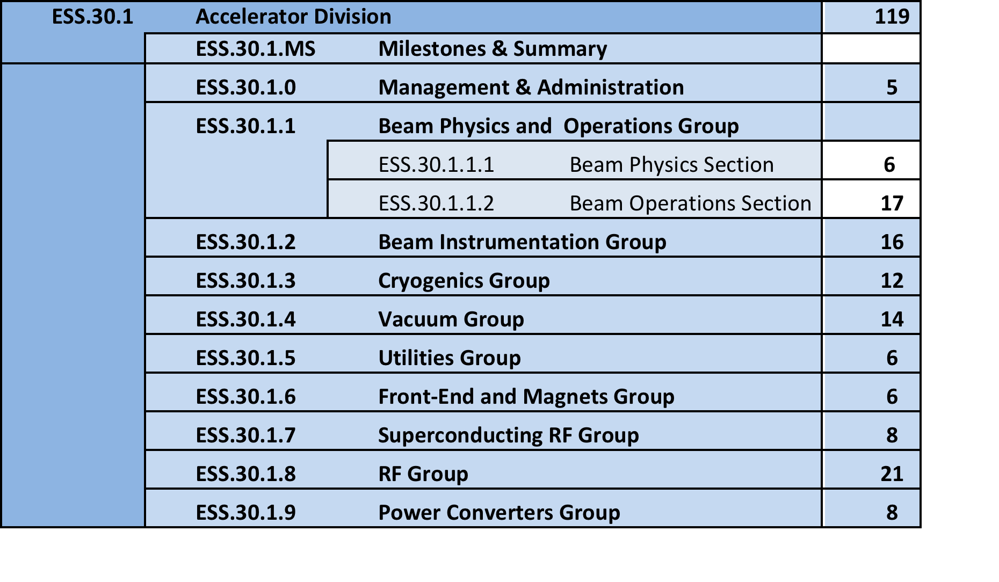
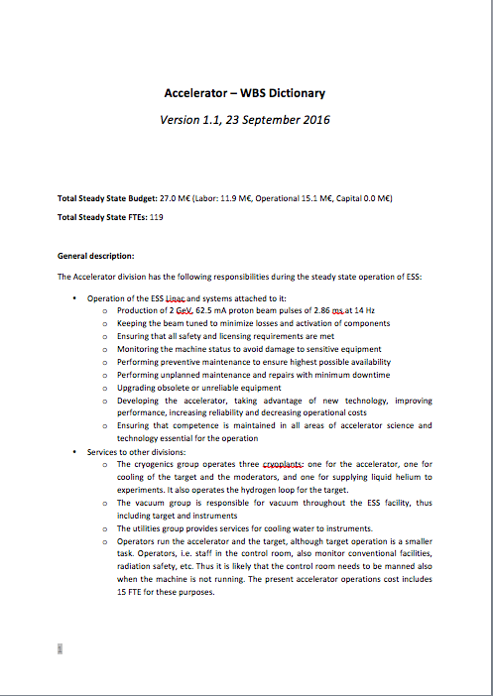
AD in operations

Slide 20
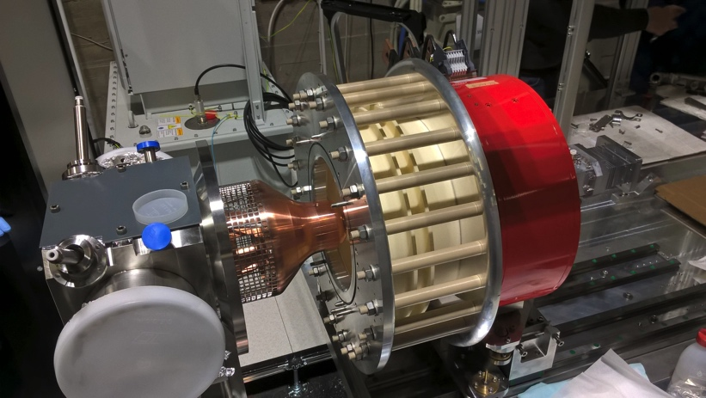
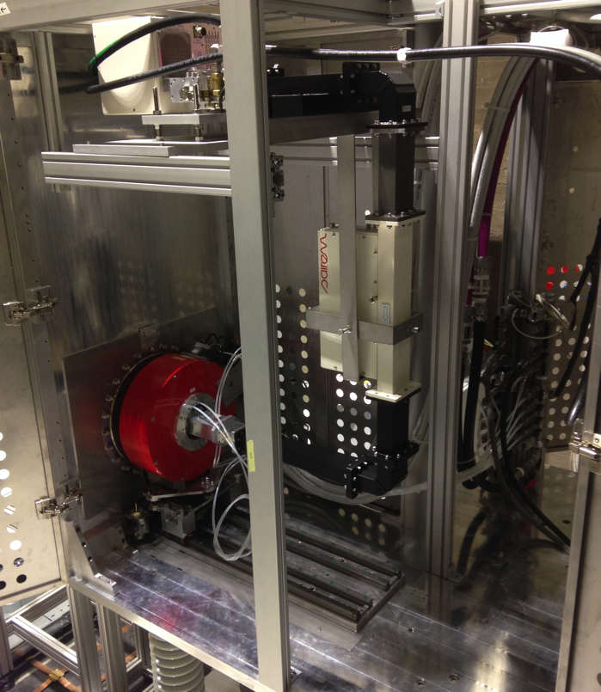
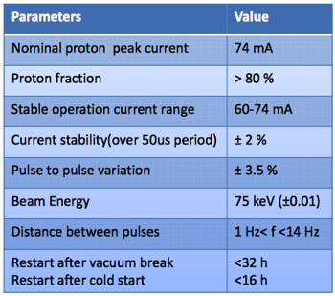
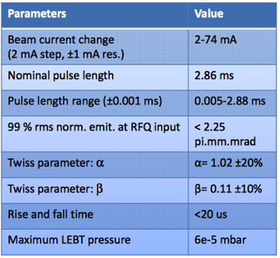
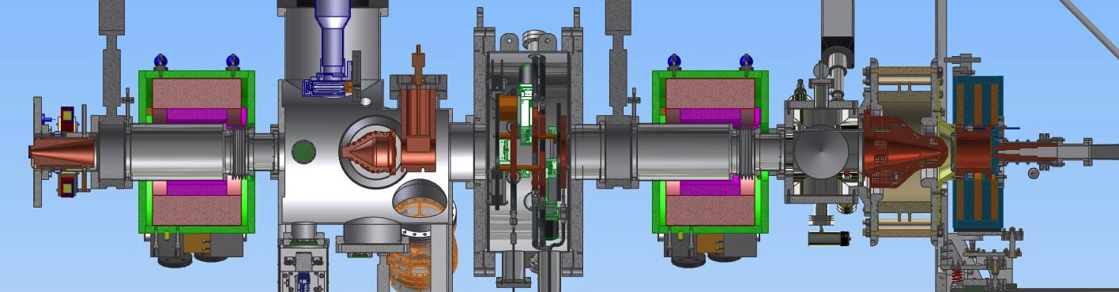
Microwave Discharge Ion Source (MDIS)

Slide 21
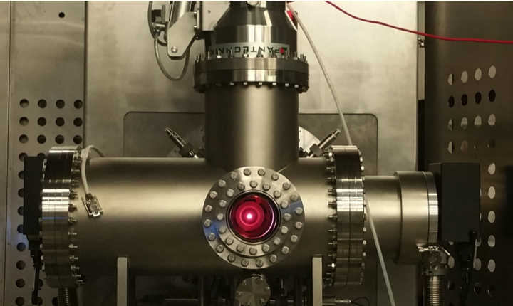
First plasma in the ion source in Catania

Slide 22
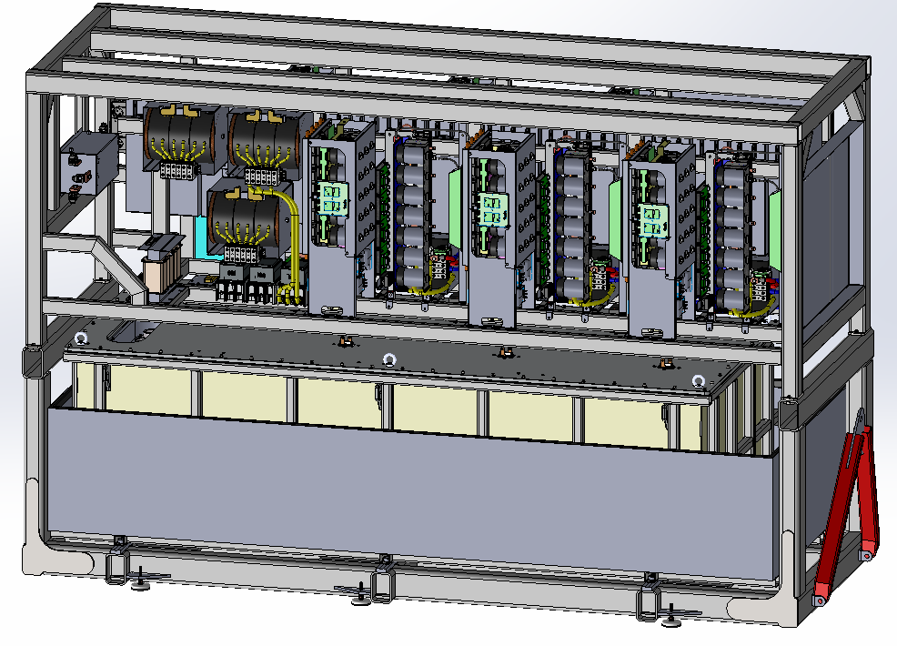
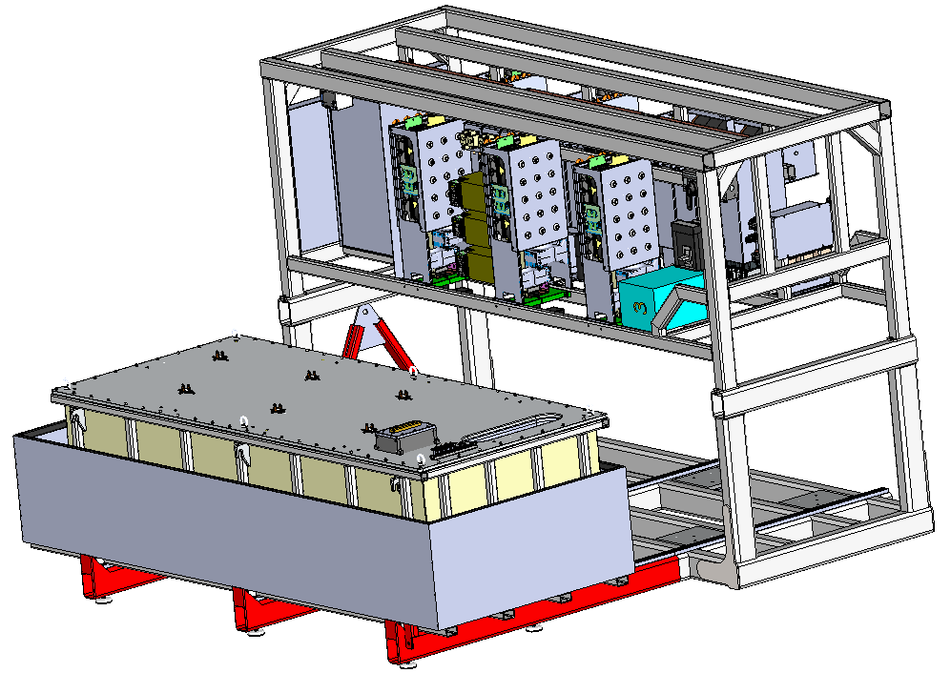
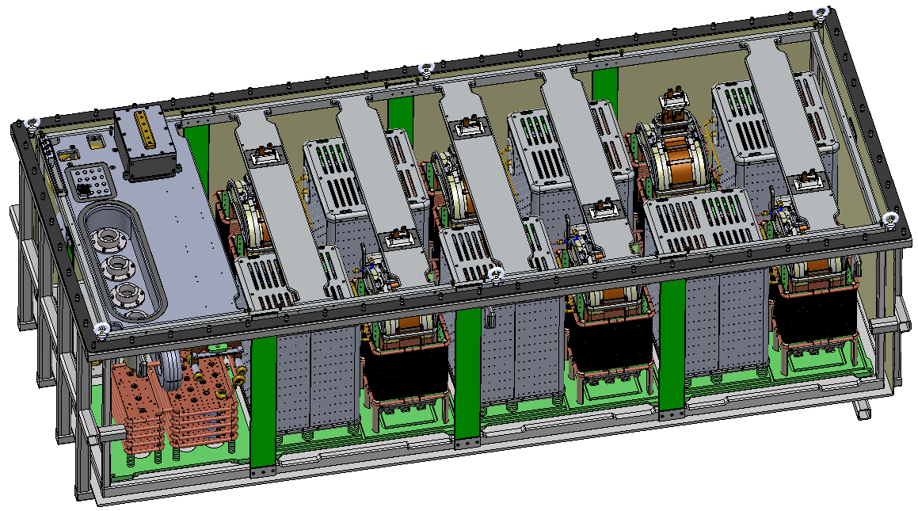
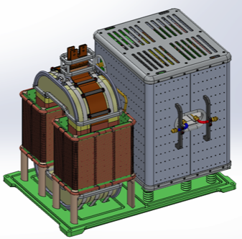
WP 17 – 660kVA modulator design
( SML topology – Supply of 4 704MHz klystrons in parallel)
3.8m
Compact
Retractable HV oil tank for easier access
2.3m
Integrated oil spill bin
1.4m
All in one frame with permanently mounted wheels for easy transportation
Total footprint: 3.8m x 1.4m
(planned was 5.5m x 1.6m, i.e. 40% less);
Total weight: < 4 tons (without oil);
Total volume of oil: ~ 2200 litters;
Preparation of “Build to Print” documentation for tendering:
Completed: → Detailed Electrical Schematic; → 3D CAD drawings; → Bill Of Materials (BOM);
Ongoing: → Technical Specification writing; → PDR is foreseen for early October
HV module

Slide 23
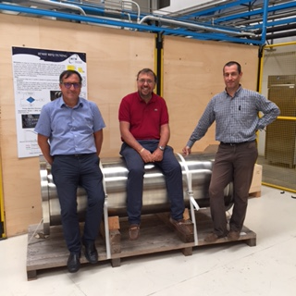



Progress on DTL in Legnaro
DTL drift tube prototypes
Santo Gammino, Andrea Pisent and Paolo Mereu on the first ESS DTL tank

Slide 24

Compressor FAT for accelerator cryoplant
WP11 Cryogenic Systems – Successful FAT of all Aerzen screw compressors for the ACCP took place in Germany this July. The FAT of the LP-HP machine was witnessed by representatives from Linde and AD

Slide 25


Work Package Highlights
Beam Instrumentation
LEBT Doppler Components - now at Catania

Slide 26



Spoke Cavities design & prototype performances
Spoke cavity prototype test results (Jan15 – Feb16):
Excellent performances, well within specifications (both on Eacc & Qo)
Pcav<0.5W
Chemical etching
Ultra pure water
high pressure rinsing

Slide 27

Work Package Highlights
WP4 Spoke Cavities and Cryomodules
First assembly of the cryomodule.
  Started in July with the mock-up cavities + MLI, the magnetic shields, the CTS…
  Problem occurred to connect the cryogenic helium feeding line to the CF16 flanges of the cavities (tubes too long). Need to shorten the tubes. Work has started and has been postponed because of vacation. –
    Demonstrates value of prototyping
  The first cool-down with liquid helium is also postponed to September (delivery of the valve box needed and planned in August).

Slide 28

Work Package Highlights
WP5 Elliptical Cavities and Cryomodules: Medium Beta P01 Cavity results

Slide 29





Work Package Highlights
WP5 Elliptical Cavities and Cryomodules: M-ECCTD Progress
Tooling and Blank Assembly Tests

Slide 30



Medium beta klystrons
The Toshiba prototype passed FAT in February and has been delivered to ESS
Thales and CPI klystrons due before end of 2016
Operation at low voltage and use of iris on the output maintains high efficiency even at reduced power levels
Actual Toshiba klystron
Notes:
~66% at 1.5MW, ~62% at 1MW, ~60% at 800kW and ~58% at 600kW,

Slide 31





Multi beam IOT
L3 IOT FAT started last week (contractual date October 2016)
15 kW solid state driver delivered (to L3) for use with factory testing
Driver, HV PSU, interlocks being testing on the single beam IOT, prior to MB-IOT tests
L3 extended testing being discussed to follow up on the contractual factory testing
Thales/CPI IOT is planned for delivery to CERN in autumn 2016
Tube will be integrated at CERN by Thales
CERN test stand (for Thales/CPI) under construction
Formal Factory testing expected November 2016
Thales/CPI
L3
L3: 15 kW driver from Tomco
L3: Output cavity cold test
L3: Tube after bake out

Slide 32


Preliminary Results L3
Efficiency > 60% from 600 kW to 1.2 MW
(HV efficiency only)

Slide 33
Summary
ESS is well into construction and the accelerator project is progressing according to plan towards first beam at 572 MeV in June 2019
The Accelerator is built with a very high percentage of IK contributions (>50%, 23 partners) with most major accelerator systems being designed, prototyped and built outside ESS.
There are still open IK packages but for 2017 it is now being budgeted as cash expenditure. We believe we still will be able to reduce that cash spending somewhat through new IK.
Prototypes for the all major accelerator elements are now being assembled and tested and the low energy part is under manufacturing
The Accelerator Division is recruiting according to plan and will be ready to take ownership of the accelerator, install it, commission it and enter it into operation for the 2019 milestone

Slide 34



Many thanks to all my colleagues in the ESS accelerator collaboration
Thank you for listening!

Slide 35
Open In-Kind Contributions
Letter issued 21st of September 2015
No or little interest
Some contacts made, no firm answer to take the scope
Project time schedule request fast reply's
Strategy available / item, but some more sales pitches will take place
If no interest “tenders has to be placed”
Support from Council/ILO/IKRC etc. is highly appreciated
11.7.7 | Beam Diagnostics | Cold linac wire scanners | 274 |  |  | AIK 7.7 | Univ Arhus
11.7.10 | Beam Diagnostics | Beam instrumentation for target and tuning beam dump | 564 |  |  | AIK 7.8 | Tender
11.8.5.6 | RF amplifiers | Medium-beta klystrons | 10 965 |  |  | AIK 8.8 | Tender porcess starts , draft specs.
11.8.5.7 | RF amplifiers | High-beta klystrons or IOTs | 26 135 |  |  | AIK 8.9 | Tender latest 2017
11,15 | Electrical support | Cables, power distribution cabinets | 1 600 |  |  | AIK 15.1
11,16 | Cooling support | Design, construction, installation of piping | 2 000 |  |  | AIK 16.1 | Univ Krakowska
11,16 | Cooling support | Design, construction, installation of cooling skids |  |  |  | AIK 16.2 | Univ Krakowska
11.17.6 | Modulators | High-beta modulators | 23 507 |  |  | AIK 17.5 | Proc ESS B / ESS in progress
Sum |  |  | 65 045

Slide 36
In Kind Status IKRC (1)
IKRC #10, October - IKCs to be endorsed
No. | Country | Type of Agreement | IKC Partner | WBS/IK No. | WP description | IKRC Status | CB Value (kEUR) | Comments | Exec Sum | Main Agreement Exists | Probability
ACCELERATOR
1 | France | IKC | CEA | AIK 3.4 | Radio-frequency Quadrupole | Planned | 8 710 | Draft TA exists | YES |  | ***
2 | France | IKC | CEA | AIK 5.1 | Elliptical Linac H-ECCTD, High Beta Elliptical cavities and cryomodule demonstrator | Planned | 4 294 |  |  |  | **
3 | France | IKC | CEA | AIK 5.2 | Elliptical Medium and High Beta Cryomodules Components Supply | Planned | 38 618 | Draft TA exists | YES |  | ***
4 | France | IKC | CEA | AIK 5.3 | Elliptical Cryomodules Engineering, Assembly and Test | Planned | 18 395 | Draft TA exists | YES |  | ***
5 | France | IKC | CEA | AIK 7.1 | Beam Diagnostics (Emmitance Measuring Unit) | Planned | 424 | Draft TA exists | YES |  | ***
6 | France | IKC | CEA | AIK 7.2 | Beam Diagnostics (Doppler Shift Measurement Unit) | Planned | 105 | Draft TA exists | YES |  | ***
7 | France | IKC | CEA | AIK 7.3 | Non-invasive profile monitor | Planned | 1 340 | Draft TA exists | YES |  | ***
8 | France | IKC | CNRS | AIK 11.2 | Cryogenic Distribution Line; Spoke Linac | Planned | 2 509 | Draft TA exists | YES |  | ***
9 | France | IKC | CNRS | AIK 4.1 | Spoke Cavities and Cryomodules | Planned | 17 451 | Draft TA exists | YES |  | ***
10 | Italy | IKC | Elettra | AIK 17.2 | Linac Magnets Power Converters | Planned - HoA Signed | 2 950 | Draft TA exists | YES |  | ***
11 | Italy | IKC | Elettra | AIK 2.1 | Linac Magnets | Planned - HoA Signed | 6 565 | Draft TA exists | YES |  | ***
12 | Italy | IKC | Elettra | AIK 8.5 | Spoke RF Power Station | Planned - HoA Signed | 19 451 | Draft TA exists | YES |  | ***
13 | Italy | IKC | Elettra | AIK 7.4 | Wire Scanner Acquisition | Planned | 502 | Draft TA exists | YES |  | ***

Slide 37
In Kind Status IKRC (2)
14 | Italy | IKC | INFN Catania | AIK 3.5 | Ion Source and Low-Energy Beam Transport | Planned - HoA Signed | 4 543 | Draft TA exists | YES | Yes | ***
15 | Italy | IKC | INFN Milan | AIK 5.6 | Medium Beta Elliptical Cavities, Fabrication and Testing | Planned - HoA Signed | 11 150 | Draft TA exists | YES | Yes | ***
16 | Norway | IKC | University of Oslo | AIK 7.6 | Beam Diagnostics Imaging Systems | Planned - TA signed pending IKRC endorsement | 2 041 | Signed TA and Main Agreement | YES | Yes | ***
17 | Poland | IKC | IFJ PAN | AIK 10.1 | Manpower for cryomodule tests in Lund | Planned - HoA Signed | 5 724 | Signed TA | YES | Yes | ***
18 | Poland | IKC | IFJ PAN | AIK 17.3 | Power Converter Systems of the ESS Linac Project (PC Installation Phase I & II) | Planned - HoA Signed | 664,2 | Signed TA | YES | Yes | ***
19 | Poland | IKC | IFJ PAN | AIK 8.6 | Manpower for installation of RF equipment | Planned - HoA Signed | 6 156 | Signed TA | YES | Yes | ***
20 | Poland | IKC | PEG | AIK 8.2 | LLRF System Units | Planned - HoA Signed | 4 496 | Signed TA and Main Agreement | YES | Yes | ***
21 | Poland | IKC | NCBJ | AIK 6.1 | Gamma Blockers | Planned | 112 | Signed TA and Main Agreement | YES | Yes | **
22 | Poland | IKC | Warsaw UT | AIK 8.7 | Phase-Reference Line | Planned - HoA Signed | 1 200 | Signed TA and Main Agreement | YES | Yes | ***
23 | Poland | IKC | Wroclaw UT | AIK 11.1 | Cryogenic distribution line, elliptical linac | Planned | 6 650 | Draft TA exists | YES |  | ***
24 | Poland | IKC | Wroclaw UT | AIK 11.3? | Cryogenic distribution line, test stand | Planned | 540 | Draft TA exists | YES |  | ***
25 | UK | IKC | STFC - Daresbury | AIK 12.1 | Linac Warm Units (LWU) | Planned | 10 250 | Draft TA exitss | YES |  | *

Slide 38



Modulator SML proto status March 2016
Electrical schematic
Part I
Part II
90 kV operation
Closed loop

Slide 39
RF Technical performances
352.21 MHz
704.42 MHz
2.4 m
4.5 m
3.6 m
40 m
54 m
75 m
179 m
Target
Source
LEBT
RFQ
MEBT
DTL
Spokes
Medium β
High β
HEBT & Contingency
75 keV
3.6 MeV
90 MeV
220 MeV
571 MeV
2000 MeV
 | Energy (MeV) | Frequency /MHz | No. of Cavities | βg | Temp / K | RF power /kW
Source | 0.075 | - | 0 | – | ~300 | –
LEBT | 0.075 | - | 0 | – | ~300 | –
RFQ | 3.6 | 352.21 | 1 | – | ~300 | 1600
MEBT | 3.6 | 352.21 | 3 | – | ~300 | 20
DTL | 90 | 352.21 | 5 | – | ~300 | 2200
Spoke | 220 | 352.21 | 26 (2/CM) | 0.5 βopt | ~2 | 330
Medium β | 571 | 704.42 | 36 (4/CM) | 0.67 | ~2 | 870
High β | 2000 | 704.42 | 84 (4/CM) | 0.86 | ~2 | 1100
HEBT | 2000 | – | 0 | – | ~300 | –

Slide 40







Selected technologies
Medium beta cavity prototype
High beta cavity prototype with its helium tank
Blank assembly of the spaceframe inside the vacuum tank
Q curve of the High beta prototype cavities

