Slide 1
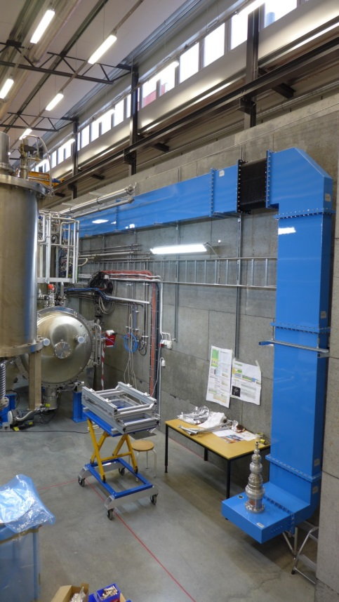
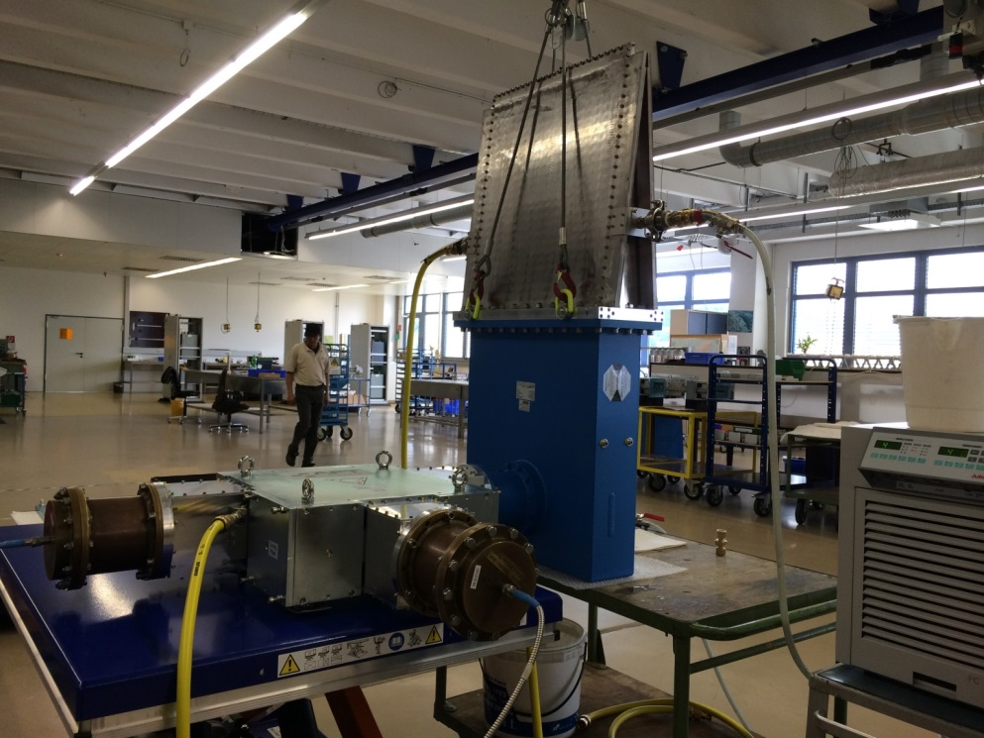
ESS RF Distribution System
Rob Edgecock
on behalf of the RFDS team
Photos: c/o FREIA

Slide 2
Overview
Introduction to RFDS project
Project scope
Project team
Current status
Schedule
Risks
Conclusions

Slide 3
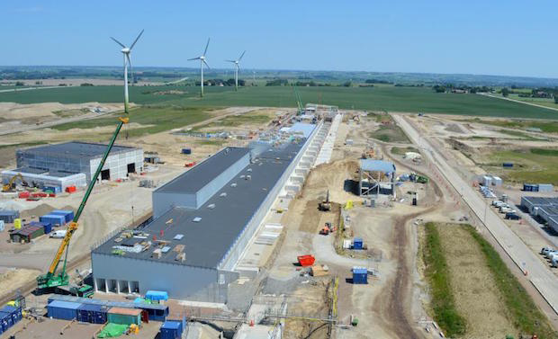
RFDS Project
The RF Distribution System for all the superconducting cavities

Slide 4
RFDS Project
ESS linac
UK in-kind contribution for all the superconducting cavities
From output flange of 2nd hybrid coupler/amplifier spoke/elliptical
To RF cavity couplers
352.21MHz
704.42MHz
2.4 m
4.6 m
3.8 m
39 m
56 m
77 m
179 m
Target
Source
LEBT
RFQ
MEBT
DTL
Spokes
Medium β
High β
HEBT & Contingency
75 keV
3.6 MeV
90 MeV
216 MeV
571 MeV
2000 MeV
~300m

Slide 5
Numbers Required
Linac module | Frequency (MHz) | Peak power (kW) | Number | Waveguide
Spoke | 352.21 | 400 | 26 | WR2300(HH) in stub, tunnel Coax upto circulator 584.2mm x 292.1mm/2
Elliptical Medium Beta | 704.42 | 1200 | 36 | WR1150 292.1mm x 146.05 mm
Elliptical High Beta | 704.42 | 1500 | 84 | WR1150

Slide 6
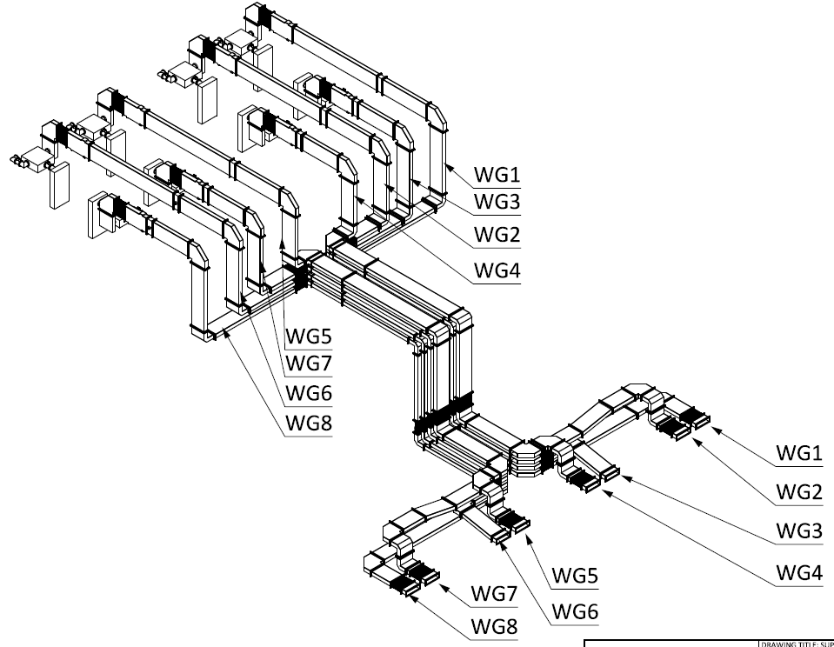
RFDS Project
Shutter switch
Circulator
Dual directional coupler
Coax
2.6m
Bellows
Load
WR2300 HH waveguide
+ Arc detectors

Slide 7
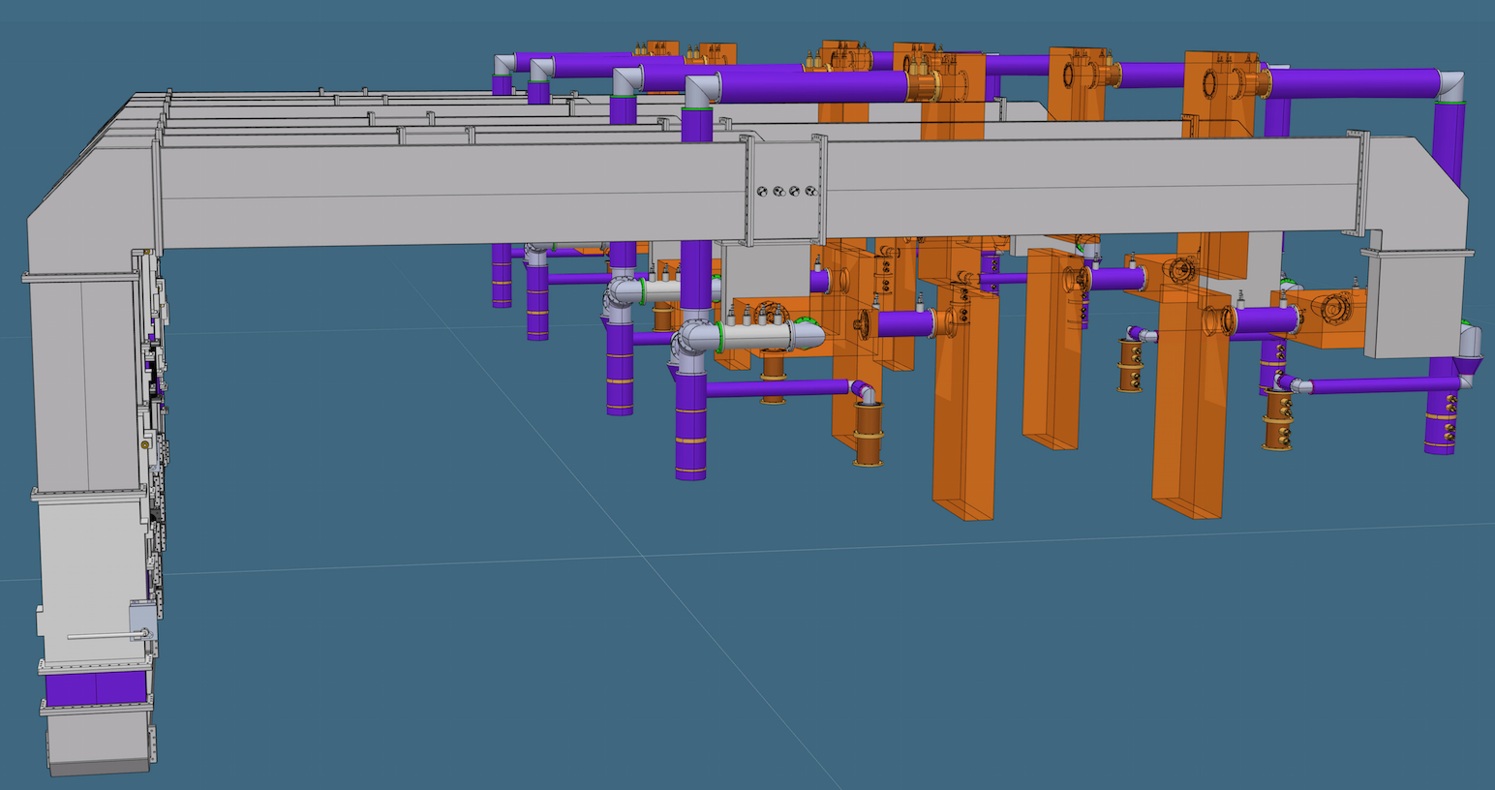
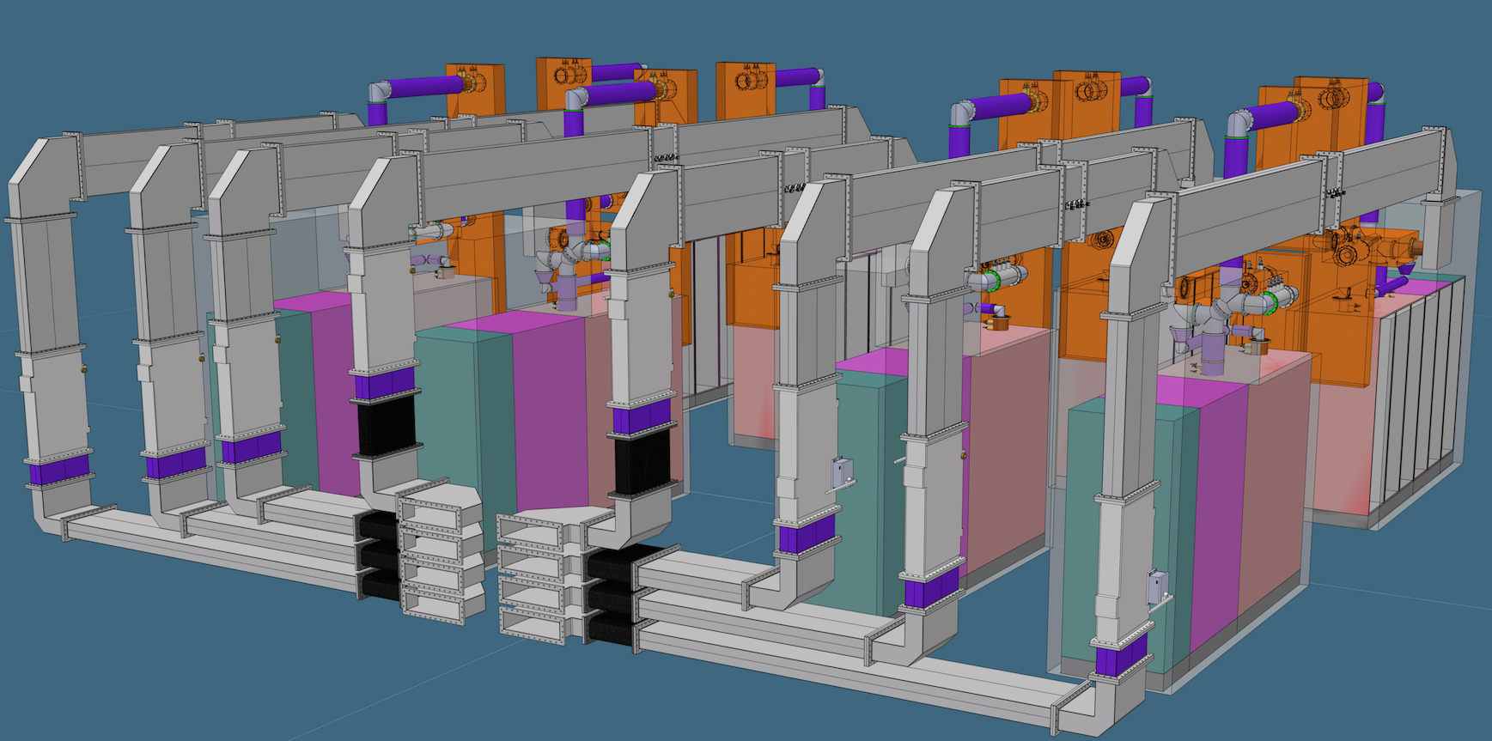
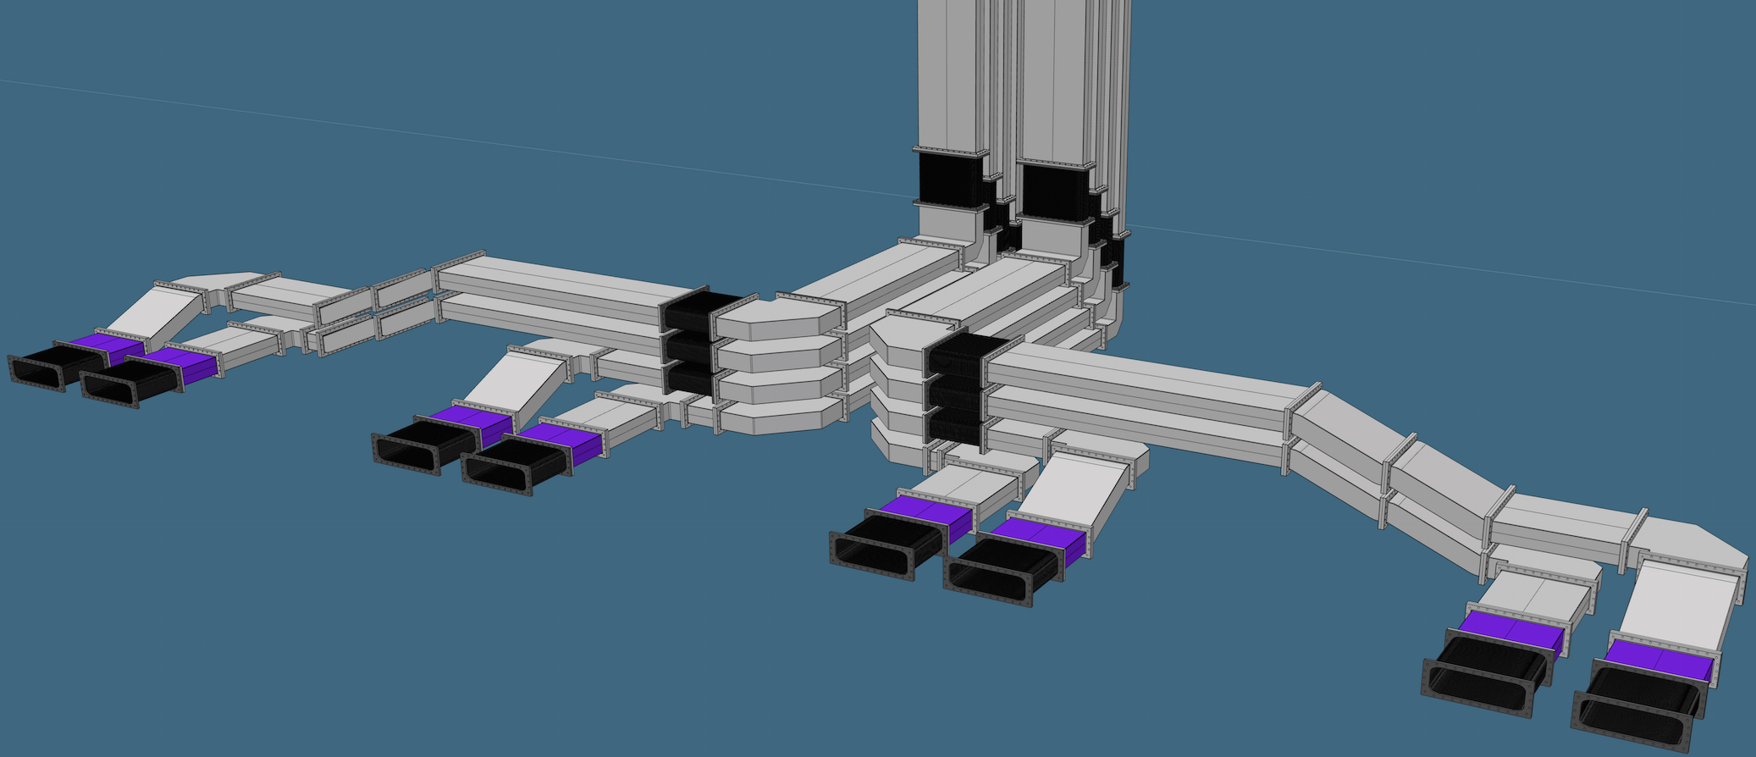

Slide 8
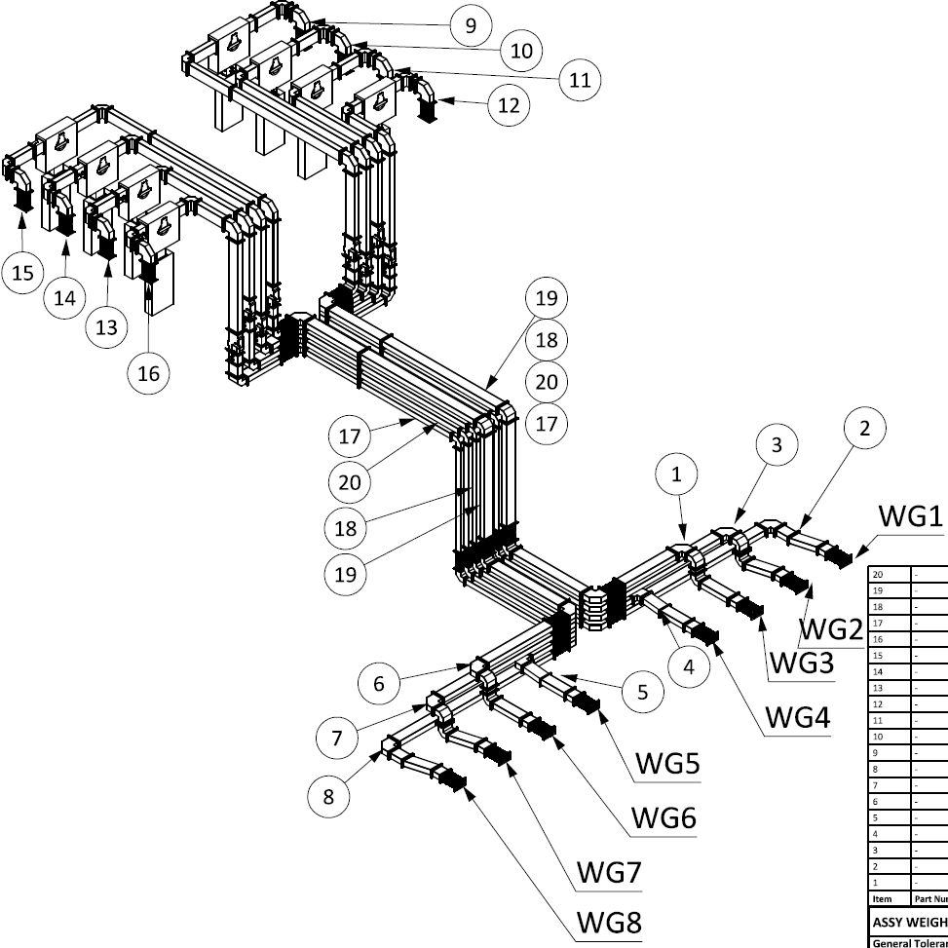
Shutter switch
Circulator
Dual directional coupler
1.7m
Load
+ Arc detectors
WR1150 waveguide
Bellows

Slide 9
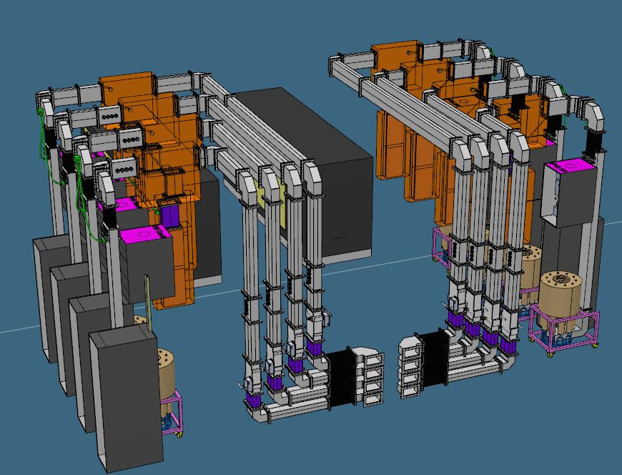
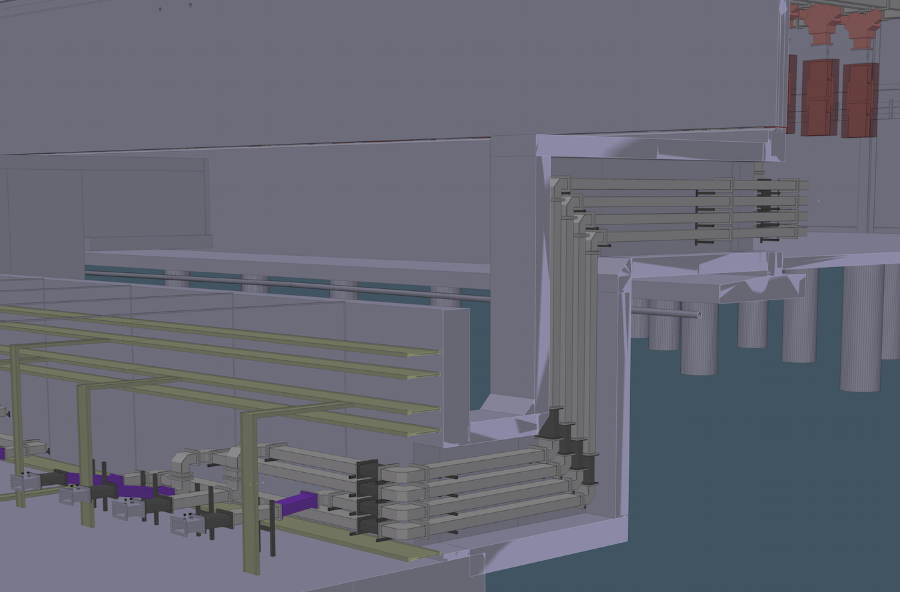

Slide 10
Approximate Numbers
Component | Spoke | Elliptical
Waveguide | 550m | 2725m
H bends | 130 | 600
E bends | 78 | 600
Bellows | 97 | 480
DC | 78 | 360
Arc detectors | 104 | 480
Circulators, loads & switches | 26 | 120
Coax elbows | 52

Slide 11
Components
Not “off-the-shelf” as such
Most have been built before with similar parameters
Loads being cooled with water at ≥50ºC is new
+ prototyping done/being done at FREIA and ESS

Slide 12


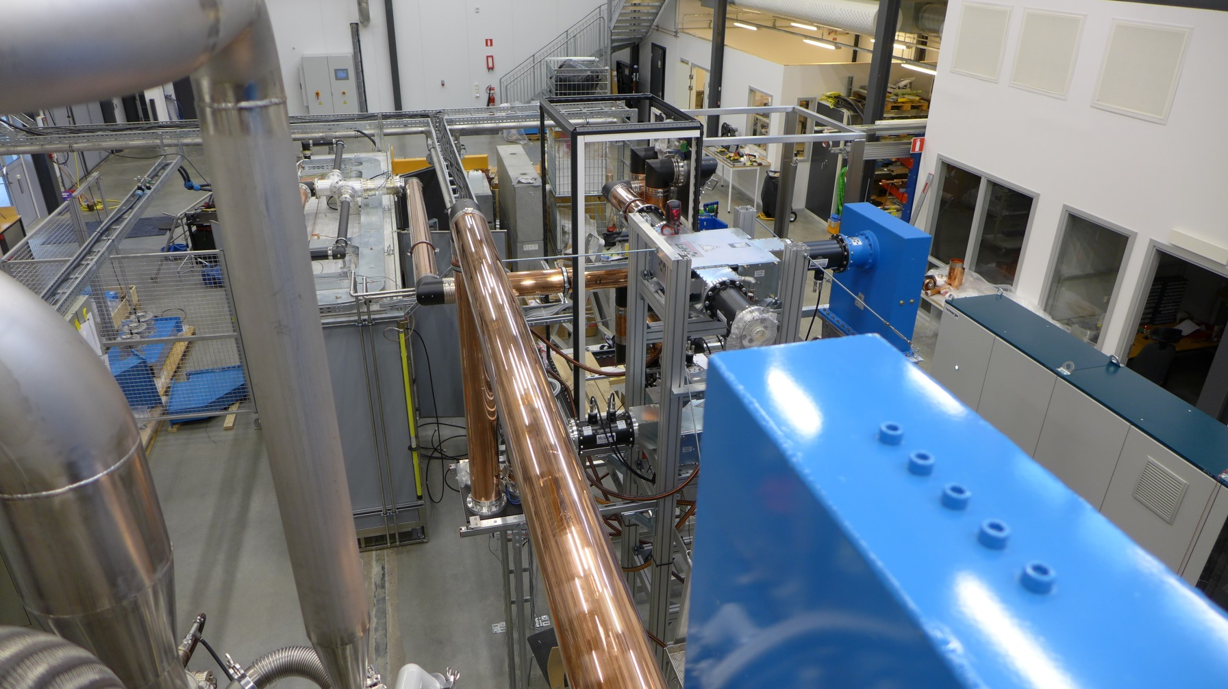
Components

Slide 13
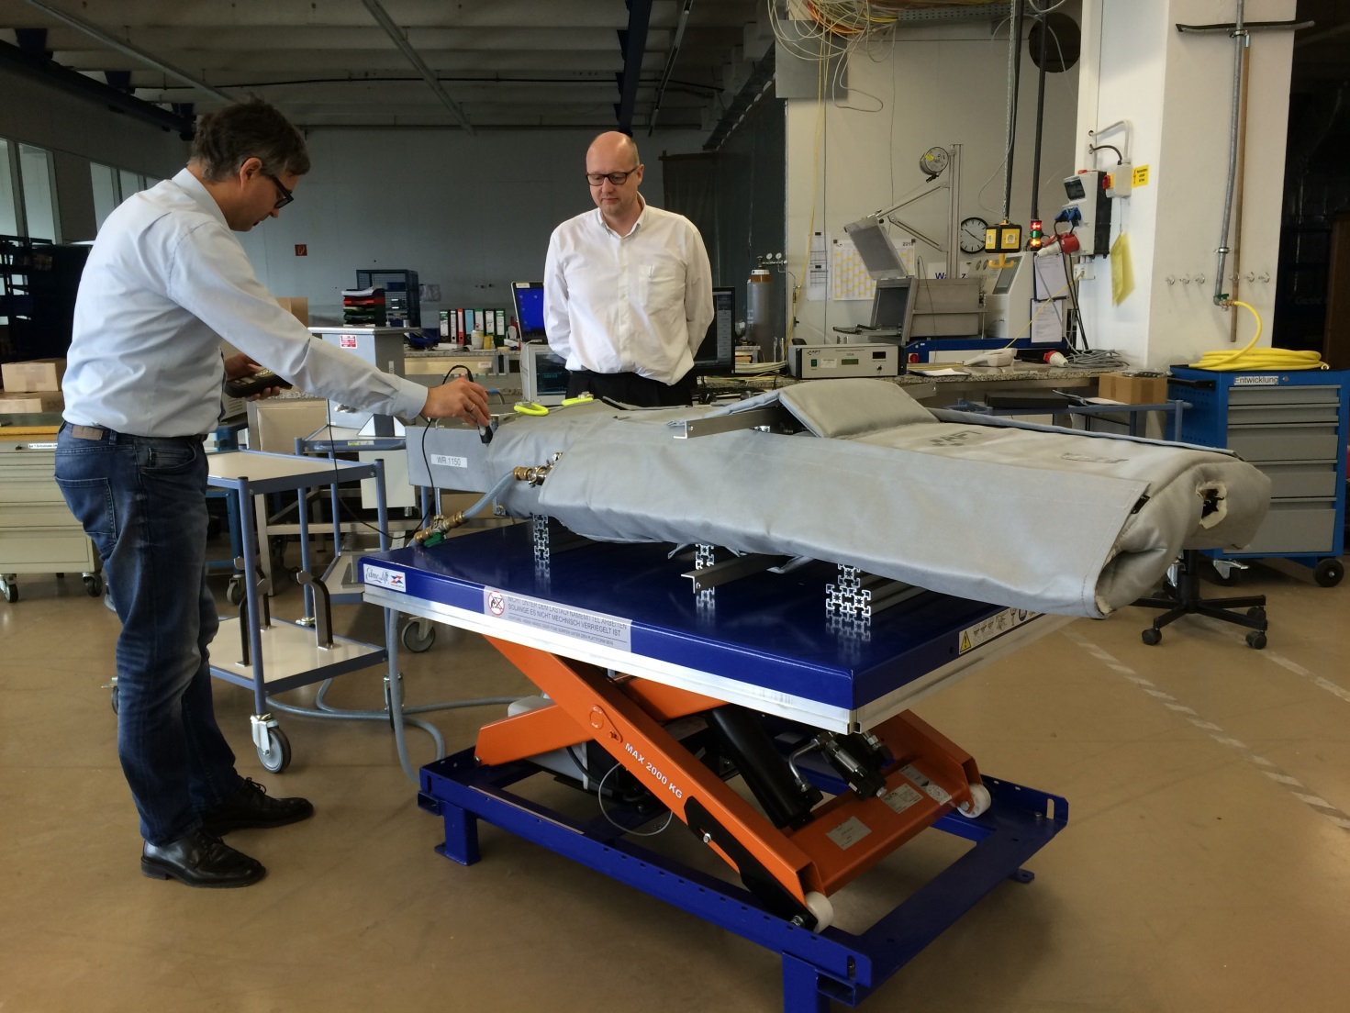
Components

Slide 14
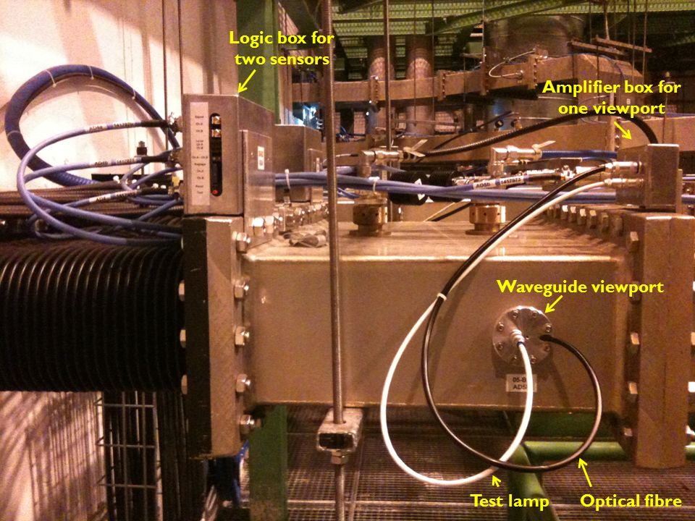
Components

Slide 15
Scope
Participation in prototype tests in Lund
Design of support structure
Procurement:
  tender documents
  tender process
  company visits
  monitoring of progress
  verification of factory testing
  documentation
Oversight of installation
Involvement in commissioning:
  of RFDS components, esp arc detectors & tuning
  participation in RF system commissioning

Slide 16
Project Team
UK team: University of Huddersfield & STFC
Rob Edgecock (40% HUD, 50% STFC)
  PI, reporting to ESS, procurement, testing, etc
Paul Aden (50% - STFC)
  Project management
Richard Smith (50% from August - STFC)
  Mechanical Engineer and Deputy PM
Gerard Bell (100% from December - STFC)
  Mechanical Engineer, main responsibility QA/QC
RF Engineer (100% - Hud)
  RF, Elec Engineer, main responsibility commissioning
Norman Turner (100% - Hud)
  PhD student: arc detectors, tuning, etc
ESS team: Rutambhara Yogi, Anders Sunesson, Morten Jensen

Slide 17
Status
Scope agreed since last November
Technical annex agreed in November
Cover page signed in November
Project plan, risk register, procurement plan all done
Critical Design Review for tenders 1 & 2 passed on 7th June
CDR for tender 4
But……still awaiting final specs for some tenders!

Slide 18
Status
Tender | Components | Cost /£M | Submission date | Status
1 | Waveguides, bends, coax | 3.7 | 09/08/2016 | Delayed due to need for cooling
2 | DC, bellows | 1.4 | 16/08/2016 | Submitted 15/08/16, now uploaded
3 | Support structure | 0.7 | 01/11/2016 | Design underway
4 | Circulators, loads | 6.3 | 02/09/2016 | Waiting for final specs
5 | Arc detectors | 1.8 | 02/11/2016 | Waiting for tests
6 | Switches | 1.3 | 02/11/2016 | Waiting for PSS approval

Slide 19
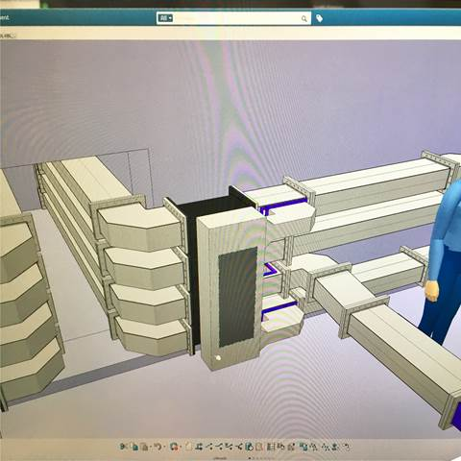
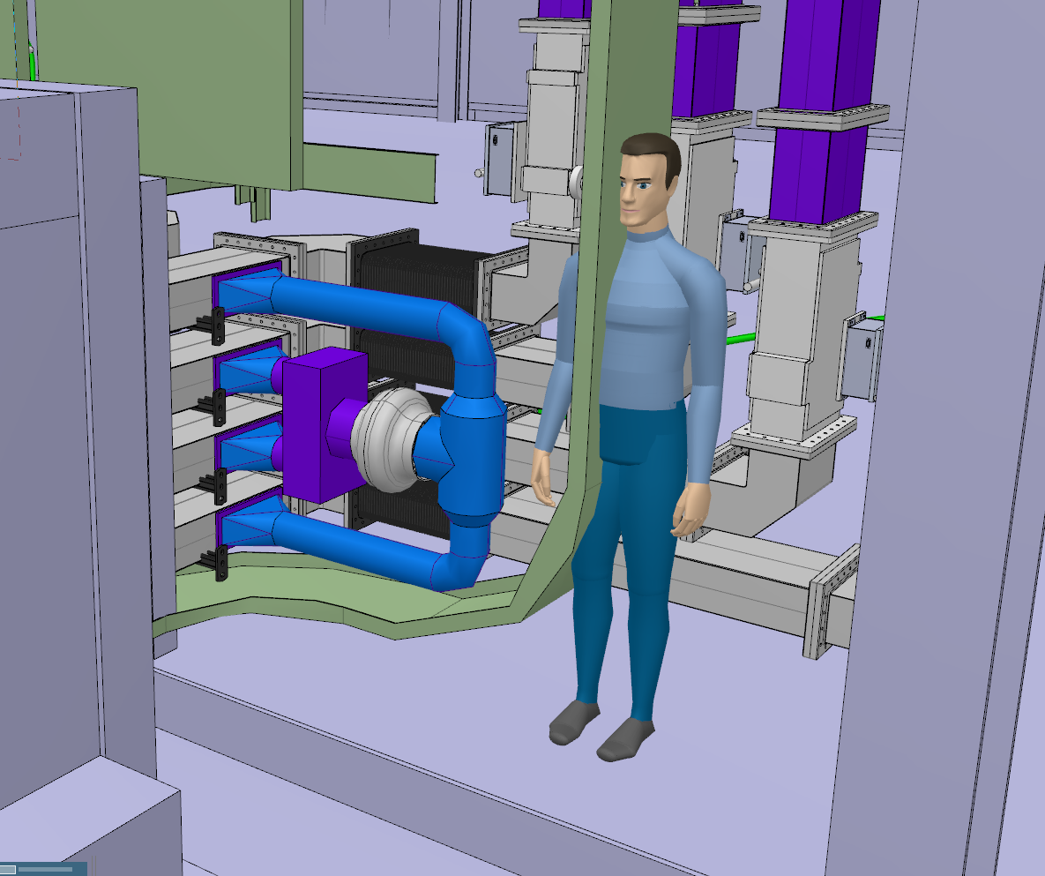
Cooling
Walls in stubs means sufficient heat generation to effect cables
Cooling required: - original idea: water - now: air flow through waveguides

Slide 20
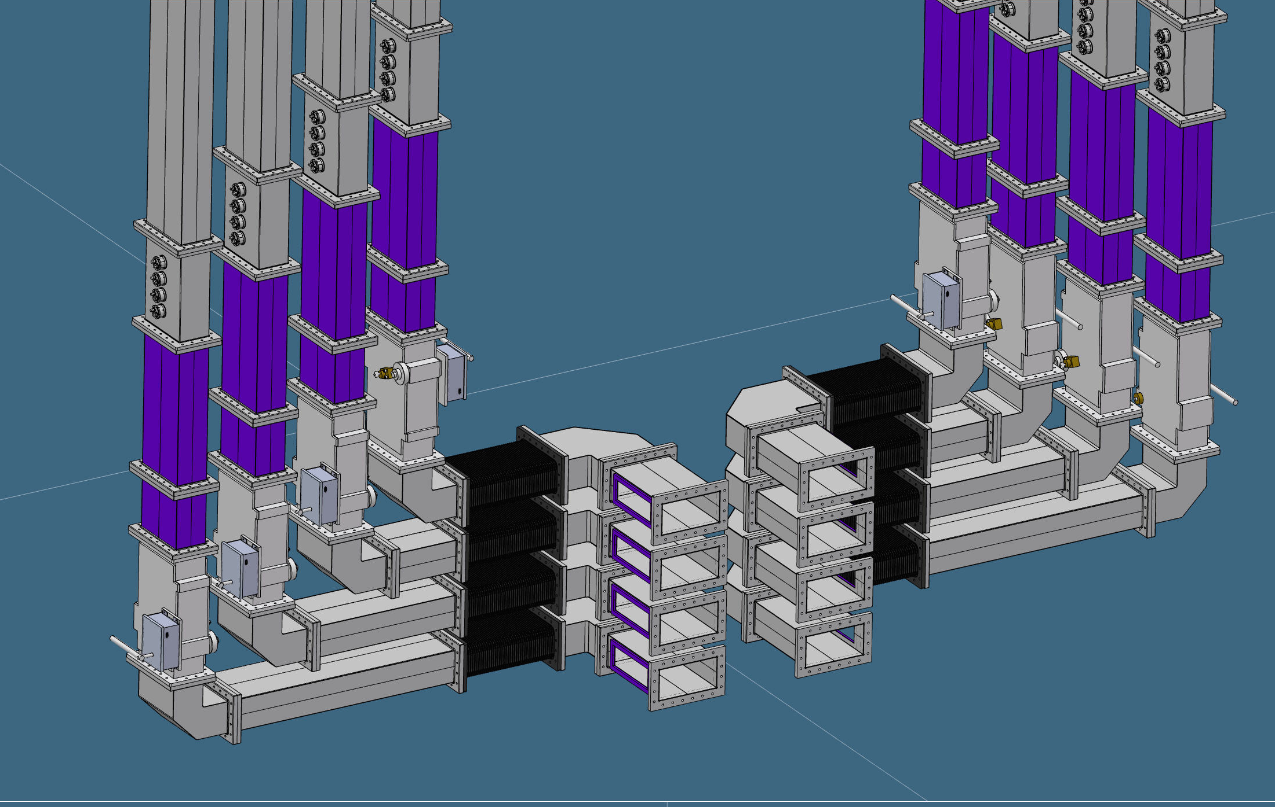
Switches
Aim: amplifiers on, but no power to cavities
Needs approval from PSS, so two independent systems required
Removable waveguide
Location of window
Shutter switch
Waveguide
Opening (to be sealed for RF leakage)

Slide 21
QA/QC
Experienced quality engineer employed
Regular factory visits planned: - monitor progress - monitor quality - witness Factory Acceptance testing
Monthly progress reports required
Factory Acceptance tests in tender documents: - some on all items - some on first 3-5, then every 10th
Site Acceptance tests: - on items with tilt- or shock-watch fired - random selection - depends on staff availability
Delivery: scheduled 4 weeks before installation to allow acceptance testing - starts September 2017 - finishes January 2019

Slide 22
Schedule
2015 | 2016 | 2017 | 2018 | 2019 | 2020
Install Window
Design
CDR Tenders 1&2
CDR Tenders 4
Support Structure
CDR Tenders 3
RFDS Procurement
RFDS Delivery
Installation
Commissioning

Slide 23
Risks
Joint STFC/ESS risk register created
31 risks in total
Top 5 as reported to STFC are:
Risks (Top 5)
 | Issues/Risks identified | Status | Proposed mitigation taken (or planned)
10 | Schedule delay due to late delivery by a supplier | Amber, Steady | Start the tender processes as soon as possible and closely monitor progress at the suppliers during construction.
1 | Three types of load are still under consideration due to cooling water changes | Amber, Steady | Loads are being prototyped to reduce risk. Load tender to start in September 2016.
15 | Cost changes due to changes in exchange rates. | Amber, Rising | Any cost increases will have to met using the contingency.
38 | Specifications for some components not yet fixed | Red, Falling | Methods for including the uncertainties in the tender have been found
45 | Tender issues causing delay | Amber, Rising | Regular meetings are taking place with John Webber (STFC) and Allan Norman (UKSBS) and the preparation of tender documents has started early

Slide 24
Conclusions
Design of RFDS nearing completion
A lot of work has been done by Yogi and ESS team!
Working well as a collaboration
Tendering has started: - tender 2 uploaded - tender 4 documents delivered this weekish - specs for tender 1 almost ready
Main issue with RFDS is size, not technology
Tender 1 - largest - late - but we will try and make up time
Support structure design advancing

