Slide 1



LLRF Systems for M-Beta and H-Beta
Polish Electronics Group in-kind contribution
Maciej Grzegrzółka
06.10.2016, Lund, ESS TAC

Slide 2
Polish Electronics Group
Consortium of 3 institutes:
  National Center for Nuclear Reasarch
  Warsaw University of Technology
  Łódź University of Technology
Previous experience:
  CERN
  DESY
  ITER

Slide 3
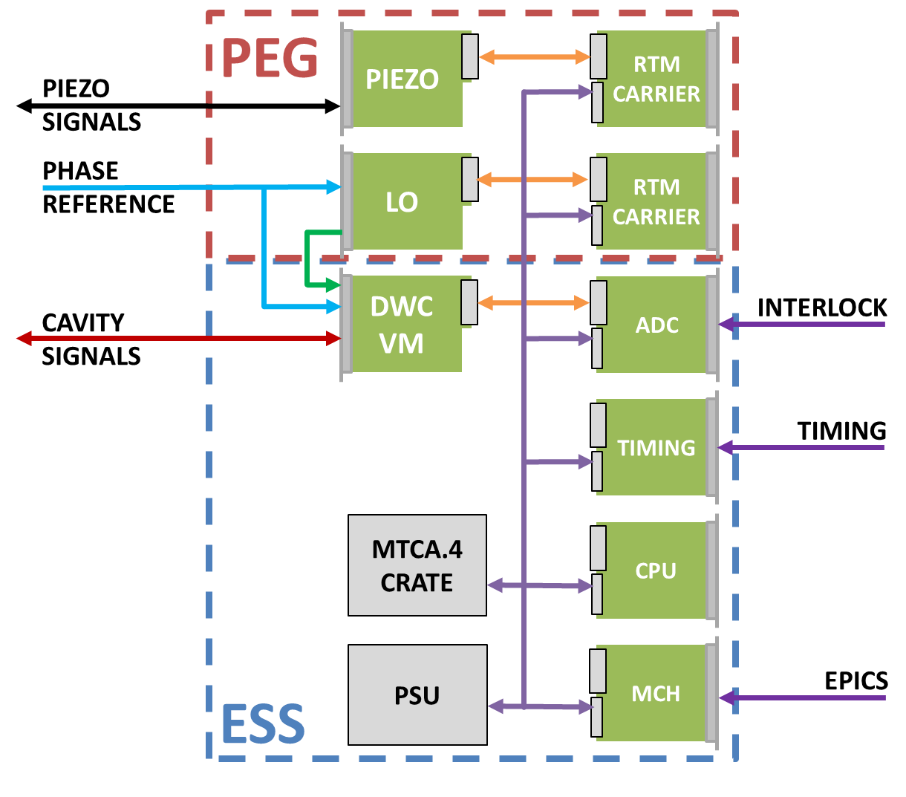
LLRF System
Final LLRF system structure is still not decided.
Solutions for Piezo Driver and LO are currently under discussion.

Slide 4
Scope of in-kind contribution
Development, testing and production of the following modules for M-Beta and H-Beta LLRF systems:
  LO generation MTCA.4 RTM Module (120 pieces)
  Piezo driver MTCA.4 Module (120 pieces)
  „RTM Carrier” AMC Module (240 pieces)
Development of the cavity simulator
In rack cabling planning
M-Beta and H-Beta LLRF system testing
M-Beta and H-Beta LLRF systems assembly and installation in the klystron gallery
Total cost: 4 496 500 €

Slide 5
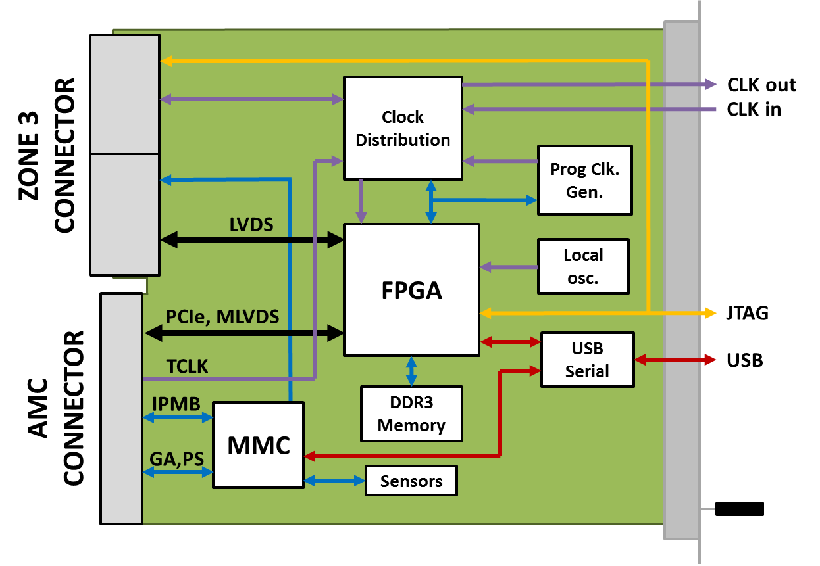
„RTM Carrier” AMC Module
Low cost (<1000 €) FPGA AMC module to control LO and Piezo RTM modules
Equipped with
  Artix 7 FPGA
  DDR3 Memory
  On board clock generation
  Communication interfaces:
    PCIe
    USB serial
    I2C (MMC, IPMI)
Compatible with MTCA.4 standard and DESY ZONE 3 Digital Class D1.0 recommendation

Slide 6
LO generation RTM module
Module responsible for generation of the LO and clock signals for LLRF system
Compliant with MTCA.4 RTM specification
4 clock signal outputs
4 LO signal outputs
Configured remotely by the AMC module
Compatible with „RTM Carrier” AMC module

Slide 7
Piezo Driver
Module to control 2 piezos
Two independent channels with configurable mode of operation: piezo actuator or sensor.
Compatible with MicroTCA.4 standard
Discussion on-going about required system parameters and integration of HV amplifier inside the module

Slide 8
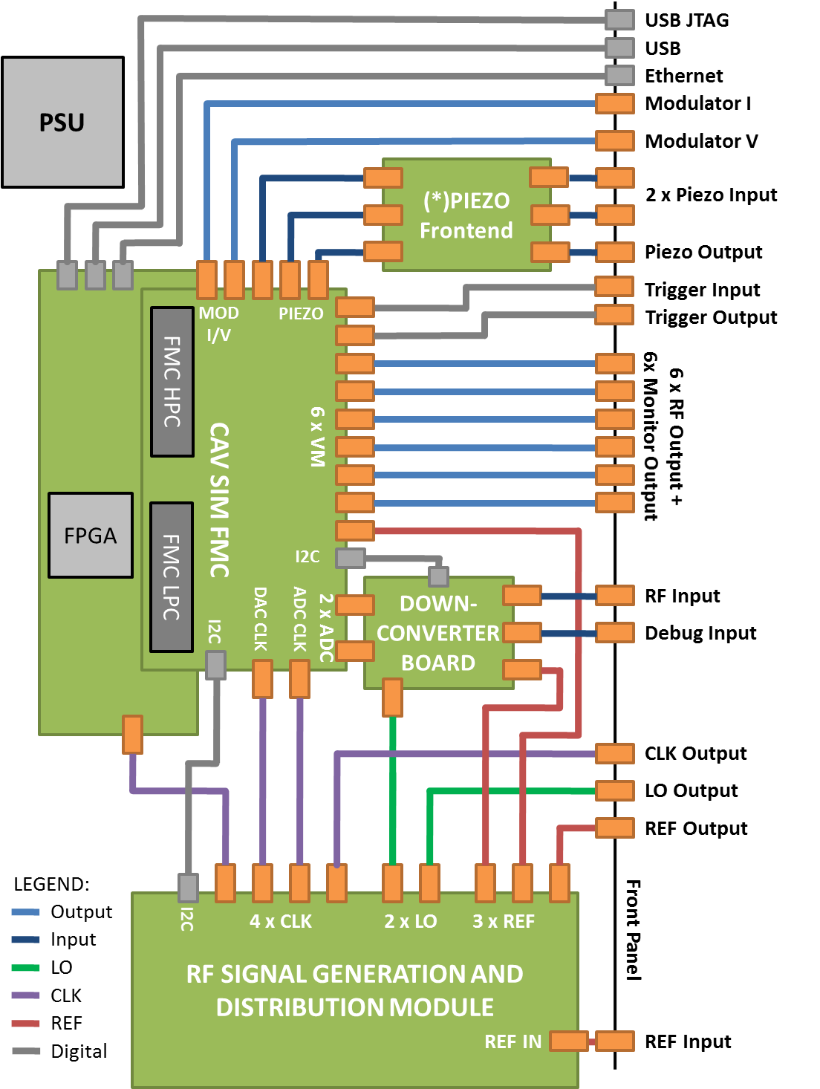
Cavity Simulator
Will be used to test the LLRF systems before installation inside the klystron gallery
Emulates the signals from the RF cavity and Klystron based on the signals from the LLRF system (Piezo, VM)
Based on high performance FPGA connected to the data conversion module with RF frontend
Build as 19” module
Remotely controlled by ethernet

Slide 9
System Testing
Each LLRF System unit will be tested after assembly and after installation
For this purpose a dedicated teststand, equipped with the cavity simulator will be prepared
List of scope and test scenarios will be agreed with ESS
PEG will prepare dedicated software that will control the teststand

Slide 10
Production, Assembly and Installation
PEG will manufacture and test LO RTM, Piezo driver, „RTM Carrier” AMC modules
The rest of components will be delivered to PEG premises by ESS
PEG will do the system integration and tests
Complete LLRF systems will be send to ESS
PEG will install the systems inside the klystron galery and connect them to rack patchpanel
After installation, PEG will again test the systems with cavity simulator

Slide 11
Challanges
Project management
Keeping the timeline
Keeping track of all components
Tight communication and cooperation with all involved parties (the LLRF system is strongly coupled with other parts like cavities/cryo systems, high power RF systems, facility operators, ICS, etc…)
Freezing technical requirements with different ESS groups

Slide 12
Status
IKC Agreement signed by PEG
RTM Carrier:
  Specification ready, first prototype design
LO RTM:
  Specification ready, first prototype design
Piezo driver:
  Finalizing requirements and specification
Cavity Simulator:
  Specification ready, internal module design

Slide 13
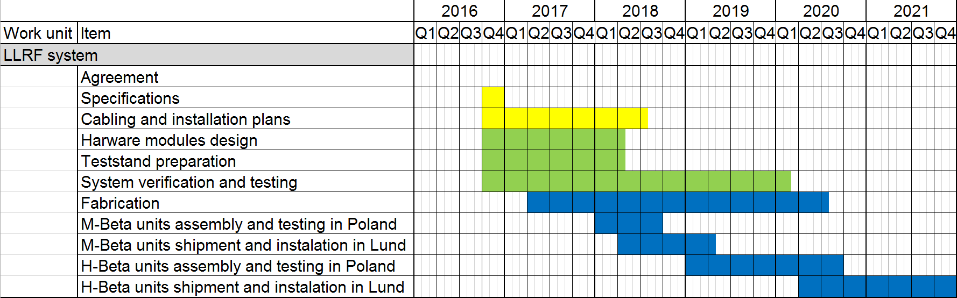
Schedule

Slide 14
Thank You for attention

Slide 15
Polish Electronics Group
National Center for Nuclear Reasarch:
Zbigniew Gołębiewski
Maciej Kudła
Jarosław Szewiński
Marcin Gosk
…
Warsaw University of Technology:
Adam Abramowicz
Krzysztof Czuba
Igor Rutkowski
Maciej Grzegrzółka
Wojciech Wierba
Krzysztof Oliwa
…
Łódź University of Technology:
Andrzej Napieralski
Wojciech Cichalewski
Dariusz Makowski
Aleksander Mielczarek
Piotr Perek
…

