Slide 1

Main Phase Reference Line
Polish in-kind contribution
Krzysztof Czuba
Warsaw University of Technology
Institute of Electronic Systems
06.10.2016, Lund, ESS TAC

Slide 2

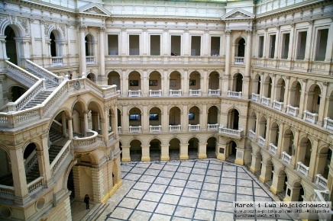
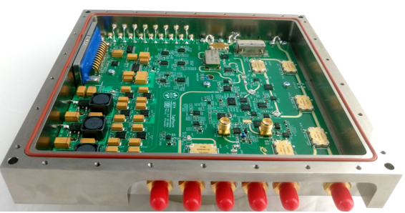
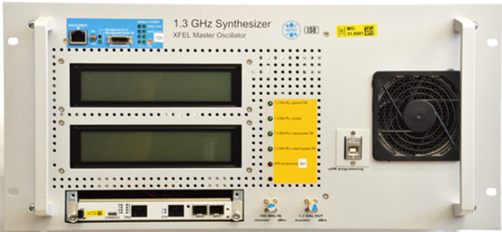
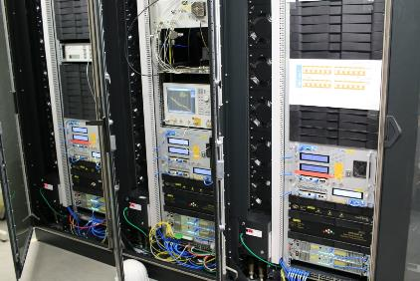
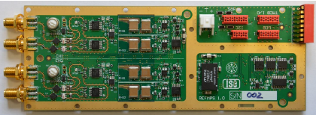
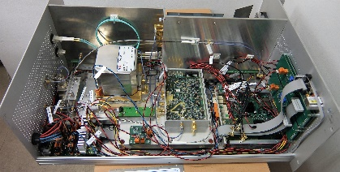
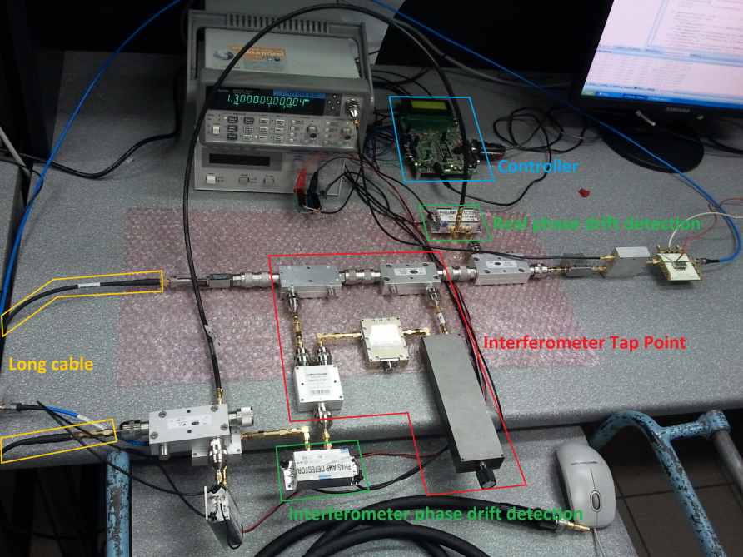
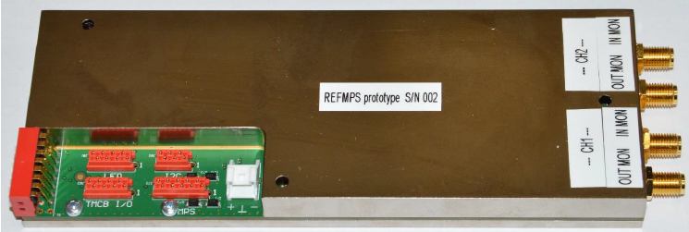
Warsaw University of Technology
  The largest technical university in Poland
  Education specialties – 30
  Faculties – 20
  Students – nearly 36 000
  Academic staff – 2 500 (500 prof.)
  Institute of Electronic Systems:
  Long term collaboration with DESY Hamburg
  Design of Master Oscillator and femtosecond PRL for E - XFEL
Examples of E-XFEL Phase Reference System Components
E-XFEL Master Oscillator System

Slide 3
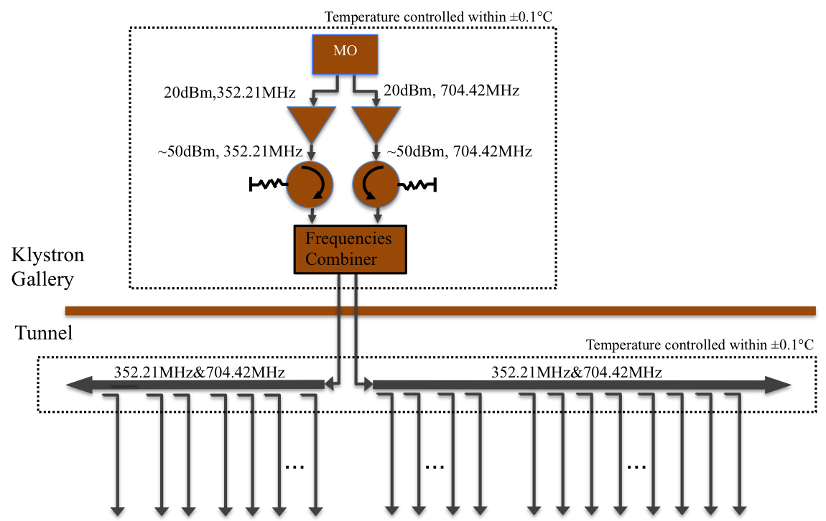
Scope
Design, delivery, installation and commissioning of the Main Phase Reference Line (PRL)
The Main PRL covers signal distribution from the Master Oscillator output to tap point outputs in the tunnel
WUT
Contribution

Slide 4
Design Requirements
Main Requirements (by Rihua Zeng):
Distribution of 2 frequencies (352.21 MHz and 704.42 MHz) from MO to the tunnel
Total length: ~600m.
Number of taps: 71 (still may vary slightly)
Power level at each tap: +15 dBm
Stability requirement:
  0.1° for short term(during pulse 3.5 ms)
  2° for long term(hours to days) between any two points in the linac
Work under heavy radiation level environment

Slide 5
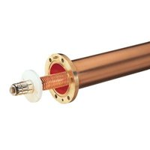
System Design
100 W power amplifier in klystron gallery (next to MO)
Coax cable based distribution down to the tunnel
2 sections of 1 ⁵/₈” coaxial rigid line with directional couplers in the tunnel
Line temperature stabilization in the tunnel (0,1 ºC)
Humidity and air pressure stabilization inside of the line

Slide 6
Project Plan
13 milestones
Most important:
  PDR – end of 2016
  CDR - March 2017
  LEBT to M-Beta hardware prepared for installation – June 2017
  Commissioning for H-Beta to A2T complete – May 2018

Slide 7
Technical Design Status – RF Components
Critical components selected: types of: rigid line, couplers, splitters, filters, …
Working on technical details to finalize rigid line section lengths and tap points positions in the tunnel
After having final lengths (plan for mid of October), we will contact companies and select the best offer
We will order several rigid line sections for tests
In parallel we are contacting companies for alternatives of couplers, filters and splitters – in October we will order and start testing selected parts
Main problem is to remove Teflon from components and connectors – companies are offering components with peek instead (but longer delivery time)

Slide 8
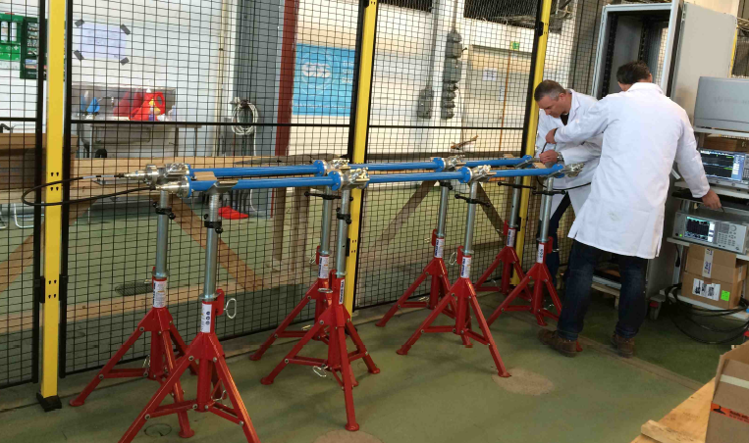
PRL Prototype Section
Line prototype assembled of standard components and tested in Lund (Rihua Zeng)
Plan to purchase final parts of the line (final section length) and rebuild the prototype for tests
In parallel an installation prototype will be build in Poland – for installation procedure investigations

Slide 9
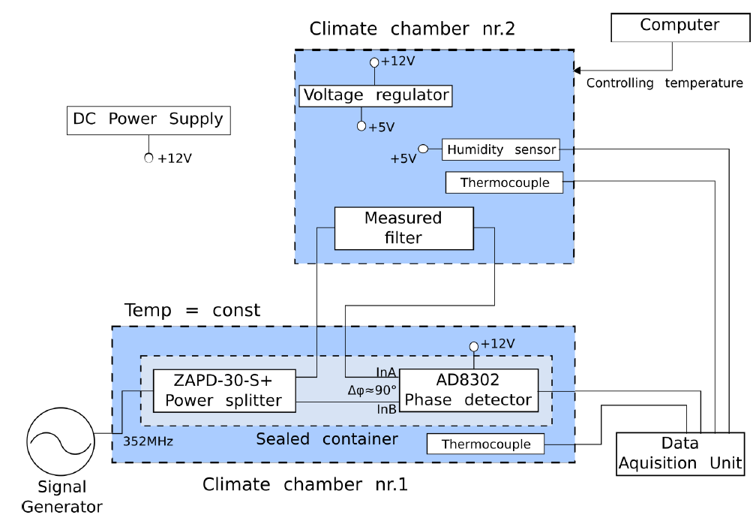
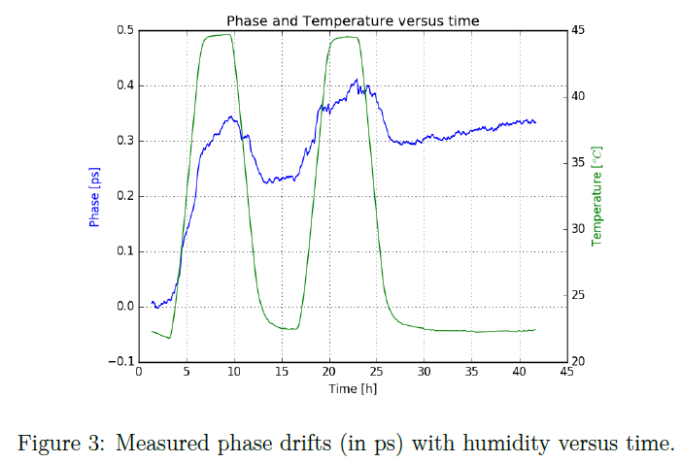
Drift Characterization of PRL Components
Test setup operating in Warsaw
Power splitters and filters characterized versus temperature
Plan to run tests versus humidity
Rigid line directional couplers under test

Slide 10
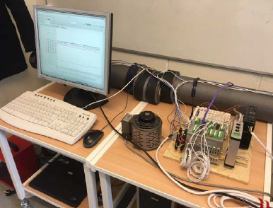
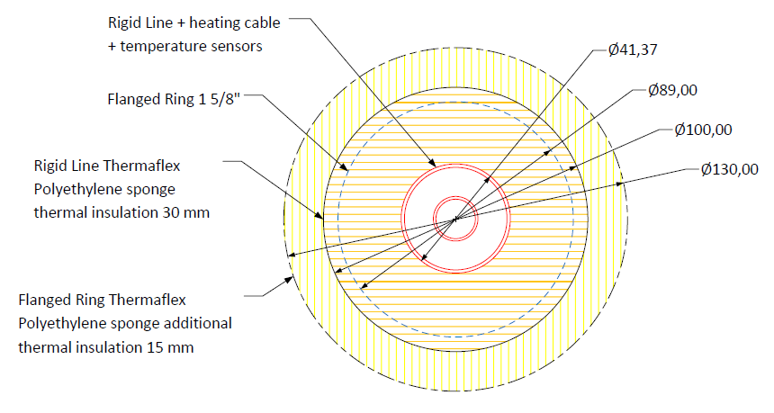
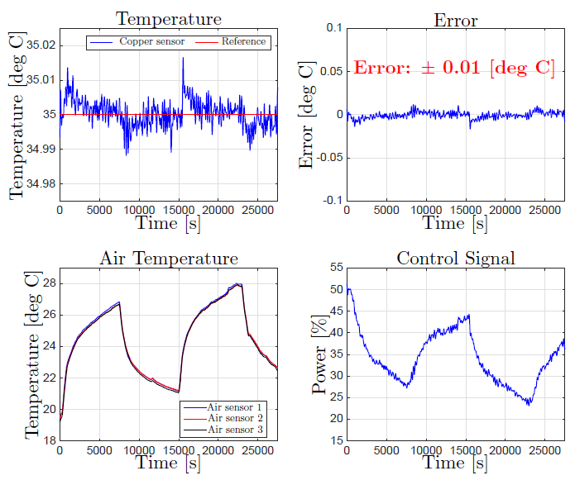
Temperature stabilization
Temperature stabilization on prototype section running (Björn Olofsson, Bo Bernhardsson)
Very good results achieved
WUT will take the prototype over in end of October and will investigate and optimize for installation procedure
We must plan how to install it effectively on 600 m of PRL
Temperature controller interface must be agreed with ESS control system – not addressed until now
Temp. stabilized ~35C with ±0.1C
Temp. sensors PT100 radiation hard
Heater – floor heater cable (?)
PI controller
30 mm of thermal insulation
Fig. Measurement results courtesy of Björn Olofsson

Slide 11
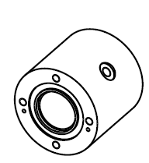
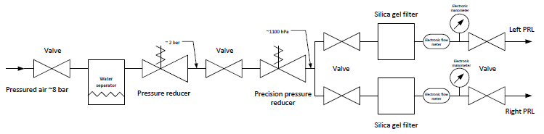
PRL pressure and humidity stabilization
Work on prototype in progress, selected preliminary components
Compressed air available on gallery
Two step pressure reduction
Silica gel filters to stabilize humidity
Electronic barometric sensors
Electronic flow meter
Started ordering components
Plan to test solutions in November/December

Slide 12
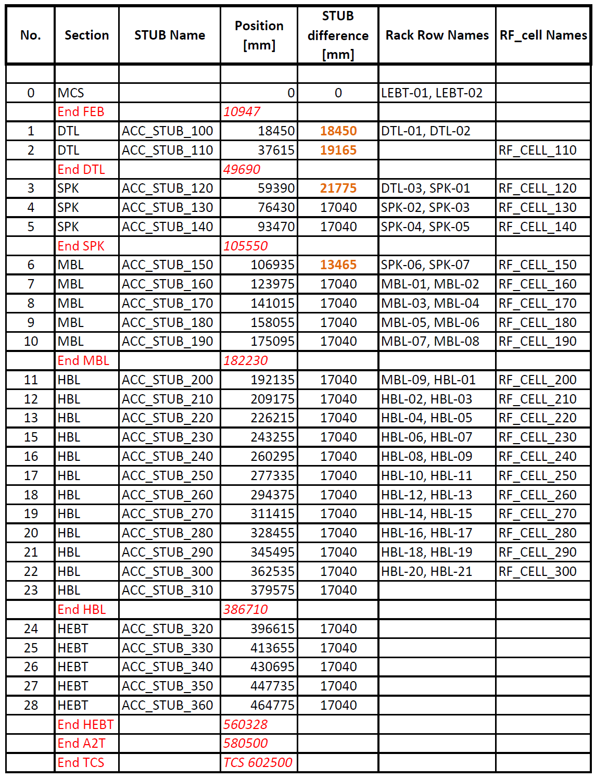
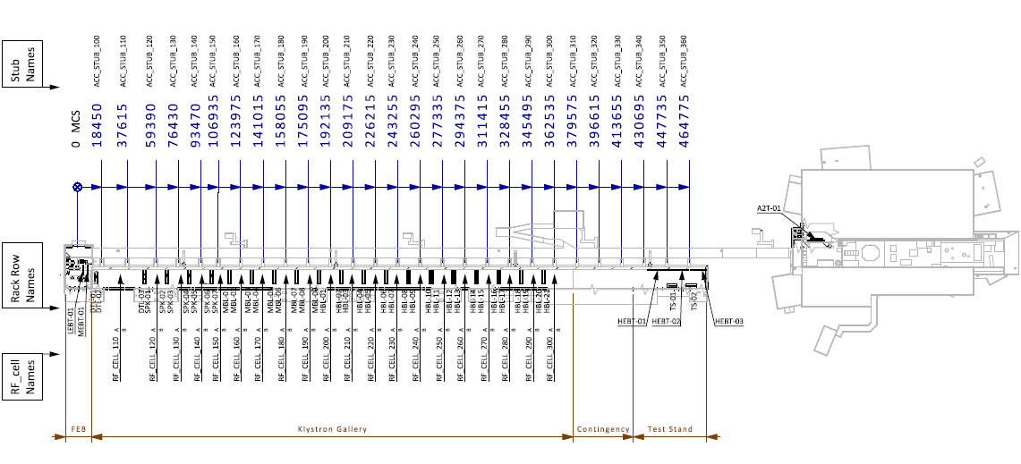
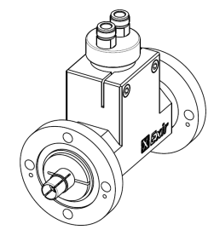
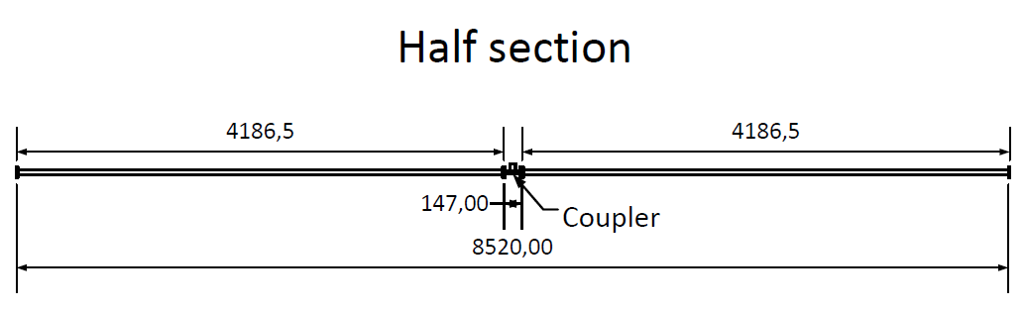
Phase Reference Line - sections
23 sections of 17040 mm
4 different length sections (18450 mm, 19165 mm, 21775 mm, 13465 mm)
2 couplers per section
HEBT and A2T sections design in progres
Table is still under development!

Slide 13
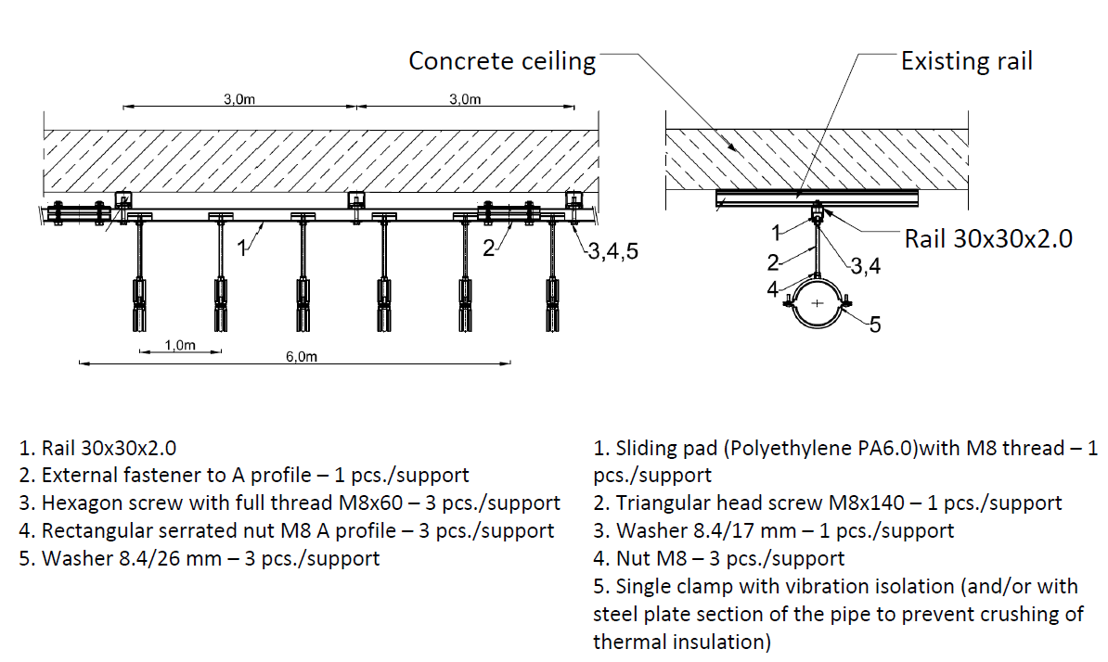
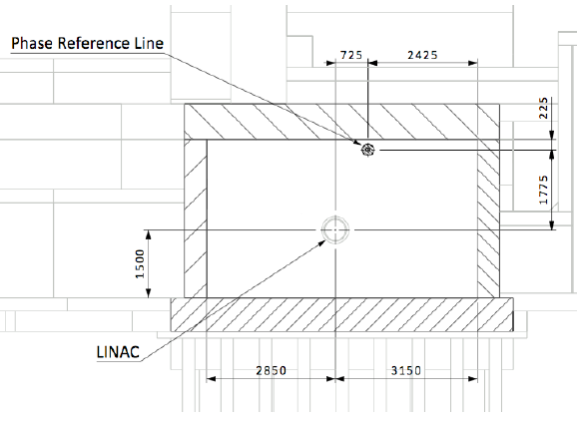
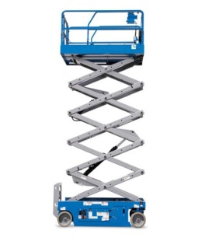
Phase Reference Line – installation Planning
We will need a special gantry to lift up half section
Two mobile lifting platforms are necessary

Slide 14
PRL – Manufacturing and Installation Procedure
Manufacturing (4 half sections/week – 3-4 people)
Considering making half sections with coupler in Poland with installed temperature sensors, heater, thermal insulation and clamps
Temperature stabilization test
Pack into wooden boxes and ship (truck) to Lund
Installation: (3-4 half sections/week – 2-4 people)
Install supporting profiles under ceiling
Unpack half section in tunnel
Move half section on special ‘bed’ and lift it up with gantry
Screw all clamps to sliding pads controlling and adjusting levelness with laser level
Screw section flanges
Install thermal insulation on flanges
Install 50 Ohm load and check signal power
Connect temperature control cables from gallery and check operation

Slide 15
PRL – Open Questions
Placement of Master Oscillator (we must analyze design data and give proposal)
Flatness of ceiling and tunnel floor - important for line leveling
Will ESS have some gantry for long components installation?
Can we rent/borrow a mobile lifting platforms for installation?
We will need a storage room at ESS (~30-40 m² ) – will it be available?
It will be very helpful to have small office for 2-4 people (Internet, shelves for documentation, components and tools)

Slide 16
Interfaces
Temperature, air pressure and humidity regulation to the control system – still not discussed
Pressurized air from klystron gallery – must discuss connection
Input from MO and outputs to LLRF clarified

Slide 17
Contract
TA, IKA and Schedule signed by WUT, waiting for ESS signature (27.09.2016)
Mo major issues

Slide 18
Challenges
Very tight schedule
Short installation time foreseen (only Q3 and Q4 of 2017)
  Would help to get 2-3 more months at the beginning of 2018
Getting all necessary data and preparing technical design in 2016
  A lot of help is provided continuously by Rihua
Organizing production and installation (logistics)
  We have to contact ESS for transport, rooms, organization during installations
Procurements – we will know how difficult it is after freezing list of components and getting delivery time information

Slide 19
Thank You for attention

