Slide 1
NBPI integration, shutter and basement handling
Jarich Koning
Remote Handling consultant
Heemskerk Innovative Technology B.V.
www.europeanspallationsource.se
2015 May 2016

Slide 2
Overview
This meeting:
Large change on ‘Light shutter’, at R5.5-R6m around the monolith – ‘Bridge’ area
Inform you on current status, which will be in the upcoming NBEX PDR
Contents:
System layout (presentation)
Few motion sequences (movies in presentation)
Interactive session (Catia)

Slide 3
Incentives
Improve shielding bunker from target radiation during shutdown
Improve shielding towards basement
Create opportunities for tailoring shutters
Increase accuracy of in-vessel vs ex-vessel guides
Increase accuracy of NBPI mount
Instruments to remain during seal refurbishment
Create option for an NB shutter
Block port when NBPI removed

Slide 4
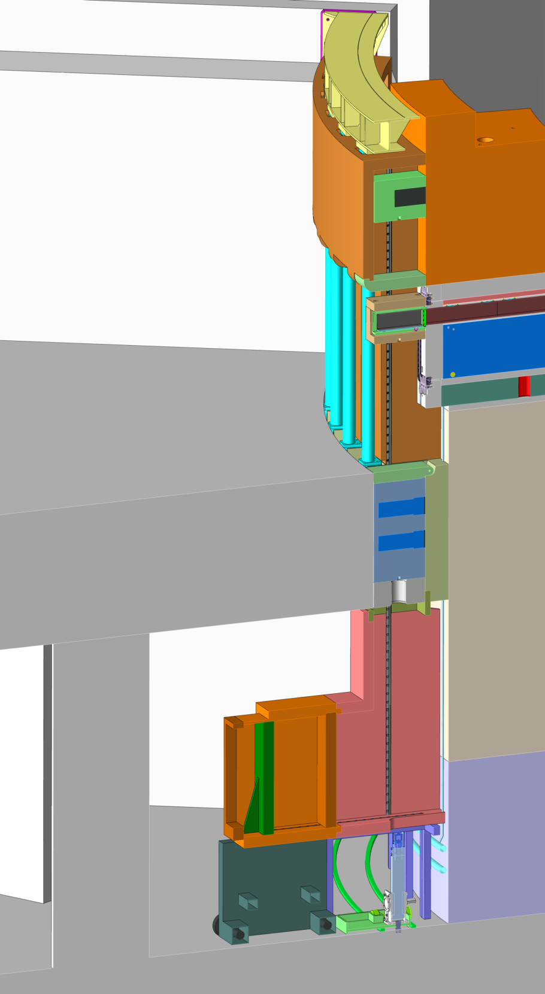
‘Bridge’ configuration
LSS shielding
Depending on instrument, various options, generic elements
Floor filler block or GBS could be used as temporary block during NBPI absence
Locking integrated on several levels (dep. on instrument)
BBG to be pushed forward in BBGH to mate with NBPI flange
BBGH ‘floats’ BBG (gravity compensation integrated)
Tailoring possible, just submit to common shutter/block handling interfaces
Sliding hatch
BBG
BBGH
NBPI
Bunker roof support
Fall hatch
Floor fill shielding
Gamma Beam Shutter
Floor filler block
Lower shielding
Shutter cask on cart
Support frame
Rigid chain actuator
Actuator cart on rails

Slide 5
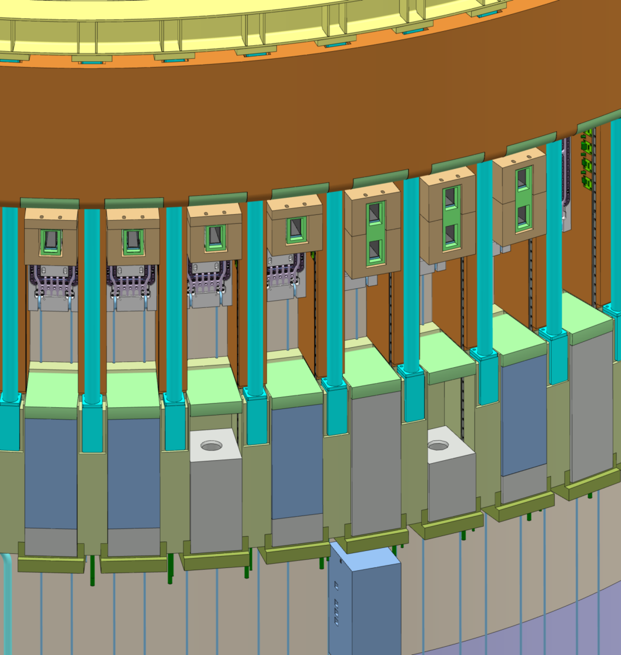
Light Shutter System
Different configurations of BBGH, GBS, NBS possible
Use cases described in ESS-0044607
Case
3.3.1, 4)
Case
3.3.4, 2)
Case
3.3.1, 4)
Case
3.3.4, 2)
Case
3.3.1, 1)
Case
3.3.1, 3)
Case
3.3.4, 1)
Case
3.3.1, 5)
Case
3.3.1, 1)
Case
3.3.1, 3)
Case
3.3.4, 1)
Case
3.3.1, 5)

Slide 6
NB sealing and BBG
He leak-testing connector
Compression spider
BBG: Bridge Beam Guide in operational position (light-green) housed in cradle (translucent-brown), mounted on insert, bourn by rails and a locking system (invisible).
Bridge Beam Guide Holder
Bridge Beam Guide
Guide
Alignment assys
Gravity compensation springs
Double sealing flange
Cooling connectors
Shutter guide rails

Slide 7
NB sealing and BBG
BBG pickup surface
GBS: Gamma Beam Shutter in shutdown position
Steel volume
Tungsten volume
Actuator interface

Slide 8
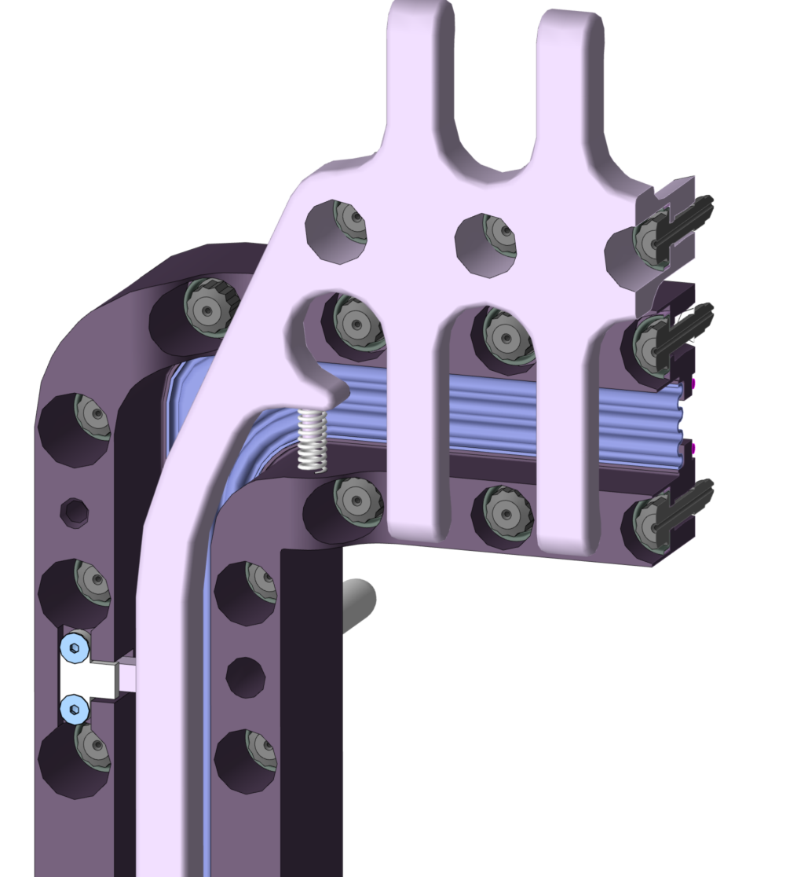
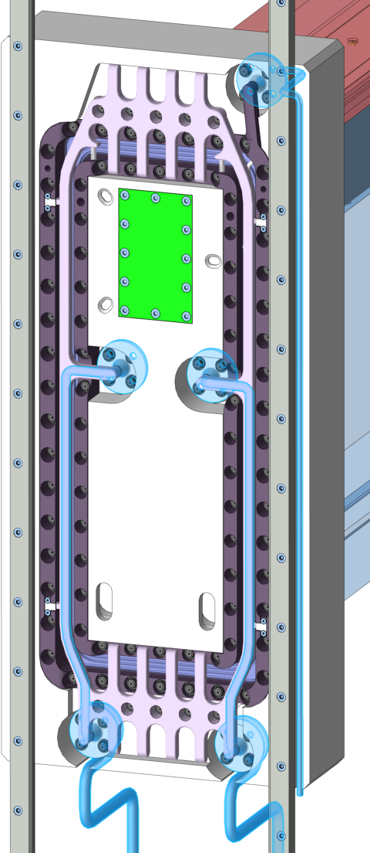
NB sealing assembly
Double sealing flange cross-section
Outer seal
RH bolts
Bellows
Lip welds
Inner seal
Gravity compensation of spider
Water cooling lines integrated in spider
Aligning pin
Restraint of spider, 2mm clearance

Slide 9
Locking system
Case 3.3.1, 1), but common concept for all shutters and blocks

Slide 10
Engaging BBG kinematic mount
Case 3.3.1, 1), but common concept for all BBGHs

Slide 11
Engage GBS
Case
3.3.1, 1)

Slide 12
Engage NBS
Case
3.3.1, 1)

Slide 13
Shutter handling
Case
3.3.1, 1)

Slide 14
FA handling
Common

Slide 15
References
Refer to ESS-0044607 for more information
Most will be in NBEX SDD-sol ESS-0058226, too.
Pictures originate from model ESS-0054148
Interface drawing ESS-0054148 (not yet released)
For now on the share at \Machines Directorate\Target division\Public Read Write\Jarich\2016-05-03 Shutter handling pics\ESS-0054148.3.pdf
This presentation ESS-0058290

