Slide 1
Cryogenic Transfer Line for Lund Test Stand 2 design overview
Janusz Skrzypacz
Jarosław Poliński
Przemyslaw Jaszak
Maciej Chorowski
Critical Design Review Meeting, 11-12 January 2017, Wroclaw, Poland

Slide 2
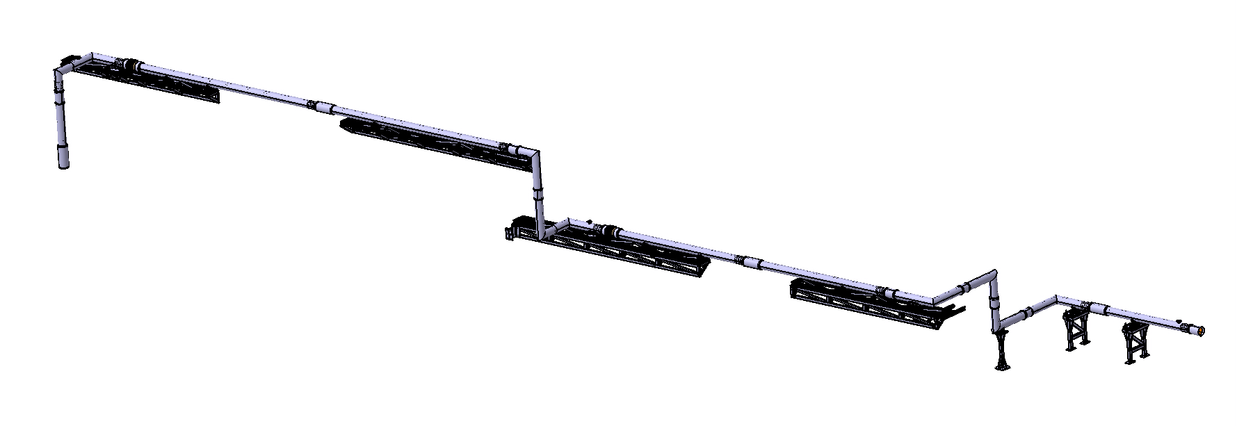
CTL-LTS2 design overview
CTL-LTS2 consists of 13 sections:
6 line sections;
5 elbow sections;
2 duble elbow sections;
Interface point to TICP
Interface point to ValveBox

Slide 3
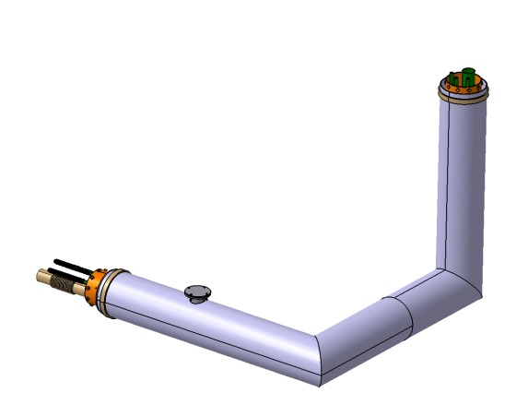
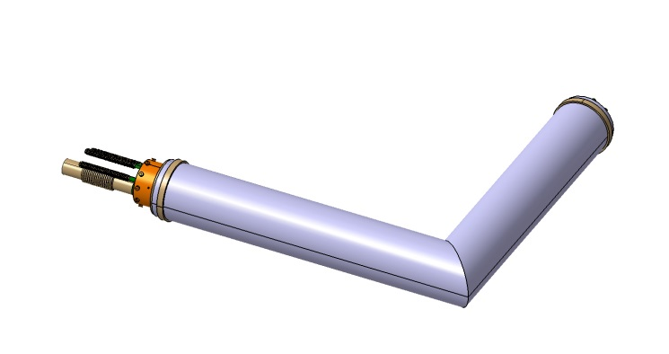
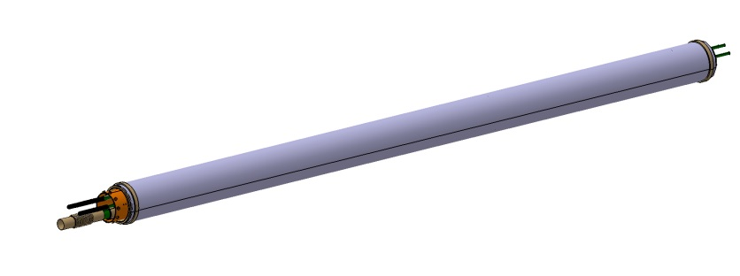
CTL-LTS2 design overview
CTL-LTs2 consists of 13 modules

Slide 4
CTL-LTS2 line section
6 line sections (the same structure but different dimensions)

Slide 5
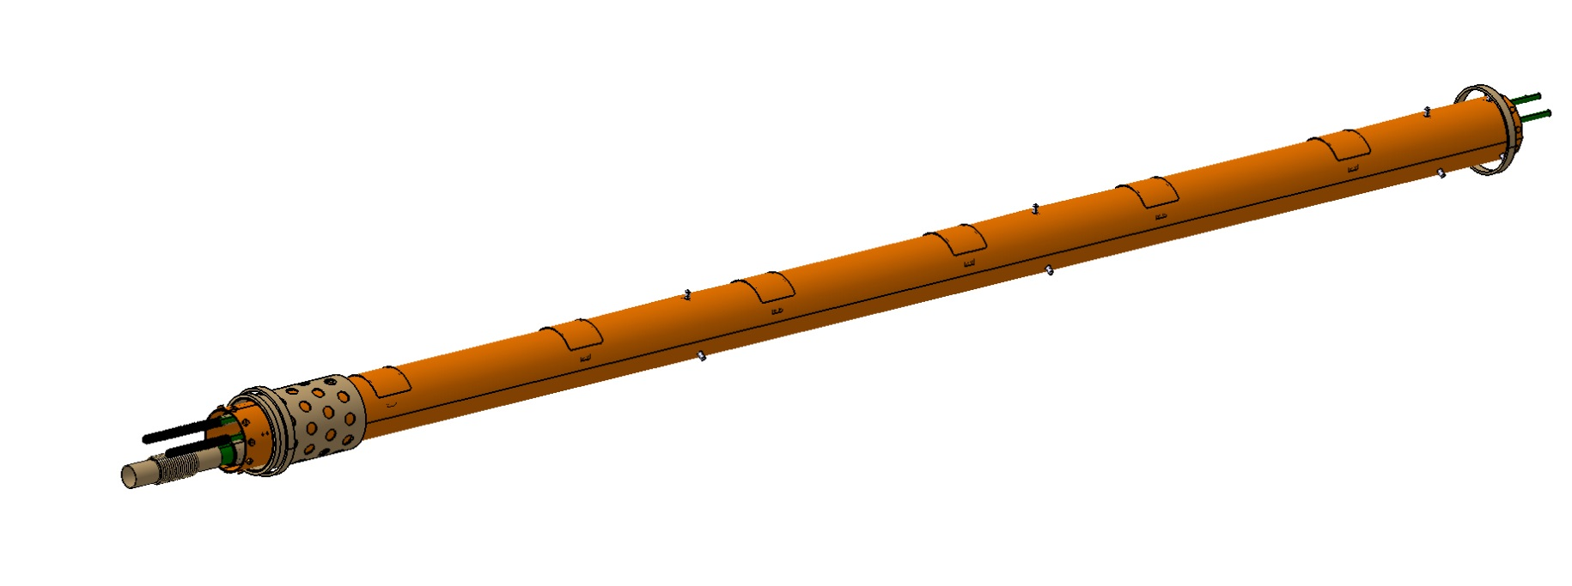
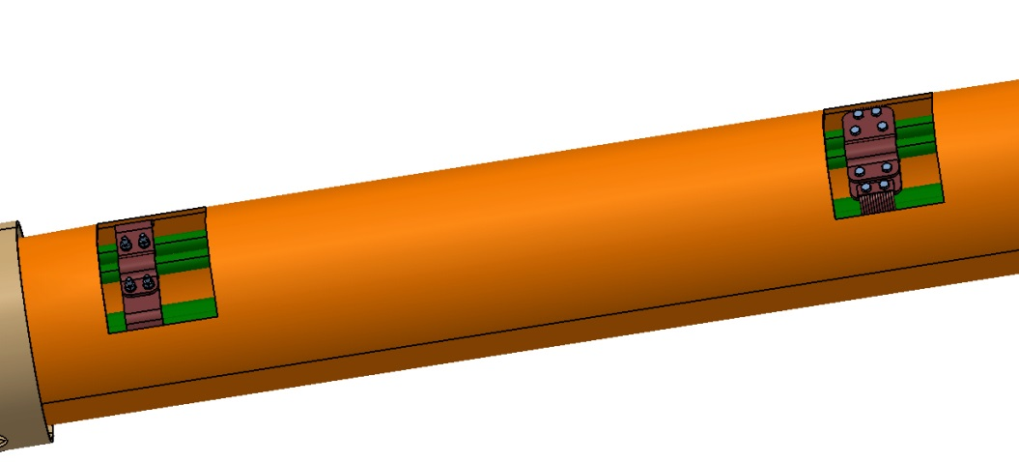
CTL-LTS2 line section

Slide 6
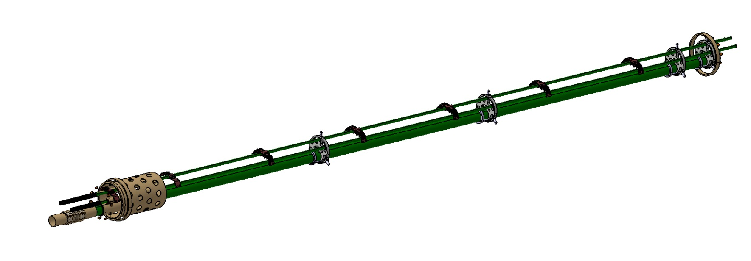
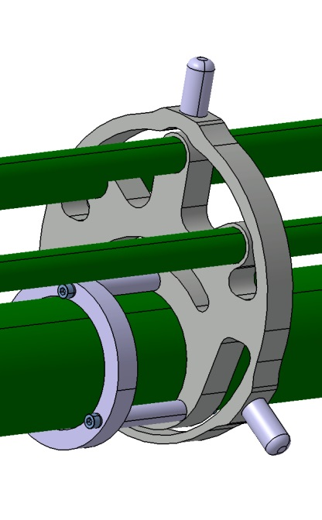
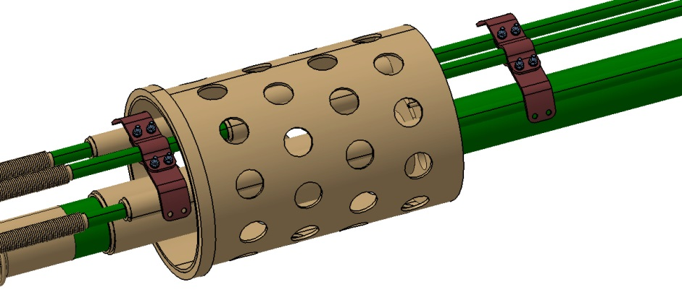
CTL-LTS2 line section

Slide 7
CTL-LTS2 elbow section
5 elbow sections (the same structure but different dimensions)

Slide 8
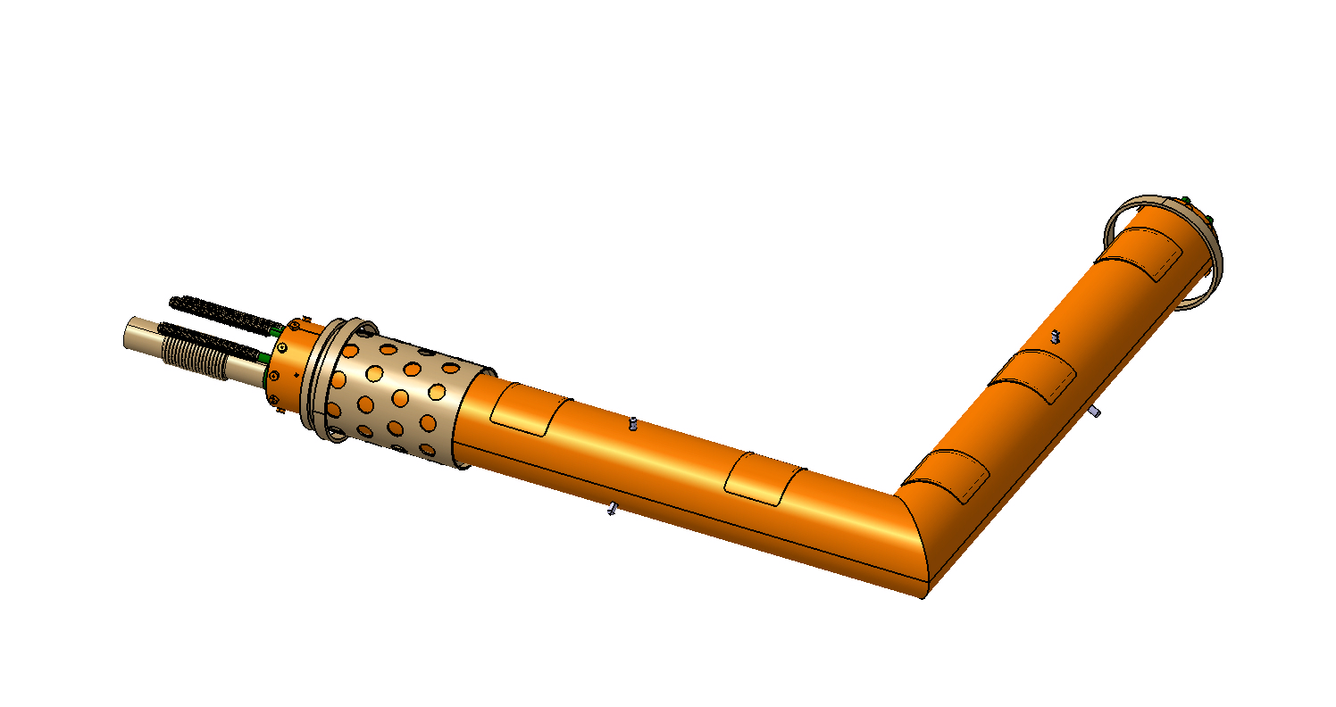
CTL-LTS2 elbow section

Slide 9
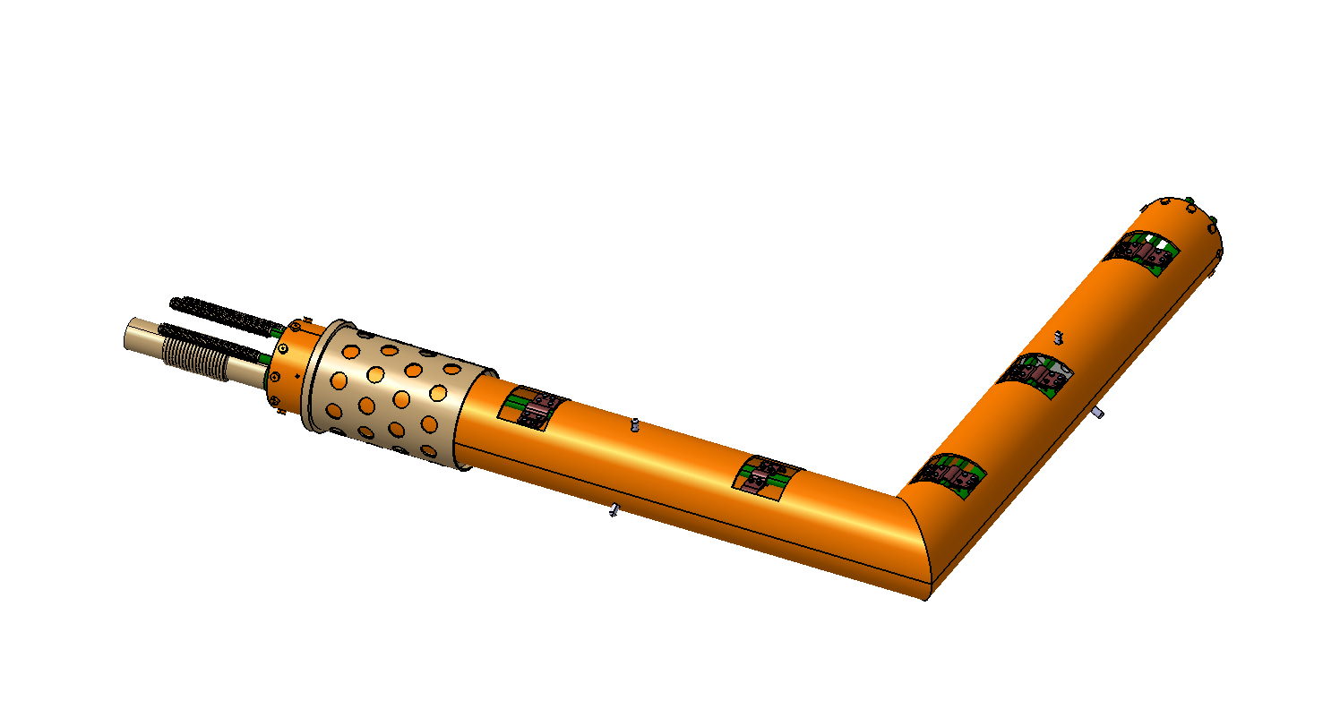
CTL-LTS2 elbow section

Slide 10
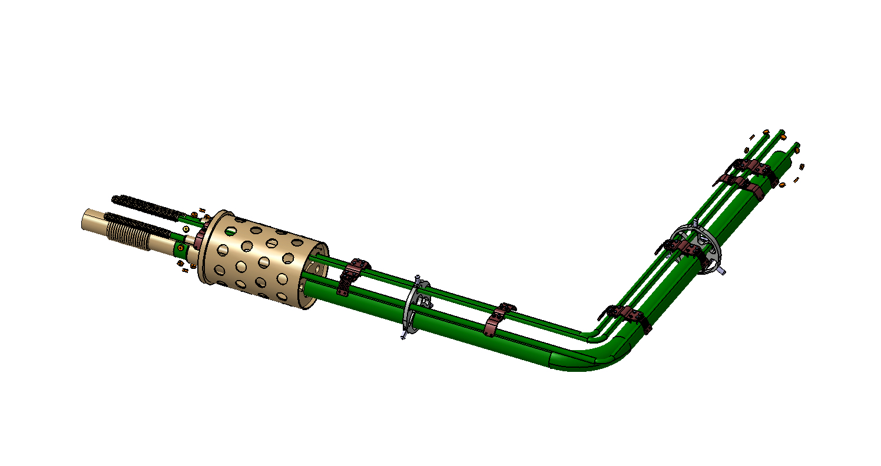
CTL-LTS2 elbow section

Slide 11
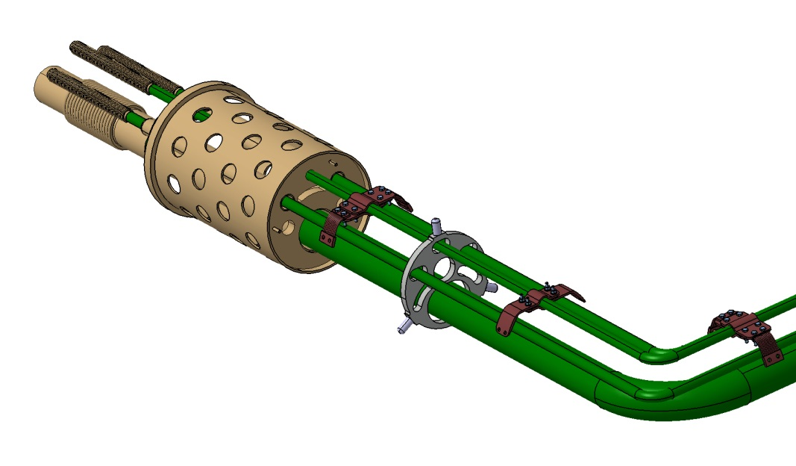
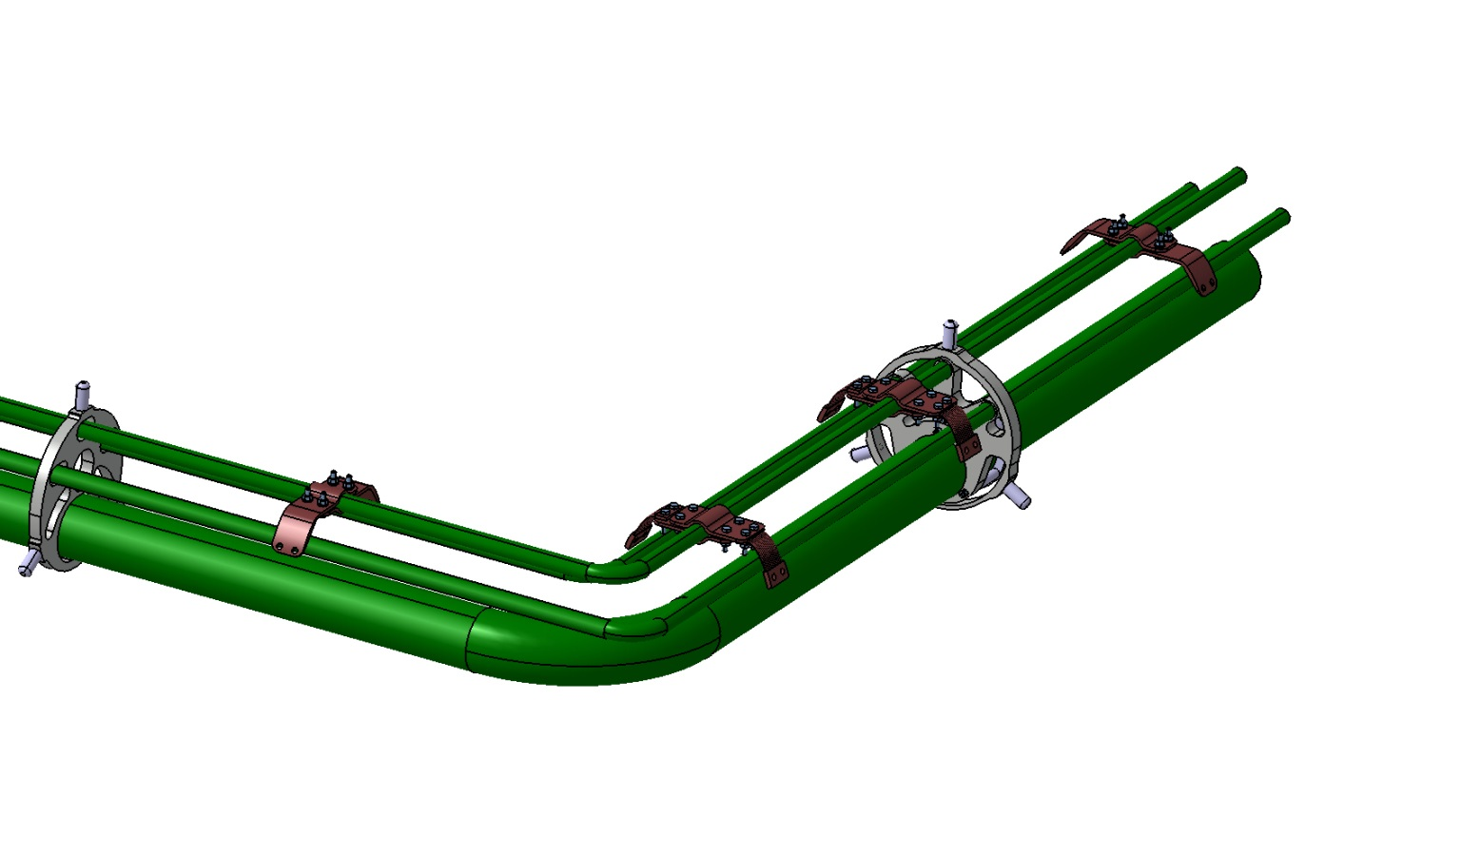
CTL-LTS2 elbow section
Fixed Support
Sliding Support
Vertical Support

Slide 12
CTL-LTS2 double elbow section
2 double elbow sections (the same structure but different dimensions)

Slide 13
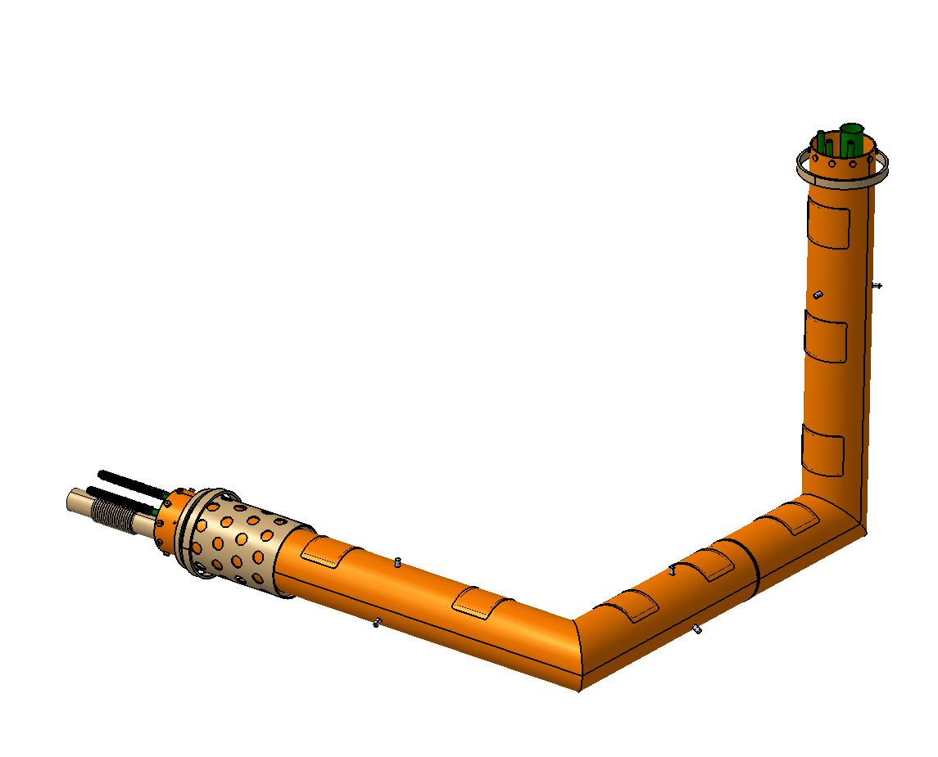
CTL-LTS2 double elbow section

Slide 14
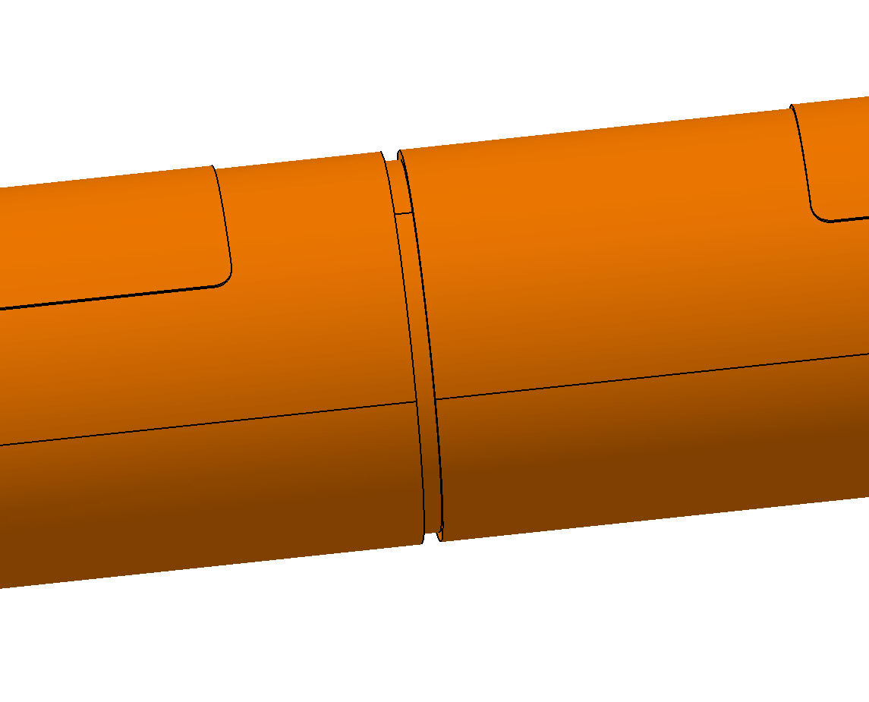
CTL-LTS2 double elbow section

Slide 15
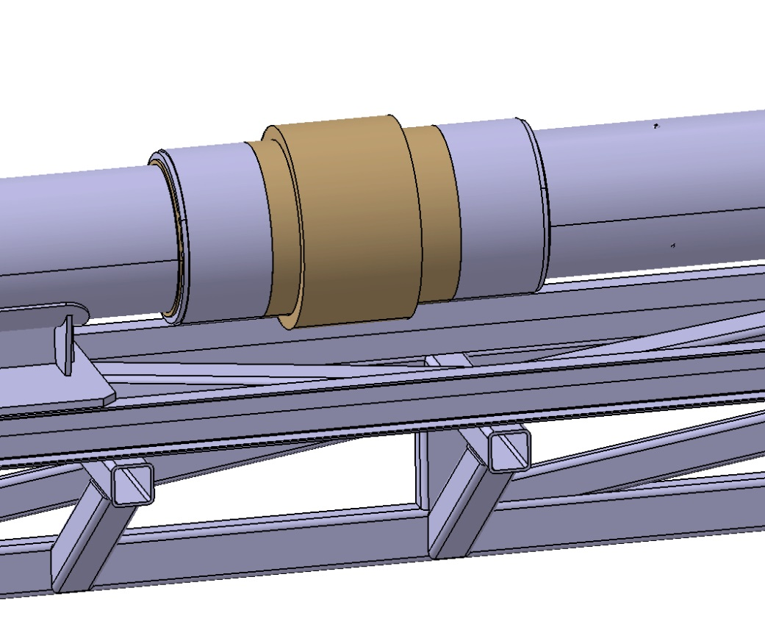
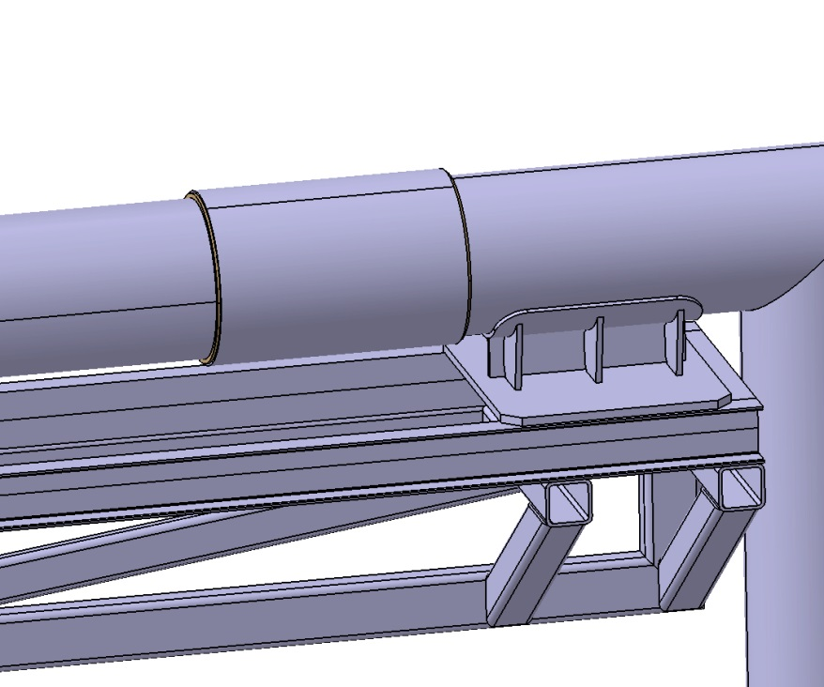
Sections interconnection

Slide 16
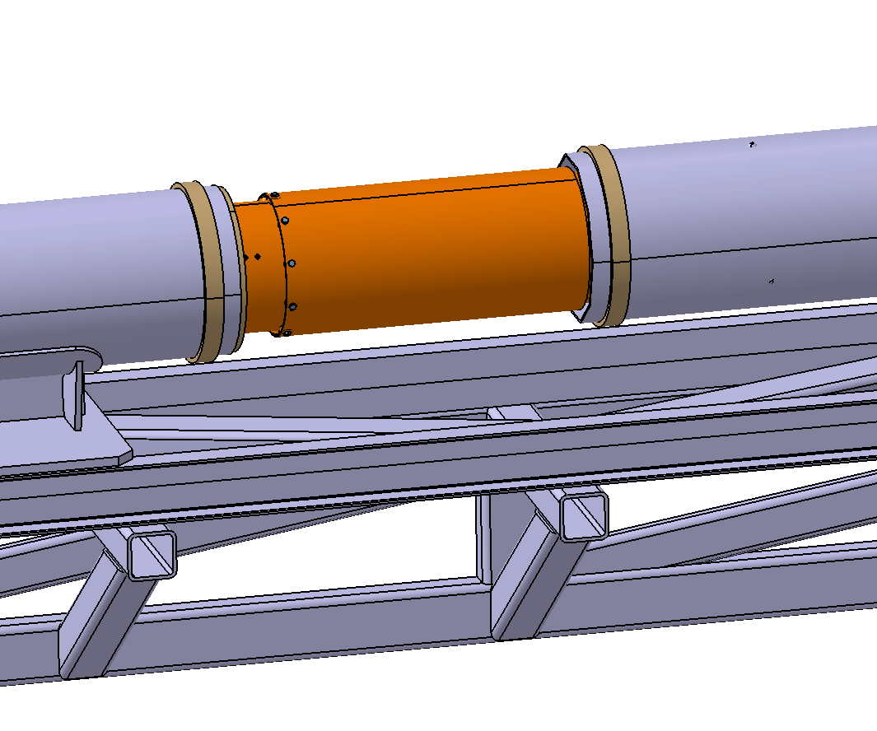
Sections interconnection

Slide 17
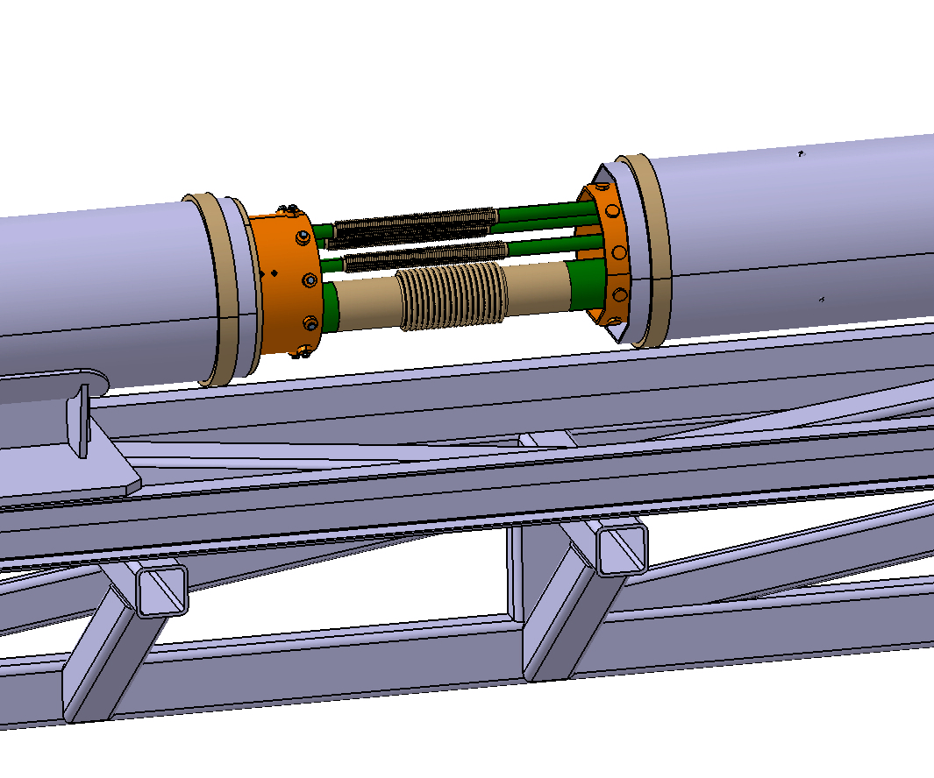
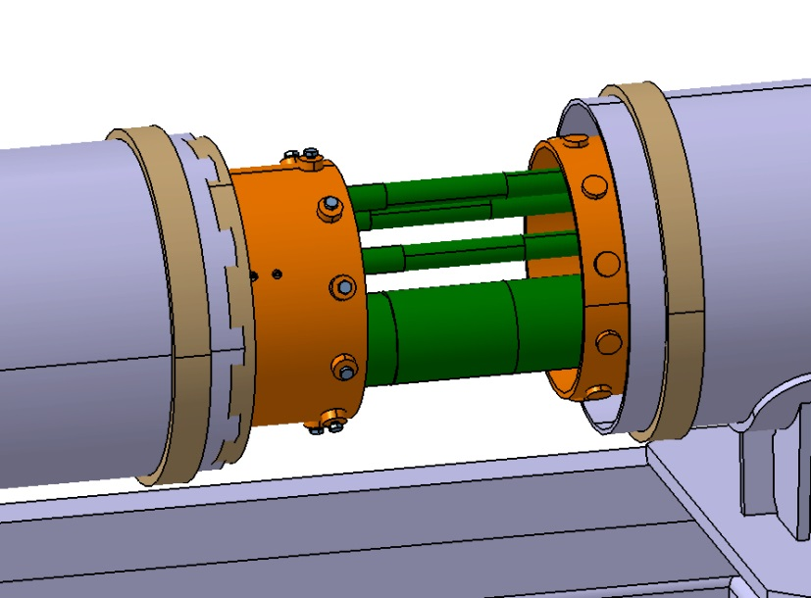
Sections interconnection

Slide 18
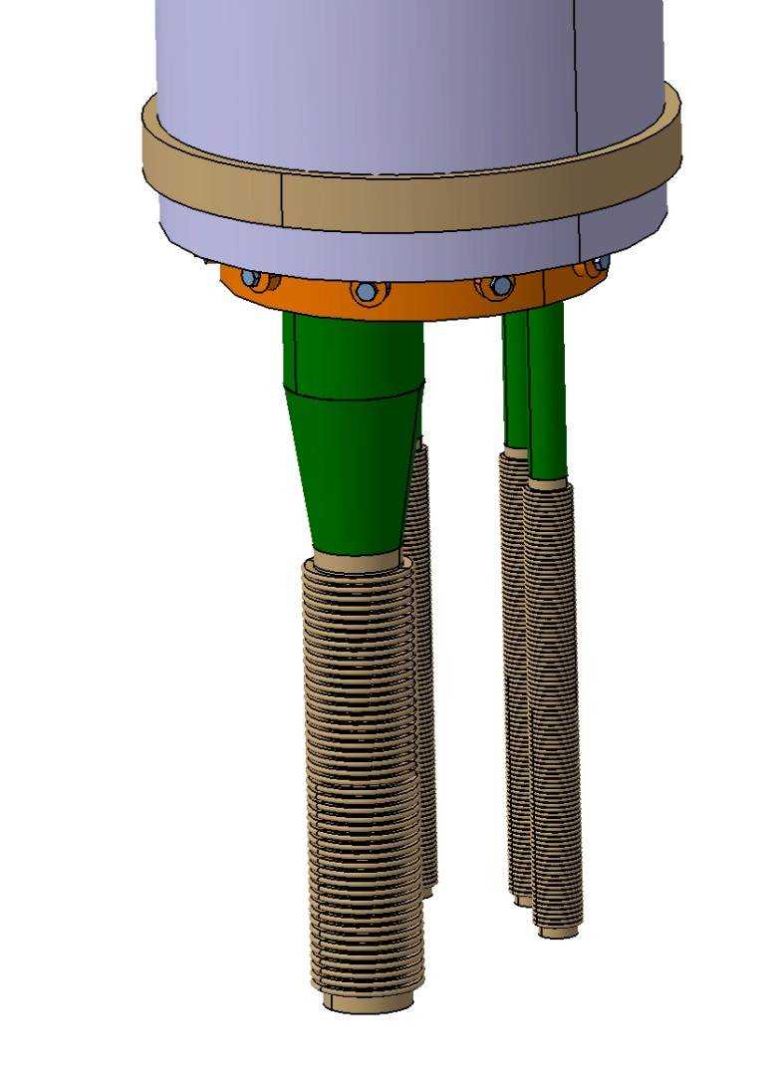
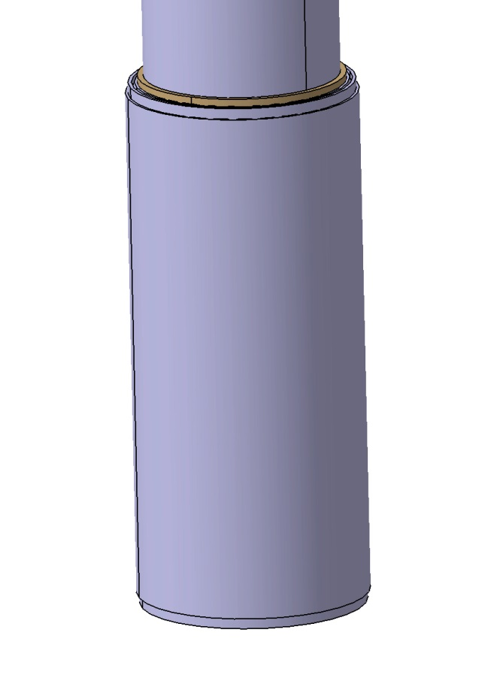
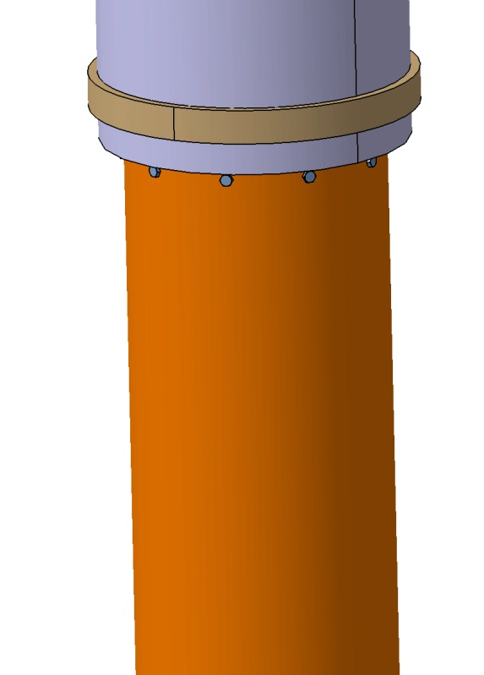
Interconnection to the TICP

Slide 19
CTL-LTS2 External Supports
Frame Supports
Supports on the Floor

Slide 20
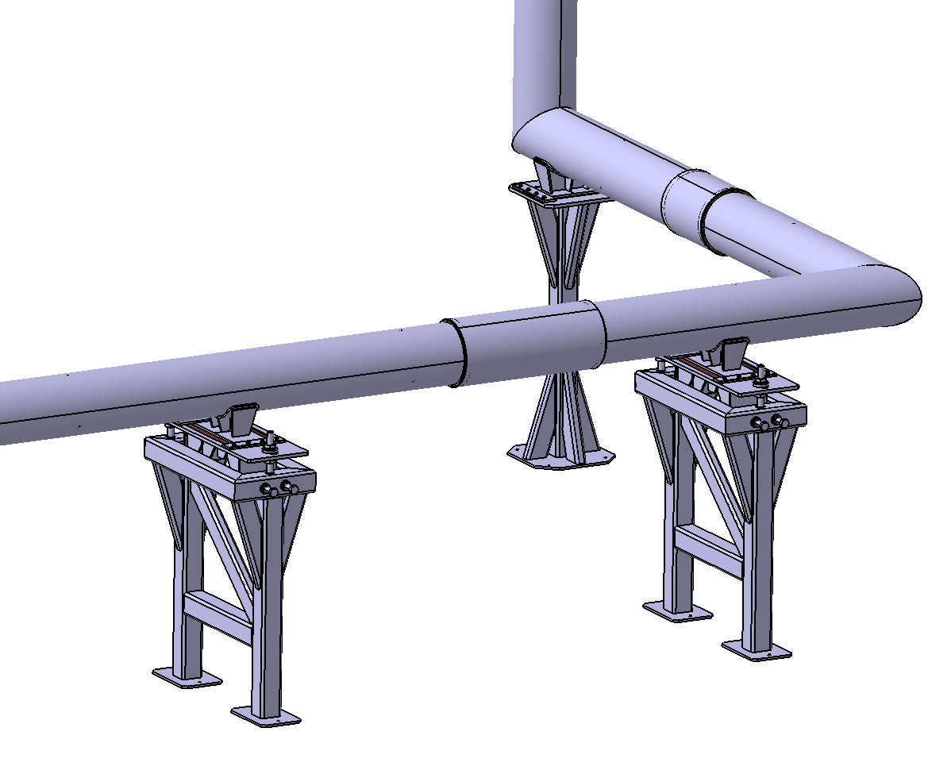
CTL-LTS2 External supports

Slide 21
CTL-LTS2 External Supports
Beams for Aux. Lines Support
Fixed Support
Sliding Support
Connection Holes

Slide 22
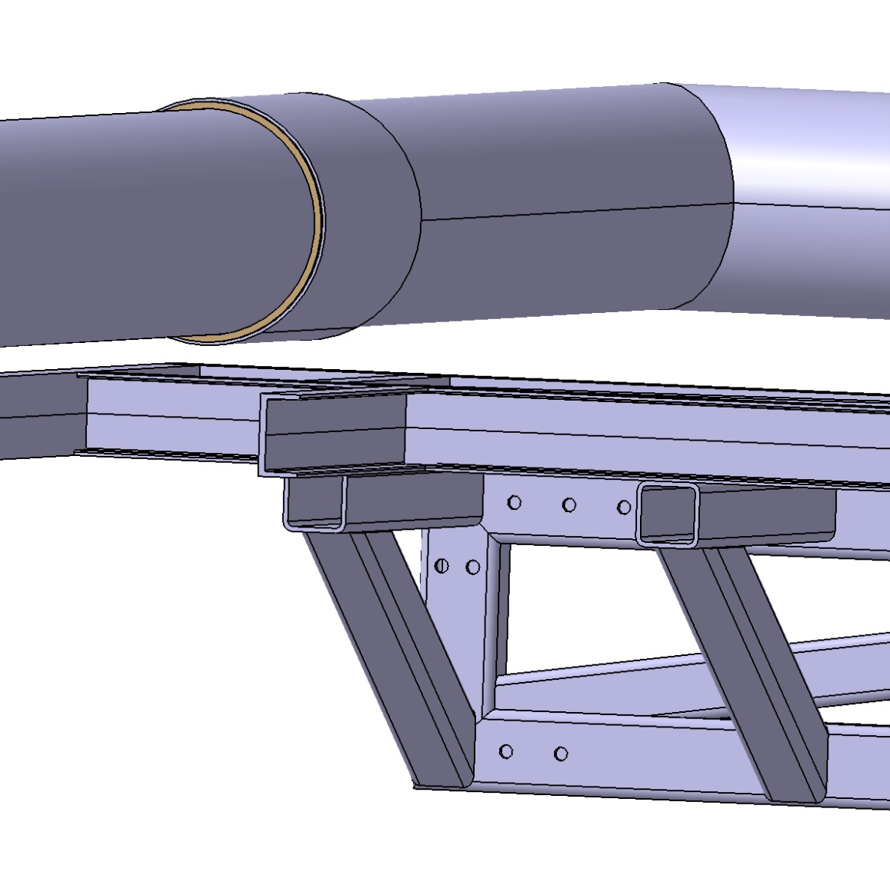
CTL-LTS2 External Supports
Connection Holes

Slide 23
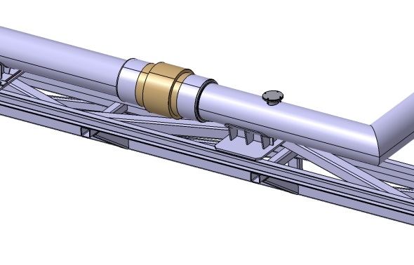
Location of the Safety Valves
Safety Valves

