Slide 1
General Overview of Work Unit 11.11.5.1
Cryogenic Distribution System for Lund Test Stand 2
Jaroslaw Fydrych
Cryodistribution Lead Engineer
CDS-LTS2 CDR, WUST, Wroclaw (PL) 2017-01-11

Slide 2
ESS cryogenic system block diagram
Pure Helium
Gas Storage 1
Standalone Helium Purifier
Helium Recovery System
Pure Helium
Gas Storage 2
Target Moderator
Cryoplant
Accelerator
Cryoplant
20 m³ LHe Tank
5 m³
LHe Tank
Test & Instrument Cryoplant
Target Cryogenic Transfer Line
LHe Mobile Dewars
Cryodistribution System for Lund Test Stand 2
Cryodistribution System for Elliptical Linac
Cryodistribution System for
Spoke Linac
LN2 Storage Tanks
Hydrogen Circulation Box
Elliptical
Cryomodules
Spoke
Cryomodules
LN2 Mobile Dewars
Instruments & Experiments
Test Stand Lund 2
Hydrogen Moderator
- Components to be delivered by WUST in the scope of Polish In-kind Contribution
- Components to be delivered by CNRS in the scope of French In-kind Contribution

Slide 3
ESS cryogenic system block diagram
Pure Helium
Gas Storage 1
Standalone Helium Purifier
Helium Recovery System
Pure Helium
Gas Storage 2
Target Moderator
Cryoplant
Accelerator
Cryoplant
20 m³ LHe Tank
5 m³
LHe Tank
Test & Instrument Cryoplant
Target Cryogenic Transfer Line
LHe Mobile Dewars
Cryodistribution System for Lund Test Stand 2
Cryodistribution System for Elliptical Linac
Cryodistribution System for
Spoke Linac
LN2 Storage Tanks
Hydrogen Circulation Box
Elliptical
Cryomodules
Spoke
Cryomodules
LN2 Mobile Dewars
Instruments & Experiments
Lund Test Stand 2
Hydrogen Moderator
- Components to be delivered by WUST in the scope of Polish In-kind Contribution
- Components to be delivered by CNRS in the scope of French In-kind Contribution

Slide 4
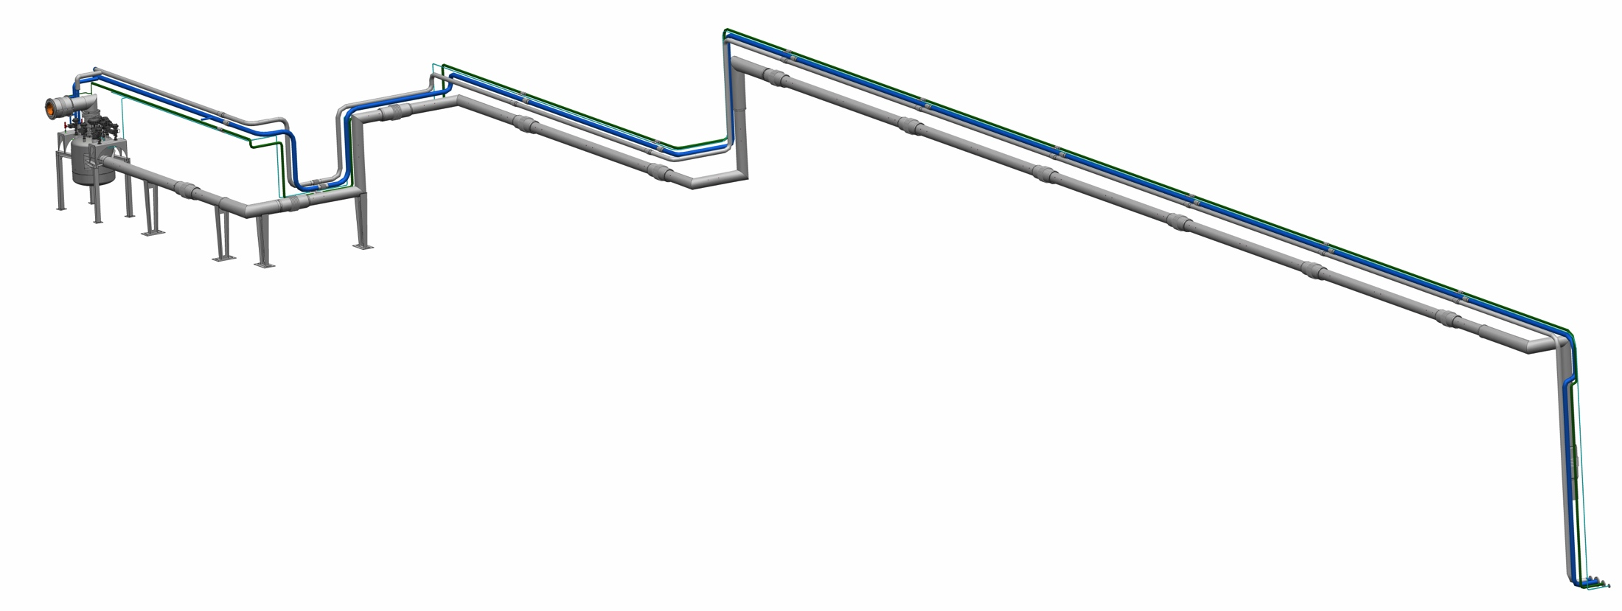
CDS for Lund Test Stand 2
- isometric view
Interface to cryomodule
3
2
Interface
to TICP
1
1. Test Stand Valve Box
2. CTL housing 4 cold process lines
  Helium supply line
  VLP line
  TS supply line
  TS return line
3. Auxiliary process lines
  HP line
  Purge return line
  Helium recovery line
  SV relief line

Slide 5
CDS-LTS2 flow scheme

Slide 6
CDS-LTS2 flow scheme
CDS-LTS2
TICP
(WP11)
Elliptical
Cryomodule
under SAT
(WP10)

Slide 7
ESS-WUST collaboration history (1/2)
Jan 2014 ESS and WUST initiate cooperation on the ESS Cryogenic
Distribution System (phone meeting on 8-Jan-2015)
Sep 2014 ESS provides the draft specification of the CDS-LTS2
Jan 2015 ESS and WUST agree on the scope, schedule and value of the CDSs
for Elliptical linac and Lund Test Stand 2
Feb 2015 ESS-WUST Collaboration Kick-off Meeting
Feb 2015 WUST works on the CDS-EL design (PDR in May 2015
to Apr 2016 and CDR in Apr 2016)
Aug 2015 ESS and WUST sign an agreement for the design of the CDS-EL and CDS- LTS2
Notes:
This technical specification defines the requirements for the design, procurement, manufacturing, transport, installation and commissioning of the CDS for the elliptical linac.

Slide 8
ESS-WUST collaboration history(2/2)
Aug 2015 ESS approves the CDS-LTS2 specification and sends it to WUST
Nov 2015 ESS modifies the CDS-LTS2 CTL routing due to TICP cold box relocation (CTL is shortened by 20 m)
WUST postpones the CDS-LTS2 design phase start to Jan 2016
Mar 2016 WUST postpones the CDS-LTS2 CDR to Sep 2016
Jun-Aug 2016 ESS introduces some changes in the CDS-LTS2 specification due to requests from the TICP project
Sep 2016 WUST postpones the CDS-LTS2 CDR to Dec 2016
Oct 2016 ESS modifies the routing of the CDS-LTS2 auxiliary lines due to changes in the TICP warm piping
Nov 2016 ESS and WUST agree on some changes in the scope, cost and schedule;
CDR is postponed to Jan 2017
ESS and WUST sign In-Kind Collaboration Agreements and Technical Annexes for the CDS-EL and CDS-LTS2
11/12 Jan 2017 Critical Design Review for the CDS-LTS2
Notes:
This technical specification defines the requirements for the design, procurement, manufacturing, transport, installation and commissioning of the CDS for the elliptical linac.

Slide 9
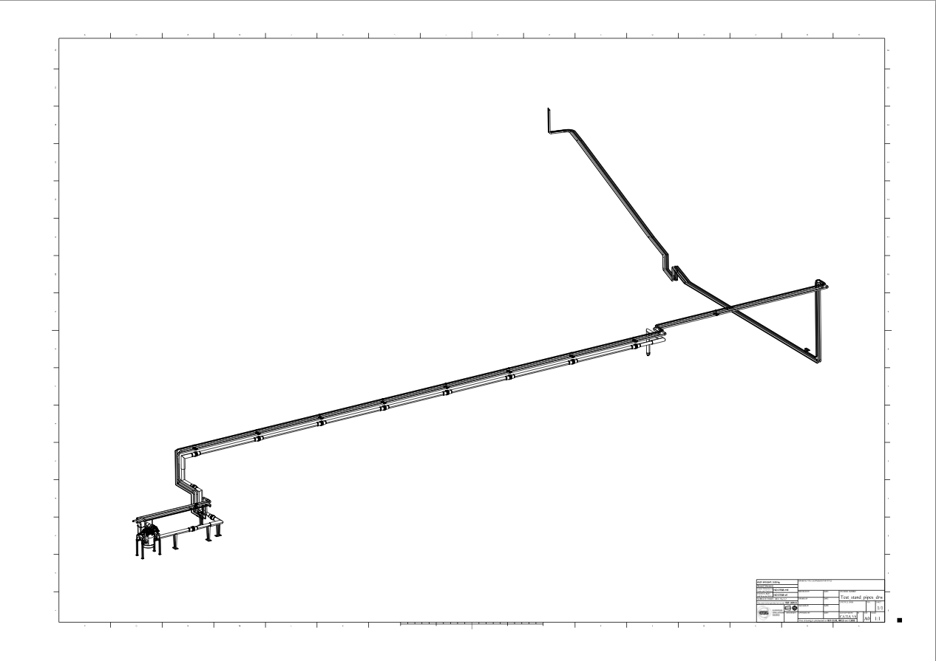
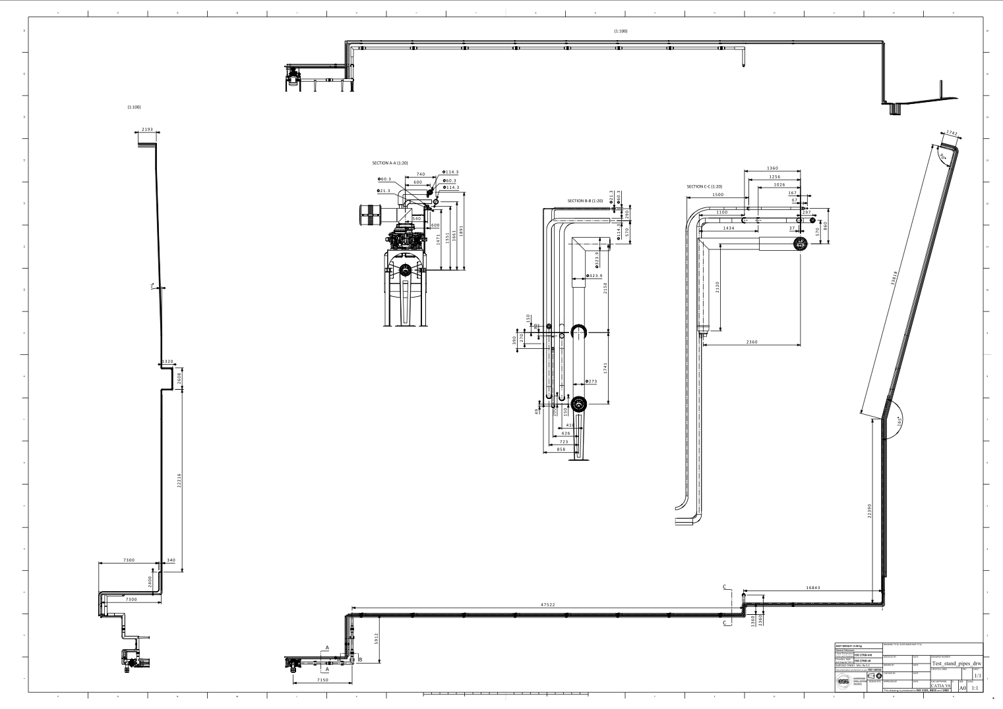
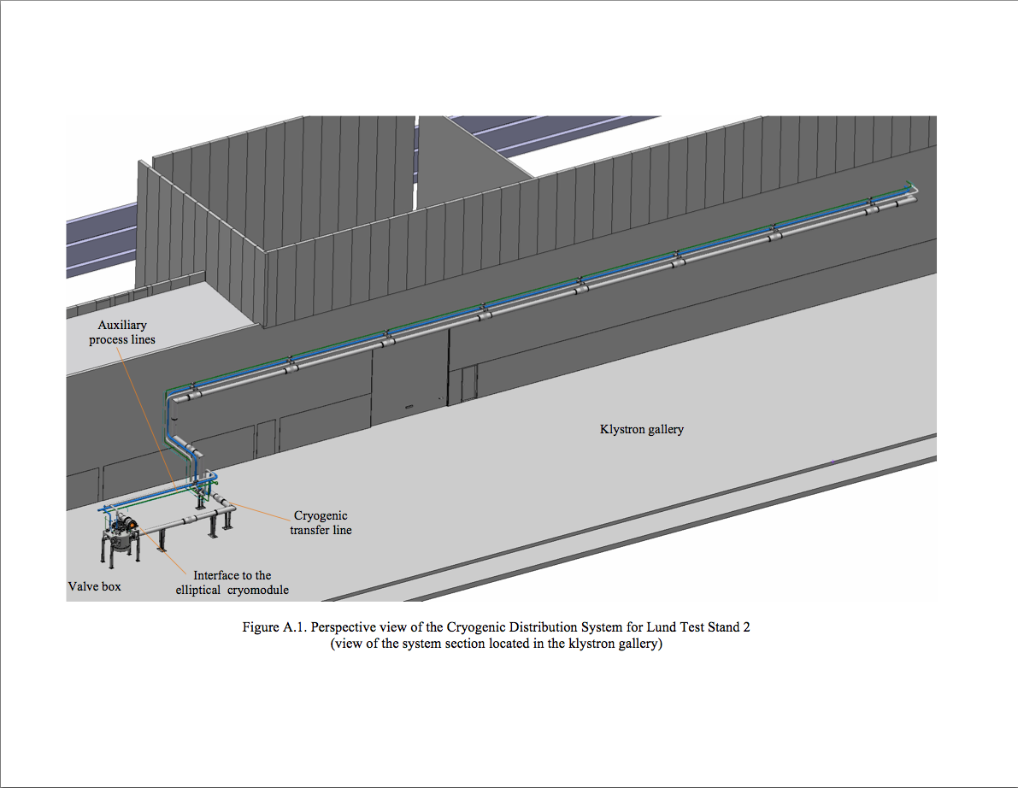
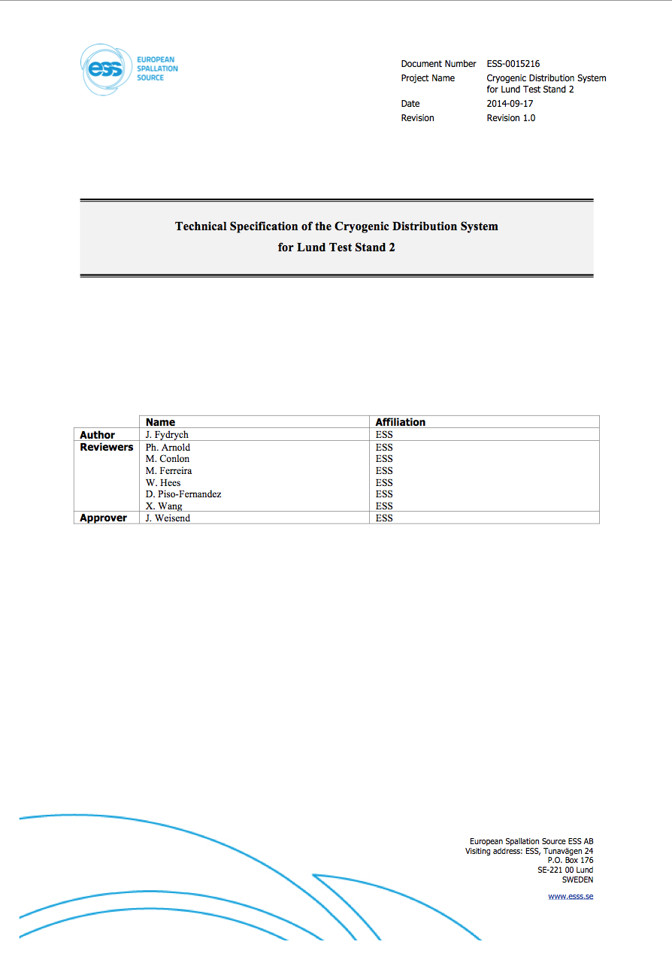
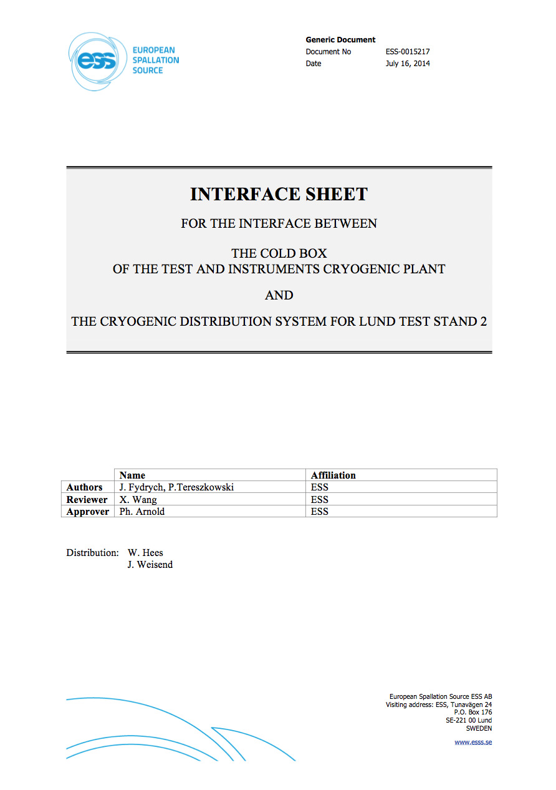
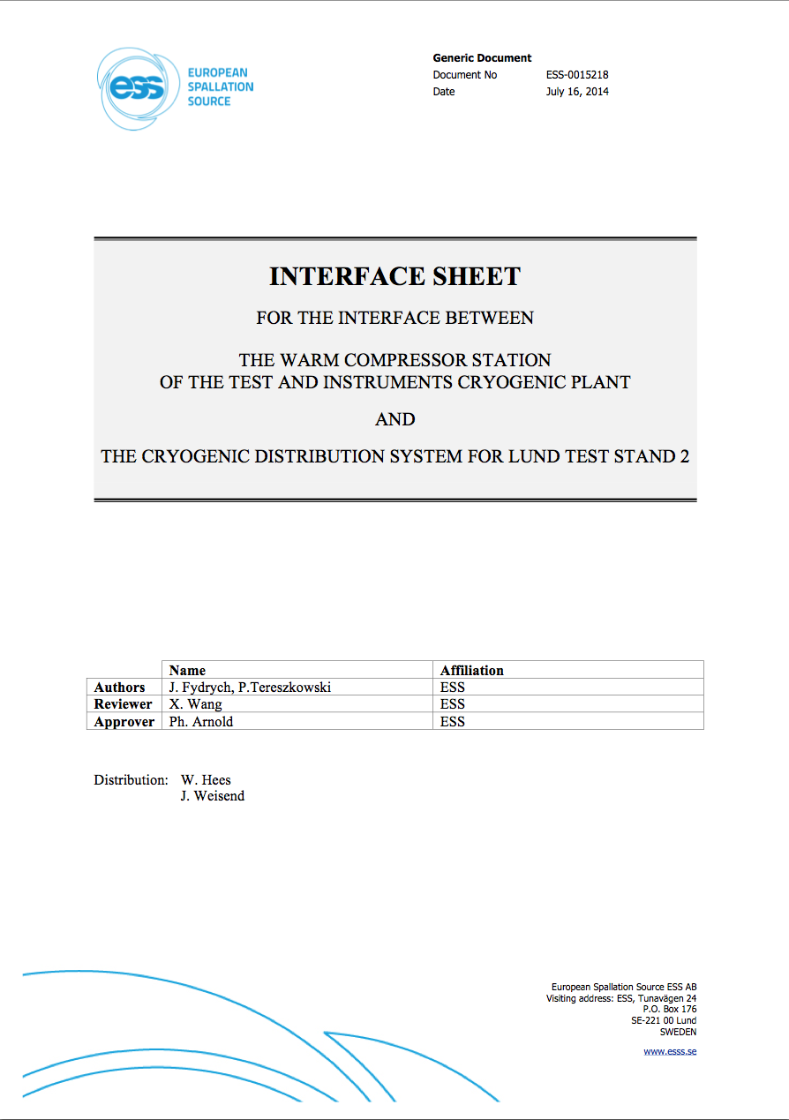
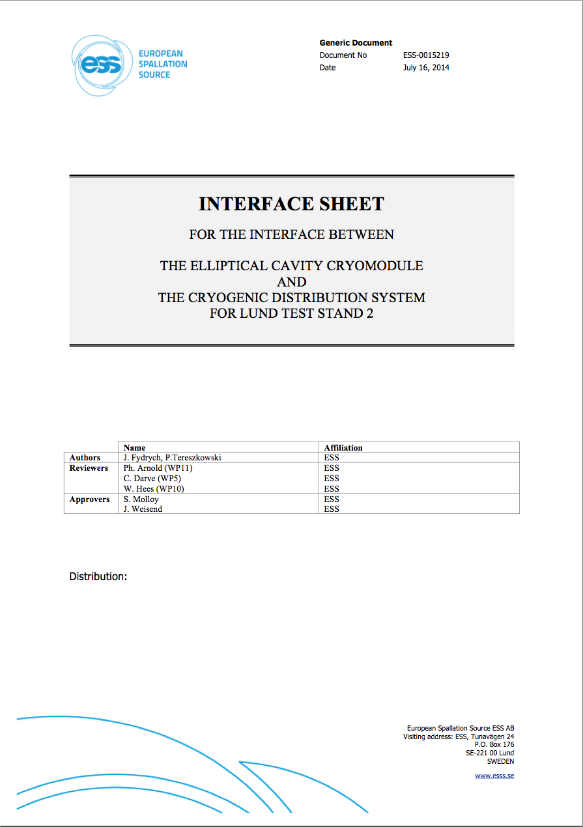
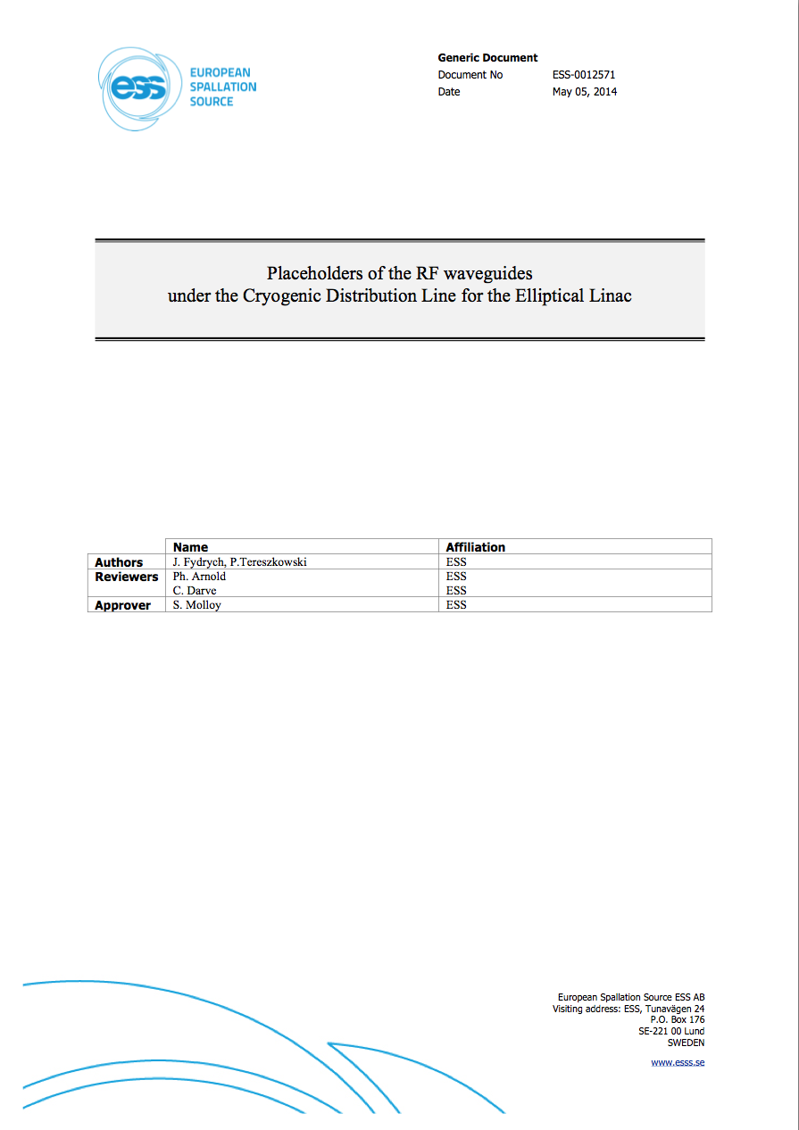
CDS-LTS2 baseline documentation
- draft specification
ESS-0011735: Technical Specification of the Cryogenic Distribution System for Lund Test Stand 2
Appendix A. Perspective view of the CDS for Test Stand Lund 2
Appendix B. Routing and overall dimensions of the CDS for Test Stand Lund 2
ESS-0015217: Interface between the TICP cold box and the CDS
ESS-0015218: Interface between the TICP-WCS and the CDS
ESS-0015219: Interface between the CDS for the elliptical cavity cryomodule
and for the CDS for the Lund Test Stand 2
ESS-0012571: Location of the wave guides under the Cryogenic Distribution Line for the elliptical linac
Draft specification was provided to
WUST in September 2014

Slide 10
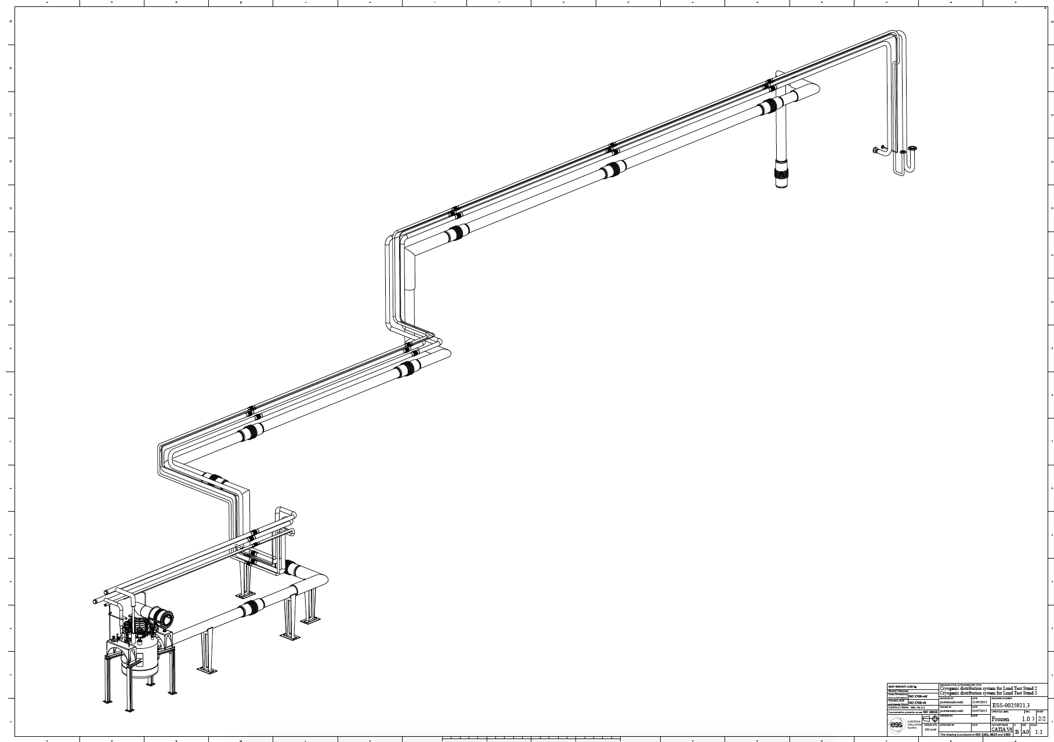
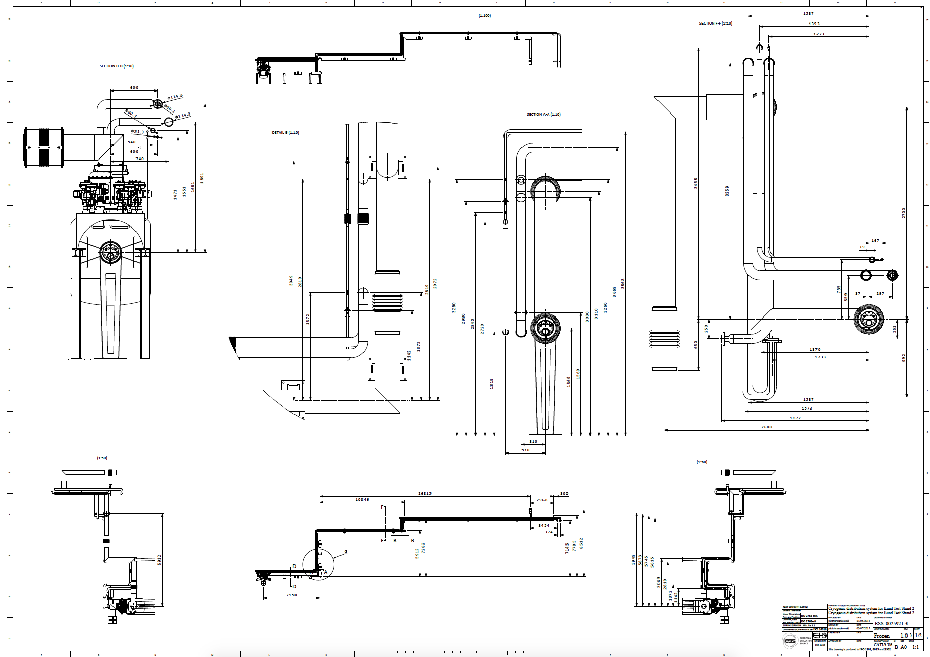
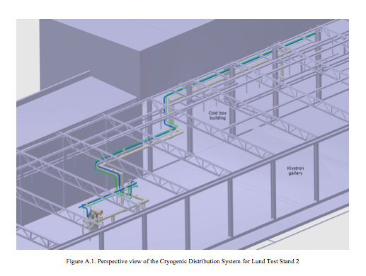
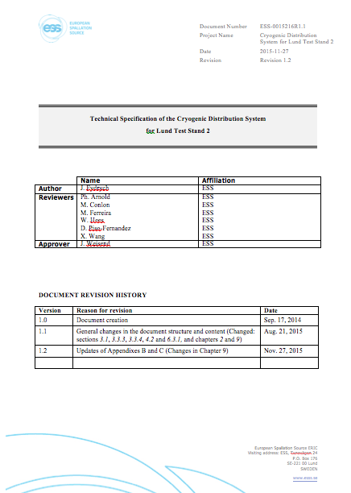
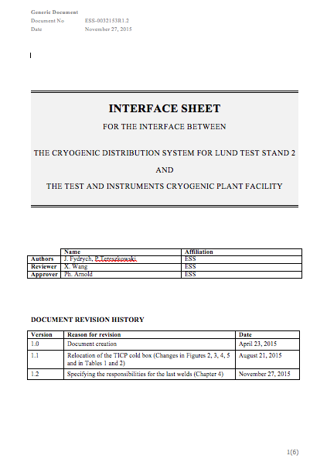
CDS-LTS2 baseline documentation
- approved specification
ESS-0011735R1.2: Technical Specification of the Cryogenic Distribution System for Lund Test Stand 2
Appendix A. Perspective view of the CDS for Lund Test Stand 2
Appendix B. Routing and overall dimensions of the CDS for Lund Test Stand 2 (ESS-0025921.3Frozen)
Appendix C. Interface sheet for the interface between the the CDS for Lund Test Stand 2
and the Test and Instruments Cryogenic Plant Facility (ESS-0032153R1.2)
Appendix D. Interface sheet for the interface between the elliptical cavity cryomodule
the CDS for Lund Test Stand 2 (ESS-0015219R1.1)
Appendix E. Placeholders of the RF waveguides under the cryogenic distribution
line for the elliptical linac (ESS-0012571R1.1)
The specification was approved
in August 2015 and updated in November 2015

Slide 11
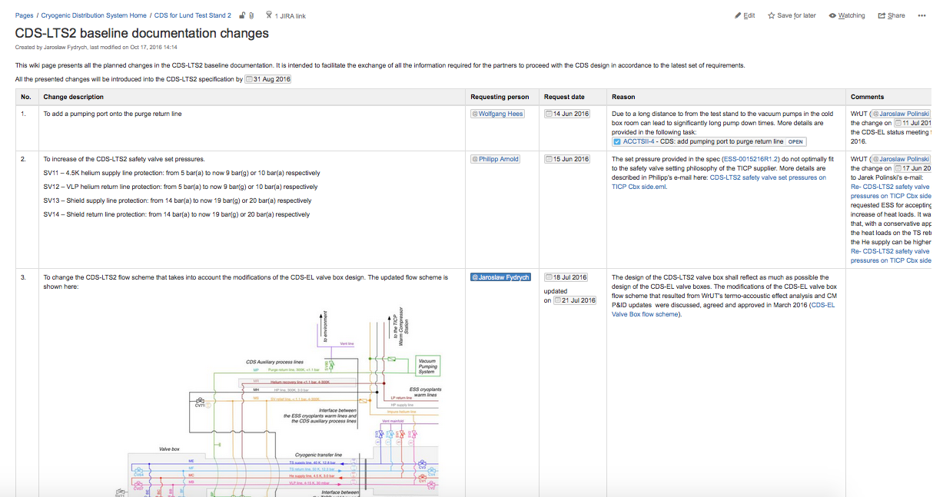
CDS-LTS2 baseline documentation
- records of last modifications
All further modifications (dated from 14-Jun-2016 to 05-Oct-2016) in the CDS-LTS2 specification and conceptual model were recorded in the ESS CDS collaboration workspace, on the following wiki page:
https://ess-ics.atlassian.net/wiki/display/CDS/CDS-LTS2+baseline+documentation+changes

Slide 12

CDS project schedule status for Oct-2015
CDS-LTS2
Design work
has not started!
CDS-EL

Slide 13
CDS project schedule status for Jan-2017
CDS-LTS2
CDS-EL

Slide 14
Thank you
for your attention!

