Slide 1
CDS-LTS2 thermo-mechanical analysis results
Janusz Skrzypacz
Jarosław Poliński
Przemyslaw Jaszak
Maciej Chorowski
Critical Design Review Meeting, 11-12 January 2017, Wroclaw, Poland

Slide 2
Allowable stresses
Allowable stress for sustained loads
for 1.4306 f_{h} = min (f_{c}; f) = 143.3 MPa for 1.4301 f_{h} = min (f_{c}; f) = 153.3 Mpa
Allowable stress for thermal loads for: E_{h}=193000 [MPa]; E_{c}=209000 [MPa]
for 1.4306 f_{a} = U(1.25f_{c} + 0.25f_{h})E_{h}/E_{c} = 198.5 [MPa]
for 1.4301 f_{a} = U(1.25f_{c} + 0.25f_{h})E_{h}/E_{c} = 212.4 [MPa]
Sum of the allowable stresses
for 1.4306 f_{h} +f_{a} = 341.8 [MPa]
for 1.4301 f_{h} +f_{a} = 365.7 [MPa]
Occasional allowable stress
f = f_{h}*k = 143.3*1.5= 215 MPa

Slide 3
Process pipes flexibility analysis

Slide 4
Process pipes flexibility analysis
LC1 - normal operating conditions
No | Parameter | VLP | He supply | TS supply | TS return
1 | DN [mm] | 65 | 15 | 15 | 15
2 | Design pressure PS [bar] | 12 | 16 | 16 | 16
3 | Temperature [K] | 3 | 4.5 | 40 | 50
4 | Fluid density r [kg/m³] | 130 | 130 | 27 | 27
6 | Max. sustained stress σ_{1max} [MPa] | 157.9 | 189.7 | 190.4 | 185.9
7 | Max. sustained stress σ_{1WRT} [MPa] | 61.82 | 82.16 | 89.37 | 82.47
7 | Max. expansion stress σ_{3WRT} [MPa] | 119.2 | 65.08 | 67.13 | 64.6
8 | Max. σ_{4WRT} = (σ_{1WRT}+σ_{3WRT}) [MPa] | 131.1 | 95.07 | 100.8 | 90.38
9 | Max. movement of a flex. element [mm] | 23 | 22.7 | 23.5 | 22.7
Forces in the all interfaces are lower than specified by ESS

Slide 5
Process pipes flexibility analysis
σ_{1WUT}
σ_{1max}
LC1 – Sustained stress σ₁ [MPa] in the VLP pipe –
the close up the maximal stress location

Slide 6
Process pipes flexability analysis
LC2 – pressure test conditions
No | Parameter | VLP | He supply | TS supply | TS return
1 | DN [mm] | 65 | 15 | 15 | 15
2 | Test pressure PT [bar] | 17.2 | 22.88 | 22.88 | 22.88
3 | Temperature [K] | 300.5 | 300.5 | 300.5 | 300.5
4 | Fluid density ρ [kg/m³] | 1.4 | 5.7 | 5.7 | 5.7
6 | Max. sustained stress s_{1max} [MPa] | 222.8 | 271.2 | 271.6 | 264.9
 | Max. sustained stress σ_{1WRT} [MPa] | 88.7 | 113.9 | 94.19 | 114.3
7 | Max. expansion stress σ_{3WRT} [MPa] | 0 | 0 | 0 | 0
8 | Max. σ_{4WRT} = (σ_{1WRT}+σ_{3WRT}) [MPa] | 88.7 | 113.9 | 94.19 | 114.3
9 | Max. movement of flex. elements [mm] | 0.8 | 0.4 | 0.5 | 0.5
Forces in the all interfaces are lower than specified by ESS

Slide 7
Process pipes flexibility analysis
σ_{1max}
σ_{1WUT}
LC2 – Sustained stress σ₁ [MPa] in the TS supply pipe – the close up the maximal stress location

Slide 8
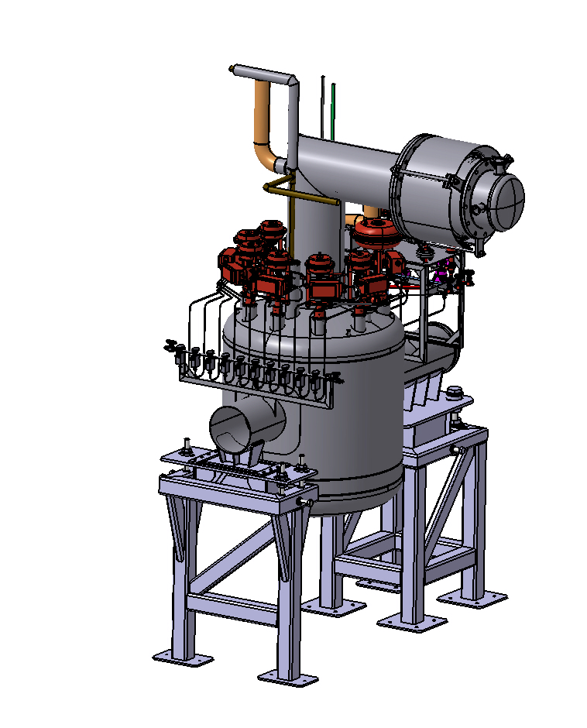
Process pipes flexibility analysis
LC2 – pressure test conditions

Slide 9
Outer Jacket flexibility analysis
Valve Box
CTL sections

Slide 10
Outer Jacket flexibility analysis
LC1 - normal operating conditions
No | Parameter | Outer Jacket
1 | DN | 300/250
2 | Pressure [bar] | -1
3 | Temperature [K] | 293
4 | Continuous load kg/m | 10
6 | Max. sustained stress s₁ [MPa] | 55.1
7 | Max. expansion stress s₃ [MPa] | 0
8 | Max. s₄ = (s₁+s₃) [MPa] | 55.1
9 | Max bellows movement [mm] | 0.9
Node | F_{x} [N] | F_{y} [N] | F_{z} [N] | M_{x} [Nm] | M_{y} [Nm] | M_{z} [Nm]
10 | -297 | 104 | -1589 | -285 | -799 | -345
95 | -1306 | 475 | -1241 | -129 | -127 | -1793
470 | 1563 | 586 | -1968 | 17 | -940 | -150
605 | -1294 | -607 | -606 | -161 | -227 | 116
699 | 2779 | 1113 | -916 | -213 | 568 | -619
4000 | 2544 | 10957 | -2812 | -16736 | 134 | 4718
4700 | 0 | -14295 | -337 | 92 | 0 | 0

Slide 11
Outer Jacket flexibility analysis
LC2 – failure conditions
No | Parameter | Outer Jacket
1 | DN | 250/300
2 | Set pressure of savety valve [barg] | 0.5
3 | Temperature [K] | 223
4 | Continuous load kg/m | 10
6 | Max. sustained stress s₁ [MPa] | 26.21
7 | Max. expansion stress s₃ [MPa] | 114.7
8 | Max. s₄ (s₁+s₃) [MPa] | 116.3
9 | Max bellows movement [mm] | 22
Node | F_{x} [N] | F_{y} [N] | F_{z} [N] | M_{x} [Nm] | M_{y} [Nm] | M_{z} [Nm]
10 | 986 | 5874 | 10966 | -8739 | 1716 | -491
95 | -15045 | -5294 | -13796 | 8358 | -10512 | 1966
470 | 14806 | 7636 | -16092 | 5954 | 365 | 2059
605 | -17019 | -7658 | 13518 | -7082 | 10817 | 3866
699 | 12933 | 24631 | -12065 | -9400 | 9430 | 13654
4000 | -15314 | -6044 | -2234 | 8002 | 704 | -2048
4700 | -107 | 7030 | -321 | 90 | 0 | -41

Slide 12
Outer Jacket flexibility analysis
Summary
In both analyzed load cases the maximal sustained and expansion stresses in the outer jacket are lower than allowable ones.
The forces in the interface points are lower than specified by ESS.
The forces and moments acting on the outer jacket supports have significant values, so that they require a strong support structure.

Slide 13
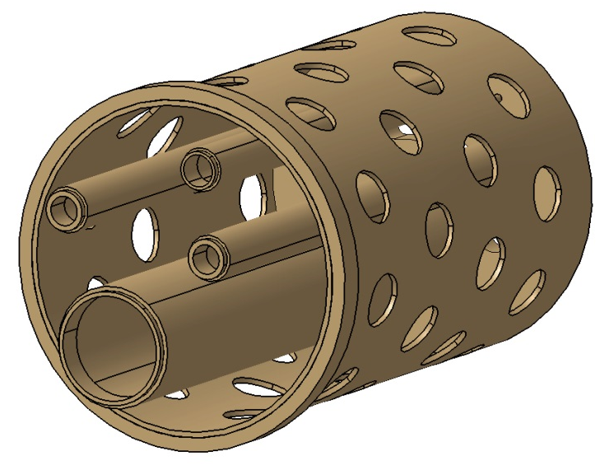
Fixed support
 | Von Misses stress [MPa] | Total deformation [mm]
LC2 – normal operating conditions | 120 | 1.24
LC3 - mechanical loads for LC2 | 114 | 0.85
LC4 – pressure test conditions | 51.65 | 0.218

Slide 14
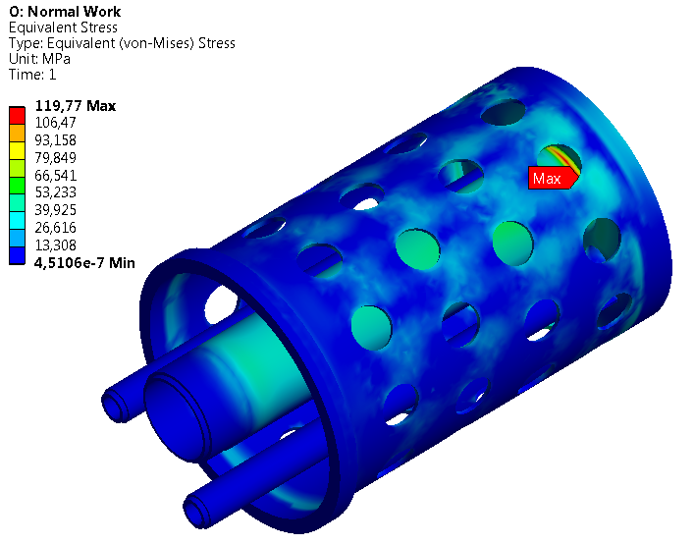
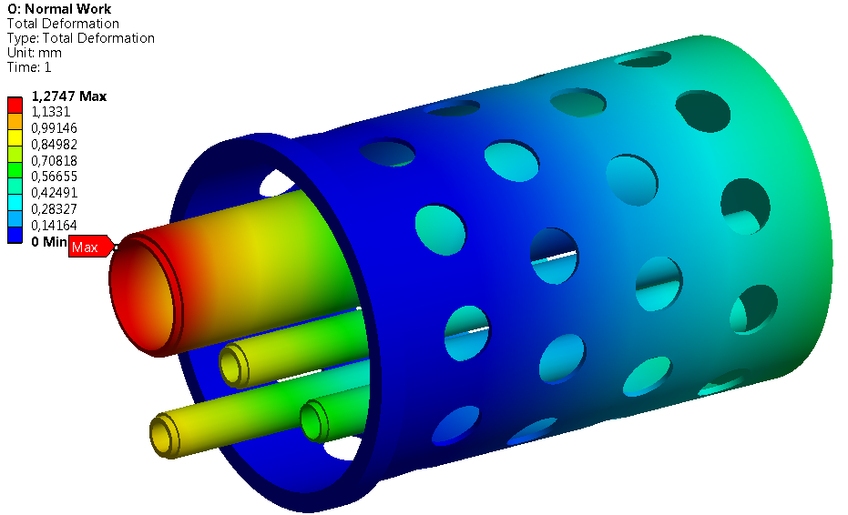
Fixed support
Examples of the calculation results for LC2

Slide 15
Jumper connection vacuum barrier
 | Von Misses stress [MPa] | Total deformation [mm]
LC1 – normal operating conditions | 109 | 1.1
LC2 – only mechanical loads that corresponds to LC1 | 77.8 | 0.24
LC3 – loss of vacuum; the forces and the moments corresponds to LC1 | 129 | 0.43
LC4 – loss of vacuum in opposite side to LC3 | 76 | 0.23

Slide 16
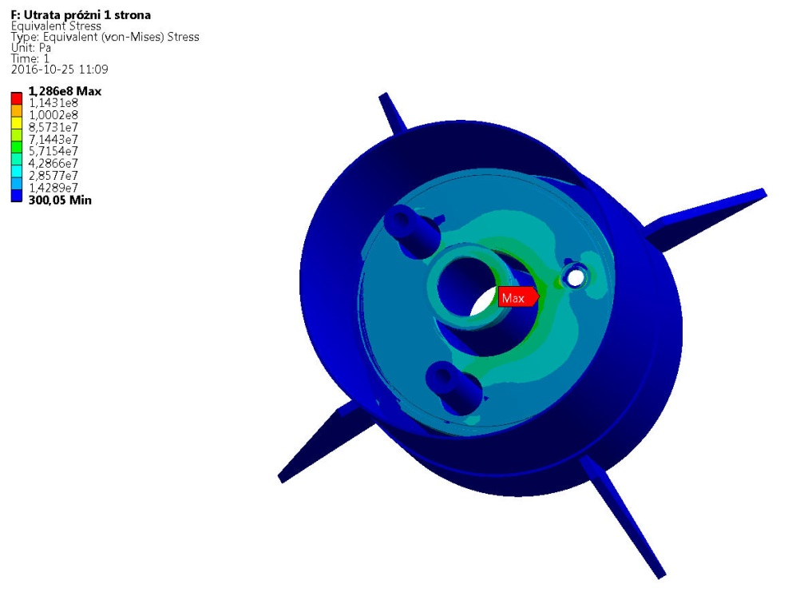
Jumper connection vacuum barrier
Examples of the calculation results for LC3

Slide 17
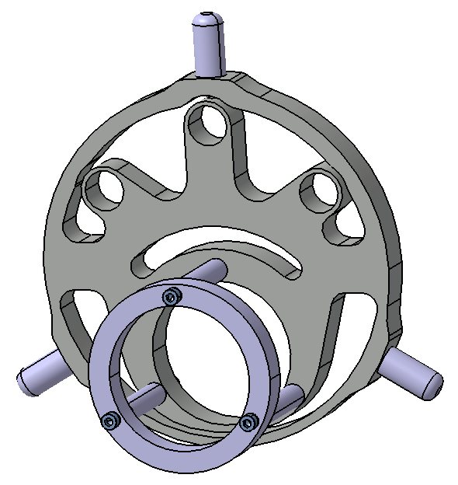
Sliding support
 | Von Misses stress [MPa] | Total deformation [mm]
LC1 – normal operating conditions | 50.1 | 3.1
LC2 – normal operating conditions with only mechanical loads | 78 | 0.4

Slide 18
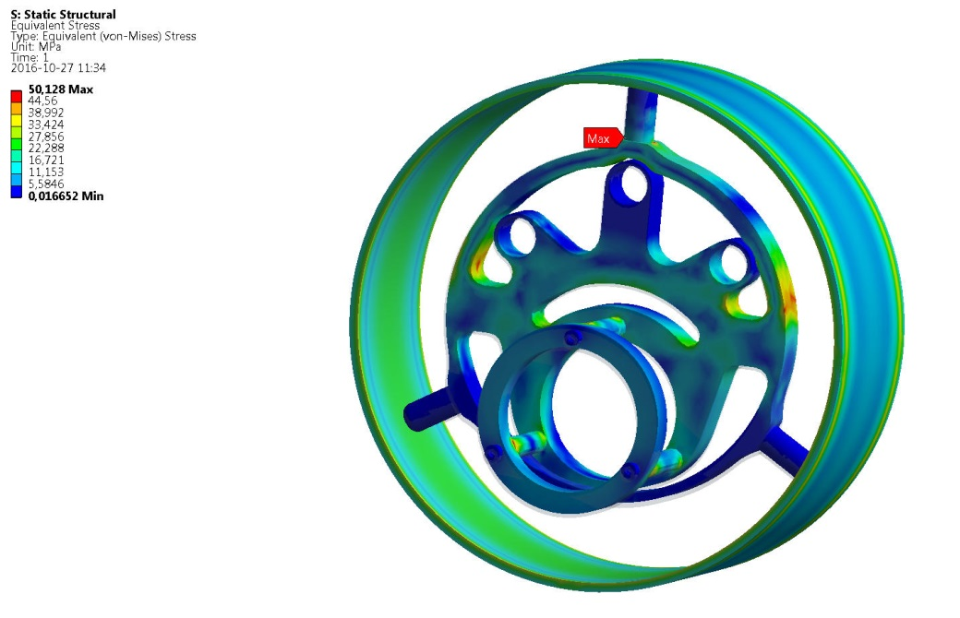
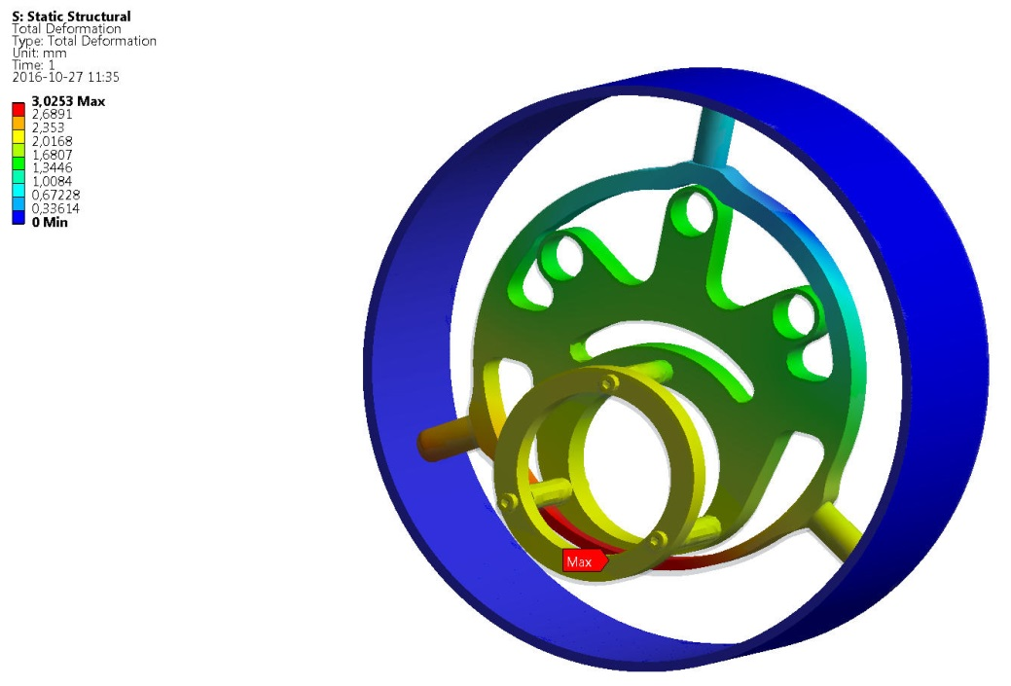
Sliding support
Examples of the calculation results for LC1

Slide 19
Frame 1 calculations
 | Von Misses stress [MPa] | Total deformation [mm]
LC1 – normal operating conditions | 128 | 0.8
LC2 – failure of a process pipe – helium fills the outer jacket and cools it down to 223 K – mechanical and thermal loads were applied. | 156.1 | 2.01
LC3 – failure of a process pipe – helium fills the outer jacket and cools it down to 223 K – only mechanical loads were applied. | 169 | 1.97

Slide 20
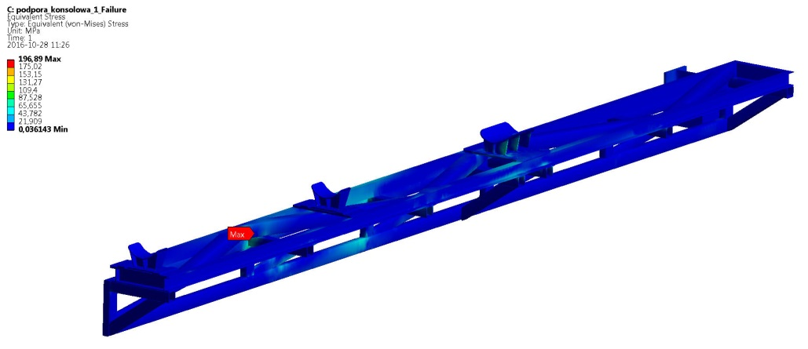
Frame 2 calculations
 | Von Misses stress [MPa] | Total deformation [mm]
LC1 – normal operating conditions | 6.52 | 0.17
LC2 – failure of a process pipe – helium fills the outer jacket and cools it down to 223 K – mechanical and thermal loads were applied. | 196.9 | 4.04
LC3 – failure of a process pipe – helium fills the outer jacket and cools it down to 223 K – only mechanical loads were applied. | 89.5 | 3.4

Slide 21
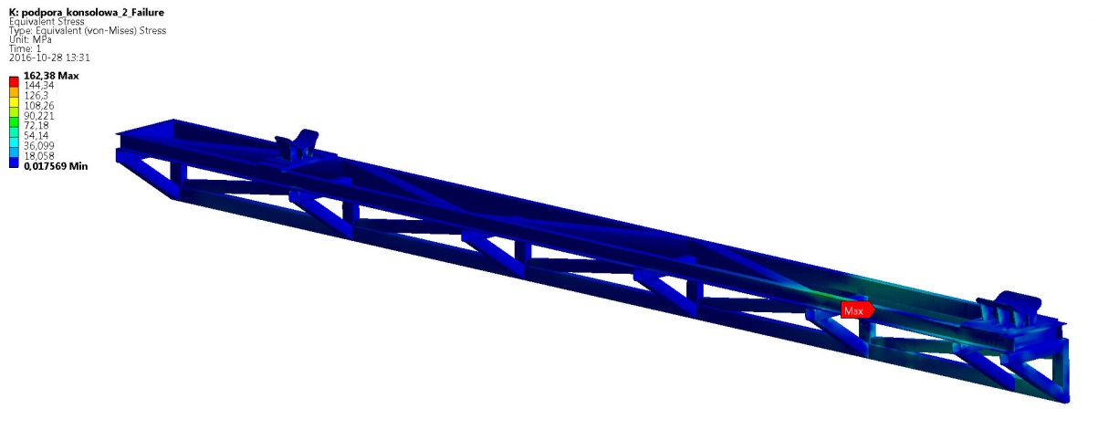
Frame 3 calculations
 | Von Misses stress [MPa] | Total deformation [mm]
LC1 – normal operating conditions | 14.87 | 0.24
LC2 – failure of a process pipe – helium fills the outer jacket and cools it down to 223 K – mechanical and thermal loads were applied. | 162.4 | 4.82
LC3 – failure of a process pipe – helium fills the outer jacket and cools it down to 223 K – only mechanical loads were applied. | 152.28 | 4.01

Slide 22
Frame 4 calculations
 | Von Misses stress [MPa] | Total deformation [mm]
LC1 – normal operating conditions | 140.1 | 1.52
LC2 – failure of a process pipe – helium fills the outer jacket and cools it down to 223 K – mechanical and thermal loads were applied. | 202.94 | 2.24
LC3 – failure of a process pipe – helium fills the outer jacket and cools it down to 223 K – only mechanical loads were applied. | 199.2 | 2.04

Slide 23
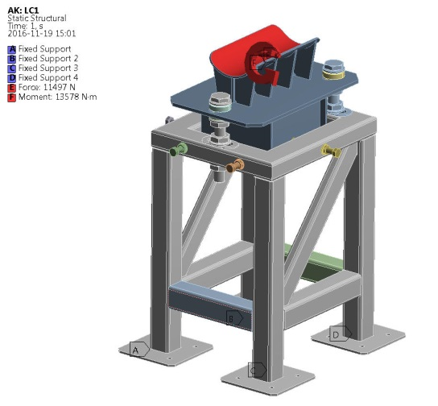
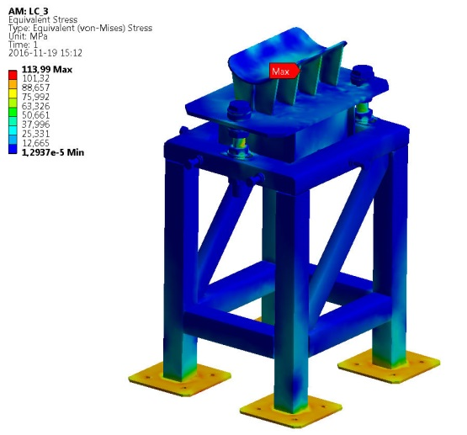
ValveBox Fixed Support
 | Von Misses stress [MPa] | Total deformation [mm]
LC1 – normal operating conditions | 144.5 | 0.96
LC2 – failure of a process pipe – helium fills the outer jacket and cools it down to 223 K – mechanical and thermal loads were applied. | 113.99 | 0.97
LC3 – failure of a process pipe – helium fills the outer jacket and cools it down to 223 K – only mechanical loads were applied. | 101.54 | 0.68

Slide 24
Sliding Support
 | Von Misses stress [MPa] | Total deformation [mm]
LC1 – normal operating conditions | 13.64 | 0.67
LC2 – failure of a process pipe – helium fills the outer jacket and cools it down to 223 K – mechanical and thermal loads were applied. | 97.33 | 2.5

Slide 25
Sliding Support
 | Von Misses stress [MPa] | Total deformation [mm]
LC1 – normal operating conditions | 8.5 | 0.05
LC2 – failure of a process pipe – helium fills the outer jacket and cools it down to 223 K – mechanical and thermal loads were applied. | 129.6 | 1.5

